Slide 1
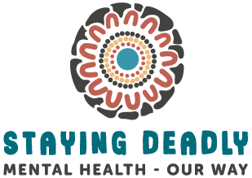
Reforming mental health services for First Nations people in Southeast Queensland
Adrian Carson
Leading Reform Summit 2024

Slide 2
Evidence – the Case for Reform
Prevalence and Service Access
Aboriginal and Torres Strait Islander people of SEQ

Slide 3
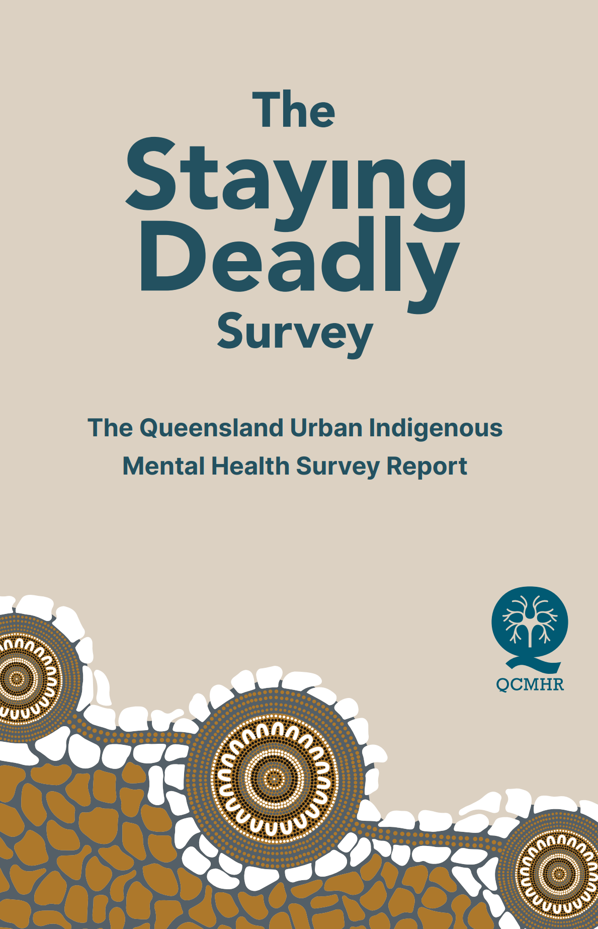
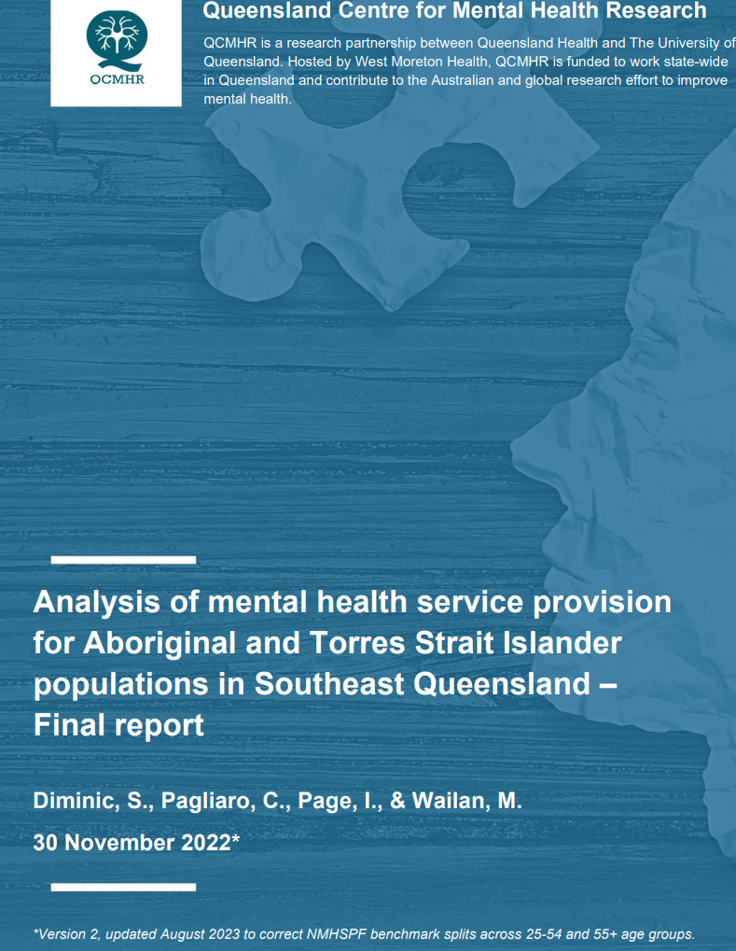
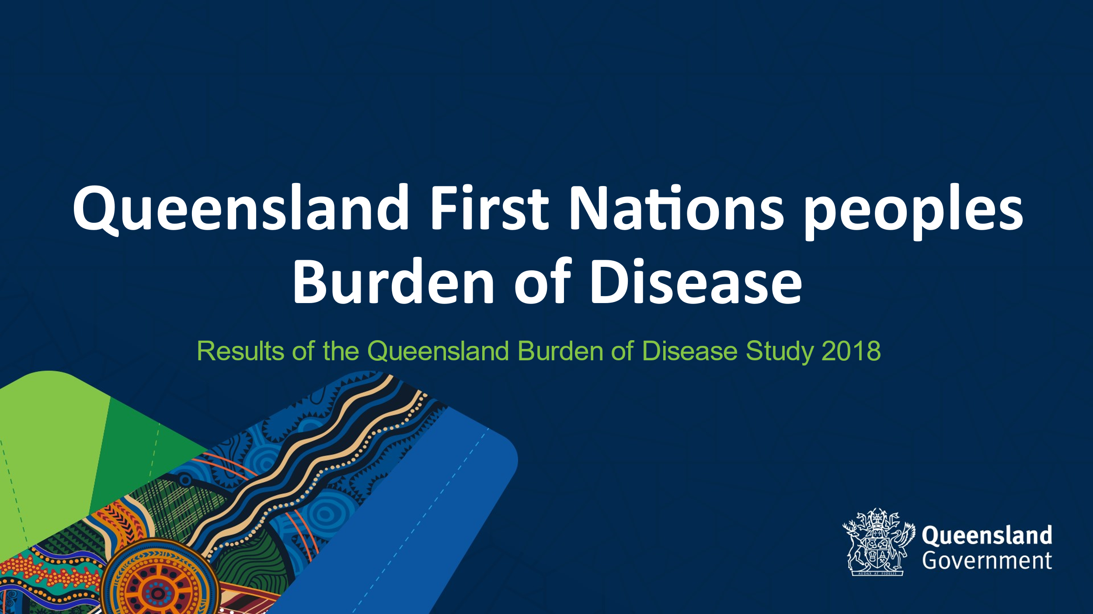
Overview of Recent Research – SEQ
Three recent studies provide valuable information for First Nations people in SEQ .
In particular:
  burden of disease
  the prevalence of mental and substance use disorders
  access to services
  service delivery preferences
  barriers to accessing services.
Notes:
Three recent studies have provided valuable information about Aboriginal and Torres Strait Islander mental health in SEQ, including:
the contribution of mental and substance use disorders to First Nations burden of disease in SEQ
the prevalence of mental and substance use disorders in First Nations people in SEQ
access to mental health services and service preferences
the barriers to accessing mental health and substance use services.

Slide 4
QH First Nations Burden of Disease
2024 Report
In SEQ, mental and substance use (MSU) disorders are the leading cause of First Nations BoD
  contributed 26.7% to First Nations BoD – compared to 23% in regional areas and 22.8% in remote areas, and 18% for Other Queenslanders in SEQ
  contributed 14% to excess burden – compared to injuries (4%), CVD and cancers (2% each) and respiratory disease (3%)
In SEQ, Injury is the second largest cause of First Nations BoD
  Suicide and self-inflicted injury is the leading cause of injury burden
  79% increase in suicide burden between 2011 and 2018 – 17% increase for Other Queenslanders in SEQ
Notes:
In 2024, Queensland Health published its second Aboriginal and Torres Strait Islander burden of disease report with 2018 as the reference year. The report, compiled by Daniel Williamson and Lucy Stanley, provides a comparison with its 2017 report and disaggregates data by age, geography and selected conditions.
In SEQ (2018), Mental and substance use disorders is the leading cause of disease and injury burden among First Nations people
contributed 26.7% to the First Nations disease burden – compared to 23% in regional areas and 22.8% in remote areas, and 18% for Other Queenslanders in SEQ
contributed 14% to excess burden (ie the amount of burden experienced that is in addition to what would be expected had First Nations peoples experienced the same burden rates as other Queenslanders) – compared to injuries (next highest at 4%), CVD and cancers (2% each) and respiratory disease (3%)
In SEQ, Injury is the second largest cause of disease burden
Suicide and self-inflicted injury is the leading cause of injury burden
79% increase in suicide burden between 2011 and 2018 – 17% increase for Other Queenslanders

Slide 5
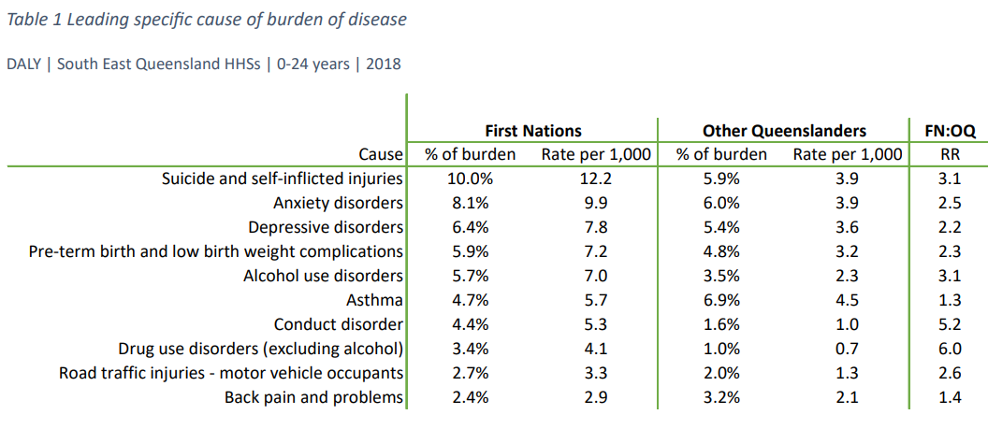
QH First Nations Burden of Disease
2024 Report - Children
In SEQ:
more than 1 in 3 years of healthy life lost among First Nations people aged (0-24 years) is due to M&SU disorders (36.4% of total BoD).
Suicide and self harm was the highest contributor to disease burden in this age group - contributing10% (3 x that for Other Queenslanders in SEQ).
Notes:
In SEQ:
more than 1 in 3 years of healthy life lost among First Nations children and young people (0-24 years) is due to mental and substance use disorders (36.4% of total BoD).
The table is very small, but it says that Suicide and Self-Inflicted Injuries was the leading cause of disease burden in 0–24-year-olds in SEQ. It contributed 10% to total disease burden compared to 5.9% for Other Queenslanders, with a rate that was 3 times that of other Queenslanders.

Slide 6
Recent Research – ISEQ - NMHSPF
  Analysis of mental health service provision for Aboriginal and Torres Strait Islander populations in Southeast Queensland – Final report
  Indigenous SEQ National Mental Health Service Planning Framework project (ISEQ NMHSPF)
  Funded by IUIH, SEQ PHNs and Gold Coast HHS
  Undertaken by the Queensland Centre for Mental Health Research
  Examined access data for primary, community, and hospital- based mental health services, psychosocial support and NDIS access
  Quantified the gap between access by First Nations people of SEQ in 2020/21 and the 2026/27 benchmarks established under the National Mental Health Service Planning Framework
Notes:
The Indigenous SEQ National Mental Health Service Planning Framework project was funded by IUIH, SEQ PHNs and Gold Coast HHS and undertaken by the Queensland Centre for Mental Health Research by Dr Sandra Diminic and her team.
It examined access data for primary, community and hospital-based services, psychosocial support services and access to the National Disability Insurance Scheme.
It analysed and quantified the gap between the National Mental Health Service Planning Framework 2026/27 benchmarks, and the level of service access by First Nations people in SEQ in 2020/21.

Slide 7
ISEQ – NMHSPF Report
Estimates approx. 37,600 First Nations people in SEQ will need a mental health service in 2026/27 (approx. 30% of the projected population)
The analysis found that:
  largest shortfalls: primary care and community-based MH services
  smallest shortfalls: bed-based mental health services
  most utilised service type: MBS-subsidised mental health care – accessed by 10.4% of SEQ First Nations people
  access to psychosocial support services for First Nations people was lower than for clinical services
  access to NDIS support packages for First Nations people with primary psychosocial disability was exceptionally low – (0.03-0.10% compared with 0.17% for general population).
Notes:
In a nutshell, the report estimated that around 37,600 First Nations people in SEQ across all age groups will need some kind of mental health service in 2026/27, which equates to about 30% of the projected population.
The largest gaps to benchmark were in primary and community based mental health services.
The smallest gap to benchmark were for bed-based mental health services, suggesting that when our Mob are acutely unwell they can access acute mental health services but there is little access to services designed to support them will managing their condition within the community.
The most utilised service type was MBS-subsidised services, especially GP services, but low levels of access to psychosocial support services. Access to the NDIS was exceptionally low.

Slide 8
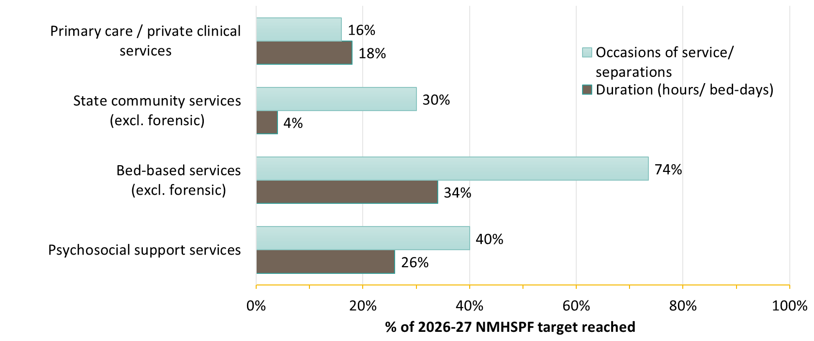
Percentage of NMHSPF Target Reached
2020/21
Notes:
This graph illustrates the percentage of the Mental Health Service Planning Framework 2026/27 target reached with the smallest gap being for bed-based services where 74% of the occasions of service target was reached, compared to only 16% of primary care occasions of service.

Slide 9
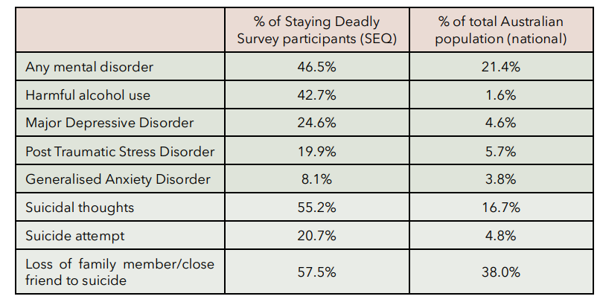
Staying Deadly Survey
Funded by Queensland Health and conducted by QCMHR in partnership with IUIH. 406 Indigenous adults surveyed across SEQ (aged 18-89 years – 72.2% female and 27.3% male). Data collected on prevalence, service access and access barriers, service preference, and the clinical appropriateness of services delivered.
Prevalence
Higher rates than the overall Australian population aged 16-85 of:
  mental disorders
  harmful substance use (HSU)
  suicidal thoughts, behaviours and exposure
Notes:
The Queensland Urban Indigenous Mental Health Survey (known as the Staying Deadly Survey) was funded by Queensland Health and conducted by Queensland Centre for Mental Health Research (Dr Alize Ferrari and her team) in partnership with IUIH.
The team surveyed 406 Indigenous adults across SEQ (aged 18-89 years – 72.2% female and 27.3% male) and collected data on
prevalence, service access and access barriers, service preference, and the clinical appropriateness of services delivered.
The survey found higher rates than the overall Australian population aged 16-85 of:
mental disorders (46.5% compared with 21.4% in the total Australian population)
harmful substance use (HSU) – 42.7% compared to 1.6% in the total Australian population
suicidal thoughts, behaviours and exposure – 55.2% (thoughts) compared to 16,7% of total Australian population and 57% who said that they had lost a family member of close friend to suicide
406 Indigenous adults surveyed across SEQ (aged 18-89 years – 72.2% female and 27.3% male)
Data collected on prevalence, service access and access barriers, service preference, and the clinical appropriateness of services delivered.

Slide 10
Staying Deadly Survey
Participants were asked what would make it easier for them to access healthcare.
Availability of services and logistical issues were the most significant barriers identified.
  Access Barriers
  availability eg after hours and weekends – 42.5%
  logistical issues eg transport – 13.7%
  cultural safety eg culturally capable staff, gender – 5.6%
  administrative issues eg effective communication – 4.9%
  more service types needed eg specialist services, home visits – 4.7%
  lack of information about the service – 3.6%
  financial cost – 2.3%
Notes:
Barriers to mental health service access were identified, with 42.5% of people citing availability of services as the biggest barrier to access. A further 13.7% of people identified logistical issues (such as transport, parking, online booking, distance) as a significant access barrier.
Others
cultural needs (culturally aware staff, less politics, gender of staff, confidentiality) – 5.6%
administrative issues (consistent staff, appointment communication) – 4.9%
more service types needed (specialist services, home visits, partnership with mainstream) – 4.7%
lack of information about service – 3.6%
financial cost – 2.3%

Slide 11
Staying Deadly Survey
Participants expressed a strong preference for accessing mental healthcare through Aboriginal Community Controlled Health Services
Service Preference
Participants expressed a preference for accessing ACCHSs over mainstream services for all types of healthcare:
  general health – 74.4%
  physical health – 68.0%
  social, emotional and mental health – 71.3%
  specialist services – 56.3%
  sensitive health issues – 70.5%
Notes:
There was a strongly stated preference for health services delivered by Aboriginal Community Controlled Health Organisations - for mental health and other conditions. For mental health needs, 71.3% of participants stated that they preferred to access ACCHSs.

Slide 12
IUIH Social Health
Existing primary mental health and psychosocial support services offered by the IUIH Regional Social Health Team.

Slide 13

CCHS Primary Mental Health Services
A common misconception is that the CCHS sector only delivers preventive social and emotional wellbeing services. In fact, CCHSs are supporting people with a range of complex physical and mental health issues and other socio-economic challenges.
CCHS Clinics – mental health services
GP assessment and mental health care plans
Psychiatry services – including child/adolescent psychiatrist and addiction medicine specialist
MBS funded allied health services
Group and family therapy and counselling services
Family wellbeing services for vulnerable families and young people
Psychosocial education and psychosocial support.
IUIH is an RANZCP accredited provider of adult psychiatry training
Notes:
When IUIH first started talking to the mainstream mental health system about the role CCHS services play in supporting people with mental health needs, a clear misconception was evident that the Community Controlled Health Sector only operates in the preventive end of the care continuum, delivering social and emotional wellbeing services and psychosocial support.
In fact, because of our Mob’s significant mistrust of the mainstream mental health system, CCHS clinics are supporting clients with more complex conditions than those usually managed in general practice.
The IUIH System of Care delivered through IUIH Network clinics incorporates a range of primary mental health services, oversighted by a full-time regional psychiatrist and IUIH’s clinical director.
The IUIH Network also provides placements for psychiatry registrars and psychology and social work students and is accredited by the Royal Australian and New Zealand College of Psychiatrists as a provider of adult psychiatry training.

Slide 14
IUIH Transition Support Services
IUIH provides mental health support and psychosocial support for some of our most vulnerable people – those released from prison and those sleeping rough
“The Social Health Team is a valued asset to us the Indigenous Community. They advocate and speak up for us when we can’t speak for ourselves.”
Social Health Client
Social Health Team – Transition Support Services
Prison Transition - planning for release and support for 6 months post release from prison – connection to healthcare and psychosocial support
Crisis intervention through opportunistic outreach
Intensive case management
‘Warm’ handovers /referrals to internal and external services
Connection to housing, crisis accommodation, domestic and family violence services and Centrelink
Notes:
IUIH is funded by State-wide Forensic Mental Health Service to work with Aboriginal and Torres Strait Islander men and women up to 6 weeks before their release from an SEQ prison and to support them in the community for up to 6 months post-release. They are connected to healthcare services through IUIH or other SEQ providers or, if they are from outside the region, supported to return home and connected with appropriate local health services.
IUIH’s Transition Support Team also provides outreach services, intensive case management and crisis intervention to hard-to-reach populations, including people sleeping rough, many of whom are living with mental health and substance use challenges. This team works closely with the Queensland Police Service and with health and other service providers to connect clients to supports as needed.

Slide 15
Service Reform 2022-24
Strengthening mental health service responses for Aboriginal and Torres Strait Islander people of SEQ

Slide 16

SEQ First Nations Health Equity Partnership
Established in 2021, partners now include all SEQ HHSs and PHNs, Mater Health, CHQ, QAS and the CCHS Sector
August 2020 - April 2021 – FNHE amendments passed to the HHB Act
August 2021 –SEQ Governance Committee established
March 2022 – SEQ First Nations Health Equity Strategy finalised and endorsed.
November 2021 - SEQ FNHE Statement of Commitment signed by Partners to accelerate the pace of reform
July 2020 – 2nd Closing the Gap Agreement signed
Notes:
The First Nations Health Equity Partnership was established and includes representation at the Board and Senior Executive level of the Hospital and Health Services, Primary Health Networks and Community Controlled Health Sector in SEQ, as well as Children’s Health Queensland, Mater Health and the Queensland Ambulance Service.
With a strong commitment to accelerated system reform to close the health gap in SEQ, the partnership has developed a ten-year regional strategy to guide priority actions at a regional system level.

Slide 17
SEQ First Nations Health Equity Partnership
Through the First Nations Health Equity Partnership:
  a Mental Health Working Group has been established to develop regional approaches to suicide prevention and response planning, improved pathways across the mental health service system, joint service planning and crisis intervention
  a Clinical Governance Subcommittee has been established, which is working on shared incident management, access and care pathways, including framing mental health as a public health issue and a key determinant of access and wellbeing.
The SEQ First Nations Health Equity Partnership prioritised mental health service reform and advocated strongly for First Nations mental health services.
Notes:
The SEQ First Nations Health Equity Partnership is doing significant work to improve mental health service planning, access and care pathways across the care continuum. Mental Health (including substance use and suicide prevention) is a established priority under the SEQ First Nations Health Equity Strategy and all Partners have been strong in their advocacy for specialised First Nations mental health services in SEQ.

Slide 18
Staying Deadly Hubs
The research told IUIH and its Partners that there was an urgent need for a First Nations specialised service that bridged the gap between primary and hospital care.
Staying Deadly Hubs
IUIH received QH funding for 4 Staying Deadly Hubs across SEQ – being rolled out in stages
  The first hub opened in Silkstone (West Moreton) in February 2024
  Planning is underway for the second hub (Inner Brisbane) which will be fully operational in early 2025
  The third and fourth hubs will be opened in Moreton Bay and northern Gold Coast in the next two years.
Notes:
The research highlighted that the burden of mental and substance use disorders is increasing amongst First Nations people in SEQ and that our Mob’s access to mental health services (particularly in the Community) is very low with significant gaps between prevalence and access. It highlighted the urgent need for community controlled First Nations specialised mental health services that sit between and bridge the gap between primary and hospital care. – services for those that the Australian Productivity Commission termed ‘the missing middle’.
Queensland Health and SEQ First Nations Health Equity Partners, acknowledged the research and IUIH’s capacity to develop and deliver a specialised model of community-based mental health care, and provided funding for four Staying Deadly hubs across SEQ. The first, at Silkstone in West Moreton, opened in February 2024 and planning is well underway for the second which will be located in Inner Brisbane due to open in early 2025.

Slide 19
Staying Deadly Hubs
Staying Deadly Hubs
For First Nations people aged 15+ years with moderate to severe mental health issues
Referral pathways into and out of primary healthcare services, the IUIH Mob Link service, and mainstream community and hospital based mental health services
The hub offers:
  a more timely, safer, planned pathway to inpatient care
  step down/transition back into community post-discharge
  multidisciplinary assessment and treatment, care for new mental health presentations and those with undifferentiated conditions
  Assertive outreach and intensive case management.
Notes:
The hubs support First Nations people with moderate to severe mental health needs that are
at risk of entering the acute care system if their symptoms are unmanaged
stepping down from an inpatient episode of care to ensure they are well supported in the community and the risk of relapse is minimised.
The West Moreton hub has referral pathways into and out of primary healthcare services operated by Kambu and IUIH, IUIH’s Mob Link extended hours care coordination service, mainstream general practices and West Moreton HHS’s community and hospital based mental health services.
The multidisciplinary hub team undertakes comprehensive assessment, treatment, assertive outreach and intensive case management for First Nations people aged 15+ years.
The hub offers:
a more timely, safer, planned pathway to inpatient care when required
step down/transition back into community post-discharge with intensive case management, clinical care and psychosocial support
multidisciplinary assessment and treatment planning, and care for new mental health presentations, undifferentiated conditions
Assertive outreach and intensive case management to connect with the hardest to reach clients and those with very complex needs.

Slide 20
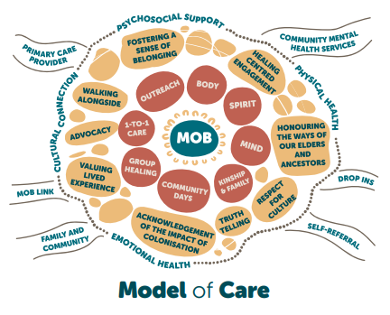
Staying Deadly Hubs
Notes:
The model of care is illustrated by this diagram, reflecting IUIH’s holistic and flexible approach to providing health care, including drops ins where people can access food and a shower, home visits, delivering services in the park or wherever our Mob are.

Slide 21
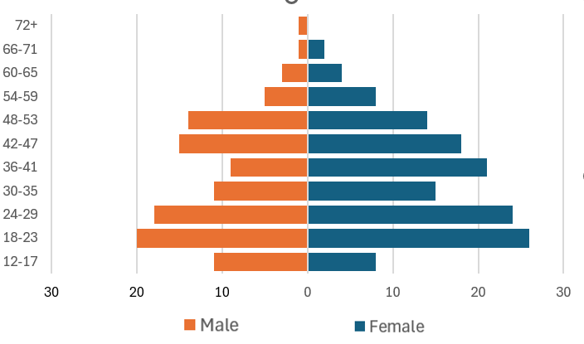
Staying Deadly Hubs – Deadly data to date
West Moreton Staying Deadly Hub – to end October 2024 (9 months)
Total 248 clients to date have had care provided through the Hub
99% Aboriginal and/or Torres Strait Islander, 1% = non-Indigenous member of an Indigenous family
56% female, 44% male
34% of males and 29% of females are under the age of 25 years
Formal evaluation is underway, funded by Queensland Health, and conducted by the Queensland Centre for Mental Health Research (QCMHR)
Notes:
In its first 9 months of operation, 248 clients have accessed care through the hub, of which 99% were Indigenous., 56% were female and 44% were male. In addition, 34% of males and 29% of females were under 25 years of age.
The hub model is being formally evaluated by the Queensland Centre for Mental Health Research as part of the funding received from Queensland Health for its operations.

Slide 22
Staying Deadly | Headspace
Youth Mental Health Services
IUIH has been funded by the Commonwealth Dept of Health through the Brisbane North PHN to establish a First Nations specific headspace service
  First of its kind in Australia
  Established in Deception Bay 2023/24
  Target: young people aged 12-25 years
  Mental health and well-being assessment, early intervention, and care
  Workforce and model concept like the Staying Deadly Hub described earlier, ensuring there is no wrong door for young people seeking access to care and support and providing age-appropriate, clinically and culturally safe and secure connection to other services if needed
IUIH also provides early intervention services for vulnerable young people (aged 10-17 years) in partnership with CHQ
Notes:
Recognising that Aboriginal and Torres Strait Islander utilisation of mainstream Headspace services was relatively low, IUIH has been funded by the Commonwealth Department of Health through the Brisbane North PHN to establish a First Nations specific headspace service
The service was established in Deception Bay this year and is the first of its kind in Australia
It provides mental health assessment, early intervention and care for young people aged 12-25 years
Called Staying Deadly-Headspace, Its model of care mirrors that of the Staying Deadly Hub whereby a ‘no wrong door’ approach is taken, and age-appropriate clinically and culturally safe are provided, including connection to other services if needed. I
IUIH also provides early intervention services for vulnerable young people (aged 10-17 years) who are exhibiting behaviours that may cause harm to themselves or to others. The service was established in late 2023 in partnership with CHQ.

Slide 23
Sources
Queensland Urban Indigenous Mental Health Survey (QUIMHS) Research Team. The Staying Deadly Survey – Queensland Urban Indigenous Mental Health Survey Report. Brisbane: Queensland Centre for Mental Health Research, 2023. DOI: 10.14264/1c4e5ce available at https://qcmhr.org/uncategorised/queensland-urban-indigenous-mental-health-survey.
Queensland Centre for Mental Health Research (QCMHR) Project Team. Indigenous Mental Health Services in SEQ (ISEQ-NMHSPF) Final Report. Brisbane: Queensland Centre for Mental Health Research, 2022 available at https://qcmhr.org/uncategorised/analysis-of-mental-health-service-provision-for-aboriginal-and-torres-strait-islander-populations-in-south-east-queensland-iseq-nmhspf
Queensland Health (2023). Queensland First Nations Peoples Burden of Disease Report, Queensland Health, Brisbane available from Office of the Chief First Nations Health Officer – Daniel.Williamson@health.qld.gov.au.

