Slide 1
Preventing gambling-related suicide
Health Innovation and
Transformation Centre
A/Professor Angela Rintoul, DPH, MSocSci, BA, VPHTS, CF
Principal Research Fellow, Federation University Australia, Honorary Principal Research Fellow, University of Melbourne
Postdoctoral Fellow, Suicide Prevention Australia Research Fund
Study team: Britt Klein, Suzanne McLaren, Kerrie Shandley
Queensland Mental Health Commission, Leading Reform Summit
Brisbane, 28 November 2024

Slide 2
Disclosures
Does not work for, consult to, own shares in or receive funding from any company or organisation that would benefit from this presentation
Employed by Federation University, Honorary @ University of Melbourne & Monash University
  Receives/d funding from the Suicide Prevention Australia Research Fund, WHO, Monash University, ARC, Victorian Responsible Gambling Foundation, ANROWS, Department of Social Services, Winston Churchill Memorial Trust
  Honoraria from Auckland University of Technology, GREO (UK regulatory settlement funds)
  Partnered with Gambling Harm Lived Experience Experts for postdoctoral fellowship
Notes:
Grateful for the support of SPA postdoctoral fellowship funding

Slide 3

Gambling harms
Australians are the worlds biggest gambling losers:
  $32bn 2022-23 or $1,555 per adult
Pareto principal: ~2% of gamblers produce ~80% losses
Harms concentrated in areas of social stress
For each “problem gambler” at least 6 others affected
Contributes to crime, family violence, child neglect, relationship breakdown
  10% increase in gambling expenditure associated with 7.4% increase in assaults (Yin Wan, Wang, Weatherburn 2024)
Diverts spending from more productive areas of economy
https://www.thelancet.com/commissions/gambling
Notes:
Industry continues to expand in Australia and globally

Slide 4
Gambling and links with suicide
Gambling causes/exacerbates mental distress and physical ill health – depression, anxiety, CVD, insomnia, skin disorders, malnutrition
  At least 4.2% of suicides in Victoria gambling-related
  Irrational behaviour fuels deepening cycles of loss
  Inaction on reform leads to sense of defeat
  Stigma compounds harm AND prevents help-seeking
  Help and support for gambling problems often inadequate, inappropriate
It felt like I was hitting things [machine] like a robot… I didn't even recognize I had a problem for 10 years and I had no food, I couldn't even afford milk, so if that's not like hijacking of the brain, yeah, I don't know what is. – G7F, 40s
Notes:
Australian’s National Suicide Prevention Strategy Advice document links gambling to suicidal distress
England’s National Suicide Prevention Plan identifies gambling as a risk factor for suicide
SPA have released a roadmap to address GRS.
I worked with CCOV and we identified 184 direct GRS and an additional 17 ‘affected others’ in Victoria alone over 8 yrs
There are many harms associated with gambling, not only financial losses

Slide 5
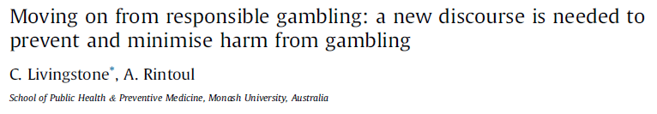
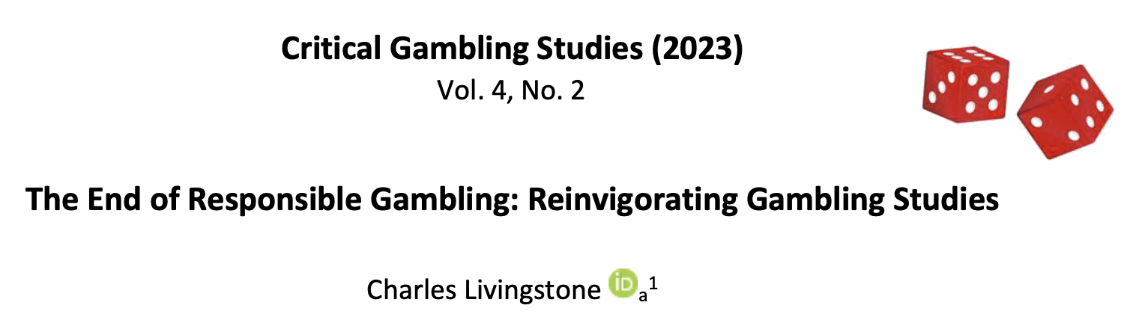
“Responsible gambling”
Gambling is harmless fun: “Harms occur only for a small minority, most gamble responsibly”
Focus is on ”problem gamblers” emphasises ‘downstream’ measures
Maintains status quo, individual orientation creates stigma and shame
Suicide prevention has typically been approached as a mental health issue – clinical responses
How we frame a problem determines how we approach solutions
Notes:
The dominant discourse and response to gambling harm has been RG
This is problematic as it has suited the industry interests, by promoting the idea that gambling harms a small minority and that most people gamble responsibly

Slide 6
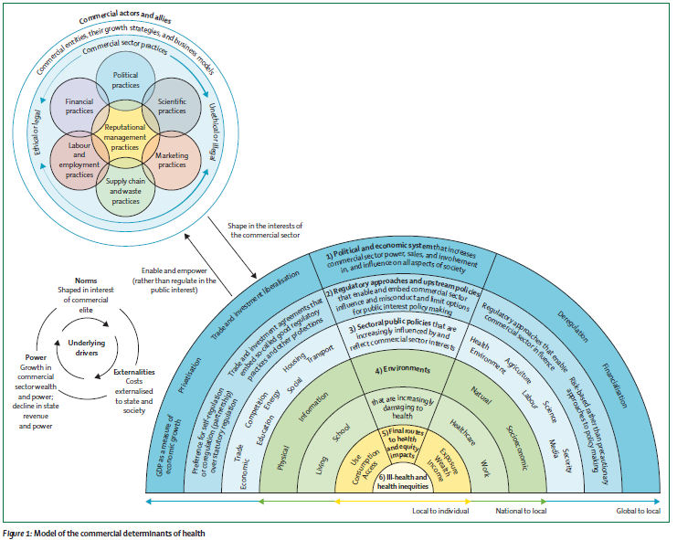
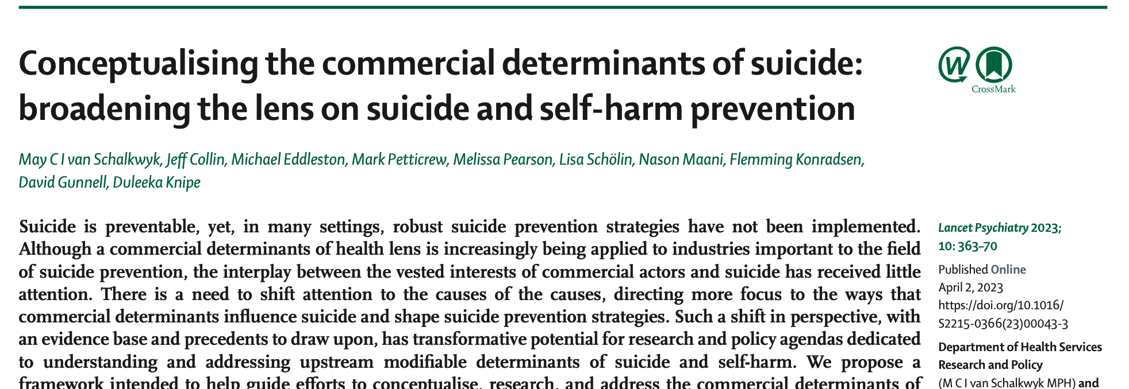
Commercial determinants of health & suicide
“the systems, practices and pathways through which commercial actors drive health and equity” - Gilmore et al, 2023
Commercial practices also undermine suicide prevention efforts – van Schalkwyk… Knipe et al, 2023
Gambling an exemplar case
Depletes financial, social, and biological resources rapidly
Few constraints on predatory practices, limited regulation
Notes:
CDoH have been influential in addressing no-communicable diseases. We are now expanding on the CDoH in the suicide prevention space, described as the commercial determinants of suicide or CDoS. The first and only paper to describe this was published last year in the Lancet Psychiatry. The commercial practices of the gambling industry seriously undermine efforts to prevent suicide, and are exemplar case of the CDoS.

Slide 7
The commercial determinants of gambling-related suicide
POLITICAL: misusing evidence, shift responsibility between levels of government
MARKETING: Normalisation
PRODUCTS: supercharged
SCIENCE: Creation of doubt
ECOSYSTEM: Economic operators who benefit from gambling
SYSTEM: Undermining systems we rely upon
Operators, manufacturers, banks, IT&T, software & game developers, media, broadcasters, sport codes
Reliance on gambling tax revenues
Industry influenced ‘help’ services do not meet needs
Legal system criminalises those harmed, not executives overseeing illegal activity
Corrosion of democracy
Risky work, poor employment standards
STIGMA
SHAME
STIGMA
Lobbying
Donations
‘Revolving door’ between ecosystem & politics
Industry funded research supports industry to deny, dismiss, distract, delay, dismay, distort, deceive
Biased evidence base “harms small minority”:
Dark patterns - Nagging, slugging
Data driven ‘tuned advertising’
Funding ‘good causes’
Overstating employment benefits
“RESPONSIBLE
GAMBLING”
Extending ‘time on device’: losses disguised as wins, unbalanced reels, near misses, free spins, celebratory sounds, images
Intensity: bet size, reward frequency, spin rate
Accessibility: digitisation, online, long opening hours, venue density
Self harm
Suicide
Access to lethal means
Notes:
This model I am progressing the conceptualisation of CDoS developed by van Schalkwyck et al to describes the ways in which gambling ecosystem in particular operates. The ecosystem is dependent up, and has a profit imperative that is fundamentally at odds with the public health efforts to reduce harm.
While many strategies and tactics are similar to those used in other unhealthy commodity industries, there are unique aspects that warrant specific identification given the often-hidden nature of gambling harm, the growing and sophisticated digital data available to gambling operators that can be used to target customers and increase harm.

Slide 8
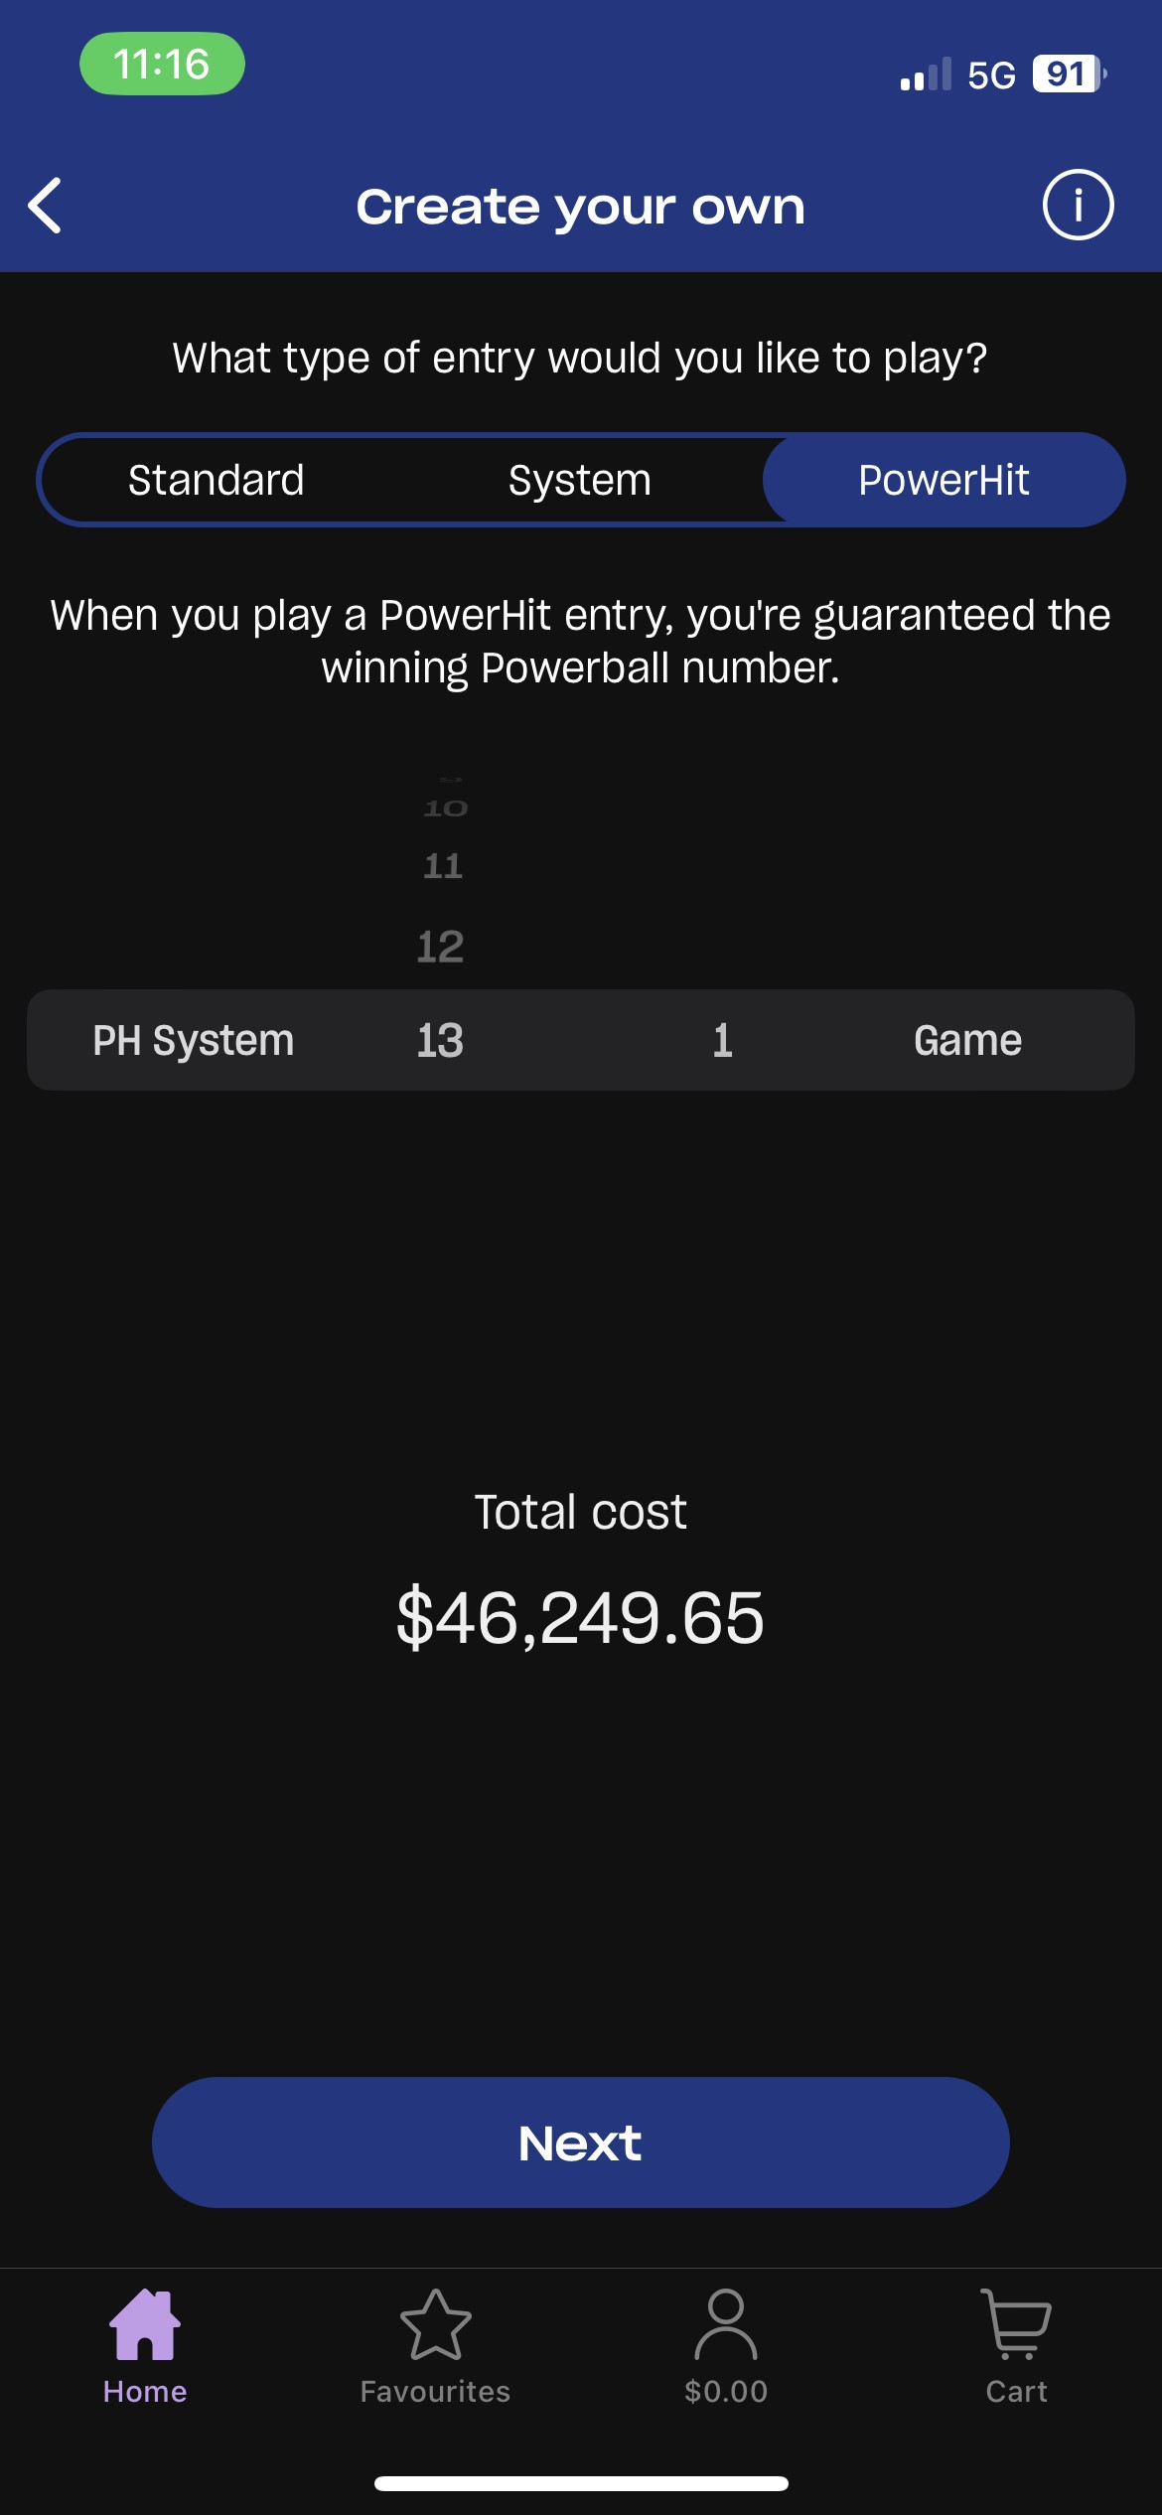
Products: ‘playing to extinction’
Regulation not keeping pace
  Intense, immersive, automated, routinised
  Few (no) limits on losses
  Widely available, 24/7 online
  Dark patterns – nagging, sludging
Notes:
‘Playing to extinction’ is the term that Natasha Schull (Addiction by design) reported industry insiders use to describe the ways in which they deploy technology to create machines and environments that entrance players to follow loss with more loss, this takes on a whole new meaning as the evidence base around the severity of harm improves, particularly in relation to suicide prevention

Slide 9


‘Good causes’: a legitimation tactic
e.g. ClubGRANTS NSW Triceratops fossil Melbourne Museum
Notes:
The gambling industry have positioned themselves as major supporters of ‘good causes’ – an alibi for the harm they know they create. This builds legitimacy for their work and creates dependencies on revenues by community organisations
Examples include special schools, sporting clubs and culture and arts – the triceratops fossil at the Melb Museum was paid for through the Victorian community support fund. Earmarking gambling revenues is problematic, when we are only just beginning to scratch the surface of the nature and magnitude of harms. Support for community initiatives can diminish support for meaningful reforms that could save lives.

Slide 10
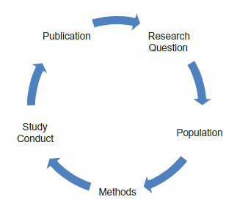
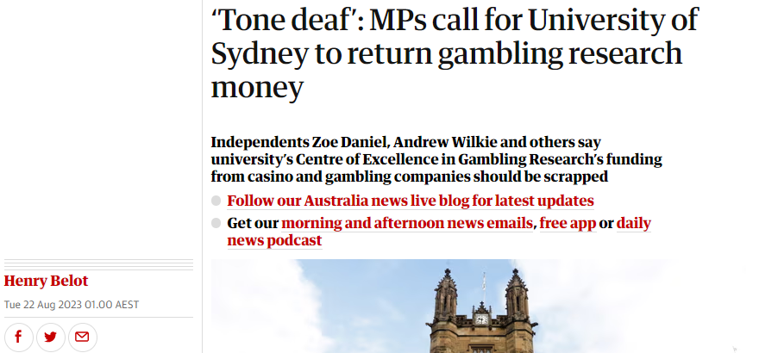
Misuse of science
Cycle of bias, Source: Odierna, et al., 2013
Notes:
Conflicts of interest that are often celebrated rather than declared, create a risk of bias that can lead to inaccurate and poor quality research. Not just funding, but the entire framing of responsible gambling has influenced the researchers that receive funding, the research questions that have been asked, and for much of history this has been individual focussed with very little attention paid to the social and commercial determinants of how and why harm occurs.
PWLE are crying out for tools to help them stop, but some ‘leading’ researchers cast doubt on the effectiveness of tools that have now been adopted in Nordic countries (account registrations allowing people to set limits).

Slide 11
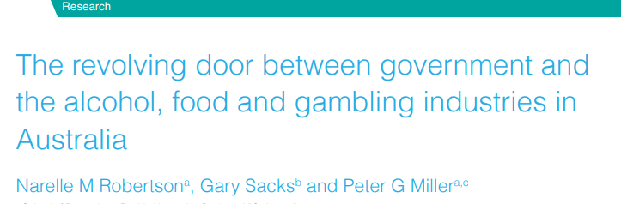
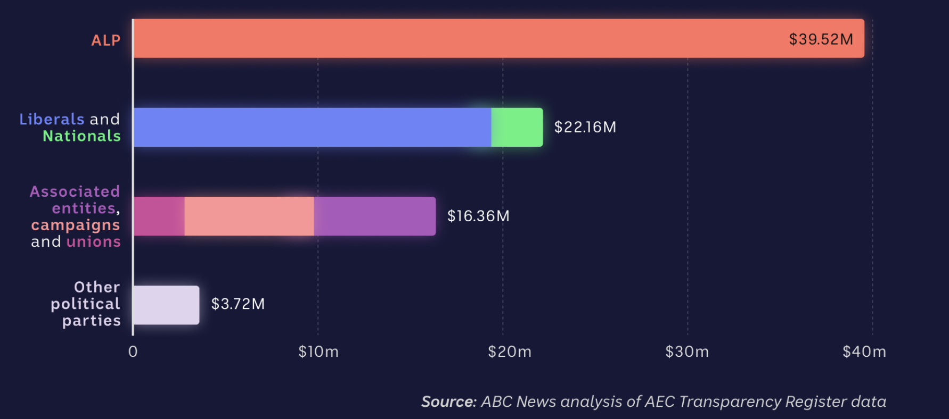
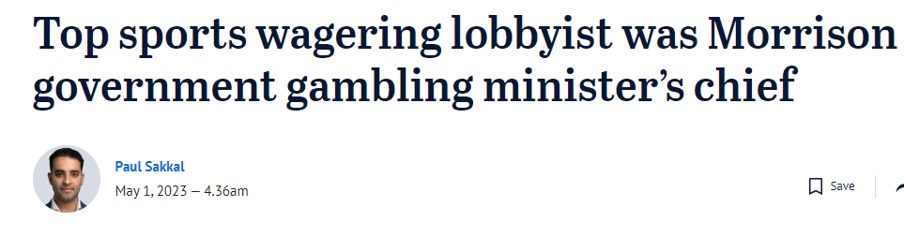
Political influence
Politics → industry
  e.g. Casino board, peak bodies
Political donations
  Pressure prevents reform
Lobbying
  PM repeats industry lines
Inaction fuels sense of defeat
Notes:
This determines what policies are adopted and which regulations and reforms are even considered.
contributes to a sense of defeat and frustration at policy inaction for those harmed, which also contributes to the suicide toll. I came across cases that left notes to that effect in study 1. Lobbying power overwhelms decision makers who may consider meaningful reforms, and they back down

Slide 12

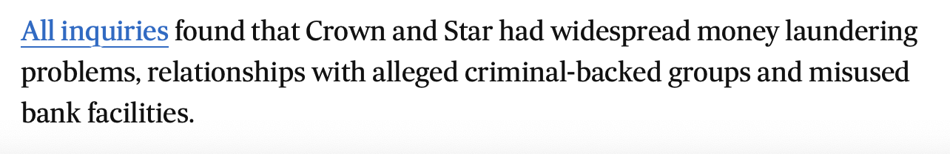
System influence
Reliance on gambling taxes
Diagnostic instruments don’t capture extent of harms
Treatment and support services don’t meet needs
  Few staff understand severity of gambling harm
  Few diagnosed with or identified as experiencing gambling disorder
Gambling and suicide overlooked in regulation, health, tax, social services, justice
Legal system prosecutes those harmed, executives overseeing illegal practices not penalised
Notes:
Despite social costs far exceeding tax revenues, perceived reliance on these revenues may make some policymakers reluctant to introduce reforms.

Slide 13
  The first thing she [counsellor] said… "you don’t look like a problem gambler. You're too pretty to be hooked on the pokies" and I thought, “What the hell?” "and then she goes “Oh, I know how you feel, I'm addicted to the beach" … I just didn't make anymore appointments.
  – G7F, 40s
I call up Gamblers Help line. They were useless. They did nothing for me. The person that I was having sessions with had never walked into a hotel or seen a poker machine. They didn't understand what I was going through ... All they said to me…[was] "oh when you get that feeling, go for a walk or take up a hobby" It's deeper than that….I've never spoken to anyone else about it. It did nothing for me.
  – G1M, 40s
Notes:
These are quotes from my study with those who have experienced GRS and show how staff likely unwittingly contribute to stigmatisation of those harmed by gambling

Slide 14
The ecosystem
Media and broadcasters, operators, manufacturers, IT&T, software developers, sports codes
‘Responsible gambling’: the framing from which policy responses and intervention, and treatment are typically based
‘Responsible gambling’
‘Problem gambler’
Stigma
Shame
Self-harm
Suicidal ideation
Suicide
Notes:
This chain also creates a flawed evidence base that frames the problem with the individual and not the system in which the individual exists.

Slide 15
The solutions
Disrupt systems, pathways, practices: population, system level approaches (public health)
Strengthen democracy, strengthen regulation
  ban political donations
  enforce duty of care - tip-off and complaints systems, data sharing between regulators
  Increase penalties for non-compliance, suspend or remove licenses
  Invest fines in prevention - regulation and research
Reducing harm will reduce profits

Slide 16
Curbing the “suicidogenic” effects of gambling
Suicide prevention should be a feature of gambling regulation
Data: visibility, transparency
  Regulators, operators, and people who gamble need accurate data
  Data vaults - requires universal account registration
Improve evidence base for action
  Knowledge of harms requires substantial investment in independent research
  Constrain industry influence of policy, research, treatment
Notes:
Data vaults have been implemented in Spain, Denmark, France, Germany, Portugal, Malta, Romania, Bulgaria, Columbia, Argentina. Require people to have a gambling account, and limits apply across products. Data should be shared with police, coroners ASIC. The remainder of my grant will document this formally but it is clear that a genuine public health approach that limits the influence of industry
This means better data, better evidence of harms, improved regulations etc etc

Slide 17
References & further reading
Chater, N. and G. Loewenstein, The i-frame and the s-frame: How focusing on individual-level solutions has led behavioral public policy astray. Behavioral and Brain Sciences, 2023. 46: p. e147
Hill, S.E. and S. Friel, ‘As Long as It Comes off as a Cigarette Ad, Not a Civil Rights Message’: Gender, Inequality and the Commercial Determinants of Health. International Journal of Environmental Research and Public Health, 2020
Gilmore, A.B., et al., Defining and conceptualising the commercial determinants of health. The Lancet, 2023
Karlsson, A. and A. Håkansson, Gambling disorder, increased mortality, suicidality, and associated comorbidity: A longitudinal nationwide register study. Journal of Behavioral Addictions, 2018. 7(4): p. 1091-1099.
Levin, L. Submission to the parliamentary inquiry into online gambling harm, What is a data vault? Financial Counselling Australia, March 2023
Legg T, Hatchard J, Gilmore AB (2021) The Science for Profit Model—How and why corporations influence science and the use of science in policy and practice. PLOS ONE 16(6): e0253272.
Livingstone, C. & A. Rintoul, Moving on from responsible gambling: a new discourse is needed to prevent and minimise harm from gambling. Public Health, 2020.
Livingstone, C. Gambling Technical Brief, WHO, 2024 (forthcoming)
Marionneau, V. and J. Nikkinen, Gambling-related suicides and suicidality: A review of qualitative evidence. Frontiers in Psychiatry, 2022.
Mills S, Whittle R, Ahmed R, Walsh T, Wessel M. Dark patterns and sludge audits: an integrated approach. Behavioural Public Policy. Published online 2023:1-27. doi:10.1017/bpp.2023.24
Nicoll, F., et al., What are Critical Gambling Studies? Critical Gambling Studies, 2022. 3(1): p. i-v.
Odierna, D.H., et al., The cycle of bias in health research: a framework and toolbox for critical appraisal training. Accountability in research, 2013. 20(2): p. 127-141.
Rintoul, A., et al., Gambling-related suicide in Victoria, Australia: a population-based cross-sectional study. The Lancet Regional Health – Western Pacific, 2023
Wardle et al, The Lancet Public Health Commission on gambling, Lancet Public Health, October 2024 [online first]
Ukhova, D., et al., Public health approaches to gambling: a global review of legislative trends. The Lancet Public Health, 2023
van Schalkwyk, M.C.I., et al., Conceptualising the commercial determinants of suicide: broadening the lens on suicide and self-harm prevention. The Lancet Psychiatry, 2023. 10(5): p. 363-370

