Slide 2

Queensland Mental Health Commission
Commitment to partnering with people with lived-living experience in Queensland
Michelle Sanders, Director, Lived-Living Experience Team, QMHC
Ellie Hodges, Chief Executive & Founder, Lived Experience Leadership and Advocacy Network
Karen Conlon, Principal Policy Officer, Lived-Living Experience Team, QMHC
Notes:
Michelle to start

Slide 3
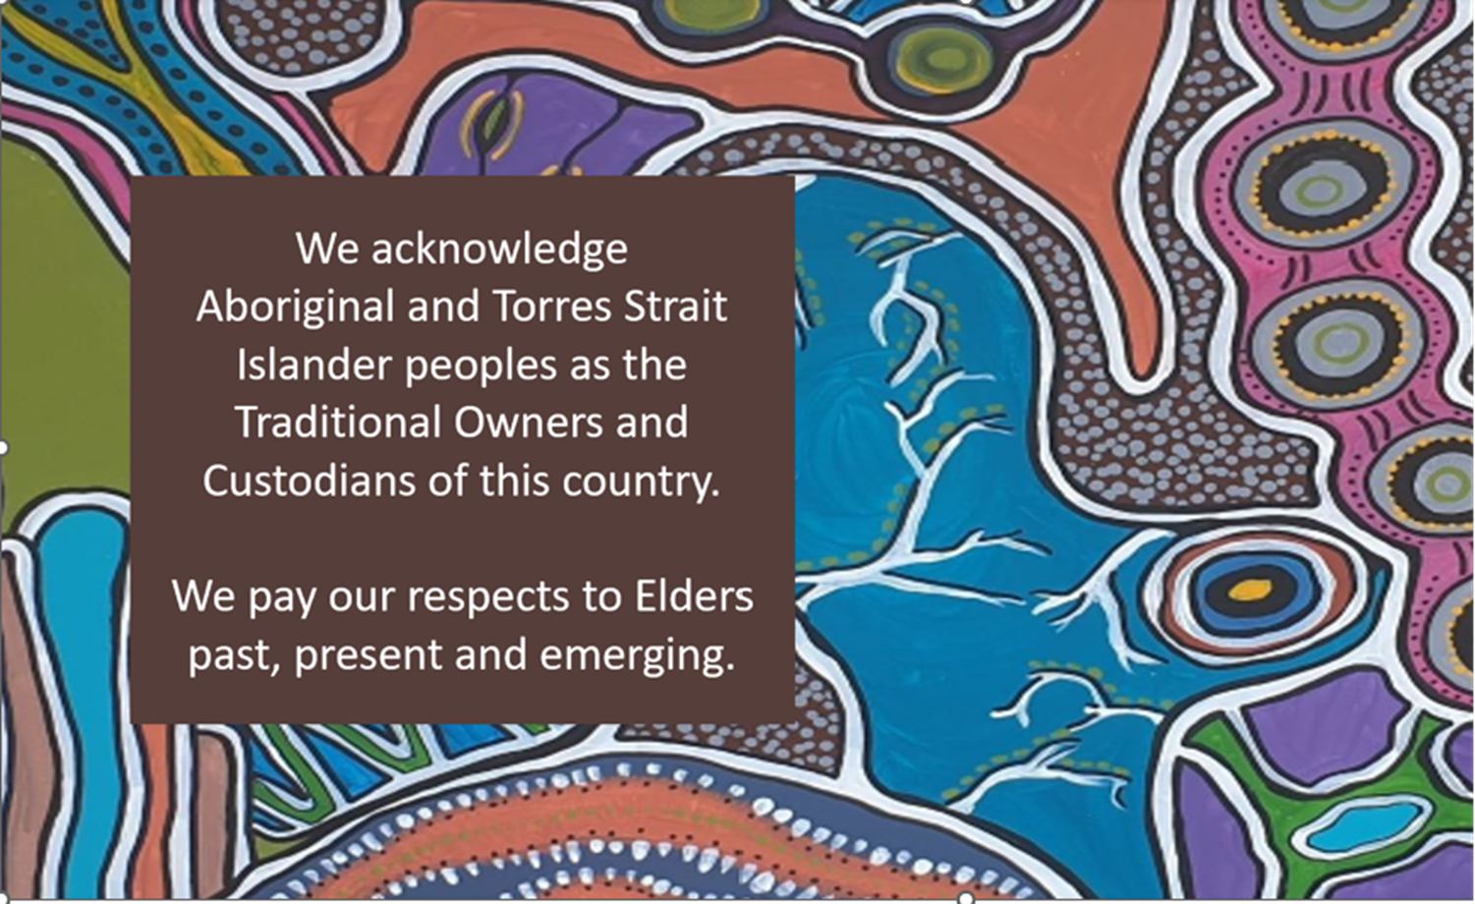
Notes:
Michelle
I would like to Acknowledge the traditional owners and custodians of the lands on which we are gathered here today in Menanjin – the Turrbal and Yuggera people.
I would also like to Acknowledge Aboriginal and Torres Strait islander people as the traditional owners and custodians of the various lands across Queensland from which many of you have travelled to be here. I have the privilege to live on the traditional lands of the Kombumerri Saltwater people on the Gold Coast.
I pay my respects to Aboriginal and Torres Strait Islander people here today.

Slide 4




Our Partners in developing the Commitment
Lived-living experience advisors
Lived-living experience peak bodies
Lived Experience Leadership and Advocacy Network (LELAN)
Notes:
Michelle
RITO
ARAFMI
MHLEPQ
QLEWN
QuIVAA

Slide 5
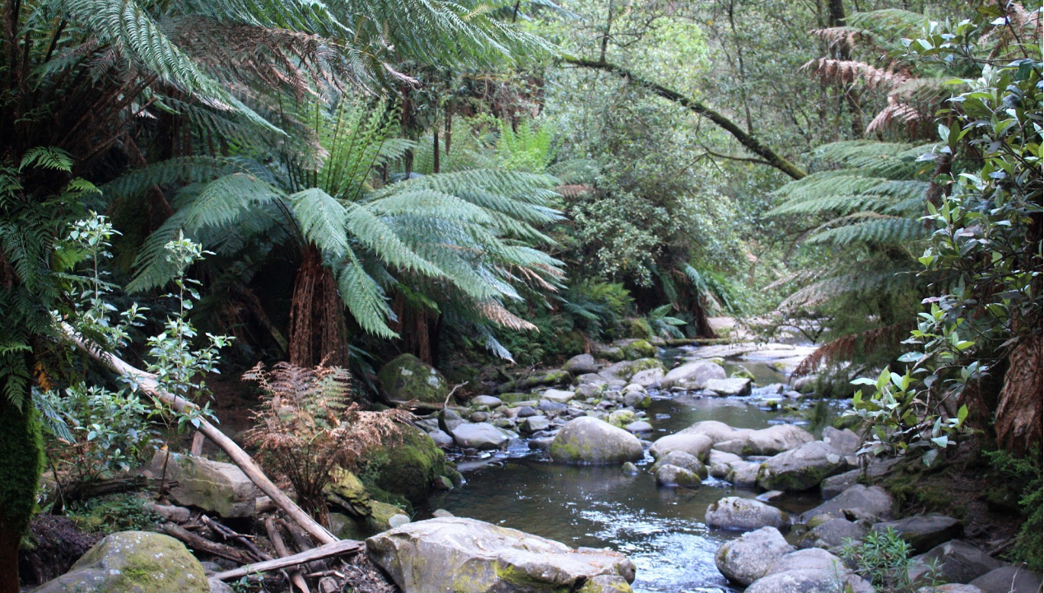

Recognition of Lived-Living Experience
Notes:
Michelle
We recognise the importance of language and note that there is no consensus on the language used to define collective lived-living experience. We define ‘lived-living experience’ as personal experience/s of mental health challenges, and/or alcohol and other drug use, and/or suicide. This includes family, kin, unpaid carers and other unpaid supporters of people experiencing mental health challenges, and/or alcohol and other drug use, and/or suicide. This also includes people who are bereaved by suicide.
Lived-living experience may be viewed as a continuum of experiences that people may have at different times in their lives. The use of the hyphen signals the movement or changing nature of our experiences along this continuum. We thank lived-living experience leaders in Queensland working in the alcohol and other drugs sector for this approach.
Lived-living expertise is developed through advanced understanding and integration of the personal and collective experience in order to benefit all, uphold human rights and contribute to system transformation. Contemporary convention is to use capitalisation when referring to the professional discipline of the Lived-Living Experience workforce.

Slide 6
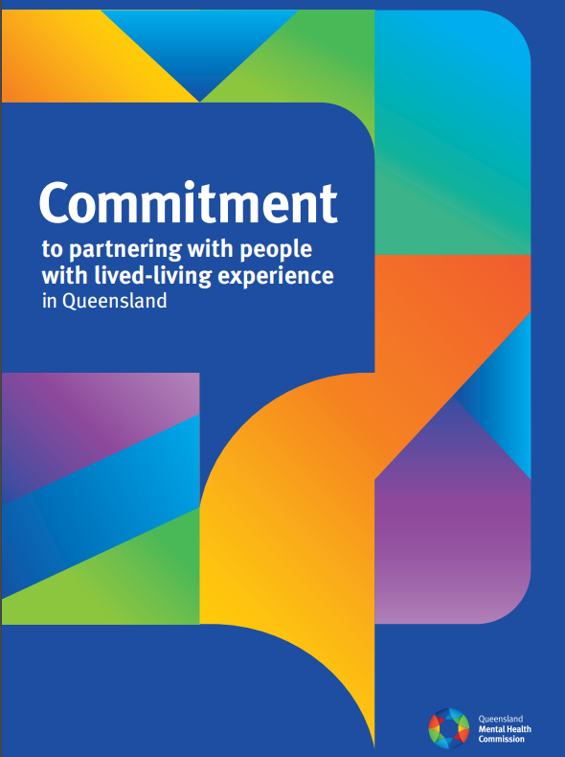
What is the Commitment?
Publicly communicates the Commission’s intentions on how they will partner with people with lived-living experience in their system reform efforts
Notes:
Ellie
Beyond symbolism
Has the values they hold and how they will put them into action when partnering
Commission aims to:
- More deeply understand what is needed to partner
- Influence policies, services and systems to reflect the rights, needs and preferences of people with lived-living experience
- Create shifts that foster partnerships and where possible enable people with lived-living experience to co-lead and drive the reform agenda.

Slide 7
How the Commitment was developed
Webinar
Surveys
Input from people with lived-living experience
Consolidation webinar
Feedback on the draft Commitment
Notes:
Ellie

Slide 8

Our values
We welcome lived-living experience involvement, expertise and leadership
We are courageous
We do what we say
We are transparent about the way we partner
We stand alongside people with compassion, listen deeply and respond with care
We uphold people’s rights
Notes:
Karen
Welcome LLE – individual and collective experiences are vital to our system reform effort
- valued equally alongside any role, title or position
Courageous – steadfast in our allyship with people with LLE
- courageously and curiously challenge our current ways of partnering and stretch ourselves to explore approaches that are new, different or uncomfortable
We do what we say – we work with integrity and if we aren’t meeting expectations we invite people with LLE to let us know and hold us accountable
We are transparent – Open and clear about what we are doing, why we are doing it and how
Stand alongside – prioritise wellbeing and foster environments where people feel safe (enough) and supported
Uphold rights – uphold people’s right to be central in system reform

Slide 9
Our values in action
We partner with people with diverse and intersectional identities and lived-living experience
We address barriers to partnering
We share and shift power towards people with lived-living experience
We take a trauma-informed approach
We learn, grow, and benefit each other
Notes:
Karen
Diverse and intersectional identities
High level of representativeness
Embracing everyone for who they are
Developing partnership approaches with First Nations people and communities
Being culturally inclusive, safe and responsive
Barriers
Identify and address barriers to partnering
Being flexible in our approaches
Collaborating with regional, rural and remote communities
Share and shift power
Promoting opportunities
Sharing information and knowledge
Acknowledging and reducing the impact of power dynamics in partnerships
Supporting shared decision making
Recognising when system reform activities should be lived-living experience-led
Trauma informed approach
Co-creating safe enough spaces
Appropriately framing experiences – reducing stigma
Providing access to supports
Learn, grow and benefit each other
Mutually for our partners with lived-living experience and Commission staff
Respecting and valuing difference – creating spaces to do this
Championing new ideas and approaches
Holding reflective spaces

Slide 10

Next steps
The Commitment is foundational for embedding lived-living experience leadership and governance in the Commission’s broader system reform efforts
Our next steps will be focused on bringing the Commitment into our everyday ways of working
Notes:
Karen
Implementation/operationalisation of the Commission’s commitment to partner with people with LLE including:
staff guidelines
Resources and training
review of the paid participation policy
mechanisms to measure success

Slide 11


Commitment to partnering with people with lived-living experience in Queensland
www.qmhc.qld.gov.au
Lived-Living Experience team – info@qmhc.qld.gov.au
Ellie Hodges & Sam Lai – info@lelan.org.au
Notes:
Karen
Hard copies available
Speak with us during breaks
Thank people with LLE who worked with us to develop the Commitment

