Slide 1

ENHANCED HARM REDUCTION
OVERDOSE PREVENTION
We can prevent overdose in our communities through a combination of enhanced harm reduction strategies.

Slide 2

Notes:
I would like to begin by acknowledging the traditional owners of the lands upon which we gather today, the Turrbal and Jagera peoples.
I also pay my respects to the elders—past, present, and emerging — and extend that respect to any Aboriginal and Torres Strait Islander people here with us.

Slide 3

Notes:
I also want to recognise the strength, resilience, and solidarity of people who use substances and remember those of the drug using community who are no longer with us today, including the impacts this has on families, significant others, and our communities.

Slide 4
… “I'm hearing about someone overdosing bloody every week. At one stage I was going to a funeral every week at one stage. You know, it's happening quite often” … Evelyn [45, female] (1)
… “[You] wouldn't believe me, but … a person dying in front of me, probably [seen] 30-40” … Levi [46, male] (1)
… “It's very rare to find people that haven’t had an experience with it [overdose] at some point. Unfortunately, it really does become part of the course, especially I think with heroin” … Leilani [51, female] (1)
Piatkowski, T., Kill, E., & Reeve. S. (2024) Voices of lived experience: Understanding overdose narratives among people who use drugs in Queensland. QMHC, Brisbane, Australia; 2024.
Notes:
Recent research undertaken by QuIVAA, and commissioned by the QMHC, sought to understand overdose narratives among PWUDs in Qld.
The research findings highlighted the normalisation of overdose as a recurring theme, illustrating a tragic reality that such occurrences have become an everyday aspect of some individuals' lives. (1)
The drivers of unintentional overdose are complex.
Individual factors include changes in tolerance following periods of abstinence or reduced use, polysubstance use, the method of use, unstable housing, and socio-economic status.
System level factors include regulatory systems related to health practitioners and medication prescribing practices, criminalisation of some substances and unregulated drug markets, and limited access to harm reduction services for people who use drugs.

Slide 5






Overdose is a critical social, political, economic, & public health issue.
Each loss of life represents a preventable tragedy that echoes through families & communities, leaving a void that can never be filled.
Notes:
Overdose is a critical social, political, economic, and public health issue.
The stark reality is that overdose deaths are not evenly distributed through our communities.
They disproportionately affect different age groups, our First Nations peoples, those living in rural and regional Australia, and those from socio-economically disadvantaged backgrounds.
Men are also overrepresented in these statistics, accounting for 70% of unintentional drug induced deaths. (2)
Unintentional drug-induced deaths were most common among those aged 40-49. (2)
However, nearly half of all unintentional drug induced deaths occurred in people aged 50 and above. (2)
The largest increases in unintentional drug overdose deaths over time are seen among older Australians, with deaths among people over 60 having more than tripled since 2002. (2)
Among Indigenous Australians, the rate of unintentional drug-induced deaths remains alarmingly high— nearly 4 times that of non-Indigenous Australians. (2)
Rural and regional Australia has also seen a disturbing trend where the rate of overdose now surpasses that of our capital cities. (2)
The numbers paint a devastating picture. In 2022, 2,356 Australians lost their lives to drug overdose. (2)
This number of lives lost to overdose in Australia is nearly double the national road toll for the same period. (2)
This staggering toll amounts to nearly 70,000 years of life lost, with an average of 31 years of life lost per death. (2)
The increase in the number of unintentional drug induced deaths has also surpassed population growth in Australia. (2)
Since 2002 the national population of Australia has increased by just over 20%, while the number of unintentional drug induced deaths has grown by nearly 110%. (2)
Each of these numbers is not just a statistic but a person—a mother, a father, a sibling, a friend.
Each loss represents a tragedy that echoes through families and communities, leaving a void that can never be filled.
These numbers represent a reflection of deep-seated socio-economic inequalities and gaps in our health and social care systems.
While the avoidance of overdose deaths should remain a primary goal, we must also not forget the impact of non-fatal overdoses, which takes a significant toll on our communities.
In 2021 to 2022 there were 370 episodes of drug- and alcohol-related hospitalisations in Australia every single day. (2)
Unlike overdose deaths, drug related hospitalisations are nearly evenly distributed between men and women. (3)
Non-fatal overdose is a strong predictor of future overdose and is associated with considerable morbidity and healthcare resource utilisation.(4–6)
Targeting individuals with non-fatal overdose experiences is considered crucial for effective prevention interventions. (6)
Today, we also confront the rising threat of potent synthetic opioids, such as nitazenes and its analogues, which have been increasingly detected in Australia by drug checking services, health authorities, and in Border Force reporting of seizures. (7,8, 9,10)
EDNA (the Emerging Drug Network of Australia) sentinel monitoring of emergency department presentations has detected 22 nitazenes cases in Queensland, South Australia, Victoria, and Western Australia. (11)
Between July 2023 and October 2024 there have been 47 border detections of nitazenes, as well as 8 seizures in Queensland by the AFP and ABF. (12)
There have also been police seizures of nitazenes in the Northern Territory. (12)
Nitazene related harms, including deaths, have led to public drug alerts being issued in the Australian Capital Territory, New South Wales, Queensland, South Australia, and Victoria. (12–21)
Nitazenes have been found to be represented as other opioids such as heroin, oxycodone, and in non-opioid drugs such as ketamine, MDMA, cocaine, benzodiazepines, and 3C-P. (12–21)
The emergence of nitazenes has the potential to exponentially increase the already unacceptable rates of overdose in the Australian community.
These numbers will continue to grow if we don’t take important life-saving measures.
Overdose touches the lives of so many Australians.
Yet it is a preventable and avoidable harm, and it is within our power to stop it.
We can prevent overdose in our communities through a combination of enhanced harm reduction strategies.

Slide 6

1
INCREASING ACCESS TO &
THE AVAILABILITY OF
NALOXONE
  We need naloxone to be available in as many settings as possible.
  Greater availability and widespread distribution of naloxone can and will avert future deaths.
Notes:
Increasing access to and the availability of naloxone
Increasing the availability of naloxone and ensuring widespread training in overdose response and management throughout the community is essential.
The Evaluation of the National Pilot Program demonstrated it enabled the equivalent of 3 overdose reversals per day. (23)
The federal government should be commended for implementing the National Take-Home Naloxone (THN) program on a permanent basis.
Under the national program, naloxone is now available across Australia for free and without a prescription to anyone who may experience or witness an opioid overdose.
While this has greatly improved accessibility and removed cost barriers, it is simply not enough.
Further efforts are needed to ensure that naloxone is accessible to all Australians at risk of experiencing or witnessing an overdose.
We need naloxone to be available in as many settings as possible.
Recent steps like QPS officers carrying naloxone are very welcomed, but we must ensure it is routinely available in all emergency services, in all healthcare settings, in every AOD service, in every homelessness service, across all correctional facilities and watchhouses, in high-risk settings like nightlife and entertainment venues, in all Universities and more generally as part of every first responder and first aiders training and tool kit.
Greater availability and widespread distribution of naloxone can and will avert future deaths.

Slide 7
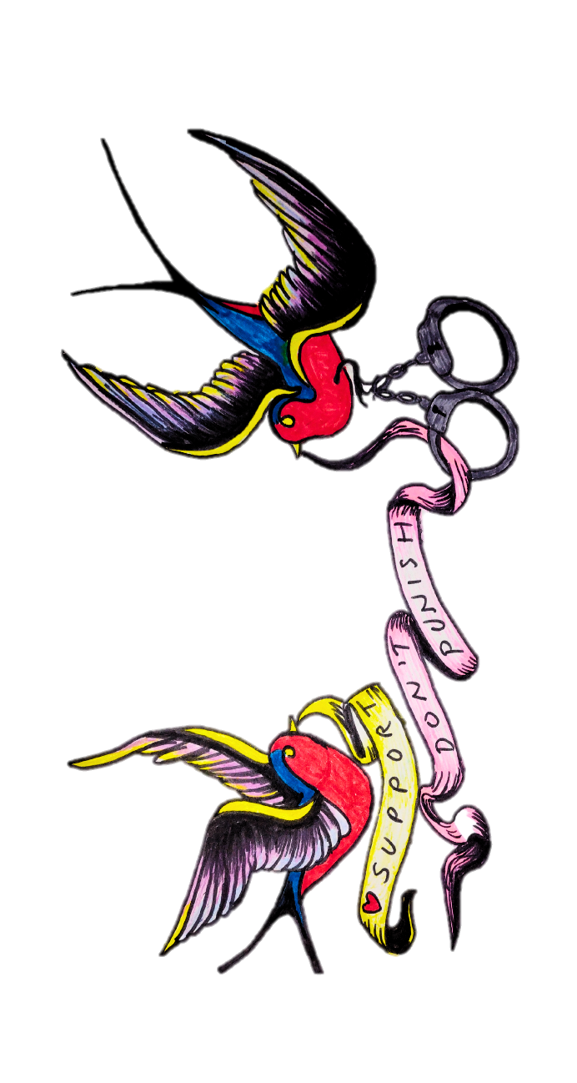
2
IMPROVING COORDINATION
TRANSITIONAL CARE FOR
INDIVIDUALS EXITING PRISONS & RE-ENTERING COMMUNITY
  Queensland makes up around 25% of the total national prison population, with around 1,400 prisoners released each month.
  These individuals are at high risk of overdose, particularly in the first 14 days after release, and remaining at most risk in the first 12 weeks of exiting custodial environments.
  It is crucial that barriers to naloxone in correctional settings are removed and that coordinated care between prison and community is enhanced.
Notes:
Improving coordination in transitional care for individuals exiting prisons and re-entering the community
Queensland makes up 25% of the total national prison population, with around 1,400 prisoners in Qld released every month. (24)
These individuals are at significantly higher risk of overdose, particularly in the first 12 weeks of exiting custodial environments. (25)
The experience of non-fatal overdose after release from prison has been positively associated with a range of factors, including dual diagnosis of mental health and substance use disorder, lifetime history of injecting drug use, lifetime history of experiencing non-fatal overdose, and having low social supports. (25)
Additionally, as the correctional system continues to scale up ODTP initiation and maintenance in the Qld prison setting, many people report significant bottlenecks in ODTP on release back to the community and require assistance and support in this respect.
We therefore need to effectively connect people exiting the correctional system to public and private ODT prescribers and dispensers, Aboriginal Community Controlled Health Services, AOD harm reduction and treatment services, and additional social and welfare supports.
We must improve the transitional care for people exiting prisons and returning to the community.

Slide 8
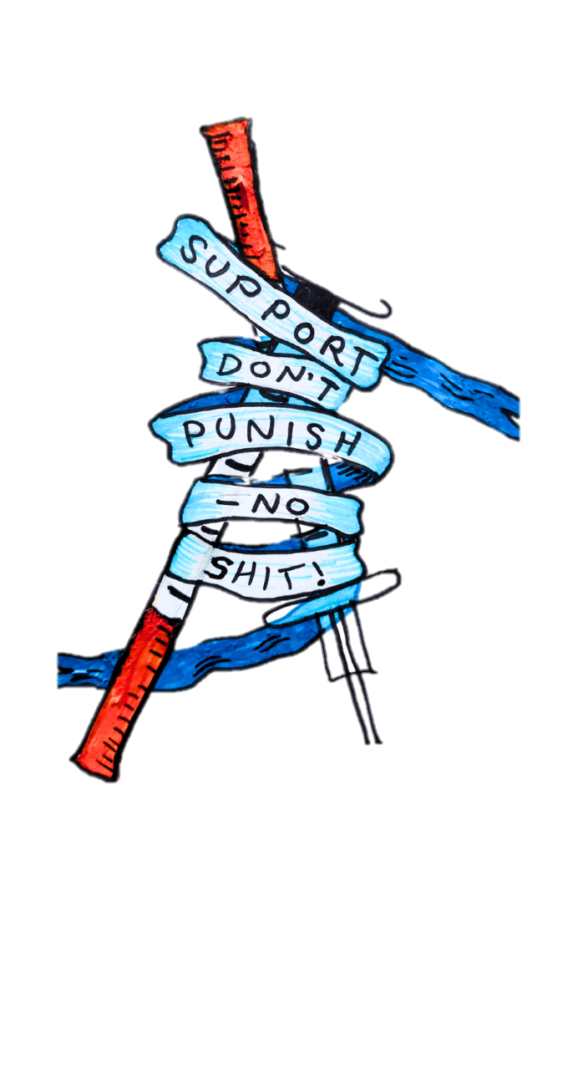
3
ADDRESSING BOTTLENECKS IN
COMMUNITY ACCESS TO
OPIOID DEPENDENCE TREATMENT
  Wider accessibility to ODT is crucial.
  We must diversify entry points to make treatment accessible and prioritise new service models that address the needs of socially and geographically disadvantaged populations.
Notes:
Addressing the bottlenecks in community access to Opioid Dependence Treatment
While the federal government should be commended for normalising ODT medications on the Pharmaceutical Benefits Schedule (PBS), further efforts are necessary to improve access to prescribing and dispensing by both state and federal governments.
Wider accessibility to ODT is crucial.
Queensland continues to have the highest patient-to-prescriber ratio (24:1) compared to the national average (19:1).
The private ODT system therefore has an overreliance on high-volume prescribers and little progress has been made towards diversification away from this model.
Enhancing access to Opioid Dependence Treatment (ODT) requires addressing significant bottlenecks in the community and reducing the reliance on these traditional models.
We must diversify entry points to make treatment accessible and prioritise new service models that address the needs of socially and geographically disadvantaged populations.

Slide 9

4
EXPANDING ACCESS TO
DRUG CHECKING SERVICES
  Drug checking services help keep the community informed about and monitors the potential circulation of harmful adulterants and emerging classes of psychoactive substances.
  Scaling up drug-checking services is a vital step in reducing overdose in the community.
Notes:
Maintaining and expanding access to drug-checking services
Maintaining and expanding access to drug checking services across jurisdictions is essential, it helps keep the community informed about and monitors the potential circulation of harmful adulterants and emerging classes of psychoactive substances.
Helping to stay ahead of emerging drug-related threats like nitazenes and their analogues.
Approximately two-thirds (64%) of Australians surveyed in the NDSHS support the expansion of these services. (26)
Drug checking is a commonsense health response, we have seen it work in our CheQpoint fixed sites with encouraging findings.
In the first four months we have seen more than 219 people accessing the service and over 392 drug samples tested. (27)
Of the people who accessed the service, 1:2 had never previously spoken to a health professional about their AOD use. (27)
1:4 clients were offered referrals to other health services like GPs or AOD treatment services. (27)
Drug checking as an intervention is highly effective, nearly 40% of people seen at our CheQpoint fixed sites in the first four months said they would either dispose of their drugs (16%) or that they would reduce their drug dosage following their consultation (23%). (27)
This reflects the critical role drug checking plays in reaching individuals who might not otherwise seek help, providing a unique opportunity for harm reduction, and in connecting people to the service system who would otherwise not be connected.
Drug checking services are publicly supported by various well respected professional bodies.
Despite this there are still political concerns regarding the future of Qld’s drug-checking services.
Faced with the liability of not saving a life when it could, any government (of any political persuasion) is obligated to introduce and support drug checking and exercise its duty to prevent harm.
We must maintain and expand access to important drug-checking services across the State.

Slide 10

5
ENHANCING OUR EARLY WARNING
SYSTEMS IN QUEENSLAND
  We must enhance our Drug Early Warning Systems and overdose monitoring.
  This is crucial for addressing the growing complexity of the drug landscape, facilitating more real time and accurate data collection for effective public health responses, policymaking, and resourcing decisions.
Notes:
Enhancing our Early Warning Systems in Qld and Nationally
A nationally coordinated approach to Drug EWS is necessary, co-led by health agencies, customs, police, and community organisations (including those with Lived and Living Experience (LLE)), with an emphasis on public health and harm reduction benefits for the Australian community rather than policing or research objectives. This national EWS should build upon the work of and collaborate with state and territory governments.
We must therefore enhance our Drug Early Warning Systems and overdose monitoring in Queensland, ensuring comprehensive integration across service stakeholders, including Law enforcement, Hospital and Emergency, Ambulance, Laboratories, Drug Checking Services, and existing networks such as the National Prompt Response Network.
A coordinated approach across Australia is essential.
This is crucial for addressing the growing complexity of the drug landscape, facilitating more real time and accurate data collection for effective public health responses, policymaking, and resourcing decisions.

Slide 11

6
ESTABLISHING & IMPLEMENTING
OVERDOSE PREVENTION CENTRES,
ALSO KNOWN AS SAFE INJECTION SITES OR DRUG CONSUMPTION SPACES
  Establishment of drug consumption spaces—safer environments where individuals can use drugs under the supervision of professionals — who can provide life-saving measures in the event of an overdose, facilitate access to care and entry points to health and social services, and reduce the risk of transmission of blood-borne viruses by providing access to sterile equipment and clean environments.
  These facilities have been shown to reduce harm associated with drug use, connect disadvantaged and marginalised populations with essential health and social services, and improve overall community well-being.
Notes:
Establishing and implementing overdose prevention centres, also known as medically supervised injecting centres (MSIC), safe injection sites, or drug consumption spaces
Expanding the establishment of OPCs is vital for providing lifesaving services and connecting individuals to healthcare, support, and AOD treatment services they might not otherwise access.
Approximately 58% of Australians surveyed in the NDSHS support the expansion of such services for reducing overdose rates and other associated harms in the community. (26)
Both Australian and International evidence suggests that OPC’s can: (28–30)
Reach people who are engaged in high-risk drug use behaviour(s) who may not otherwise be reached by the health and social care system.
Effectively manage overdose and decrease overdose-related mortality.
Enhance safe injecting practices and reduce risks of injecting related harms and injuries.
Prevent BBV transmission and therefore yield future cost savings.
Decrease public drug use and improve public amenity.
Increase access to drug treatment and other health and social services.
The evidence supporting such services is robust, encompassing health, social, and economic benefits.

Slide 12

7
SUPPORTIVE HOUSING
AND HOUSING FIRST
APPROACHES
  Homelessness is associated with increased mortality from accidental drug and alcohol poisoning.
  Safe and affordable housing facilitates social inclusion, access to support services and treatment – this is key to people remaining well and reducing risk of harms, including overdose.
Notes:
Supportive housing and housing first approaches
Homelessness is associated with increased mortality from accidental drug and alcohol poisoning. (31–34)
Conversely, the relationship between safe and affordable housing in facilitating social inclusion, access to support services and treatment – is key to people remaining well and reducing the risk of overdose.
A greater focus is therefore needed on solutions that are tailored to meet the needs of people experiencing homelessness around their AOD concerns.
In the US steep increases in overdose deaths among people experiencing homelessness have been driven by the synthetic opioid fentanyl. (35)
We should be ensuring that we are considering populations of people experiencing homelessness in our preparedness for the potential of an emergent opioid overdose crisis driven by synthetic opioids such as nitazenes.
We need to ensure there is access to secure housing with integrated health, social, and tenancy supports.
This also requires resourcing and building of capacity of housing and homelessness services to integrate AOD services and approaches and ensuring a focus on supportive housing.
It has been encouraging to see the recent release of the QMHC Supportive Housing Position Paper: More than a roof. (36)
Which outlines the need to ensure a housing first approach, requiring collective action across the whole-service-system working towards safe and secure housing that facilitates social inclusion, treatment and recovery, and prevents discharges and exits into homelessness. (36)

Slide 13

8
COORDINATED ACTION AGAINST
DRUG-RELATED STIGMA
AND DISCRIMINATION
  Coordinated action against drug-related stigma and discrimination is essential.
  Drug use stigma is deeply embedded across society and its institutions, and it can be fatal.
  We must stand and oppose drug-related stigma and discrimination, working together we can dismantle it.
Notes:
There is a need for coordinated action against drug-related stigma and discrimination
Drug use stigma is deeply embedded across society and its institutions, and it can be fatal.
The impacts of drug stigma and discrimination was demonstrated in the recent findings of the Victorian Coronial Inquest into the death of Veronica Nelson. (37)
The report on the Inquest found that drug stigma was so normalised it desensitised the very staff charged with her health and social care, ultimately failing in her care and casually contributing to her death. (37)
The Queensland Parliamentary Inquiry into the opportunity to improve mental health outcomes for Queenslanders recommended a public health campaign to a) reduce stigma and b) encourage help-seeking and help-offering behaviours.
Strategies must target specific audiences and systems and must support, platform, and elevate the LLE voice of people who use drugs, and their families and significant others impacted.
Education, anti-stigma, and anti-discrimination campaigns and training are required to be tailored and targeted to specific audience and system segments, including media and journalism, health care, welfare and social services, criminal justice, corrections, policing, DFV services, the child protection system, employment, and the general community more broadly.
We must stand and work together to dismantle drug related stigma and discrimination.

Slide 14
9
ENSURING EQUITY BY REBALANCING
THE 3 PILLARS OF
AOD POLICY SPENDING
  The persistently high rates of overdose deaths in Australia are partly a symptom of chronic underfunding of AOD harm reduction services.
  Rebalancing drug policy investment must prioritise essential harm reduction measures, creating a responsive system to address high overdose rates and the increasing threat of potent synthetic opioids.
Notes:
Ensuring equity through the rebalancing of the three pillars of Australian AOD policy spend is required
The persistently high rates of overdose deaths in Australia are partly a symptom of chronic underfunding of AOD harm reduction services.
The current national policy spending does not equitably support the pillars of the National Drug Strategy (2017–2026).
65% of government spending on the illicit drug efforts is directed towards law enforcement (supply reduction). (38)
This is in stark contrast to spending on drug treatment services and prevention activities, with 27% and 7% of the total spend respectively. (38)
Even more concerningly, less than 2% of the federal spend on illicit drug responses are spent on harm reduction measures. (38)
This has been highlighted by at least two national Government inquiries led by the Australian Parliamentary Joint Committee on Law Enforcement. (39,40)
Both inquiries recommended reviewing and reallocating resources to better balance funding across the three pillars. (39,40)
Public priorities also show a disconnect; according to the NDSHS, taxpayers consistently prioritise spending on education and treatment over law enforcement. (41)
The inequitable allocation of resources also results in an inability to meet demand.
Estimates indicate an unmet demand for drug treatment services of four times the current capacity. (8, 2–4,9)
We must ensure we address this inequity through the rebalancing of the three pillars of Australian AOD policy spend.

Slide 15
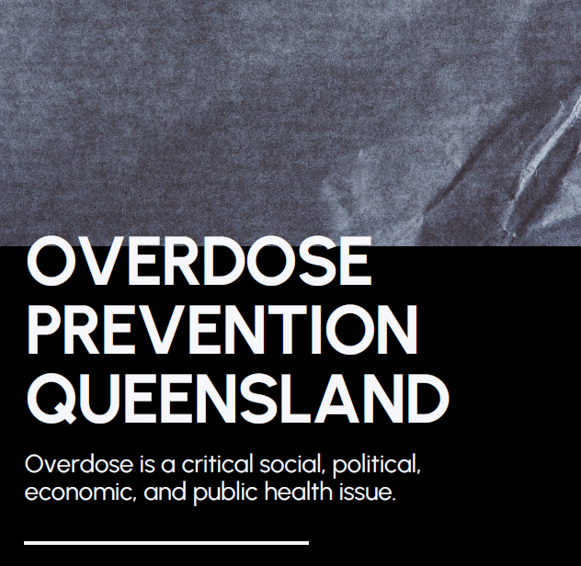
10
OVERDOSE PREVENTION
QUEENSLAND
Notes:
Overdose prevention requires coordinated responses from both Federal and State governments, agencies, and stakeholders.
The significance of overdose rates in Australia warrants a National Sub Strategy focused on its prevention and preparedness for the rising threat of synthetic opioids.
Similarly, there is a need for every jurisdiction, including Queensland, to develop overdose prevention strategies, working collaboratively with leading agencies and services in the sector.
Such plans must prioritise peer led initiatives, and enhancing our harm reduction responses.
QuIHN, QuIVAA, QNADA, and The Loop Australia are shortly releasing our official call to action, which outlines a blueprint to address the urgent need to proactively combat the rising threat of a synthetic opioid crisis.

Slide 16

Notes:
Executing this comprehensive suite of harm-reduction strategies will not be easy but every life saved is the reward.
This requires our law-and-policy makers to make the right decisions, allocate the necessary resources, and act with dedication, courage, and a strong moral and ethical compass.
Every life lost to overdose is a catastrophe, and every life saved is a victory for our collective humanity.
Together, as a community, we have the power to prevent overdose.

Slide 17
Geoff Davey
QuIHN Ltd
gdavey@quihn.org
www.quihn.org.au
Notes:
References
1. Piatkowski, T., Kill, E., & Reeve. S. Voices of lived experience: Understanding overdose narratives among people who use drugs in Queensland. Brisbane, Australia; 2024.
2. Penington Institute. Australias Annual Overdose Report 2024. Vol. Annual Ove. 2024.
3. Chrzanowska, A., Man, N., Sutherland, R., Degenhardt, L., Peacock A. Trends in drug-related hospitalisations in Australia 2002-2022 [Internet]. Sydney; 2022. Available from: https://unsworks.unsw.edu.au/handle/1959.4/102289
4. Degenhardt L, Grebely J, Stone J, Hickman M, Vickerman P, Marshall BDL, et al. Global patterns of opioid use and dependence: harms to populations, interventions, and future action. Lancet [Internet]. 2019 Oct 26 [cited 2024 Nov 5];394(10208):1560–79. Available from: http://www.thelancet.com/article/S0140673619322299/fulltext
5. Roxburgh A, Hall WD, Gisev N, Degenhardt L. Characteristics and circumstances of heroin and pharmaceutical opioid overdose deaths: Comparison across opioids. Drug Alcohol Depend. 2019 Dec 1;205:107533.
6. Conway A, Valerio H, Peacock A, Degenhardt L, Hayllar J, Harrod ME, et al. Non-fatal opioid overdose, naloxone access, and naloxone training among people who recently used opioids or received opioid agonist treatment in Australia: The ETHOS Engage study. Int J Drug Policy [Internet]. 2021 Oct 1 [cited 2024 Nov 5];96. Available from: https://pubmed.ncbi.nlm.nih.gov/34452808/
7. The National Centre for Clinical Research on Emerging Drugs [NCCRED]. Emerging drug briefing: Increasing reports of nitazene toxicity in Australia Nitazenes [Internet]. Australia; 2024. Report No.: 5 April 2024. Available from: https://nccred.org.au/translate/emerging-drug-briefings/
8. Australian Federal Police [AFP]. Rising imports of potent drug nitazene raises concern [Internet]. Media Release. 2024 [cited 2024 Nov 11]. p. 5 May 2024. Available from: https://www.afp.gov.au/news-centre/media-release/rising-imports-potent-drug-nitazene-raises-concern
9. White A, Seah V, Brown J, McDonald C, Tran J, Roberts DM. Acute metonitazene poisoning reversed by naloxone. Clin Toxicol [Internet]. 2023 [cited 2024 Nov 11];61(2):137–8. Available from: https://www.tandfonline.com/doi/abs/10.1080/15563650.2022.2164505
10. Schumann JL, Syrjanen R, Alford K, Mashetty S, Castle JW, Rotella J, et al. Intoxications in an Australian Emergency Department Involving “Nitazene” Benzylbenzimidazole Synthetic Opioids (Etodesnitazene, Butonitazene and Protonitazene). J Anal Toxicol [Internet]. 2023 Jan 1 [cited 2024 Nov 11];47(1):E6–9. Available from: https://pubmed.ncbi.nlm.nih.gov/35983900/
11. Smith JL, Soderstrom J, Dawson A, Alfred S, Greene S, Isoardi K, et al. The Emerging Drugs Network of Australia: A toxicosurveillance system of illicit and emerging drugs in the emergency department. Emerg Med Australas [Internet]. 2022 Feb 1 [cited 2024 Nov 11];34(1):58–64. Available from: https://pubmed.ncbi.nlm.nih.gov/34382338/
12. Australian Federal Police [AFP]. AFP public warning over rising presence of nitazenes [Internet]. Facebook Post. 2024 [cited 2024 Nov 11]. p. 3 October 2024. Available from: https://www.facebook.com/AusFedPolice/photos/the-afp-is-issuing-a-public-warning-over-the-rising-presence-of-nitazene-a-dange/994961822670142/
13. ACT Health. “Heroin” found to contain a potent opioid ('nitazene’) [Internet]. Drug Alert. 2024 [cited 2024 Nov 11]. Available from: https://www.health.nsw.gov.au/aod/public-drug-alerts/Pages/heroin-found-to-contain-nitazenes.aspx
14. ACT Health. Public Health Alert: Dangerous drug warning for Canberrans - Chief Minister, Treasury and Economic Development Directorate [Internet]. Drug Alert. 2024 [cited 2024 Nov 11]. Available from: https://www.cmtedd.act.gov.au/open_government/inform/act_government_media_releases/hd/2024/east-row-iga-supermarket-sentenced-for-food-health-and-safety-and-misleading-conduct-offences/public-health-alert-dangerous-drug-warning-for-canberrans
15. NSW Government. Fake Kalma alprazolam tablets found to contain strong opioids - Public drug warnings [Internet]. NSW Health Public Drug Warnings. 2022 [cited 2022 Dec 16]. p. August. Available from: https://www.health.nsw.gov.au/aod/public-drug-alerts/Pages/fake-kalma-contains-strong-opioids-aug2022.aspx
16. NSW Health. Yellow powder containing potent synthetic opioid (isotonitazene) circulating on the NSW Central Coast [Internet]. Drug Alert. 2024 [cited 2024 Nov 11]. Available from: https://www.health.nsw.gov.au/aod/public-drug-alerts/Pages/yellow-powder-isotonitazene-central-coast.aspx
17. NSW Health. “Red Bull” logo red/orange rectangular tablets sold as MDMA (ecstasy) found to contain a nitazene (potent opioid) and no MDMA [Internet]. Drug Alert. 2024 [cited 2024 Nov 11]. Available from: https://www.health.nsw.gov.au/aod/public-drug-alerts/Pages/nitazenes-mdma-red-bull-Jan24.aspx
18. Queensland Health. Alert issued over dangerous counterfeit tablets | Queensland Health [Internet]. Drug Alert. 2024 [cited 2024 Nov 11]. Available from: https://www.health.qld.gov.au/newsroom/doh-media-releases/alert-issued-over-dangerous-counterfeit-tablets
19. Victorian Department of Health. Protonitazene sold as “3C-P” | health.vic.gov.au [Internet]. Drug Alert. 2024 [cited 2024 Nov 11]. Available from: https://www.health.vic.gov.au/drug-alerts/protonitazene-sold-as-3c-p
20. South Australia Health. Warning of potentially deadly synthetic opioid | SA Health [Internet]. Drug Alert. 2024 [cited 2024 Nov 11]. Available from: https://www.sahealth.sa.gov.au/wps/wcm/connect/public+content/sa+health+internet/about+us/news+and+media/all+media+releases/warning+of+potentially+deadly+synthetic+opioid
21. Victorian Department of Health. Protonitazene sold as ketamine | health.vic.gov.au [Internet]. Drug Alert. 2024 [cited 2024 Nov 11]. Available from: https://www.health.vic.gov.au/drug-alerts/yellow-powder-containing-protonitazene-may-be-sold-as-ketamine
22. Victorian Department of Health. Metonitazene sold as cocaine | health.vic.gov.au [Internet]. Drug Alert. 2024 [cited 2024 Nov 11]. Available from: https://www.health.vic.gov.au/drug-alerts/metonitazene-mis-sold-as-cocaine
23. Salom, C., Maravilla, J., Thomas, N., Juckel, J., Daly, C., Peacock, A., & Gisev N. Evaluation of the Pharmaceutical Benefits Scheme Subsidised Take Home Naloxone Pilot [Internet]. Brisbane, Australia; 2022. Available from: https://www.health.gov.au/resources/publications/evaluation-of-the-pharmaceutical-benefits-scheme-subsidised-take-home-naloxone-pilot
24. Australian Bureau of Statistics [ABS]. Corrective Services Australia - Prisoner receptions and prisoner releases - June Quarter 2024 [Internet]. Data downloads. 2024 [cited 2024 Nov 13]. Available from: https://www.abs.gov.au/statistics/people/crime-and-justice/corrective-services-australia/latest-release#data-downloads
25. Keen C, Young JT, Borschmann R, Kinner SA. Non-fatal drug overdose after release from prison: A prospective data linkage study. Drug Alcohol Depend [Internet]. 2020;206(November 2019):107707. Available from: https://doi.org/10.1016/j.drugalcdep.2019.107707
26. Australian Institute of Health and Welfare [AIHW]. National Drug Strategy Household Survey 2022 - 2023 [Internet]. Canberra; 2024 [cited 2024 Oct 25]. Available from: https://www.aihw.gov.au/reports/illicit-use-of- drugs/national-drug-strategy-household-survey
27. QuIHN, The Loop Australia Q. CheQpoint Our first four months: Service delivery April to August 2024 [Internet]. Vol. April to A. Brisbane, Australia; 2024. Available from: https://www.quihn.org/cheqpoint/
28. Belackova, V., & Salmon C. Overview of international literature - supervised injecting facilities & rooms [Internet]. Sydney; 2017. Available from: https://www.uniting.org/community-impact/uniting-medically-supervised-injecting-centre--msic/research-and-resources
29. KPMG. Further Evaluation of the Medically Supervised Injecting Centre during its extended Trial period (2007-2011): Final Report [Internet]. Sydney; 2010. Available from: https://www.health.nsw.gov.au/aod/resources/Documents/msic-kpmg.pdf
30. Victorian Government D of H. Review of the Medically Supervised Injecting Room 2023: Final Report [Internet]. Final Report. Melbourne, Victoria; 2023. Available from: https://www.health.vic.gov.au/publications/review-of-the-medically-supervised-injecting-room-2023
31. David Bradford W, Lozano-Rojas F. Higher Rates Of Homelessness Are Associated With Increases In Mortality From Accidental Drug And Alcohol Poisonings. Health Aff (Millwood) [Internet]. 2024 [cited 2024 Nov 13];43(2):242–9. Available from: https://pubmed.ncbi.nlm.nih.gov/38315926/
32. Paradise RK, Desmarais J, O’Malley SE, Hoyos-Cespedes A, Nurani A, Walley AY, et al. Perspectives and recommendations of opioid overdose survivors experiencing unsheltered homelessness on housing, overdose, and substance use treatment in Boston, MA. Int J Drug Policy. 2023 Sep 1;119.
33. Booth RG, Shariff SZ, Carter B, Hwang SW, Orkin AM, Forchuk C, et al. Opioid-related overdose deaths among people experiencing homelessness, 2017 to 2021: A population-based analysis using coroner and health administrative data from Ontario, Canada. Addiction. 2024 Feb 1;119(2):334–44.
34. Austin AE, Shiue KY, Naumann RB, Figgatt MC, Gest C, Shanahan ME. Associations of housing stress with later substance use outcomes: A systematic review. Addict Behav. 2021 Dec 1;123.
35. Los Angeles County Department of Public Health Center for Health Impact Evaluation. Mortality Rates and Causes of Death Among People Experiencing Homelessness in Los Angeles: 2014 - 2022 [Internet]. Los Angeles; 2023. Available from: http://publichealth.lacounty.gov/chie
36. Queensland Mental Health Commission [QMHC]. More than a Roof: Supportive Housing Position Statement [Internet]. Brisbane, Australia; 2024. (Position Paper). Available from: https://www.qmhc.qld.gov.au/sites/default/files/more_than_a_roof_supportive_housing_position_statement.pdf
37. Coroners Court of Victoria. Finding into Death with Inquest: Inquest into the Passing of Veronica Nelsson [Internet]. Melbourne, Victoria; 2023. Available from: https://www.coronerscourt.vic.gov.au/finding-passing-veronica-nelson
38. Ritter, A., Grealy, M. Kelaita, P., & Kowalski M. Monograph No. 36: The Australian’ drug budget’: Government drug policy expenditure 2021/22. Sydney; 2024.
39. Parliamentary Joint Committee on Law Enforcement. Inquiry into crystal methamphetamine (ice): Final Report [Internet]. Canberra; 2018. Available from: https://www.aph.gov.au/Parliamentary_Business/Committees/Joint/Law_Enforcement/Crystalmethamphetamine45/Final_Report
40. Parliamentary Joint Committee on Law Enforcement. Australia’s illicit drug problem: Challenges and opportunities for law enforcement [Internet]. Canberra; 2024. Available from: https://www.aph.gov.au/Parliamentary_Business/Committees/Joint/Law_Enforcement/IllicitDrugs/Report
41. Australian Institute of Health and Welfare [AIHW]. National Drug Strategy Household Survey 2019. 2020.
42. Australian Institute of Health and Welfare [AIHW]. Alcohol and other drug treatment services in Australia: Annual Report. [Internet]. Canberra; 2024. Available from: https://www.aihw.gov.au/reports/alcohol-other-drug-treatment-services/alcohol-other-drug-treatment-services-australia/contents/about
43. Ritters, A., Chalmers, J., Gomez M. ‘Measuring Unmet Demand for Alcohol and Other Drug Treatment: The Application of an Australian Population-Based Planning Model.’ J Stud Alcohol Drugs. 2019;18(18):42–50.
44. Henriksen S. ‘Rethinking the national quality framework: Improving the quality and safety of alcohol and other drug treatment in Australia’. Regul Gov. 2024;18(3):914–33.
45. van de Ven K, Ritter A, Berends L, Chalmers J LK. ‘Perceptions of purchasing and payment mechanisms in alcohol and other drug treatment services in Australia: A qualitative study involving alcohol and other drug service providers and purchasers of treatment’. Drug Alcohol Rev Rev. 2020;39(2):189–97.
46. Chalmers, J. Ritter, A. Berends, L. Lancaster K. ‘Following the money: Mapping the sources and funding flows of alcohol and other drug treatment in Australia’. Drug Alcohol Rev. 2016;35(3):255–62.

