Slide 1
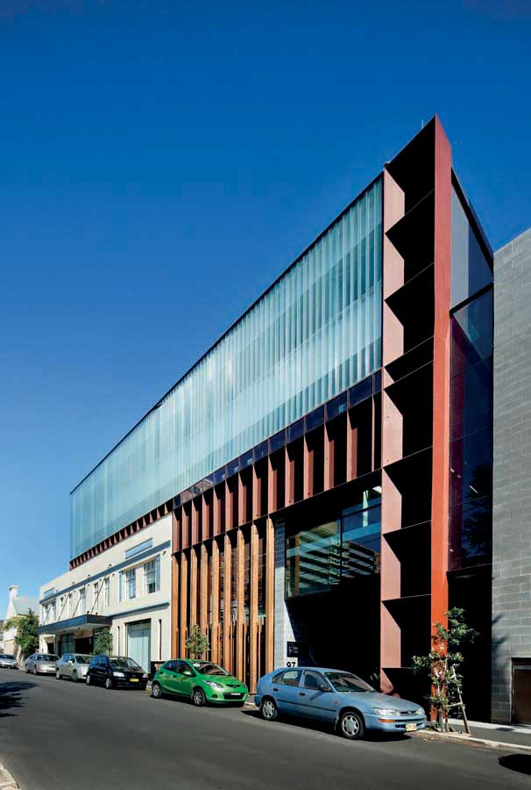
Supporting region-based mental health systems development and suicide prevention
“Right care, First time, Where you live!”
Prof Ian Hickie AM MD FRANZCP FASSA FAHMS
Co-Director, Health and Policy
Brain and Mind Centre, USYD
Email: ian.hickie@sydney.edu.au Twitter: @ian_hickie

Slide 2
Disclosures
3.2% Equity share in Innowell – the joint venture technology spin-off of University of Sydney and PwC
  Responsibility for delivery of R&D through independent University Trials and not Commercialization
Australian National Mental Health Commissioner 2012-2018
“Right Care, First Time, Where You Live” supported by BHP Foundation

Slide 3

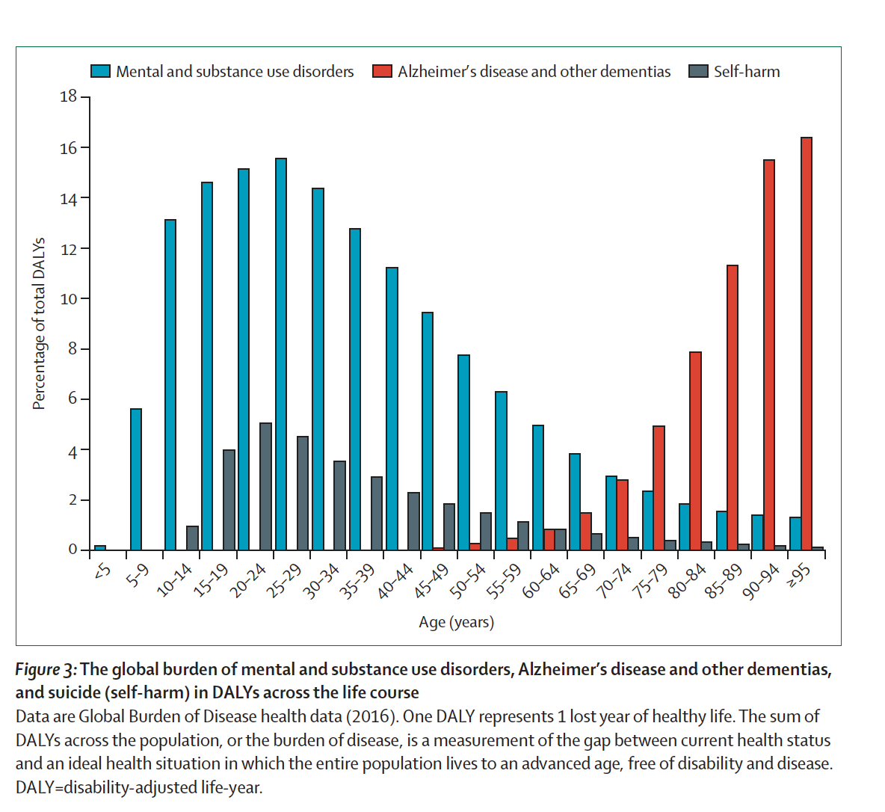
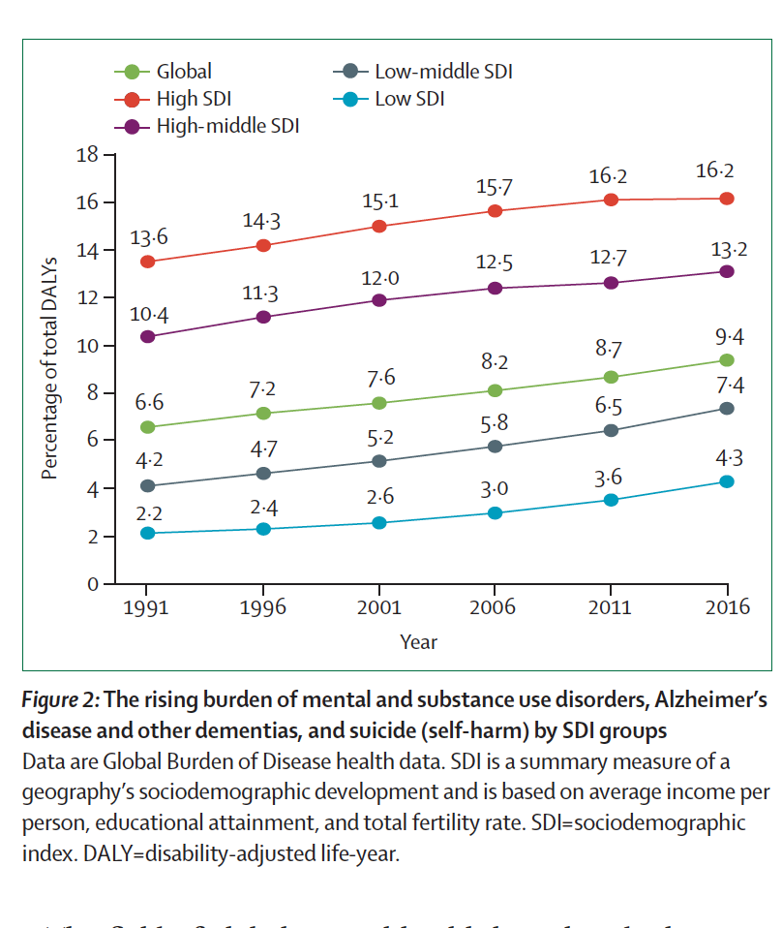
Global Mental Health Challenges: Multiple and Complex:
Demand will continue to outstrip supply and the services gap will widen;
Limited skilled workforce availability’
Young people are most affected – so LMIC will be most affected;

Slide 4
Opportunities: 21st Century priorities in mental health:
Where can new approaches to planning and implementation deliver?
Roles of dynamic statistical modelling (DSM) and digital technologies
1. Population level
  Enhanced Productivity – Workforce and Education Participation
  Economic Growth and Smart People-based investments
  Regional Perspectives
  Suicide Prevention
  Dynamic Modelling and Technology-enhanced
2. Health Care Systems
  More Specialized Care for Common Disorders in Non-hospital Settings
  Smarter use of Hospital-based episodes of care (Private and Public)
  Greater emphasis on early intervention and continuing smart care for a range of better health, social and economic outcomes
  Dynamic Modelling and Technology-enabled – for the individual, clinician and the service system

Slide 5
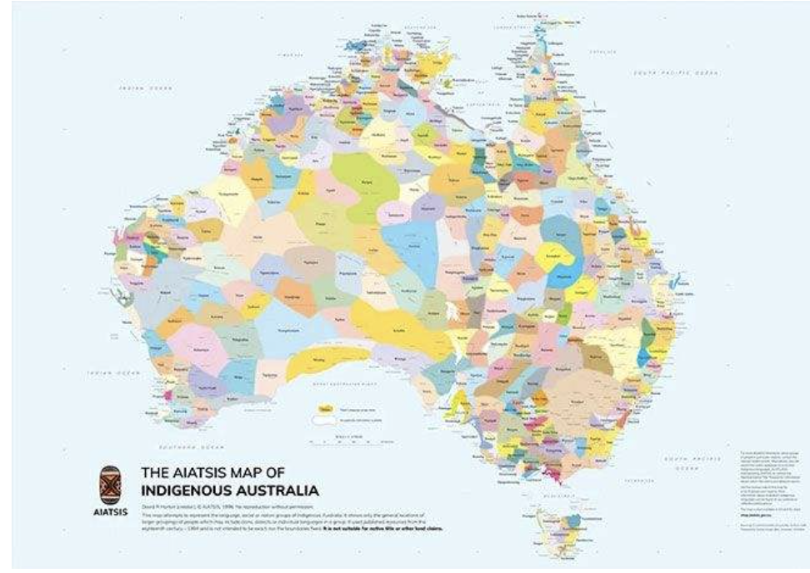
Original map of regions in Australia

Slide 6
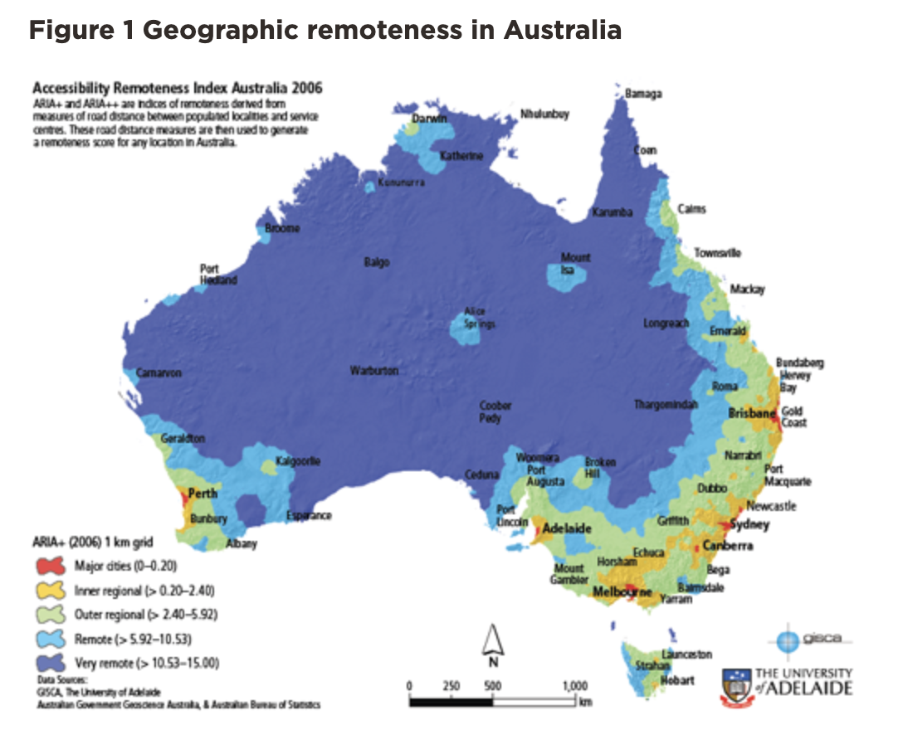
Australia (and Qld) is a very varied place!

Slide 7
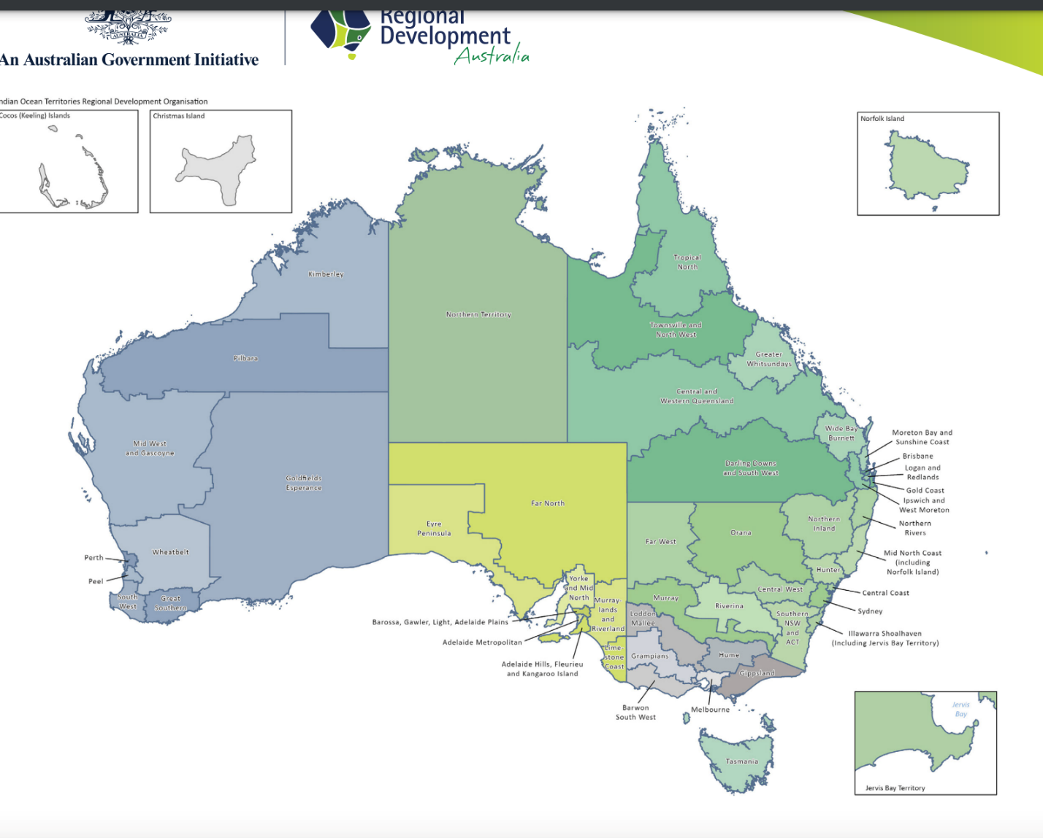
Australia has regions (not simply states and territories)

Slide 8

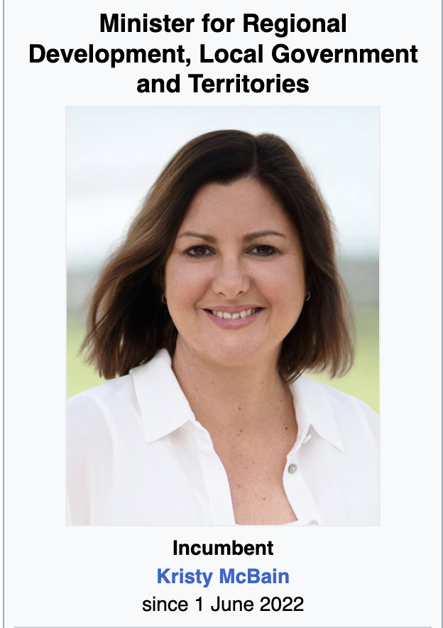

Australia has (50) regional development authorities…
Can you name the Minister for Regional Development?

Slide 9
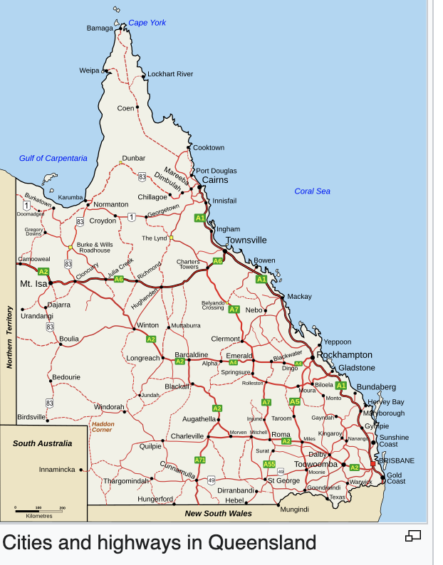
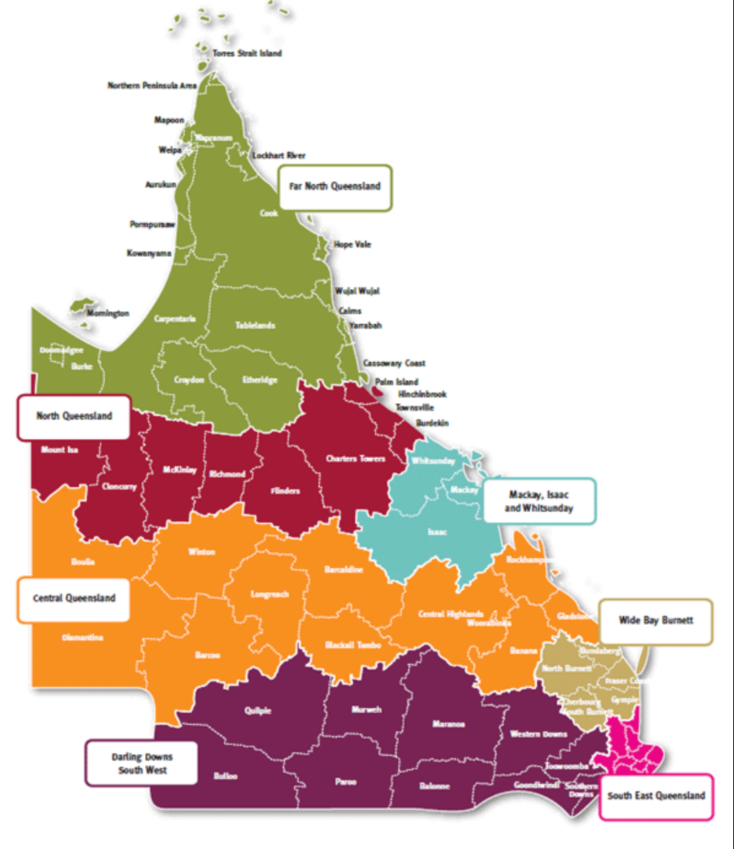
Qld has regions (7 but not PHNs)!!

Slide 10
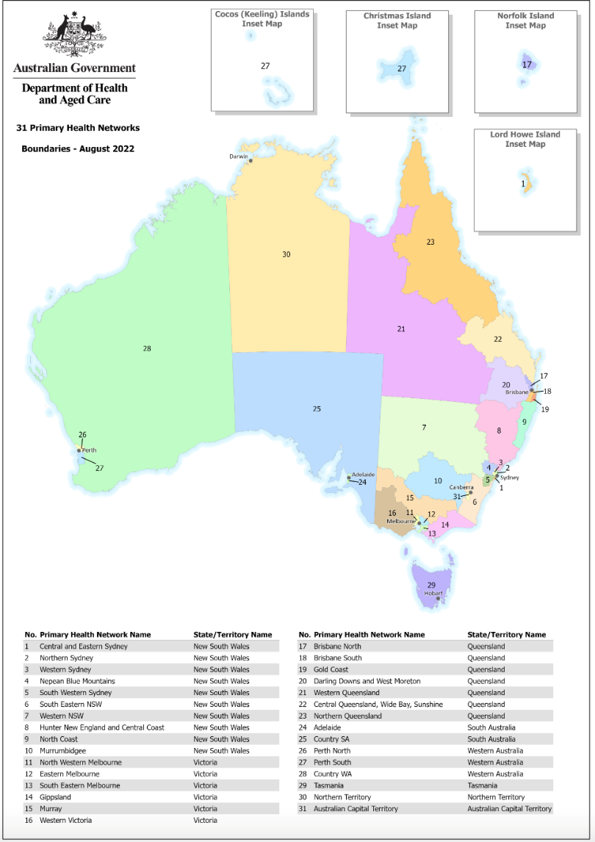
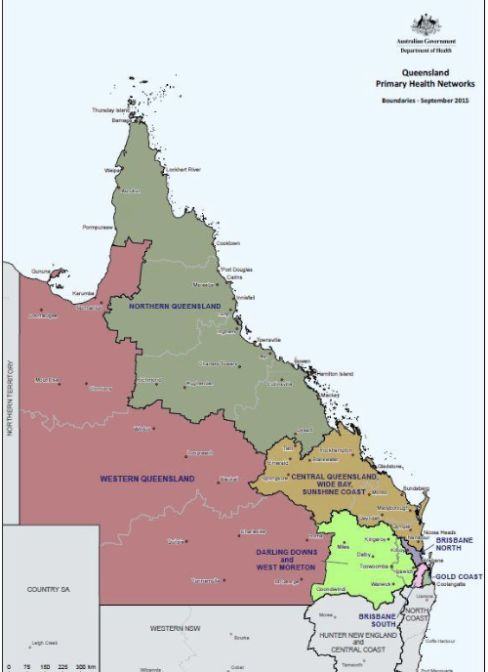
And Health (Fed and state) and others (e.g. education) have Regions and local councils…..

Slide 11
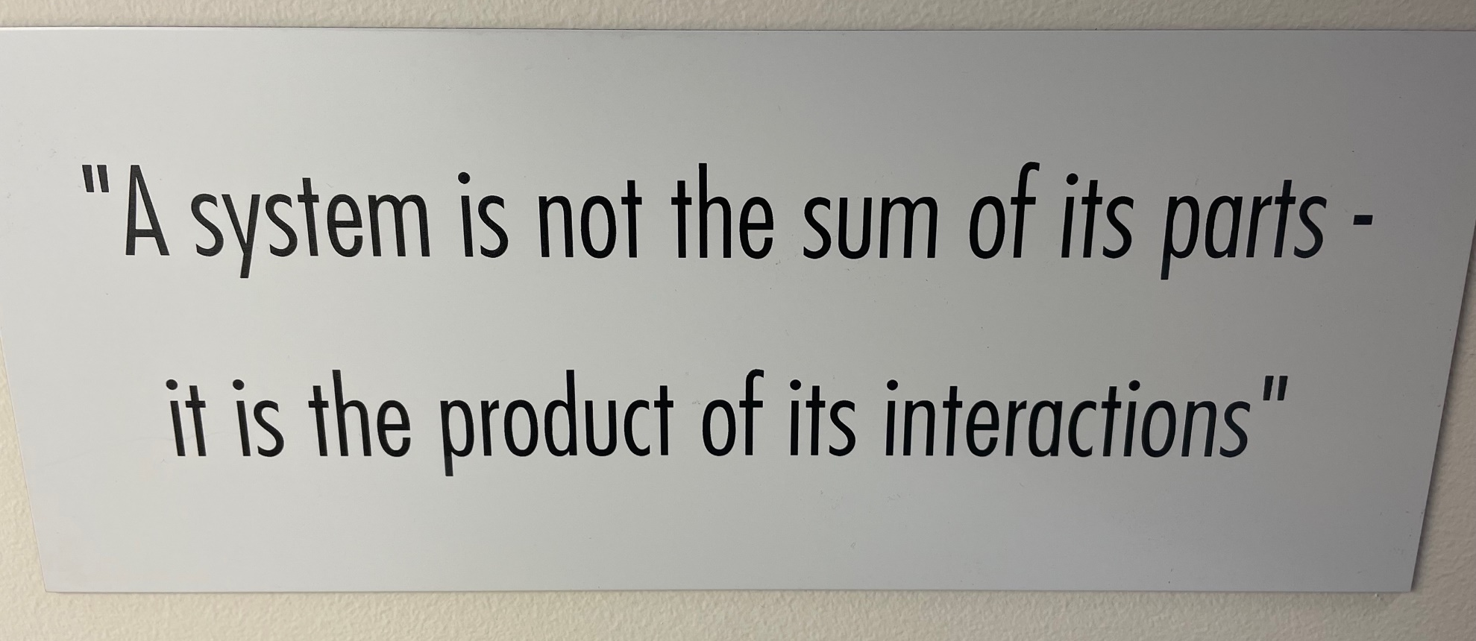
Building Systems Models:
Using complex maths and available data to provide simulations of real world situations

Slide 12
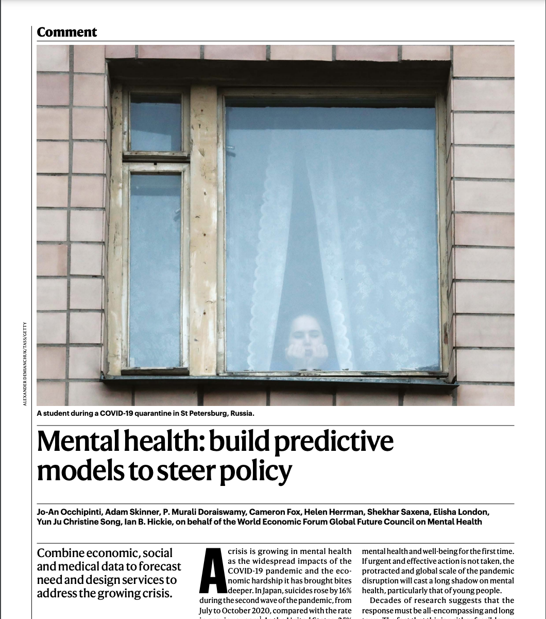
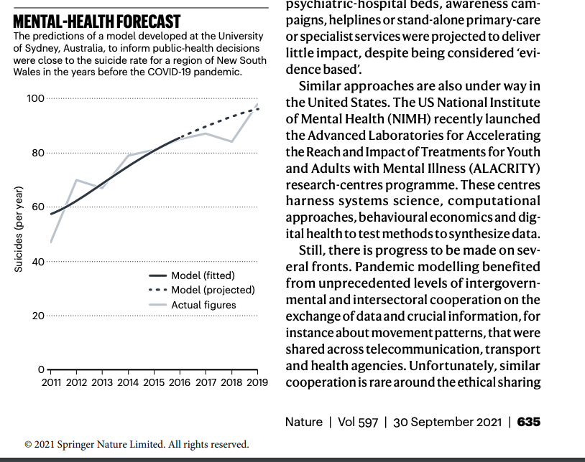
Nature September 2021:
Predictive Mental Health Models

Slide 13
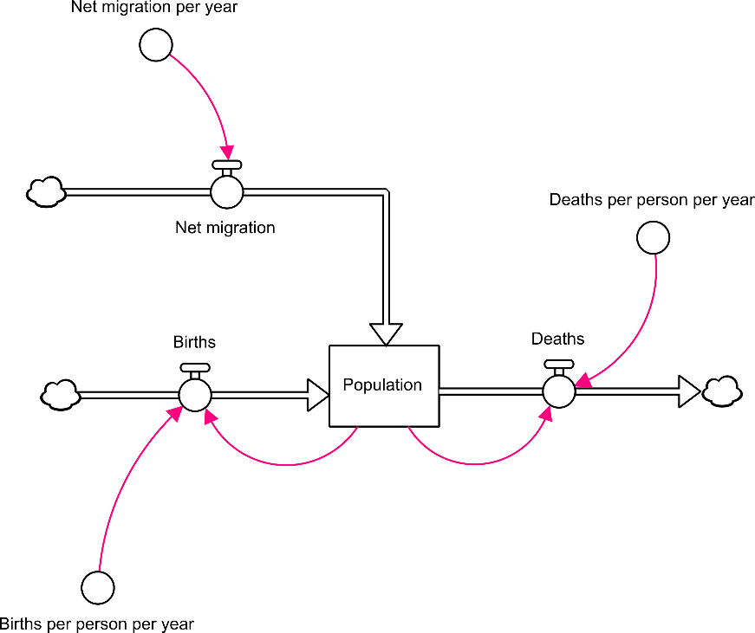

System dynamics 101
• Population is modelled as a stock with two inflows (births and net migration) and one outflow (deaths)
• Stocks change over time in response to their inflows and outflows, like water level in a bath
Notes:
Modelling is such a ubiquitous term and there has been some misunderstanding about this modelling, so I’ll briefly introduce the basic architecture of system dynamics modelling There a stocks (squares) which are quantities (and in this case we have a quantity of people that constitute a particular population), and there are flows (the arrows) which are rates of inflow and outflow from the stocks. So in this simple example, the population changes over time depending on what is being added to the population (through births and migration) and what is being subtracted from the population. Just like a bath tub whose water lever rises if the quantity of water flowing in from the tap is greater that what is escaping from the drain and visa versa.

Slide 14
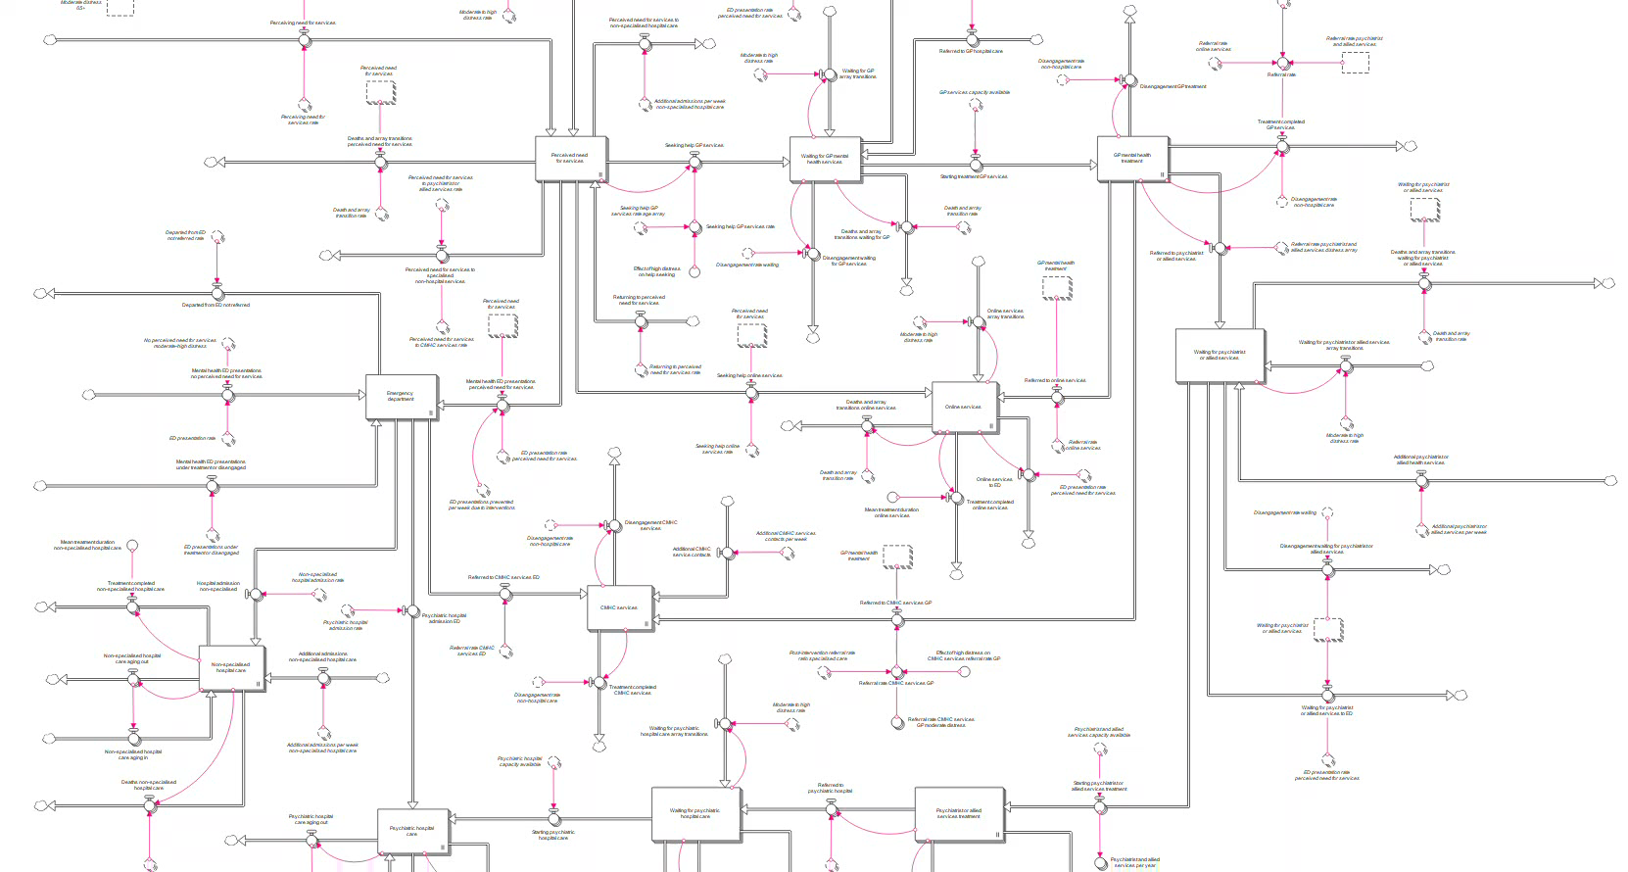
Capturing the dynamics of the mental health system
Notes:
So from these very simple building blocks we can represent health systems and social systems, the flows of people through them, and the factors that influence those flows. In this example of the mental health system, when we run the model, the proportion of the population waiting for services or receiving services, is changing over time based on different rates of flow into, within, and out of the service system.

Slide 15
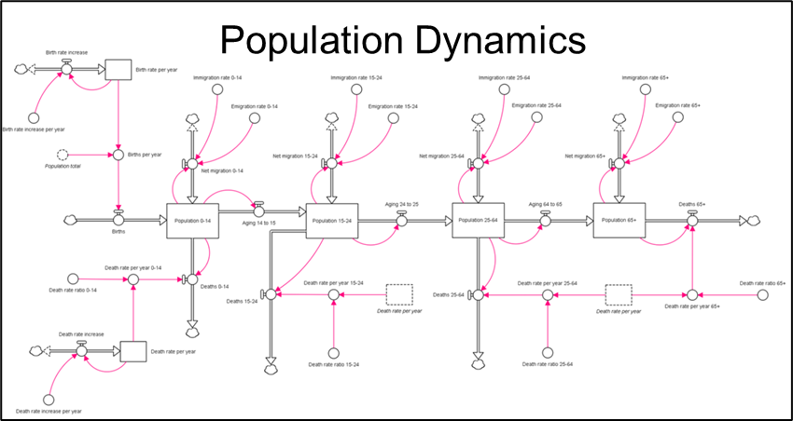
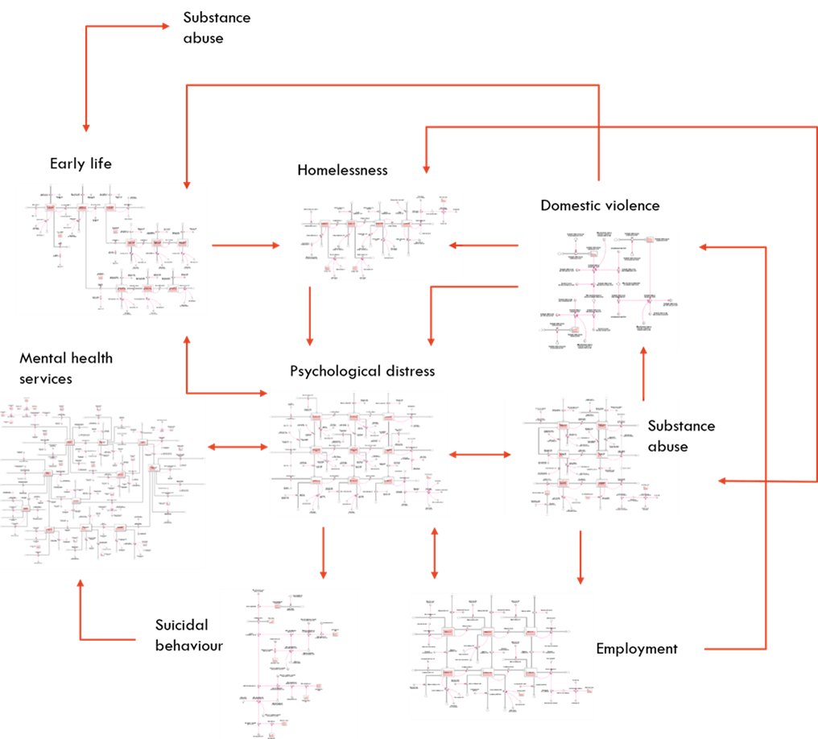
High level overview of the causal structure and pathways of a model
Captures complexity of the problem and is unconstrained by simplifying assumptions of traditional analytic approaches (i.e. that influencing factors are linear, independent, unidirectional, constant through time).
Notes:
We can also represent broader causal pathways that drive demand for services, such as the social determinants of mental health.
Systems modelling is different to traditional statistical approaches such as regression modelling (that articulate statistical associations between a risk factor and an outcome). Systems modelling is causal modelling – it articulates a complex causal mechanism underpinning the interrelationships between risk factors / dynamic drivers of particular health and social outcomes
Systems modelling is uniquely able to capture population and demographic dynamics, changes over time in social and economic drivers of psychological distress, it captures feedback loops that drive the vicious cycles and virtuous cycles that exist in the real world, it captures the fluctuating interplay between service supply versus demand, workforce dynamics, and it captures change over time in individual intervention effects and the potentially non-additive effects of intervention combinations; factors that bedevil traditional analytic approaches.

Slide 16
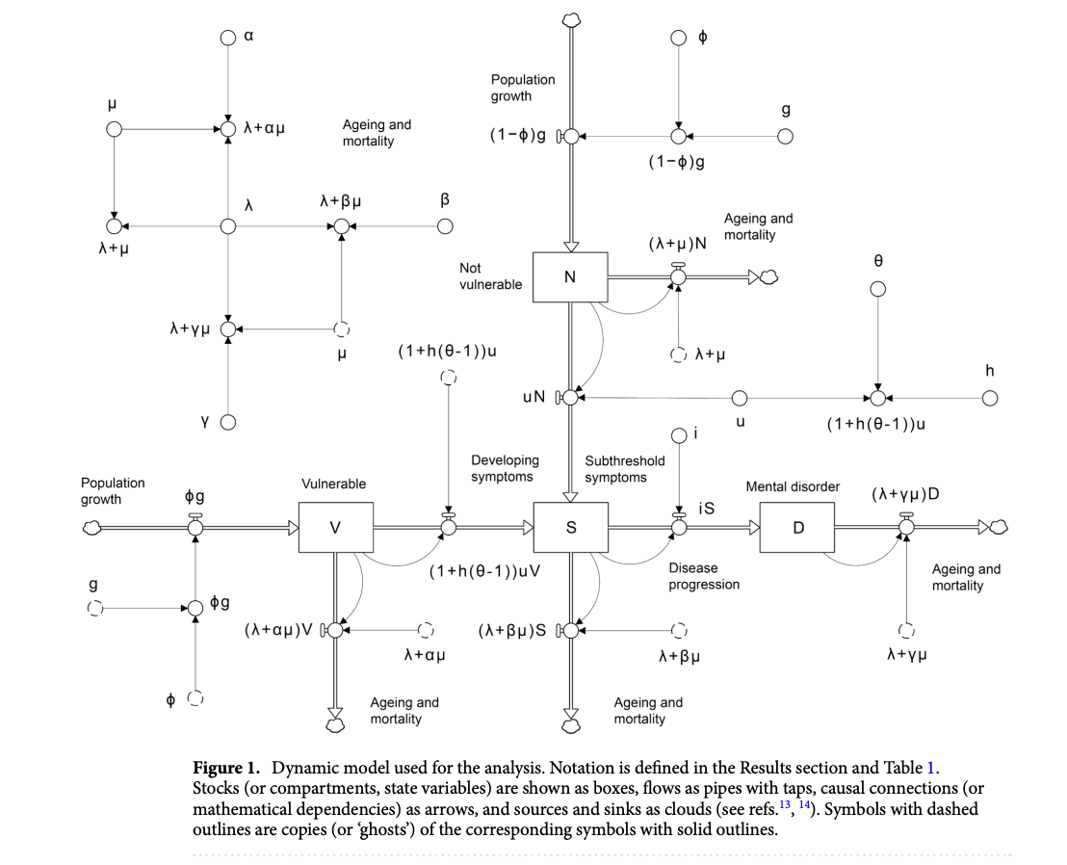
Building dynamic models:
For specific populations, in specific places, for specific outcomes, at a point in time (dynamic)

Slide 17

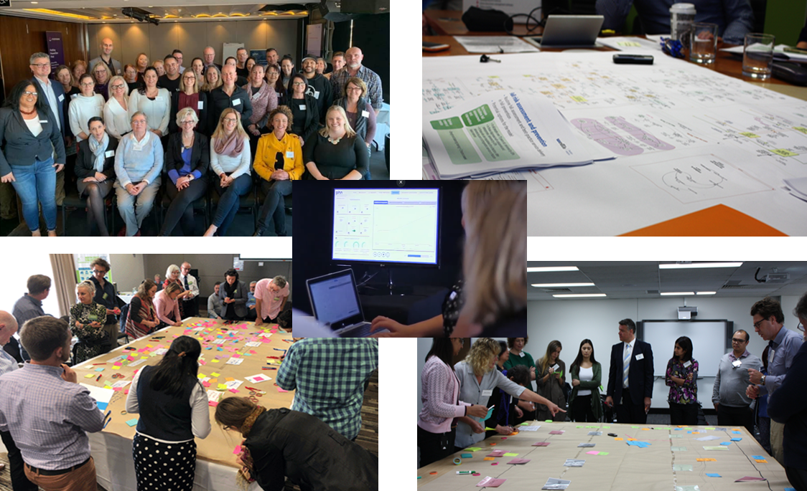
Collaborative model development with multi-disciplinary stakeholders
Harnessing participatory processes for model transparency and knowledge mobilization
Notes:
Over the last 5 years we have been committed to taking this sort of modelling out of back rooms and into meeting rooms exposing the work to open, transparent, participatory processes.
We bring together representatives from academia, policy, program planning, clinical practice, economics, the private and NGO sectors, local government, emergency services, and consumer representatives to co-develop these models. Having stakeholders get under the hood to critique the structure, parameters and assumptions that underpin the models helps ensure that the final tool is credible, valid, robust, and grounded in the local context. It also generates greater confidence in the model outputs and insights. This approach has delivered significant benefits in facilitating communication between different players in the system, it can help advance contentious debates, it empowers communities by helping them understand system behaviour and why some seemingly good strategies are unlikely to have impact, and facilitate consensus building and alignment of agendas for collaborative action.
It is on the foundation of this work over many years that we were able to rapidly deploy systems modelling and simulation to understand the likely impacts of the current crisis on mental health outcomes and us it to try to inform national discourse regarding best strategies to prevent another crisis – a mental health crisis – from unfolding.

Slide 18
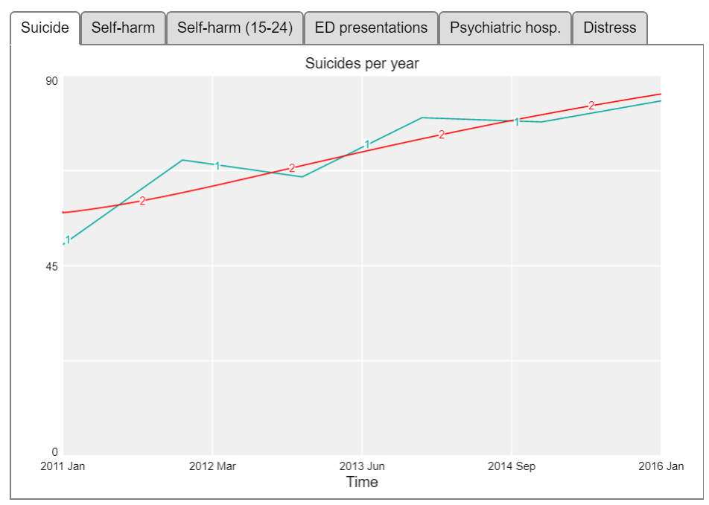
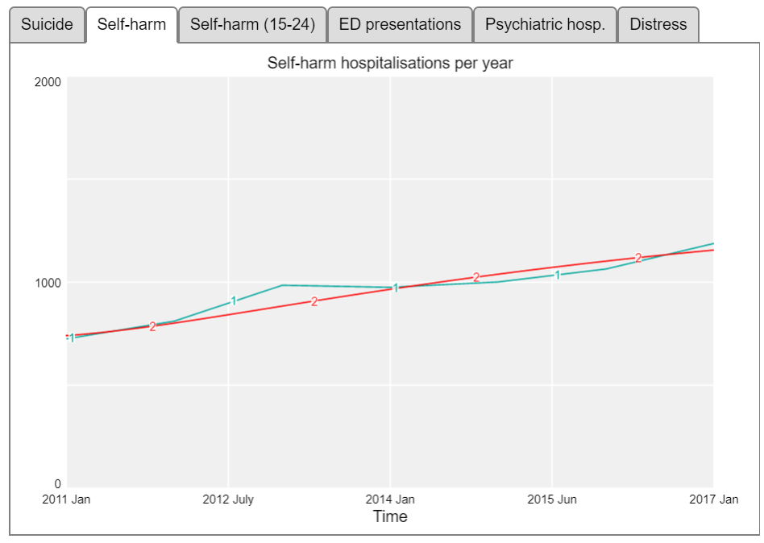
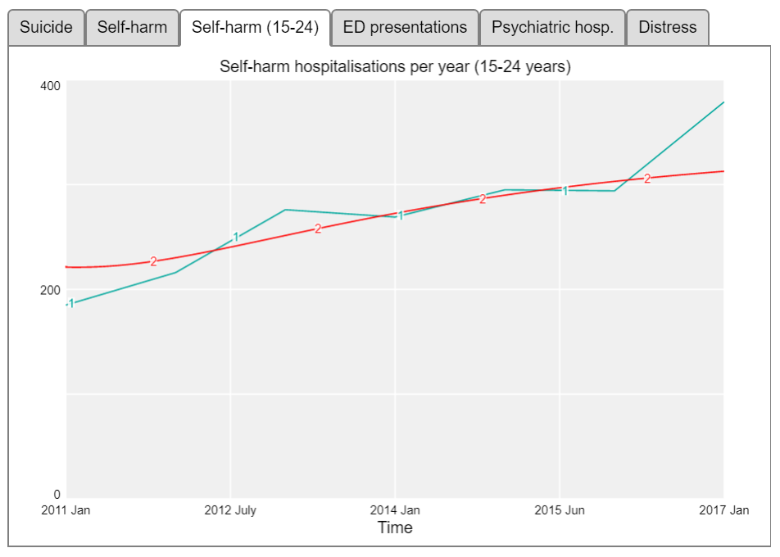
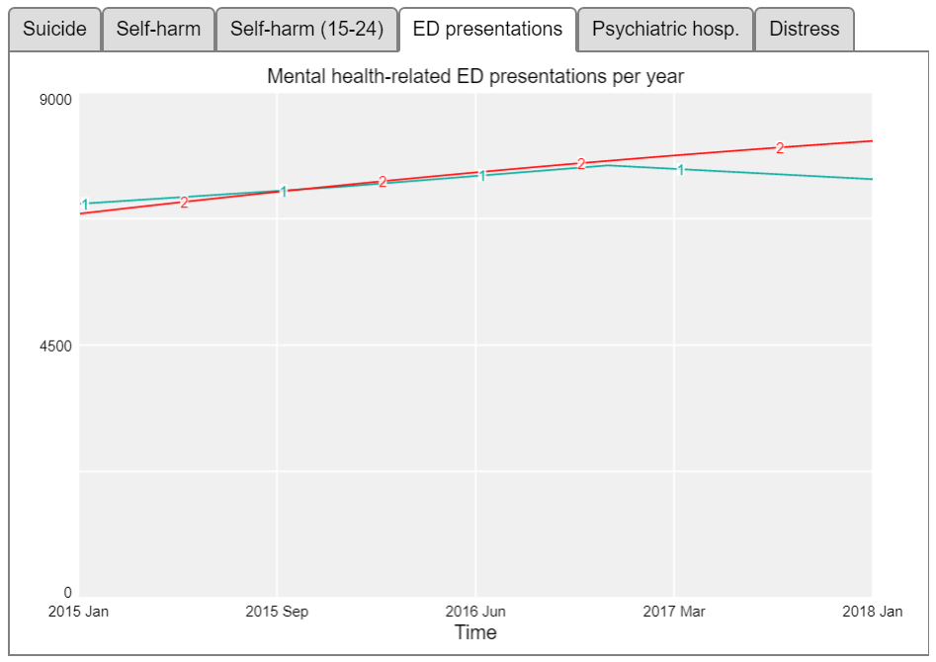
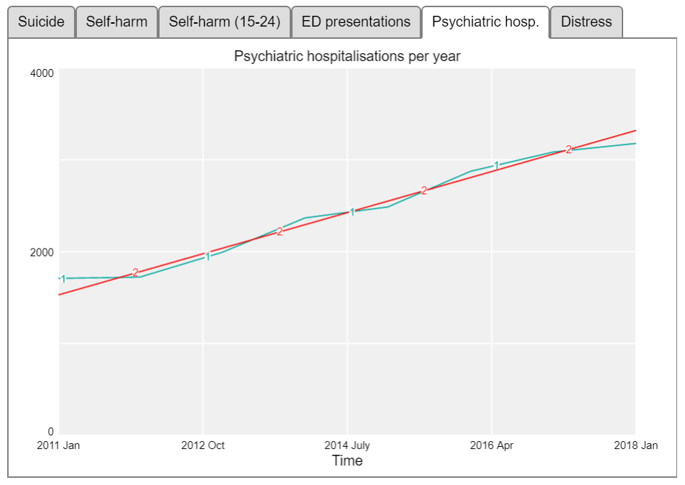
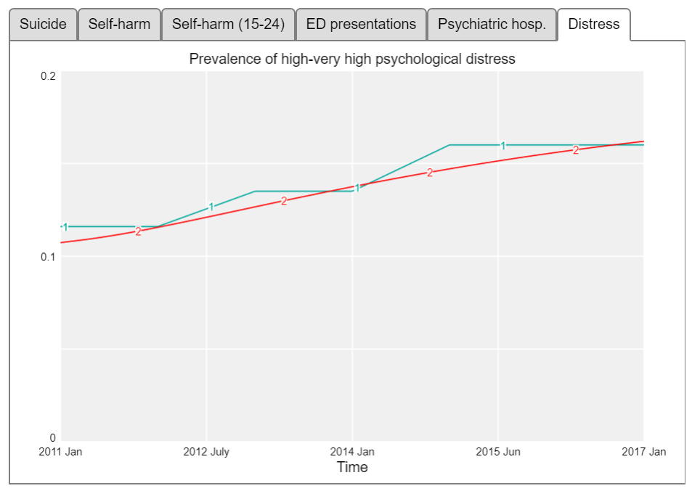
Model Validation
Notes:
An important part of building these models is being able to test whether our hypothesis of how the system works (based on available evidence, data and best collective understanding) is actually valid. We do this by:
Testing whether the model can reproduce the data we have from the real world – for this model we tested whether it was able to broadly reproduce trends in key indicators such as rates of psychological distress, psychiatric hospitalizations, ED presentations, self-harm hospitalizations, and suicide deaths (the results of which you can see here - where the blue line represents real world time series data from 2011-2017 and the red lines are the outputs of the model);
We also we ensured face validity of the model structure and performance with the diverse group of stakeholders through the participatory process;
And as an ongoing step, these models are embedded locally in an ongoing monitoring and evaluation cycle, so as new data comes in, we can refine the model to further improve its forecast capability over time.

Slide 19
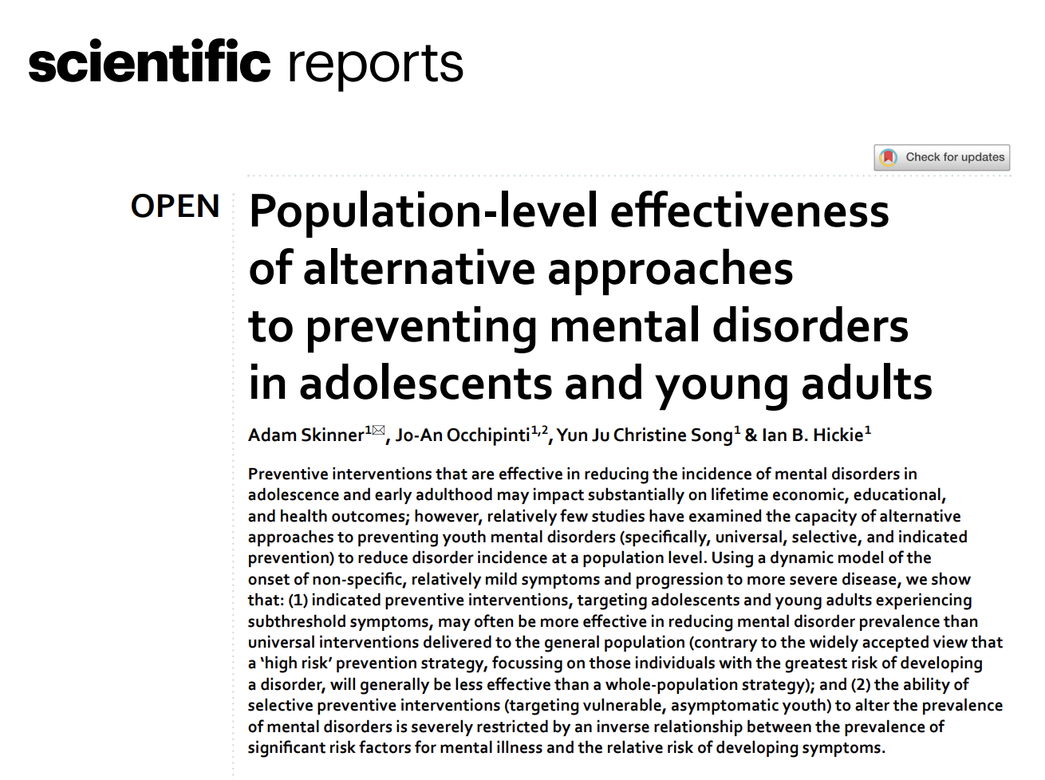
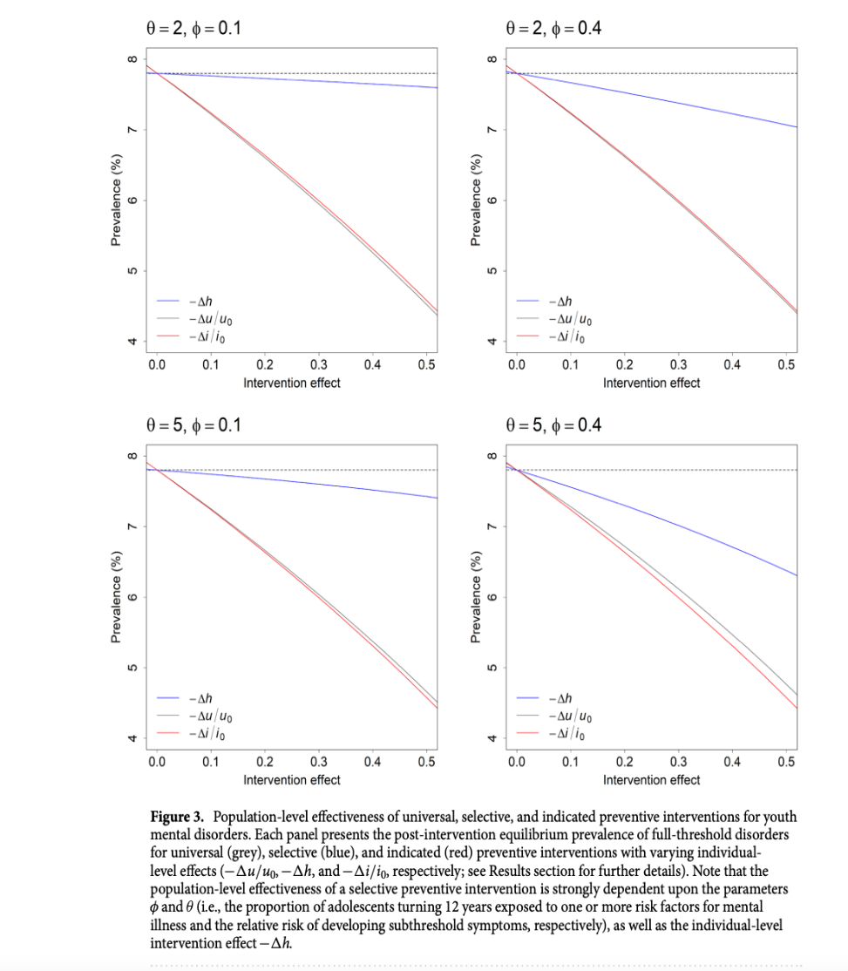
How do we reduce the prevalence of Mental Ill-health? Universal interventions are not the only options:
Indicated Prevention and early intervention do work (but need to be scaled)!

Slide 20
Real Challenges in Global Mental Health Services
ACCESS AND QUALITY!! (NOT Access OR Quality)
  Facilitating early entry to care (early clinical stages for indicated prevention and early intervention)
  Specialist Expertise at entry to systems and ongoing
    A very big challenge for traditional primary-care and profession based systems
  Person-Centred & Inclusive of others (families, communities)
  Highly accountable: outcome not activity-focused!

Slide 21

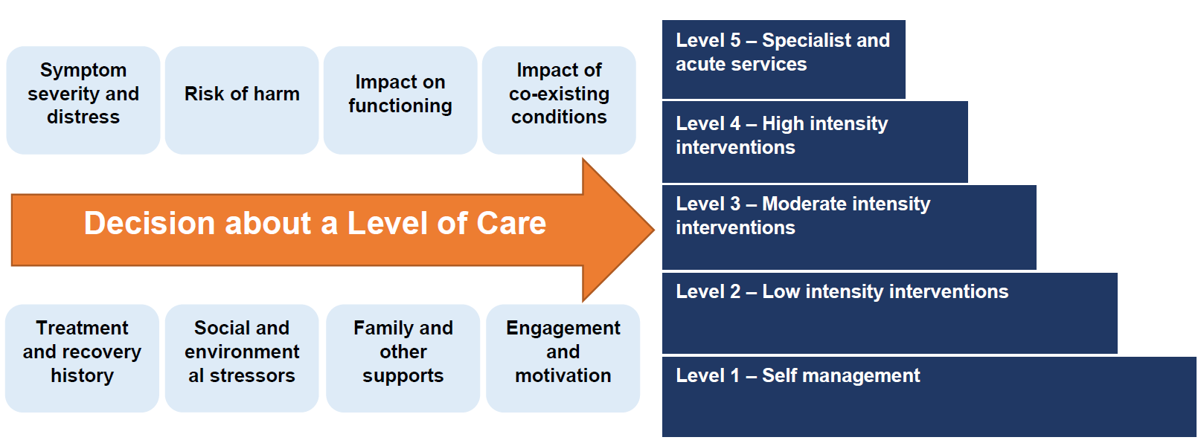
Current solutions to improve assessment and care allocation
‘Initial Assessment Referral Decision Support Tool’

Slide 22
The clinical and psychosocial index scores capture a wide range of needs
Clinical needs
Multidisciplinary needs
Self-care / low-intensity treatment
Psychosocial needs

Slide 23
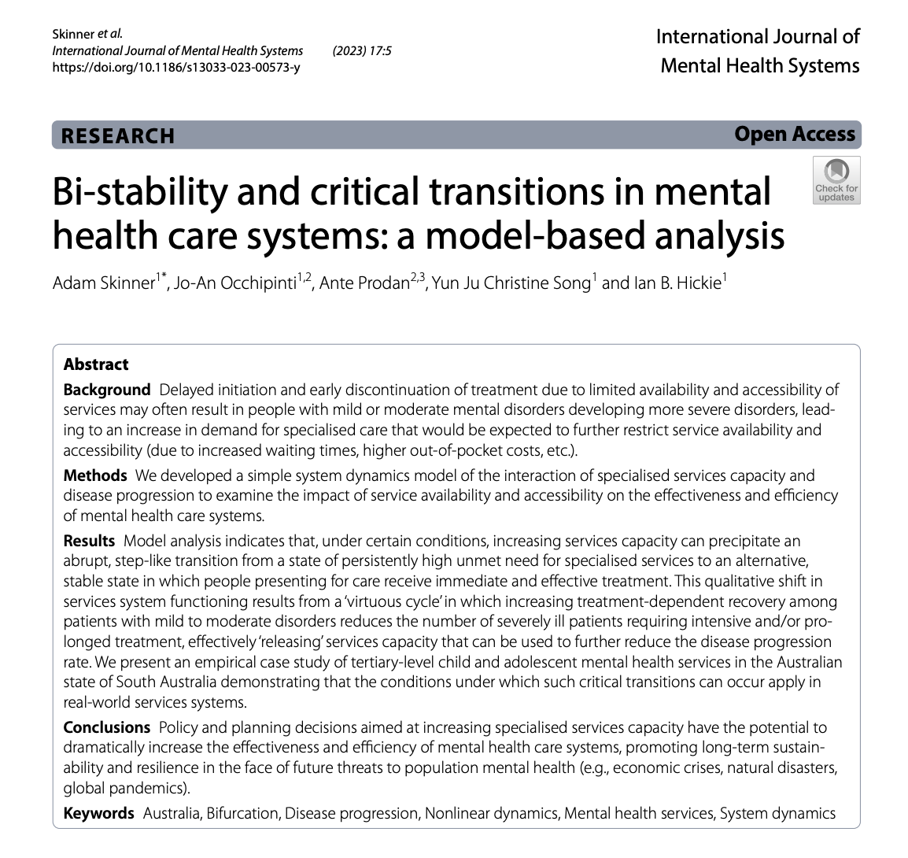
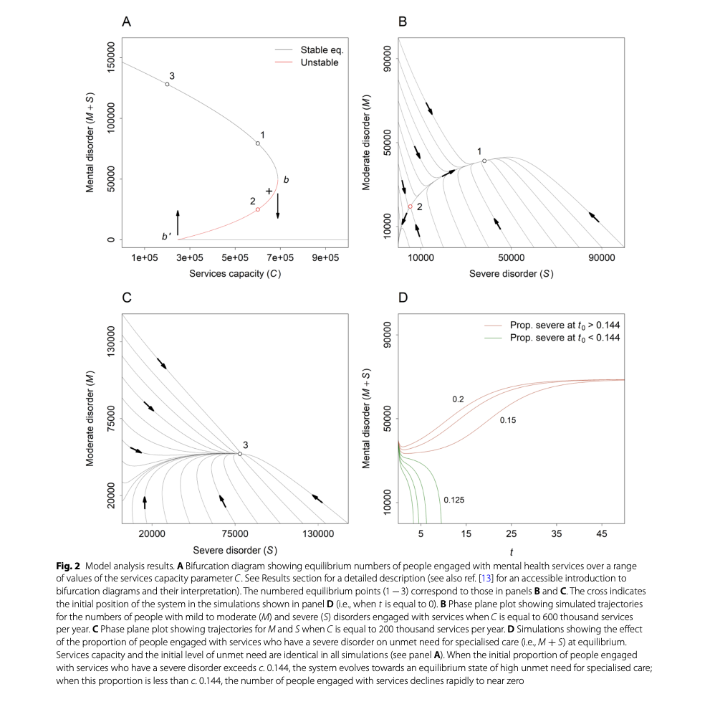
More effective (affordable and equitable) and scalable systems that can enhance early access to specialized services and appropriate services mix
BUT: NOT expanding the current stepped-care models

Slide 24
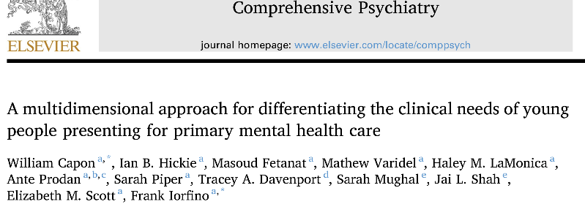
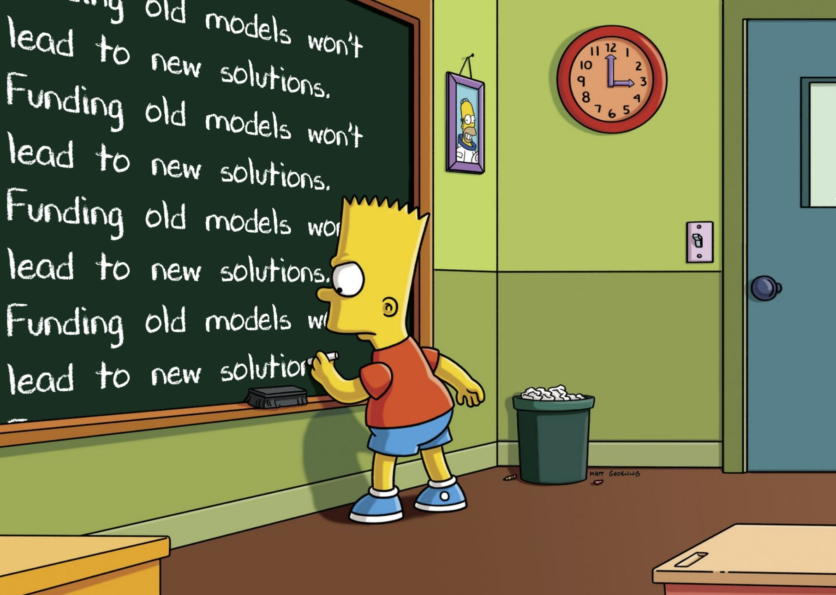

Young people’s treatment needs demand smarter systems
Young people’s needs are complex, often leading to reactive, not proactive decisions
Early illness stage
(23.75%)
Very high and complex
needs (48.75%)
Established depression with functional impairment (27.50%)
N=1280

Slide 25
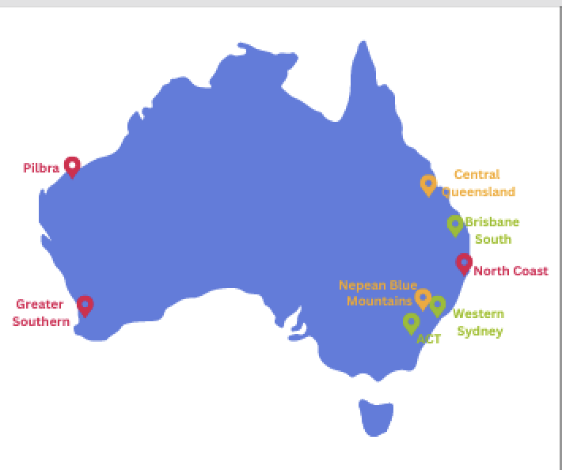
BHP Foundation: Regional Models of implementation
“Right Care, First Time, Where you live”
For Youth Populations – 8 sites nationally

Slide 26
Program goals
Regionality:
Bringing Organizaions lived experience/expertise together
System-level Modelling
‘What if” scenarios
Implementation
Local decisions
Advocacy
Novel approaches including Digital coordination

Slide 27

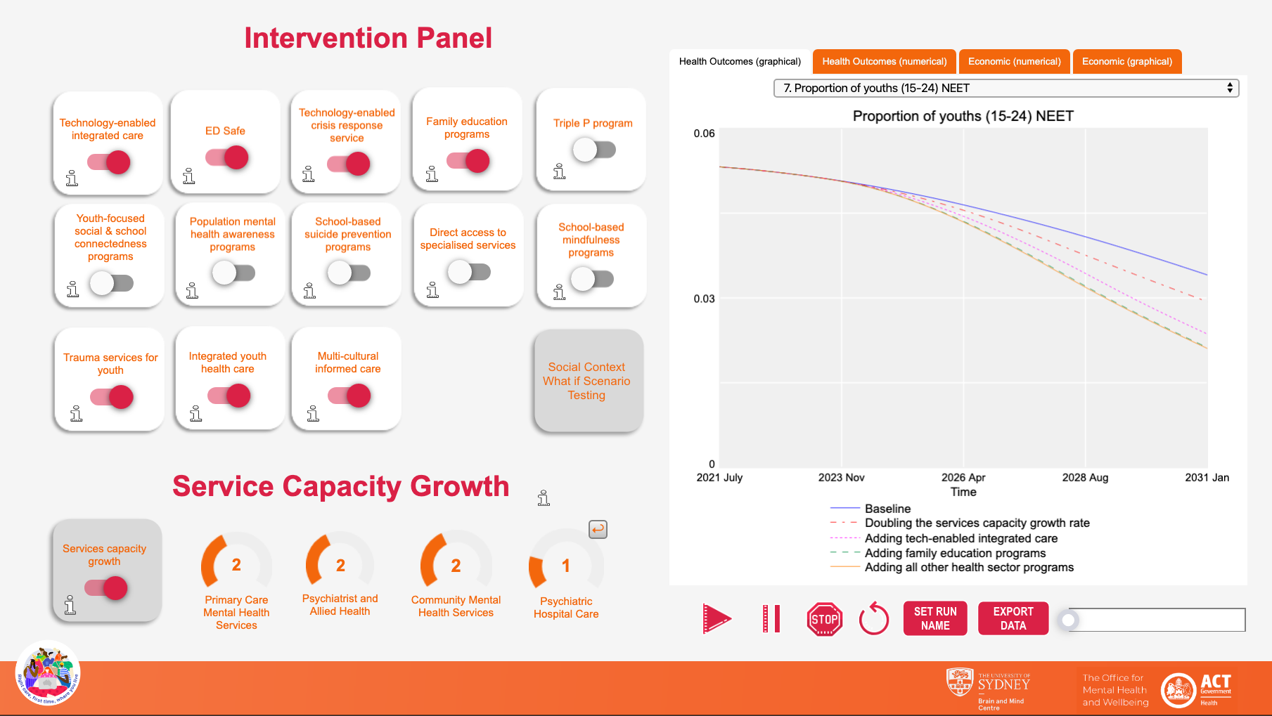
Health sector response: Doubling services capacity growth rate PLUS technology-enabled integrated care PLUS family education & support programs PLUS all other programs
Modelling Outcomes at Scale: Regional Systems
Notes:
Or the proportion of youth not in employment, education, or training….

Slide 28
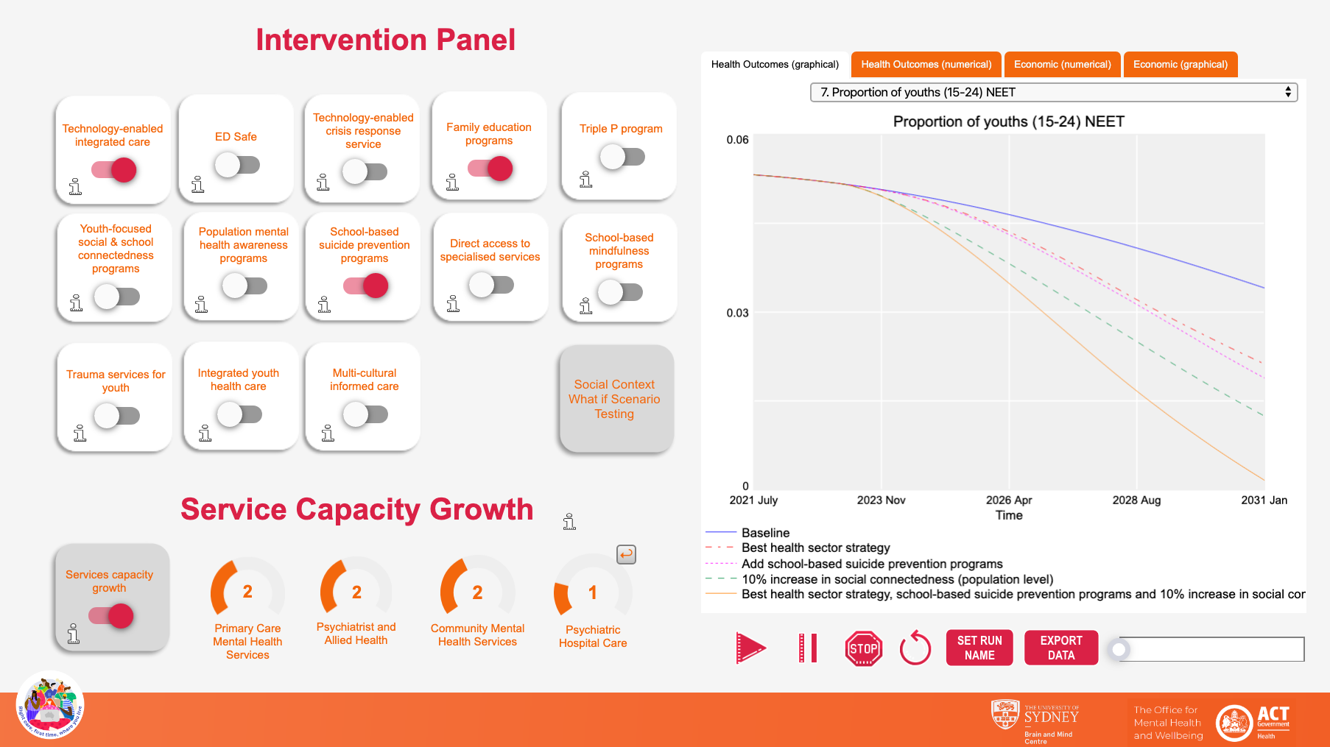
Multi-sectoral strategy: Best health sector strategy PLUS school-based mental health education program PLUS 10% increase in social connectedness
Modelling Outcomes at Scale: Health and Social Systems
Notes:
…and youth not in employment, education and training.

Slide 29
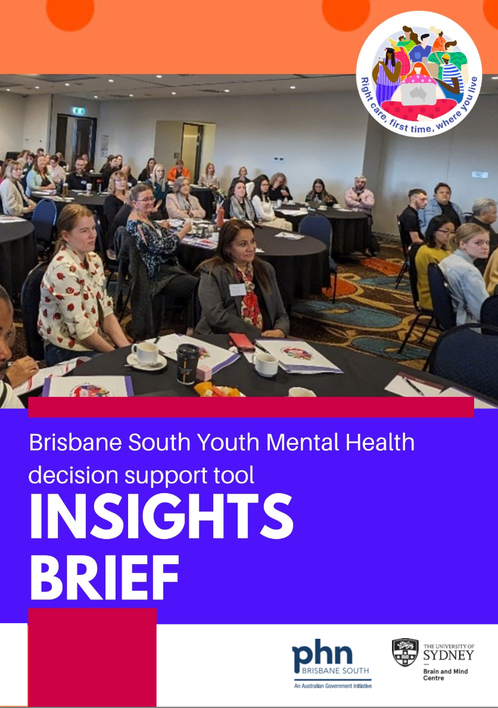
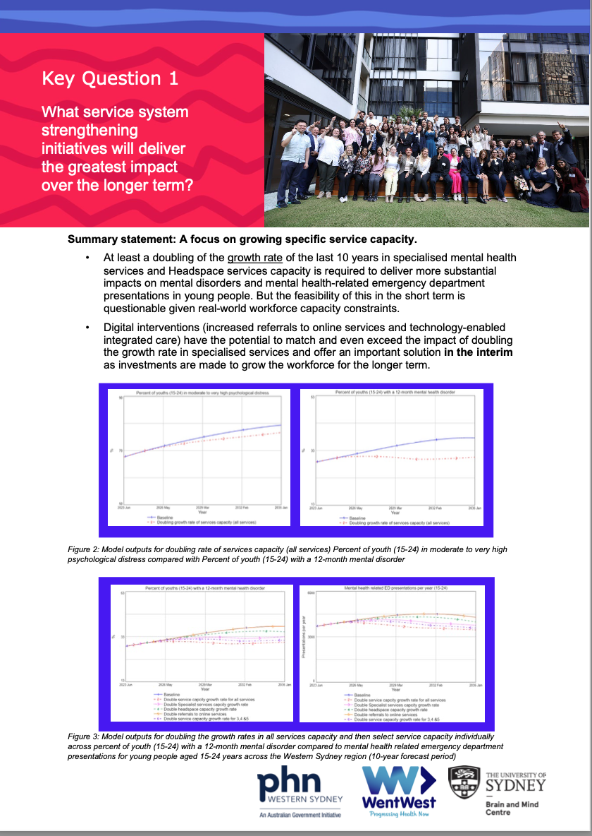
Brisbane South worked model -1

Slide 30
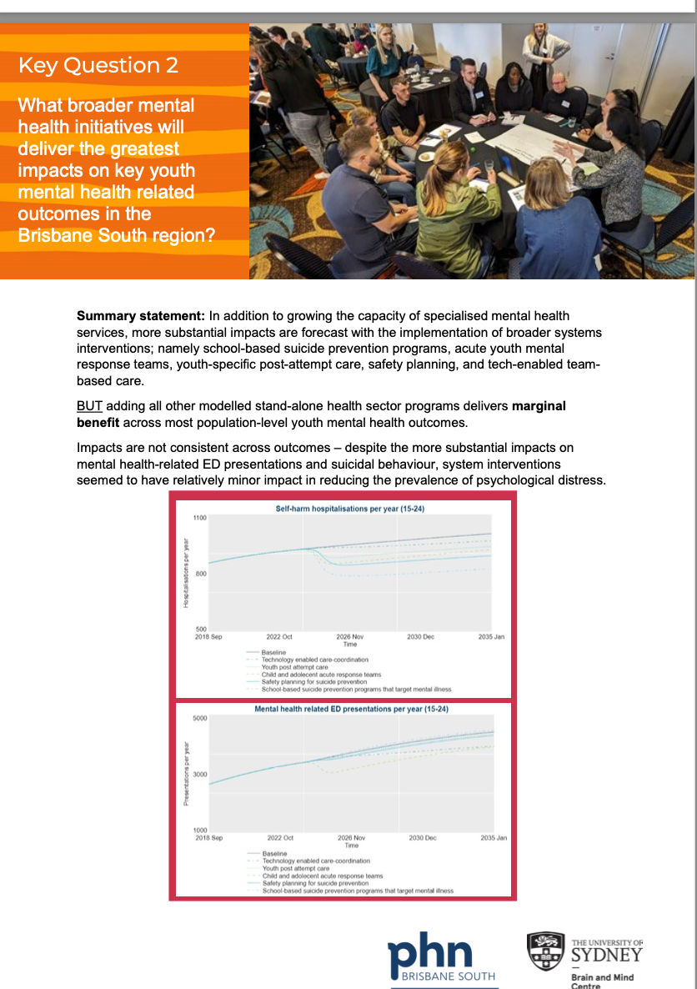
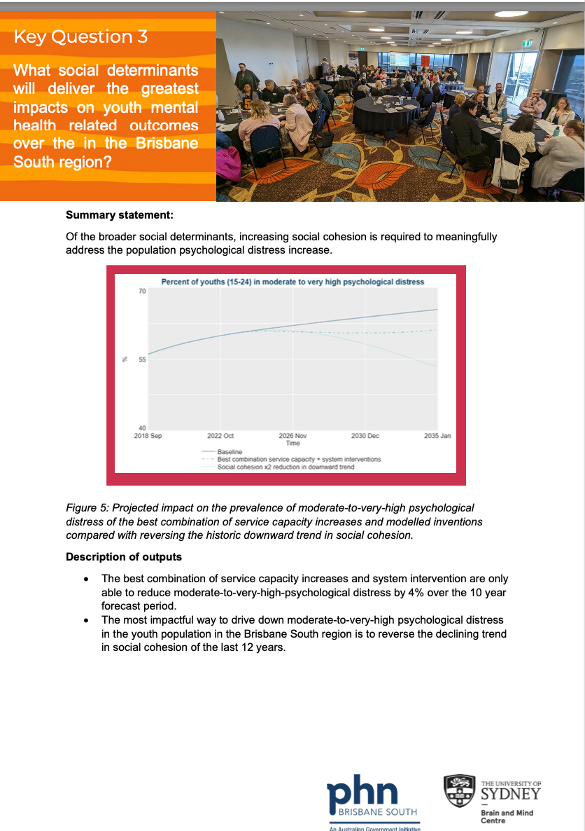
Brisbane South – 2

Slide 31
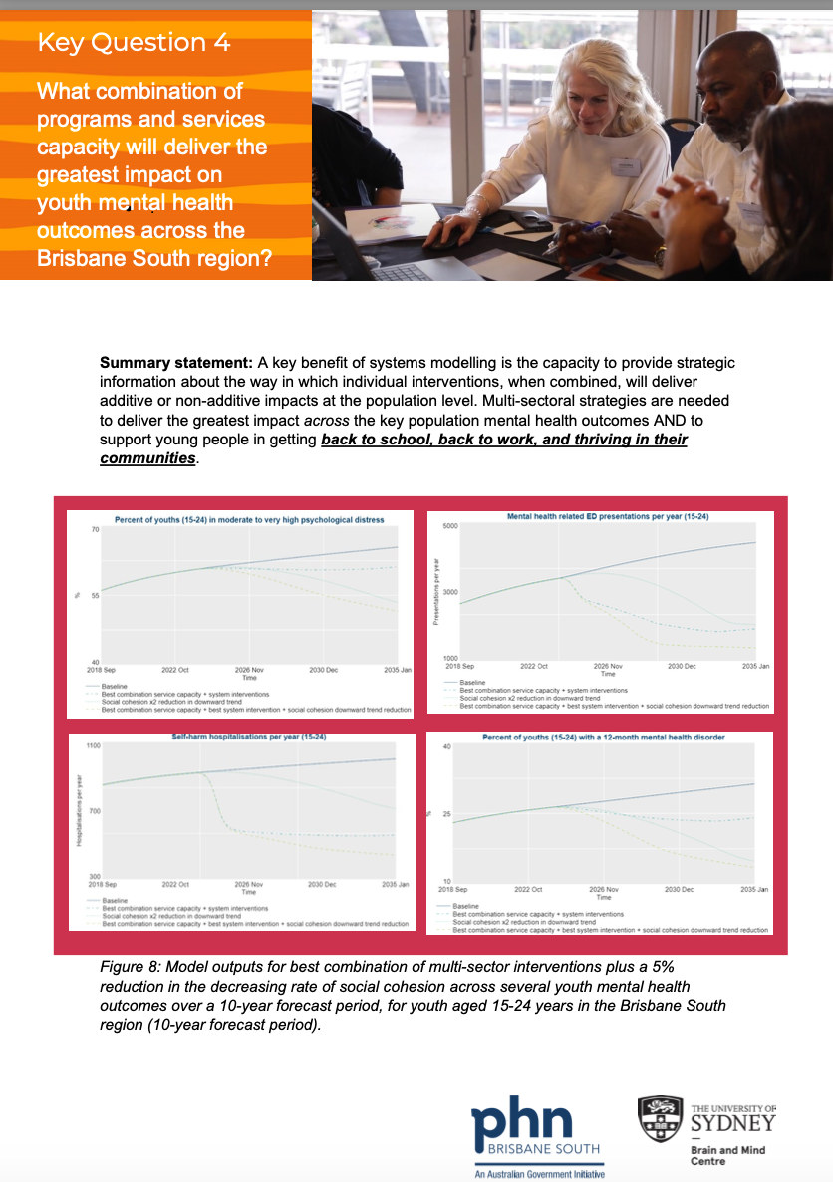
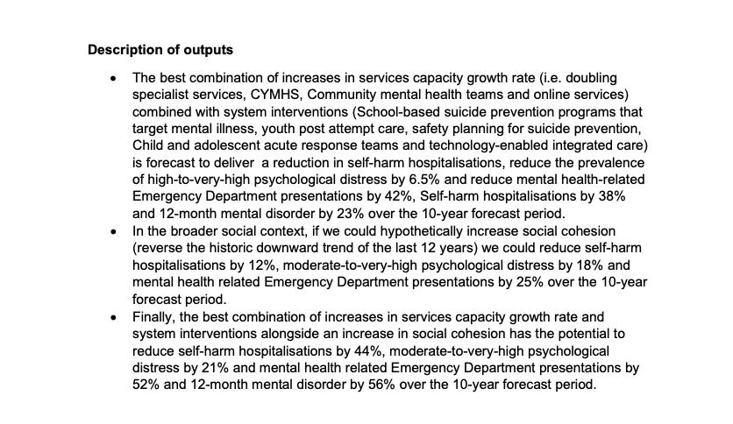
Brisbane South - 3

Slide 32
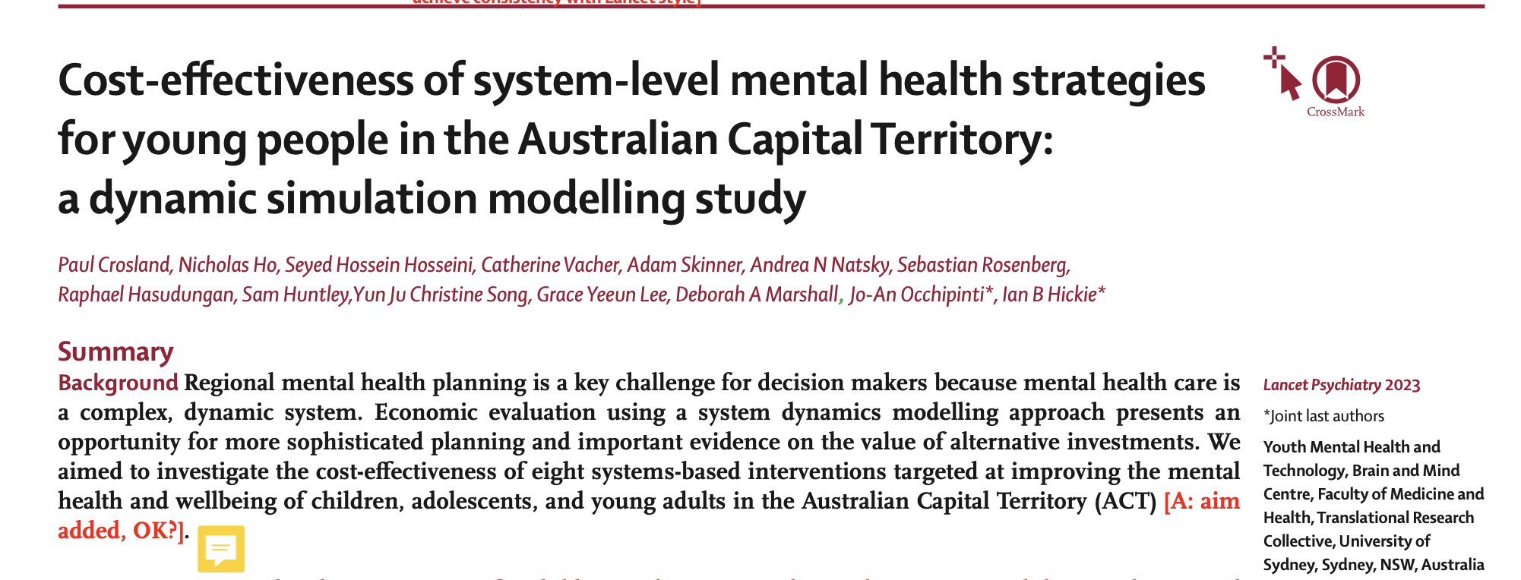
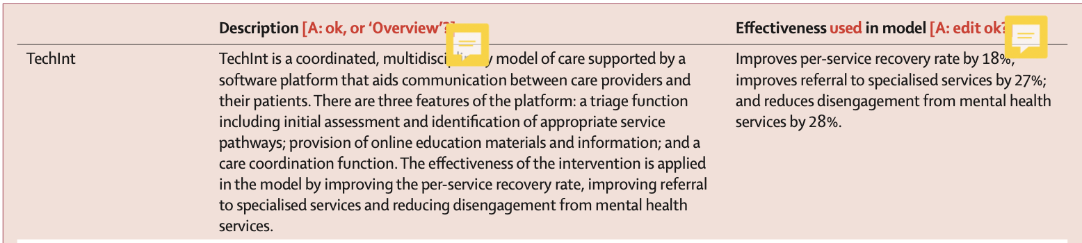
Cost-effectiveness of technology-integrated care at scale!

Slide 33
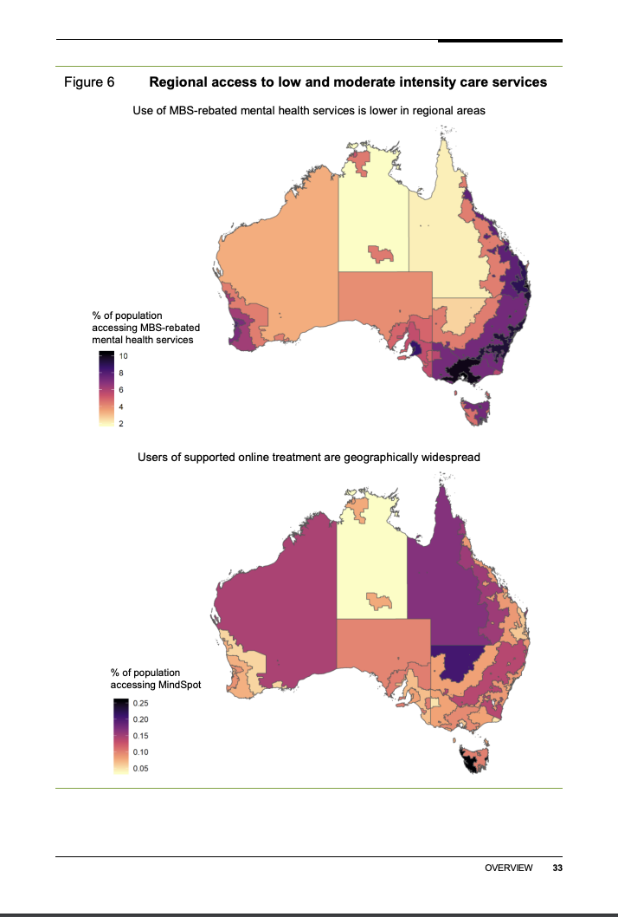

Regional Planning – Will it ever happen?

Slide 34
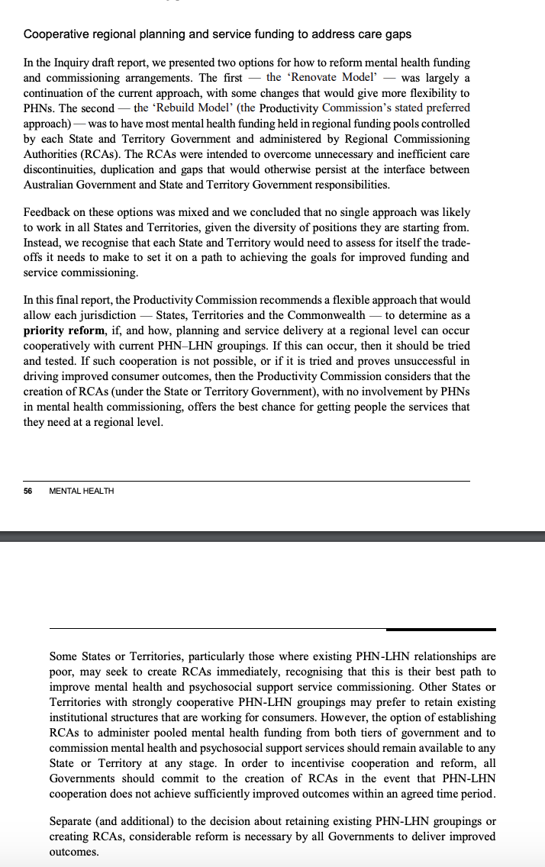
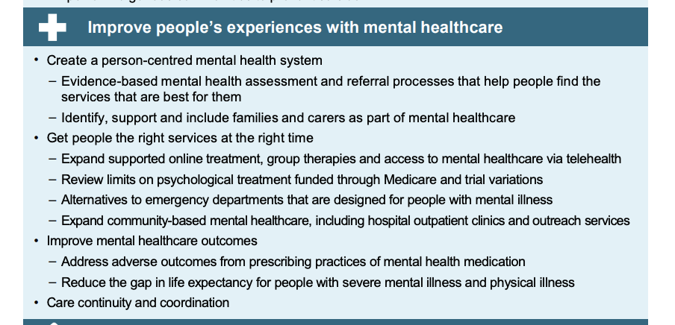
Regional Planning models??

Slide 35

Digital Transformation of Mental Health Care: the only way we will ever respond to legitimate demand

Slide 36
What is the attraction of digital mental health care (alone or in partnership with clinical services)?
For the users:
Clear needs
Access and Quality
Highly engaged
EMPOWERMENT!
Minimal Stigma
For the Community/Family:
New opportunities to engage directly
For the (private or public) funder:
Clear demand
sound investments
accountability
-For the providers/clinicians
Use of real time data to personalize care and deliver better outcomes

Slide 37
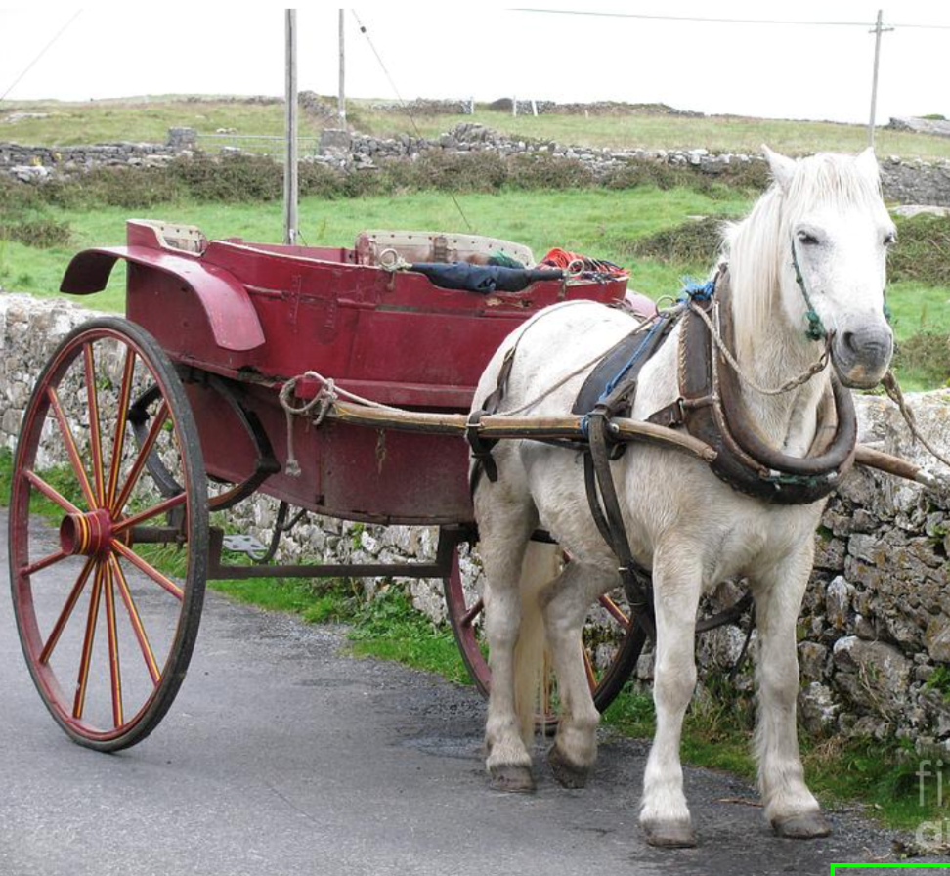

Which Technologies can we choose to help us face these 21st C challenges??
The User Journey supported by Digital 2.0 Health Information Systems (where the pilot doesn’t fly the plane!!)
The expanded ‘Clinic’ with EMR, 20th C coding for payments, some add-on apps.

Slide 38
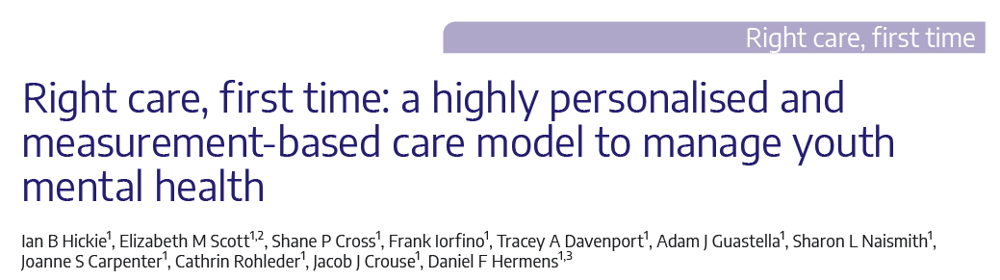

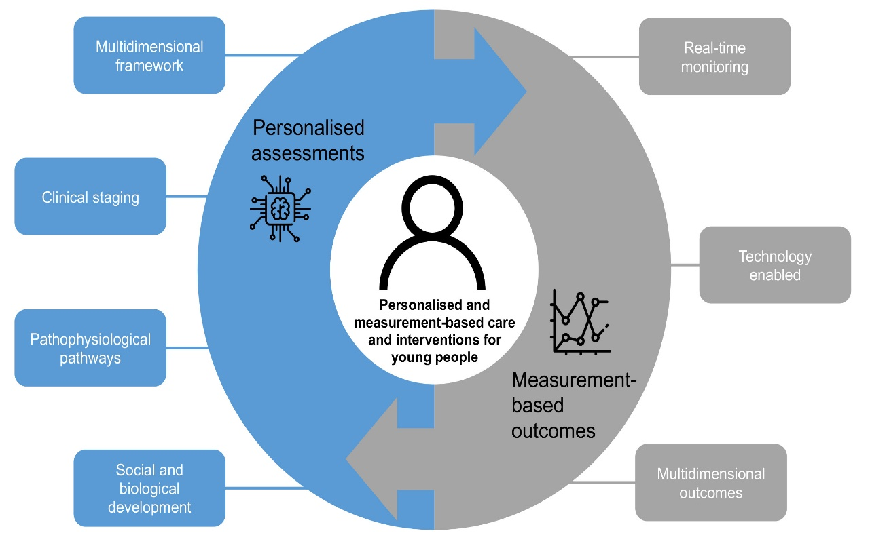
New models: Tech-enabled, Highly-Personalized and Measurement-Based, Early Intervention, Mood Disorders

Slide 39
Closing the gap for a scalable, expert workforce
There is natural variation in workforce capability (due to experience, resource, training, fatigue etc.)
Mia is an AI-in-the-loop system that ensures consistent, high-quality mental health assessments
Specialised
expertise
Level of mental health expertise
With Mia
Without Mia
Different members of the workforce

Slide 40
Conclusions
Need to get serious about regionally-based solutions (and what constitute best ‘regions’)
We can plan better by using:
  New modelling tools
  Engaging communities of practice
  Supporting smart decisions
We need to think of new partners
  Notably in eductation, employment, social services
We need to work both within and outside the existing health systems

Slide 41









Thank you
for listening
Special thanks to the team
Professor Ian Hickie
Dr Christine Song
Dr Ashlee Turner
A/Prof Elizabeth Scott
Dr Jacob Crouse
Alissa Nichles
William Capon
Luke Borgonolo
Alexander T-Beckwith
Dr Rafael Oliveira
Dr Matthew Varidel
Dr Sarah McKenna
Natalia Zmicerevska
A/Prof Jo-an Occhipinti
Dr Haley LaMonica
Dr Joanne Carpenter
Dr Ante Prodan
Carla Gorban
Min Chong
Dr Kirill Glavatskyy
Contact information
@frankiorfino
Collaborators
Professor Sally Cripps (UTS)
A/Prof Roman Marchant (UTS)
Professor Jan Scott (Newcastle University, UK)
A/Professor Jai Shah (McGill University, Canada)
Professor Kathleen Merikangas (NIMH, USA)
Partners
frank.iorfino@sydney.edu.au

