Slide 1
Navigating the path to elimination
Kobie Hatch, Office of the Chief Nurse Officer
Jannette Newell, Office of the Chief Psychiatrist
Notes:
Navigating the path to elimination. This presentation will outline the work that has been led by the Office of the Chief Psychiatrist in working towards the elimination of the restrictive practices in Queensland’s mental health services.Reducing restrictive practices in mental health services is both an international and national imperative. Despite considerable investment, commitment and efforts, there has been limited improvement in the rates of restrictive practices, such as involuntary treatment, seclusion, and restraint in Queensland in recent years.
In alignment with the priorities of Better Care Together (Queensland’s five-year mental health alcohol and other drugs plan) several initiatives have been implemented to support addressing the review recommendations and work towards the reduction of restrictive practices within Queensland.
In late 2022, the Queensland Chief Psychiatrist coordinated an external review to consider how seclusion and mechanical and physical restraint were used across the mental health service system. The review sought to identify key actions to support improvement in clinical practice to reduce and where possible eliminate the use of seclusion and restraint. The review identified 18 system wide recommendations across 8 key domains, which closely align to the Six Core Strategies© in reducing seclusion and restraint. The Hospital and Health Services have been supported to utilise a Six Core Strategies© approach and audit to develop and inform action plans to reduce and where possible eliminate restrictive practice (including seclusion) in Queensland.
The recent appointment of a Nursing Director (Mental Health Alcohol and Other Drug Advisor), and a Least Restrictive Way Clinical Nurse Consultant in 2023 has provided an opportunity to support state-wide mental health nursing leadership on this issue.
State-wide forums, networks and projects have been undertaken in collaboration with the mental health workforce, people with lived experience and First Nations people to identify key strengths and areas for action to reduce restrictive practices within mental health services.

Slide 2

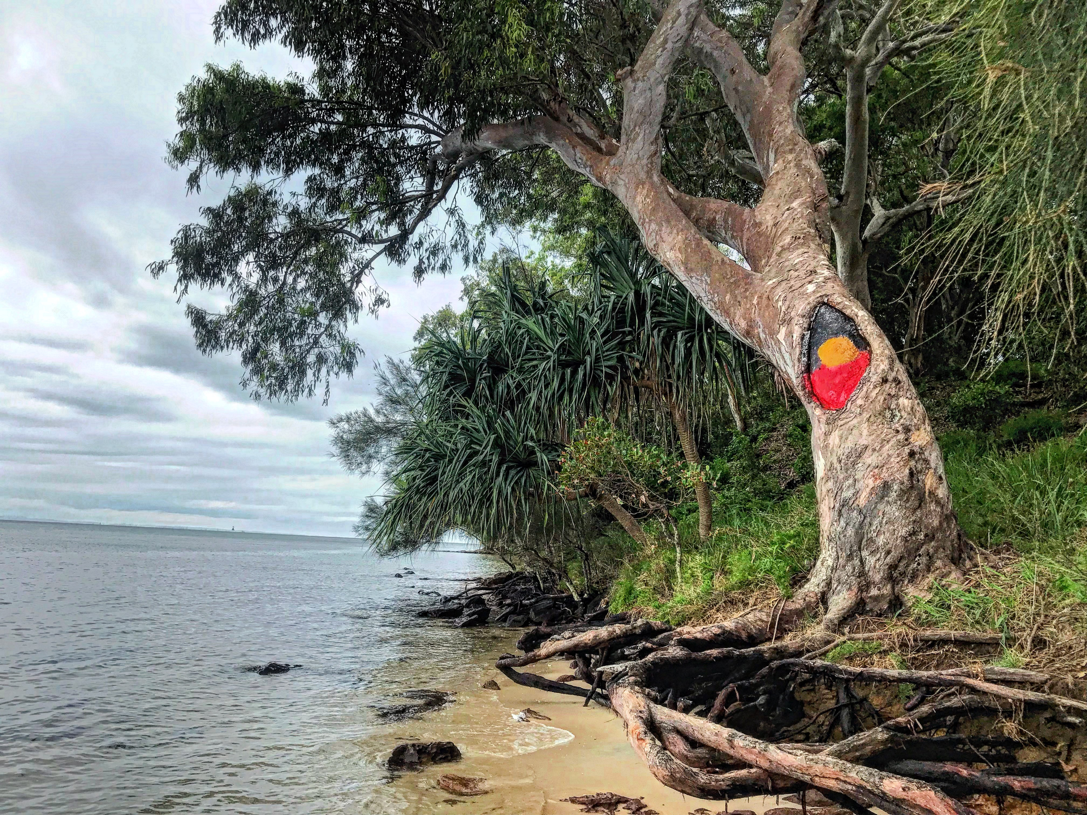
Acknowledgement of Country
We’d like to acknowledge the traditional custodians of the land on which we meet and recognise their continuing connection to land, waters and community.
We pay our respects to Elders both past and present, for they hold the memories, traditions and knowledge of their cultures, and we extend that respect to all Aboriginal and Torres Strait Islander peoples here today.
Artwork- Rachel Saraa is a Goreng Goreng artist. This artwork represents caring and connection
Notes:
Acknowledgement
We want to begin by acknowledging the traditional custodians of the land on which we meet – Jagera and Turbal peoples- and recognise their continuing connection to land, waters and community. We pay our respects to Elders both past and present, for they hold the memories, traditions and knowledges of our cultures, and we extend that respect to all Aboriginal and Torres Strait Islander peoples here today.
We would also like to acknowledge Rachel Saraa who designed this artwork for the Office of the Chief Nurse, Queensland. Rachel is a Goreng Goreng artist and this artwork represents caring and connection.

Slide 3

Recognition of lived and living experience
Queensland Health recognises people with a lived and living experience of mental illness, problematic alcohol and other drug use, mental health crisis, trauma and suicidality, their families, carers and support persons. Their contribution to driving and informing reforms to the mental health, alcohol and other drug service system is critical and valued.
Notes:
Recognition of lived and living experience
Queensland Health recognises people with a lived and living experience of mental illness, problematic alcohol and other drug use, mental health crisis, trauma and suicidality, their families, carers and support persons. Their contribution to driving and informing reforms to the mental health, alcohol and other drug service system is critical and valued.
Recognition of lived and living experience
Queensland Health recognises people with a lived and living experience of mental illness, problematic alcohol and other drug use, mental health crisis, trauma and suicidality, their families, carers and support persons. Their contribution to driving and informing reforms to the mental health, alcohol and other drug service system is critical and valued.
This is a reminder of why we are all here at the 2024 ACMHN Conference.

Slide 4


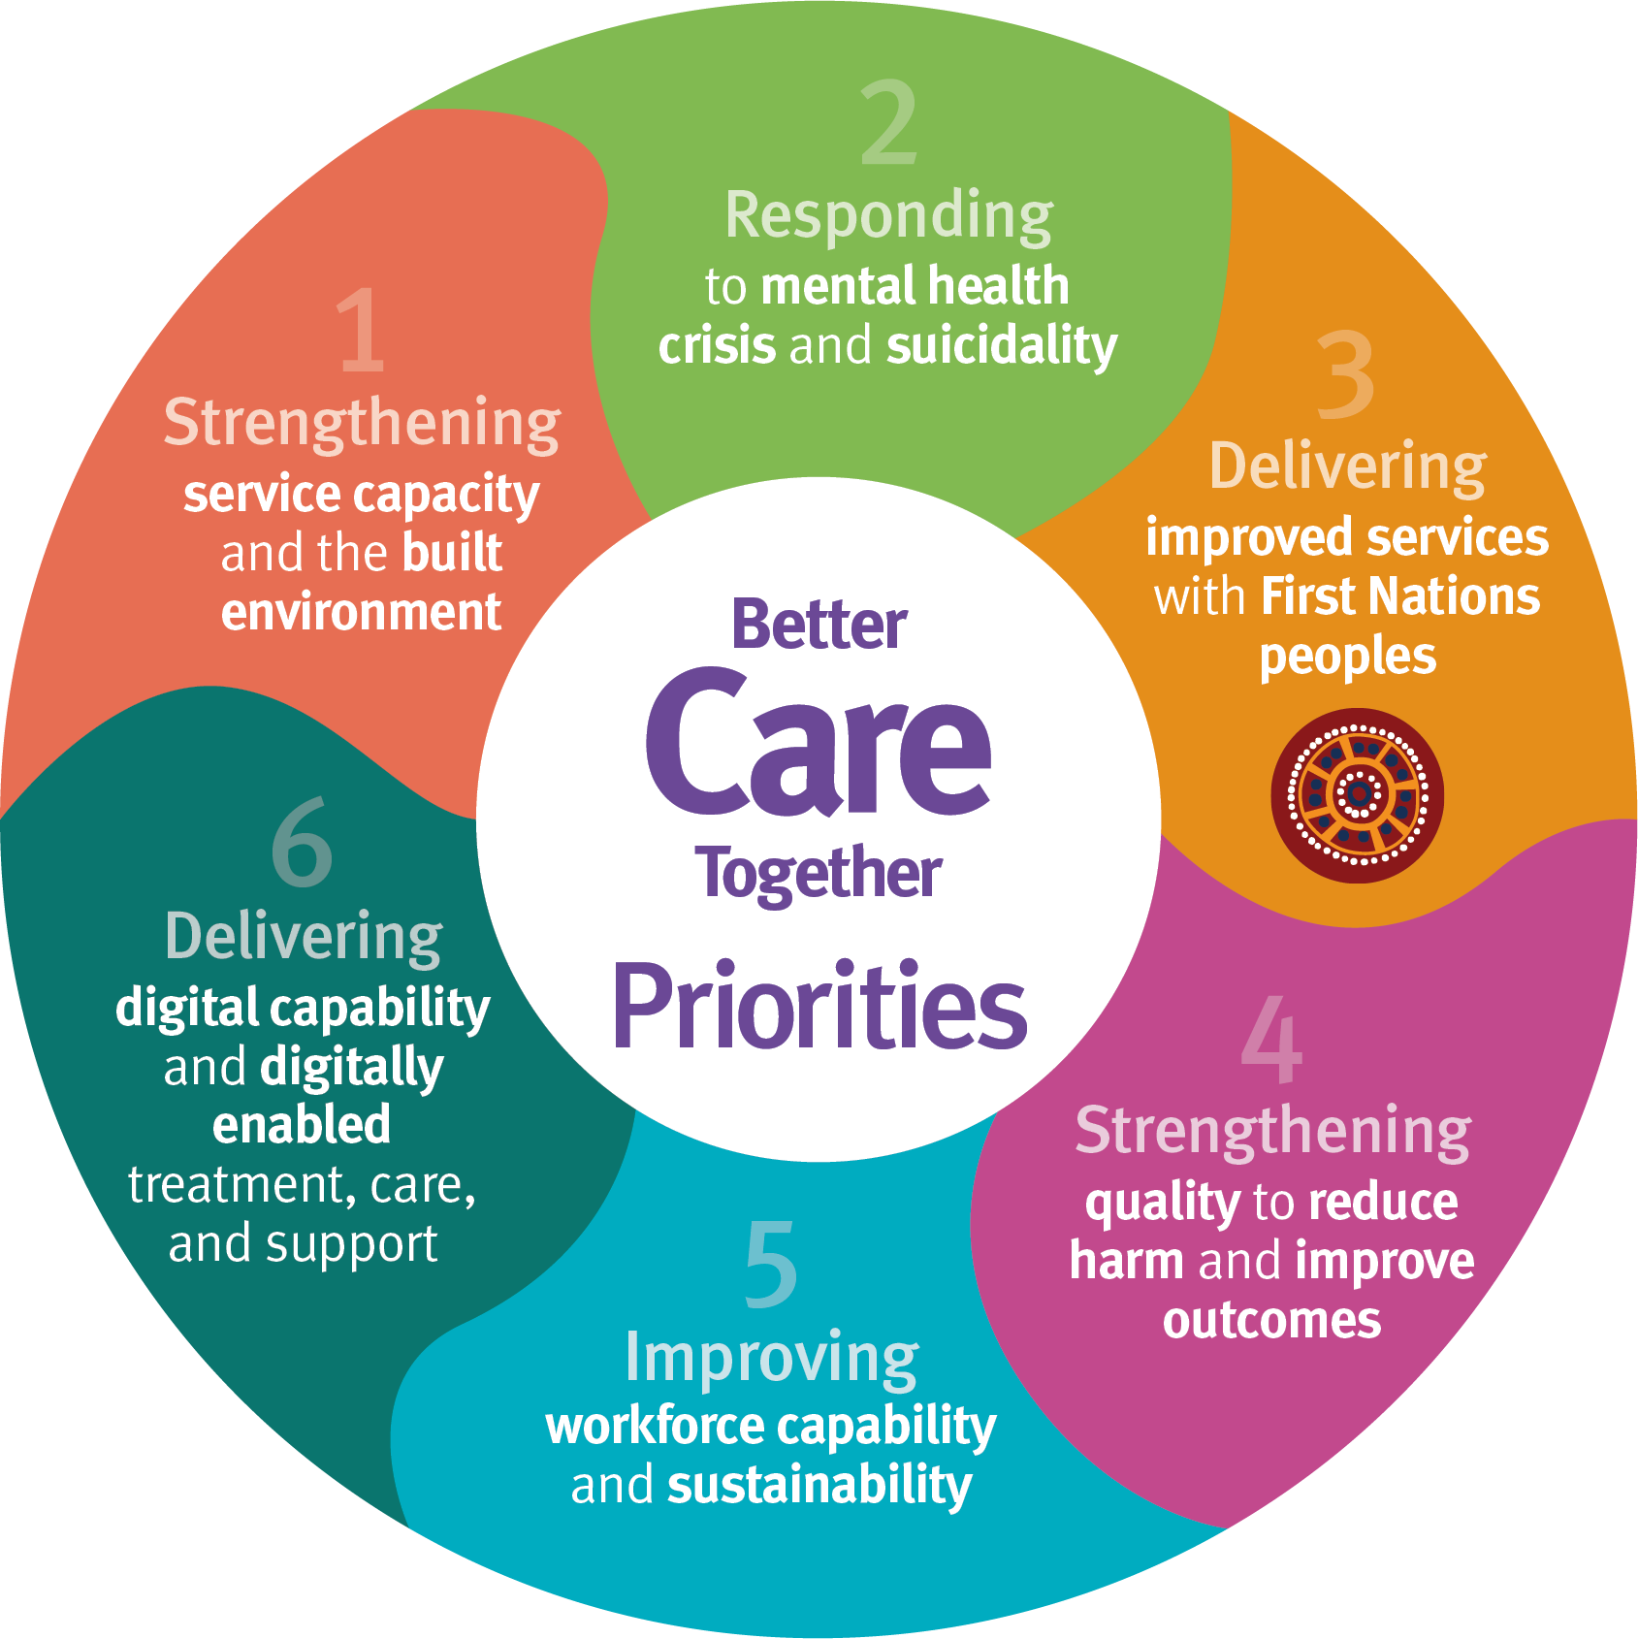

Queensland Context
Better Care
Together 2022-2027
Mental Health
Select Committee
2022
$1.948 billion dollar investment into the Mental Health of Queenslanders - 6 key Domains.
An inquiry into the opportunities to improve mental health outcomes for Queenslanders.
Least Restrictive Way
Project 2023
Office of the Chief Psychiatrist Statewide Project
SECREST 2022
Chief Psychiatrist Review into the use of seclusion, mechanical restraint and physical restraint under the Qld MHA 2016
Notes:
In late 2022, the then Health Minister commissioned a Parliamentary Enquiry into Mental Health Services within the state of Queensland. The Inquiry yielded 57 recommendations to make improvements to the Queensland's state-funded mental health, alcohol and other drug services system.
Further to this in mid - 2023 the state government launched a $1.65 Billion dollar investment program into Queensland Mental health, alcohol and other drug services system, through Better Care Together, the plan for Queensland’s state-funded mental health, alcohol and other drug services to the year 2027.
We are now nearly halfway through the life of Better Care Together, this investment has increased and is on track to deliver around a total increase of $1.9 Billion dollars over the 5 year period.
In addition to the parliamentary inquiry and Better Care Together, the Chief Psychiatrist established a review into how seclusion and mechanical and physical restraint is used in Queensland's mental health service system. Referred to as the SECREST review, 18 recommendations were made and the Least Restrictive Way project born, Kobie will speak to this statewide project.
LRW funded by BCT- priority 4

Slide 5
The Least Restrictive Way Project
AIM
To support Hospital and Health Services to identify, implement and evaluate strategies and resources to reduce the use and associated harm of restrictive practices within authorised mental health services (AMHS) in Queensland.
Notes:
Prioritise the Least Restrictive Way
Empower the workforce
Hear experiences
Support whole of system approach
The Least Restrictive Way Project
Funded under Better Care Together, the Least Restrictive Way project is supported by the appointment of a Least restrictive way CNC was appointed late last year to lead this project.
First phase focus on reducing seclusion and restraint
There’s a lot of literature regarding reducing restrictive practices and I think it would be fair to say that every mental health service has identified this as a priority in recent decades. During initial phase utilised literature and the findings and key recommendations from recent reviews to assist in identifying a way forward. It quickly became apparent that Six Core Strategies, Safewards, Trauma Informed Care, Clinical supervision are strategies that would be familiar to most MHNs, many of which were implemented in the HHS that I was working in prior to moving into the statewide LRW project. With all best intentions, we weren’t really making identifiable progress in reducing restrictive practice rates.
So, I looked at the review recommendations, looked at the literature and spoke to people- lots of people- and found there were some experts in the state who had done amazing things, but I only find out about them by chance. There were also some great resources out there- but it wasn't neccessarily easy to find. So in the liaison between OCNO and OCP we decided that we needed to:
Get a commitment from MH leaders and the broader community on prioritising the vision to RRP
Empower MNH to lead this important work
Fnd out what is actually happening in each service- hear their needs from those who are working in each area (rather than a top down we'll tell you what you need, as we know that each culture is different everywhere you go)
We needed a whole of system RRP model like Six Core Strategies,
We knew engagement was going to be critical to identify what the issues, successes and challenges were across a very large state. We needed to connect with leadership and we needed people on the ground.
So we decided to hold a 2-day forum to inspire and connect, and funded funded a temporary part-time Restrictive Practices CNC in each AMHS to attend the 2-day forum, and then to review local practices and identify priority actions to support least restrictive practice.
Project recognises the multifaceted factors contributing to restraint and acknowledges that collaborationand a whole of system approach are required to make change and improve experiebce of care.

Slide 6




FULL INCLUSION OF LIVED EXPERIENCE
LEADERSHIP
6 Core Strategies©
Codesign lived experience
Codesign across all aspects, including environmental redesign
Culture of continual learning and improvement
Communication strategies and forums
Review of regulatory frameworks
Leadership training
Escalation pathways
Partnerships outside of mental health
MHA2016- Review of use of seclusion and restraint
USE OF SECLUSION AND RESTRAINT REDUCTION TOOLS
Safewards or equivalent framework
Sensory modulation areas
De-escalation
Risk assessment and management
DEBRIEFING
Incident reviews
Lived experience
WORKFORCE DEVELOPMENT
6 CORE STRATEGIES ©
USING DATA TO INFORM PRACTICE
Multidisciplinary Scope of Practice
Trauma Informed Care
Risk assessment and management
Safewards
Restorative Just Learning Culture
De-escalation
Reduce administrative reporting requirements
Additional monitoring and support for higher complexity groups
Incident reviews
Data transparency and availability
First Nations
Notes:
In late 2022 by the Office of the Chief Psychiatrist (OCP) and several AMHSs to consider how seclusion and restraint are used across key elements of the service system. The purpose of this review was to identify themes, lessons and actions which can be embedded at system and service levels to support improvement in clinical practice and the reduction, and where possible the elimination, of seclusion and restraint over time.
The subsequent Mental Health Act 2016 Report- Review of the use of seclusion and restraint (SECREST) was published in November 2023 and provided 18 recommendations for improvement across a number of areas (as identified here) . Queensland Health supported the recommendations from this report which align with a number of system-wide initiatives, and the Branch has developed a monitoring and evaluation plan to oversee the implementation of the recommendations. The MHA 2016 report- review of the use of secusion and restraint
18 recommendations across 8 key domains:
Lived Experience
First nations
Office of the Chief Psychiatrist
Leadership and Culture
Models of Care
Workforce
Environment
Information
First Nations- Te Pou had already done a cultural adaptation tool

Slide 7
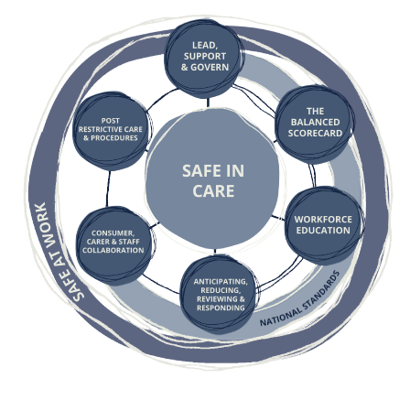
Safe in Care, Safe at Work
1. Lead, support and govern for safe in care and safe at work
2. The balanced scorecard for safe in care and safe at work
3. Workforce training for safe in care and safe at work
4. Anticipating, reducing, responding to and reviewing seclusion and restraint
5. Consumer, carer and staff collaboration for safe in care and safe at work
6. Post-restrictive care and procedures
Notes:
Six Core Strategies Checklist- Australian adaptation
6-14 objectives per strategy
Suggested last column be changed from ‘objective met’ to ‘strengths & areas for improvement’- recognising this is an ongoing journey rather than an ‘achieved/not achieved’
References cultural considerations, including examples of Aboriginal and Torres Strait Islander and service user inclusion and consultation throughout the document
Benefits- it acknowledges the intersect between the caregivers and the consumer. Supported, educated staff are able to provide a better, safer experience for everyone. Received well in some areas with very challenging circumstances.

Slide 8
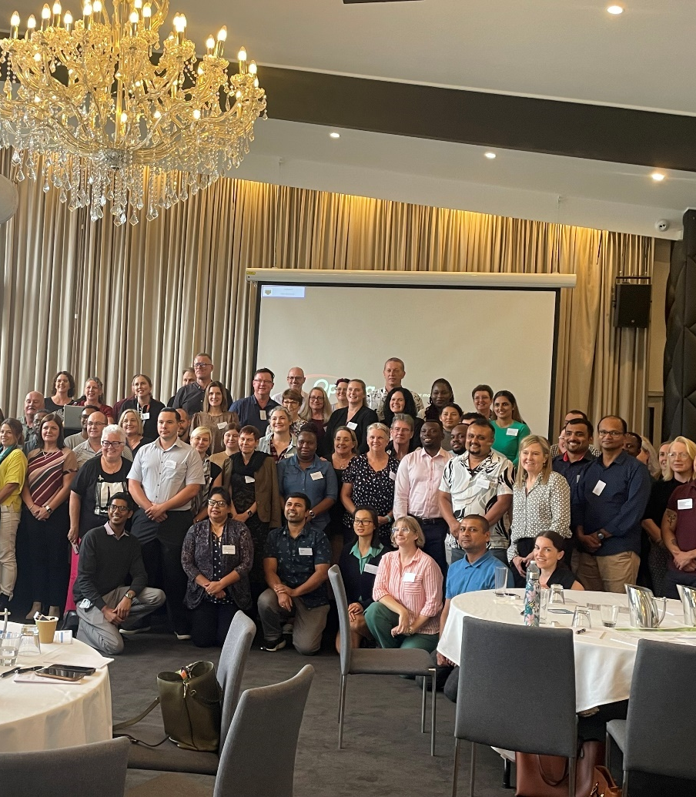
Least Restrictive Way Forum
Hear and understand the impact of restrictive practice
Share experiences and ideas to achieve the vision
International/ National speakers
Identify ways to develop system-wide practices
Collaborative Workshops
Empower the workforce
Strengthen statewide networking and partnerships
Notes:
Day 1- 105 attendees
MHAOD overview
The lived experience voice Shining a Light : A human rights based conversation about eliminating restrictive practices
Poem from Ailsa
Overview of LRW
The Townsville experience
Te Pou (NZ) success in RRP- Six Core strategies Service Review Tool
RRP in a high secure setting- NSW
Afternoon workshops- whats working well, what can we do better, what are our top 3 priority actions
95% participants stated the forum helped them to identify actions to reduce seclusion and restraint
100% satisfied with the event
Day 2- Over 92 attendees- nurse leaders and aspiring/future nurse leaders
MH Nursing Leadership focus with introduction and vision setting from CNO and the MHAOD Nursing Director, OCNO
Kevin Huckshorn and Janice LeBel-
TIC
Clinical Supervision
Workshops providing an opportunity to identify practical ways that MHN can operationalise the vision of LRW
Compassionate Leadership and Empowering the MHAOD professions
99% of those surveyed agreed that the forum provided them with an opportunity to hear and contribute to the MHN professiona future direction and needs

Slide 9
Evaluation Highlights
Seeing so many people motivated to move in a more positive, accepting and respectful direction with mental health care​​
Learning about the six strategy model in practice and the feedback from the group work- really good ​​
Important aspect was the networking, great opportunity to understand what was happening in different areas including what’s was going well and challenges ​​
Hearing the lived experience voice
Cross pollination with a wealth of knowledge and skills shared
​
​
Strengthen statewide networking and partnerships ​
Variety of professions and level of experience present​​
Notes:
Particpiant Highlights
95% participants stated the forum helped them to identify actions to reduce seclusion and restraint
100% satisfied with the event
Education & Information
Engagement and Networking to provide a state wide approach
Understanding challenges that other HHS are experiencing and we are not siloed in our challenges. Identified that there is no consolidation or standardised approach to least restrictive practices
Hearing of international and interstate implementation of 6 Core Strategies
Collaborative work with other attendees identify ways to improve the service
Cohesion of colleagues.
Strengthen statewide networking and partnerships (day 1)

Slide 10
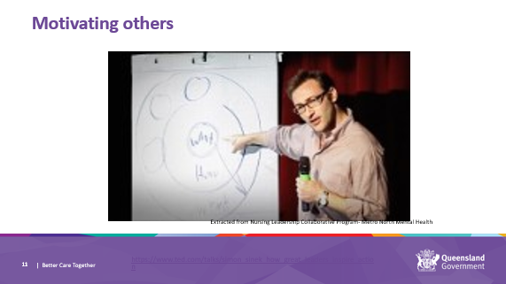
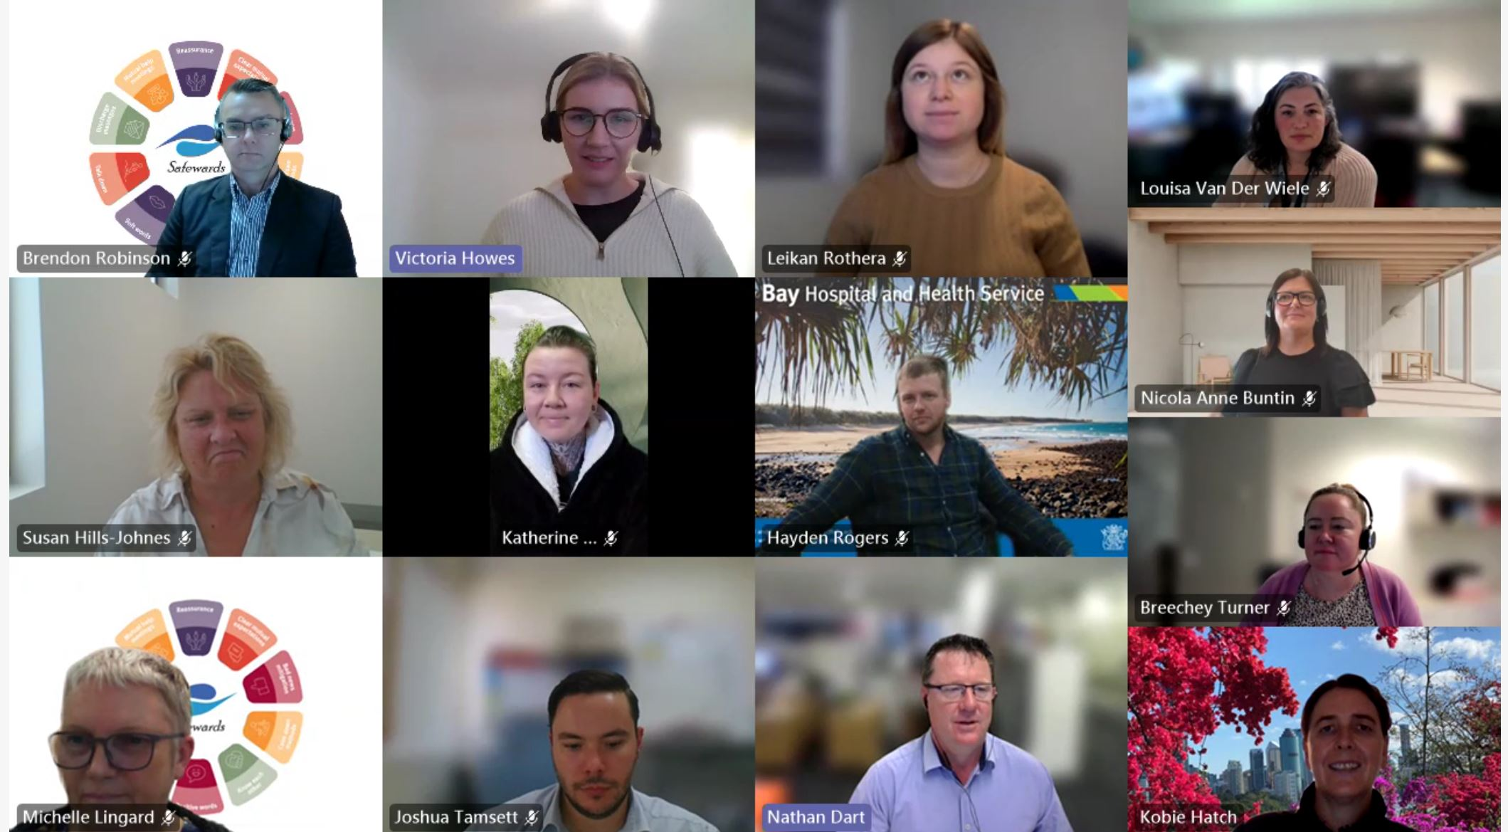
Least Restrictive Way Project Nurses
14 participants
10 Mental Health Services
12-week program
6 online sessions
Develop leadership skills
Audit current practices and available resources
Identify key priorities
Develop a local action plan to reduce restrictive practices
Notes:
14 senior nurses from 10 HHSs (some with separate sites)
2 day forum and then 3.5 hour Teams sessions combining leadership and project education with networking and project support
Topics included change management,
Six core strategies service review tool, safety and systems, seclusion and restraint data, embedding alternative to restraint, safewards fidelity,
Debriefing, giving and receiving feedback, outcome measurements
Final session- all together presenting overview of their findings and their final action plan

Slide 11
Feedback
Being valued by the organisation for what I am passionate about
Sharing challenges and celebrating wins. Sharing what works in other areas and listening to the passion that was clearly displayed by all participants
Networking and sharing ideas. like a think tank. Assisted with motivation to keep energy levels up for the project
The Six Core Strategies Checklist;
Prompting to consider things I never would have though of
A framework to follow and highlighted the standards to aspire to
A good tool for evaluating existing practices and lack thereof
It was comprehensive
A straight forward way to collate our audit information
Notes:
Did the first phase of the program achieve it's objectives? Absolutely. We wanted to engage with the broader workforce including lived experience and First Nations an we did that in the state-wide forum. From there we built capacity by supporting the the LRW CNCs to consult widely in their own HHSs to understand what was working well and what could be improved. It was different for every HHS and we expected that. Our biggest wins- we rekindled the enthusiasm for this important work, we built some capacity within the nursing workforce to lead this work, we established a network of involved nurses who can continue to meet to share their experiences and to support each other in this space.
Of the LRW CNC project- participants said the most meaningful aspects were the regularly meeting with other HHSs and networking and sharing experinces- all 14 participants ID'd these as the most useful aspect. 12 of the 14 appreciated having contact with the MHAOD LRW nurse and 10 appreciated the education component.
100% of participants reported either some or noticeable impact on RRP from the LRW project
12 out of the 14 participants would recommend repeating the Six Core Strategies checklist to monitor progress

Slide 12
QLD SICSAW Snapshot
Trauma Informed Care Frameworks and education
Safewards implementations
Clinical Supervision Capability for nurses
reviews and consideration of Chief Psychiatrist Policies and processes
Statewide Lived Experience (Peer) worker positions
Pipeline of Capital works
First Nations Cultural capability training
Occ violence prevention program
consumer and carer engagement framework
Alternative Models of Care
Notes:
The SICSAW AUDIT across AMHS inpatient units in phase 1 revealed a variety of interventions and initiatives and processes being implemented or planned to support the LRW.
We observed lots of efforts to enhance workforce capacity to respond through education and training initiatives and professional support frameworks.
We observed various BCT funded initiatives ranging from alternative models of care to integrating lived experience workforce, and Capital works investments.
We also observed some of the statewide initiatives supporting cultural and engagement capacity and strengthening systems and processes such as creation of Statewide First Nations positions and Statewide Lived Experience (Peer) worker positions within the MHAOD-Strategy and Planning Branch.
As Kobie already noted the project nurses from 10 services also used their results to identify priorities for quality improvement to reduce restrictive practices and developed local action plans to set the agenda on them. We had also collated action priorities from the 2 day forum. I completed a thematic analysis of priorities to discover shared strateggic priorities informing future focus.
I then completed a thematic analysis of the priorities to find shared strategic priorities to inform future direction.

Slide 13
Shared Strategic priorities
Identified through phase one consultation
DATA
INCIDENT REVIEWS
DEBRIEFING
Reviewing how Data is used to inform practice and monitor progress
Governance partnering
Statewide leadership to promote Debriefing capacity
consistency and equity in analysis and accountability
Notes:
Shared priorities provide an opportunity for a co-ordinated collaborative approach
These 3 originating from 4 SICSAW domains require strengthening
DATA
Clearly measuring and monitoring improvement is problematic due to the very limited nature of data currently observed. there was repeated acknowledgement of the need for data that goes beyond performance indication to support a learning culture, telling us what changes are contributing to reduction.
We need to
Review current restrictive practice data monitoring, reporting, governance and communication
Review how regulated RPs data is used to inform practice, monitor progress and inform learning.
Scope international developments in quality improvement strategies related to data supporting the reduction and elimination of restrictive practices in mental health settings.
Utilise those findings to identify areas of strength and those for improvement.
Develop monitoring and auditing processes to support performance improvement and harm reduction
Post restrictive care as a response within the sicsaw framework consistently featured as a priority area for improvement,
this strategy requires acknowledgment that RP events are a breach of safety to staff and consumers, they're a serious event and require appropriate support and subsequent effective review. This approach aims to reduce the use of S&R through knowledge gained from a rigorous analysis of the events and by mitigating adverse effects for anyone involved/witnessing. Hence debriefing and incident review processes are a focus of this project going forward. Debriefing also featured as a means of enhancing workforce capacity through wellbeing via the forum.
Debriefing- worldwide reduction efforts report inconsistency in the approach to debriefing in mental health responding to seclusion and restraint, we also observed that statewide around processes, application, purpose, training, documentation and reporting
No shared understanding of the purpose or process. Who is it helping and how? Are we debriefing to heal? To Learn? Conducted by different people We see it included in Statewide policy,
We need to bring Statewide leadership facilitating collaboration to promote Debriefing capacity at a statewide level
Likely required a dual pathway approach
Firstly, Co-design an approach to consumer debriefing with Lived experience expertise, intended outcomes developed through the co-design process.
Secondly, develop staff debriefing capability, from literature review through to resource development, operations and review.
Collaborate with AMHSs to support translation of learnings gained through debriefing to practice.
Incident review processes:
This approach would provide Targeted support for developing consistency in governance of regulated restrictive practices in AMHSs
Identifying these as significant safety breaches and having review mechanisms and processes supported through a restorative Just and learning approach, promoting partnering with consumers, with clear channels of escalation and feedback for practice improvements
Additionally lead support and govern featured in sicsaw priorities which interacts with all priorities, namely in regards to clinical and operational accountability for changes needed to identify, resource, achieve and sustain improvements. The forum called us to promote visibility of LRW practices and data. And repeated emphasis across all domains around partnering for improvements with consumers and carers, which we need to role model.
Learning form others excelling in this space has taught us that capable clinical governance systems establish a strong safety culture that places consumers at the centre of decision making and ensure accountability for high quality care.
Then to how we do it

Slide 14
Incidences of seclusion and restraint have NOT sustained a downward trend and remain persistent, harmful and in need of a heightened focus.
Careful planning in determining a strategy for proceeding.
Our designated role is to support and lead networking and collaboration
We need to move forward strategically, collectively and collaboratively.
Notes:
Incidences of seclusion and restraint have NOT sustained a downward trend and remain persistent, harmful and in need of a heightened focus.
So Solutions to reducing and eliminating seclusion and restraint are multifaceted encompassing prevention, response and recovery strategies.
No single, universal intervention can be endorsed to reduce or eliminate the use of seclusion or restraint in acute mental health settings without compromising safety.
A combination of a committed comprehensive approach using the SICSAW strategy framework and a quality improvement framework can guide us on a pathway towards elimination as the desired destination.
Imagining this realization at times seems an impossible feat, however restraint and seclusion compete with our ethical duties to avoid harm and promote justice for consumers and carers, they can invoke lasting fear and resentment towards health care staff, and traumatization and create barriers to accessing health. Staff can be negatively impacted, physical and psychological harm are common, with workforce attrition and wellbeing issues reported.
We have interventions, frameworks, priorities and resources, we need to build our capacity for a quality improvement approach if we are to stop causing preventable harm, improve consumer experiences of care, have a safe workplace with a healthy workforce and carers reporting inclusion.

Slide 15
Our role in Leading, Supporting and governing for Safe Care
Lead collaboration with Authorised Mental Health services in QLD to promote alignment with SICSAW objectives
Promoting consumer and carer inclusion, perspectives and leadership
Statewide networking through the least restrictive way project to promote shared learnings, and adoption of strategies demonstrating improvements
Notes:
This position must work collaboratively with MHAOD services, people with Lived Experience and their families and carers to promote treatment through a least restrictive way and reduce the use of RPs such as S & R. A Communication strategy on alternatives and the sharing of learnings across services has been a key focus. We seen the supported nursing activities and the forums bring stakeholders together to raise awareness, highlight the impact of RPs, introduce potential solutions and explore priorities.

Slide 16
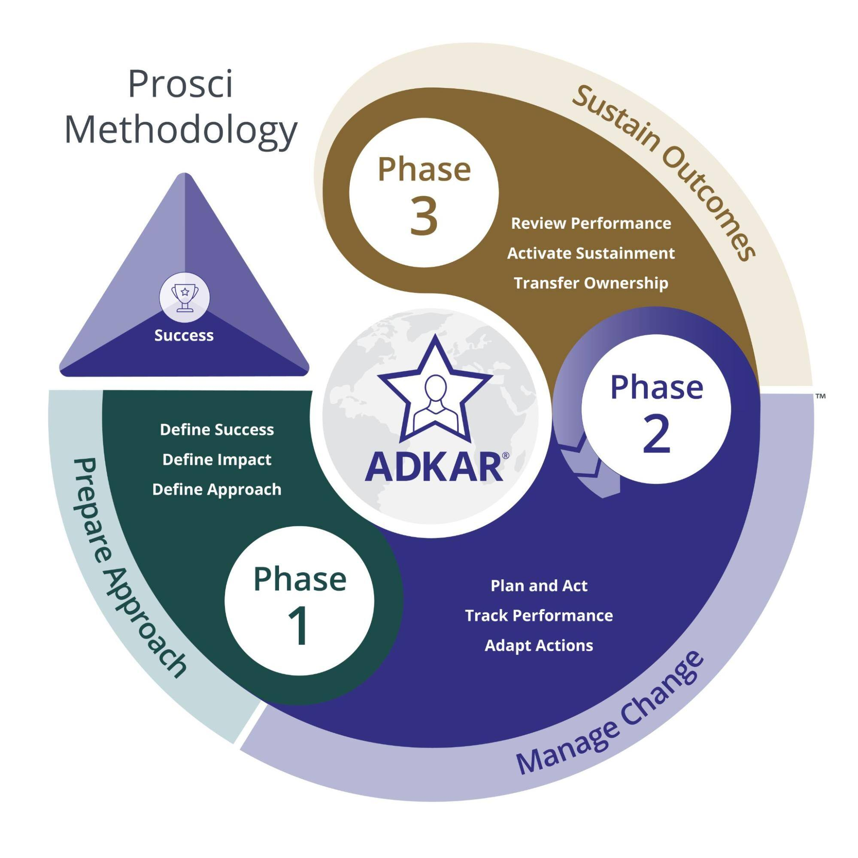
We need Individual change for this organisational change
Does everyone know the why?
Does everyone believe the why?
What if they don't?
A very significant barrier to advancing towards elimination is the myth around seclusion being a means of avoiding harm.
Intervention: 6CS approaches
What needs to change for the impact?
Impact: reduction in RPs
Notes:
Improvement projects fail if there is no understanding of the behavioural and cultural changes needed to support process change, or of the improvement methods needed. We cannot look at it as just this project but instead it is a way of working. I was alerted to pay attention to the missing middle component thanks to Change models. The missing middle asks
Does everyone know the why?
Does everyone believe the why?
What if they don't?
Awareness meets desire
we know there are organisational motivators, community motivators, health motivators but personal practitioner motivation we know is more like apprehension and fear so desire for change is not complete, this needs to be explored with compassionate curiousity and an evidenced based solution.
So that we learn How will these interventions change target behaviours and what are the changes to target behaviours
Next slide

Slide 17
Yarning new stories
David Korten sums up the key importance of stories to systems change when he says: "Change the story and you can change the future.”
Stories shape how we understand the world, our place in it, and our ability to change it;
This shared world has been shaped by institutions, which are based largely just on the stories that we agree upon. We need to face the truth and tell a new story, one where seclusion isn't seen as treatment, or inevitable.
Notes:
We will continue with creating awareness and belief in our leaders promoting a cultural shift
Dispelling the myth that elimination IS NOT a tradeoff for staff safety. Elimination can result in us all being safer when we all journey together, learning as we go, sharing and building collective capacity

Slide 18
LIVED EXPERIENCE LEADERSHIP
Partnering in the PROJECT
Partnering in care
Learning our way to elimination
Reducing seclusion and restraint through consumer partnership
Notes:
Lived expertise leadership is vital in acknowledging the human rights issues and bringing us into compassionate conversations on the moral dilemmas at the heart of these practices and always keeping a focus on the consumer perspective in terms of impact and opportunities for improvement.
Keeping in mind the eight safety priorities from the National safety priorities in mental health: a national plan for reducing harm include Partnering for improved safety, directing us to partner in identifying, avoiding and reducing harm across all environments in which care of people with mental health disorders is provided.
2 potential pathways/streams dually running, first is a Dynamic flowing experimental emerging approach prioritising a partnering approach, curiously seeking to discover a novel way for consumers to keep each other safe and us safe, learning our way to Zero at a project planning and stakeholder engagement level,
Secondly; Advancing action plans in AMHS
Currently scoping and planning for ongoing lived experience engagement whilst scoping strategic responses to the shared priorities

Slide 19
Thank you
Questions?
Jannette.newell@health.qld.gov.au
Kobie.hatch@health.qld.gov.au

