Slide 1
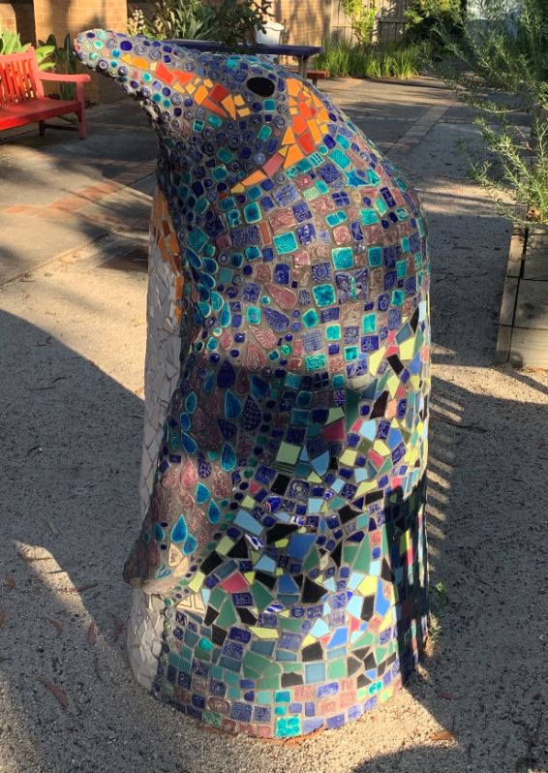



Reducing Restrictive Interventions and the Elimination of Seclusion
The Peninsula Health Story
Notes:
Jaine

Slide 2
Dr. Kerryn Rubin – Clinical Director
Mental Health and Wellbeing Service
Leading Reform Summit 2024
27 November
2025

Slide 3



Acknowledgement of Country
Notes:
LUCY to speak and to add lived experience acknowledgement

Slide 4
Thanks to
Prof Richard Newton – Mental Health Head of Research/Prev Clinical Director
Fiona Reed – Executive Director
Dr Simone Keogh - Head of Adult Psychiatry
Dr Kausik Goswami – Head of Hospital Based Psychiatry
Melissa Osborne – Nurse Unit Manager (prev)
Rebecca Thompson - Nurse Unit Manager (prev)
Janine Davies – Mental Health Director of Nursing (on secondment)
Jacinta Jolly – Health Information Manager
Michelle Shanti – Consumer Consultant
Tessa-May Zirnsak – Research Fellow/Consumer Academic
And team at Latrobe Uni
Our staff, our consumers, and their families/supports.

Slide 5
Why is this Important?
Restrictive interventions
Are not inherently therapeutic, but intended to help keep people safe
Are traumatic for consumers, staff and anyone witnessing the incident
Are a high risk for injuries to consumers and staff
In Victorian a Royal Commission has recommended the elimination of restrictive interventions
Notes:
Janine

Slide 6

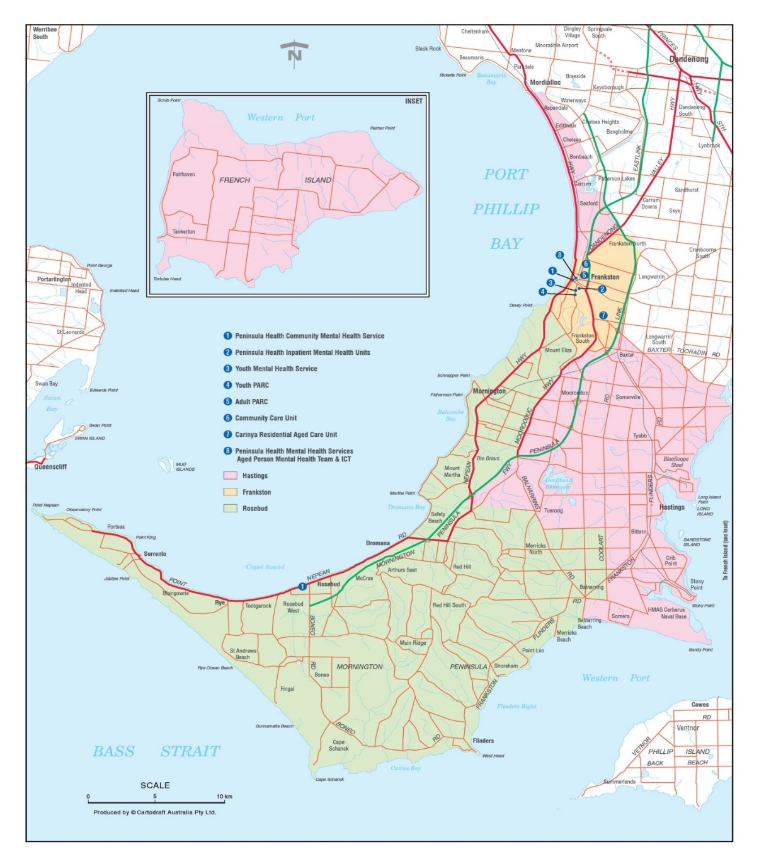
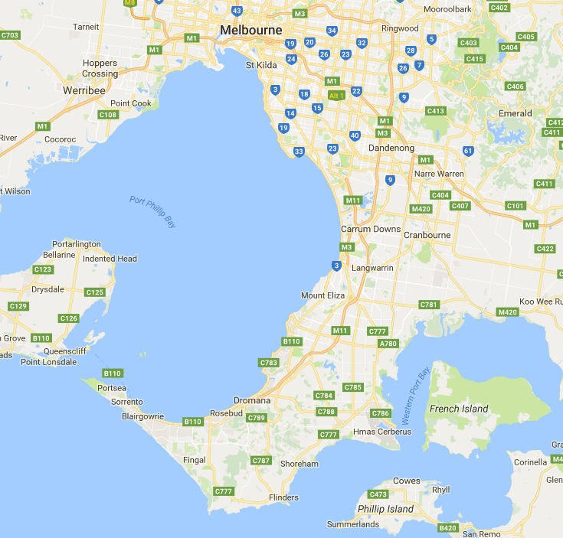
Catchment Area
Notes:
Melissa

Slide 7
Inpatient Services
Acute Adult Inpatient Unit – 2 West
29 Bed Unit
Acute Aged Inpatient Unit – 1 West
15 Bed Unit
Psychiatric Assessment and Planning Unit – PAPU
6 Bed Unit
Notes:
Melissa

Slide 8
The Role of Leadership, Culture, and the Peninsula Health Story
National and Statewide Strategies have lead to relatively minor reductions in the use of restrictive interventions. Why is Peninsula Health Different?
What have we achieved? - Outcomes
6 Core Strategies, the Beacon Project, and Safewards
What do we mean by leadership?
What do we do? From strategy to fine detail.
What role does service culture play in this?
The Future

Slide 9
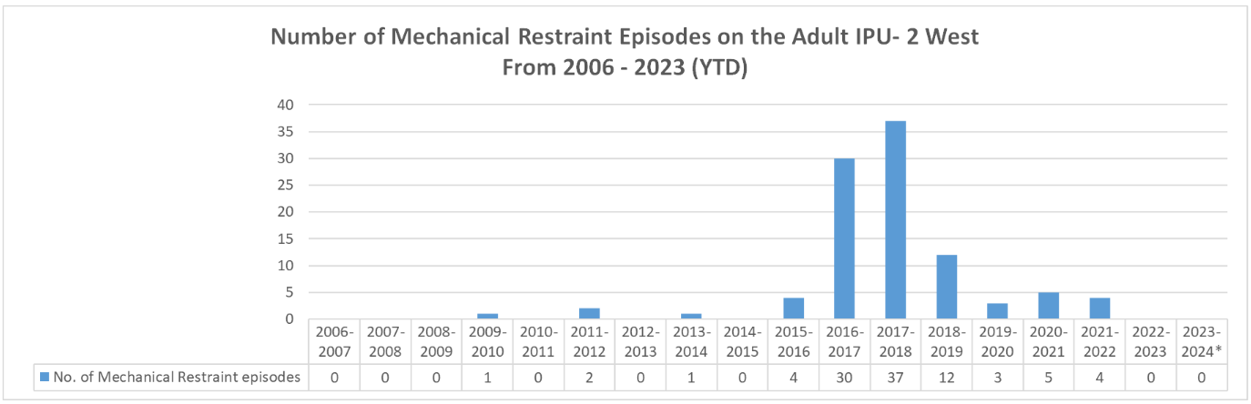
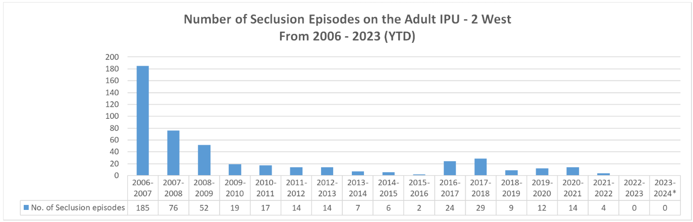
Seclusion/Restraint Data
Notes:
Melissa

Slide 10
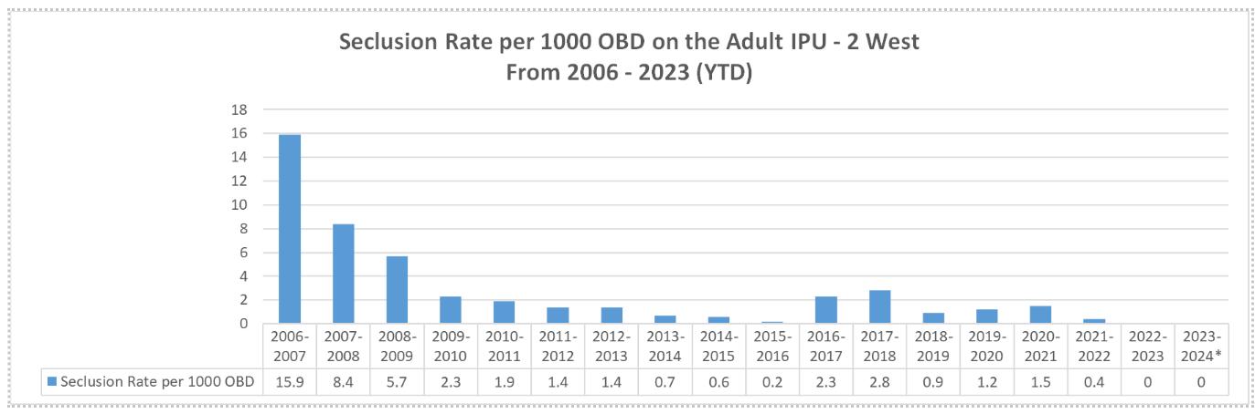
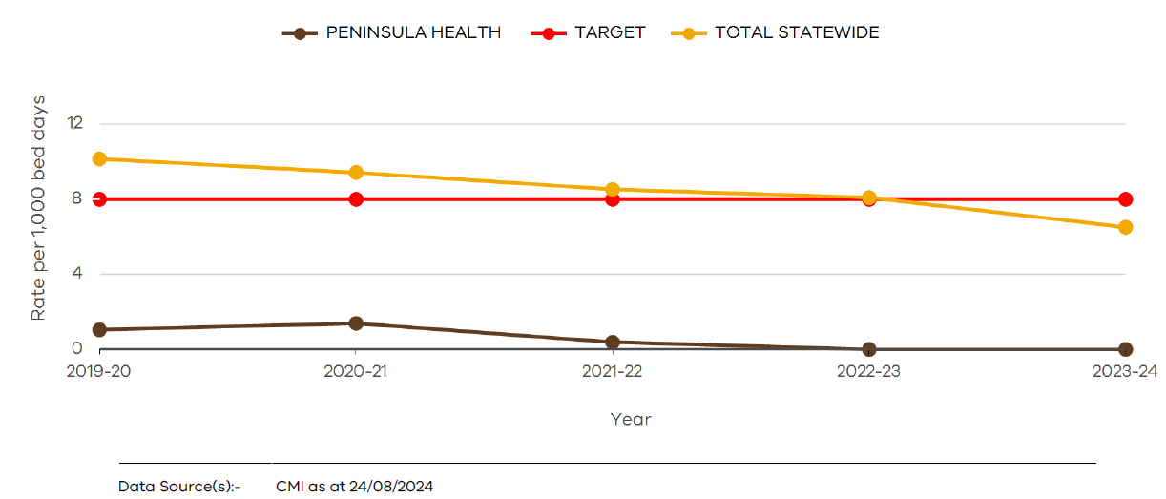
Seclusion Data Continued
Notes:
Melissa

Slide 11
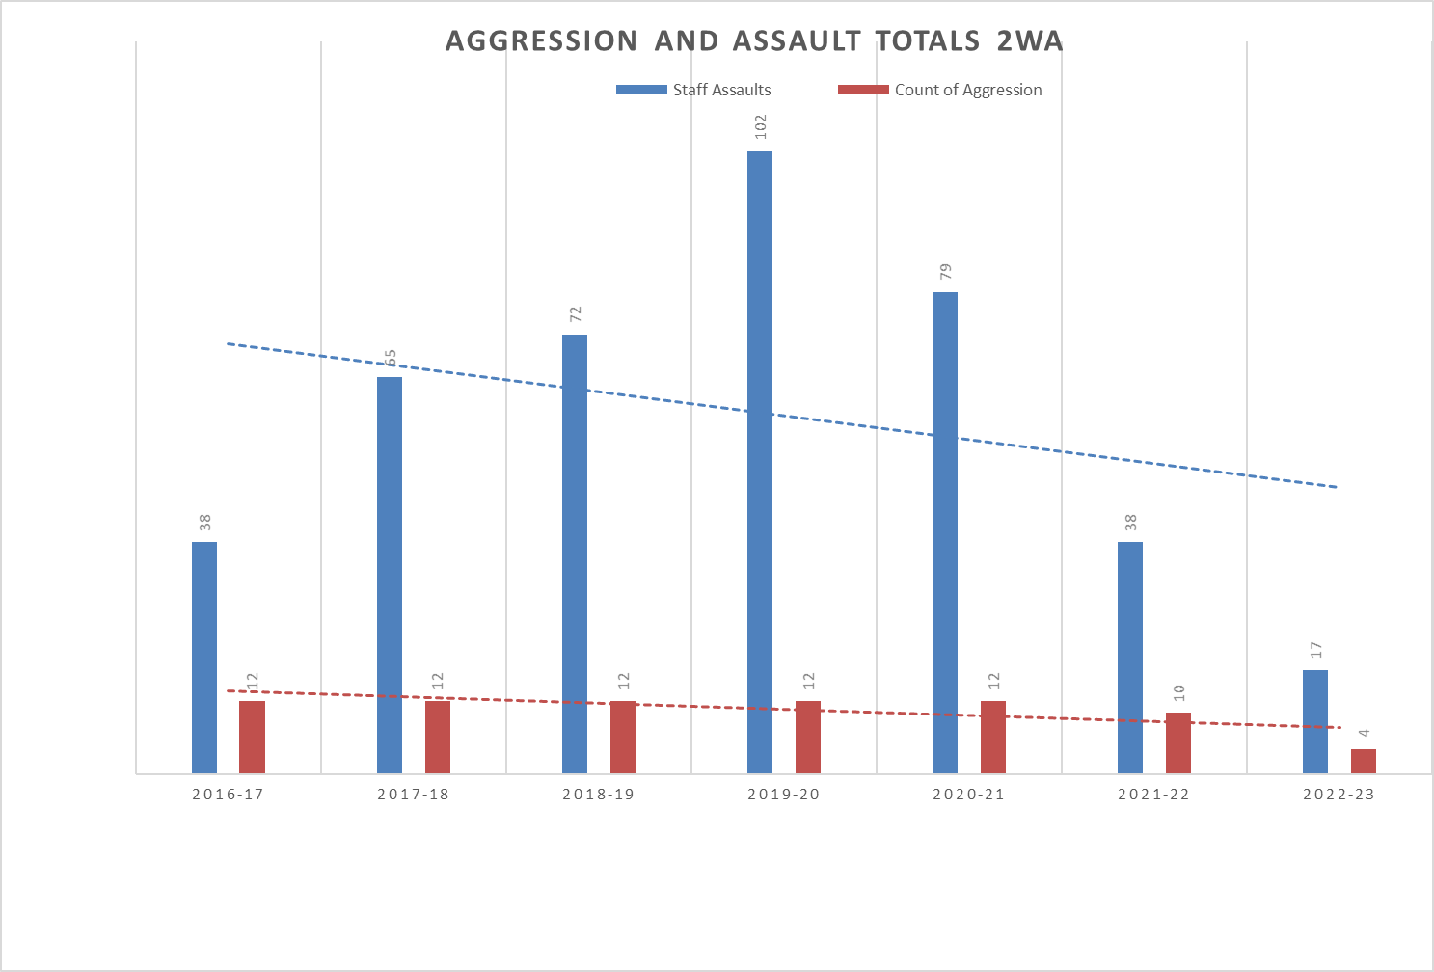
Occupational Violence Data
Notes:
Melissa to talk to

Slide 12

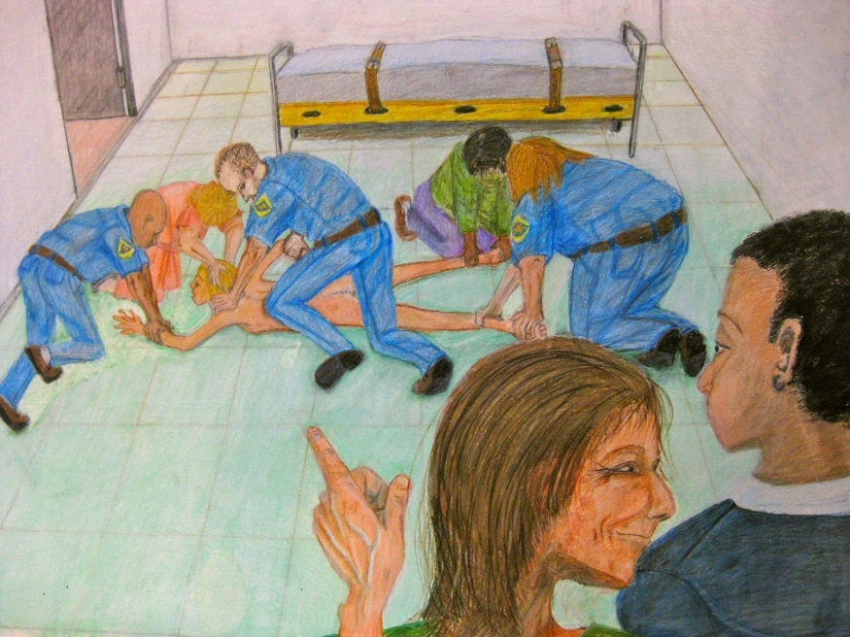
Background
National Plan for the Reduction of Harm 2005
Commonwealth Department of Health and Ageing – Beacon Demonstration Sites
DHS Victoria and Victoria Quality Council
Peninsula Health Reduction Project
Study Tour – USA and UK
Victorian Royal Commission – Recommended Elimination of Restrictive Interventions
Notes:
Melissa

Slide 13
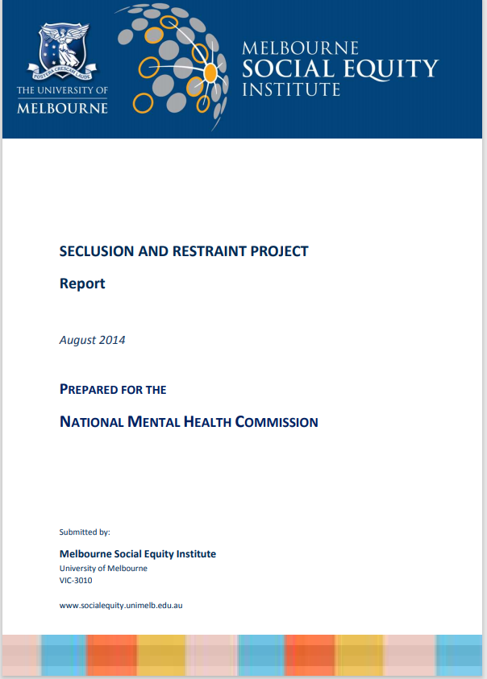

Framework around us
6 Core Strategies
  Leadership toward organisational change
  Use of data to inform practice
  Workforce development
  Use of restraint and seclusion reduction tools
  Consumers’ roles in inpatient settings
  Vigorous debriefing techniques
Safewards
The Mental Health Intensive
Care Framework
Notes:
Leadership needs to reinforce positive change, and support people and the broader system to sustain change.
Leadership is the first core strategy, because without leadership the others do not occur.
The Mental Health Intensive Care Framework
Reflective practices
Clinical supervision

Slide 14
What do we mean by leadership?
Leadership is an action, not a person.
Leadership is not an individual, but a key leader may inspire the leadership group.
Shared vision across senior leadership team.
Formal Leadership structures
Informal leaders
Notes:
Team – Across the whole leadership group, multidisciplinary, with multiple levels. Leadership is not an individual, but a key leader may inspire the leadership group. Shared vision across senior leadership team.
Formal Leadership structures – Ops manager/Clinical Director; program managers, NUM, ANUMs, discipline specific leaders, unit consultants, CNC, Lived experience leaders.
Informal leaders, key advocates for reducing restrictions.

Slide 15
What did we do?
This has been a 17 year effort and has been ongoing and iterative
Broad, multidisciplinary approach – Medical, nursing, OT, Social Work, Lived Experience peer workers, psychology, and security
We listen to and validate staff and their concerns, and are supportive and non-blaming
The role of security
Notes:
Leadership for Culture – sees seclusion as a last resort, which is potentially very traumatic. Each episode of seclusion is viewed as an opportunity to explore and recognise what could be done differently in future to avoid similar episodes of seclusion. It is not “what did we do wrong”. It is an opportunity to think outside the box, and find the next improvement in our processes.
Leadership - helps utilise the data to create a narrative that drives a positive culture of working with people, and minimising restrictive interventions. Data demonstrates that reducing seclusion does not increase assaults on staff. A significant number of assaults occur at the times of utilising restrictive interventions.

Slide 16
What did we do?
We reviewed each and every episode of seclusion as “what could be done differently?” rather than “what did you do wrong?”
There are robust governance systems and restrictive interventions are reported up through multiple levels of daily huddles, up to the CEO. Restrictive intervention reduction is viewed as a whole of service responsibility.
We utilise data to review and understand what is occurring. This has included working with individuals who were more likely to seclude people to help understand what was occurring.
Notes:
Leadership for Culture – sees seclusion as a last resort, which is potentially very traumatic. Each episode of seclusion is viewed as an opportunity to explore and recognise what could be done differently in future to avoid similar episodes of seclusion. It is not “what did we do wrong”. It is an opportunity to think outside the box, and find the next improvement in our processes.
Leadership - helps utilise the data to create a narrative that drives a positive culture of working with people, and minimising restrictive interventions. Data demonstrates that reducing seclusion does not increase assaults on staff. A significant number of assaults occur at the times of utilising restrictive interventions.

Slide 17

What did we do?
Notes:
Leadership for Culture – sees seclusion as a last resort, which is potentially very traumatic. Each episode of seclusion is viewed as an opportunity to explore and recognise what could be done differently in future to avoid similar episodes of seclusion. It is not “what did we do wrong”. It is an opportunity to think outside the box, and find the next improvement in our processes.
Leadership - helps utilise the data to create a narrative that drives a positive culture of working with people, and minimising restrictive interventions. Data demonstrates that reducing seclusion does not increase assaults on staff. A significant number of assaults occur at the times of utilising restrictive interventions.

Slide 18
What do our teams do?
We assess and treat in a timely manner
We have trained staff to be better in recognising early signs of distress, agitation, or deterioration.
We have rapid and responsive escalation processes.
We give people space
We de-escalate
We give people time
We don’t keep people in hospital where risks outweigh benefits
Notes:
Leadership for Culture – sees seclusion as a last resort, which is potentially very traumatic. Each episode of seclusion is viewed as an opportunity to explore and recognise what could be done differently in future to avoid similar episodes of seclusion. It is not “what did we do wrong”. It is an opportunity to think outside the box, and find the next improvement in our processes.
Leadership - helps utilise the data to create a narrative that drives a positive culture of working with people, and minimising restrictive interventions. Data demonstrates that reducing seclusion does not increase assaults on staff. A significant number of assaults occur at the times of utilising restrictive interventions.

Slide 19

What do our teams do?
Notes:
Leadership for Culture – sees seclusion as a last resort, which is potentially very traumatic. Each episode of seclusion is viewed as an opportunity to explore and recognise what could be done differently in future to avoid similar episodes of seclusion. It is not “what did we do wrong”. It is an opportunity to think outside the box, and find the next improvement in our processes.
Leadership - helps utilise the data to create a narrative that drives a positive culture of working with people, and minimising restrictive interventions. Data demonstrates that reducing seclusion does not increase assaults on staff. A significant number of assaults occur at the times of utilising restrictive interventions.

Slide 20
How do our staff and consumers feel about this?
“From my experience using more restrictive interventions leads to further aggression and OV so I am glad we have a RRI approach and we are supported to use creative, less restrictive interventions. It is less traumatizing for all involved (staff included)”
“I feel that the mindset of going 'hands off' for as long as possible has supported my safety.”
“I don’t feel my safety is compromised due to the focus on reducing RI. Instead it has initiated me to be more diligent as a clinician to identify client specific trigger flash points at a early stage and minimise possible future distress stemming from the same.”
“The success is simply based on our consistency and be a team ( nursing & medical & allied health)”
“Being in seclusion felt like a kind of torture. If I am admitted again, I want to get Acuphase as soon as possible, as that helps me settle faster and is much better than seclusion”
Notes:
Whilst we wait for formal ethics approval and ability to talk with clients, I always make it a point to talk to clients as they progress their recovery, asking how can we help, how can we do things better or differently, what they would like to see happen. Improving on small things can avoid the bigger things.
Supporting advanced decision making and working with families

Slide 21
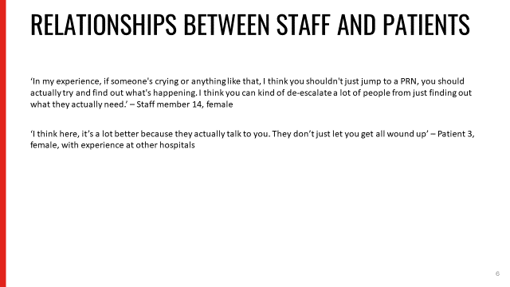
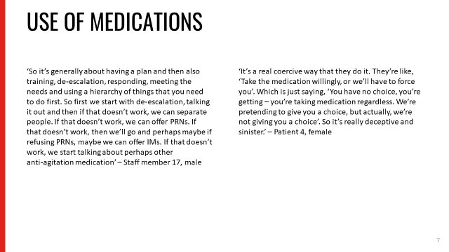
Research Findings
Strategies to minimise Restrictive Practices in Acute Inpatient Services: A Qualitative Study
Tessa-May Zirnsak, Lisa Brophy, Kerryn Rubin, Janine Davies, Catherine Brasier, Richard Gray. 2024 In Press
Notes:
Whilst we wait for formal ethics approval and ability to talk with clients, I always make it a point to talk to clients as they progress their recovery, asking how can we help, how can we do things better or differently, what they would like to see happen. Improving on small things can avoid the bigger things.
Supporting advanced decision making and working with families

Slide 22
The Future
Further research – Partnership with another AMHS to do implementation and generalizability research
Further data breakdown
Extending the reduction of restrictive interventions research to our Emergency Department settings
Development of new models of care/new hospital being built to further reduce restrictive practices (inbuilt research framework).

