Slide 1
Dr Kylie King
School of Psychological Sciences
Monash University

Slide 2
I wish to acknowledge the Turrbal people, on whose land we meet today.
I pay my respects to their Elders, past and present
I acknowledge those who have lived and living experience of suicide
I acknowledge those of diverse gender, who are often misrepresented in research and health care

Slide 3
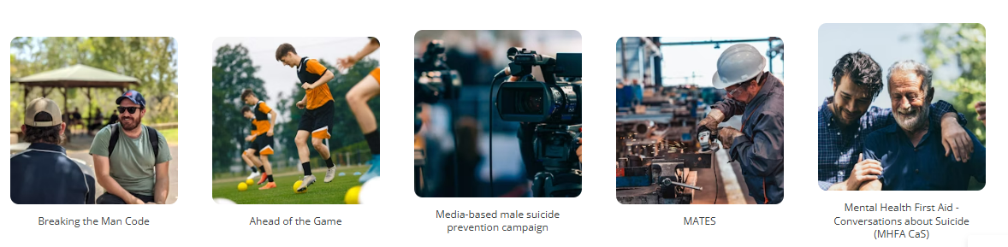
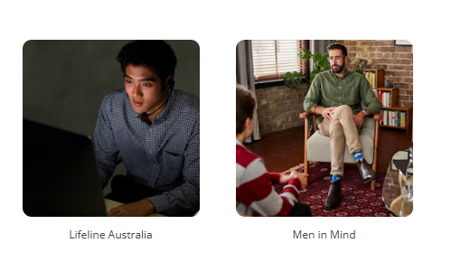
What is the Buoy Project?
7 suicide prevention programs
14 community organisations
5 universities
Funded by the Australian Government
Led by Prof Jane Pirkis

Slide 4
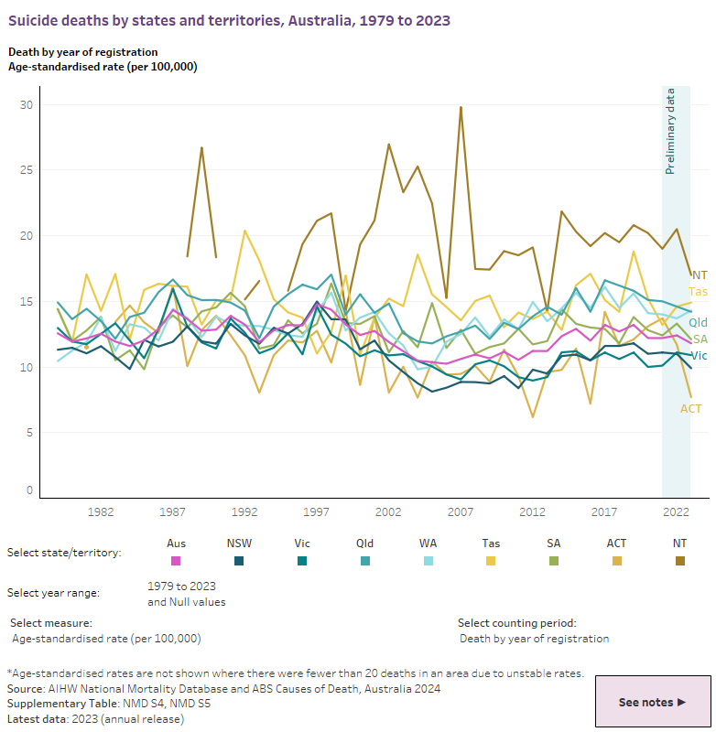
Why do we need the Buoy Project?

Slide 5
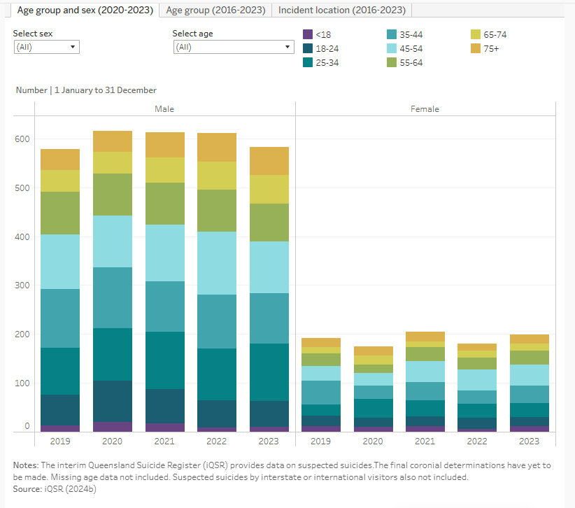
QLD suicide rates by binary gender
https://www.aihw.gov.au/suicide-self-harm-monitoring/data/behaviours-risk-factors

Slide 6
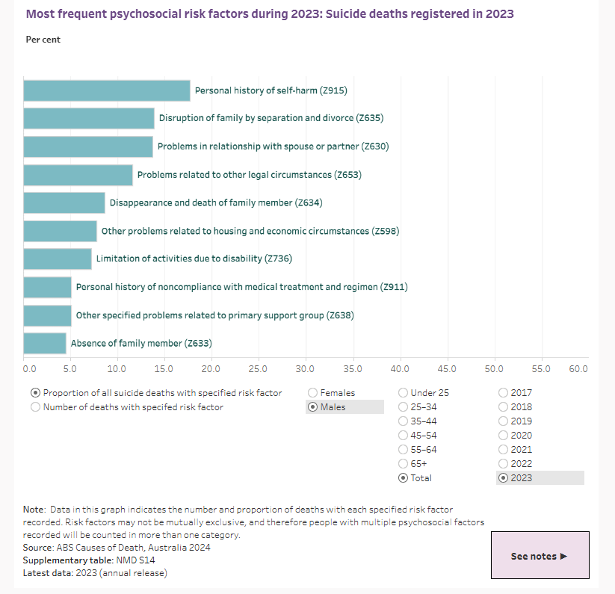
Psychosocial factors in male suicide 2023

Slide 7
Why are suicide rates higher among men?
More lethal means
Acquired capability
Stronger intent to die
Gendered expectations around suicide
Externalising of depression
Aggression, substance abuse, risk taking
Alienates people, reduces help-seeking, increased capability for suicide
Depression not identified by health professionals
Substance use
Increased distress, impulsiveness, disinhibition
Social connectedness
High levels of social disconnection among men
Self-reliance
Help-seeking and unhelpful help
Negative attitudes towards help-seeking
Reduced help-seeking
Masculine norms
Likely underpinning the other factors
Social connection is protective
Unhelpful or ‘feminine’ services
https://www.tandfonline.com/doi/abs/10.1080/00050067.2024.2404116

Slide 8
Suicide prevention
Wellbeing
Addressing key social determinants and building resilience
Universal
(whole population)
Awareness raising, restrict access, responsible media, promote resilience, help-seeking.
Selective
(at risk populations)
Training, detection, diagnosis, treatment
Indicated
(those with symptoms)
Treatment, support, aftercare
Postvention
Responding to those impacted and bereaved by suicide
https://lifeinmind.org.au/splash-page/docs/LIFE-framework-web.pdf

Slide 9
The Buoy Project
Five ‘upstream’ interventions that encourage boys and men to look out for each other and talk to a counsellor or other professional if they are facing challenges
Two ‘downstream’ interventions that aim to ensure that the services available to boys and men are tailored to their needs
2020-2025

Slide 10
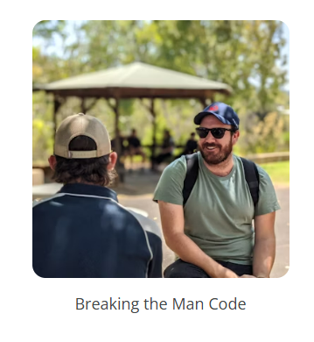
Testing the impact of ‘Breaking the Man Code’ workshops on adolescent boys’ help-seeking, masculinity and suicide risk factors
Tomorrow Man’s workshops aim to challenge potentially harmful masculine norms (the ‘man code’) and promote positive attitudes towards help-seeking among adolescent boys in schools.
1225 boys across 24 schools
No changes in measures of help-seeking or other outcomes
Open-ended questions – increased help-offering and connections with peers, and some barriers to change
https://www.tomorrowman.com.au/

Slide 11
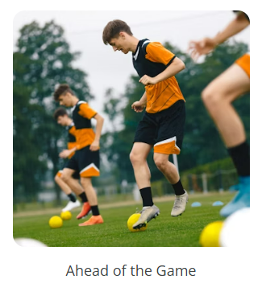
A randomised controlled trial of the Ahead of the Game Program
A program for 12-21 year old males to teach how to recognise mental health problems, what to do about them, and when to get help
92 sports teams with 367 participants
Increases in intentions to seek help from formal sources, resilience, and confidence to provide help
Reductions in mental illness stereotypes
https://aheadofthegame.movember.com/

Slide 12
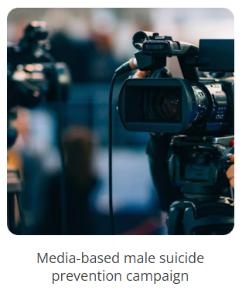
The Boys do Cry randomised controlled trial
‘I think it would prompt some men to reflect on their feelings and how they express them. Even if they can't picture themselves singing to a group it could encourage men to do lower stake things like initiate a conversation with another person and be candid about their feelings.’
‘…needs to be alongside some other approaches also. Any major change to societal norms will take considerable time.’
4-minute video
476 participants
Positive impacts on viewers’ intentions to seek help for a personal or emotional problem
‘It would only have an affect [sic] on those who are open to this kind of message. I can't see it having a dramatic affect [sic] on those that believe in the old-fashioned idea that men should not express their feelings.’
https://youtube.com/watch?v=PMBNYRiBNT8

Slide 13
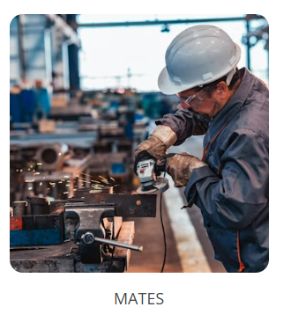
Evaluating the impact of MATES in manufacturing program
An integrated industry intervention program to raise awareness and connect to help.
1523 participants in trial
Interviews - 40 workers, 4 Project Steering Group members, 2 Field Officers
Increased mental health literacy, increased confidence to offer help, some reduction of stigma
No difference in help-seeking
Challenges with real-world implementation
https://mates.org.au/manufacturing

Slide 14
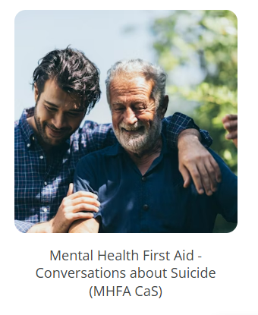
The effectiveness of Mental Health First Aid Conversations about Suicide Course for Men’s Sheds
Four-hour course focussed on recognising and supporting people with suicidal thoughts
211 participants across 20 Men’s Sheds
Increased intention and confidence to support others
Less negative attitudes towards others
https://www.mhfa.com.au/our-courses/specialised-courses/conversations-about-suicide/

Slide 15
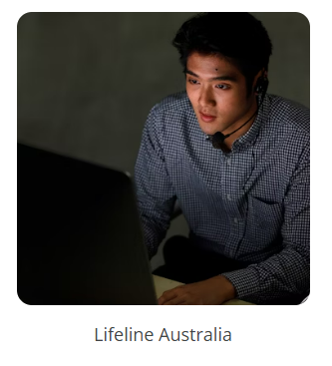
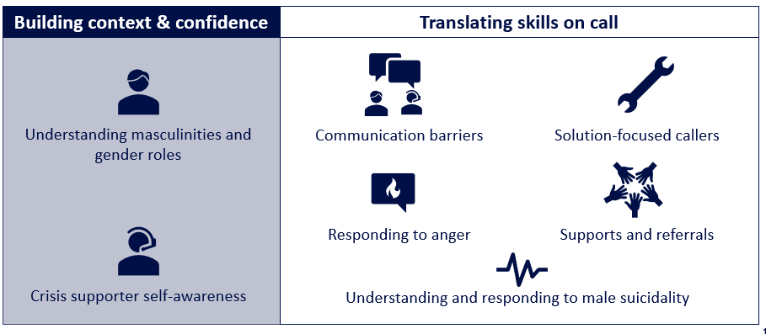
A randomised controlled trial of a specialist service delivery for men calling crisis centres developed with Lifeline Australia
Participants | Target | Recruited
Male-identifying callers | 1,400 | 24
Crisis Supporters | 140 | 239
https://www.lifeline.org.au/

Slide 16
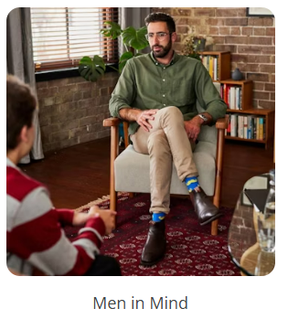
Men in Mind: Preventing male suicide by training clinicians to work better with men
Online, five-module training program for mental health clinicians
587 participants
Increases in mental health professionals’ competency in engaging men in psychotherapy and reported self-efficacy to work with men
https://meninmind.movember.com/

Slide 17
Learnings about male suicide prevention
Awareness raising – about self and others
Addressing psychosocial drivers
Encouraging emotional expression and help-seeking
Increasing social connection
Equip to support each other
Supportive Communities
Accessible and useful services

Slide 18
Challenges for male suicide prevention
Intersectionality and gender diversity
Unequal responsibility for change - individual change isn’t always fair or possible
Supportive friends, families, and communities aren’t always available
Unintended or negative impacts
Working alongside men
Many solutions for suicide prevention are outside of individuals
  Socioeconomic factors, access to means etc.

Slide 19
Thank You kylie.king@monash.edu
https://lifeinmind.org.au/suicide-prevention/collaborations/buoy-project

