Slide 1


Harm minimisation in Australian prisons – the reform agenda
Liz Barrett, Drug Policy Modelling Program, UNSW Sydney

Slide 2








About the harm reduction in prison working group
Notes:
To start – just a note about the harm reduction in prisons working group.
First who or what is the harm reduction in prison working group?. We are a national group of concerned practitioners, researchers, academics and advocates. We currently have 36 members with representatives from every state and territory in Australia and also members in New Zealand/Aotearoa. We’ve been operating since 2019 and are an informal network, so I don’t have a logo or flashy website to share. But here are some logos from some of the organisations involved that you might be familiar with.

Slide 3
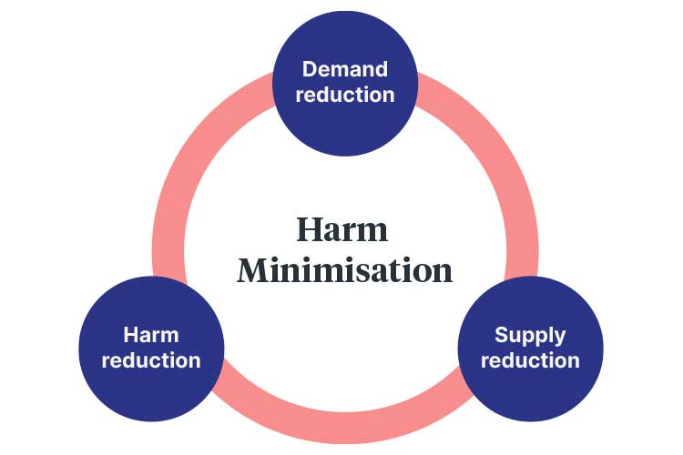
What is harm reduction
Notes:
Harm reduction aims to reduce the health harms related to drug use and injecting drug use, including blood-borne virus infection, drug overdose and injecting injuries. All of these harms are preventable with effective harm reduction programs. But harm reduction is more than preventing harms from occurring. Harm reduction is a practice that supports people to improve their health through non-judgemental support. It supports people where they are, does not require behaviour change such as abstinence in order for people to receive help, and is grounded in principles of justice, human rights and equity. Harm reduction is an approach that is effective at reaching some of the most marginalised members of society who may not otherwise have access to healthcare.
Harm reduction forms one of three pillars of harm minimization within the national drug strategy. The other two being to reduce demand for AOD and reduce supply of AOD
The aim of harm minimisation is to building safe, healthy and resillient communities through preventing, responding and reducing alcohol, tobacco and other drugs related health, social and economic harms.

Slide 4

The need for harm reduction in prison
Had ever injected drugs
n=149
People in prison have much higher rates of injecting drug use than general population
Lack of access to clean and new injecting equipment results in shared use and homemade items
Rates of BBV much higher among prison population than in community
Injecting related injuries and disease
Overdose risk
Injected drugs in the past month in prison
n=63
44%
Shared
injecting
equipment
in prison
n=58
Queensland data on injecting drug use in prison from:
Hajarizadeh, 2024, HCV infection in Australia’s prisons
92%
Notes:
This data on the left is taken from a recent AusHep study undertaken by the Kirby Institute, based on results of a survey of undertaken with 248 people at 4 different prisons in Qld.
People in prison have much higher rates of injecting drug use than the general population with almost half of new prison entrants reporting a history of injecting drug use.
Despite attempts to prevent drug use and supply in prison, the use of drugs, including injecting drug use, remains common.
At same time lack of access to harm reduction and programs and interventions that are available in the community, and the prison environment itself can increase harms
Lack of access to clean, new and sterile injecting equipment is a particular issue, as it leads people to share equipment and also to the creation of homemade injecting equipment using unsterile items found in prison such as parts of spray bottles, pens and lighters.
It will be no surprise to learn that rates of Rates of BBV much higher among prison population than the community. HIV estimated to be about 4 x higher than the general population. Modelling indicates that 23% of all new Hepatitis C infections between 2020-2029 will be through incarceration (Stone et al, 2022).
Injecting related injuries and disease: Skin and soft tissue infections are common among people who inject drugs and can include abscesses, cellulitis and vascular damage, bone and joint infections, endocarditis and sepsis. BBVs have generally got more attention, because of their infectious nature of disesase and potential to harm people outside of the person in prison. However, IRIDS can need urgent care, can be incredibly painful and fatal if left untreated
People who inject drugs hav ea high risk of overdose particularly in the first few weeks post-exiting prison continuing up to 3 months following release. One study In Victoria from 2023 followed 400 people with a history of injecting drug use who were released from prison. Out of those 400. 27 (12%) died and 47 reported non-fatal opiod overdose events (Curtis, Dietze, Winter et al., 2023). While that gives some statistics and perspective on the numbers of people at risk, each one of those numbers was a person, with family and friends and loved ones. Each one is a tragedy. Now with nitazenes in the drug supply in Australia heightened risk of overdose in prisons too. And unfortunatey we’ve witnessed overdose deaths in the UK and Ireland in prison due to nitazenes.

Slide 5

Prison health is public health (AIHW)
>62,000 reception and releases out of prison each year
Hepatitis C elimination targets: prison a key site
Harm reduction improves health and safety for the prison environment, including correctional officers
Notes:
This is a statement from the Australian institute of health and welfare. They note that the prison population is much more disadvantaged, higher healthcare needs than the wider Australian population, including chronic disease, mental health conditions and drug use.
<click> because there are more than 62,000 releases into and out of prison each year, the health of people in prison impacts on and contributes to the broader public health. So while we should absolutely be concerned with trying to provide the best possible care and support to people in prison, this also has broader impacts.
<click>
Good example of this - Australian government has committed eliminating hepatitis C by 2030. And we have lots of national strategies on this and other bbvs.
National strategies for Hepatitis B, Hepatitis C, HIV, STIs and the Aboriginal and Torres Strait Islander Blood Borne Virus and STI strategy and in all of them prison are a key site for intervention because of ongoing transmission. - I’ll talk about this more in the next slide
Final point to make is that Harm reduction is a health and safety issue for the broader prison population including correctional officers. Interviews with correctional officers have noted fears around needle stick injuries received unintentionally when searching rooms. If equipment is being shared by multiple people, no access to new equipment or cleaning products, much higher risk for that equipment to be carrying HCV or HIV than if clean and new equipment available. Puts correctional officers at higher risk of contracting BBVs or being harmed in the event that they do receive a needle stick injury in the course of their work.

Slide 6
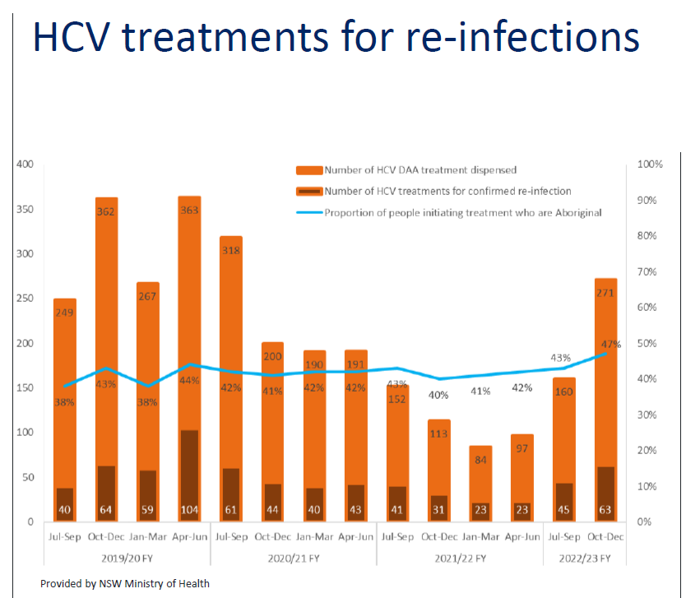
Data provided by NSW Ministry of Health
Notes:
We know prison is a site of infection and reinfection for hepatitis C because people are being treated for it, and then recontracting it
And the reason I’m showing this as there has quite rightly been an effort to scale up testing and treatment, but this graph demonstrates the issues that we’re facing. And that we can’t just band aid ourway out of this – there needs to be preventative efforts
NSW Health have been recording DAA treatment rates since the start and also infections post-DAA treatment and have kindly given me permission to share this information today.
So the orange blocks provide the number of HCV DAAs dispersed. The dark orange bar shows the number of HCV treatments for confirmed re-infection and the blue line is the proportion of people initiating treatment who are Aboriginal (with Aboriginal people disproportionately represented in prisons across Australia).
E.g. in the period Oct-Dec 2022/23 FY, 271 DAA treatments were dispensed, 63 of these treatments were for confirmed reinfection and 47% of all people initiating treatment were Aboriginal. There is real equity issue here as well
Impacts more than just than people in prison. If people contract HCV or HIV in prison and don’t know and are released, they are taking HIV/HCV into their families and communities. And this is a particular issue for rural and remote communities where there may be less access to ongoing healthcare and testing.

Slide 7
What works to reduce harm in prisons?
 | BBV | IRID | Overdose
BBV screening | ✔
Hepatitis A and B vaccination | ✔
HIV and HCV Treatment (PrEP, PEP, DAAs) | ✔
Opioid Agonist Therapy (OAT) | ✔ | ✔ | ✔
Naloxone |  |  | ✔
Needle exchange program | ✔ | ✔
Overdose prevention sites | ✔ | ✔ | ✔
Needle Cleaning agents | ✔ | ✔
Condoms | ✔
Education and information | ✔ | ✔ | ✔
Peer-led education and programs | ✔ | ✔ | ✔
Prison tattoo and piercing programs | ✔ | ✔
Notes:
What works to reduce harm in prisons?
We have a wealth of evidence from Australian and overseas prisons and initiatives in the community to draw from. And guidance from national strategies, world health organisation and consensus statements and guidelines, recommending best-practice based on evidence (including our own consensus statement on harm reduction in prison)
This table provides an overview of a range harm reduction interventions with evidence of effectiveness at reducing different risks.
Some things worth highlighting on this list:
Opioid agonist therapy – traditionally methadone but now includes long acting injectibles. Gives people an opportunity to stop injecting drugs in prison, have access to healthcare and health interventions. Hugely important in terms of blood borne viruses, IRIDs and overdose. Ensuring that people have appropriate transition to community and community prescribers is a really important consideration. Should be consideration of access to initiate treatment while in prison – often only available for those who go into prison with a prescription.
I’m going to talk about some innovations in the harm reduction space in a moment.
Of course how these programs operate can be just as important for effectiveness and impact.
Condoms – are they available in the health service, do people have to ask corrections officers for them? Are they available in a vending machine? Is that machine operational, where is it located?
All of these things can impact the accessibility of the intervention

Slide 8

What is the current state of harm reduction in Australian prisons?
Notes:
So what is the current state of harm reduction in Australian prisons?
The answer to that is we don’t actually know – or at least we only know a bit of what is happening.
The reason for this is that there is no national guidelines and each state and territory does it’s own thing, some of which we know about because it is in policy guidelines, or announcements, and others we don’t.
The other piece to know is that how these harm reduction initiatives are implemented or operate can vary from prison to prison.
What do we know?
There is Opioid agonist therapy in each state and territory apart from the NT (well done queensland for introducing this)
Variety in what is offered. Some prisons moving to long acting injectibles only, others still offer a choice of OAT. Some only allow OAT for those who came into prison already on OAT, others allow people to initiate OAT while in prison. It is not clear if any prisons in Australia offer OAT for people on remand or it is for sentenced people only
No state or territory offers a needle exchange program or a safe consumption site
Needle cleaning agents are available in Victoria and NSW only (at present)
Not sure what is happening with naloxone in exit, or where available in prisons
Queensland is the only states/territory where condoms are not provided in any prisons, although NT did make an announcement saying they would be made available in 2023

Slide 9
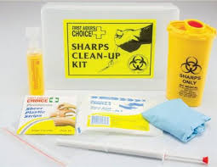
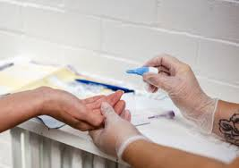


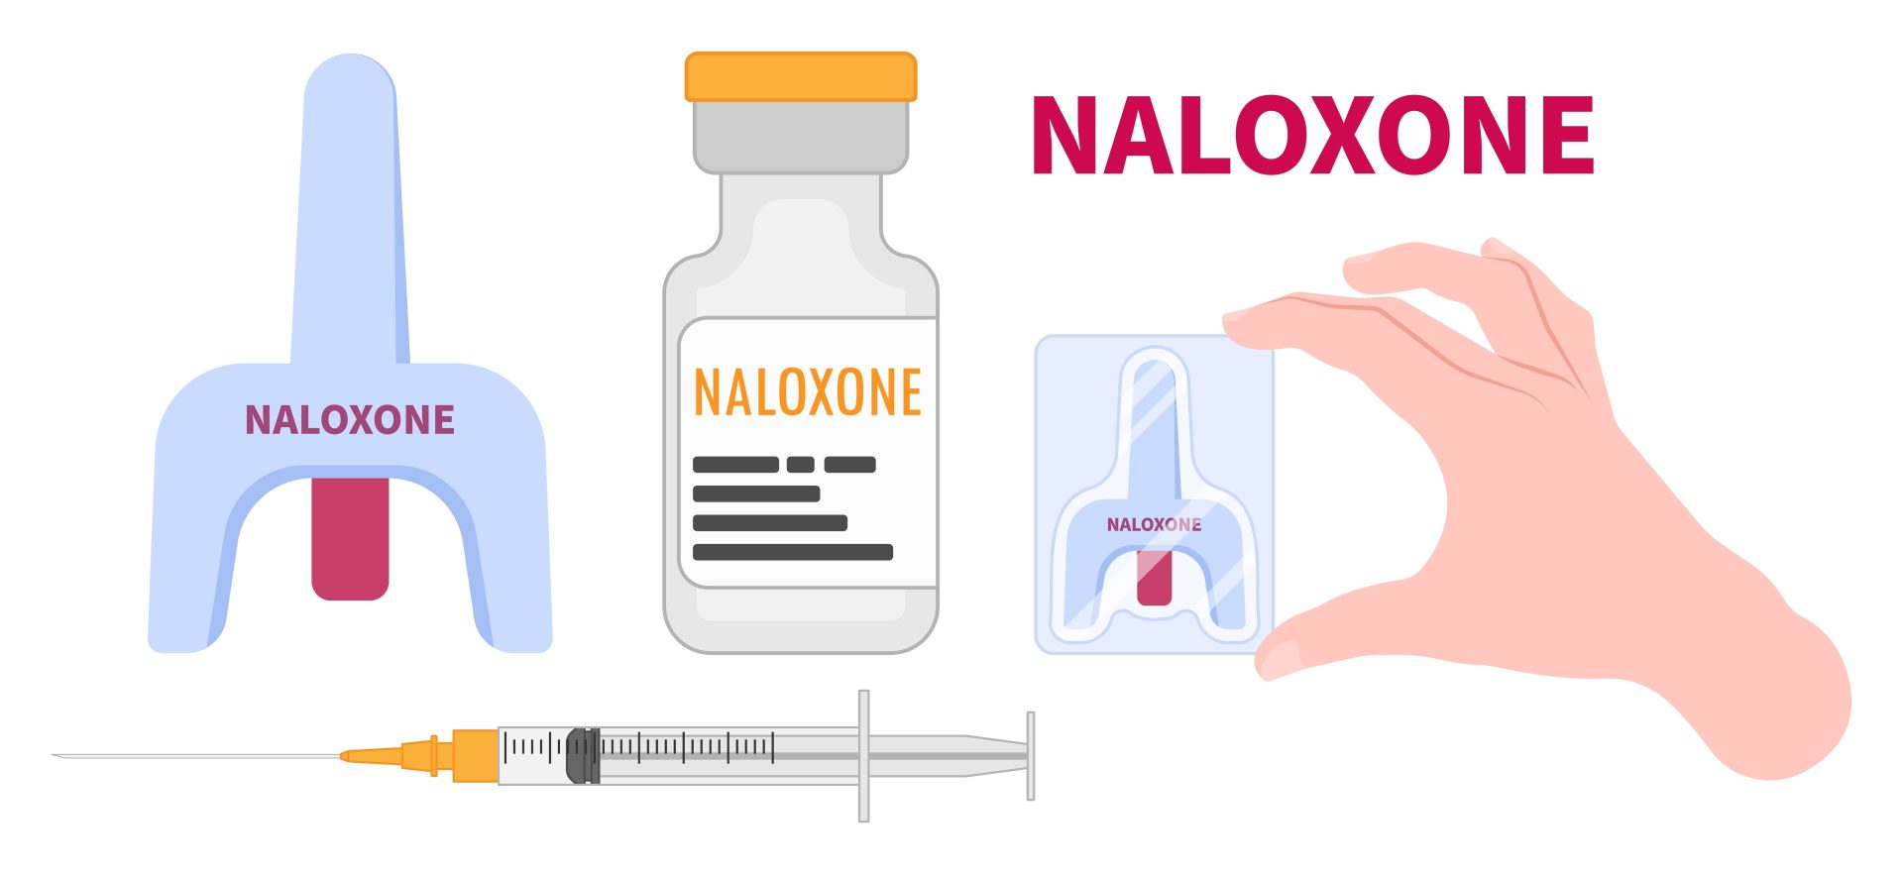
Innovations in Australia
Notes:
Harm reduction in Australia innovations:
Testing and treatment scale up
Point of care testing
Testing that includes HCV, HIV and syphilis in the one test
Testing, treatment blitzes (Kombi clinic)
Peers and peer education and harm reduction
Case study from NSW, but using peer workers, so people with history of injecting drug use and incacertation to educate and train people in prison and training peer harm reduction workforce in prison
Needle cleaning agents
Education and information – whole of prison approach
Accesible information for people in prison
Education and training for custodial officers to better understand challenges of HCV, stigma and drug use
Mandatory AOD training now in NSW for custodial officers
Naloxone
Geoff has spoking about this. There is a national program to get naloxone into exit packs but more needs to be done here. The other initiative is making sure naloxone is available in prisons. At the moment it appears that some states and territories have naloxone available in some prisons through health centres, but as these are only open certain hours, and also access is restricted, naloxone needs to be available more broadly in the prison community including making sure that custodial officers have access. Dealing with overdose and finding someone who has overdosed can be extremely distressing for custodial officers. So really important to equip them with the tools to manage and respond to overdose and this includes training and having access to naloxone as well. NSW are going to be training custodial officers – I think they are the first and maybe only group doing this.

Slide 10
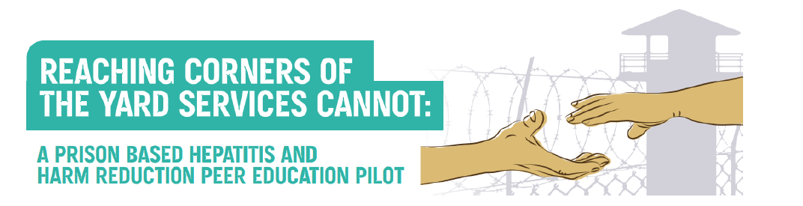

Case study 1: Peer harm reduction in the Yard (PHRY) NSW Justice Health
Aim: To support participants to employ best practice harm reduction strategies, engage in hepatitis c (HCV) services as required and encourage other in the correctional setting to do the same.
Images and information shared with permission from NSW Justice Health
Notes:
NSW JH are running a range of different peer education and research (thanks to them for sharing this slide)
Impetus for this is some research by justice health that dentified that a peer program in which people receive education and support from an individual with lived experience of injecting drug use, may increase engagement and the impact of messages
JHNSW formed a partnership with a NSW based peer organisation, the NSW Users and Aids Association (NUAA) and launched a pilot in 2020
The aim of this pilot was to “Aim: To support participants to employ best practice harm reduction strategies, engage in hepatitis c (HCV) services as required and encourage other in the correctional setting to do the same”
Under the pilot, someone with lived experience of injecting drug use from NUAA provide education in prison to a small group of people in custody through 8, 1xhour sessions. Education was around best practice prevention strategies, engagement in testing and treatment and encourage others at the centre to also get treated
Group participants also worked with NUAA and the Network to plan a Hepatitis C testing and overdose education event for the broader population at the centre.

Slide 11
PHRY outcomes
High levels of new knowledge and skills reported
Evidence of messaging being shared peer to peer
Delivery of peer designed and lead health promotion event: Over a 2 hour access period, 42 people came forward and received a HCV Dried Blood Spot (DBS)
A peer program can deliver education not otherwise available in the system
Images and information shared with permission from NSW Justice Health
Notes:
Outcomes from the pilot included (read slide)
Pilot groups demonstrate good retention and positive feedback (read from slide)
People in prison who use drugs can successfully be engaged to contribute to the design and delivery of clinical and education interventions in prisons.

Slide 12

Case study 2: Learnings from Canada
The Collins Bay Institute in Kingston, Ontario
Notes:
Canada operates prison needle exchange programs and overdose prevention sites at correctional facilities across the country (including Collins Bay pictured).
Overdose prevention sites operate on the same principles as the community based Medically Supervised Injecting Centre in Sydney and Melbourne. Namely, that people who inject drugs, can go to a service and be supervised by health staff while they inject. Medical staff can respond to overdose, and provide additional services including health education and counselling. Which is really important for those people who may not otherwise be connected to health services or treatment (i.e. OAT).
There is an ongoing evaluation of the PNSP program. 2 studies recently published used interviews with custodial officers, healthcare staff and people in prison who inject drugs or have used the PNSP and overdose prevention services.
The overdose prevention services are housed within the institutional health care centres.
Participants use self-supplied substances but all other equipment is held at the service, any equipment and left-over substances being safely disposed of after use by the service.
The purpose of the services is to prevent overdose, reduce the sharing of injecting equipment, reduce the transmission of infectious diseases, reduce skin infections and facilitate referrals to other health care services and programs.
Currently no evidence on impact of these services in prison in terms of BBV transmission– but we know in the community that they are very effective at preventing overdose and for providing health and other social interventions. Sydney MSIC has been operating since 2001. they’ve supervised over 1.28 million injections, managed over 11,000 overdoses and there has not been 1 single fatality. They’ve also provided 22,000 referrals to ongoing care and support.

Slide 13
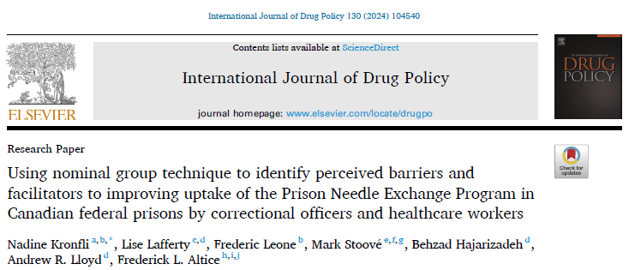
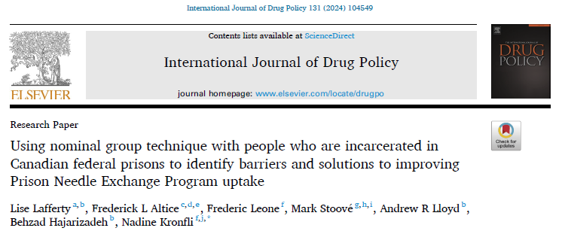

NEXUS study: Prison needle exchange programs in Canadian federal prisons
Notes:
One recent study took place looking at the barriers and solutions to implementation of prison needle exchange programs in Canadian prisons.
one analysis focused on perspectives of prison personnel (officers and healthcare) and one analysis focused on perspectives of people who are incarcerated (including peer advocates and current/previous PNEP and/or OAT participants).

Slide 14

Supervised/safe injection site (Officers, 35%, top voted solution)
Safety injection site. […] And now it makes my job a lot safer. You have a supervised injection site. I know that they haven't OD'd, they're not in the cell laying there dying. So, when I do my round, everything should be good. And I'm not going to get stuck with a needle because everything's controlled. (Officers, Prison 5)
External responsibility (PNEP/OAT users, 32%, top voted solution)
Directly to healthcare staff, so CSC [Correctional Service Canada] knows nothing about it, or […] to have a dispensing facility where you can just go and pick them up anonymously […] like where you would get your methadone or something from healthcare (PNEP/OAT user, Prison 2)
Notes:
What did they as people – what was this a response to?
What was interesting from the officer perspective was the top voted solution was for an overdose prevention site <quote>
While people who are incarcerated also saw benefit of OPS, they didn’t fully rate it as a top solution for enhancing PNEP access. <Click>
This demonstrates that overdose prevention sites are credible options for prison environments that have some support from custodial officers. It also demonstrates that including people in prison who use drugs in program design can make programs more accessible and appropriate.

Slide 15
Challenges and opportunities
There are a range of different harm reduction tools available
How programs implemented and program design fundamental to access and effectiveness
People in prison can and should be involved in program design
Evidence shows harm reduction interventions can improve safety for everyone
Need better monitoring and publication of research on infection, reinfection and harm reduction program provision
Notes:
*Famous quote from Eleanor Roosevelt “what gets measured gets managed” so understanding the scale and particular types of harms, as well as getting a handle on what is being provided and where there are gaps is a good first starting point.

Slide 16
Acknowledgements
Lise Lafferty, Centre for Social Research in Health, UNSW
Behzad Hajarizadeh, Kirby Institute, UNSW
Tracey Brown, Justice Health NSW
Katherine Tree, Justice Health NSW
Tom Wright, Justice Health NSW
The Harm Reduction in Prisons Working Group
Liz Barrett
Liz.barrett@unsw.edu.au
@DrugPolicy_Dpmp

