Slide 1
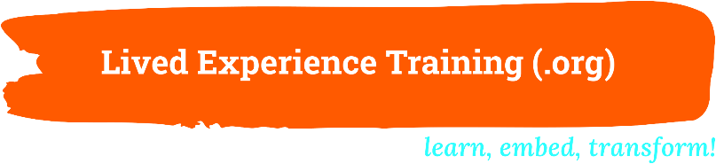
Why Reform requires meaningful Lived-Living Experience Leadership and how to enable it
Dr Louise Byrne
Notes:
NEXT SLIDE

Slide 2
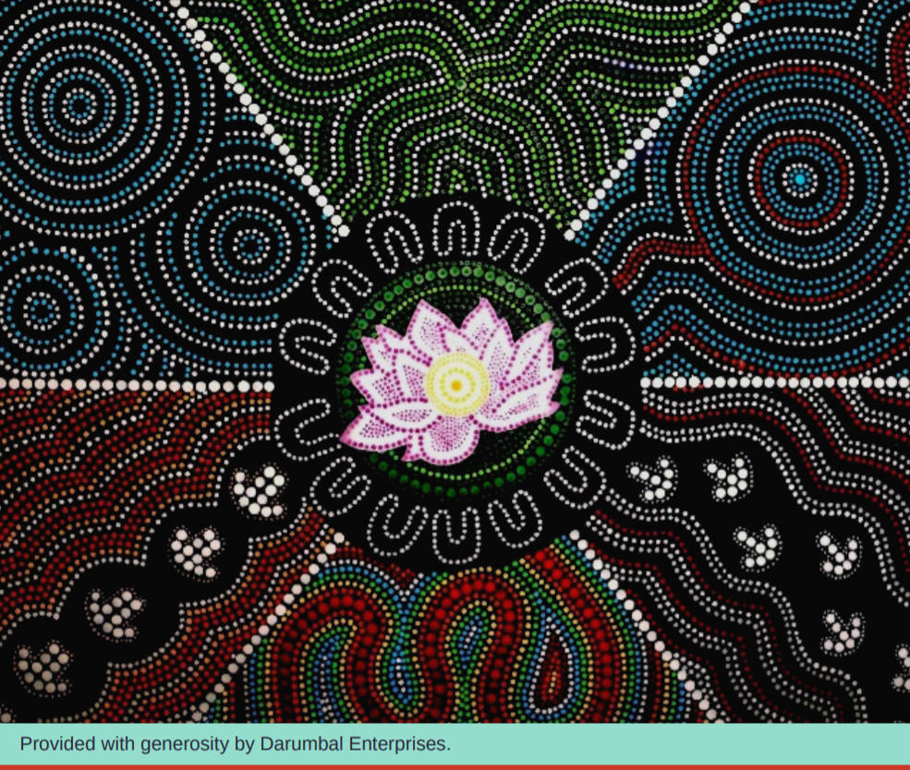
Notes:
I would like to thank AUNTIE OR UNCLE …. And acknowledge the Jagera people and the Turrbal people as the Traditional custodians of the unceded lands upon which we are meeting.
I pay my respects to Elders past and present and thank them for their cultural knowledge and deep connection to land, sea and community. I pay my deep and heartfelt respect to these essential leaders and thank them for their guidance. Always was, always will be, Aboriginal land.
I would like to recognise all the folk attending who have their own significant lived experience and pay respect to the giants who came before us, blazing these trails and upon whose shoulders we now stand.
I am a middle-aged woman of medium height and weight with long brown hair, light skin and black framed glasses.
NEXT SLIDE

Slide 3
Lived-Living Experience Workforces
Personal/
consumer
Family/carer/
supporter
Multiple Perspectives
Notes:
Lived-Living experience communities have a firm commitment to honouring multiple perspectives, including the terms we use. Language in this space is evolving rapidly and will continue to change over time. Consequently, there are different key terms favoured across diverse settings, including the terms Lived Experience and Lived-Living Experience which are variously used to describe both past and current challenges with adversity and healing. In my work I use a variety of terms depending on the preference of the setting and due to the mixed company, will switch between some popular options today.
NEXT SLIDE

Slide 4
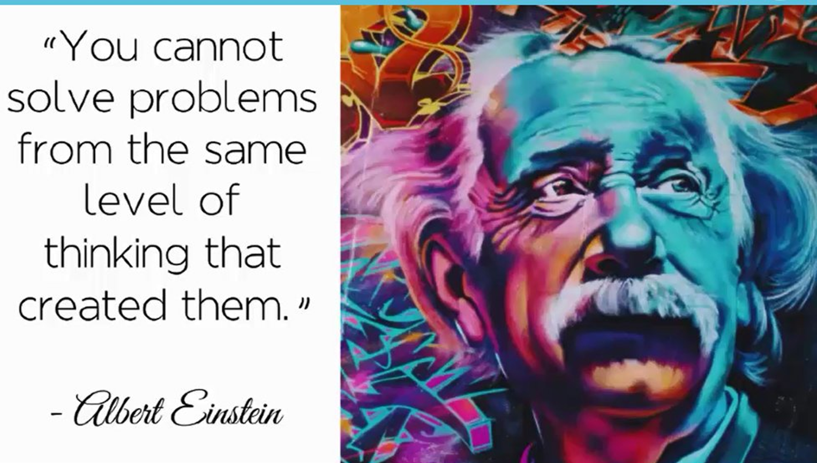
Notes:
Now it’s time to buckle up folks – this is a whistle-stop tour of 15 years of research findings in just over 15 minutes…
I’m sure you’re all familiar with the reform agenda increasingly emphasising the need for transformational change within service systems and the crucial role of lived experience in achieving this aim.
But why is Lived-Living Experience so important to effective transformation and reform? Well, if we do what we’ve always done, we’ll get what we’ve always gotten. Or in other words: “We can't solve problems with the same kind of thinking we used when we created them” and what Lived Experience provides of course, is a different and uniquely informed kind of thinking: based in practical, experiential and applied knowledge, and therefore adds a relevant, fresh perspective to the design, development and delivery of services.
NEXT SLIDE

Slide 5
Lived Experience workforces (employed in designated roles)
facilitate meaningful participation for…
People accessing services
Family, friends, carers/supporters and significant others
Notes:
However, while all types of lived experience are valuable and contribute to more effective service design, it is the designated Lived-Living Experience workforces that provide advanced understanding of collective perspective and practices.
Importantly, and this is key - adequately resourced and supported designated Lived-Living Experience roles help facilitate meaningful opportunities for consumer and carer participation at all levels of empowerment, which in turn provides opportunity for more meaningful impact.
NEXT SLIDE

Slide 6
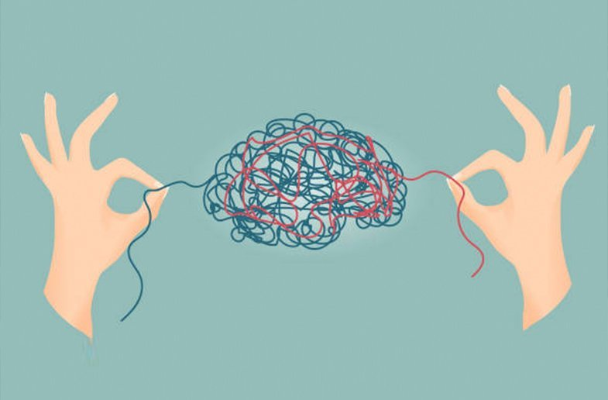
Why can’t we just engage with personal/consumer and family/carer/supporter representatives?
Notes:
Designated Lived-Living Experience roles are needed to facilitate meaningful consumer and family/carer participation due to the fundamentally unequal power differentials between service providers and people accessing services.
People in designated Lived Experience positions are informed and trained to participate fully in co-production, with honed ability and confidence to contribute to service design, delivery, evaluation and decision-making in equitable ways.
NEXT SLIDE

Slide 7
Lived Expertise informs Lived Experience work
Individual Experience
Collective Experience
+
Lived Expertise
=
Notes:
Further, Lived-Living Experience roles provide a level of knowledge that goes beyond individual experience alone.
Lived Expertise is a built knowledge derived from both individual and collective experiences and impacts
NEXT SLIDE

Slide 8
Individual Experience
impacts of specific experiences
e.g.: particular types of service use or inability to access services
intersectional issues
including… culture, background and identification
Notes:
Knowledge and understanding gained by individual experience includes the impacts of specific experiences e.g.: particular types of service use or diagnosis, and intersectional issues such as culture, identification or disability.
NEXT SLIDE

Slide 9
Collective Impacts/ Experiences
impacts of diverse experiences
that are common for people with lived experience
e.g.: social isolation, marginalisation, discrimination, trauma
Assists to:
- build rapport with folks accessing services
- increase understanding and empathy of others
Notes:
Collective experience and impacts also contribute to Lived Expertise and refer to the impacts of diverse types of experience that are common for people with lived experience, for example - social isolation, marginalisation, discrimination, loss of income or status, trauma, and loss of and regaining of hope. The ability to deeply understand and articulate impacts of common experiences assists in building rapport with folks accessing services and increases the understanding and empathy of others who haven’t had those same experiences.
The Collective experience also includes the collective thinking and evidence base that’s been generated by Lived-Living Experience communities internationally over many decades, which helps us to refine and define our underpinning values, perspectives, and practice.
NEXT SLIDE

Slide 10
Lived Expertise is distinct from other professions…
With unique values, principles and ways of working
Notes:
Lived Expertise is a distinct discipline, informed by a set of values, principles and practices that are uniquely developed from experiential learning and an emphasis on human rights and systems change.
NEXT SLIDE

Slide 11
Not just Having lived experience but…
How we use the learning from our Lived Expertise
to Benefit Others
Notes:
Lived Expertise draws from the collective knowledge base and applies both individual and collective knowledge for the benefit of others.
NEXT SLIDE

Slide 12
People in Designated Roles
holding positions of authority
can contribute equitably
influence decision making
and contribute to structural change
Notes:
There are different informing role types as well as specialisations that increase the relevance and validity for people from diverse backgrounds, cultures, identifications and experiences. Lived-Living Experience roles also have many functions and position types.
People in senior or leadership Lived Experience roles must hold deep discipline knowledge, like any other profession, and in positions of influence, drawing from that knowledge can ensure authentic Lived Experience perspectives have real impact.
NEXT SLIDE

Slide 13
the unique Values and Practices of Lived-Living Experience
Explain the importance of designated roles
We need to hold onto our professional identity
Without competing priorities
From a whole other profession or job role
Notes:
While the value of people with lived experience across non-designated positions is warmly acknowledged, designated roles allow fidelity to the discipline of Lived Expertise, without competing priorities from another profession or discipline lenses.
This then allows Lived Experience principles and practices to be best represented and implemented.
NEXT SLIDE

Slide 14
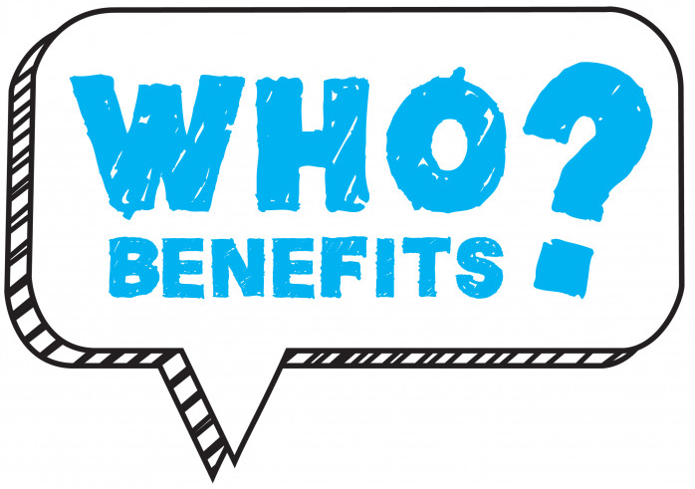
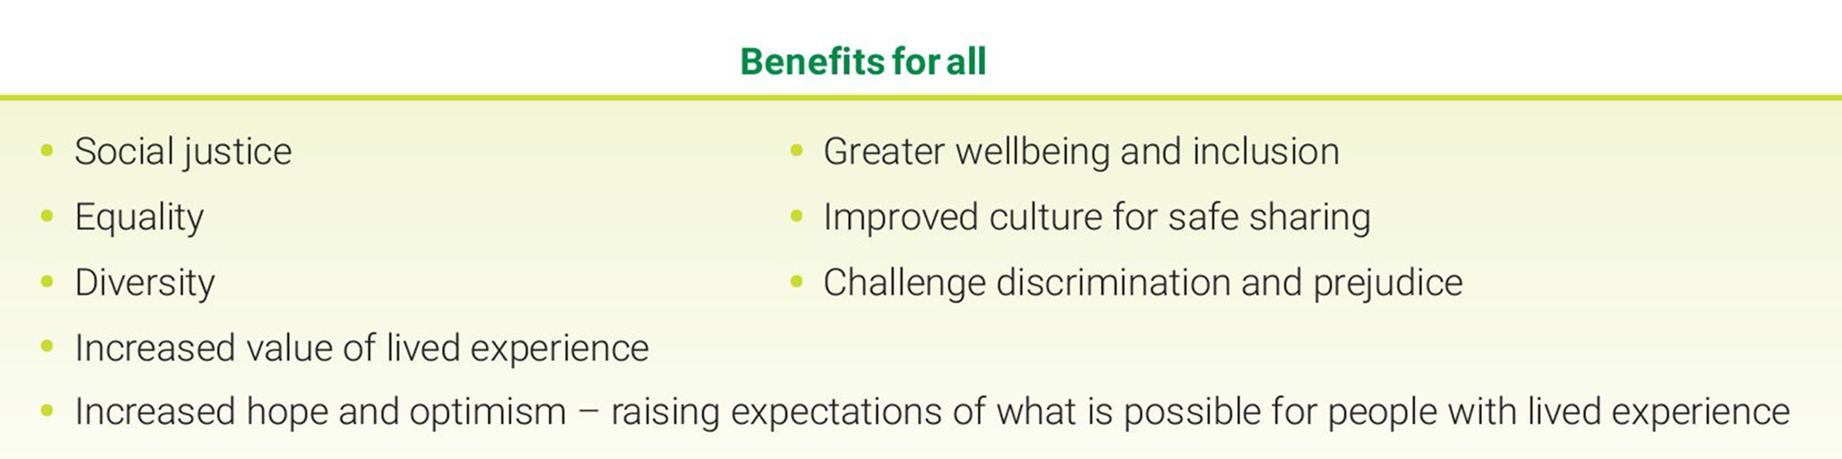
- People Accessing Services
- Organisations and Colleagues
- Families, Carers and Social Networks
Notes:
The benefits of well-supported and designed Lived-Living Experience workforces are broad and deep. I will now skim the surface of a few key areas that relate to how Lived Experience roles contribute to reform efforts.
NEXT SLIDE

Slide 15

Lived Expertise…
‘Super’ good at understanding and promoting personal recovery and person-directed approaches…
Notes:
Concepts of personal recovery are still relatively new to health professions and the service system. Whereas personal recovery was first devised and championed by people with lived experience in the 1800s. Lived experience roles exemplify recovery and promote increased recovery understanding and engagement throughout the organisation.
The concepts of personal recovery that might seem fuzzy to people who haven’t walked the journey themselves, are very real and have been learned directly by people with Lived Expertise, who understand the ‘inside’ stuff that happens on someone’s journey of healing.
NEXT SLIDE

Slide 16
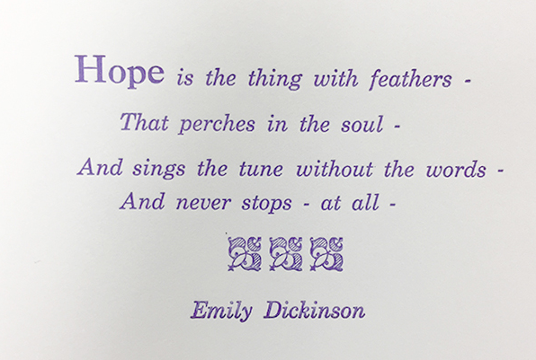

Notes:
Belief is a core concept of Recovery that is slippery to grasp. Designated Lived Experience workers understand the role of belief in healing and how to assist others to believe. They can help supporters and service providers to understand how their belief could be the most valuable thing they give to someone in crisis.
Even if we have to re-visit difficult times again and again, and many of us do! People in designated roles are proof that you can get back on the horse time after time and learn skills to handle feelings that may have seemed impossible during crisis. Without hope, there is no real motivation to try, and personal recovery is therefore much less likely. Lived Experience roles often inspire hope, just by showing up.
NEXT SLIDE

Slide 17

Notes:
Lived experience roles are successful in the engagement of people who historically avoid services or have had negative service experiences, as well as providing valuable assistance in ‘navigating’ the often-complex service system.
Designated lived experience roles are necessary because they challenge stigma towards people accessing services by being out and proud with their own experiences. These findings correspond with the significant body of work, led by Professor Pat Corrigan in the US, on stigma reduction and the essential role of people with lived experience. Going forward, research shows us, this can contribute to creating more psychologically safe and accepting work culture for all staff.
NEXT SLIDE

Slide 18
Build psychologically safe work culture for all staff and consequently people walking through the door
- Lived and Living Experience facilitated support spaces
- Lived and Living Experience led training on use of personal story
- Lived and Living Experience perspectives and safe disclosure in policy
Notes:
If supported and respected Lived-Living Experience roles can promote a workplace culture where it’s safe for workers in other roles to disclose and be accepted by colleagues and supervisors.
This is particularly important because we are kidding ourselves if we think the discrimination and stigma that does still exist in our service system doesn’t filter down and compromise how safe our service environments consequently are for people walking through the door.
Until and unless we eliminate these attitudes completely, we will not, and we cannot fulfil the mandate of the reform agenda.
NEXT SLIDE

Slide 19
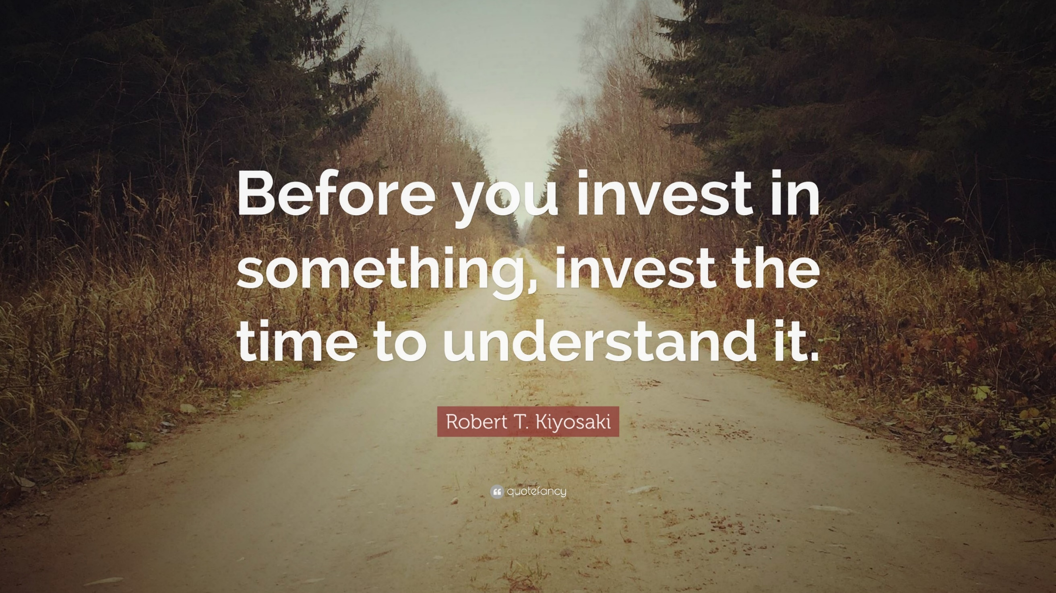
Notes:
So we’ve heard that Lived Expertise is a discrete discipline and building Lived-Living Experience Workforces can provide a multitude of benefits, particularly to progressing reform. But! Before the benefits we’ve outlined can be realised in a meaningful way, Lived Experience workforces must be well understood, accepted and respected.
Senior and executive Leadership – people like yourselves, understanding and consequently valuing authentic Lived Experience perspectives and practice is key to fostering this understanding and respect.
NEXT SLIDE

Slide 20

Notes:
I want to zero in for a moment on the term ‘authentic’. What we often see are Lived-Living Experience roles being asked to shrink and ‘fit into’ the existing system, to modify our practice to align with what is already being done by other professions. This of course disenables the kinds of transformative change that can occur when Lived-Living Experience practices are embedded within services and systems and intentionally used to contribute to the reform agenda.
So, it’s not enough to build Lived-Living Experience workforces, senior leaders and others need to also understand and value authentic Lived Experience perspectives to reap the potential benefits.
NEXT SLIDE

Slide 21
Understanding and Commitment
Exposure
Actions to develop LLE Workforce
Increased Understanding of authentic LLE work
Increased Leadership Commitment
Higher Perceived Value
Adapted from: Byrne, L., Wang, L., Roennfeldt, H., Chapman, M., & Darwin, L. (2019). Queensland Framework for the Development of the Mental Health Lived Experience Workforce. Queensland Government: Brisbane.
Notes:
How senior leaders can gain this understanding and valuing is via exposure to authentic Lived-Living Experience work and concepts.
When a process of understanding Lived Experience work is undertaken, research demonstrates exposure leading to increased understanding, which in turn leads to a higher perceived value for the workforces, inspiring increased leadership commitment and importantly, actions taken to develop the workforce and protect its authenticity.
Strategies to increase exposure and understanding centre on building Lived-Living Experience literacy and relationships with Lived Experience leaders, LE-led organisations and services, and referring to Lived-Living Experience-led research and industry documents.
NEXT SLIDE

Slide 22
Whole of Workforce
Understanding promotes
Authenticity/
fidelity to discipline
Demonstrated Valuing
Increased Philosophical and Financial Commitment
Centrality of lived experience
and Lived-Living Expertise
Respectful and safe workplace culture for all
Mutual understanding and respect
Notes:
In addition to increased understanding and valuing from senior and executive leadership, to embed Lived-Living Experience workforces there is likewise a need for whole of workforce understanding to develop effective collaboration.
Fostering a whole of workplace culture that accepts and sees lived experience and Lived Expertise as valuable and essential to the core business, is foundational to creating safe spaces for people accessing services, their family, friends, supporters and significant others.
Proactively fostering both top down and bottom-up support and intentionally providing opportunity to build mutual understanding and respect between all role types embeds effective collaboration and co-production.
Whole of workforce understanding also contributes to organisational policies and processes that support authentic Lived Experience work and help maximise the potential benefits of the work while reducing psychological hazards for Lived-Living Experience workers and others.
NEXT SLIDE

Slide 23

Building Lived-Living Experience Literacy
Use credible Lived Experience Sources
Foster whole-of-workforce understanding
Highlight the benefits when LLE is well understood and supported
Test and challenge assumptions
Enlist allies
Notes:
Research tells us, to create and maintain a work culture that genuinely values lived experience and Lived-Living Expertise, whole of workforce literacy to develop foundational, shared understanding of Lived Experience concepts and work is essential for all staff from orientation on and periodically needs to be revisited.
When whole of workforce literacy building or training is implemented, care should be taken to make sure it’s Lived Experience led and effective. Effective literacy uses credible Lived Experience sources, builds shared understanding, highlights the benefits of the work, tests and challenges assumptions and aids in enlisting allies.
In addition to fostering a workplace culture that better understands and values the work, literacy for and about Lived-Living Experience workforces also assists to overcome a number of common attitudinal barriers.
NEXT SLIDE

Slide 24

Overcoming Common
Barriers
Notes:
Misconceptions and/or less effective earlier experiences with Lived Experience contributes to significant attitudinal barriers and has put some people off the idea of lived experience work. Literacy addresses the myths and informs on the progress that’s been made in understanding how to design and develop Lived-Living Experience workforces effectively.
Literacy also acknowledges that discriminatory attitudes do still exist and while Lived Experience roles are a powerful way to challenge negative beliefs, Lived-Living Experience workers are also exposed to the attitudes they’re challenging. Good understanding of the roles and championing from management and colleagues, alleviates the professional isolation some Lived Experience workers face and fosters mutual understanding and respect, to create opportunities for multi-disciplinary and inter-disciplinary collaboration that significantly benefits people accessing services and their supporters.
NEXT SLIDE

Slide 25
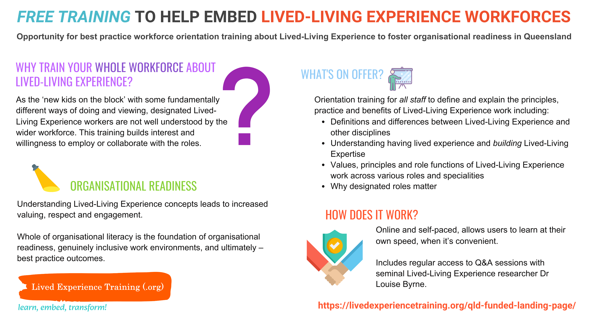

Notes:
Which brings us to… You may have noticed the colorful flyer on your seat. On the screen is a snippet of some of the information provided on these flyers and the reason you have them is, the Queensland Mental Health Commission has risen to the challenge of increasing whole of sector and cross-sectoral literacy for and about Lived-Living Experience workforces by funding access to the training developed by my team and I, that encapsulates key findings of the same 15 year body of internationally recognised and applied Lived Experience led research I’ve just been describing, and was the evidence base for numerous key policy documents and initiatives including the Queensland Framework for the Development of the Lived Experience Workforce, the National Lived Experience (Peer) Workforce Development Guidelines and many others across a broad range of sectors, specialisations and countries.
SAME SLIDE NEXT PAGE
Importantly, in addition to ensuring people participating in the research and verification of findings provided strong representation from various sectors and settings there was also a strong focus on diverse and intersectional perspectives. The research team itself included people who could authoritatively represent diverse cultures/backgrounds, identifications and experiences, and did so in other professional contexts.
This inclusion from concept design through all stages of development and evaluation, truly embeds diverse and intersectional views in the findings of the research and within the training.
Eligible organisations include any relevant sector or service type based in Queensland, including: AOD, harm reduction, mental health, disability, housing, suicide prevention, First Nations, etc.*
Qld Health/HHS and relevant state government funded departments, as well as all non-government services and charities, including PHN funded services and PHN’s themselves are all eligible to sign their whole workforce up.
So, you are encouraged to pop the flyer in your bag, scan the barcode, enter the web address or come talk with me and the team at lunch to learn more and provide your organisation or department with the necessary shared knowledge, concepts and definitions to begin shaping a workplace culture that ultimately embeds Lived-Living Experience work and consequently, empowers reform.
It’s probably worth adding ‘wait folks, that’s not all’ stay tuned for an announcement in the coming weeks regarding additional deeper dive sessions to address region by region engagement with Lived-Living Experience concepts and planning for regional Lived Experience Workforce Development. It’s a smorgasbord of opportunity, be in it to harness the transformative power of Lived-Living Experience contribution and boost the effectiveness of our collective reform efforts.
Thank you.
END PPT

