Slide 1
Acknowledgement
Jingeri
We acknowledge the Jagera and Turrbal Traditional Custodians of the land in which we meet today. We also pay our respects to Elders past, present and emerging. We also acknowledge other Aboriginal and Torres Strait Islander people present today.
Acknowledgement of People with a Lived Experience
We would like to recognise those with lived experience of mental health conditions. We acknowledge that we can only provide quality care through valuing, respecting and drawing upon the lived experience and expert knowledge of consumers, their families, carers, support people, staff and the local community.

Slide 2
Introduction
Kristy Hayes- First Nations Executive Director • Aboriginal and Torres Strait Islander Health Services
Malcolm McCann - Executive Director MHSS • ESS MHSS Mental Health & Specialist Services
Presentation Outline
Context
Health and Mental Health Reform from a First Nation Perspective.
- Background to our approach
- Journey so far
- Aspirations for Direct Care and System working

Slide 3
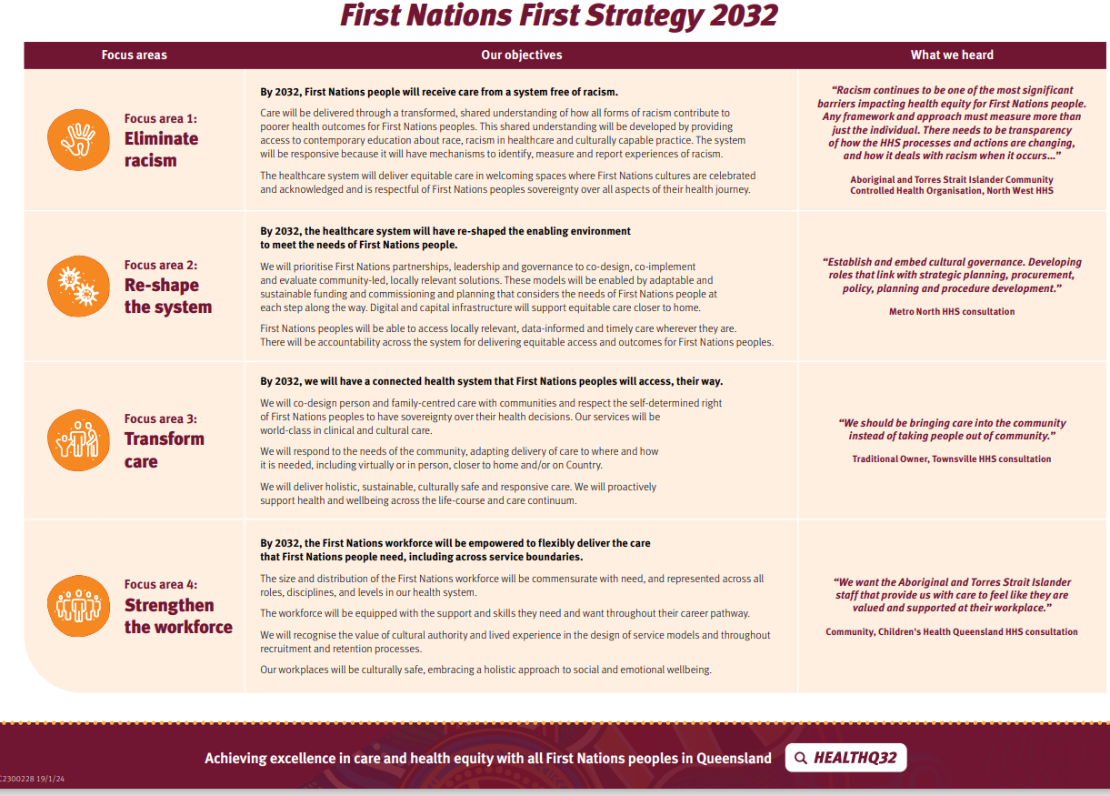
Notes:
Also link to NSQHS Standards

Slide 4
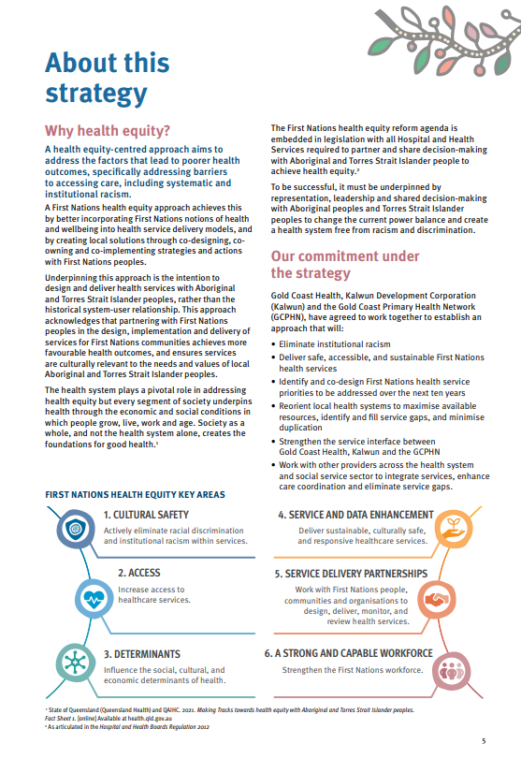
Notes:
HE everyones business
Prescribed stakeholders - staff, community, qhaic, acchos, consumers
FNHEQSEQ =- aupiced by IUIH, its member orgs, MN, MS, WM, GC, CHQ kalwun gc
Same key areas with seq focus including Mental Health and suicide prevention

Slide 5
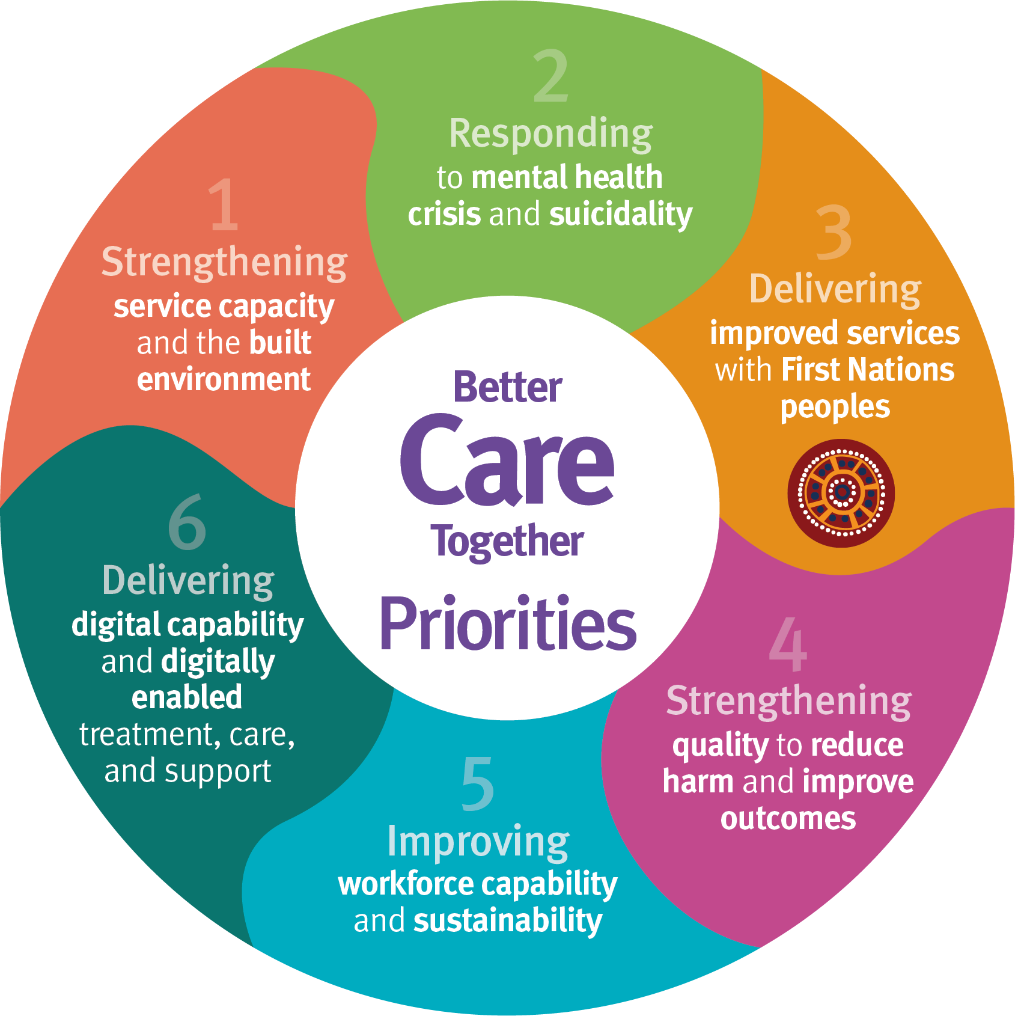
GC MHSS Journey of Improvement and Ambition
Invest
Grow
Transform
Notes:
Integrated care approach of FN strategies state, local level GC and BCT
BCT QH approach
Suggested invest, growth and transform
FN’s element read and focus

Slide 6
GC MHSS Approach
MHSS and HHS First Nations leadership working together
Before committing resources
Agreed external review
Running parallel to
-MHSS review of leadership capacity
-Strengthening system collaboration to develop the 2025-2028 Joint Regional plan for Mental Health Alcohol and other Drugs
Notes:
Would have been easy to just run with allocated suggested BCT funding…. but

Slide 7
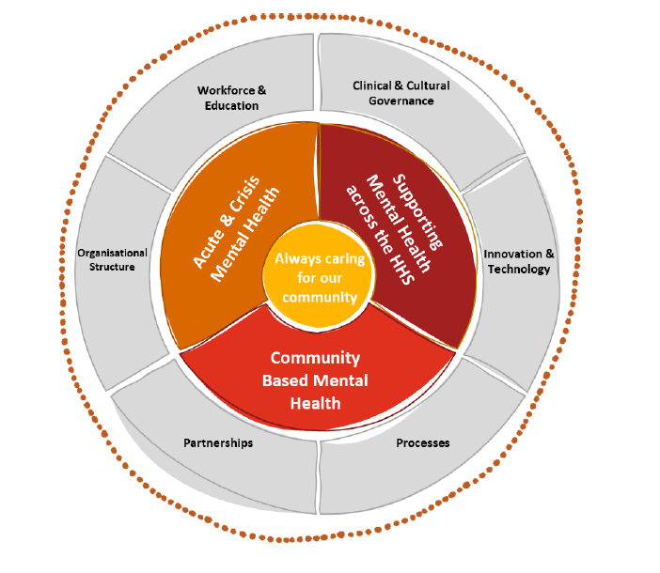
Utilised Better Care Together funding to commission a
First Nations Workforce Review by PWC Indigenous Consulting and commissioned Cassandra Nest from Health Consumers QLD to provide ‘First Nations consumer’ feedback

Slide 8
Health Consumers Queensland – Key Messages
  Prolonged wait times
  Inconsistent service quality
  Financial burdens –travel / parking
Access
  Lack of culturally safe care delivery, unique cultural practice and values of First Nations people
Safety
  Inadequate processes for identifying First Nations consumers
  Clinical environments lack cultural touches (NSQHS Standards)
Respect
  Underutilisation of Community voice to address culture, psychological and logistical barriers to care
Partner-ship

Slide 9
PWC Review Recommendations
Review reporting lines to allow identified roles to have dotted line to Aboriginal and Torres Strait Islander Health Service.
Increase resourcing of identified MH roles within the newly formed Aboriginal MH Team.
Increase Mental Health training for all staff
Review Professional Development and training provided to Identified staff
Review recruitment process of MHSS staff to integrate importance of cultural lived experience.
Develop a cultural governance framework that supports cultural infrastructure across the HHS.
Review integration of CIMHA and ieMR to support effective sharing of information.
Explore innovative models of care delivery specifically tailored to meet the unique needs of First Nations people.
Review D/C processes to enhance collaboration with community services.
Enhance referral processes to IHLOS, including for consumers presenting to ED.
Review partnership with Kalwun to expand collaboration

Slide 10
Agreed Senior leadership capacity to reposition focus on consumer
Director of Person-Centred Care (Lived Experience)
Lived Experience (Peer) Workforce,
Consumer, Carer Peer Unit
Cultural & Linguistic Diversity
Identified First Nations, Aboriginal & Torres Strait Islander

Slide 11
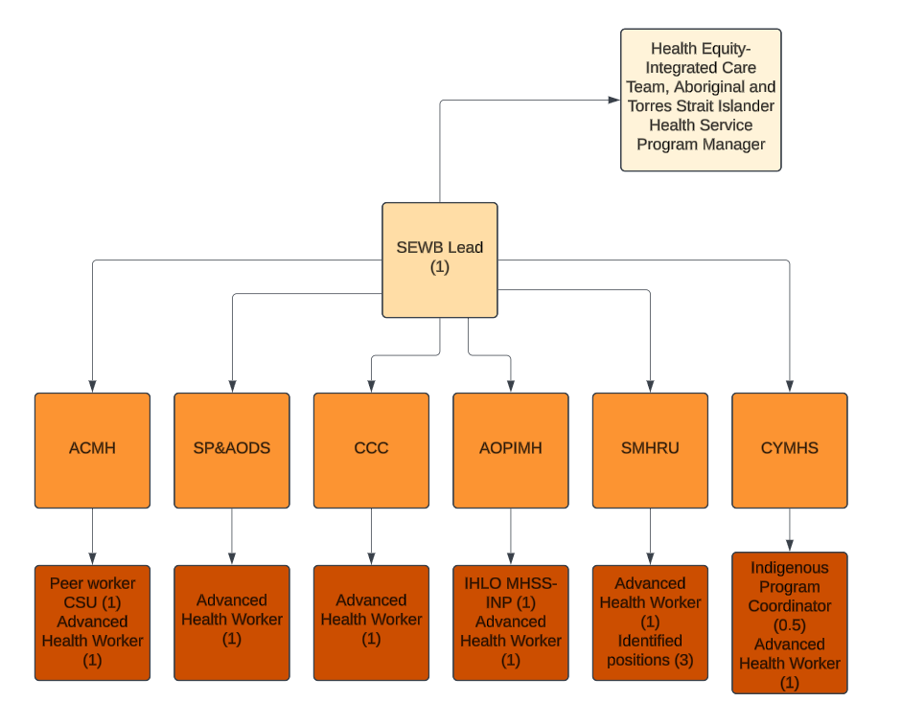
Proposed Structure within MHSS

Slide 12
1. National Agreement on Closing the Gap (NACG)
10. Gold Coast Joint Regional Plan 2020-2025
2. National Strategic Framework of A&TSI People’s Mental Health and Social Wellbeing 2017-2023
9. GCHHS Local Needs Assessment 2022-2025 (LANA)
3. A&TSI Health Workforce Strategic Framework 2016-2026
Strategic Alignment Opportunities
8. GCHHS Workforce Strategy 2019-2024
4. Better Care Together Plan
7. GCHHS Health Equity Implementat-ion Plan
2022-2025
5. Shifting Minds: QLD Mental Health Alcohol and Other Drugs Strategic Plan 2018-2023
6. GC PHN– Needs Assessment 2022

Slide 13
JRP Strategic Vision
Joint Regional Plan
Alternative Governance Structure (PHN HHS Board support to view options)
Membership ??????
Primary Health Network
Gold Coast HHS (MHSS)
Lived Experience
First Nations (IHUI)
Housing
Education
Social Services
Police
Leisure
Industry/Employment
Joint Regional Plan Governance Structure
Membership
Primary Health Network
Gold Coast HHS (MHSS)
Lived Experience
First Nations
Links with IUIH
Aspirations

Slide 14
What Next?...Together we are
1. Developing a project plan to take forward strategic recommendations
2. Consultation on the new team structure
Together we see the opportunity to improve the service we offer our First Nations consumers and families
3. Running parallel-
Working together on MHSS leadership structure and part of wider GC system review leading to ‘whole’person approach to prevention and ` recovery.

