Slide 1
Multisystemic Therapy (MST)
Presented by:
Dr Mark Porter – MST Programme Manager
W. A. Child & Adolescent Mental Health Service
Supported by:
Dr Yui Nuntavisit – MST Research Officer

Slide 2
Executive Summary:
Violent & aggressive children & adolescents often become violent adults without effective help, and frequently diagnosed with “conduct disorder”.
Conduct disorders are common, but low rates of clinical intervention due to service access problems, fear of child removal/charges, and parent shame.
Without effective intervention, conduct disorders predicts various adult mental illness including substance abuse, aggression, family violence, chronic unemployment, incarceration, premature death & very high costs.
Much evidence parenting interventions for conduct disorder are effective, and Multisystemic Therapy (MST) is an intensive parenting intervention.
W.A. Department of Health has operated 2 MST teams in Perth since 2005.

Slide 3
Conduct Disorders :
The term ‘conduct disorders’ generally refers to conduct disorder (CD) and oppositional defiant disorder (ODD). Conduct disorders are characterised by repetitive violation of age-appropriate social norms including antisocial, aggressive &/or defiant conduct. (ICD -10)
UK NICE guidelines (2013) state conduct disorders are the most common mental & behavioural disorders in children & youth, and note a strong relationship between conduct disorder and social class (poverty).
Conduct disorders are more common in boys (approx. 2 :1) but female rates are increasing; and evidence that prevalence rates of all the conduct disorders are increasing in many western countries.
Youth with CD usually don’t seek help, thus interventions to help parents and carers improve family dynamics and communication styles, are the most successful and enduring interventions for ODD & CD.

Slide 4
Prevalence of mental health problems amongst U.K. children & young people X family's employment & age group
 | Family's employment
 | Both parents working (inc. lone parents) | One parent working | Neither parents working (inc. lone parents) | All
 | Percentage of children with each disorder
11-15 year olds
Emotional disorders | 4.5 | 6.2 | 10.8 | 5.6
Conduct disorders | 4.7 | 6.4 | 14.5 | 6.3
Hyperkinetic disorders | 1.1 | 2.1 | 2.3 | 1.4
Less common disorders | 0.4 | 1.2 | 0.9 | 0.6
Any disorder | 9.1 | 11.7 | 22.5 | 11.2
Base | 3,249 | 699 | 591 | 4,536
All children (5-15 year olds)
Emotional disorders | 3.4 | 4.5 | 8.5 | 4.3
Conduct disorders | 4.1 | 4.5 | 12.5 | 5.3
Hyperkinetic disorders | 1.1 | 1.6 | 3.0 | 1.5
Less common disorders | 0.4 | 0.9 | 0.9 | 0.6
Any disorder | 7.6 | 9.1 | 19.7 | 9.5
Base | 6,939 | 1,961 | 1,411 | 10,312
Source: Meltzer H, Gatward R, Goodman R, Ford T (2000) “The mental health of children and adolescents in Great Britain”. HMSO: London.

Slide 5
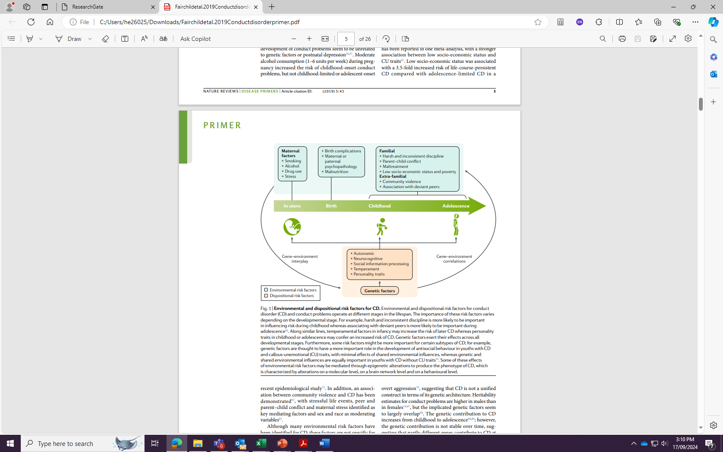
Environmental and Dispositional Risk Factors for CD
Source: Fairchild, G., Hawes, D.J., Frick, P. J., Copeland, W. E., Odgers, C. L., Franke, B., Freitag, C.M., De Brito, S. A. Conduct Disorder. Primer. 2019, 5:43

Slide 6
Parenting Intervention Strategies:
Common parenting interventions for child & adolescent conduct disorders:
Parent Management Training (PMT) (Kazdin, 1997)
Functional Family Therapy (FFT) (Barton & Alexander, 1981)
Multisystemic Therapy (MST) (Henggeler et al, 1998)
Positive Parenting Programs (PPP) (M. Sanders, 1987?)

Slide 7
What is: “Multisystemic Therapy” (MST)?
Form of “Structural Family Therapy” (Salvador Minuchin, 1960’s), designed to work with poor &/or marginalised families with children & adolescents at risk.
Works systemically with local supports including Government agencies, school, local community, and especially parents/ carers as key stakeholders.
MST builds strength of the natural systems most influential on young person’s behaviour, and empowers caregivers to become long-term change agents.
Therapeutic alliance between clinician & parent is critical for engagement, to support & motivate parent/carers to persevere with required interventions.

Slide 8
Brief Description of MST Intervention:
WA CAMHS MST clinicians usually Clinical Psychology registrars.
WA includes Aboriginal clinical staff (Psychology, Social Work, etc).
MST is an intensive outreach intervention occurring in family homes.
4 - 5 month intervention, involving home & school visits 3 x each week.
Client visits often after-hours, combined with 24/7 phone support.
Close supervision of clinical work to ensure fidelity to MST model.
Work focuses on the primary problems identified by parent/caregiver.
Involves teaching primary care-givers problem-solving techniques, improved communication styles and dispute resolution skills.
Typical goals include reducing conflict / violence, improving behavioural boundaries, behavioural rewards, communication style & family warmth.

Slide 10
MST Referral Population & Selection Process:
12-16 year olds (10, 11 & 17 year olds when severe).
Complex & severe behaviour problems of at least 12 months duration.
Priority Referrals & Selection Process:
Referrals are selected & prioritised by a Multi-Department Committee.
Referrals with the most severe symptoms and history are prioritised.
Considering risk of out of home placement, and/or school exclusion.
Comorbid MH difficulties, anti-social behaviour & substance use/abuse.
Exclusion/Diversion Criteria:
Must be still living in family home, or stable carer situation.
Not actively self-harming or suicidal intent in recent months.
Not suitable when neuro-developmental disorders (IQ < 70).

Slide 11
MST-WA Referral Sources (N=956)
January 2006 - December 2023

Slide 12
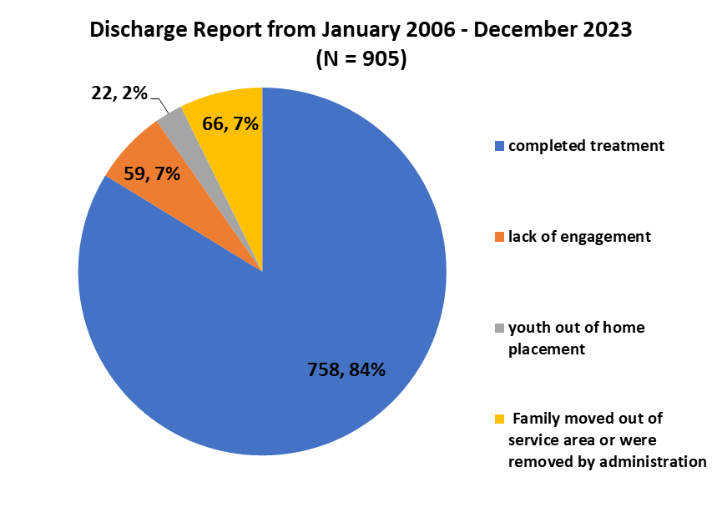

Slide 13
Demographic profile of adolescents and families involved in W.A. CAMHS MST (2007 – 2023):
.
Average age: 13.7 years old
72% male and 28% female
12% Aboriginal and 8% CaLD
49% Single parent, 25% intact family, 20% Blended family and 6% Foster/adopted family
Around 50% had a family annual income less than $50K.

Slide 14
Quality Assurance
Therapist Adherence Measure
(Collected monthly from start to discharge)
Client Satisfaction Report
(Collected at discharge)
Demographics
1. Age
. Gender
. Diagnose
. Education
. Employment
status
. Household
income
. Ethnicity
. No. of people
living at home
. Primary referral
reasons
1. Previous
agencies involved
2. Family history
Baseline
Parent-reported
1. Child Behaviour Checklist
(CBCL)
2. Family functioning
. Parenting style
4. Strengths and difficulties
questionnaire (SDQ)
. Depression Anxiety Stress
scale (DASS21)
Youth-reported
6. School attendance or
Employment status
. Family functioning
. Number of offending
(in the past 6 months)
. Drug & alcohol use
0. SDQ
Clinician-reported
11. Health of the Nation Outcome
Scales Child and Adolescents
(HoNOSCA)
2. Child Global Assessment
Scale (CGAS)
3. Global Family Environment
Scale (GFES)
4. School attendance/ suspension
(school record)
Post-treatment
Parent-reported
1. CBCL
2. Family functioning
3. Parenting style
. SDQ
. DASS21
Youth-reported
6. School attendance or
Employment status
. Family functioning
. Number of offending
(in the past 6 months)
. Drug & alcohol use
0.SDQ
Clinician-reported
11. HoNOSCA
2. CGAS
3. GFES
4. School attendance/ suspension
Follow-up 6, 12 months
Parent-reported
1. CBCL
2. Family functioning
3. Parenting style
. DASS21
Youth-reported
5. School attendance or
Employment status
. Family functioning
. Number of offending
(in the past 6 months)
. Drug & alcohol use

Slide 15
Child Behavioural Checklist (CBCL)
Anxiety/Depression
Withdrawn/Depression
Somatic Complaints
Social Problems
Thought Problem
Attention Problems
Rule-breaking Behaviour
Aggressive Behaviour
Other Problems
Internalising behaviour
Total
Problems
Externalising behaviour

Slide 17
Effectiveness & Suitability of MST with Aboriginal Families:
Aboriginal sub-committee formed (2004) prior to W.A. implementation of MST to determine cultural suitability and effectiveness of the program.
Sub-committee comprised of senior Aboriginal staff (Child Psychiatrist, and mental health liaison staff), and several recognised local elders.
Sub-committee determined MST program was very suitable because overcame access & other barriers, centred around family needs, strength-focused, and empowered families with relevant skills.
Recommended an Aboriginal clinician or support worker in each team to help non-Aboriginal clinicians engage and work with Aboriginal families.
MST has highest rate of engagement with Aboriginal families for the W.A. Child & Adolescent Mental Health Services (CAMHS).
Most of the Aboriginal families engaged in the longitudinal research have obtained enduring positive changes for the whole family.

Slide 19
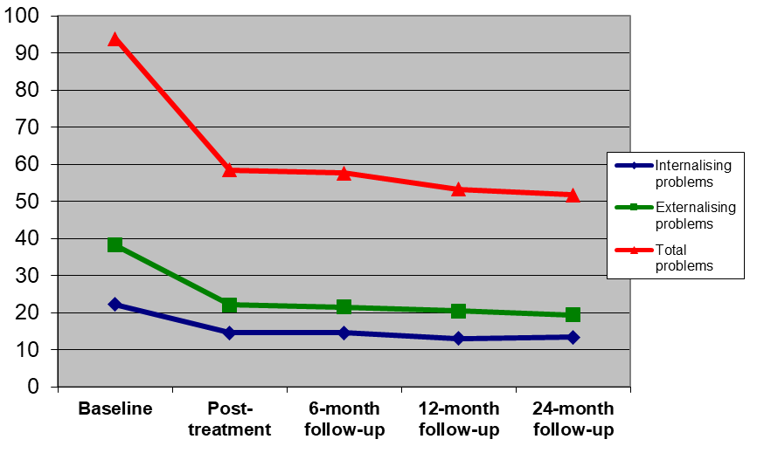
Average Total, Internalising and Externalising CBCL scores: Baseline, Post-Treatment, 6 month, 12 month & 24 months: (N = 166)

Slide 20
* Value of +0.5 of one standard deviation as an index of significant change was used to determine range of change in child behaviours from baseline.

Slide 21
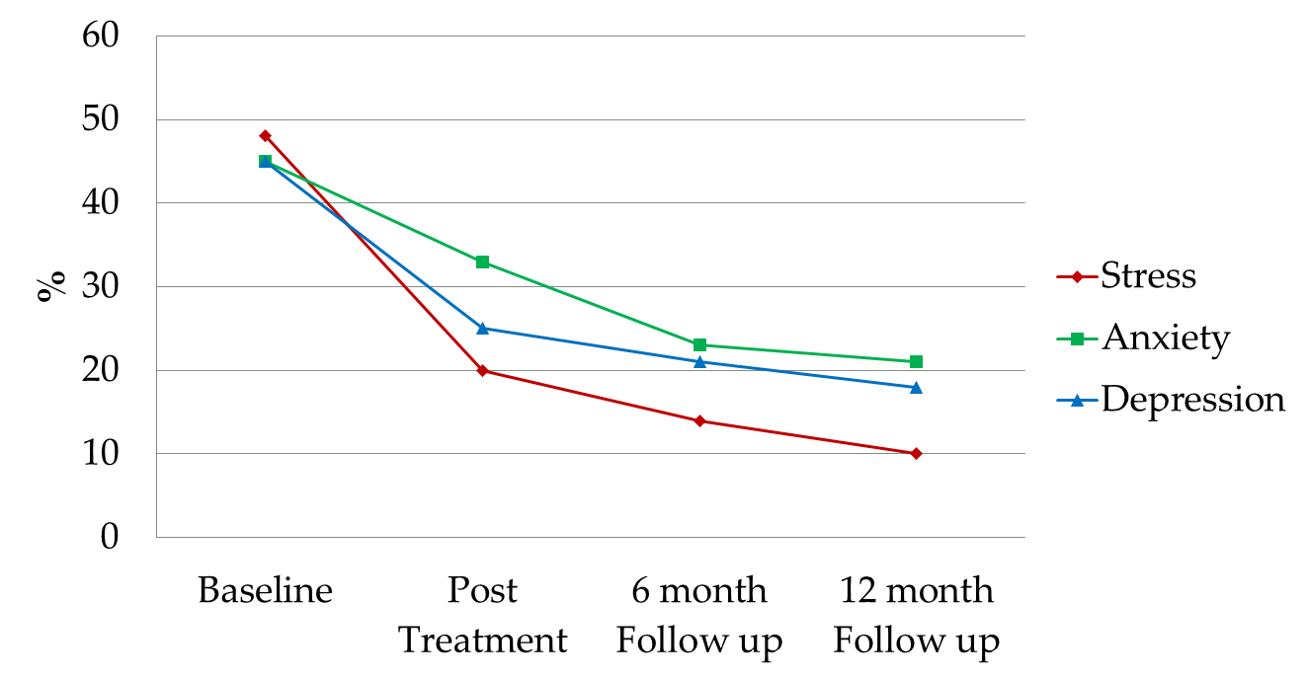
% of caregivers reporting Depression, Anxiety & Stress Scale (DASS) in clinical range* at baseline, post-treatment, 6-month and 12-month follow-up (N = 241).
*Clinical range = the percentile above 87

Slide 23
Key Post-Treatment Outcomes: (N = 834)
Item | N | %
1. Youth living at home | 782 | 94
2. Youth in school/working | 647 | 78
3. Youth with no new arrests | 720 | 86

Slide 24
International Implementation of MST:
MST implemented internationally in child mental health, child protection and juvenile justice services last 40 years.
500 teams in 34 states of U.S.A., and 14 other countries:
Ex: New Zealand (6 teams) & Australia (approx.15 teams).
Australia teams are standard MST, and MST-CAN (NSW).
First Australian MST-CAN team (2004 – 2007?) at Mater Hospital, Brisbane, Consultant Psychiatrist, W. Bor (dec.)
Most Australian MST teams operate in CAMHS, or similar child & adolescent mental health settings, that offer the advantage of earlier intervention than Justice settings.

Slide 25
Evaluation and Recognition of the W.A. Health MST Program (2005 – 2015):
2008 W.A. “Good Outcome” Awards (“Child & Adolescent” category winner)
2008 W.A. Healthy Awards (“Healthy Communities” category winner)
2009 Australian Mental Health Service Award (silver ”CAMHS” category)
2011 National Drug & Alcohol Awards (Judged unanimously as winner of the category: “Excellence in AOD Prevention & Community Education”)
2011 National Crime & Violence Prevention Award (Australian Heads of Government & Ministerial Council for Police & Emergency Management)
2012 W.A. Premier’s Awards (“Stronger Families & Communities” finalist)
2014 Australian Mental Health Service Awards (gold in “Treatment” category)
2015 W.A. Health Awards (“Overcoming Inequities” award).

Slide 26
Summary:
Conduct disorders common (7%), but low rates of professional intervention.
Outreach & a/hours support overcomes service access & other barriers.
Early intervention important before school drop-out &/or home expulsion.
Multisystemic Therapy is an intensive, home-based parenting intervention.
Considerable (20+ RCT) evidence of enduring positive effects with MST.
Enduring positive client outcomes correlated with implementation fidelity.
CD should be a priority target for prevention of various mental illness, family violence, substance use/abuse, chronic unemployment, juvenile detention, adult incarceration, and premature death, with very high costs to society.

Slide 27
