Slide 1
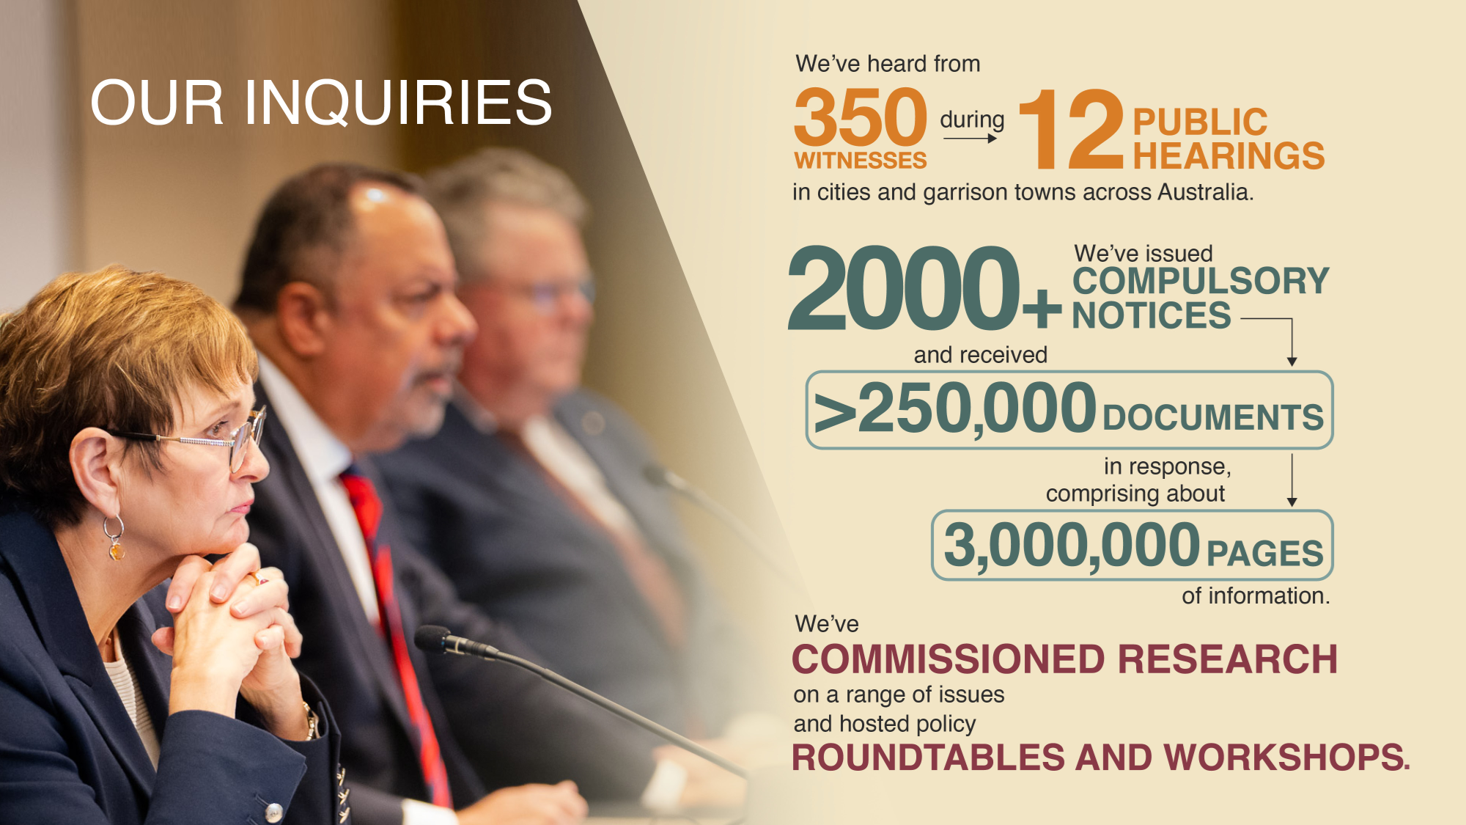
Findings from the Royal Commission into Defence and Veteran Suicide: What does it mean for you and your organisation?
Dr Peggy Brown AO
Former Commissioner
Royal Commission into Defence & Veteran Suicide
QMHC Leading Reform Summit
28th November 2024

Slide 2

Commencement and completion of DVSRC
The Royal Commission into Defence and Veteran Suicide (DVSRC) ran for 3 years from 8 July 2021 to 9 September 2024.
Veteran suicide is a national tragedy:
Between 1/1/1997 and 31/12/2022, 1763 confirmed deaths by suicide of serving and ex-serving members of the ADF who had served since 1/1/1985
This number is an underestimate (does not include suspected suicides or those who served prior to 1/1/1985)
Commenced 8/7/2021
Completed 9/9/2024
Methodology
The Royal Commission’s Terms of Reference were broad as was its methodology. It held 12 public hearings (101 days), received almost 6000 submissions, conducted almost 900 private sessions, visited 26 Defence bases, issued > 2000 compulsory notices resulting in >250,000 documents (over 3 million pages), commissioned internal and external research, and held roundtables, workshops and stakeholder meetings.
Veteran = any person who has served or is still serving in the ADF (permanent forces or reserves)
Notes:
2093 confirmed suicide deaths from 1/1/85 – 31/12/2022

Slide 3
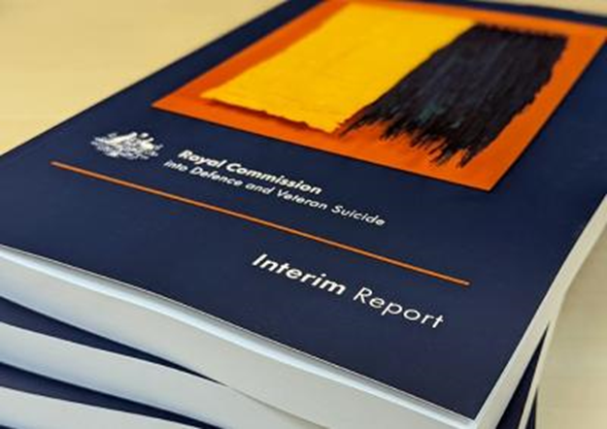

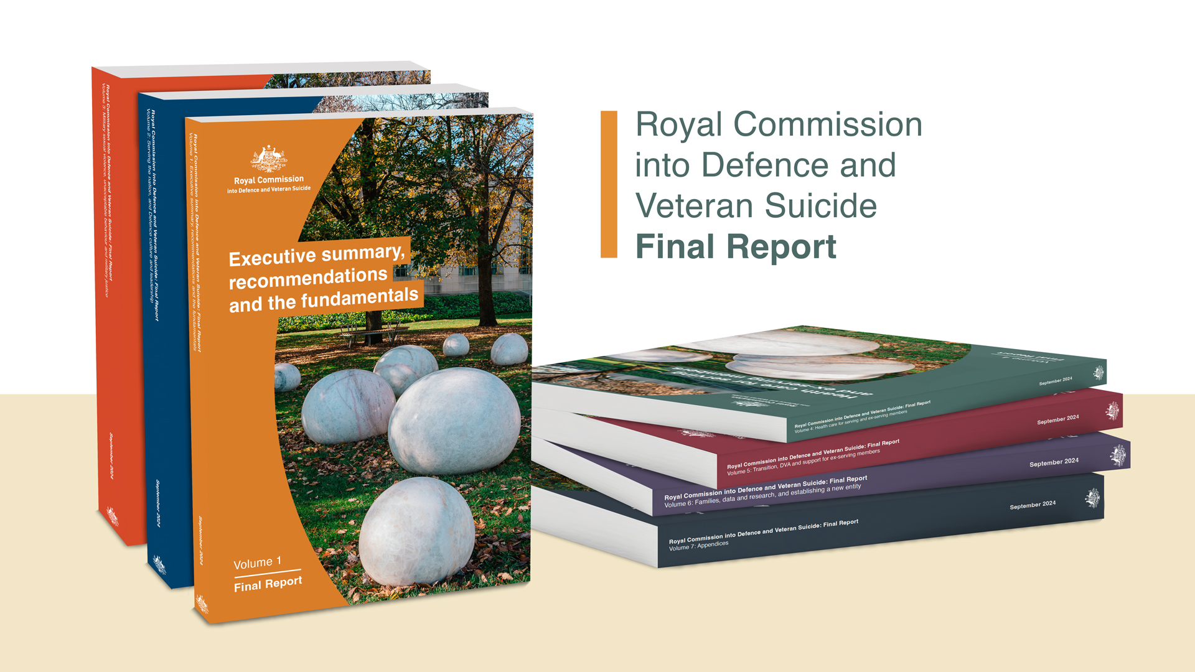
Key DVSRC Publications
August 2022
13 recommendations – 11 accepted & 2 noted
June 2024
September 2024
122 recommendations – Government response due December 2024

Slide 4
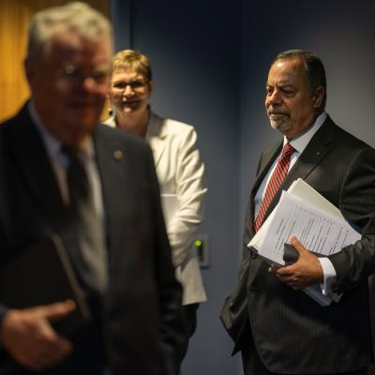
At the outset of the Royal Commission
Defence believed that service is protective
Therefore, there was no problem to be addressed
Perceived that suicide occurred primarily after veterans left service
DVA recognised it had a problem with complex legislation and claims processing

Slide 5
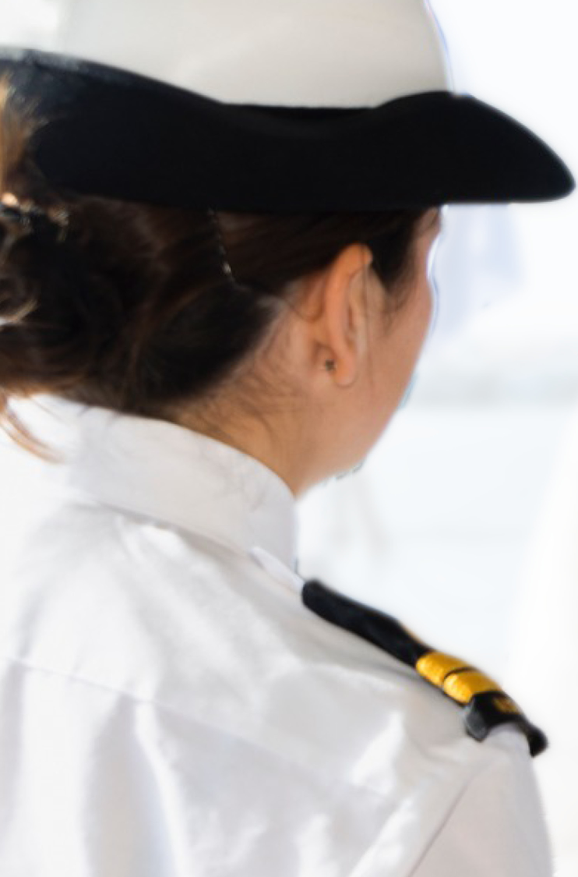
Key findings - Defence
Recruitment and Training – high risk period of adapting to service; need enhanced support and screening and a focus on injury prevention
Service life – frequent postings and time away from home on training and deployment can impact connections with family and supports; career management issues
Defence culture –hierarchical, command and control organisation – culture of military masculinity (self-reliance, don’t show weakness, don’t ask for help, don’t ‘jack’ on your mates), exceptionalism, and tribalism; risk of abuse - bullying and harassment, hazing and bastardisation, ostracization, sexual assault, and psychological abuse
Deployment – desired end-goal but level of support varies before, during and after-deployment
Military employment classification – informs operational capability but lacks procedural fairness; limited opportunities for those who cannot deploy
Injury prevention – prioritises organisational readiness over workforce health and wellbeing; limited focus on psychosocial safety; need to strengthen workplace health and safety system

Slide 6

Key findings - Defence
Military justice system – unacceptable behaviours and military sexual violence prevalent and not well managed; weaponisation of administrative justice system (including administrative discharge); IGADF not perceived to be independent; inadequate process for reviews of suicide deaths
Healthcare system – range of barriers to accessing healthcare (stigma, structural, cultural); confidentiality and privacy challenges; inadequate attention to brain injury; rehabilitation outcomes sub-optimal; suicide prevention training needs codesign; response to suicidal crisis and postvention inadequate; research fragmented and translation lags
Moral injury – need to prevent, minimise and treat moral injury
Leadership, governance and accountability – leadership selection and development processes need to be strengthened; governance systems are disjointed and not maximally effective;

Slide 7
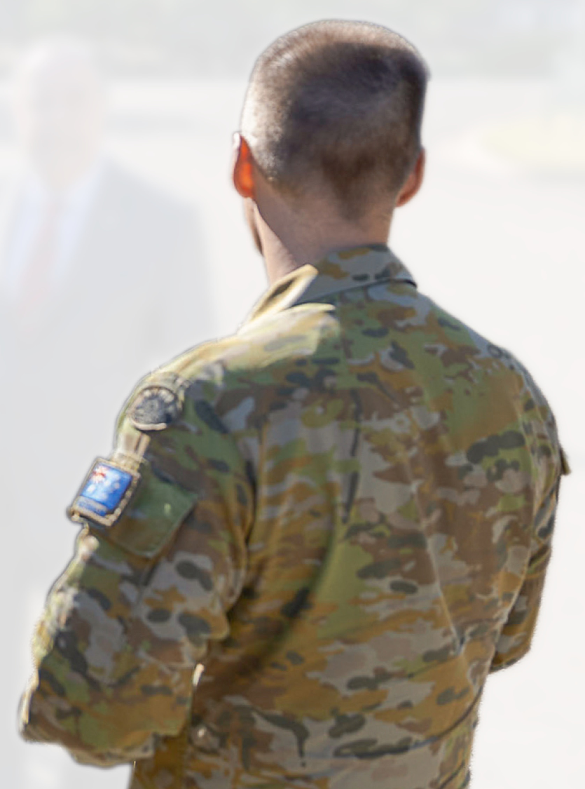
Key findings - Defence
Transition and discharge – transition period is high risk especially for those being discharged involuntarily; transition processes do not meet veterans’ needs; inadequate support throughout transition process; challenges with community reintegration (civilian qualifications and employment)
Families – inadequate support for families overall; inadequate response to family and domestic violence; Defence Families Australia under-resourced
Data and research – issues with data assets, including data quality, management, access, integration and use; suicide database is limited and research on suicide/suicidality uncoordinated

Slide 8
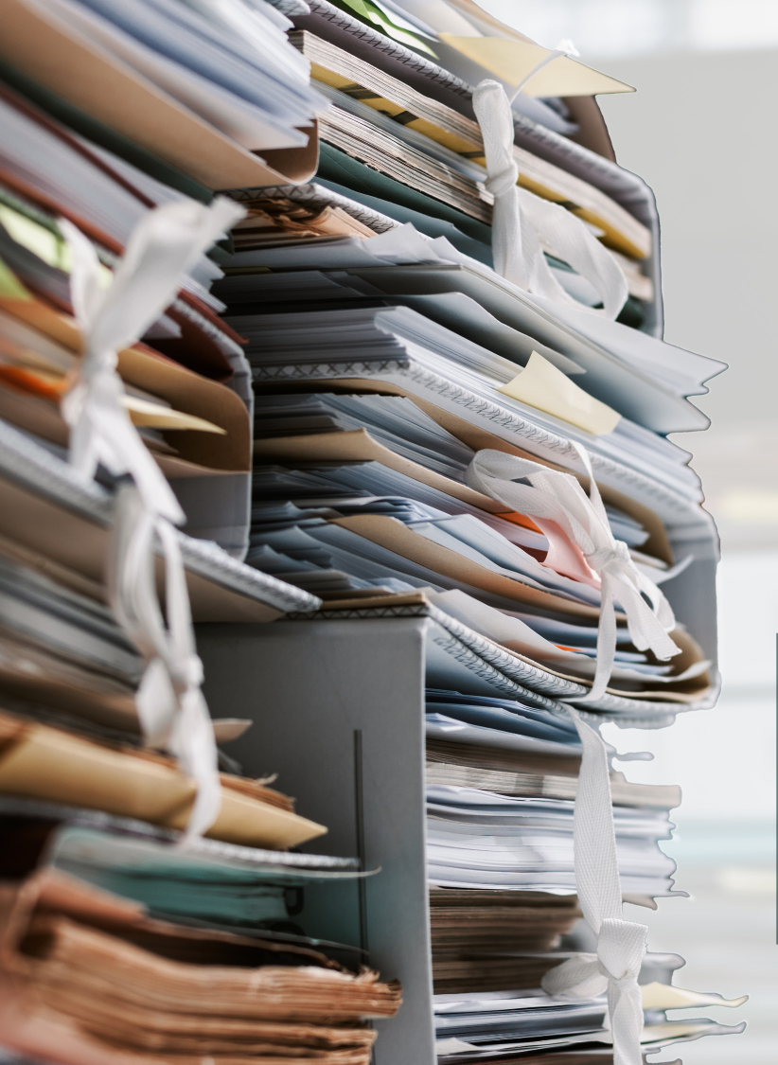
Key findings - DVA
DVA – complex legislation; claims processing not timely; organisational culture experienced as adversarial; issues with transparency and accountability; need a greater focus on veteran wellbeing and veteran engagement; inadequate access to advocates; health care system fragmented, not integrated and access is variable; inequitable provider remuneration; multiple administrative issues; military cultural competence not assured; rehabilitation system suboptimal; information sharing between Defence and DVA is problematic; approach to Veterans’ Hubs not strategic; data and research challenges
Open Arms – numerous issues raised but recent change to model; needs further evaluation

Slide 9

Key findings - Other
ESOs – critical role; large number; not collaborative; gaps and duplication; no clear standards; governance sometimes inadequate; no peak body
States/Territories – service offering varies by jurisdiction
Federated governance – Veterans’ Ministerial Council for ‘information only’
Community – important role to support integration and could do more
Trauma informed approach to care and support often lacking

Slide 10

Key data

Slide 11
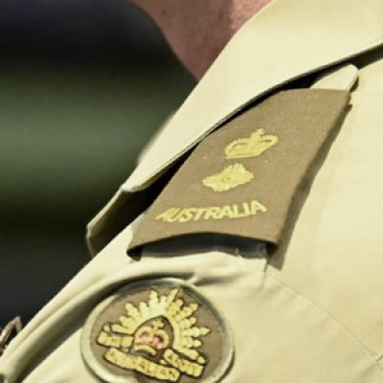
Males serving in the permanent forces
30% more likely to die by suicide than employed Australian males (rates vary within sub-cohorts)
  combat and security roles (100% higher) – highest in Navy (150% higher)
  boatswain’s mate (426% higher) and rifleman (153% higher)
No statistically significant difference for those with operational experience compared to Australian employed males.
Convicted of an offence under section 26 (insubordinate conduct) - (1,239% higher)

Slide 12
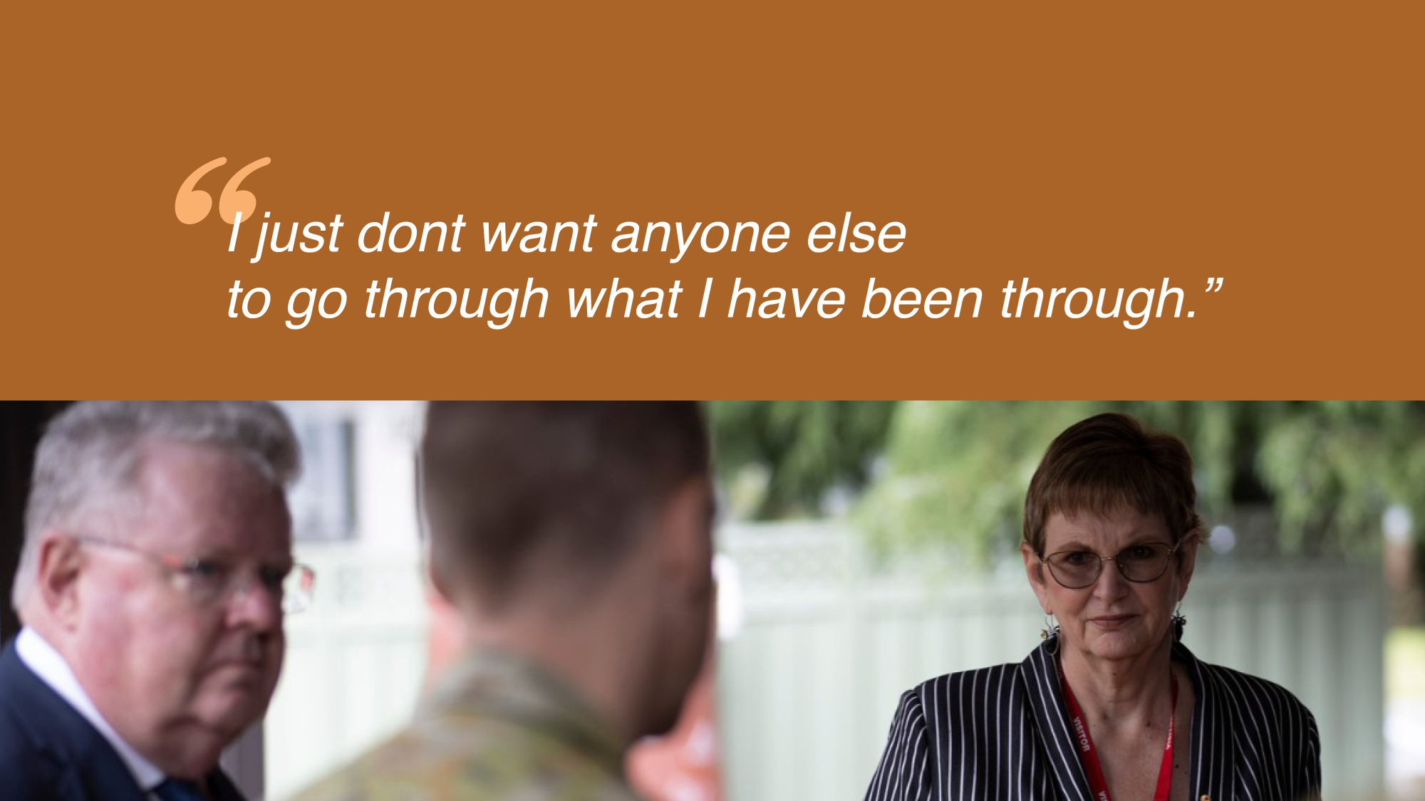
Males serving in the Reserve forces
62% less likely to die by suicide than Australian males.
Notes:
Never served in the permanent forces

Slide 13
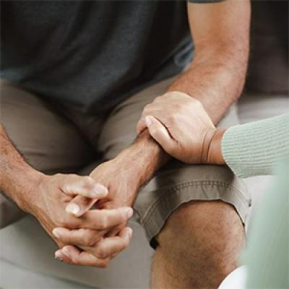
Ex-serving males who served in permanent forces
37% more likely to die by suicide than Australian males
  Army combat and security roles (112% higher)
  logistics roles (69% higher)
  medical technician (515%)
  commando (364% higher)
  maritime logistics chef (174% higher)
  rifleman (120% higher)
  artillery gunner (117% higher)
Enlisted aged 16 or 17 (27% higher) or 30 to 34 (84% higher)
Separated during initial training in Army (132% higher)
Warlike operational service (55% higher) or non-warlike operational experience (67% higher)

Slide 14
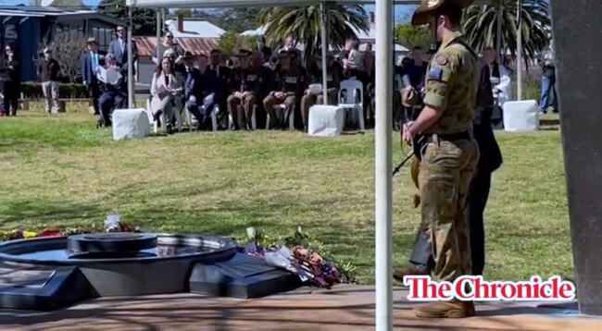
Ex-serving males who served in permanent forces
Higher rates of suicide are associated with:
suffered select injuries (reported in the Defence WHS system) - ‘falls, trips and slips’ (317% higher) and ‘motion’ (358% higher)
suffered a mental disorder during service (reported in the Defence WHS system) (640% higher)
separated involuntarily for medical reasons (202% higher) or ‘retention-not-in-service-interest’ (187% higher)
convicted of non-compliance, unsatisfactory conduct or unauthorised absence offences
  convicted of an offence under the DFDA by a summary authority e.g. section 60 (prejudicial conduct) (1144% higher)

Slide 15

Ex-serving males who served solely in the reserves
Suicide rate similar to that of Australian males

Slide 16

Ex-serving females who served in the permanent forces
110% more likely to die by suicide than Australian females
  combat and security roles (452% higher)
  health roles (212% higher)
  logistics roles (263% higher)
enlisted as a minor (88% higher) or aged 25 to 29 (257% higher)
suffered a serious injury or illness during service (reported in the Defence WHS system)
    falls, trips and slips’ (721% higher)
    traumatic joint, ligament, muscle or tendon injury (578% higher)
faced trial for an offence under the DFDA during service (354% higher)
separated during initial training in Other ranks (433% higher)
separated involuntarily for medical reasons (388% higher) or ‘retention-not-in-service-interest’ (245% higher)

Slide 17
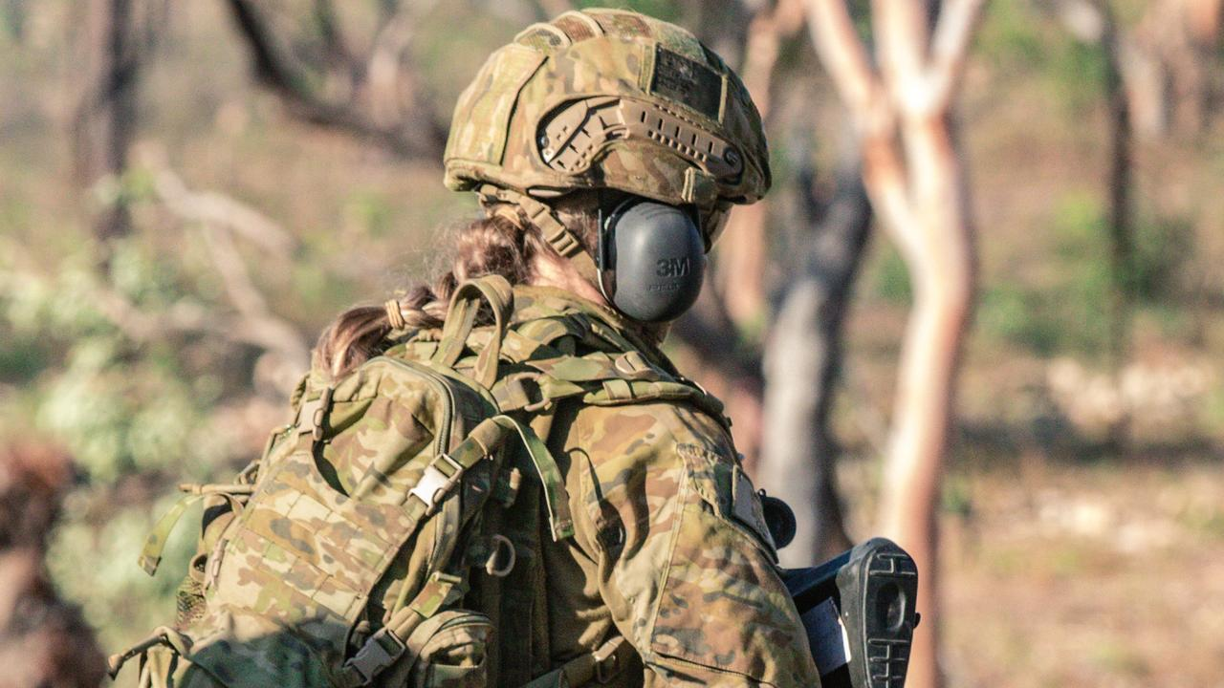
Ex-serving females who served solely in the reserves
89% more likely to die by suicide than Australian females
  enlisted as a minor (189% higher)
  separated during Army soldier initial training (225% higher)

Slide 18

Summary
Broad range of risk factors
Not just related to trauma from deployment
Potential cumulative organisational stressors
Long-term impact
Opportunity to better explore the identified high-risk cohorts to develop tailored interventions to reduce risk

Slide 19

Key recommendations
Establish a new statutory entity
Service life
Leadership, governance and accountability
Unacceptable behaviour, military justice system, IGADF
Health and safety
DVA
National funding agreement
National ESO peak body
Families
Coroners
Data
Research
Notes:
Establish a new statutory entity to oversee system reform across the whole Defence ecosystem
Service life - training, career management, posting, decompression, MEC procedural fairness, employment when non-deployable
Leadership and accountability - respect at work, accountability for culture and health and wellbeing, importance of a healthy workforce to operational readiness, governance and accountability
Military discipline- sexual offences, unacceptable behaviour, military justice system, IGADF processes,
Health and safety - workplace health and safety, injury prevention, brain injury, help seeking, mental health screening, rehabilitation, clinical governance, privacy and confidentiality, better integration through research translation centres, suicide prevention, crisis response, aftercare and postvention
DVA - remuneration, healthcare services for veterans, military cultural competence, Open Arms, moral injury, respect and recognition, transition, access to bases, civilian qualifications, employment pathways, Veterans’ and Families’ Hubs, focus on veteran wellbeing, service differential, streamline claims processing, continue TMAP, expand presumptive liability, continue PAMT, veteran health payment, reporting and transparency, compensation advocacy, DVA rehabilitation, more choice and autonomy
National funding agreement on veteran’s wellbeing
National ESO peak body
Families - domestic and family violence, support to families and DFA
Coroners
Data - suicide database, national veterans’ data asset, data maturity, data assets, data standards, data catalogue, use of data
Research - prioritise and publish research, Census data and other surveys, increase research funding

Slide 20
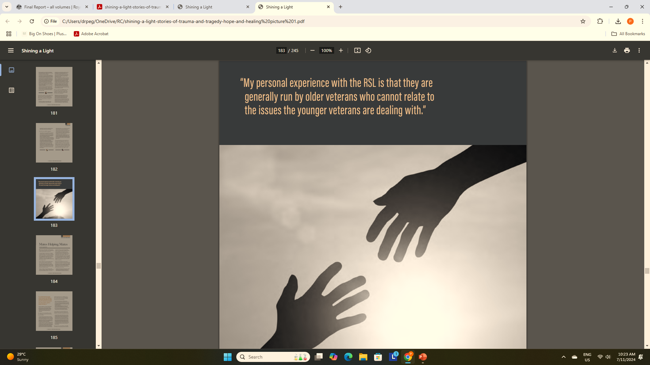
So, what does it mean for you and your organisation?
Government Department
Public/private service provider
Community organisation
ESO
Oversight agency
Individuals
Veteran specific implications
Broader implications

Slide 21
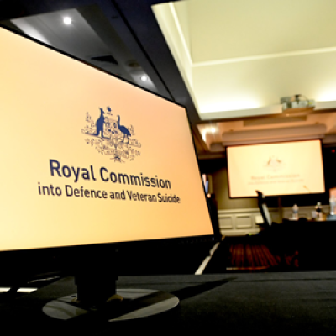
Veteran-specific implications
Do you offer services tailored to meet the needs of veterans? If not, why not?
Are there barriers to veterans accessing care at your service?
Do you demonstrate stigma or discrimination towards veterans?
Does your service providers demonstrate military cultural competence?
Are your services (truly) trauma-informed?
Do you collect veteran data? If so, how do you use it to build a better understanding of veterans’ needs?
How well do you collaborate and integrate with other services in the care of veterans?
Can you do more to learn about and support veterans and their families?
Notes:
Do no further harm
Do not replicate the dynamics of past traumas
Understand the source and impact of trauma
Prioritise safety and wellbeing
Principles – trust, collaboration, empowerment, accessibility, cultural responsiveness
Critically review practice regularly

Slide 22

Broader lessons
Role of leadership and organisational culture in maintaining a safe workplace
Impact of cumulative stressors in the workplace
Importance of curiosity in analysing and understanding data
Consider effectiveness of suicide awareness training (not tick-a-box)
Understand the barriers to help-seeking, including stigma
Lag time between trauma and tragedy can be long
Everyone has a role to play in preventing suicide – what you do and how you do it - role of compassion, kindness, respect and recognition

Slide 23
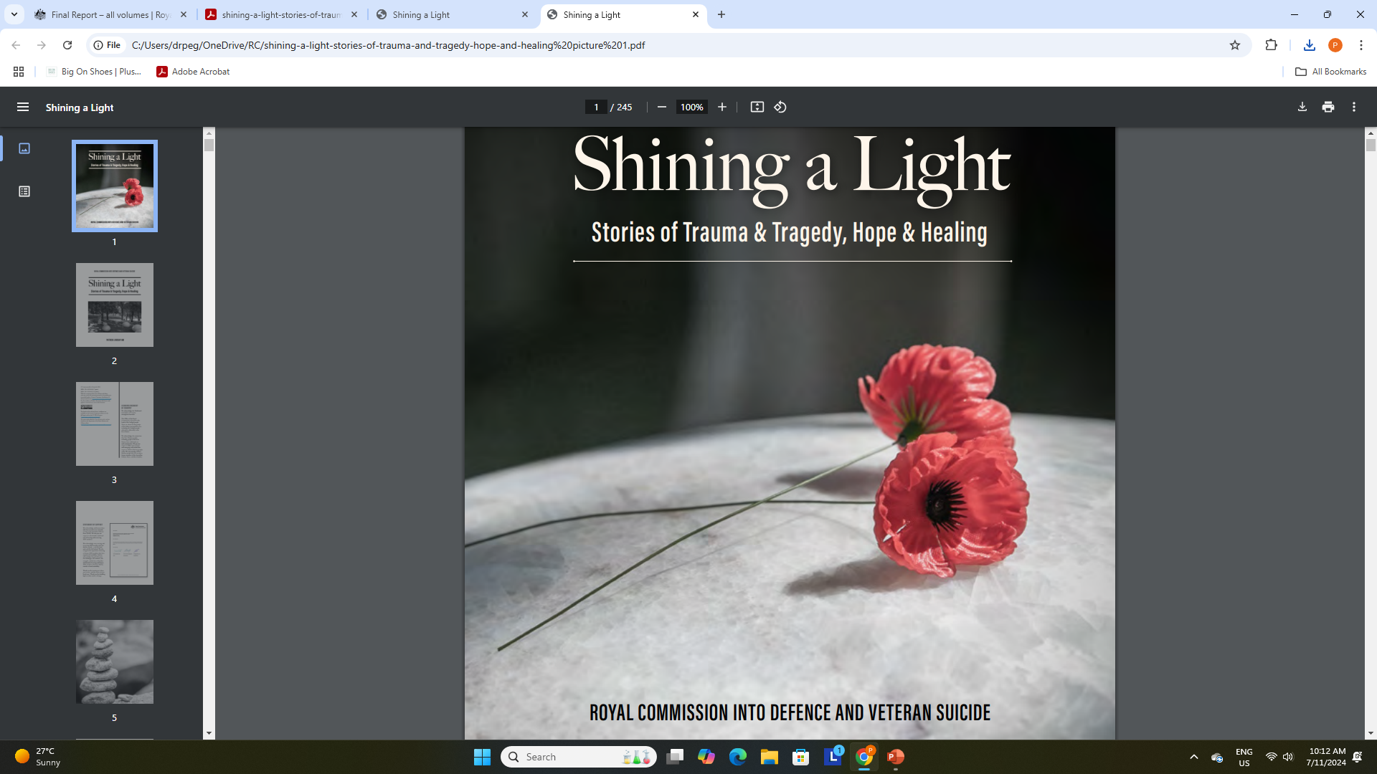
Thank you

