Slide 1
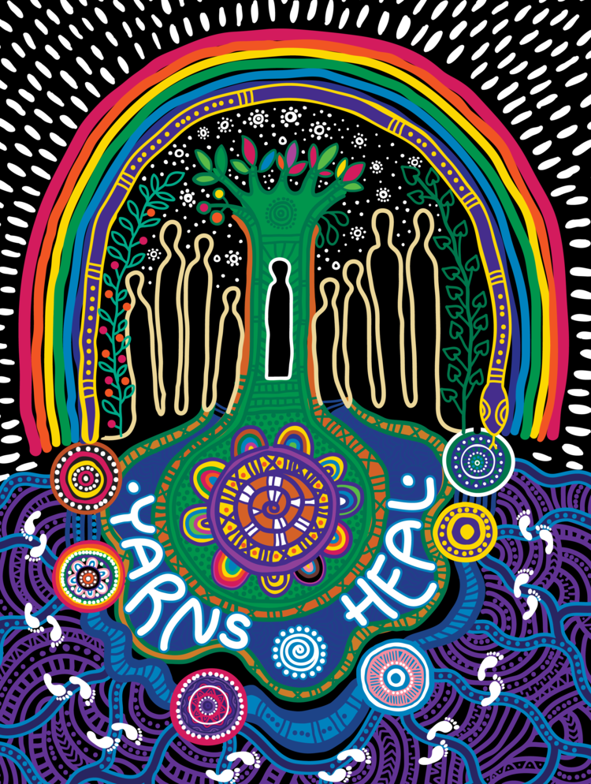


Yarns Heal Project
2023 – 2024
Presented by:
Rochelle ‘Rocky’ Byrne
Proudly funded by the Queensland Mental Health Commission

Slide 2
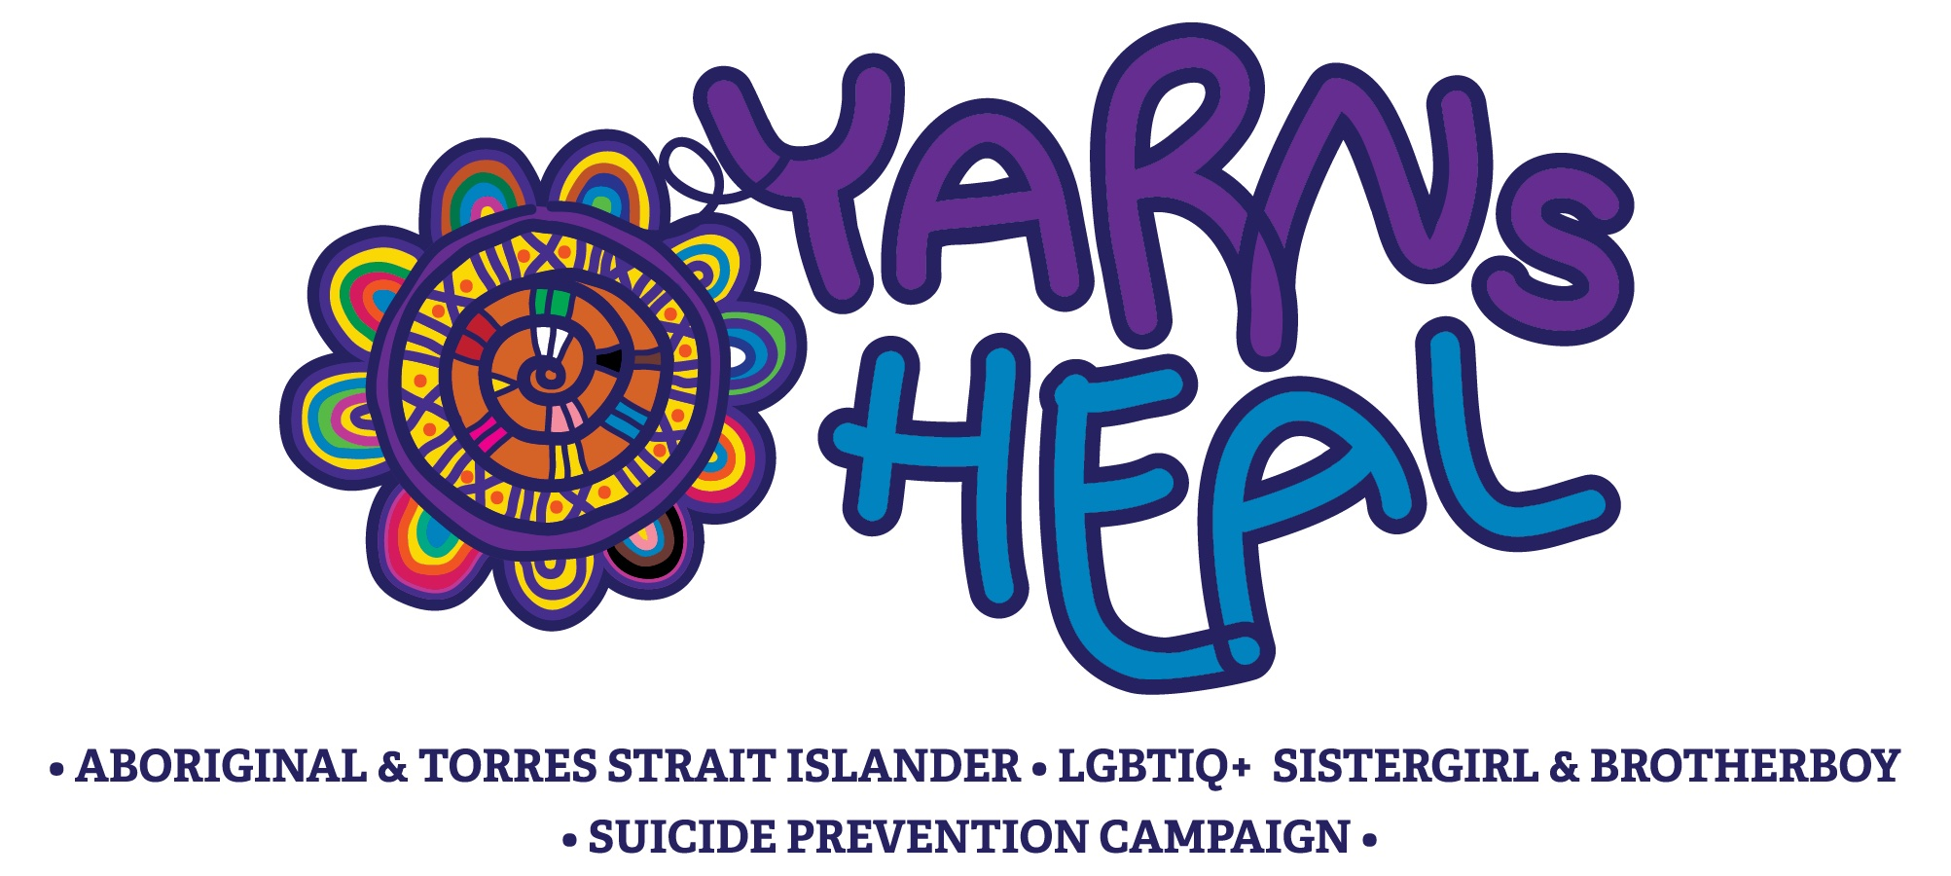
Acknowledgement of Country
We acknowledge and pay our respects to the Traditional Owners of Country across these lands, oceans and waterways now known as Queensland.
We acknowledge that your sovereignty of these lands was never ceded, and that for us to do our work with integrity, that you, your ancestors and your Elders, and the ways of knowing, being and doing, must be central to how we work, live, walk and play.

Slide 3
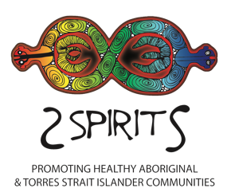

Introducing 2Spirits and the Queensland Council for LGBTI Health
https://www.qc.org.au/2spirits
https://www.qc.org.au/

Slide 4
The National Suicide Prevention Trial (NSPT) - Yarns Heal Journey
The Australian Government supported the implementation and evaluation of twelve suicide prevention trial sites across Australia as part of the National Suicide Prevention Trial. Brisbane North PHN identified 3 populations to target their work towards;
    Aboriginal and Torres Strait Islander peoples;
    LGBTIQ+ peoples;
    Men aged 24-54 years of age.
IndigiLez Women’s Leadership and Support Group and the gar’ban’djee’lum Network were selected to lead a suicide prevention campaign for the Aboriginal and Torres Strait Islander community and the LGBTIQ+ Sistergirl and Brotherboy communities.
Yarns Heal was co-designed and co-delivered with and by community at each stage of the campaign through community meetings and consultations.
Notes:
Additional Notes:
The Australian Government is supporting the implementation and evaluation of twelve suicide prevention trial sites across Australia as part of the National Suicide Prevention Trial.
Brisbane North PHN identified 3 populations to target their work towards; Aboriginal and Torres Strait Islander people, LGBTIQ+ people and men aged 24-54 years of age.
IndigiLez Women’s Leadership and Support Group and the gar’ban’djee’lum Network were selected by the Brisbane North PHN Aboriginal and Torres Strait Islander Implementation Team to lead a suicide prevention campaign for the Aboriginal and Torres Strait Islander community and the LGBTIQ+ Sistergirl and Brotherboy communities.
Yarns Heal was co-designed and co-delivered with and by community at each stage of the campaign through community meetings and consultations.

Slide 5
“Woven Together”
Artwork created by Riki Salam in collaboration with the Yarns Heal Community Working Group
Stars shine bright in the vast expanse, in this quiet place we remember those who have come before us, and those who have gone too soon.
We gather together like woven threads under shaded trees, Wisdom and knowledge of old flow through us.
Community supports, giving strength in understanding who we are.
We belong to this place, we belong to this land. This land replenishes us, renews and nurtures us.
Our Spirits are strong, we connect as one as we are woven together.
Notes:
Additional Information:
The Yarning circle at the centre of the artwork represents the beginning of an individuals journey as they are guided and supported by Family, Friends and Community through difficult times. Each thread acts as a lifeline of support both personally and professionally for the individual - the woven spiral shape depicts the beginning of a traditional woven basket or dilly bag where each thread is important and necessary for the basket to be complete. When yarns become loose is when things can go wrong.
The individual is depicted under the tree surrounded by the Ancestors who ground and connect us back to Country and Culture. The water represents the Brisbane River and the passing on of knowledge, the Lilly-Pilly and the Yam vine represent the traditional healing methods and practices (healing from within).
The Rainbow represents hope and the promise of a new day. It also depicts the Gay and Lesbian Communities, culturally it also represents the traditional story of the Rainbow Serpent.
The stars in the sky represent our loved ones who we have lost, those who have passed on who are ever present and will always be with us.
The lines at the bottom of the artwork represents the different country both Aboriginal and Torres Strait Islander Cultures and people who come from different places across Australia who call Brisbane home, they bring with them their Cultures, knowledge, wisdom and connections.
The footprints represent all of us walking together to create awareness whilst supporting each other, we are woven together.

Slide 6
Yarns Heal Project
2023 – 2024

Slide 7
Yarns Heal Project Outcomes 2023 - 2024
The project will achieve the following outcomes:
  Suicide prevention campaigns and web-based resources which raise awareness of suicide prevention and reduces inappropriate media coverage of the Aboriginal and Torres Strait Islander LGBTIQ+ Sistergirl and Brotherboy communities across Queensland.
  This will utilise existing Yarns Heal resources and frameworks to rapidly scale up conversations about suicide and create local responses that create visibility and a soft-entry into available services and supports within both institutional settings and communities.
  Local communities will be empowered to identify and respond to the local needs for people with lived experience, Aboriginal and Torres Strait Islander people and LGBTIQ+ Sistergirl and Brotherboy wellbeing needs.

Slide 8
Yarns Heal 2023 – 2024 Deliverables
An expansion of Yarns Heal and Talking Heals suicide prevention campaign and increase community engagement with campaign resources through promotion and training.
A detailed work plan
A sustainability plan detailing planned approach to embed sustainability in each of the 6 locations
Delivery of co-design workshops of Yarns Heal artworks and materials at the 6 locations/corridors
Program delivery (training, campaigns and activities) at the 6 locations, including:
  Partnership with QLife
  Retreats and/or activities at the 6 sites/corridors
Training package which will inform sectors on how to best meet the needs of Aboriginal and Torres Strait Islander LGBTIQ+ Sistergirl and Brotherboy diverse communities, with a focus on improving empathy by raising awareness of triggers of suicidality in media, communications and key service delivery stakeholders
Evaluation report

Slide 9
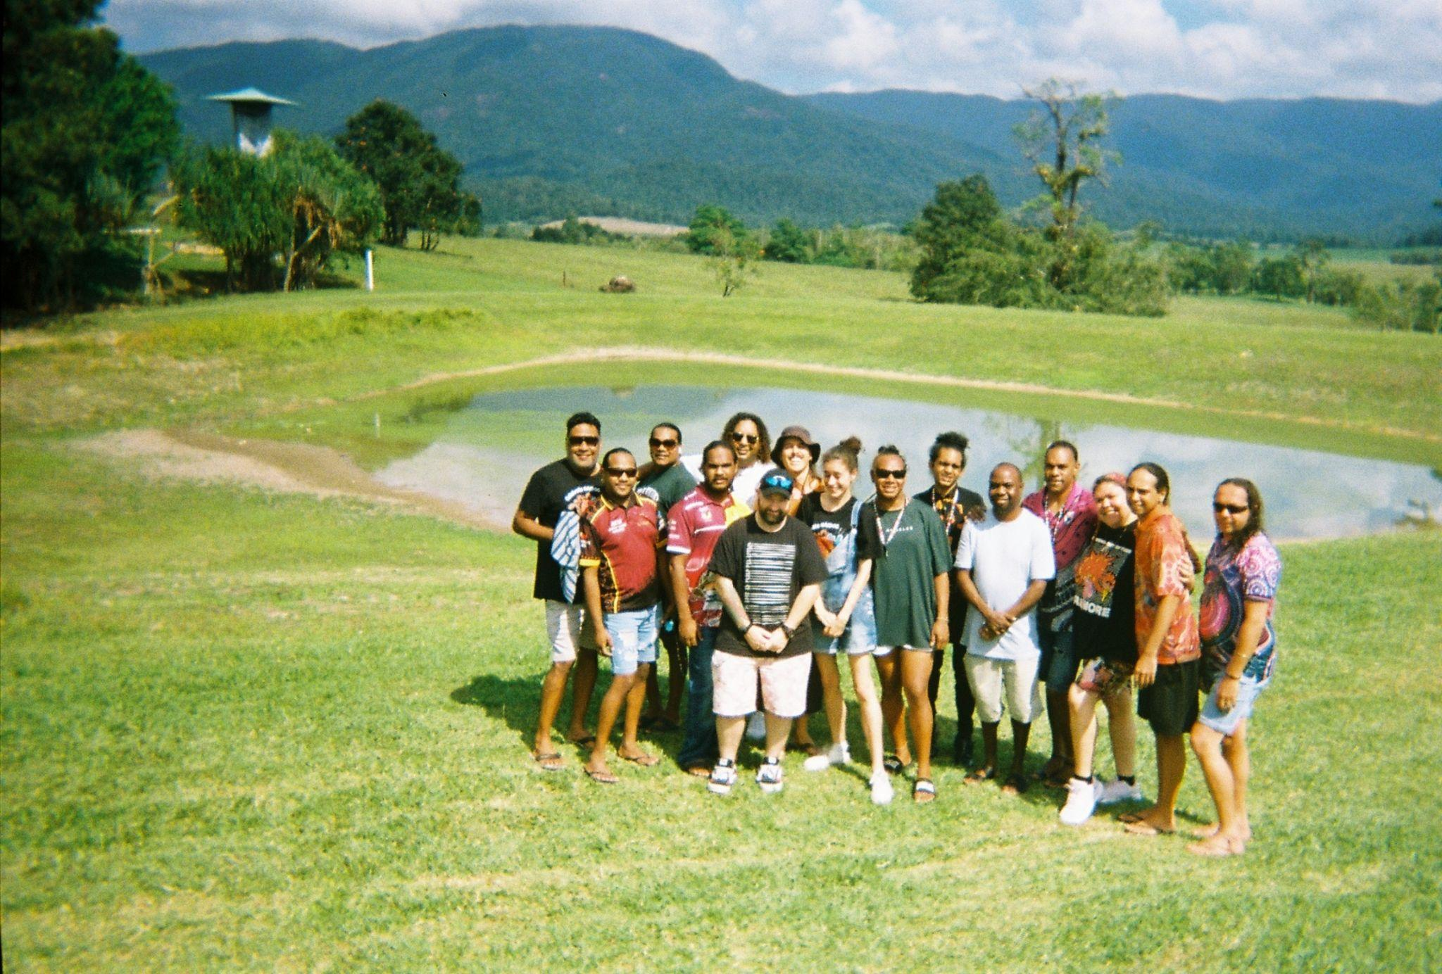
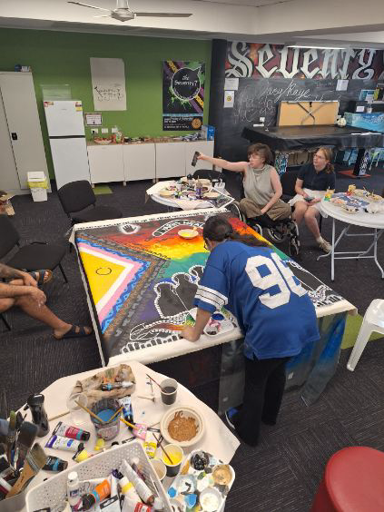
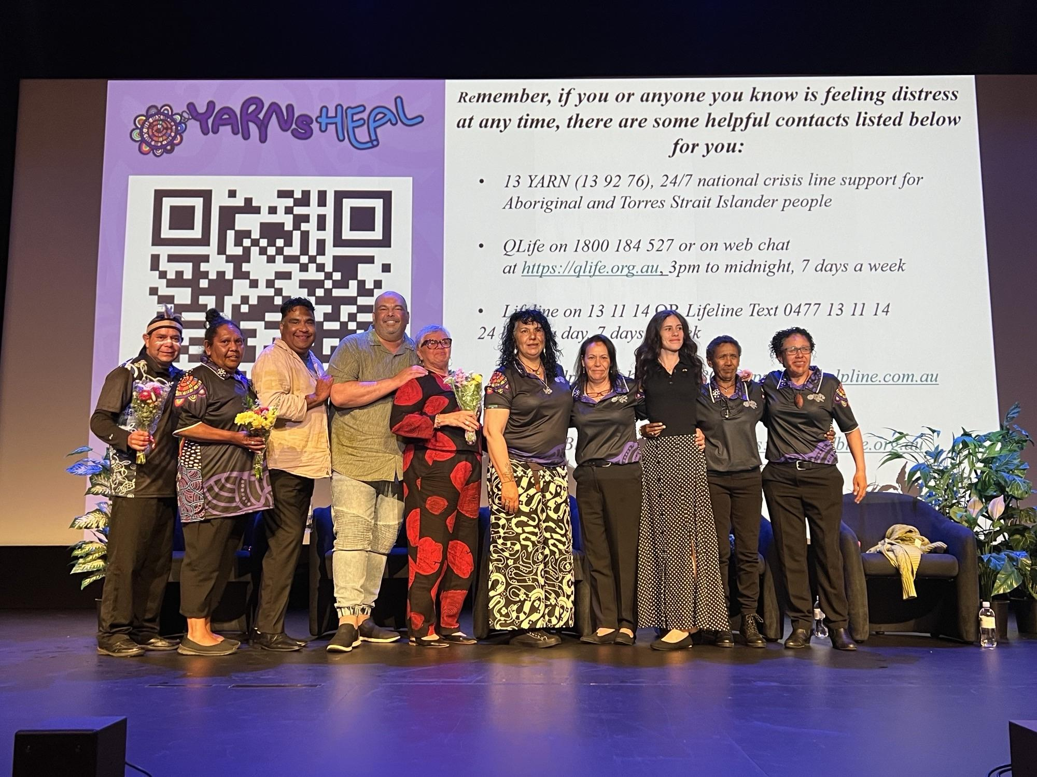
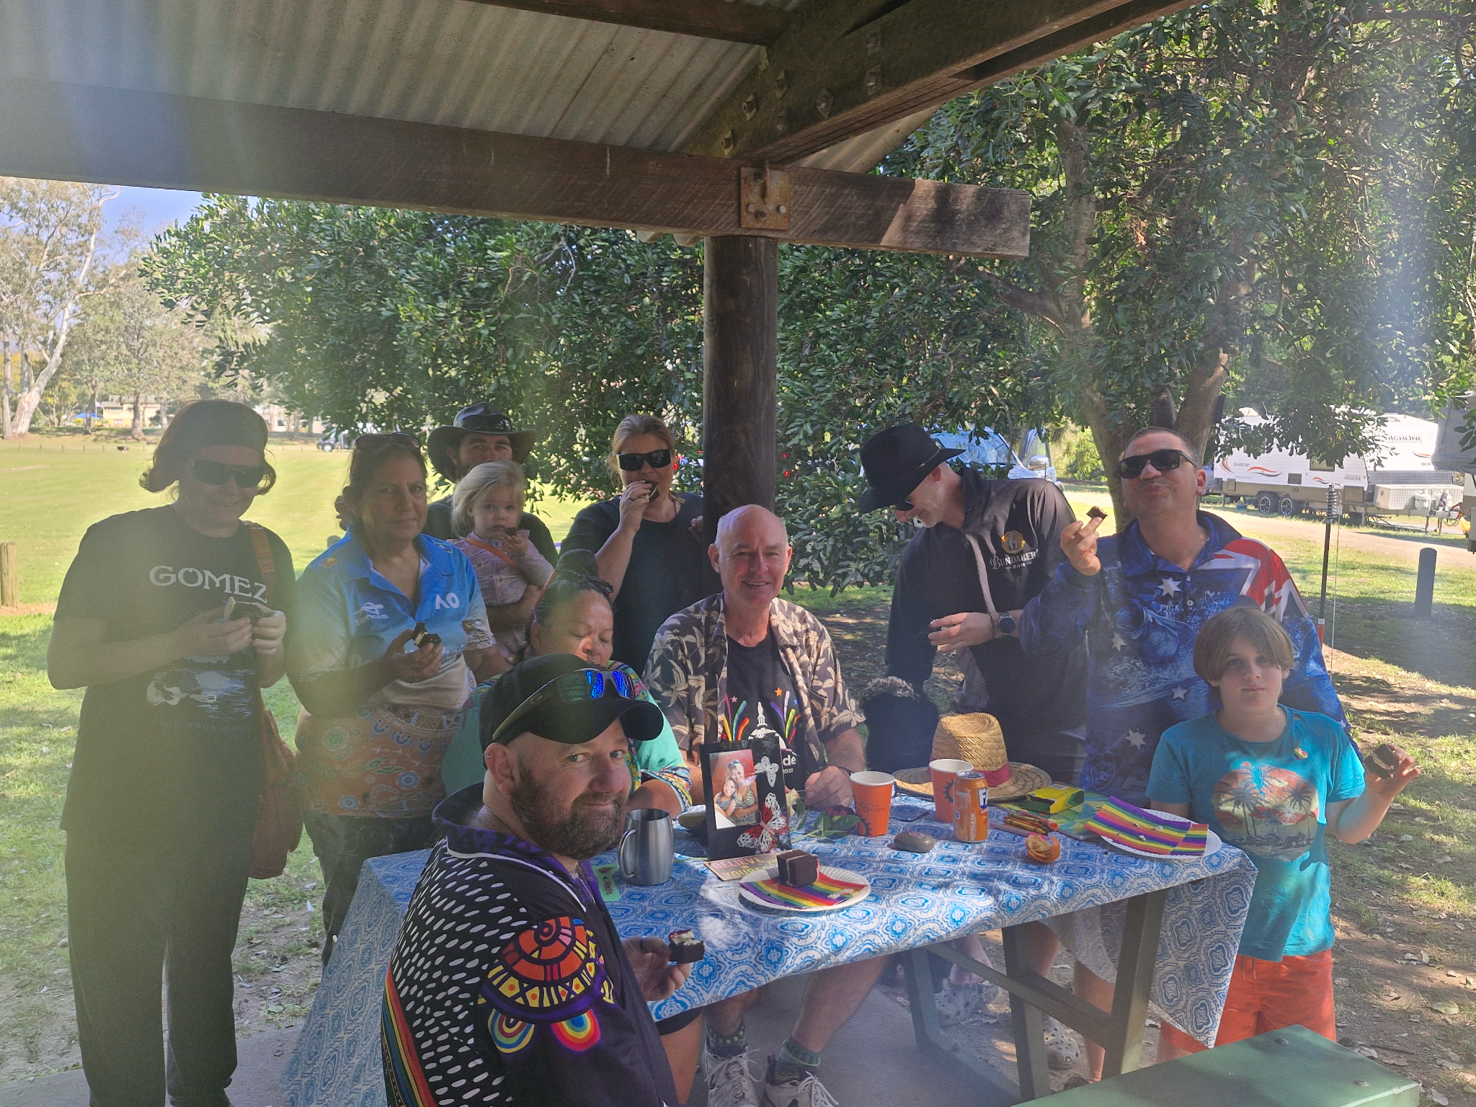
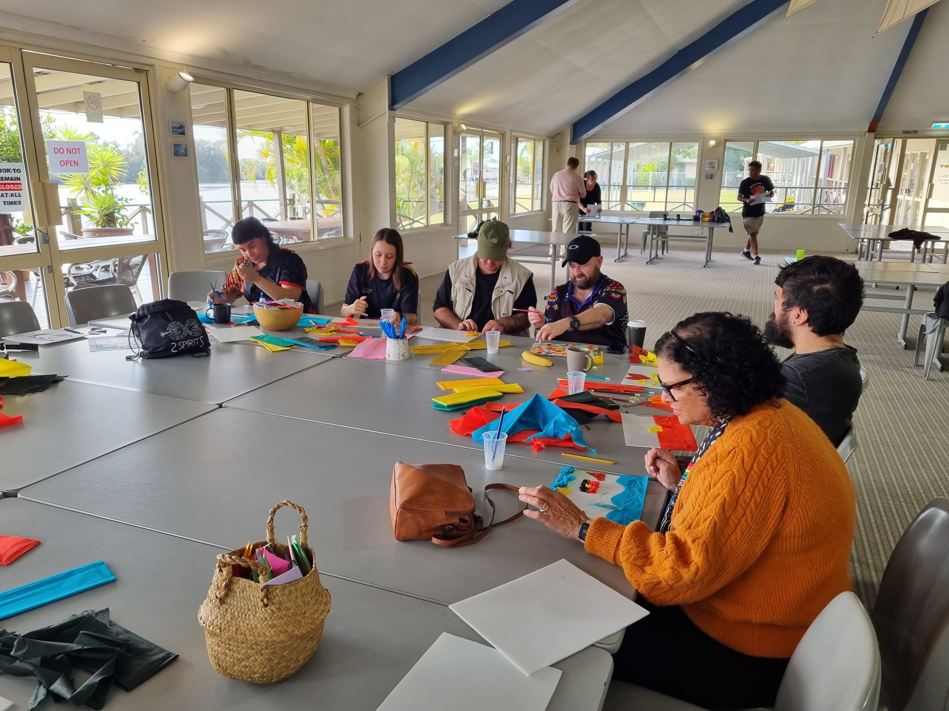
ACTIVITIES

Slide 10
Yarns Heal Model for 2023 - 2024
Locally Led
Expert Guidance & Support
Healthier Communities
Local Experts
Specialist Project Advisors
YARNS HEAL
Local Groups
Project Team
Local Activities

Slide 11
Specialist Project Advisors
Connect with key people in project corridors
Establish an ongoing relationship with key people
Introduce to the right team member for the work to happen
Participate in local activities (as you can)
Safeguard evaluation for the right funding into the future through Process Integrity.
Specialist Project Advisor Members:
Uncle Ross Williams
Aunty Merle Cashman
Rebecca Johnson
Phil Sariago

Slide 12
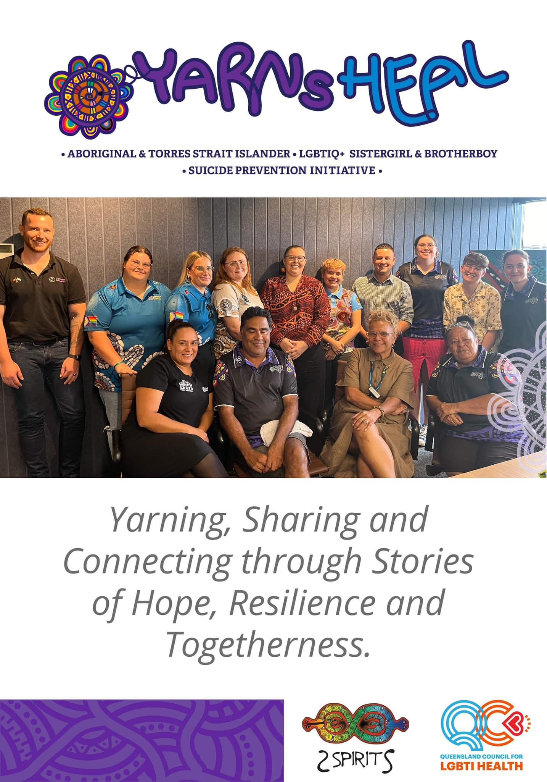
Yarns Heal Project 2023 – 2024 Six Corridors
    Inala/Toowoomba/Dalby;
    Rockhampton/Gladstone/Bundaberg;
    Yarrabah/Cairns/Hinterland/Townsville;
    Fraser Coast/Sunshine Coast/Brisbane North;
    Gold Coast/Beaudesert/Quandamooka Country
    Thursday Island, Aurukun, Doomadgee, Mt Isa

Slide 13
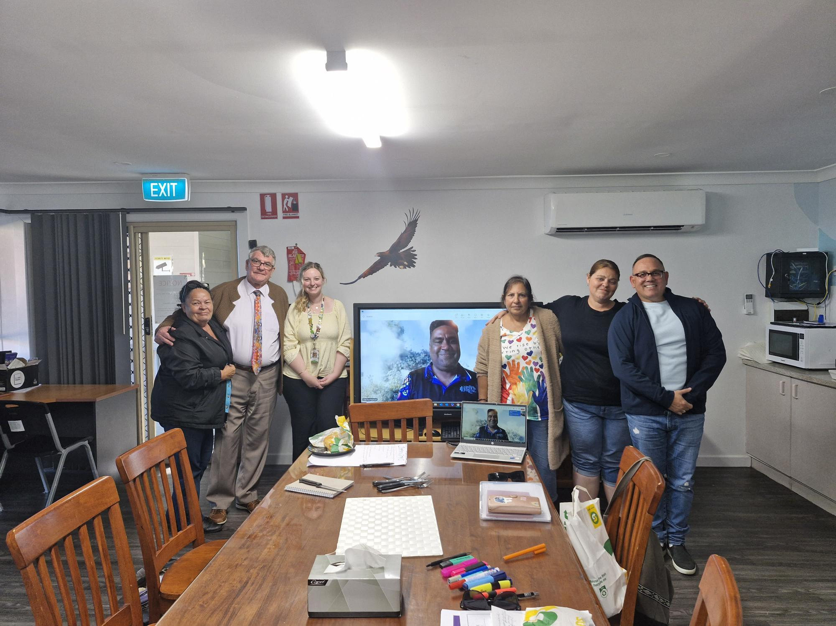
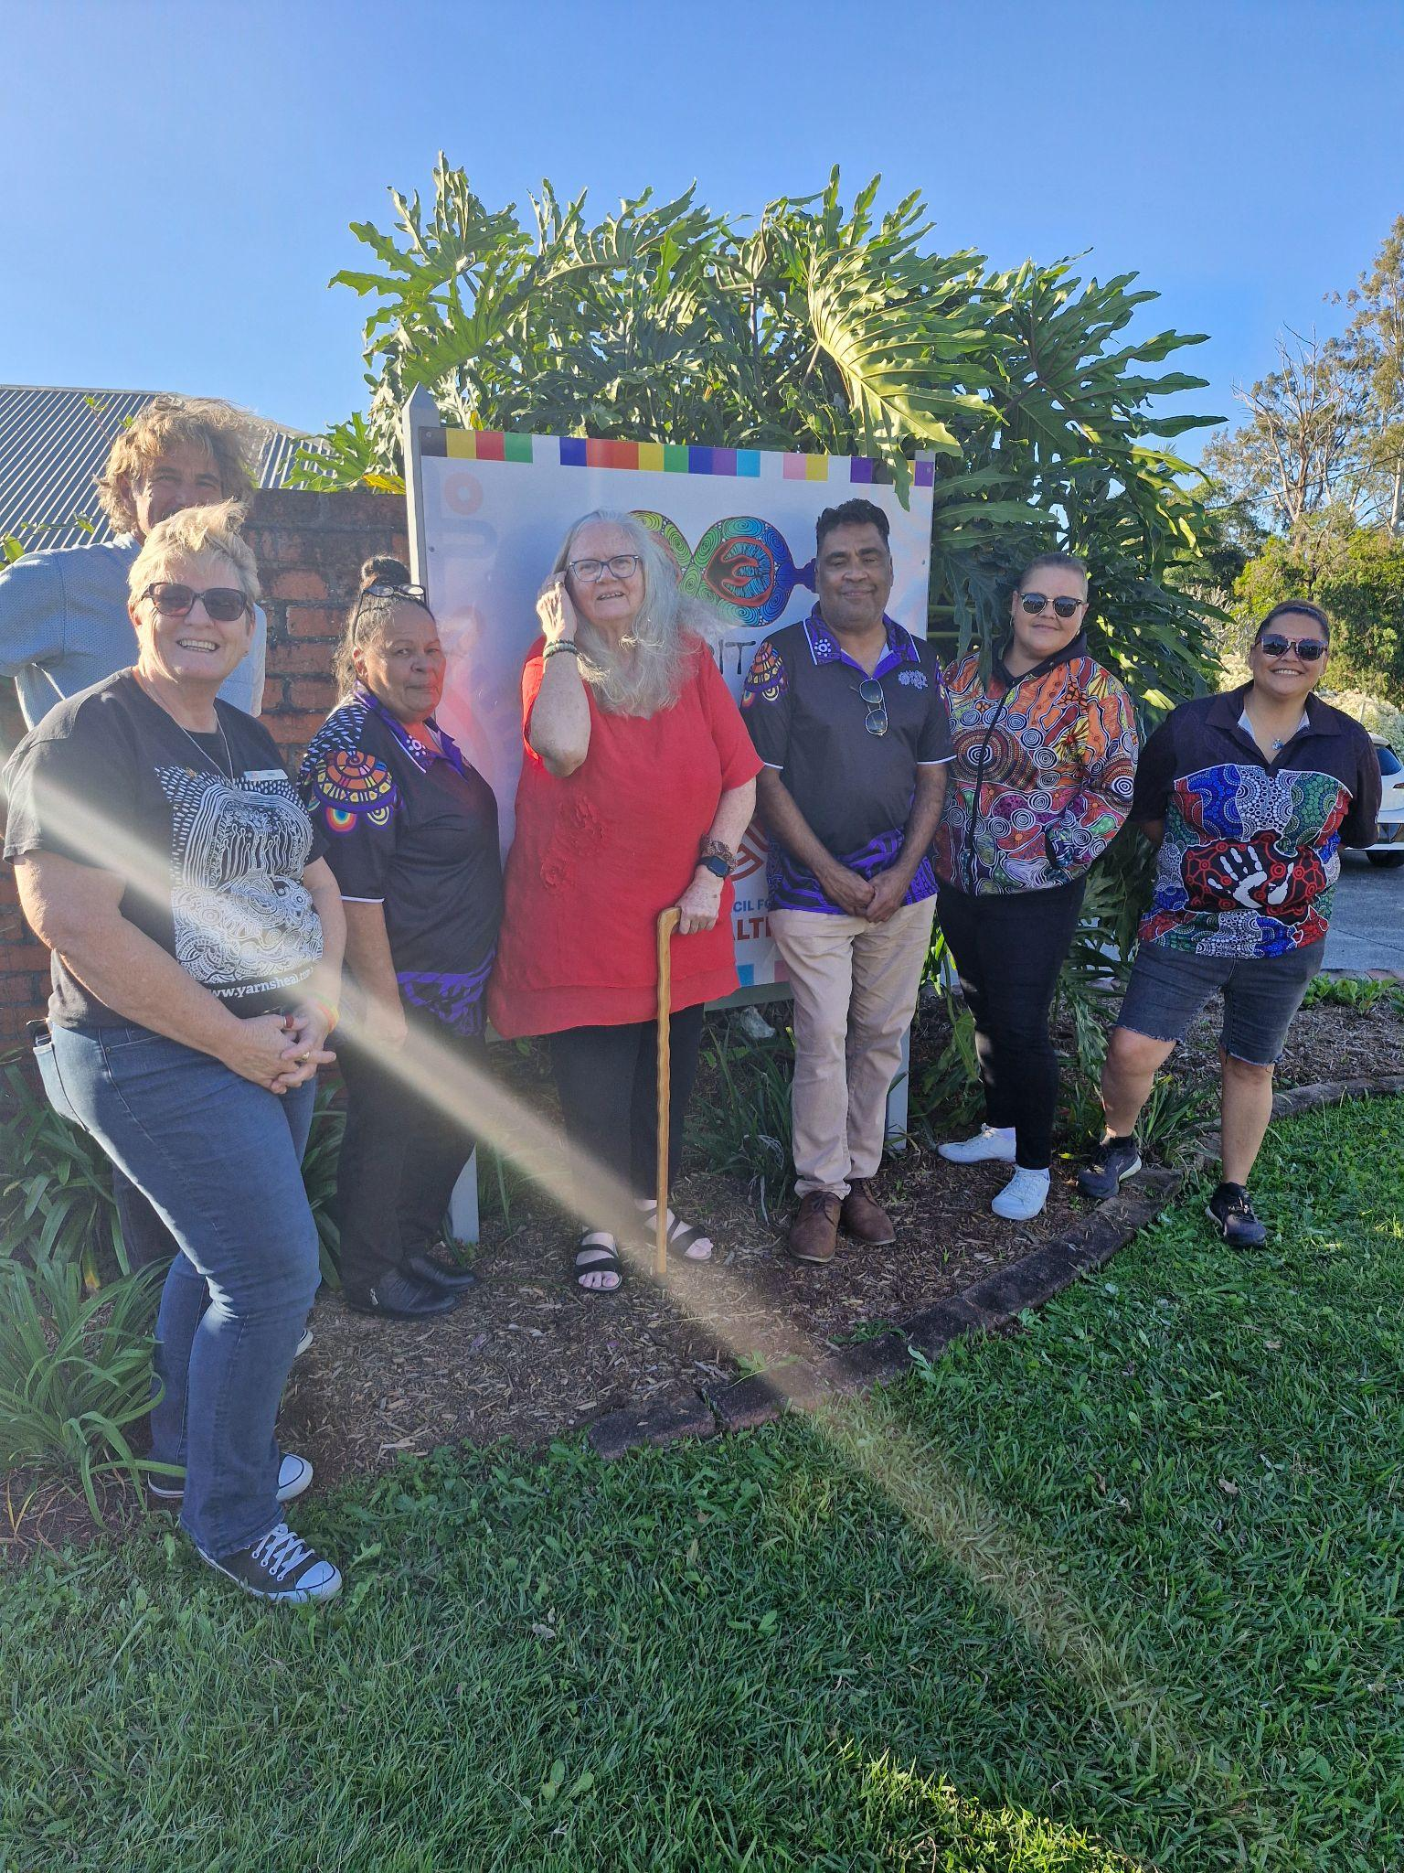
Corridor Community Conversations and Co-design
Community Conversations
  Talk about the project and work out what will and won’t work
  Local Expert Groups
    Paid Sitting Fees
    4 Meetings over project (Jan, Mar, May, Oct)
    Integrity and Guidance of Local Project Plan
  Local Project Plan
    Communities Conversations
    Campaign Artwork Design
    Local Activity Planning
    Local Education Sessions
    Evaluation & Sustainability

Slide 14
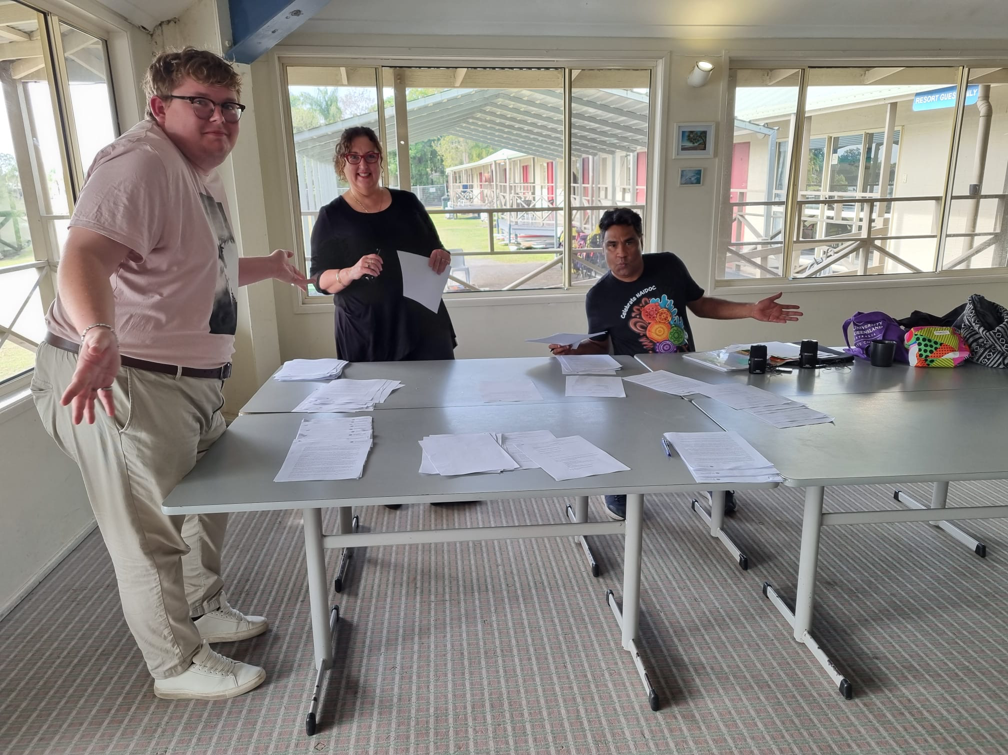
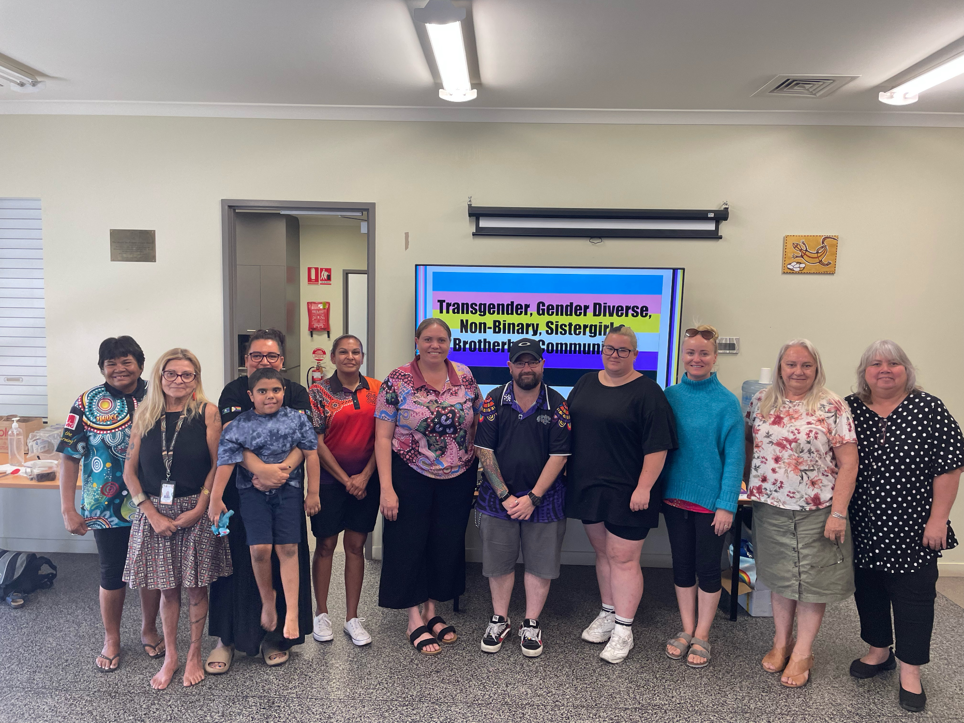
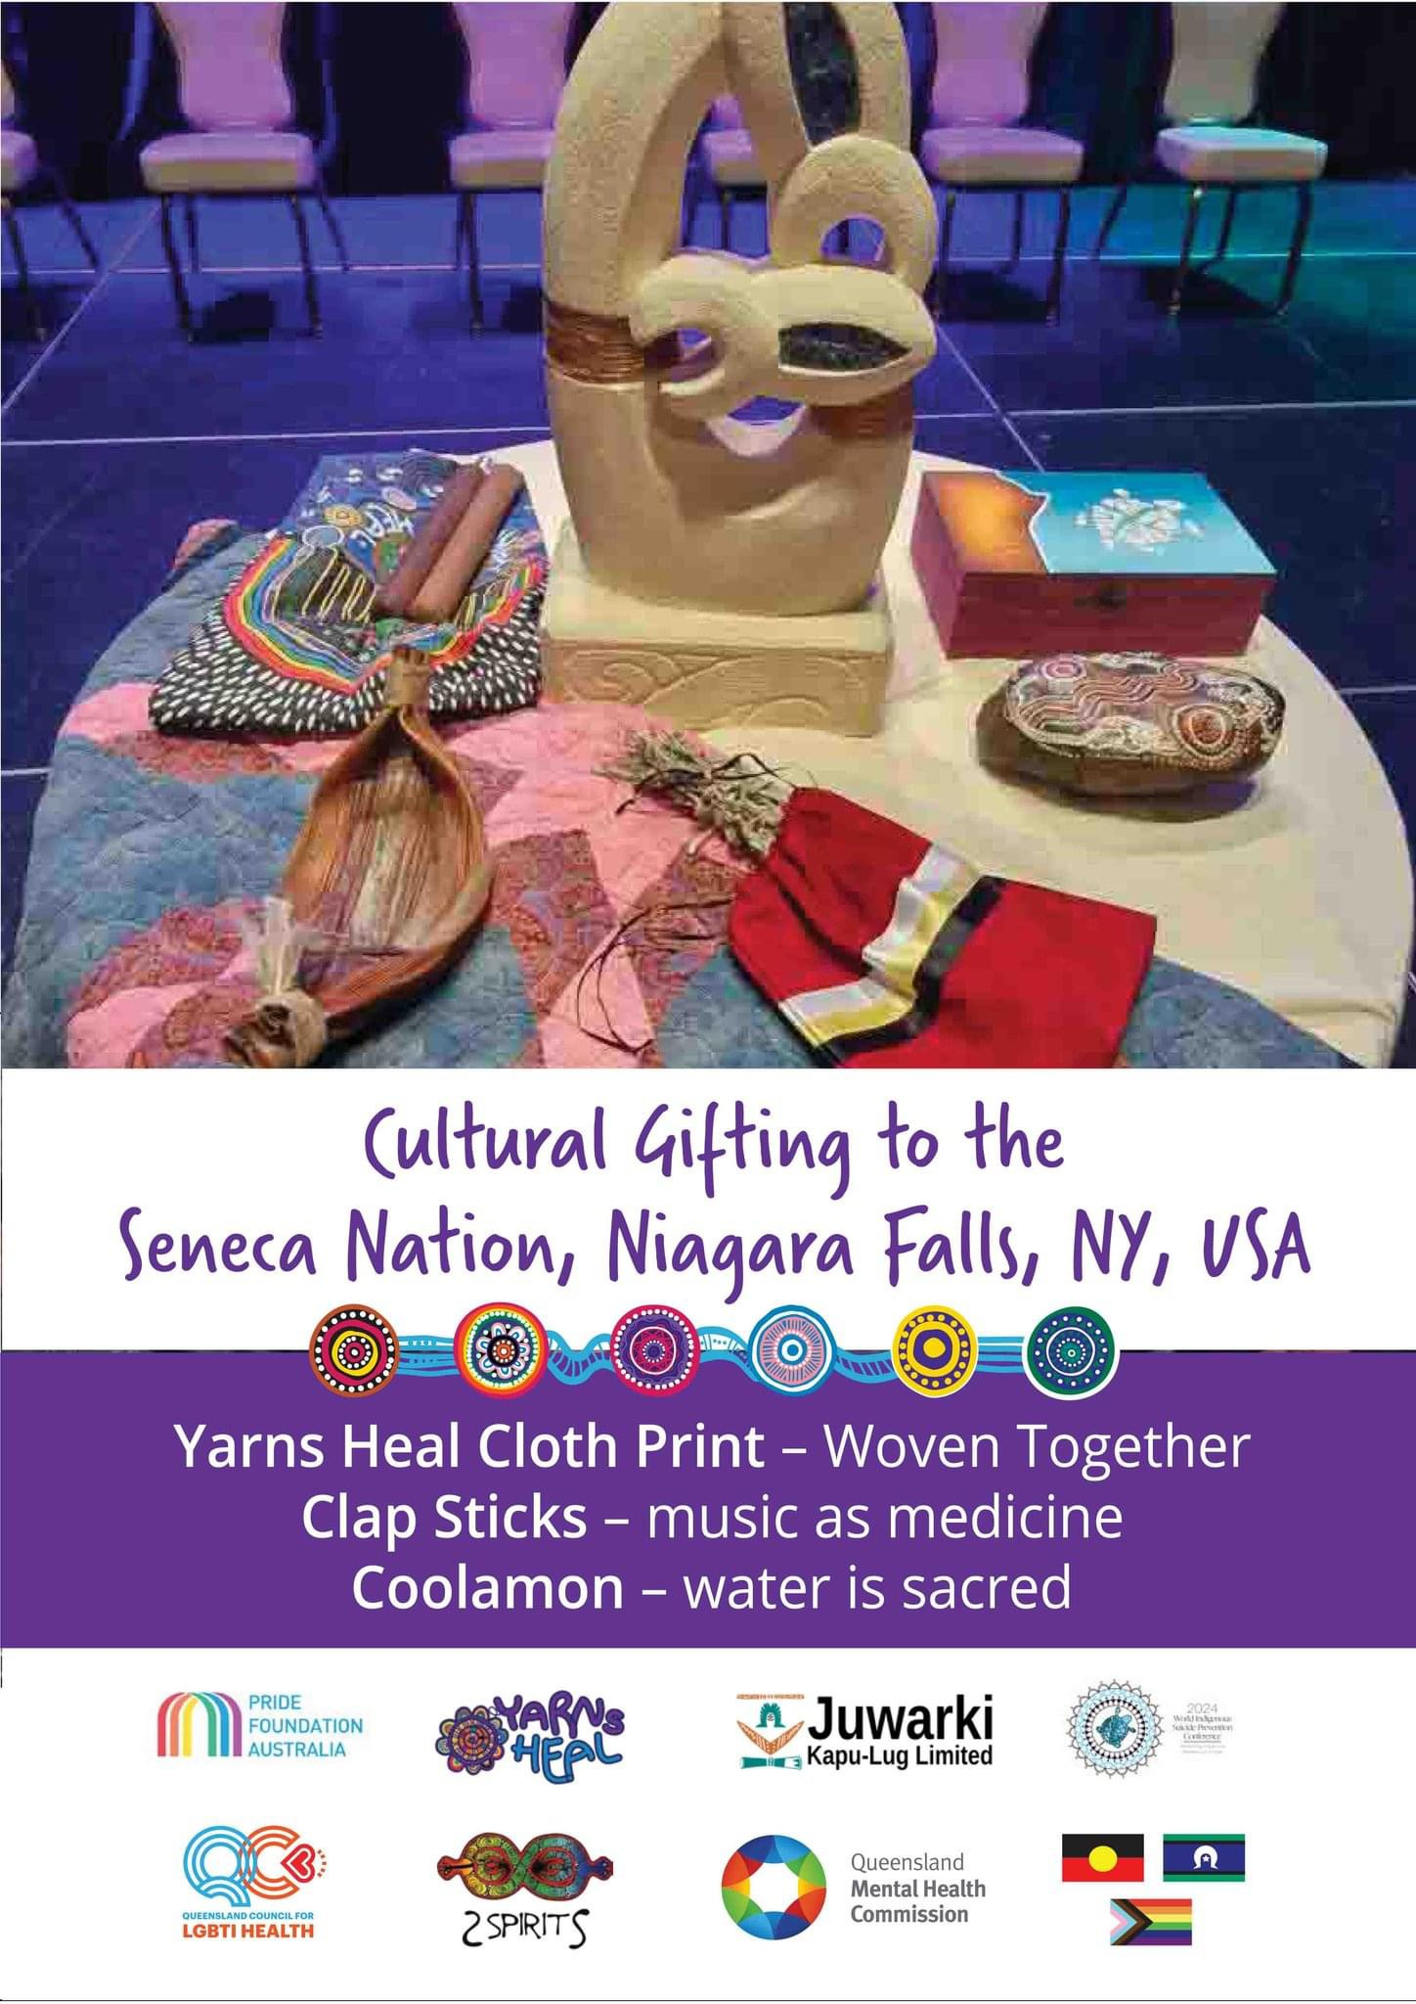
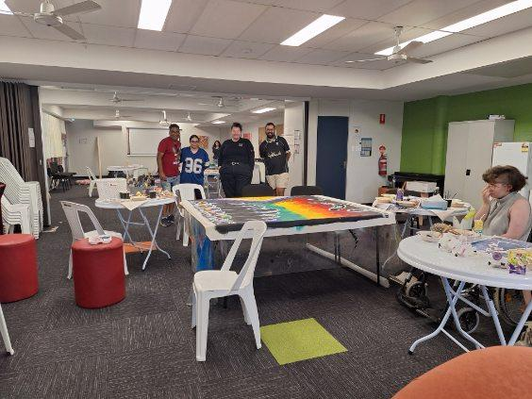
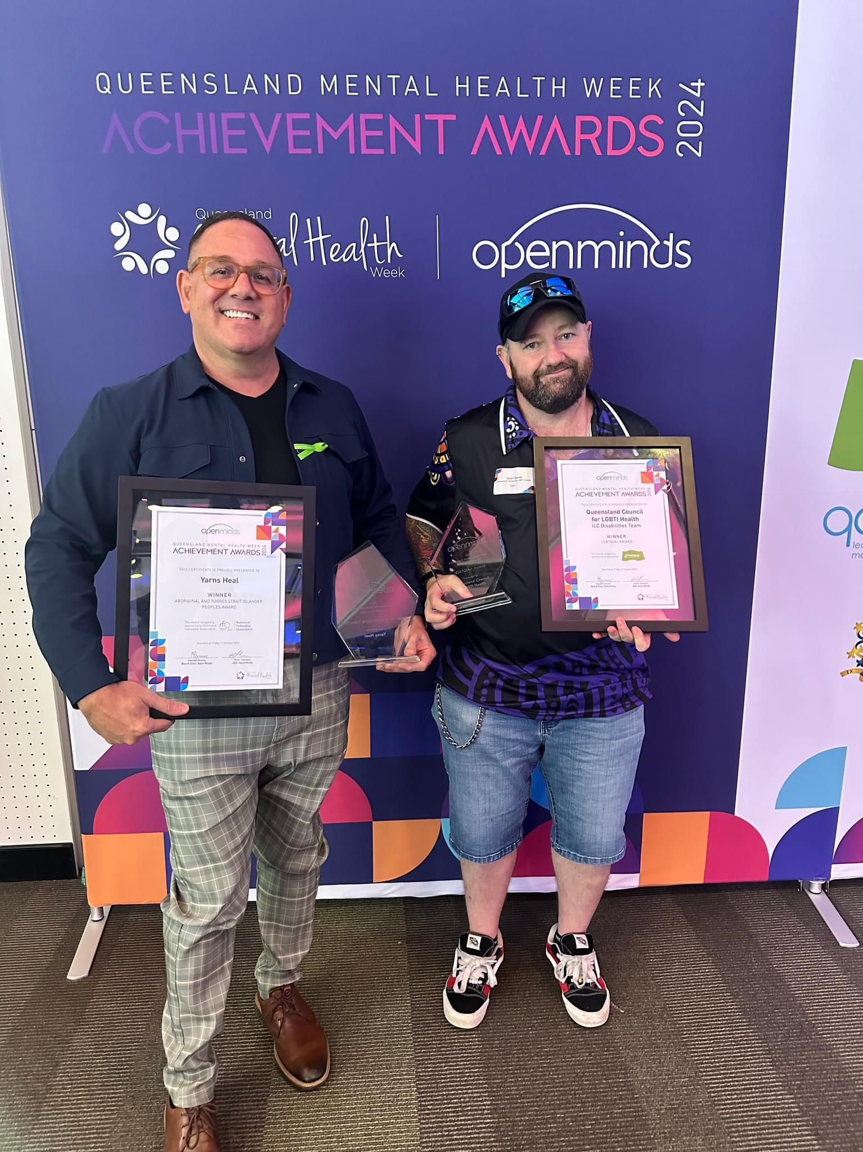
CELEBRATING COMMUNITY EXCELLENCE
If you give yourself that grace it helps you give that grace to anybody else that’s in your path… it gives them the strength… you never know what seed you plant, you may never see that seed grow and blossom
Yarns Heal - Participant Words of Wisdom 2024

Slide 15
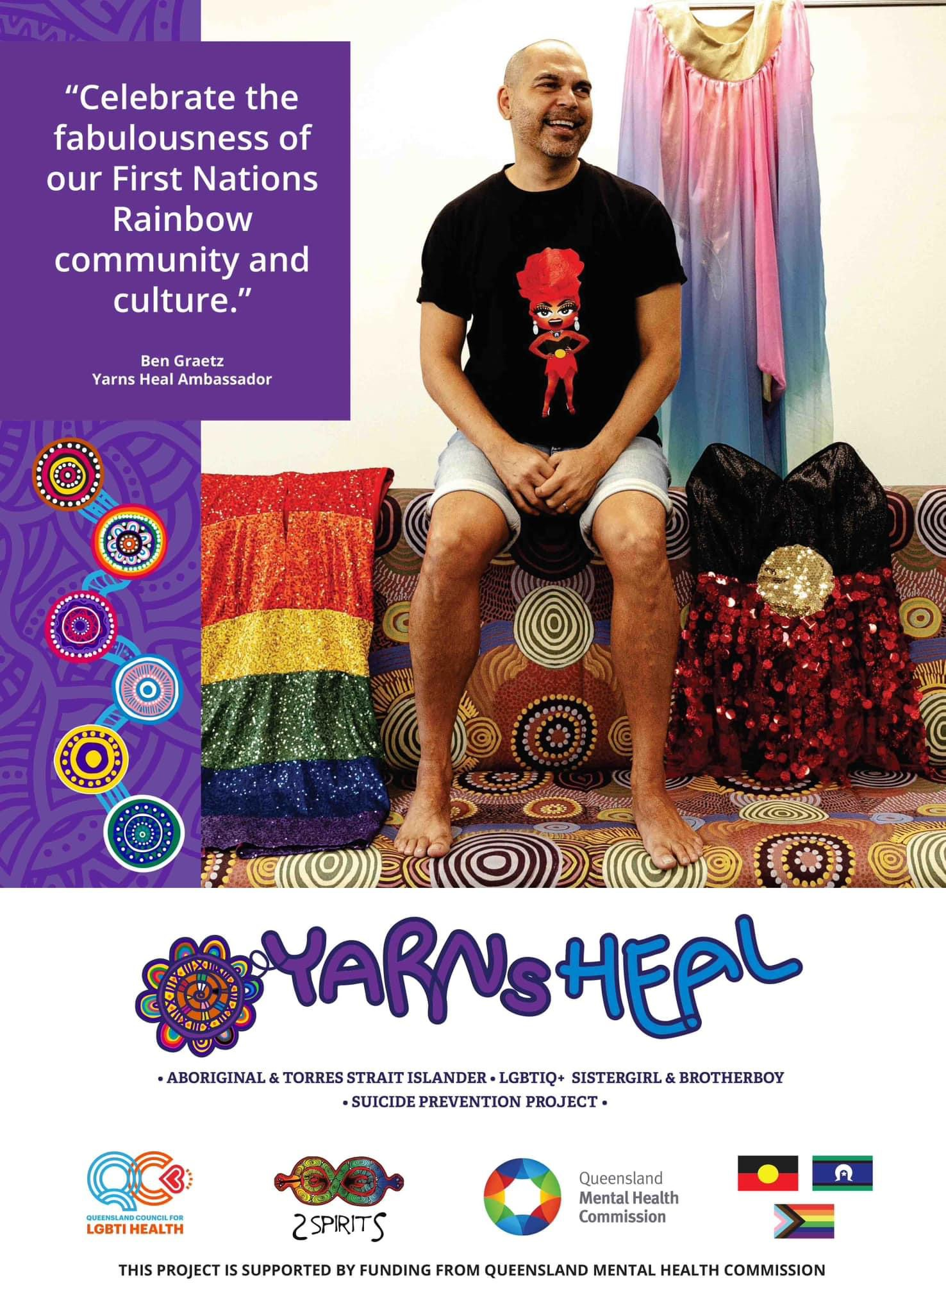
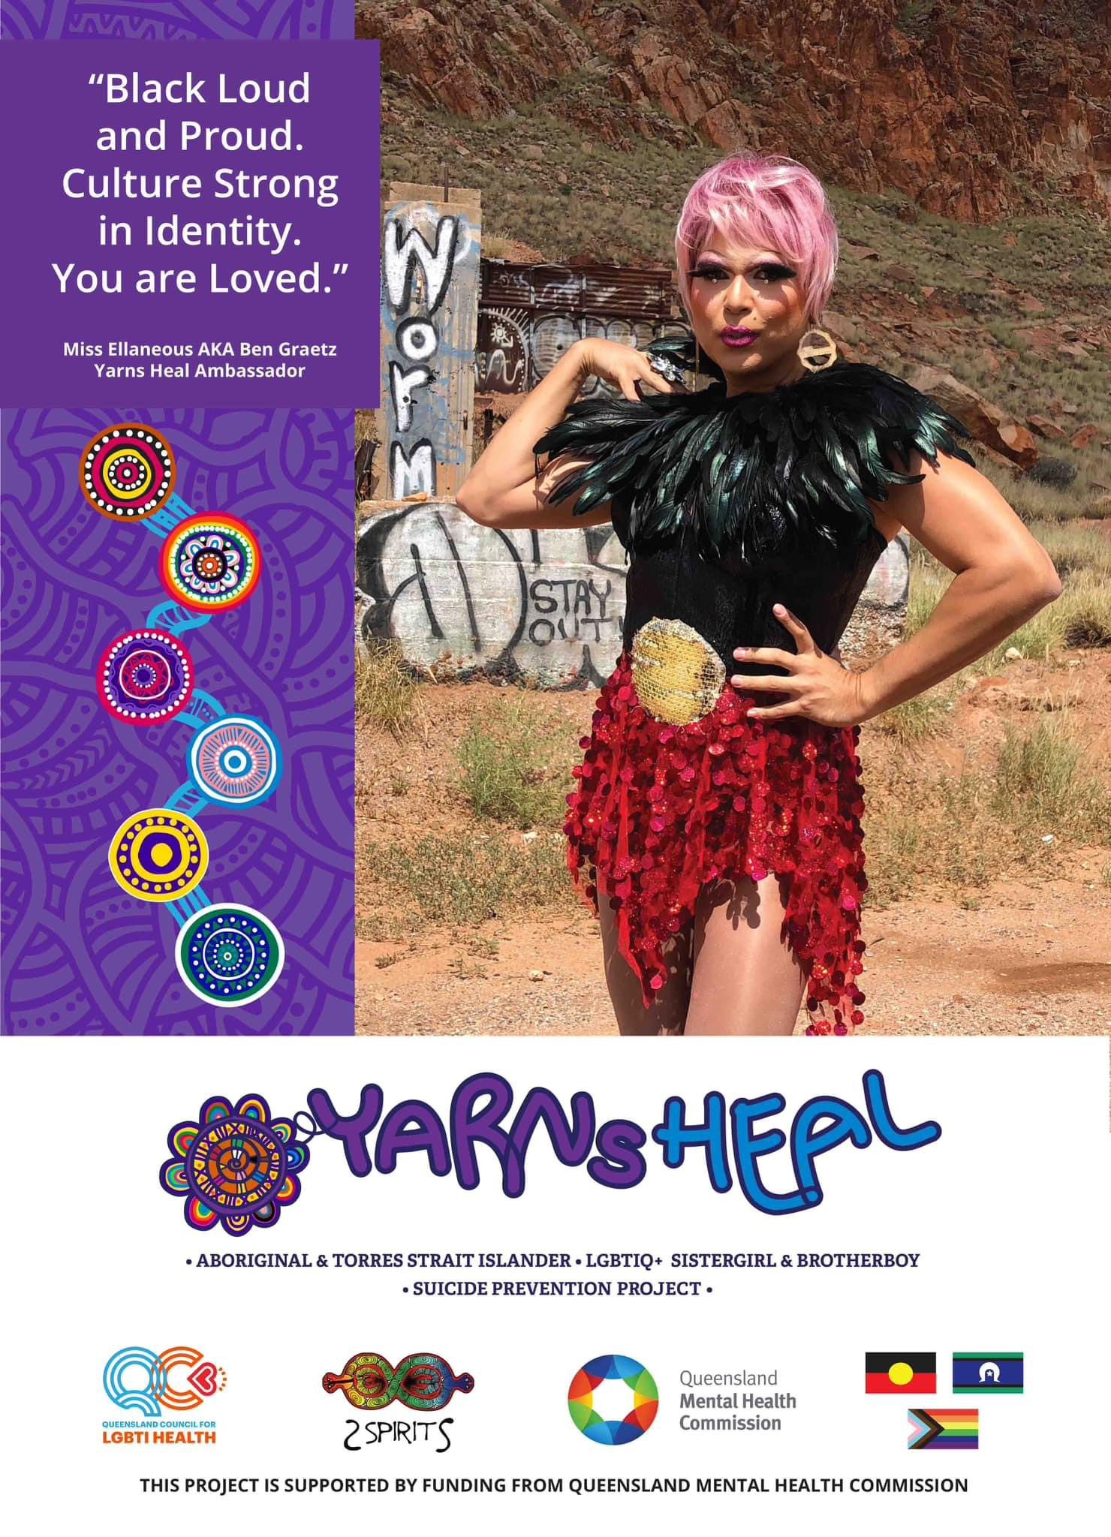

Slide 16
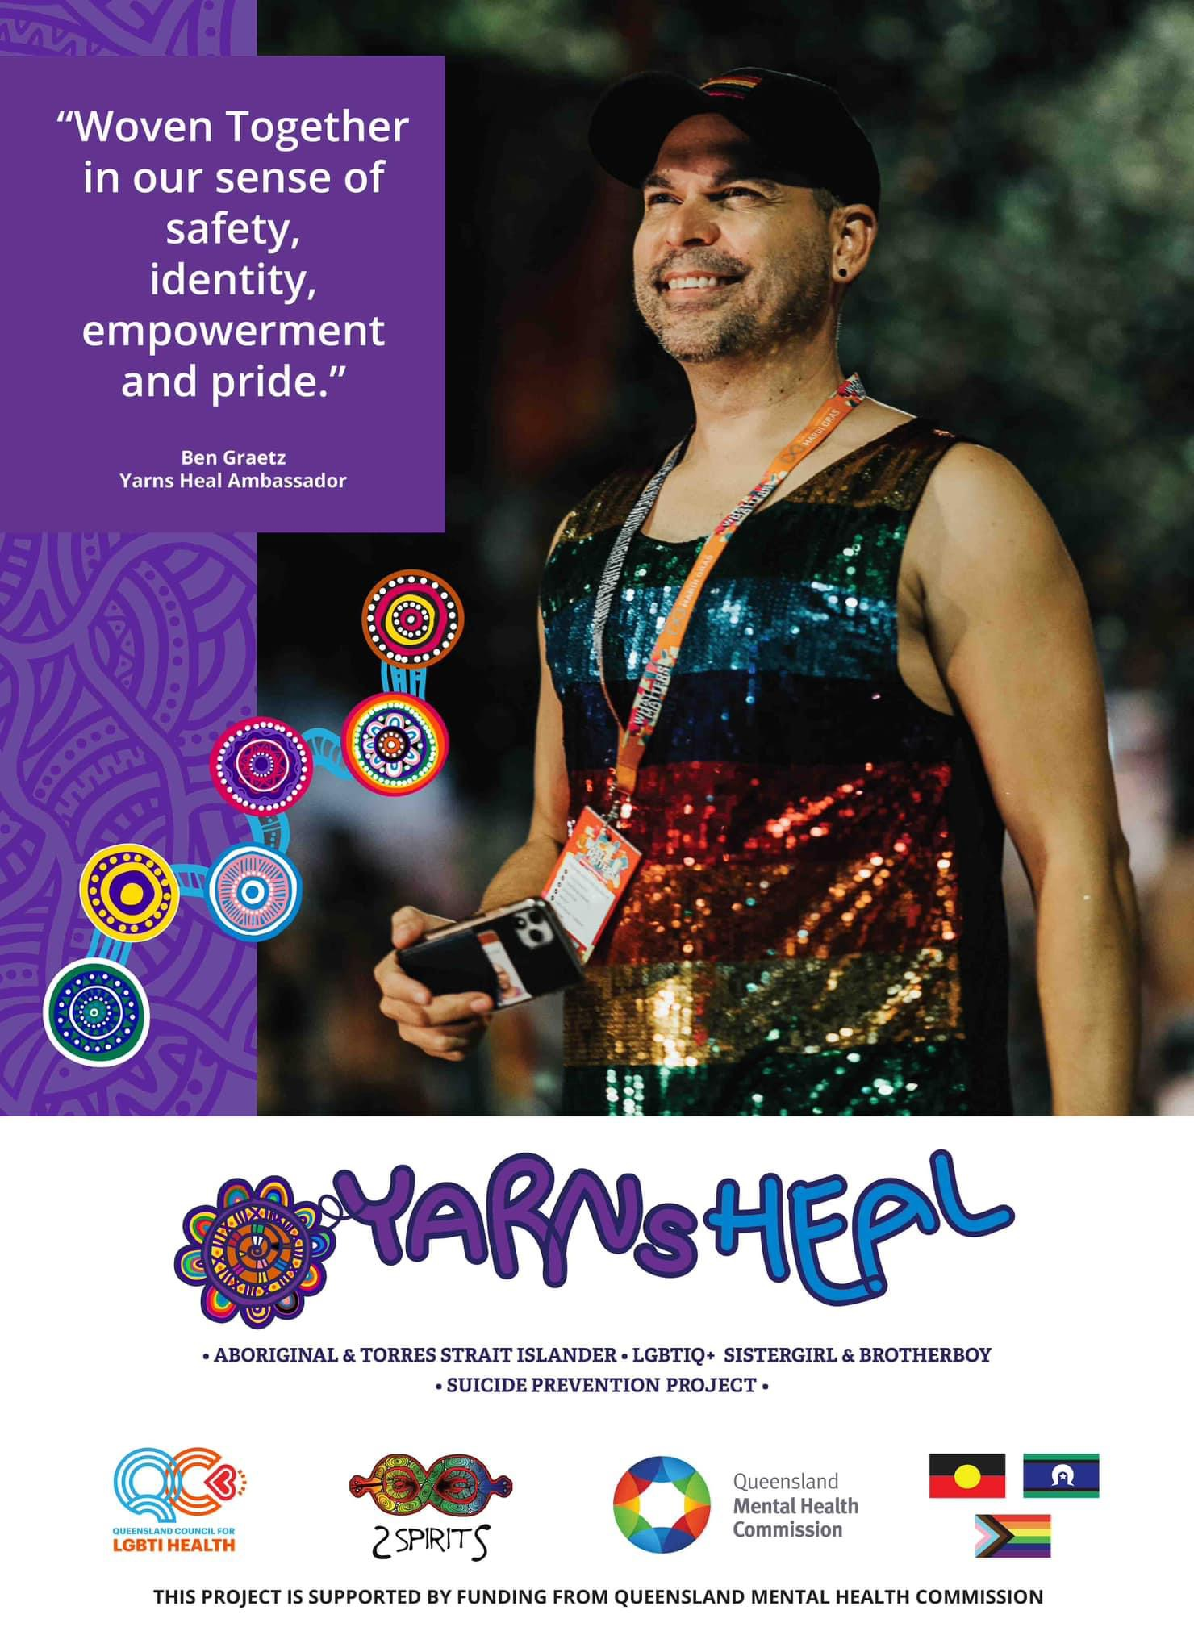
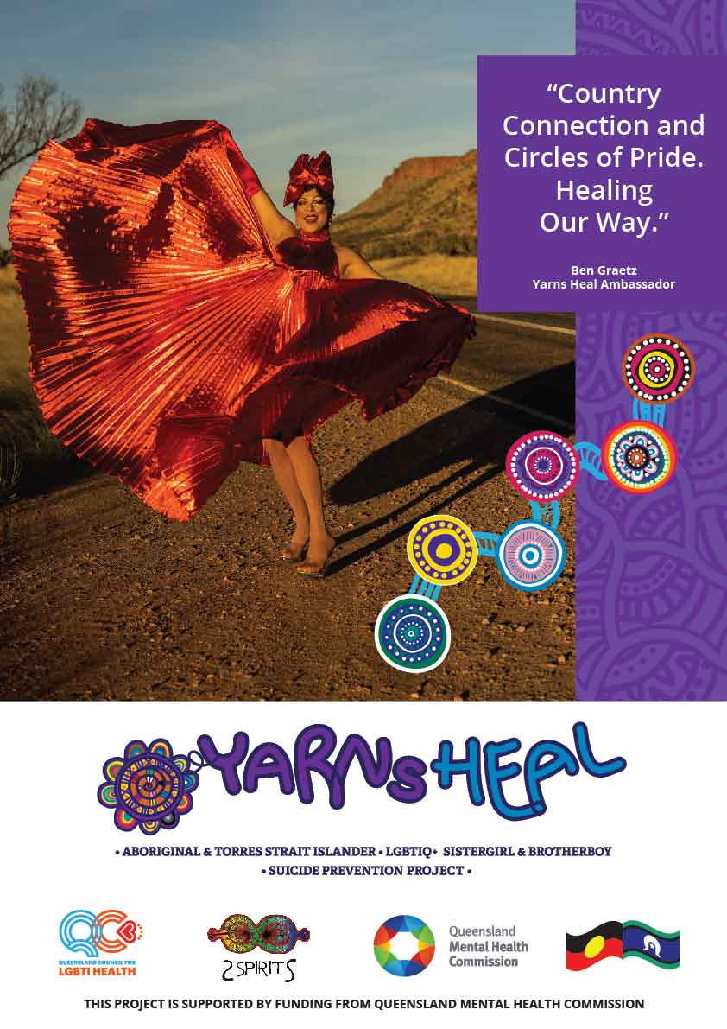

Slide 17
What is next

Slide 18
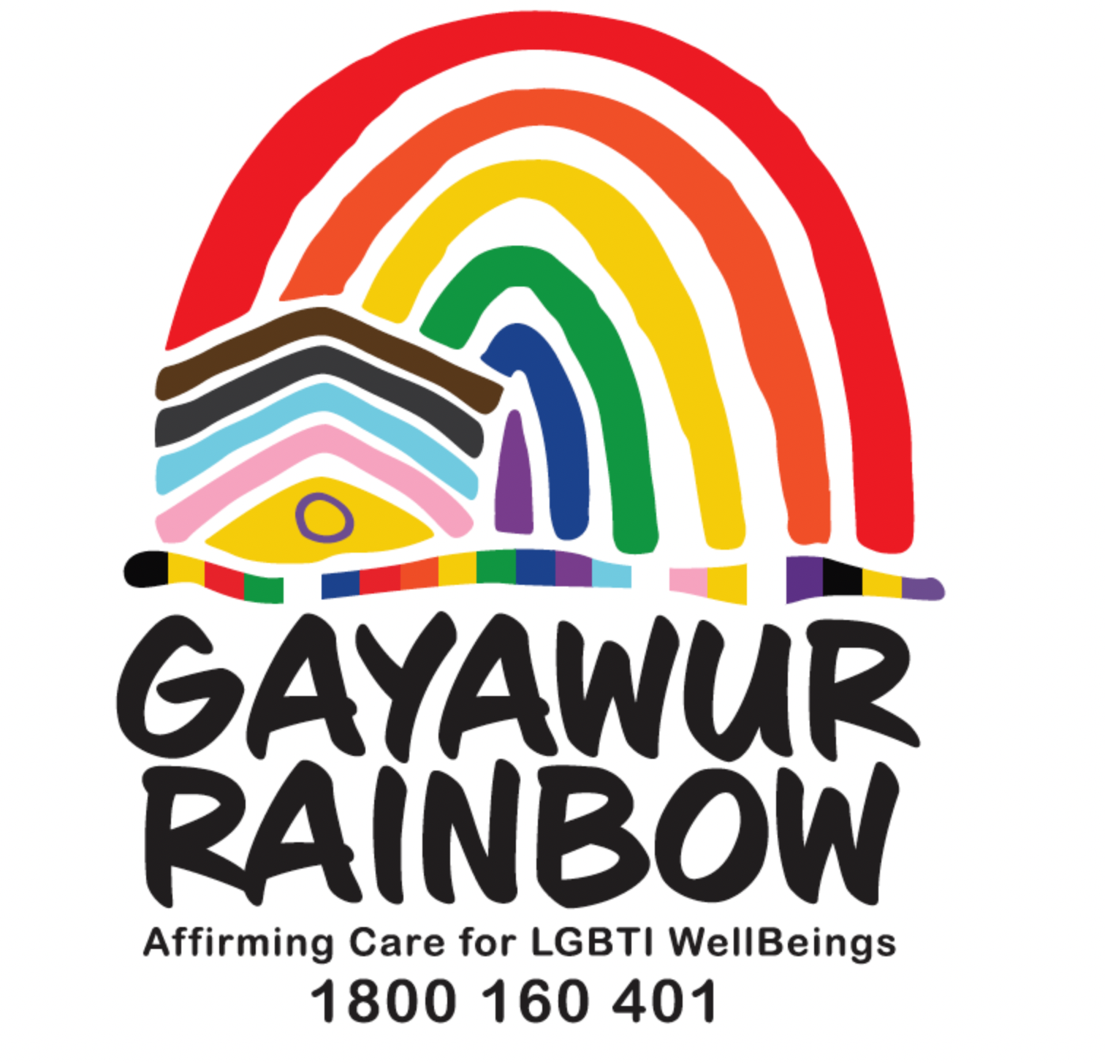
A call to action: Nothing about us without us
2Spirits - Aboriginal and Torres Strait Islander Corporation for Queensland LGBTIQ+ Sistergirl and Brotherboy Health and Wellbeing - June 2024
Completion of final report - Executive Summary will publicly available
First Nations LGBTIQ+ Sistergirl and Brotherboy Peer workforce
Gayawur Rainbow - Statewide Gender affirming care for wellbeing(s)
Notes:
A Call to Action: Building Safer Communities Together The journey does not stop with Yarns Heal. Suicide prevention is a collective responsibility, and we call on all sectors—governments, businesses, community organisations, and individuals—to join us in this work. The future of suicide prevention lies in the hands of those who understand that healing cannot happen without inclusion, cultural respect, and meaningful partnerships. Together, we have the opportunity to change lives, strengthen communities, and create a safer, more compassionate world for all.
By investing in projects like Yarns Heal, we are investing in futures where no one is left behind, where stigma is replaced with understanding, and where the strength of our communities becomes the backbone of long-lasting mental health outcomes.

Slide 19
THANK YOU

Slide 20
Support
Please remember, if you or anyone you know is feeling distress at any time, there are some helpful contacts listed below for you:
  13 YARN (13 92 76), 24/7 national crisis line support for Aboriginal and Torres Strait Islander people
  QLife on 1800 184 527 or on web chat at https://qlife.org.au
  3pm to midnight, 7 days a week
  Lifeline on 13 11 14
  Lifeline Text 0477 13 11 14
  24 hours a day, 7 days a week
  Lifeline web chat is available 24 hours a day 7 days a week
  https://www.lifeline.org.au/crisis-chat/
  Kids Helpline – 1800 55 1800 https://kidshelpline.com.au
  Available anytime

Slide 21
For more information, please contact;
2Spirits
2Spirits@qc.org.au
Queensland Council for LGBTI Health info@qc.org.au
Yarns Heal Project is proudly funded by the Queensland Mental Health Commission

