Slide 1
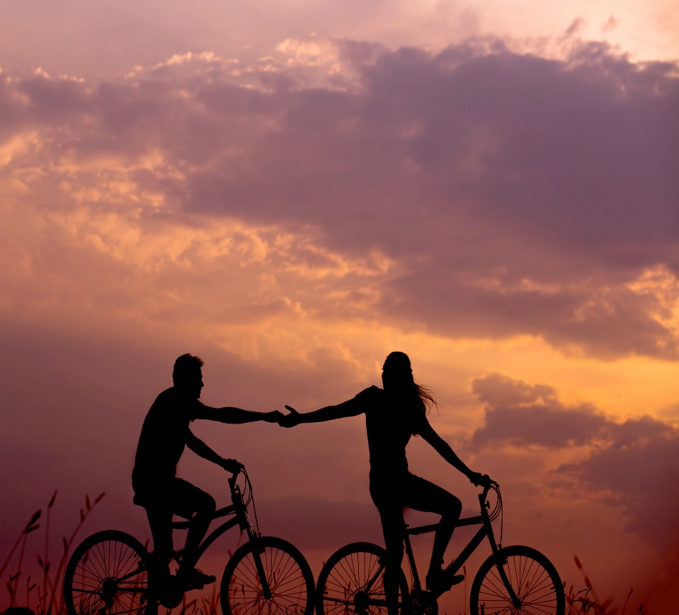

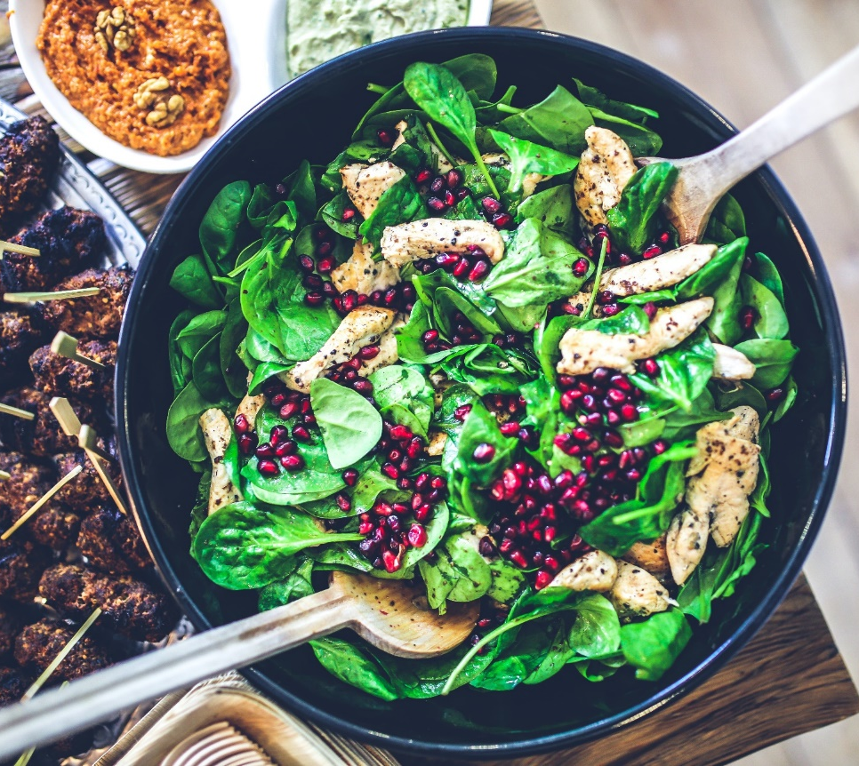
Lifestyle medicine in mental health care
Dr Sam Manger MBBS BSc FRACGP FASLM
GP, Clinical and Academic, Lifestyle Medicine Postgraduate Academic Lead, James Cook University
Vice-President Australasian Society of Lifestyle Medicine
Ambassador Equally Well Australia
Podcast Host - The GP Show
Notes:
All images copyright free – Pexels/unsplash
Thank you – organisers and acknowledge of country
2 parts = L a M, and L in M

Slide 2
Acknowledgement of Country
I respectfully acknowledge the Traditional Custodians of the Country on which this event is taking place, and all indigenous Elders past, present and emerging

Slide 3
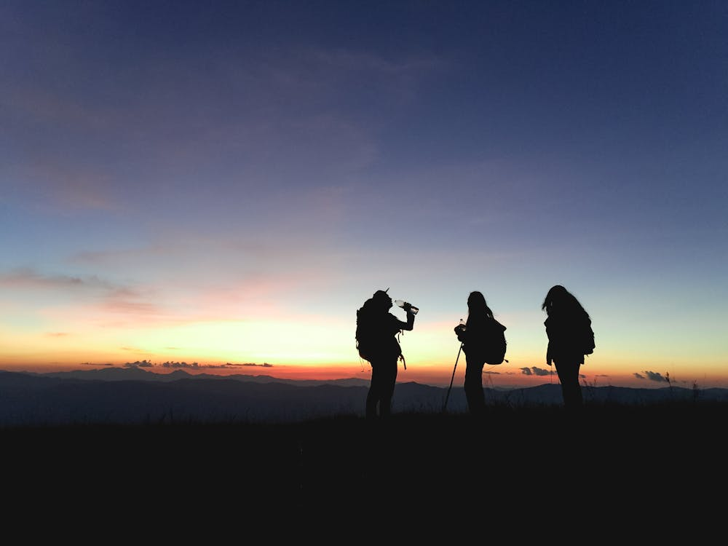
Acknowledgement of You

Slide 4
Contents: in 15 minutes!
What is lifestyle medicine and lifestyle psychiatry
Brief review for lifestyle medicine in mental health and co-morbid physical illness
Example of lifestyle medicine models of care in mental health

Slide 5
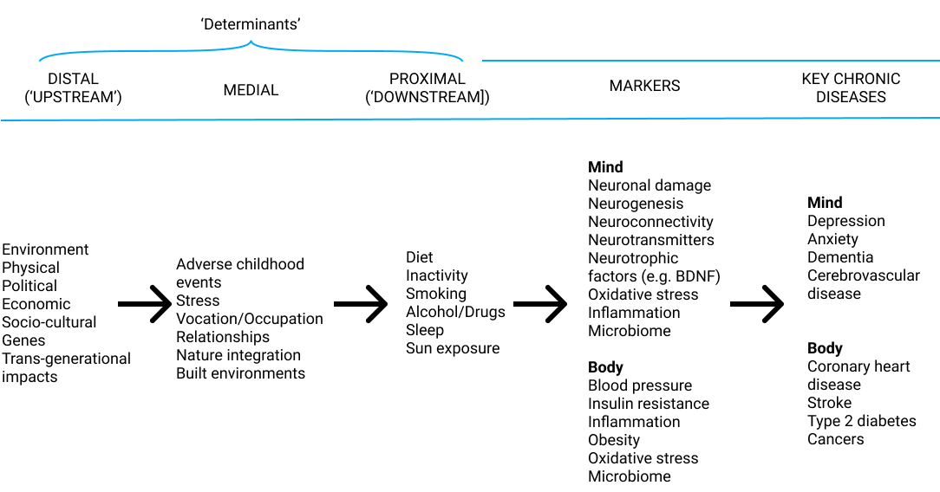
Lifestyle Medicine Model of Disease
Advocate and drive change at macro-environment
Effect positive and healing change here at individual and micro-environment
Dr Sam Manger 2019, Adapted from Egger, G., Binns, A., Rossner, S., & Sagner, M. (Eds.). (2017). Lifestyle medicine: Lifestyle, the environment and preventive medicine in health and disease. Academic Press.
Notes:
Cauase of markers = LM
SM = obesity class analogy – saturated in sugar and every turn in our society is truly awful
3. Heritability of your age at death is only ~25%, ~50% of the aging of your brain due to your genes, rest environmental factors,
The more we learn about epigenetics the more these numbers shift

Slide 6
“Ingredients” of Lifestyle Medicine
Nutrition and Fasting
Movement
Mind-body approaches
Sleep
Reducing harmful screen and substance use
Social Connection
Nature prescriptions
Creative arts
Social prescribing and determinants
Drivers of Lifestyle Medicine
Behaviour Change Science e.g. health coaching, behavioural science
Models of Care e.g. group, peer, coaches, links, digital, proactive
Technology
Research
Personalised and culturally adapted
:
Notes:
Slide
Lots I cannot cover due to time and I didn’t include as covered in other talks I suspect

Slide 7
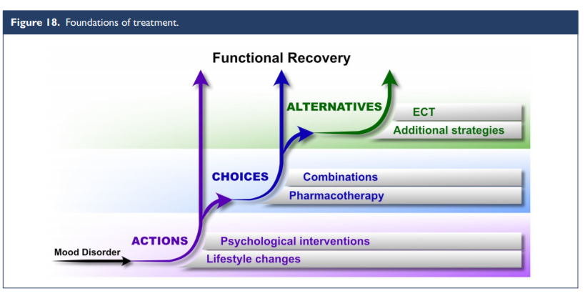
Recommended
“lifestyle changes and psychological interventions are foundational in the treatment of mood disorders. These are both recommended Actions – essentially non-negotiable and to be discussed with all patients”
Malhi GS, Bell E, Bassett D, et al. The 2020 Royal Australian and New Zealand College of Psychiatrists clinical practice guidelines for mood disorders. Australian & New Zealand Journal of Psychiatry. 2021;55(1):7-117. doi:10.1177/0004867420979353

Slide 8
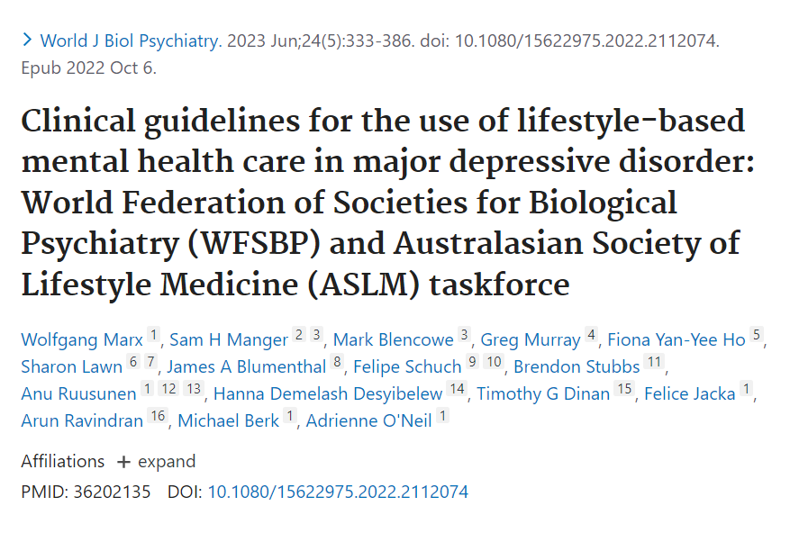
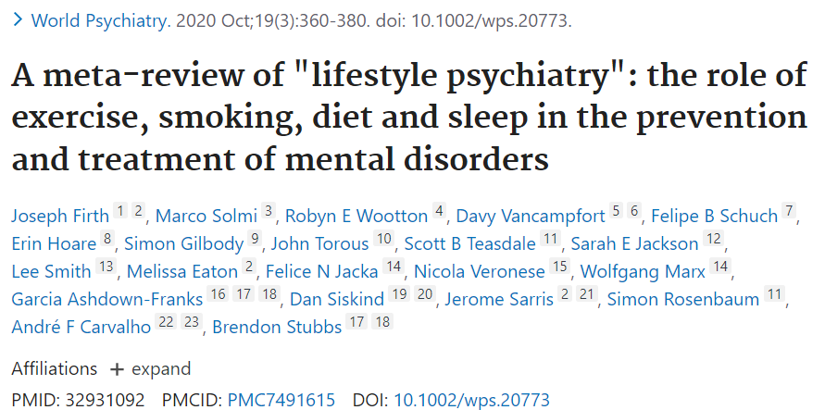
Lifestyle psychiatry

Slide 9
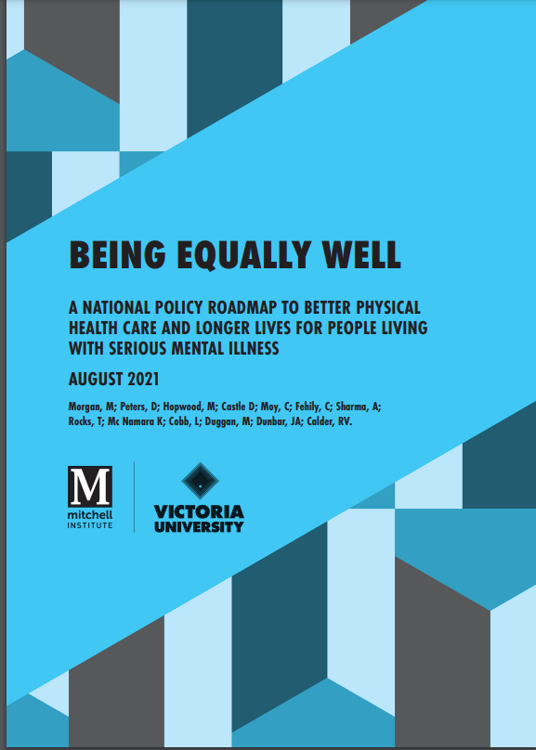
For both mental & physical health
“Nearly 80% of people with serious mental illness die prematurely of chronic physical health conditions that could be effectively managed and often prevented.”
10-20 year life expectancy between people with severe mental illness and the general population

Slide 10
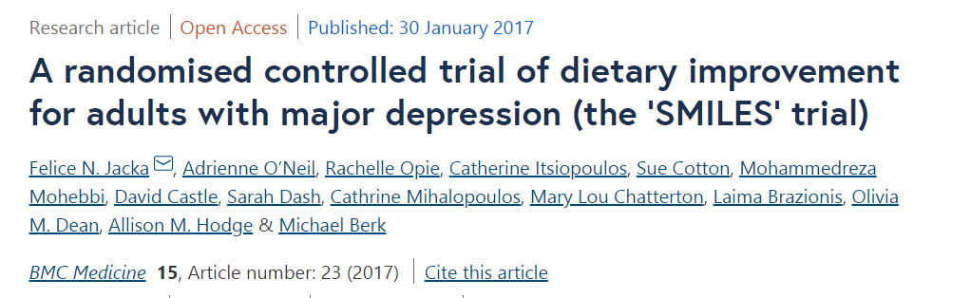
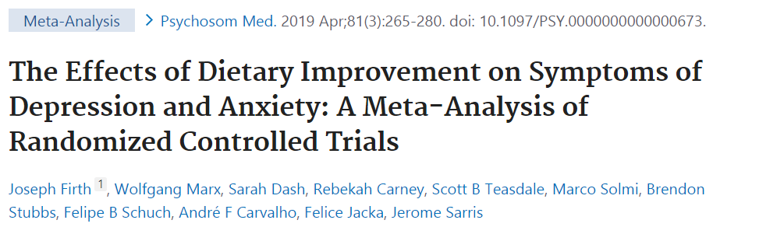
Food and Mood
32% of patients with moderate-to-severe major depression disorder remit with Mod-Mediterranean diet (vs 8% of control)
Now 4* RCTs have been repeated showing similar results for adolescents, elderly and 2 in adults
>45,000 participants with nonclinical depression; the results showed that dietary interventions significantly reduced depression and anxiety symptoms, particularly in women
Notes:
Benefits multiple areas, MH

Slide 11
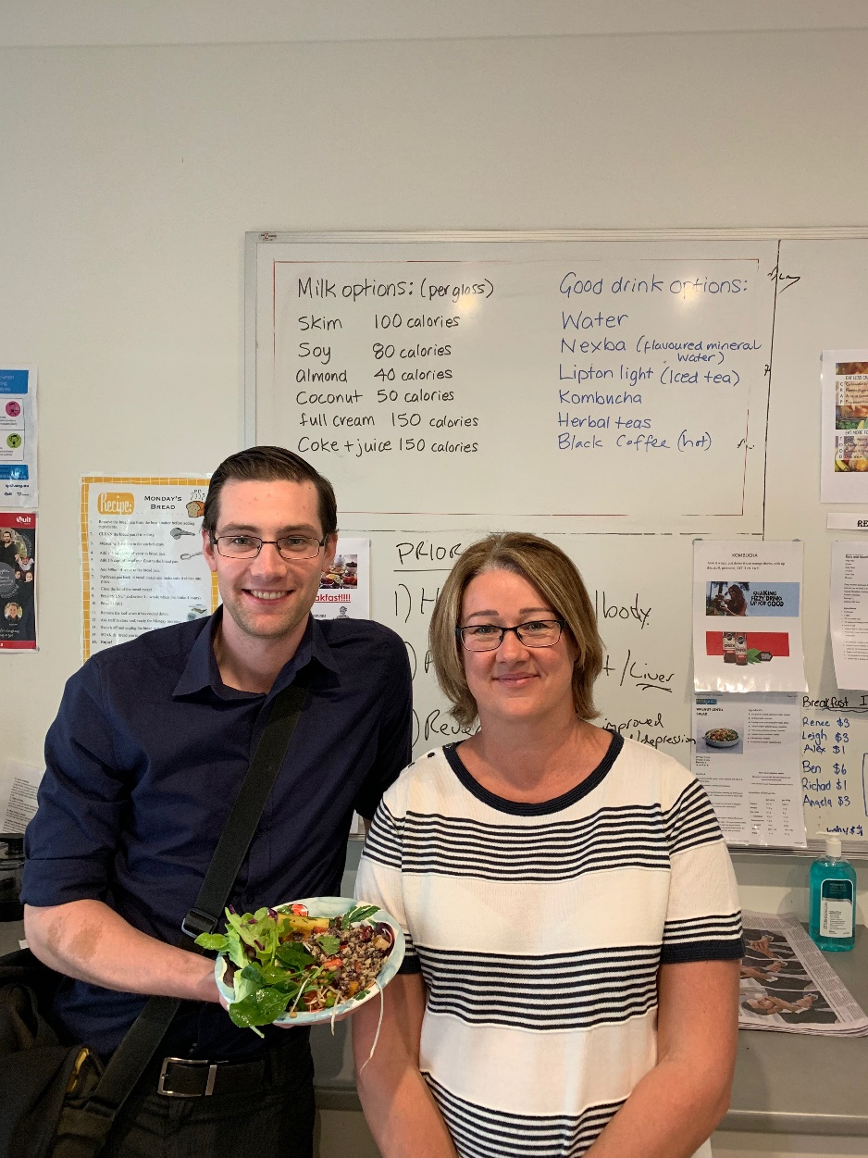
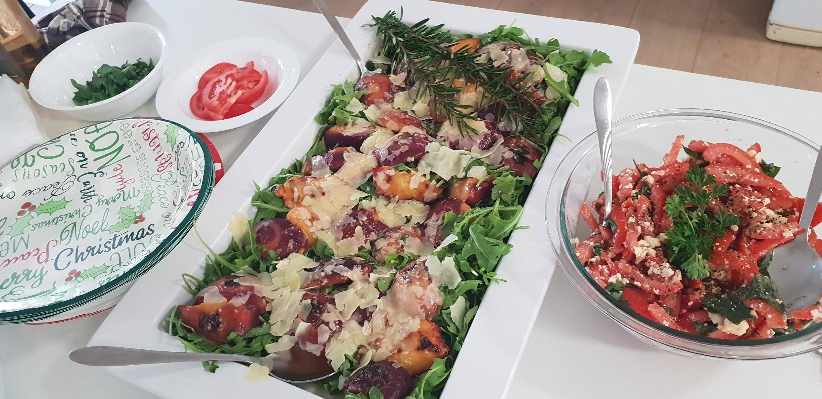
Not just what, but how!
Dr Linda Barron, Consultant Psychiatrist, CCU, Mountain Creek, Sunshine Coast, QLD Health

Slide 12
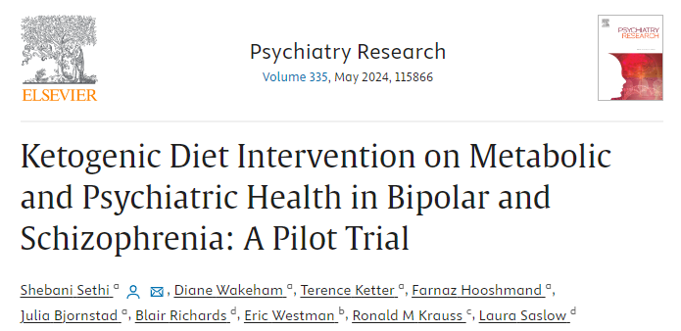
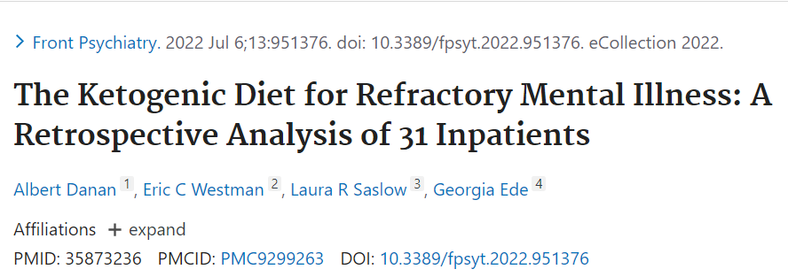
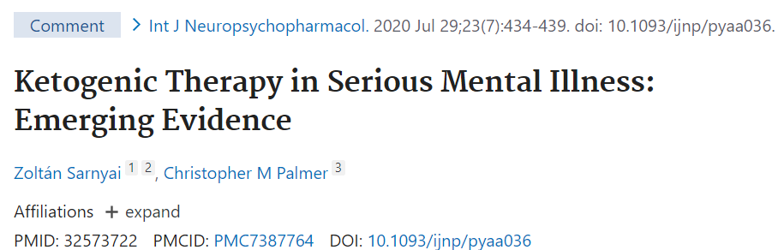
Emerging roles of more intensive dietary approaches?
2022 analysis: 31 adults with severe, persistent mental illness e.g. bipolar, schizoaffective d/o
3 were unable to adhere to the diet
10 patients with schizoaffective illness, Positive and Negative Syndrome Scale scores improved from 91.4 to 49.3
Hamilton Depression Rating Scale scores from 25.4 to 7.7
2024 pilot:
32 % reduction in Brief Psychiatric Rating Scale scores and Clinical Global Impression (CGI)
36% reduced in visceral adiposity

Slide 13
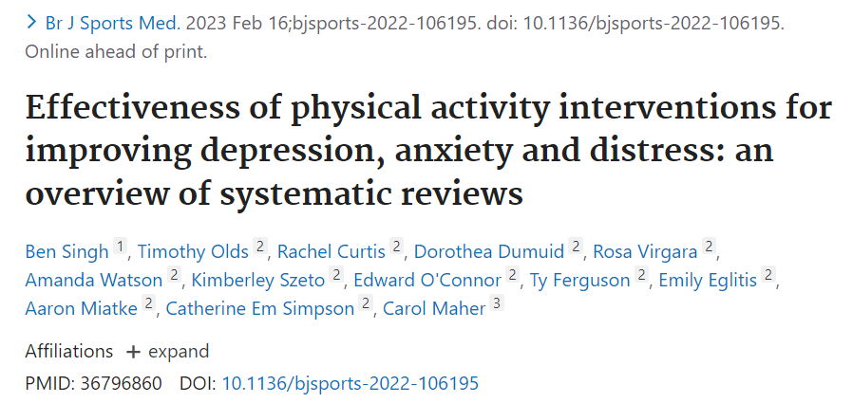
Movement and mental health
“The effect size reductions in symptoms of depression (−0.43) and anxiety (−0.42) are comparable to or slightly greater than the effects observed for psychotherapy and pharmacotherapy (SMD range=−0.22 to −0.37)”
“All PA modes were effective, and higher intensity exercise was associated with greater improvements for depression and anxiety.”

Slide 14
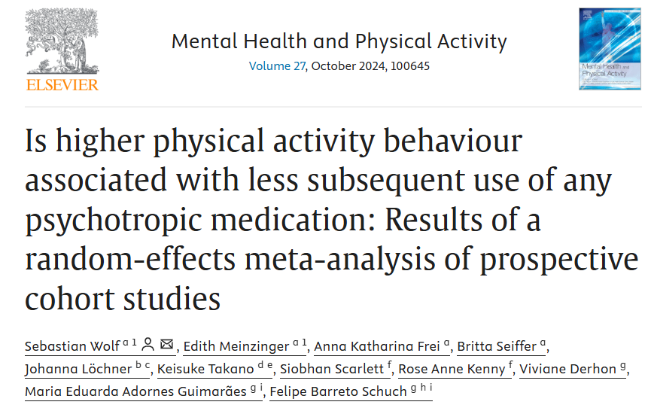
More PA → Less Medication
40,111 participants
Physical activity lowers the risk of future psychotropic medication use by 15%.

Slide 15
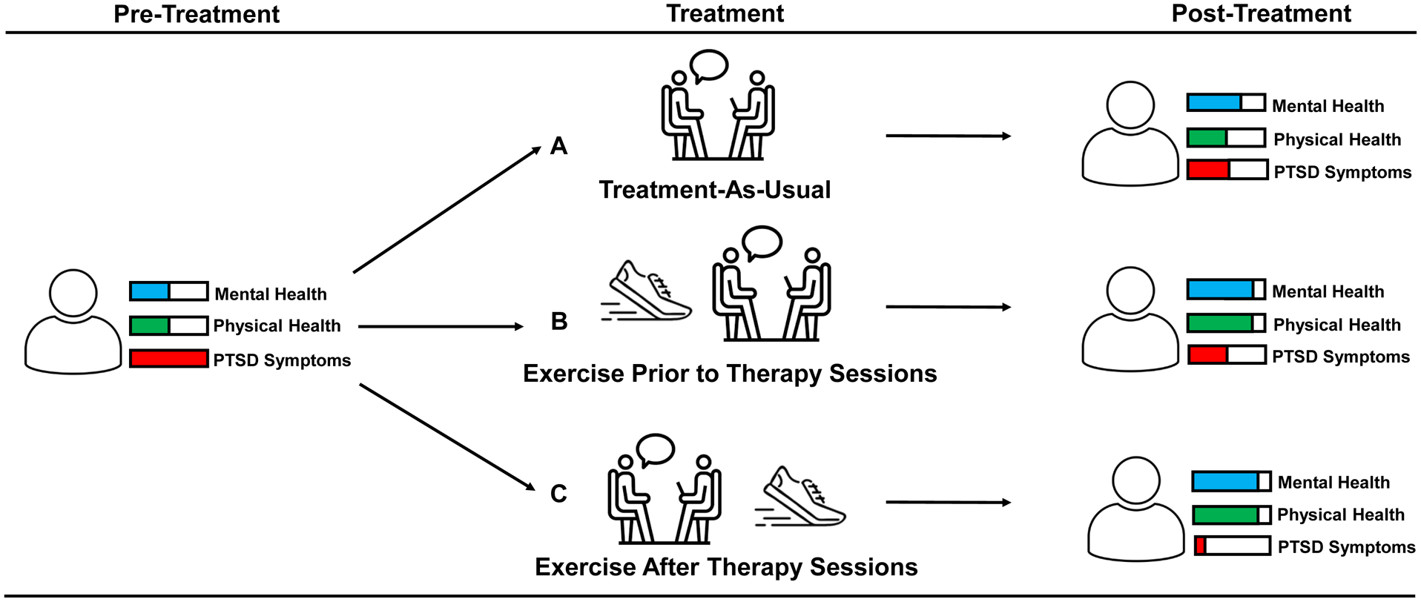
LM + psychotherapy = the golden combination
Precisely timed administration of aerobic exercise can enhance the consolidation and subsequent recall of fear extinction learning
Exercise after therapy in particular is where the evidence is pointing
Crombie KM, Adams TG, Dunsmoor JE, Greenwood BN, Smits JA, Nemeroff CB, Cisler JM. Aerobic exercise in the treatment of PTSD: An examination of preclinical and clinical laboratory findings, potential mechanisms, clinical implications, and future directions. J Anxiety Disord. 2023 Mar;94:102680. doi: 10.1016/j.janxdis.2023.102680. Epub 2023 Feb 6. PMID: 36773486; PMCID: PMC10084922.

Slide 16
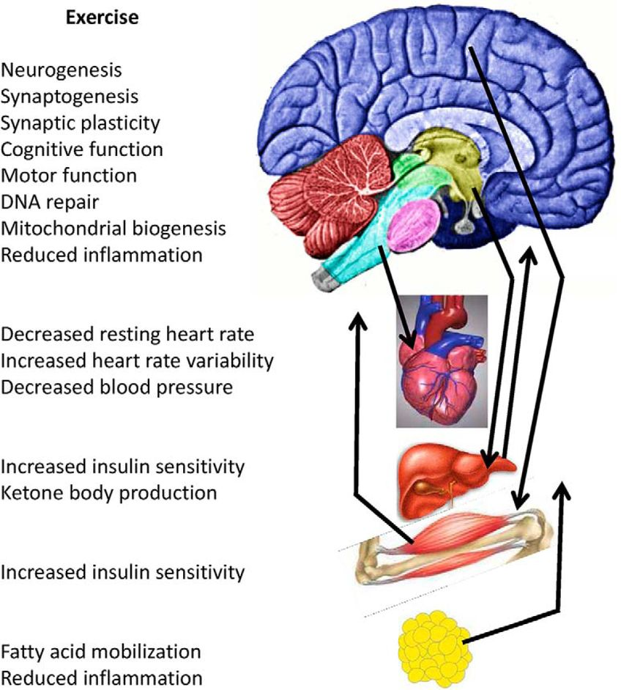
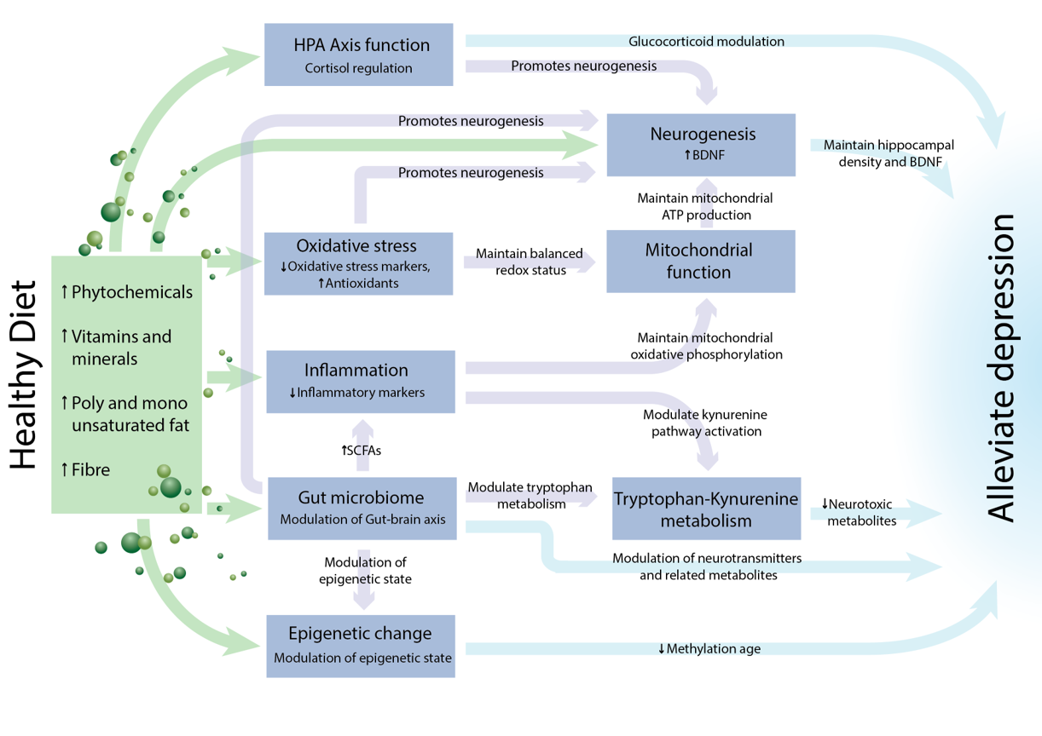
Mechanisms
van Praag H, Fleshner M, Schwartz MW, Mattson MP. Exercise, energy intake, glucose homeostasis, and the brain. J Neurosci. 2014;34(46):15139-15149. doi:10.1523/JNEUROSCI.2814-14.2014
Marx W, Lane M, …, Jacka FN. Diet and depression: exploring the biological mechanisms of action. Mol Psychiatry. 2021

Slide 17
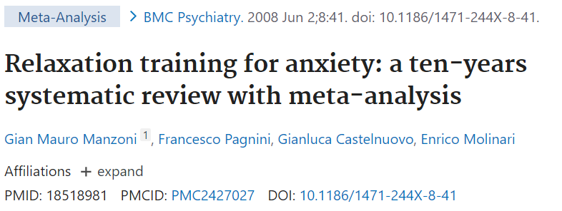
Mind-body approaches e.g. “Relaxation therapy”
Relaxation training showed a medium-large effect size in the treatment of anxiety. Cohen's d was .57
Efficacy was higher for meditation, among volunteers and for longer treatments

Slide 18
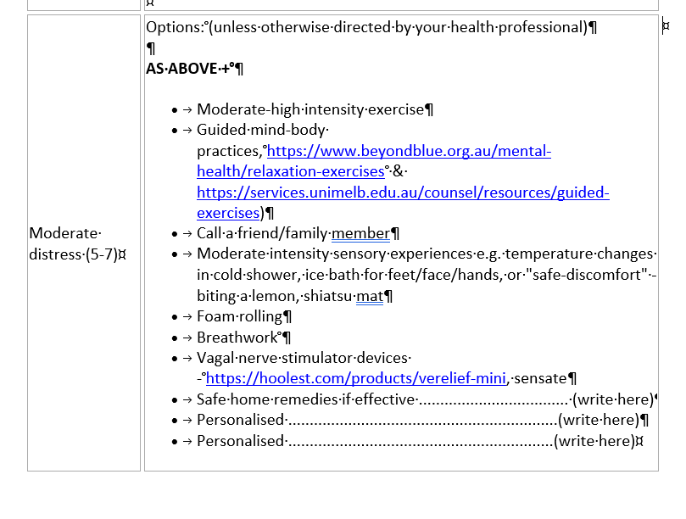
E.g. “PRN” Lifestyle Psychiatry
73% of p.r.n. medication administrations, no other therapeutic intervention was documented
Major opportunity for non-drug interventions
Curtis J, Baker JA, Reid AR. Exploration of therapeutic interventions that accompany the administration of p.r.n. ('as required') psychotropic medication within acute mental health settings: a retrospective study. Int J Ment Health Nurs. 2007 Oct;16(5):318-26. doi: 10.1111/j.1447-0349.2007.00487.x. PMID: 17845551.

Slide 19
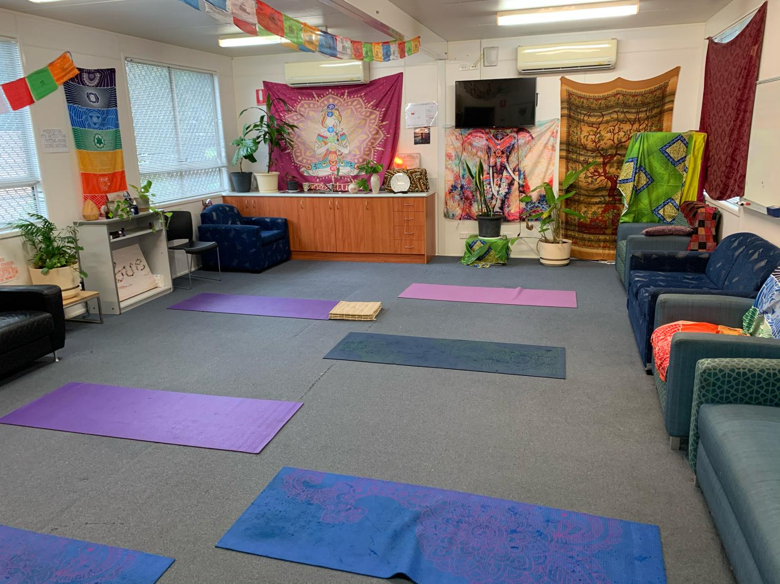
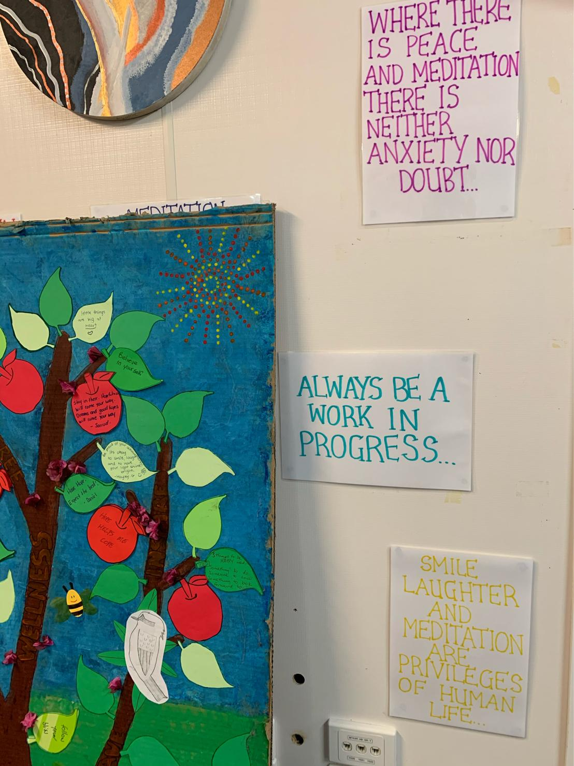
Create space, time, culture
Image source: Dr Sam Manger

Slide 20

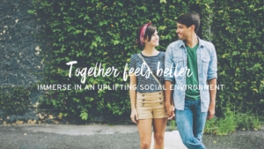
Digital Lifestyle Medicine and PP: LIFT
→ waitlist program
Combined online LM program (videos/audio), quizzes, workbooks
RCT demonstrated:
– 41% reduction in depression symptoms
– 38% reduction in anxiety symptoms
– 31% reduction in stress
– 22% increased in vitality
Przybylko G, Morton D, Kent L, Morton J, Hinze J, Beamish P, Renfrew M. The effectiveness of an online interdisciplinary intervention for mental health promotion: a randomized controlled trial. BMC Psychol. 2021 May 11;9(1):77. doi: 10.1186/s40359-021-00577-8. PMID: 33975645; PMCID: PMC8111974.

Slide 21
Sleep in mental illness
40% of ppl with a mental illness have a sleep disorder
Severity of sleep disorder → higher levels of symptom severity
A risk factor for new-onset and recurrent depression in children, adolescents and adults, affecting severity, duration and relapse rates and treatment resistance
Hombali A, Seow E, Yuan Q, et al. Prevalence and correlates of sleep disorder symptoms in psychiatric disorders. Psychiatry Res 2018;pii: S0165-1781(18)30268–23. doi: 10.1016/j.psychres.2018.07.009.
Franzen PL, Buysse DJ. Sleep disturbances and depression: Risk relationships for subsequent depression and therapeutic implications. Dialogues Clin Neurosci 2008;10(4):473–81.
Kaskie RE, Graziano B, Ferrarelli F. Schizophrenia and sleep disorders: Links, risks, and management challenges. Nat Sci Sleep 2017;9:227–39. doi: 10.2147/NSS.S121076.
Notes:
Image from: https://www.health.harvard.edu/blog/strategies-to-promote-better-sleep-in-these-uncertain-times-2020032719333
Hombali A, Seow E, Yuan Q, et al. Prevalence and correlates of sleep disorder symptoms in psychiatric disorders. Psychiatry Res 2018;pii: S0165-1781(18)30268–23. doi: 10.1016/j.psychres.2018.07.009.
Franzen PL, Buysse DJ. Sleep disturbances and depression: Risk relationships for subsequent depression and therapeutic implications. Dialogues Clin Neurosci 2008;10(4):473–81.
Kaskie RE, Graziano B, Ferrarelli F. Schizophrenia and sleep disorders: Links, risks, and management challenges. Nat Sci Sleep 2017;9:227–39. doi: 10.2147/NSS.S121076.

Slide 22
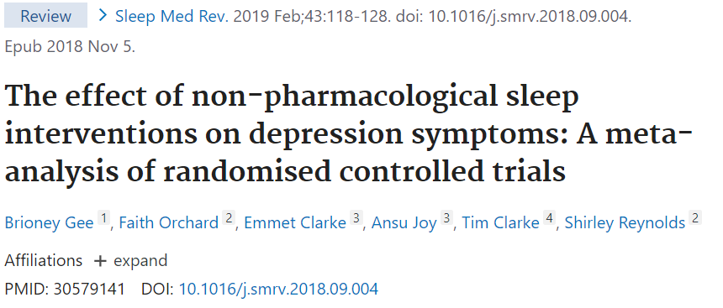
“In studies of participants with mental health problems, sleep interventions had a large effect on depression symptoms ([cohen’s] d = -0.81, 95% CI: -1.13,-0.49)”

Slide 23
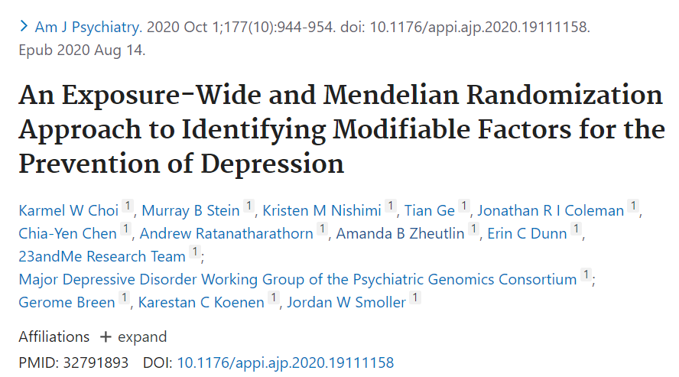
Social connection
“The impact of trusted social connections as causally protective for depression”
“confiding in others showed the strongest phenotypic associations”
= trusted social connection was the strongest protective factor for depression
Notes:
https://www.sciencedaily.com/releases/2020/08/200814131007.htm

Slide 24
DIFFERENT TYPES OF
HUMAN CONNECTION
HUMAN RELATIONSHIPS
SELF
ANIMAL
RELATIONSHIPS
ANCESTRY
HUMAN
CONNECTION
CULTURE
NATURAL
WORLD
DIGITAL
CONNECTION
Image source: Dr Sam Manger

Slide 25
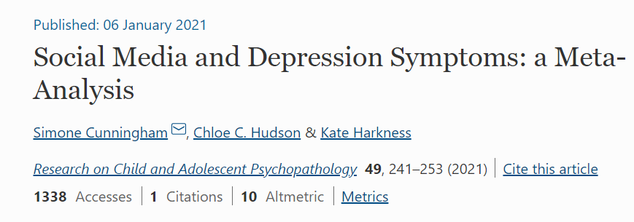
Social Media and mental health: Is it the how?
First MA to consider the multi-dimensional nature of SNS use = time spent using SNS, intensity of SNS use, problematic SNS use
Depression symptoms were significantly, but weakly, associated with time spent using SNS and intensity of SNS use
The association of depression symptoms to problematic SNS use was moderate (r = 0.29)*
Not significantly moderated by age, gender, year of study publication
*Pearson r or correlation coefficient
Effect size r Small = 0.10 Medium = 0.30 Large =0.50
Notes:
Pearson r or correlation coefficient
Effect size r Small0.10 Medium 0.30 Large0.50

Slide 26
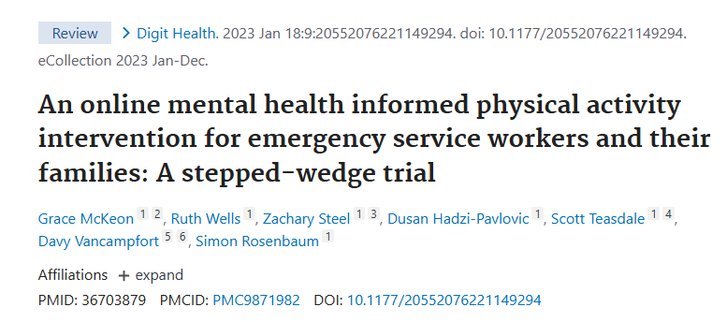
Examples: using social media and events for health!
10-week intervention via a closed Facebook group
facilitated by exercise physiologists, dietitian and peer-facilitators
Retention high (92%)
Improvements in mental health symptoms, minutes of PA, sedentary time and quality of life were significant
“Reverse Diabetes 2 Netherlands holistic programme”
– Groups
– Practical events eg cooking classes
– Social media closed groups
At 6 months
49% reduced glucose-lowering medication
60% “to-target” HbA1c levels
Pot GK, et al. BMJ Nut Prev Health 2019 May 13; bmjnph-2018

Slide 27
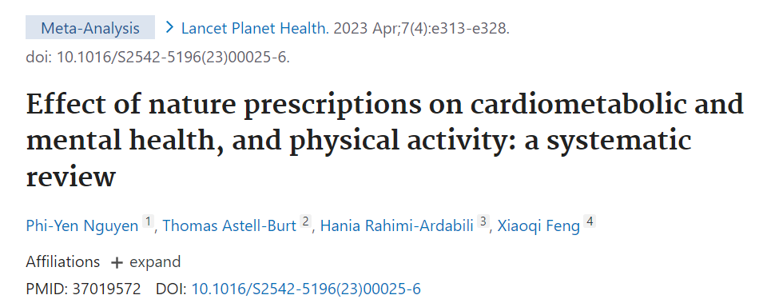
Connection with the natural world
“Nature prescriptions also had a moderate to large effect on depression scores (mean difference -0·50) and anxiety scores (mean difference -0·57).”

Slide 28

Connection with the natural world
Image source: pexels

Slide 29
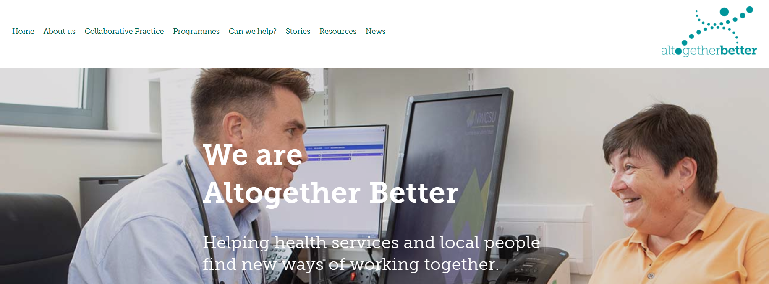
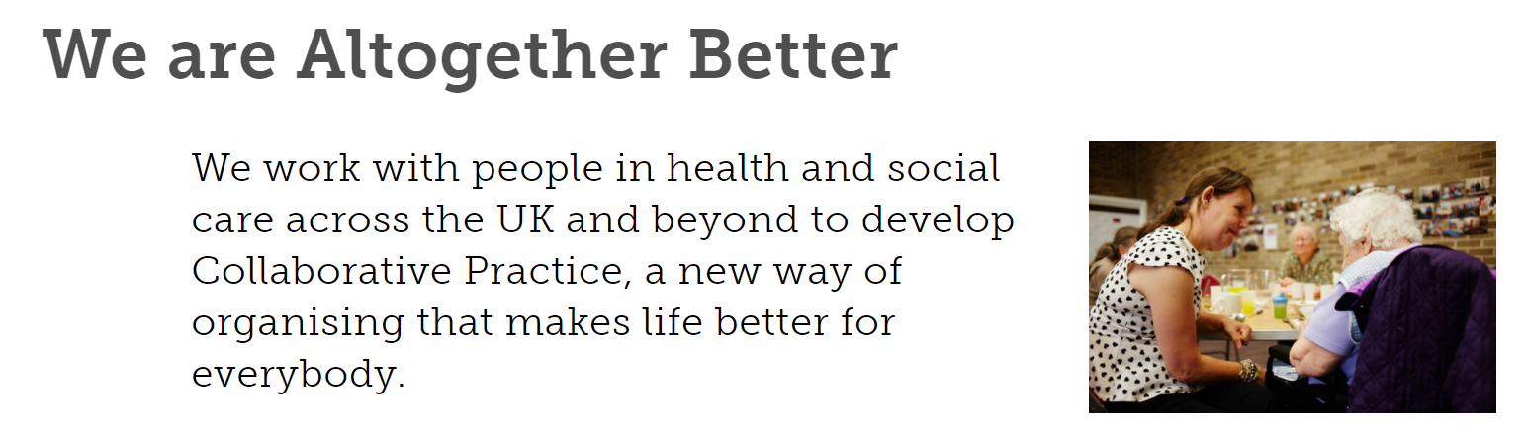
Example: Altogether Better (UK)
“I estimate that 40-55% of patients I see every week could be better supported by someone else – they don’t need to see someone with five degrees.”
- Dr Niall Macleod, GP, Exeter

Slide 30
Altogether Better (UK) (Since 2008)
Model of Collaborative Practice invites local people to gift their time to a local GP practice or health service
>350 GP practices, 18,000 volunteers as community “health champions” who have in turn reached over 104,000 other participants deliver >200 types of programs from flu clinics, films, choirs, carer support, dancing.
Demonstrated effectiveness in supporting positive behaviour change, improving health outcomes, the use of health care services and decreasing hospital admissions

Slide 31

Substances and mental illness
Contrary to popular belief:
2021 Cochrane review + 2017 Systematic review = people who give up smoking (2021) or alcohol (2017) have a reduction in depressive and anxiety symptom severity and an improvement in mental health and quality of life
→ with the effect being equal to antidepressant therapy (2014 SR)
On top of everything else…
Risk factor for suicide
Cytochrome P450 metabolism of certain medications
Image source: pexels
Taylor GM, Lindson N, Farley A, Leinberger-Jabari A, Sawyer K, Te Water Naudé R, Theodoulou A, King N, Burke C, Aveyard P. Smoking cessation for improving mental health. Cochrane Database Syst Rev. 2021 Mar 9;3(3):CD013522. doi: 10.1002/14651858.CD013522.pub2. PMID: 33687070; Charlet K, Heinz A. Harm reduction-a systematic review on effects of alcohol reduction on physical and mental symptoms. Addict Biol. 2017 Sep;22(5):1119-1159. doi: 10.1111/adb.12414. Epub 2016 Jun 29. PMID: 27353220.
Notes:
Image: unsplash, Dylan Fout
References:
Mendelsohn CP, Kirby DP, Castle DJ. Smoking and mental illness. An update for psychiatrists. Australas Psychiatry 2015;23(1):37–43. doi: 10.1177/1039856214562076
Prochaska JJ, Das S, Young-Wolff KC. Smoking, mental illness, and public health. Annu Rev Public Health 2017;38:165–85. doi: 10.1146/annurev-publhealth-031816-044618
Tsuda Y, Saruwatari J, Yasui-Furukori N. Meta-analysis: The effects of smoking on the disposition of two commonly used antipsychotic agents, olanzapine and clozapine. BMJ Open 2014;4(3):e004216. doi: 10.1136/bmjopen-2013-004216.
Taylor G, McNeill A, Girling A, Farley A, Lindson-Hawley N, Aveyard P. Change in mental health after smoking cessation: Systematic review and meta-analysis. BMJ 2014;348:g1151. doi: 10.1136/bmj.g1151

Slide 32
Consider the physical health benefits!
In people with Severe Mental Illness
Reduction in life expectancy of around 15-20 years – mostly due to CVD/DM/COPD
→ 2-to-3 times more likely to have cardiovascular disease, respiratory illness, metabolic syndrome, diabetes and osteoporosis
67% of those with BPAD and schizoaffective d/o have metabolic syndrome
John, A.P., Koloth, R., Dragovic, M. and Lim, S.C.B. (2009), Prevalence of metabolic syndrome among Australians with severe mental illness. Medical Journal of Australia, 190: 176-179. https://doi.org/10.5694/j.1326-5377.2009.tb02342.x
Lawrence D, Hancock K, Kisely S. The gap in life expectancy from preventable physical illness in psychiatric patients in Western Australia: Retrospective analysis of population based registers. BMJ 2013;346:f2539. doi: 10.1136/bmj.f2539

Slide 33
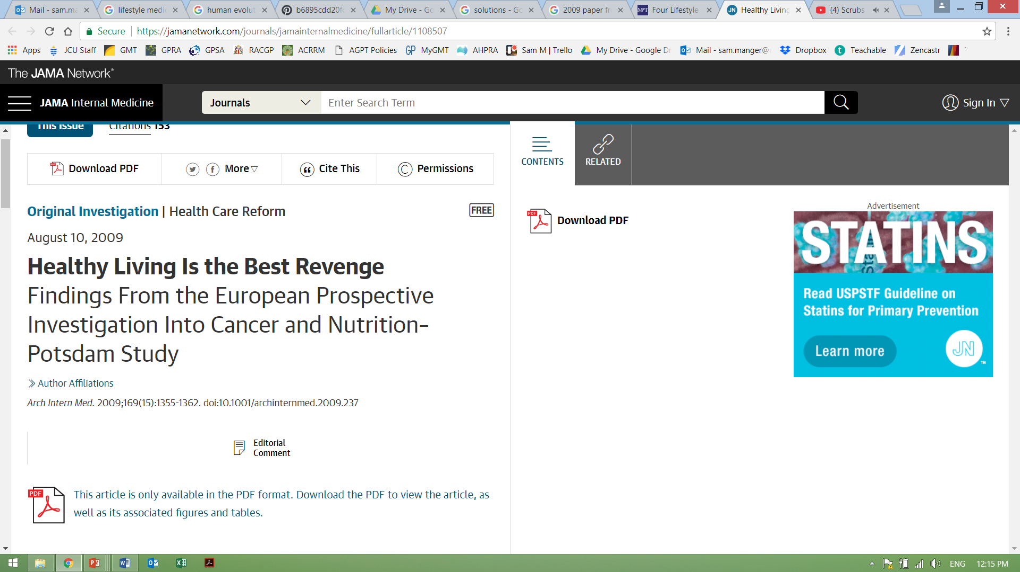
Prevention…
4 lifestyle choices = ~80% reduced risk of chronic illness:
a 93% lower risk of diabetes
81% lower risk of heart disease
Over 35% of cancer
Not smoking
BMI <30
3.5 hours physical activity/ week = 30 mins/day
Healthy diet

Slide 34
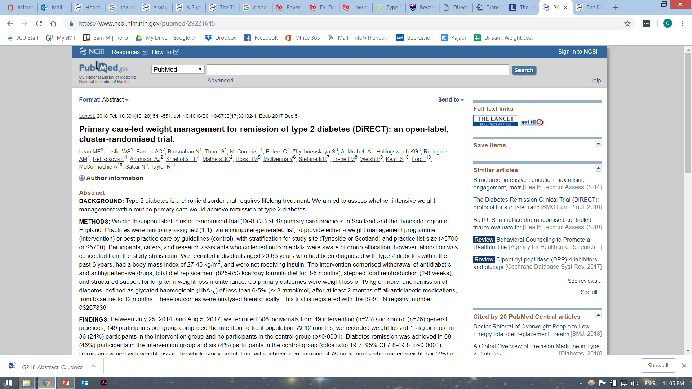
Diabetes/prediabetes
Diet alone:
46% T2D remission in 12 months if dx in past 6 years
80% remission if >15kg lost
Multiple dietary approaches as options

Slide 35
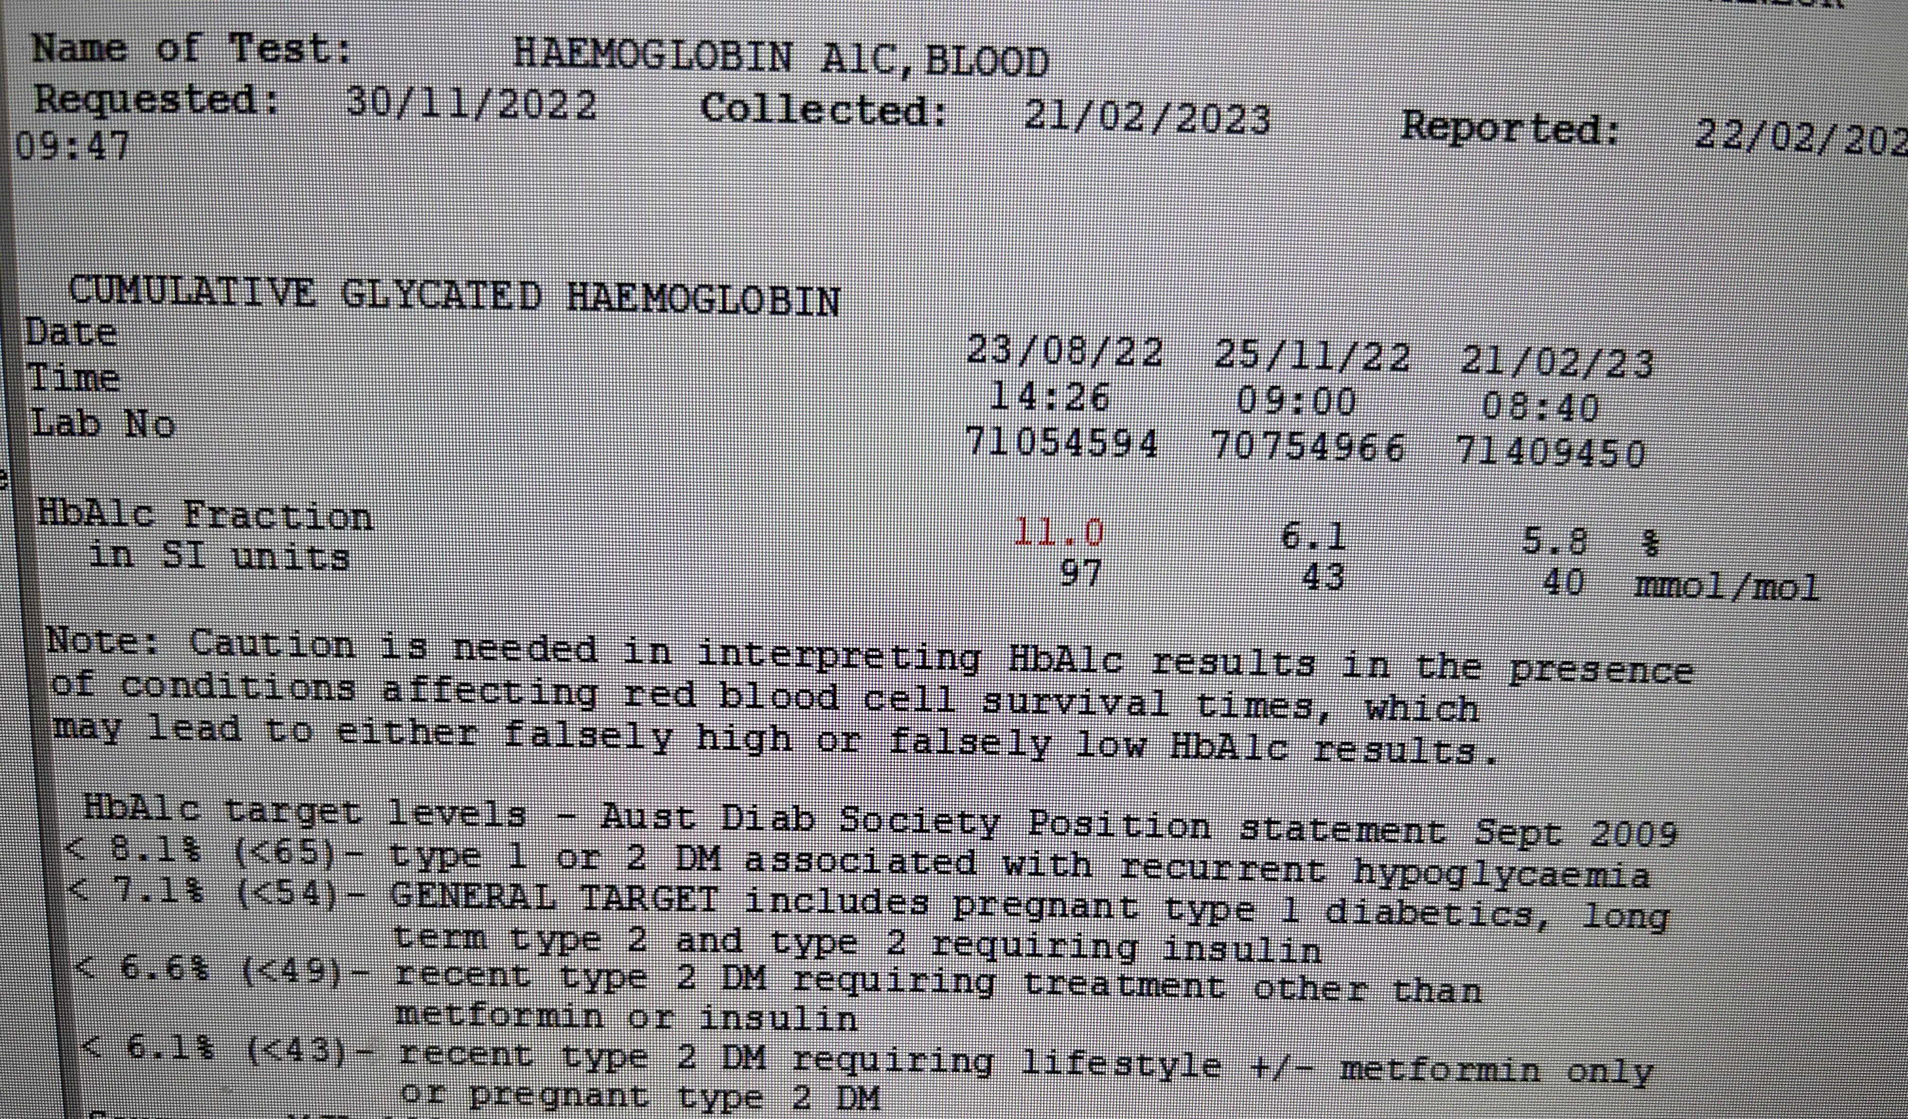
Can be more than HbA1c 2.0% reduction
Image source: Dr Sam Manger

Slide 36
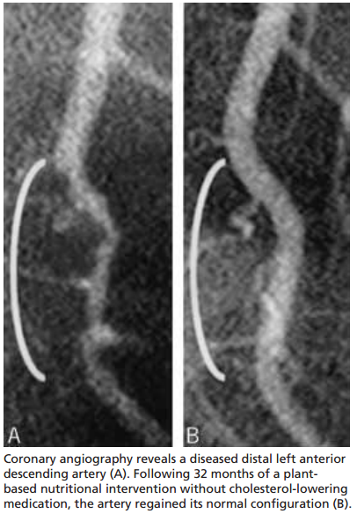
Ischaemic heart disease/CAD:
The Lifestyle Heart Trial
  – 5 year RCT
  – Intervention: whole foods plant-based diet, aerobic exercise, stress management training, smoking cessation, group psychosocial support
After 5 years:
  – Exp = 7.9% reduction in stenosis diameter, 25 cardiac events
  – Cont = 27.7% worsening, 45 cardiac events
  – Difference of stenosis = 35.6%
Ornish D, Scherwitz LW, Billings JH, Brown SE, Gould KL, Merritt TA, Sparler S, Armstrong WT, Ports TA, Kirkeeide RL, Hogeboom C, Brand RJ. Intensive lifestyle changes for reversal of coronary heart disease. JAMA. 1998 Dec 16;280(23):2001-7. doi: 10.1001/jama.280.23.2001..
Notes:
Spectrum
Only meds able = statins + pcsk9 inj MABs

Slide 37
Addressing physical illness is an overlooked suicide prevention strategy.
Physical health issue
Mood disorder
Substance use disorder
Previous self harm
Anxiety
Separation or divorce
Relationship problems
Schizophrenia
%
Australian Bureau of Statistics. Psychosocial Risk Factors as They Relate to Coroner-Referred Deaths in Australia 2017, Research Paper, Cat. no. 1351.0.55.062, Canberra. Canberra,: ABS; 2019.
Australian Bureau of Statistics. Causes of Death Australia 2017 Intentional Self-Harm Key Characteristics, Cat no. 3303.0 Canberra: ABS; 2018.
Productivity Commission. Mental Health Inquiry Report. Canberra: Commonwealth of Australia; 2020. Chapter 9 Suicide prevention
Notes:
TO REPLACE PAGE14 (FOR REVIEW) Can you redo this animation as a series of bars – from lowest to highest. (don’t include any psychosocial risk factor, or any mental or behaviour disorder categories.

Slide 38
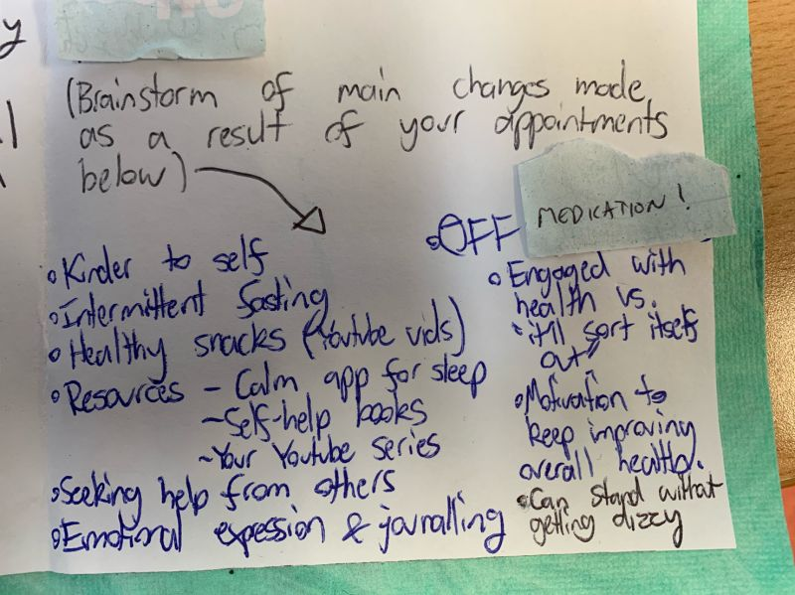
All this adds up: Synergy
Effective
Biopsychosocial (cultural and spiritual) benefits
Acceptable (and desired)
Safe
Identifiable mechanisms of action

Slide 39
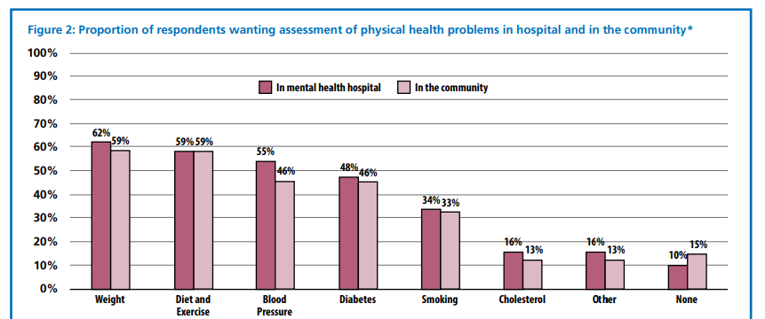
People with mental illness want support
2016: For people with severe mental illness
2024: 649 ppl surveyed
~77% participants felt positive about lifestyle medicine
~75% felt that such approaches aligned with their personal values.
NHS England, Improve the physical health of people with severe mental illness: a practical toolkit, 2016
Richardson K, Petukhova R, Hughes S, Pitt J, Yücel M, Segrave R. The acceptability of lifestyle medicine for the treatment of mental illness: perspectives of people with and without lived experience of mental illness. BMC Public Health. 2024 Jan 13;24(1):171. doi: 10.1186/s12889-024-17683-y. PMID: 38218774; PMCID: PMC10787508.

Slide 40
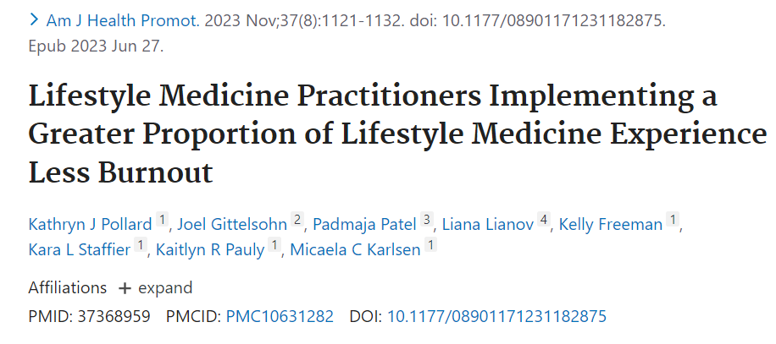
Lifestyle Medicine protects against burnout
482 medical professionals were surveyed
90% reported LM had positively impacted their professional satisfaction
Associated with a 43% decrease in the odds of experiencing burnout

Slide 41

How do we connect the patient to these?
The model of care
Image source: pexels

Slide 42
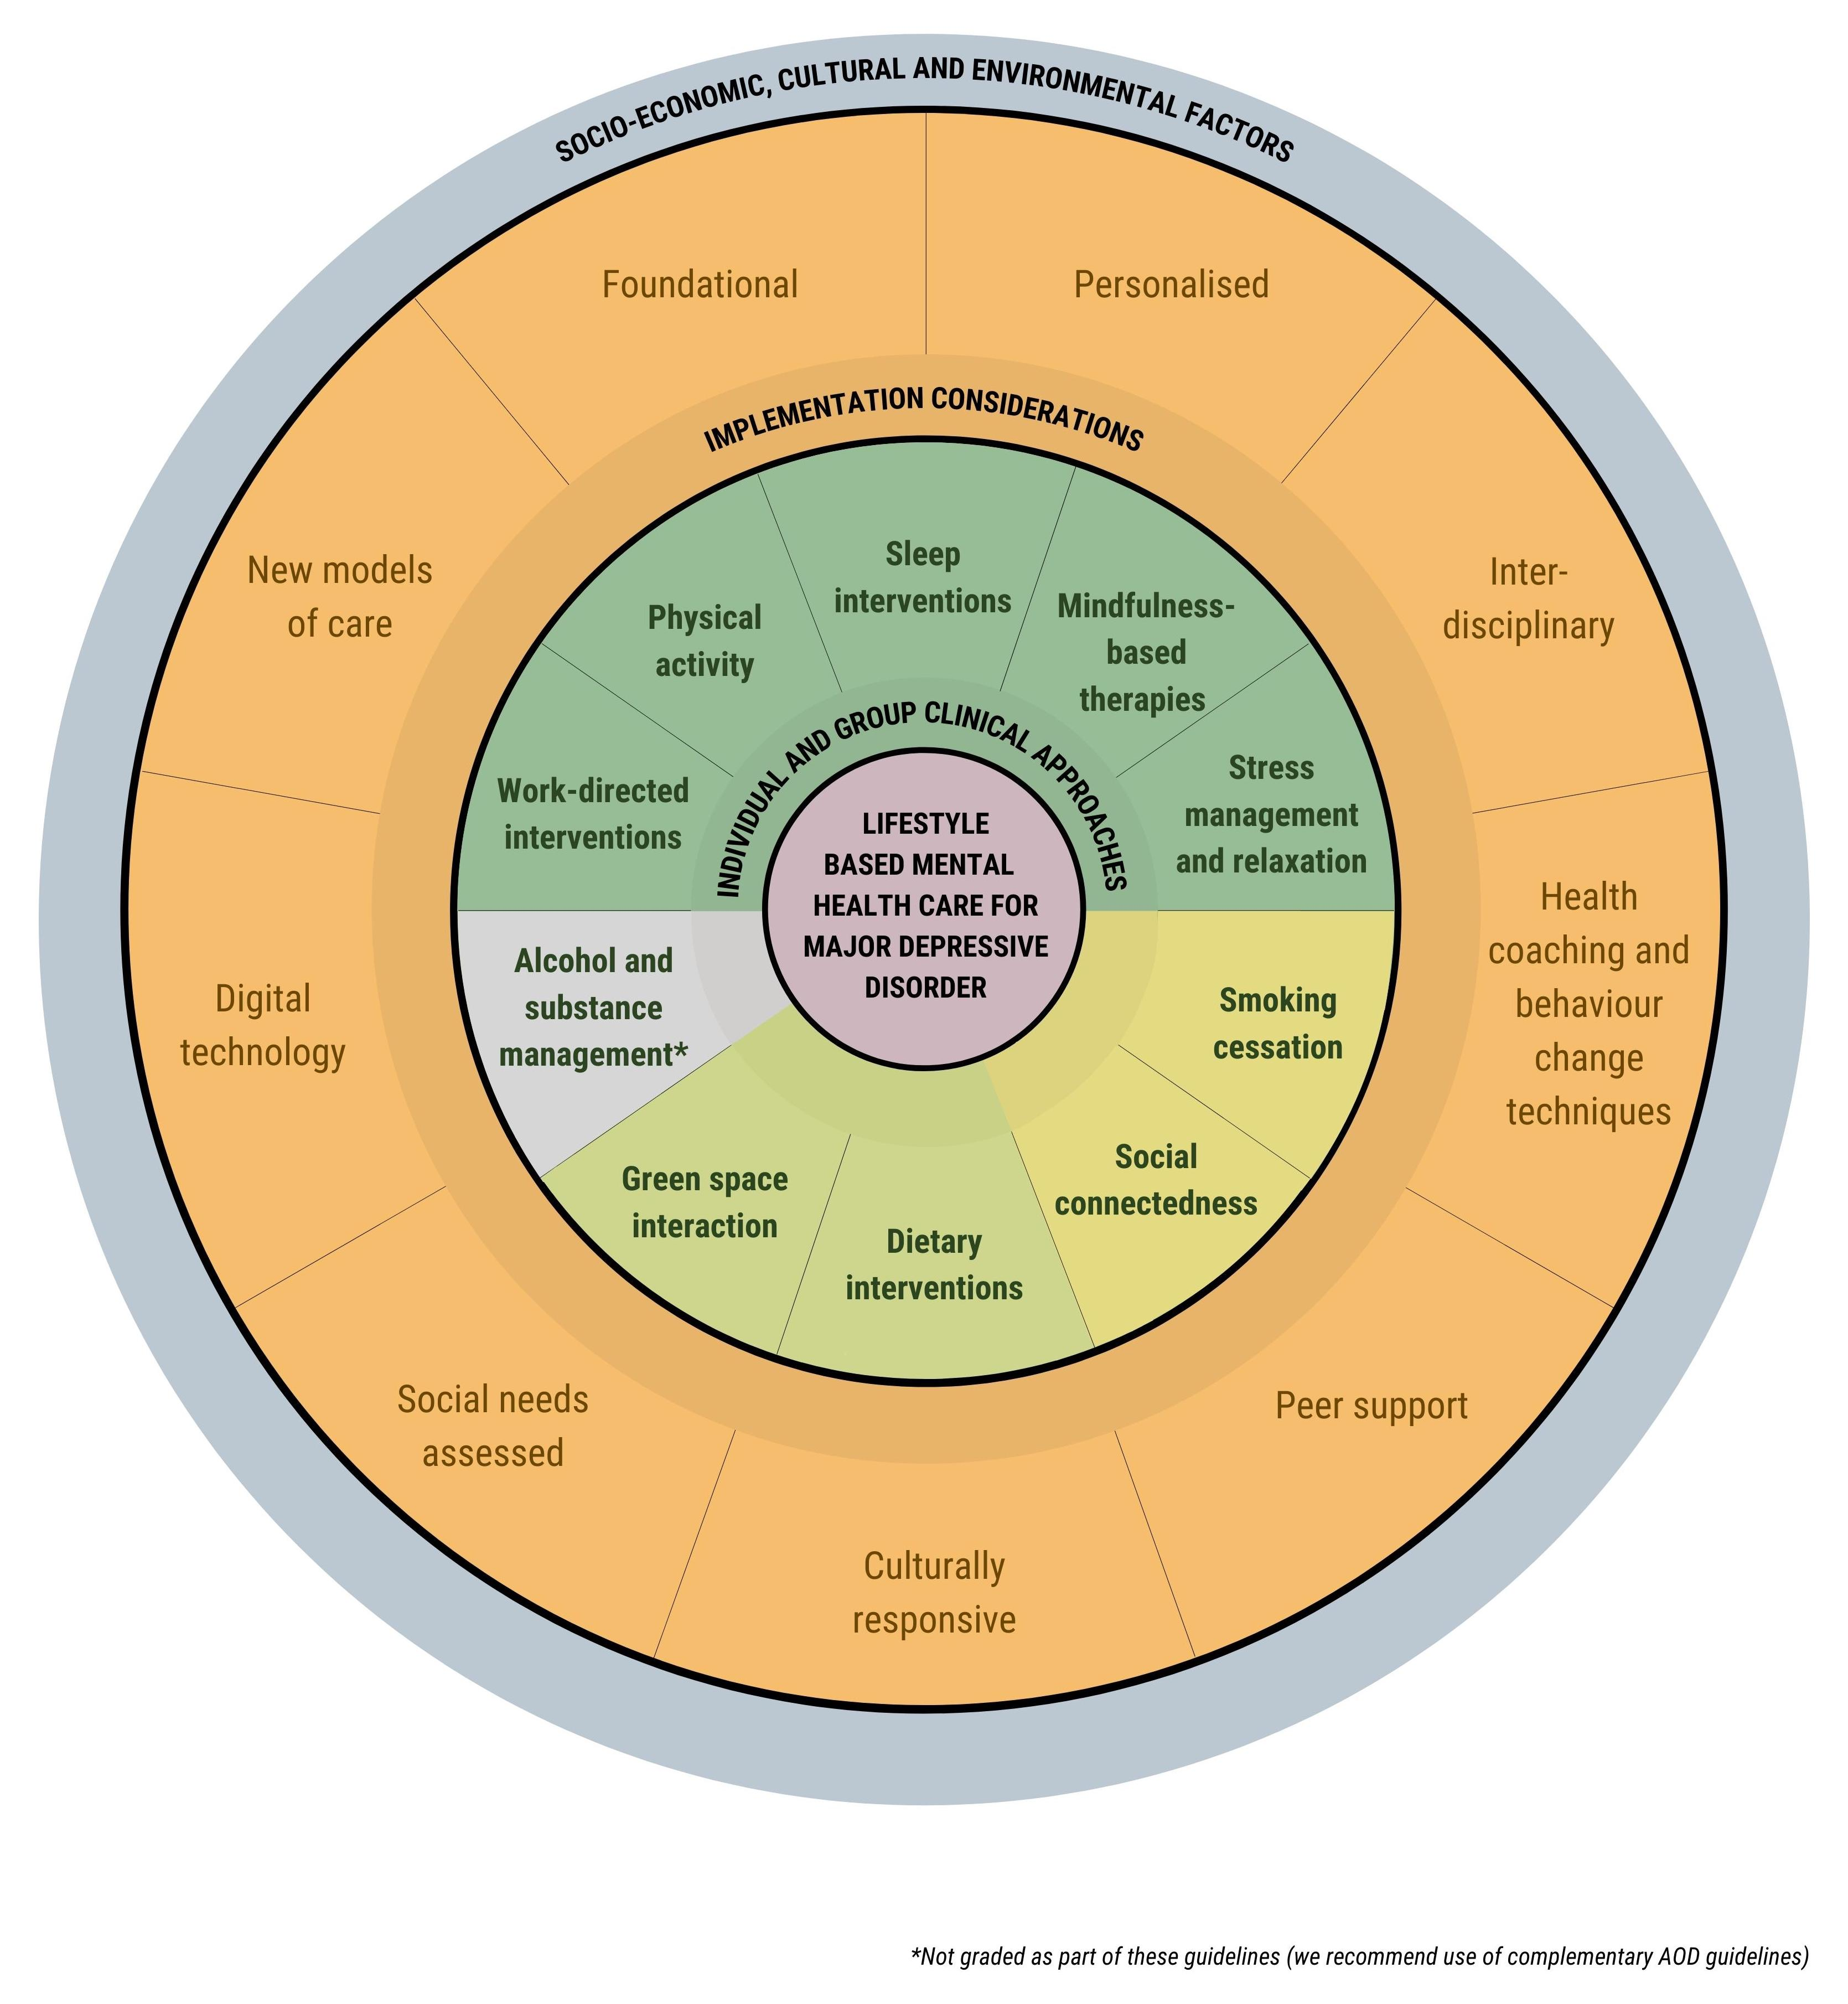
Options for implementation at each level
Socio-Environmental
Advocacy
Micro-environments: Clinical and settings models of care innovation
Individual/group
knowledge and skills
Marx W, Manger S, O’Neill A, et al, Clinical Guidelines for the Use of Lifestyle-based Mental Health Care in Major Depressive Disorder: The World Federation of Societies for Biological Psychiatry (WFSBP) and Australasian Society of Lifestyle Medicine (ASLM) Taskforce, The World Journal of Biological Psychiatry, 2022 (pre-print, not to be shared)

Slide 43
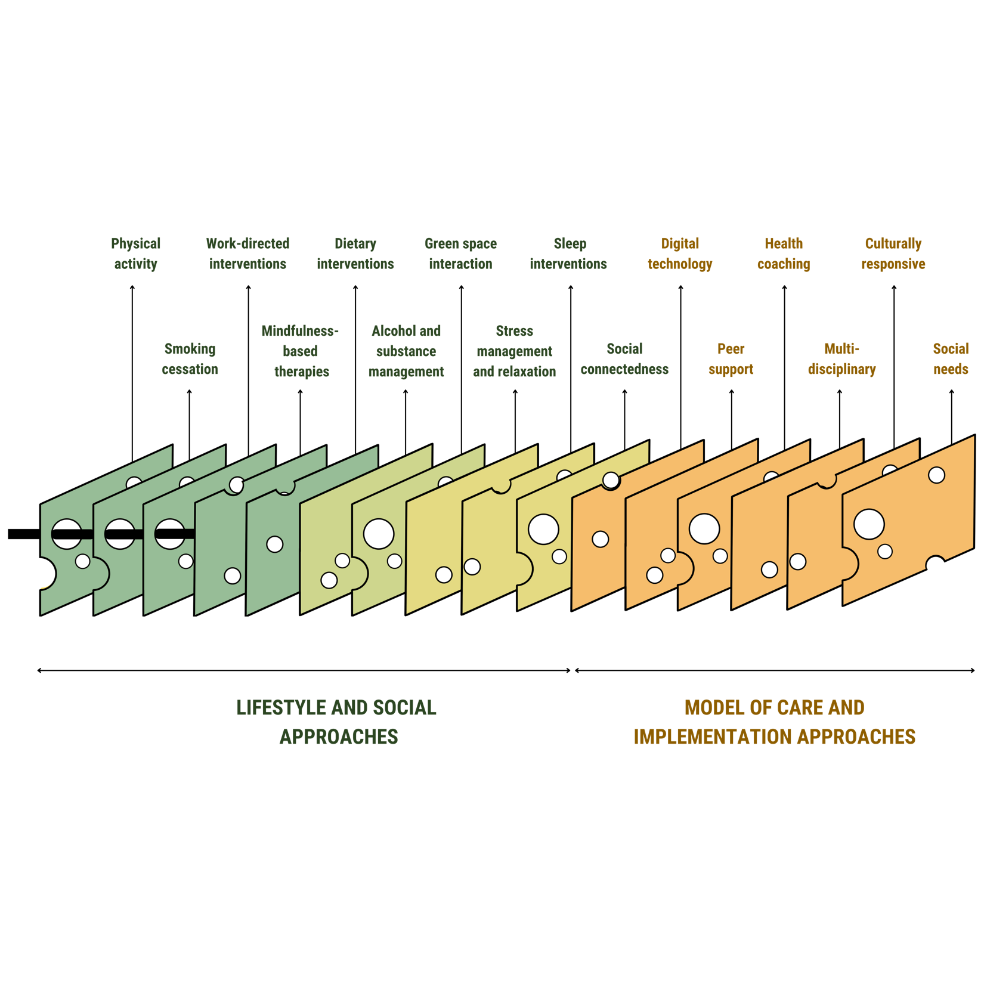
Many layers of LM that can make it effective
Marx W, Manger SH,… O'Neil A. Clinical guidelines for the use of lifestyle-based mental health care in major depressive disorder: World Federation of Societies for Biological Psychiatry (WFSBP) and Australasian Society of Lifestyle Medicine (ASLM) taskforce. World J Biol Psychiatry. 2022 Oct 6:1-54. doi: 10.1080/15622975.2022.2112074.

Slide 44
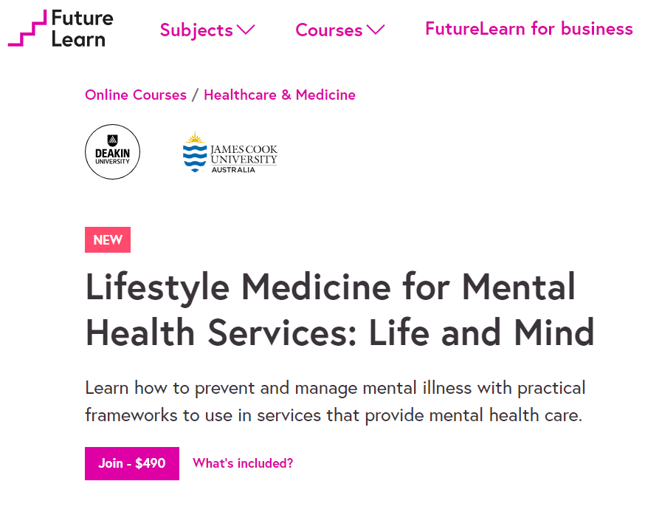
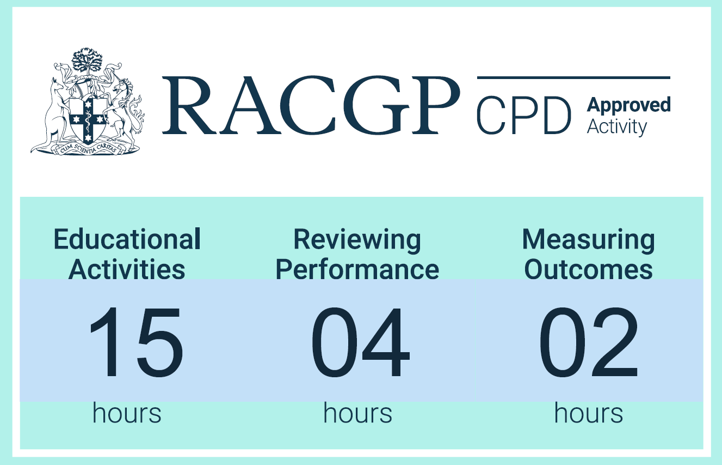
3-week micro-certificate available online…

Slide 45

College of Medicine and Dentistry
All health professionals
Online
RPL accepted
Commonwealth supported places
Advanced clinical lifestyle medicine
Wide range of research projects
Awards also include Fellow of the Australasian Society of Lifestyle Medicine (FASLM), Accredited Health Coach, Graduate Certificate in Research, and PhD pathways*
Contact: sam.manger@jcu.edu.au

