Slide 1
Psychosocial Supports in Queensland
Sandra Eyre
Senior Director, Mental Health Alcohol and Other Drugs Strategy and Planning Branch
Department of Health
Leading Reform Summit 27 November 2024

Slide 2
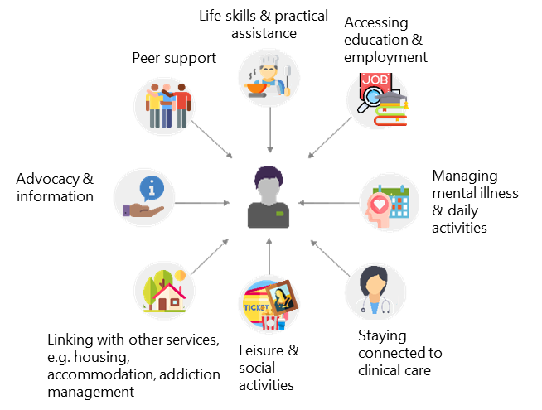
Defining Psychosocial Supports
Important that we have a shared definition:
  non-clinical community-based supports that aim to facilitate recovery in the community for people experiencing mental illness – through a range of services to help people manage daily activities, rebuild and maintain connections, build social skills and participate in education and employment.
(Productivity Commission 2020, Mental Health, Report no. 95, Canberra – Volume 3, Chapter 17)

Slide 3
Current Arrangements for Psychosocial Supports in Australia
Currently, both the Commonwealth and States and Territories are involved in funding, commissioning and delivery of psychosocial supports (in addition to the NDIS):
States and Territories have generally prioritised funding and provision for those people with more severe mental illness entering the state public mental health system. These are delivered through non-government providers (NGOs).
The Commonwealth more recently has provided supports through the National Psychosocial Support Measure and the National Psychosocial Support Transition (NPS-T) Continuity of Support (CoS) targeted at those people outside of the NDIS. Many of these supports are delivered by NGOs commissioned via Primary Health Networks (PHNs).

Slide 4

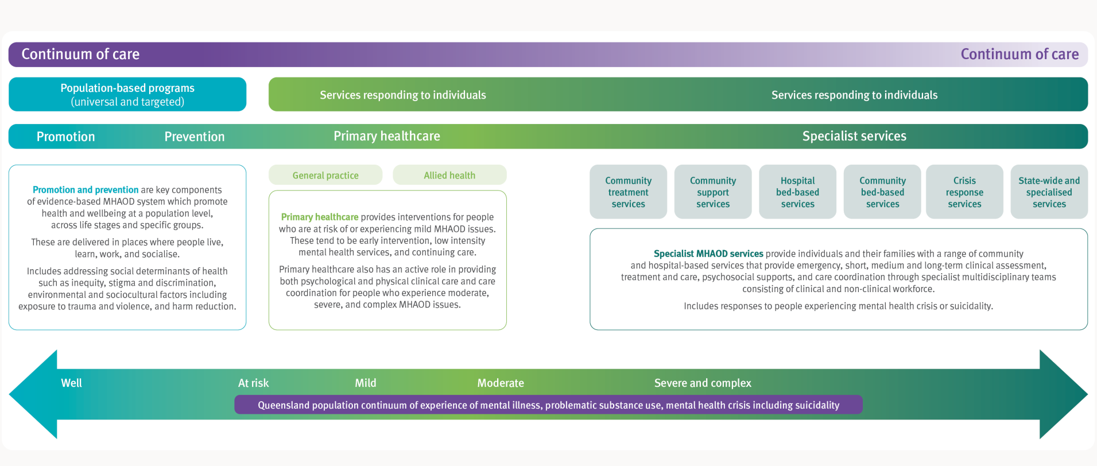
Psychosocial supports in the Queensland continuum of care

Slide 5

A system of psychosocial supports
Community Support Services
  Individual Recovery Support Program & Group Based Peer Recovery Support program
  Range of other specialist and statewide psychosocial supports
  Community bed based
  Psychosocial supports provided in Step-Up Step-Down and residential services
crisis service responses
  Crisis support spaces

Slide 6
Mental Health Community Support Services Program (MHCSS)
Individual Recovery Support Program
Group Based Peer Recovery Support program
Individuals at Risk of Homelessness program
Transition from Correctional Facilities program

Slide 7
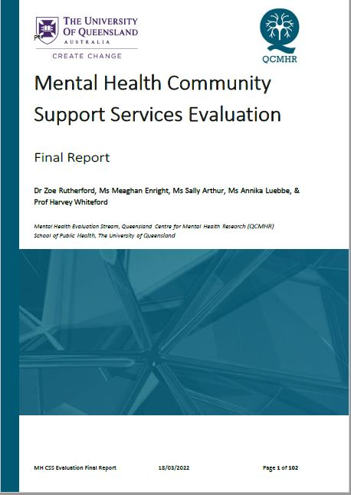
Mental Health Community Support Services Evaluation
Governance is critical element in program design
Warm handovers with the HHS
Flexibility required – locally and to tailor for individual recovery
Duration of delivery needs to be tailored to individuals need
Staffing turnover is a given and relationship with HHS is critical

Slide 8
Considerations for service improvement
Streamlining current referral processes between HHS and MHCSS Providers
Workforce readiness
Improving consistency in program delivery
Introduction of standardised outcomes measures
Explore options for future program design

Slide 9




Service improvement considerations: Outcome measures
Supplemental to any data already captured by the HHS.
  Supported in the literature as efficient measurements of mental health outcomes.
Results of the outcome measures are fed back into the program to inform and support ongoing person-centred and recovery-oriented processes and program improvements
OUTCOME
MEASURES
SHOULD BE:
Have acceptable validity and reliability.
Training of staff to analyse and interpret these data.
Implementation of a follow-up measure post-consumer exit to assess long-term monitoring and evaluation.
Used to facilitate IRP and processes.
Collected regularly throughout a consumer’s journey on a program (i.e., at 3 months, 6 months, 9 months, and 12 months at exit) to monitor program efficacy

Slide 10
Psychosocial Workforce Initiatives
Pillar 1
Qualifications & Training
Finalise core competency framework
Access to and develop professional development opportunities
Consider a centralised resource hub/navigation mechanism
Pillar 2
Attraction & Retention
Costed awareness and recruitment campaign plan
Develop supervision and mentoring framework
Audit professional development (PD) opportunities and develop costed plan to support priority PD opportunities
Support NGOs to leverage Govt programs to attract, recruit and train staff
Support implementation of worker wellbeing policies and procedures
Publish career pathway information
Develop strategy to improve service delivery with culturally and linguistically diverse people including increasing representation in sector workforce
Pillar 3
System Enablers
Establish governance structure for QAMH Community MH & Wellbeing Workforce Strategy
Develop strategy to improve service delivery with Aboriginal and Torres Strait Islander people including increasing representation in sector workforce

Slide 11
National Policy Journey for Psychosocial Supports
Productivity Commission Report
(2020)
National Mental Health and Suicide Prevention Agreement
(2022)
Analysis of Unmet need for Psychosocial Supports
(2024)
Next Steps
NDIS Review report - Working together
to deliver the NDIS
(2023)

Slide 12
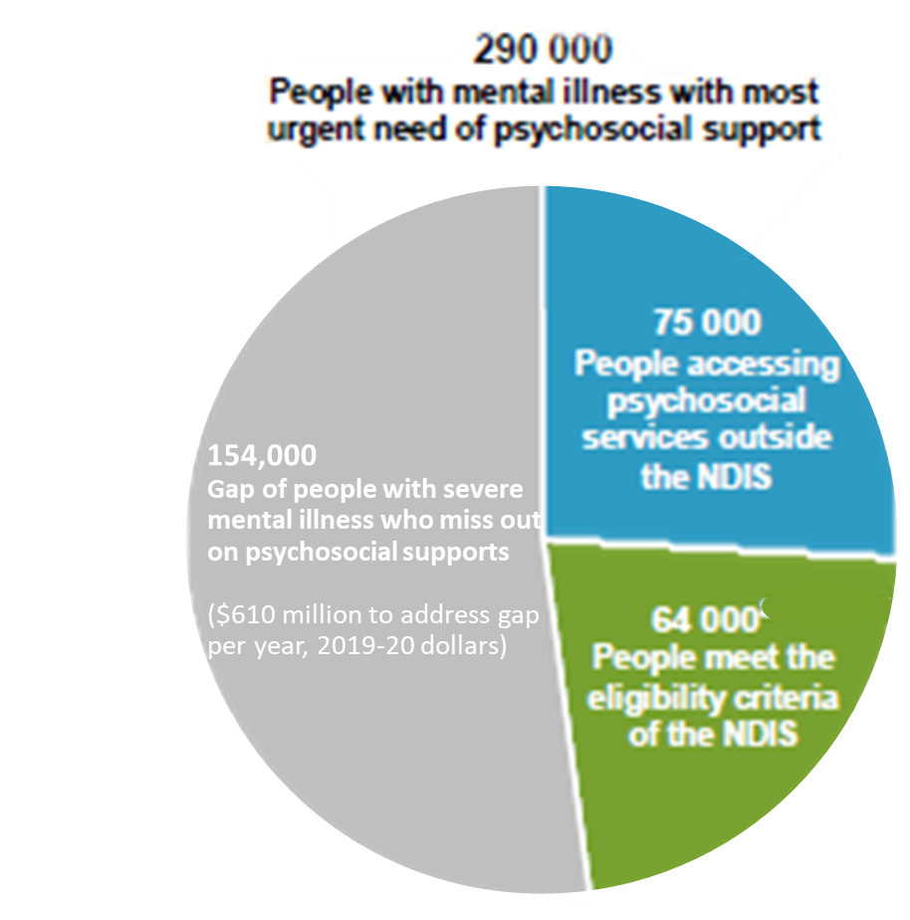
PC Report (2020)
extend the funding cycle length to a minimum of five years
shortfall in the provision of psychosocial supports should be estimated and increased to meet shortfall
State and Territory Governments should take sole responsibility for commissioning psychosocial supports outside of the National Disability Insurance Scheme
a National Mental Health and Suicide Prevention Agreement be developed

Slide 13

National Mental Health and Suicide Prevention Agreement
All governments agreed to estimate demand for, compared to current availability of, psychosocial supports outside of the NDIS. Governments also agreed to work together to develop and agree future psychosocial support arrangements (including roles and responsibilities) for people who are not supported through the NDIS.

Slide 14
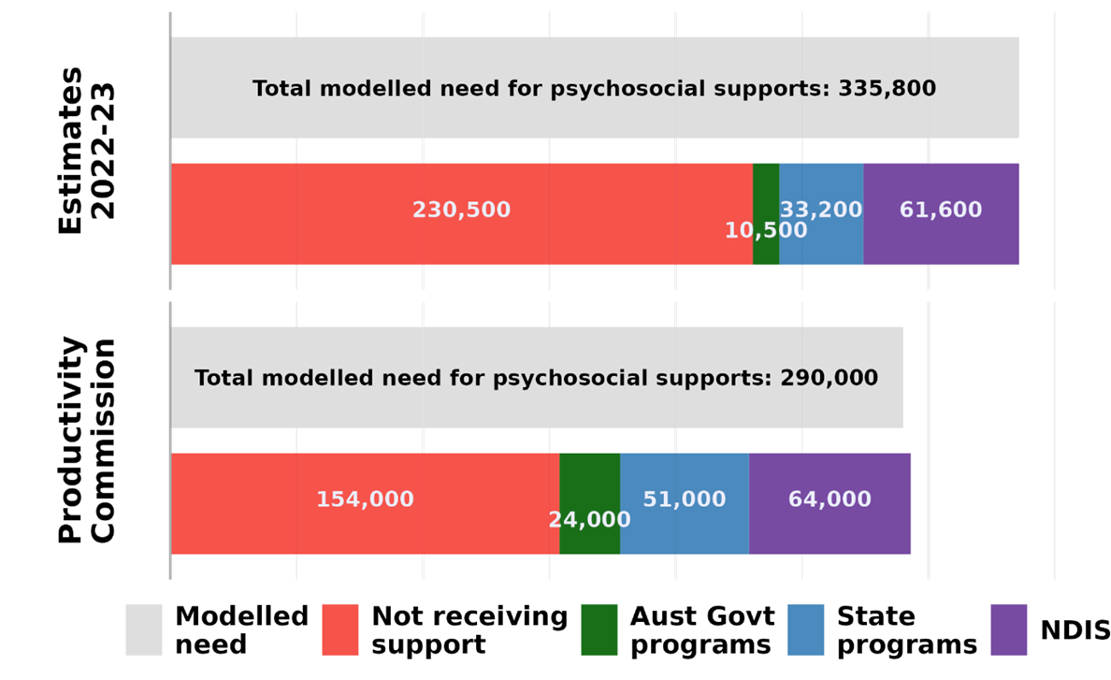
Analysis Findings Unmet Need (National view)
Unmet need/ Gap

Slide 15
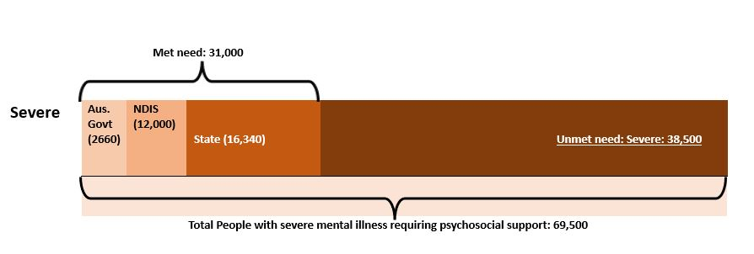
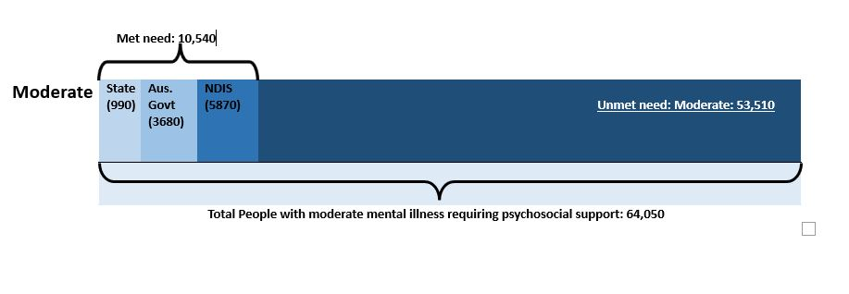
Analysis Findings Unmet Need: (Queensland view)

Slide 16

Better Care Together commitments
Under Better Care Together, new investment is allocated to further enhance psychosocial support programs.
This will contribute to addressing the shortfall in supports for people with severe and complex mental illness who are not eligible for the NDIS.

Slide 17
Sector and Public Consultations
Oct. 2023
Face to Face Forum hosted by Queensland Health and the Queensland Alliance for Mental Health with NGO sector delivering psychosocial supports
Nov.–Dec. 2023
Queensland Health Statewide older persons and children and young people’s clinical networks
Mar. 2024
Get Involved public consultation

Slide 18
Where to from here …
Participating in National mental health reform work
Co-Chairing the Psychosocial Project Group

Slide 19
“…Ministers agreed to work with mental health stakeholders, including lived experience and First Nations, to develop a robust plan for future psychosocial support arrangements*. This will be done in the context of continuing work on a renewed National Mental Health and Suicide Prevention Agreement and ongoing National Disability Insurance Scheme reform. This work will build on reforms already undertaken to ensure those with the most severe mental health needs have access to supports in the community…”.
*emphasis added
Health Ministers Meeting Communique
16 August 2024 - Sydney

Slide 20
Considerations – there are many
Investment
Access and coordination
Existing services and programs
Workforce
Cultural considerations
Lived experience
Evidenced-based

Slide 21
Thank you
Sandra Eyre
Senior Director, Mental Health Alcohol and Other Drugs Strategy and Planning Branch
Department of Health
Leading Reform Summit 27 November 2024

