Slide 1

Aboriginal and Torres Strait Islander Lived Experience-led
Peer Workforce Guide:
A Learning Tool for All Peer Workforces and Organisations
Tony Lee – Advisory Co-Chair & Project Working Group Member/Co-Author, Aboriginal and Torres Strait Islander Lived Experience Centre, Black Dog Institute
Sara Walsh - Assistant Director,
Lived Experience (Peer) Workforces and Stakeholder Engagement, Western Australian Mental Health Commission
Notes:
Introductions
Including Uncle Tony and his connection to the project (Working Group Member/Guide Author) etc.

Slide 2

Acknowledgement of Country
We would like to acknowledge the Traditional Custodians of the land on which we meet today, the Turrbal and Jagera peoples of the Turrbal Country. We would like to honour the ancestors of yesterday, the custodians of today and those of tomorrow. We recognise the continuing connection to land, waters and how culture is held, nurtured and shared.
Notes:
Tony: Acknowledgement - We would like to acknowledge the Traditional Custodians of the land on which we meet today, the Turrbal and Jagera peoples of the Turrbal Country. We would like to honour the ancestors of yesterday, the custodians of today and those of tomorrow. We recognise the continuing connection to land, waters and how culture is held, nurtured and shared.
Sara: To set the scene, the Guide document I’m going to speak to you about today, uses an analogy I’d like to share. It states: Picture a river, like the Derbarl Yerrigan (Swan River in WA or the Maiwar here in Brisbane), or any river of significance. The water moves upstream, downstream, moving over stone and sustaining life. Often parts of nature such as plants, leaves, bark, and wildlife enter the river, but the river keeps moving, manoeuvring in and around the environment in the direction it needs to go, but rarely forceful. There is a fluidity or flow to the river, navigating through nature, but does this with ease. The flow of the river is peer work.“
Tony: Peer work is the flow between different knowledge systems, different worlds, and different environments. It navigates the space in between First Nations and western knowledge systems and the many worlds that First Nations Peoples must find their way through every day. Peer work flows with an exceptional strength and capacity to understand, negotiate, and balance the difference of often competing systems. Peer work is part of who First Nations Peoples are. It is part of cultural obligations, it is woven into heritage and is foundational to taking care of one another and Country. It is the deep, interconnected , reciprocal, respectful relationships that First Nations People have for each other

Slide 3
Recognition of lived experience
On behalf of the Mental Health Commission, we recognise the individual and collective expertise of those with living and lived experience of mental health, alcohol and other drug issues and or suicidal crisis.
This also includes those who love, and have loved and care for them. We value the vital contribution they make by sharing their unique experience to achieve better outcomes for all.
We also recognise First Nations Lived Experience, acknowledging the compound loss and grief felt by our Communities and the kin we have lost.
Notes:
Sara: On behalf of the Mental Health Commission, we recognise the individual and collective expertise of those with living and lived experience of mental health, alcohol and other drug issues and or suicidal crisis.
This also includes those who love, and have loved and care for them. We value the vital contribution they make by sharing their unique experience to achieve better outcomes for all.
Tony: We also recognise First Nations Lived Experience, acknowledging the compound loss and grief felt by our Communities and the kin we have lost.

Slide 4
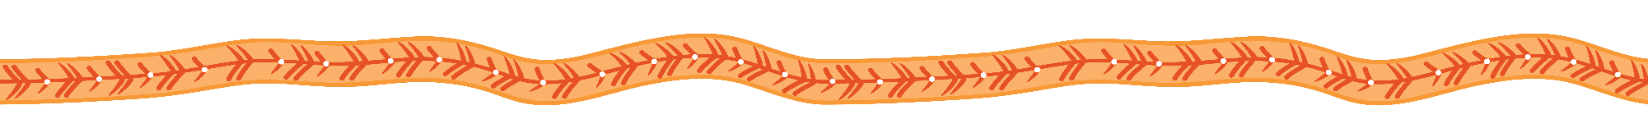
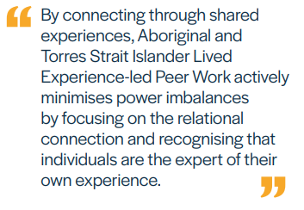
The Importance of Lived Expereience Peer Work - in a First Nations Context
Before we talk about the guide...
Peer work is the flow and interconnectedness between different systems and worlds - it navigates the space between First Nations and western knowledge systems.
Notes:
Sara: We would like to begin by briefly discussing the importance of Lived Experience Peer Work in a First Nations Context.
As Tony mentioned during our Acknowledgment of Country, Peer work is the flow and interconnectedness between different systems and worlds - it navigates the space between First Nations and western knowledge systems. Aboriginal and Torres Strait Islander Lived Experience Peer Workers understand the diverse community dynamics, cultures and histories. They are often located within community enabling them to relate through shared experiences and culture which are unique to them.
Tony: The unique experiences that Peer Workers share with their and communities allow for effective and culturally responsive work in the mental health, Alcohol and other drug, suicide prevention and post-vention sectors. There are many positive attributes that make a good peer worker, these include, non-judgmental, shares their story safely, acts and promotes lateral kindness, creates a space free from racism.
The latter attributes of promoting lateral kindness and creating a space free from racism are unique to First Nations Peer Work.

Slide 5
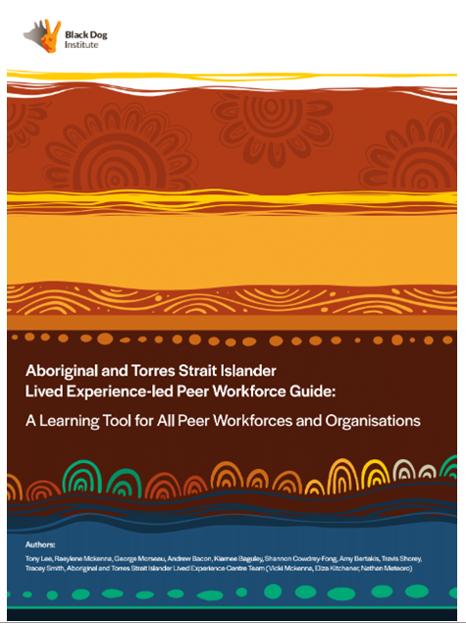
Aboriginal and Torres Strait Islander Lived Experience-led
Peer Workforce Guide
Notes:
Sara:
Aboriginal and Torres Strait Islander Lived Experience led Peer Worker Guide
This Guide is part of the additional resources created to support the implementation of the Western Australian Lived Experience (Peer) Workforces Framework which was released in late 2022.
While it is intended to sit alongside the WA framework, it is a stand-alone guide that can be used by all organisations and lived experience (peer) workforces in all jurisdictions.
The development of the Guide was a true partnership between the Western Australian Mental Health Commission and the Black Dog Institute's Aboriginal and Torres Strait Islander Lived Experience Centre.
The Mental Health Commission sought the expertise of the Aboriginal and Torres Strait Islander Lived Experience Centre (ILEC) allowing for a clear purpose of collaborative partnership throughout the process.
Community-led approach prioritised the voices and experiences of the community ensured that the creation of the Guide is culturally accurate, relevant, and respectful
Central to the project's success was the commitment to collaborative methods, specifically true co-design and co-production practices, with the ILEC and the broader Aboriginal and Torres Strait Islander working group.
It is a document developed by the community for the community.
[ I will now pass to Uncle Tony to reflect further on the process]

Slide 6
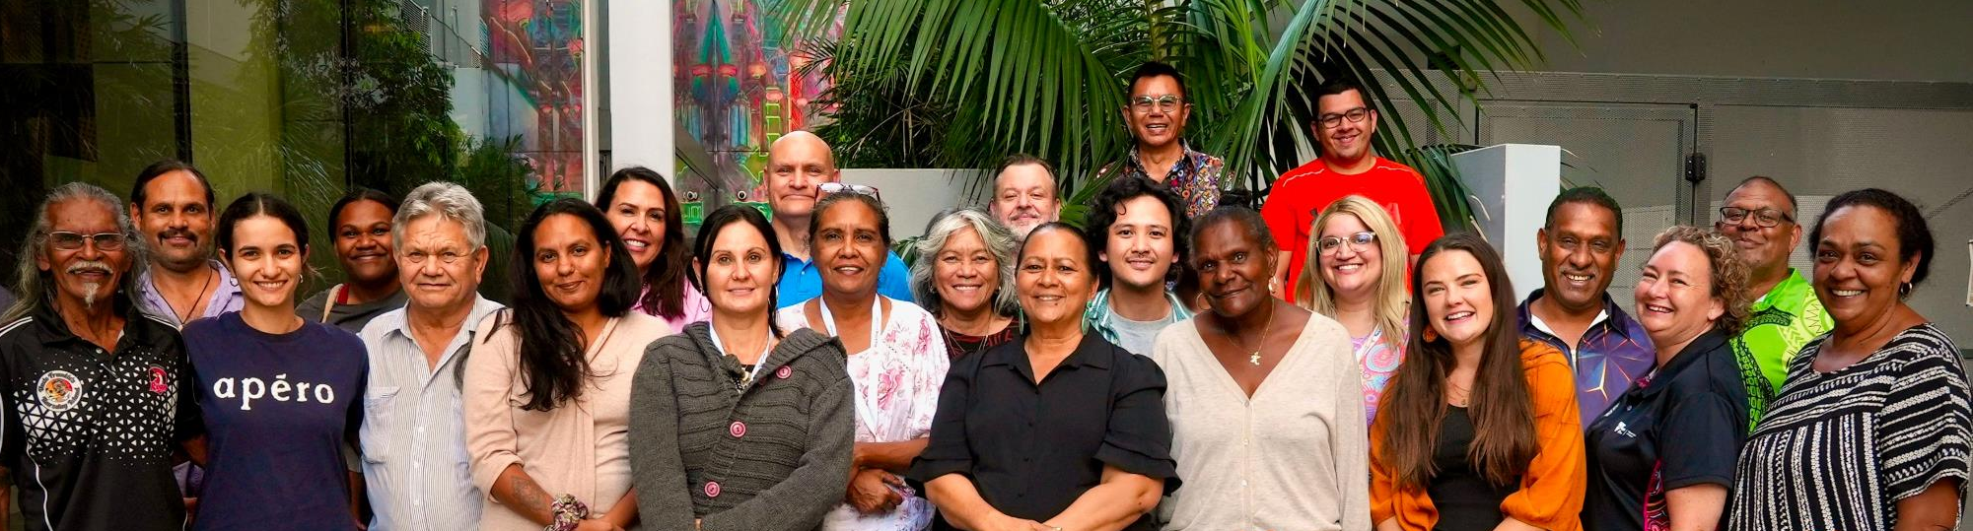
The Aboriginal and Torres Strait Islander Lived Experience Centre (ILEC) seeks to elevate Aboriginal and Torres Strait Islander Voices in Mental Health and Suicide Prevention Initiatives
Lived Experience National Network Members
Notes:
Uncle Tony: I will take a brief moment to explain what the ILEC is, of which I am the Co-chair of the Advisory group. We are an advocacy Centre that elevates First Nations lived experience voices in mental health and suicide prevention and communicates the needs of communities across our spheres of influence. Our Centre is First Nations led and governed, a Centre driven by community, for community. Our Centre is the first-of-its-kind Nationally and Internationally.

Slide 7
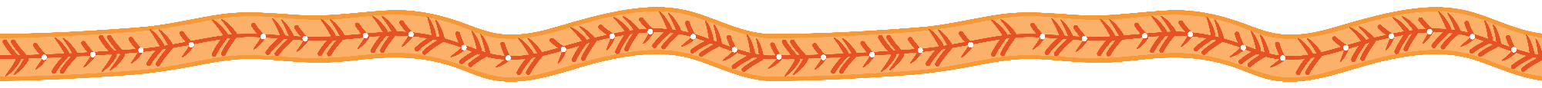
Process
Reflections/Notes:
Flexibility/Adaptability
  Structure of sections have been entirely re-written based on feedback
  Out of session contributions and meetings for those who would like to contribute in a 1-1 setting
Transparency
  Feedback from each member is logged and attributed in a public document other group members can see
Integrity
  Finding the story the group wants to tell
  The group returned to the story of the guide, and the purpose. Continually asking “what do we want this to do?”, “how do we want this to land?”, “how could this help our mob?” and redrafted based on this.
Collect feedback on sections drafted
Log all feedback on sections and communicate back to group members feedback received
Change guide based on group feedback
Present sections to group at monthly meetings
Remunerate group members for all contributions (including out of session review/contributions)
Notes:
Sara:
The commission engaged ILEC
2 day yarning session with key agencies in WA including our Elders in residence Aunty Helen and Uncle Charlie Kickett, lived experience leaders involved in the LE Framework and other key stakeholders.
We engaged the ILEC to lead the process to ensure the end result was by the community for the community.
Uncle Tony:
Reflecting on the process – acknowledge other working group members.
- As you can see from the process, it was flexible and collaborative. There was transparency which upheld the integrity of the outcome.

Slide 8
Purpose
The Guide gives formal recognition to those Aboriginal and Torres Strait Islander people doing this work, enabling them to be recognised, remunerated, properly respected. The Guide also provides a framework to formalise what First Nations peer work by outlining the systems requried that enable First Nations Lived Experieence Peer workers to contnue this work that is innatley part of their culture.
For organisations, whether you are at the beginning of your journey in peer work, or already on the peer work path, this guide will support you in providing a framework for establishment, sustainability, and continuous improvement.
For Aboriginal and Torres Strait Islander Lived Experience-led Peer Workers, this guide is to help you recognise what your role and responsibilities are in supporting community members, and what you should be expecting from the organisations you work with.
Notes:
Sara: The guide is a purposefully overarching document to allow for use to be tailored to meet community's diverse needs, that differ region to region and group to group.
It was developed for both organisations and peer workers.
Uncle Tony: The Working group knew that there's so much work to be done in assisting organisations to properly support our Aboriginal practitioners to do the work that we intuitively know how to do, the work that our cultures and our communities have been doing for thousands of years. We know the answers to the challenges that our communities face and we saw this guide as one step in the process to helping the structures and the systems ‘catch up’ and enable us to do our work in caring for our mobs in the ways that we know how.
We know that organizations have power and privilege, and therefore responsibility. The onus of this guide is primarily on how organizations can really shift the way that they can do their work to support peer workers and by extension the communities that they're meant to be serving.

Slide 9
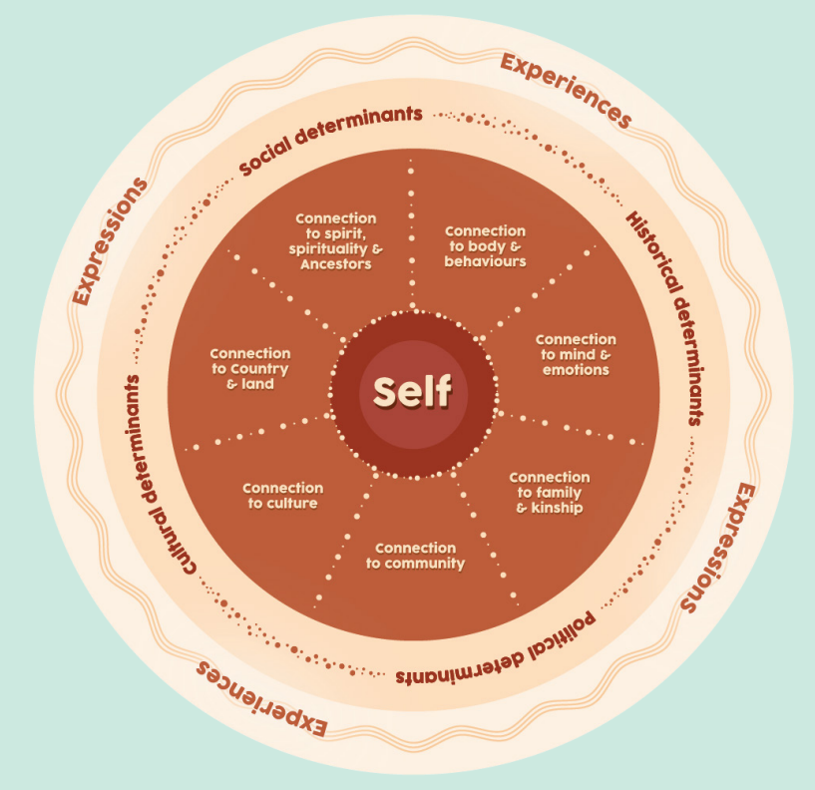
Aboriginal and Torres Strait Islander Peer Work
Peer Work aligns to Aboriginal and Torres Strait Islander ways of knowing and being and is woven into their rich culture, that has been passed down for tens of thousands of years.
Aboriginal and Torres Strait Islander Peer work is grounded in:
Grounded in:
Social and Emotional Wellbeing
Cultural Responsiveness
Diversity and Inclusivity
Self-determination for First Nations Peoples
Centrality of Culture
Intersectionality
SBLGBTQIA+
Notes:
Tony: The Guide tells us that Aboriginal and Torres Strait islander Lived Experience led Peer Work is grounded in the concept of Social and Emotional Wellbeing and Aboriginal ways of working. It's culturally responsive, diverse, inclusive and reflective of (differing) community needs.
Sara: The Guide outlines ways for peer work to be done right to ensure the community is supported and the workforces is sustainable. It articulates the role of the Organisations to fulfil their responsibilities to peer workers and the community as well as highlighting the responsibilities of the Peer workers themselves.

Slide 10






7 Domains of Getting Peer Work Right
Supervision
Professional Development
Local Considerations
Establishing Boundaries
Self-Care
Training
Role Flexibility and Leave Accommodations
Notes:
Sara: Key components so the guide include supervision, self care, local considerations, training, role flexibility and leave accommodations, establishing boundaries and professional development.
Tony: Expand on one item if timing allows.

Slide 11
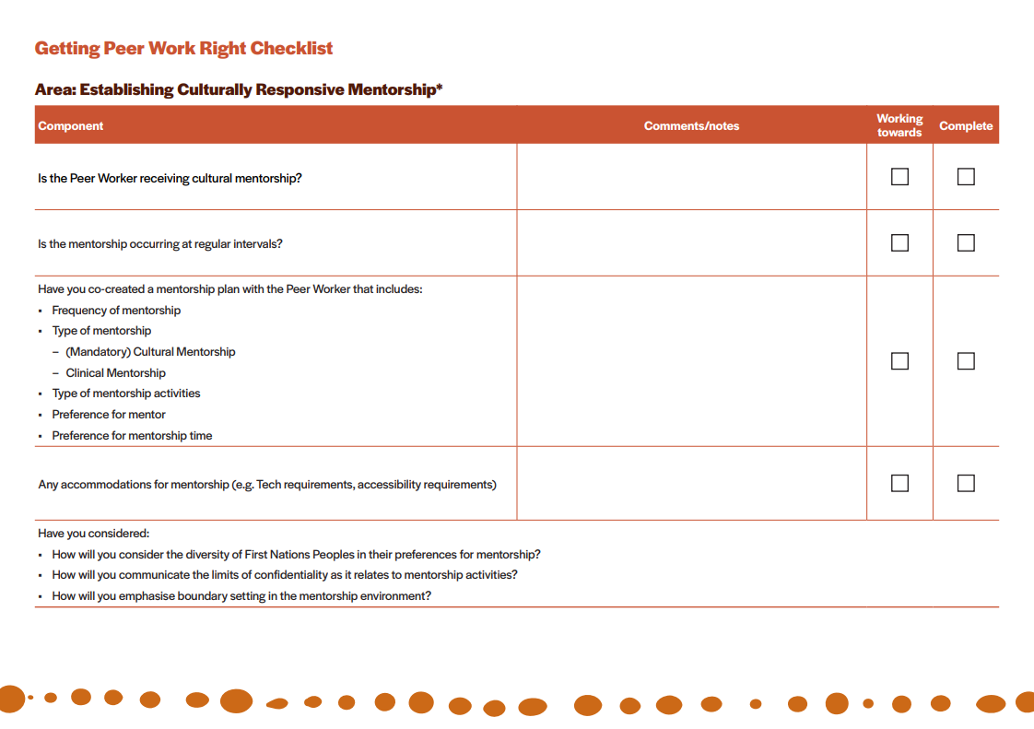
Getting Peer Work Right - Checklist
The ‘Getting Peer Work Right Checklist’ is a supporting document that provides further practical ways organisations can contribute to the safe implementation of Aboriginal and Torres Strait Islander peer work/ers.
The checklist discusses a range of areas with associated components to track progress and maintain accountability.
Notes:
Sara: This is an example page from the checklist that speaks to Establishing Culturally Responsive Mentorship. The checklist has components, comments, progress markers as well as further considerations.Headings on checklist:
Establish Culturally Responsive mentorship
Consider the local context
Communicating transparency regarding peer work
Cultivating an environment of self-care
Supporting training and professional development
Establishing boundaries
Role flexibility and leave accommodations
Uncle Tony:
Organisations can use this to work with Aboriginal and Torres Strait Islander peer workers to co-design meaningful systems that enable, cultural security, psychological safety, personal development and guide organisational readiness.
Soure: Getting-Peer-Work-Right-Checklist.pdf (blackdoginstitute.org.au)

Slide 12
Final Thoughts
It is important that Peer Worker's and Organisations understand that First Nations people are not homogenous, there are hundereds of countries, with distinct lore, language , culutre and perspectives. This is furthered by the diverisity in Lived Experiences and perspectives.
We recognise that this is a guide - meaning that implementation will vary to consider the diversity of First Nations communities and local community needs. Understanding this will enable organisaitons to tailor culturally responsive actions and plans to meet the needs of local peoples and communities.
In being culturally responsive, peer work should not be seen in isolation, they should be integral, and part of the organisation. From policies, to procedures, to practice, effective integration of peer work means that communities are getting best practice support which they deserve.
When peer work is done right, it benefits everyone.
Notes:
Tony: It is important that Peer Worker's and Organisations understand that First Nations people are not homogenous, there are hundreds of countries, with distinct lore, language , culture and perspectives. This is furthered by the diversity in Lived Experiences and perspectives. The guide shows us that understanding the diverse histories, lived experiences, cultures and traumas are unique and integral to building culturally responsive lived experience workforce.
Sara: We recognise that this is a guide - meaning that implementation will vary to consider the diversity of First Nations communities and local community needs. Understanding this will enable organisations to tailor individual and organisational responses, actions and plans to meet the needs of local peoples and communities. In being culturally responsive, peer work should not be seen in isolation, they should be integral, and part of the organisation. From policies, to procedures, to practice, effective integration of peer work means that communities are getting best practice support which they deserve.
Tony: Overall, this approach will ensure greater inclusivity, effectiveness and pays respect to Aboriginal and Torres Strait Islander culture. In being culturally responsive, peer work should not be seen in isolation, they should be integral, and part of the organisation. From policies, to procedures, to practice, effective integration of peer work means that communities are getting best practice support which they deserve. When peer work is done right, it benefits everyone.

Slide 13
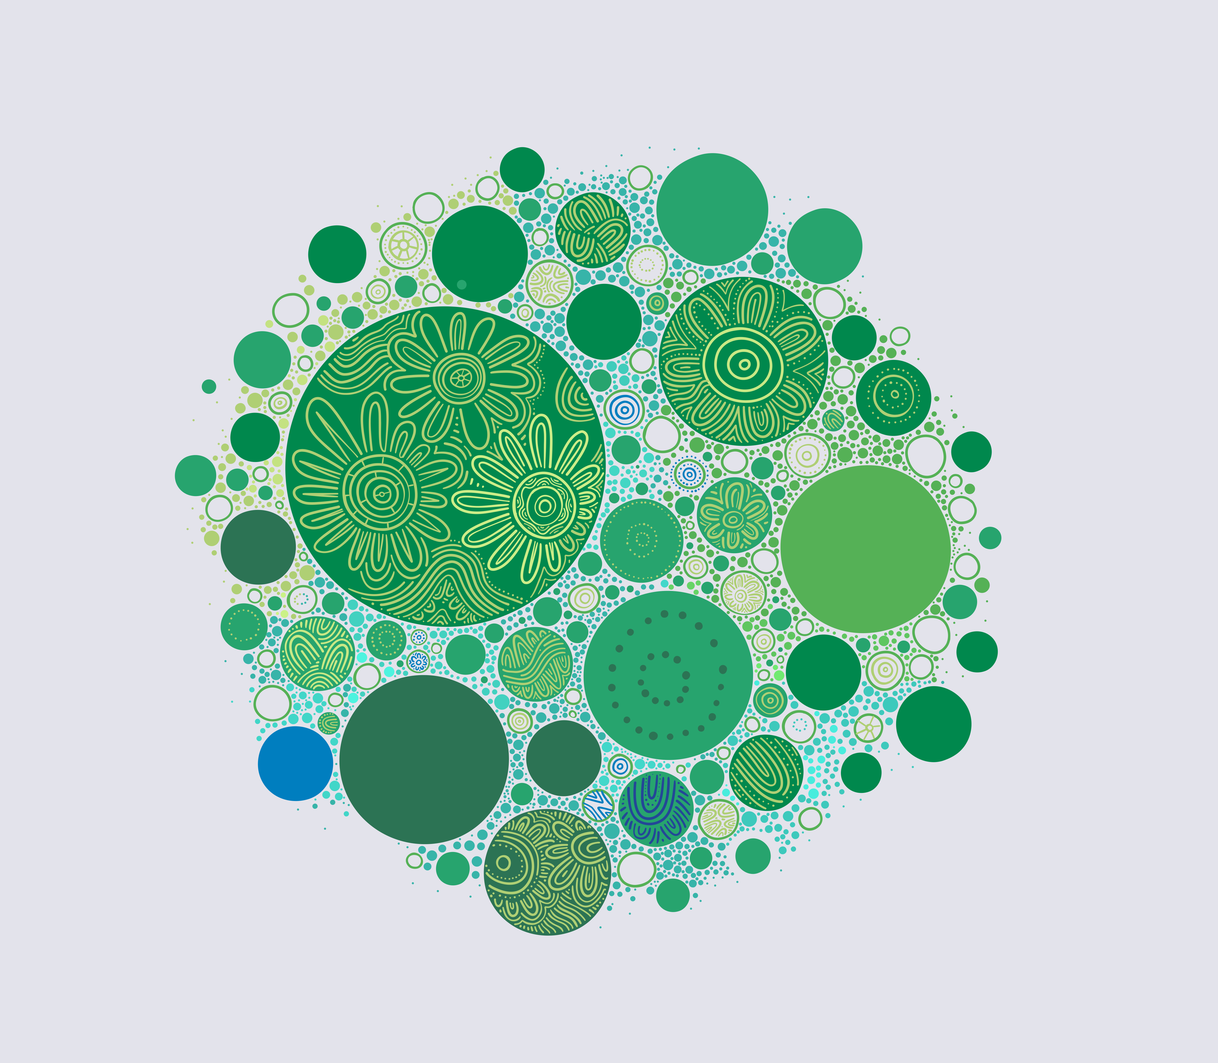
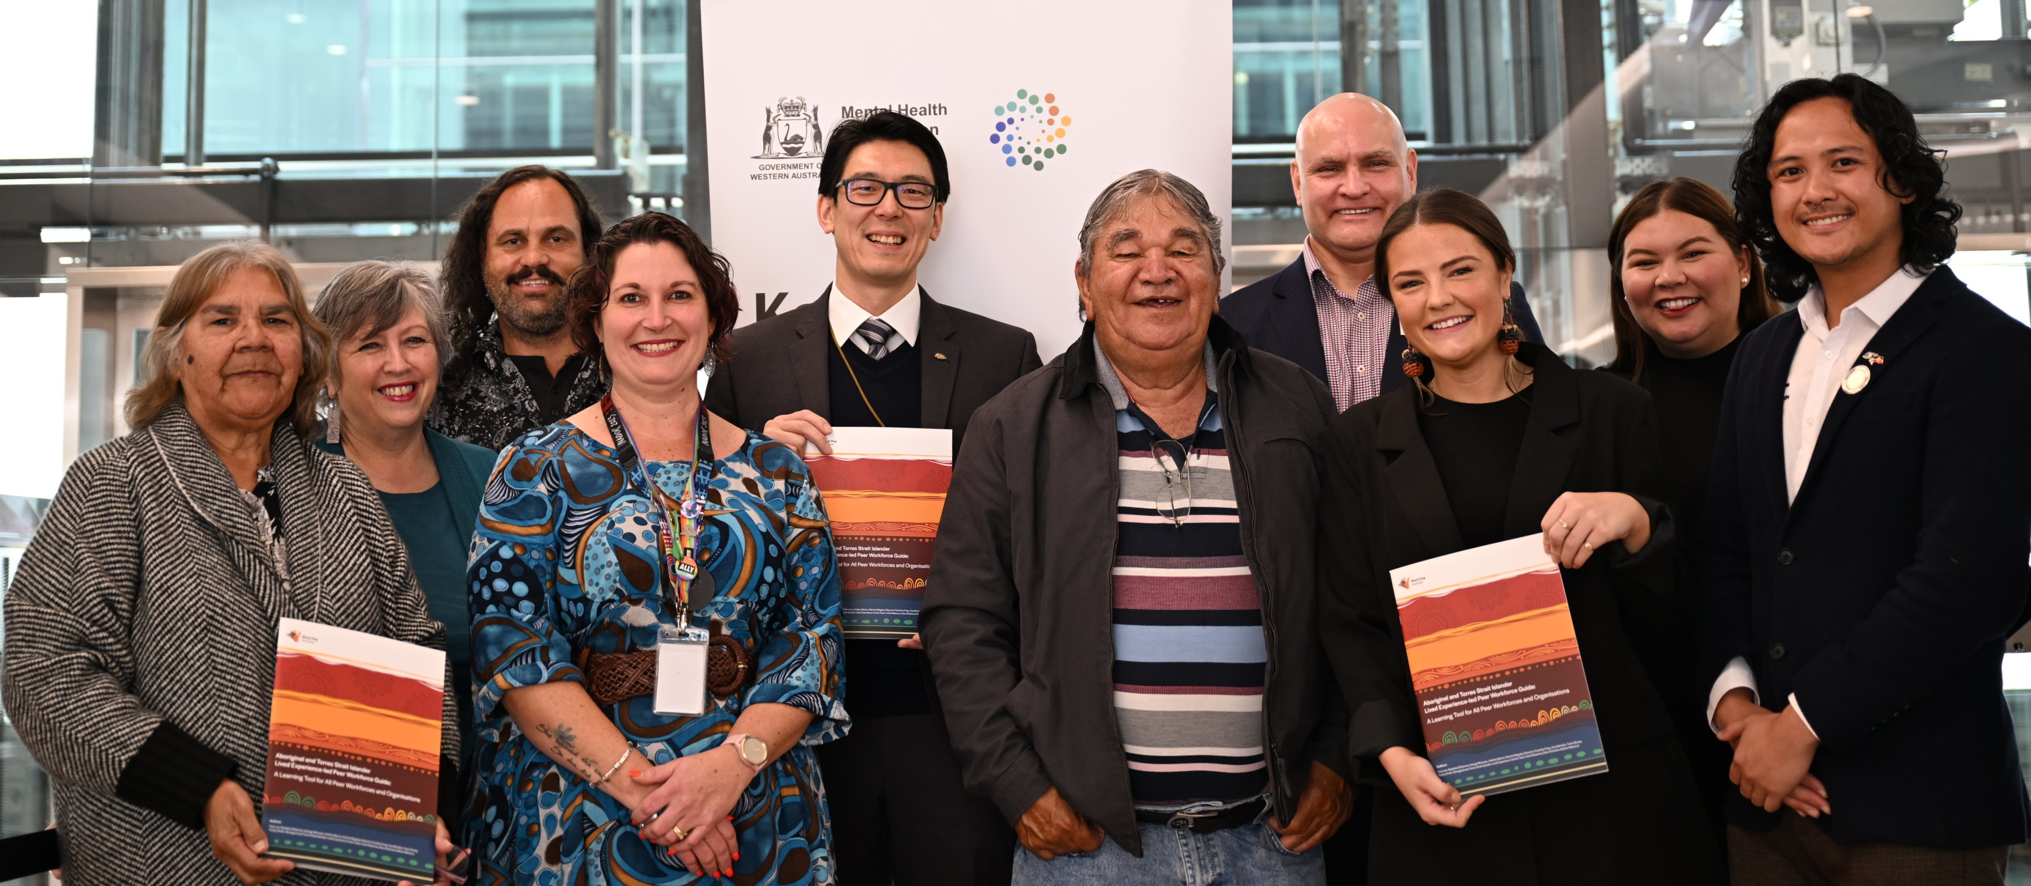
Notes:
Here is a picture from our launch event.
Aboriginal and Torres Strait islander Lived Experience led Peer Workforces Guide was launch on 13 August 2024.
There was a face to face launch that was well attended, the online launch saw almost 400 registrations.

Slide 14


This work is copyright. It may be reproduced in whole or in part for study or training purposes subject to an acknowledgement of the source and no commercial use or sale. Reproduction for purposes other than those above requires written permission of:
Mental Health Commission PO Box X2299
Perth Business Centre WA 6847
The information contained in the document is considered to be true and correct at the date of publication however, changes in circumstances after the time of publication may impact upon the accuracy of the data. The databases are active databases and therefore the data may change without notice. Changes may relate to a number of issues, including amendments made to the databases and variations in syntax used to perform the individual queries. The Mental Health Commission is not in any way liable for the accuracy or repeat reliability of any information.

