Slide 1
Nobody dies here.
Learnings from the Victorian experience of the Medically Supervised Injecting Room.
Simone Heald, Chief Executive Officer ¹
Dr Nathan Stam, Principal Research Fellow ^{1,2,3}
1 - North Richmond Community Health
2 - School of Population and Global Health, The University of Melbourne
3 - Monash Addiction Research Centre, Monash University

Slide 2
Acknowledgement of Country
We respectfully acknowledge the Traditional Owners of the land on which we gather, the Turrbal and Jagera peoples. We recognise their enduring connection to the land, waters, and communities, and we pay our respects to their Elders past, present, and emerging.
As participants in this health summit, we reflect on the profound impact of colonisation, displacement, and systemic inequities on First Nations peoples' health and well-being. This understanding informs our commitment to culturally safe and inclusive practices in the delivery of care and the shaping of health policy.

Slide 3

What we will cover today:
What does the Medically Supervised Injecting Room (MSIR) provide.
What are the learnings from delivering and managing the MSIR.
Key themes on establishing or operating a Supervised Injecting Facility.

Slide 4
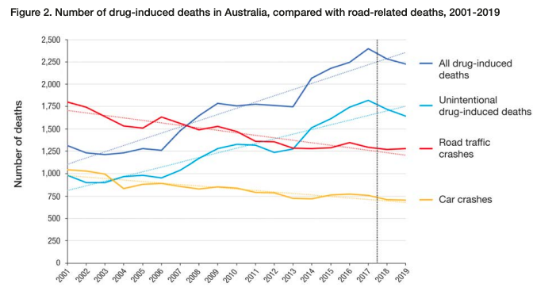
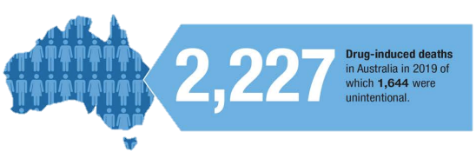
Drug-related deaths in Australia
Drug-related deaths are a major public health issue both in Australia and internationally.
Opioid drugs (including heroin) are the largest cause of drug-related deaths in Australia.
Opioid-related deaths are disproportionately higher than the number of people who use these drugs.
Australia’s Annual Overdose Report 2021, Pennington Institute, ISSN: 2652-7790.

Slide 5
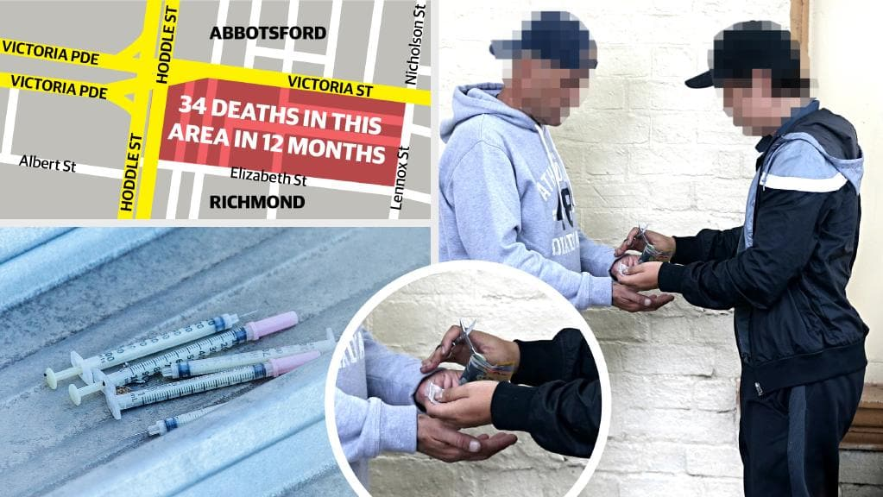

Slide 6
What does the facility look like?

Slide 7
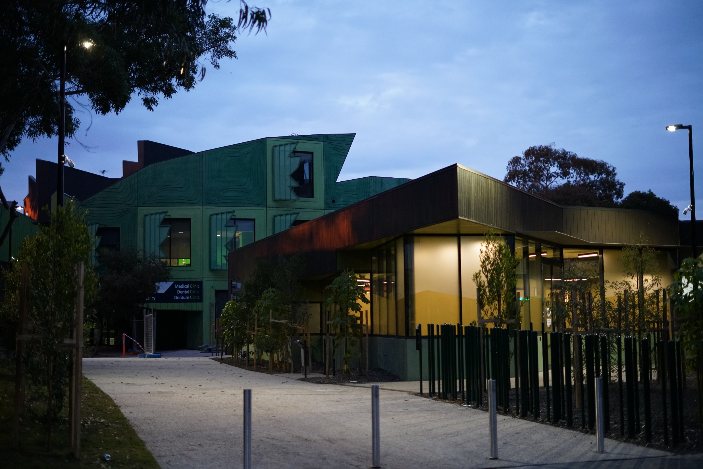

Slide 8
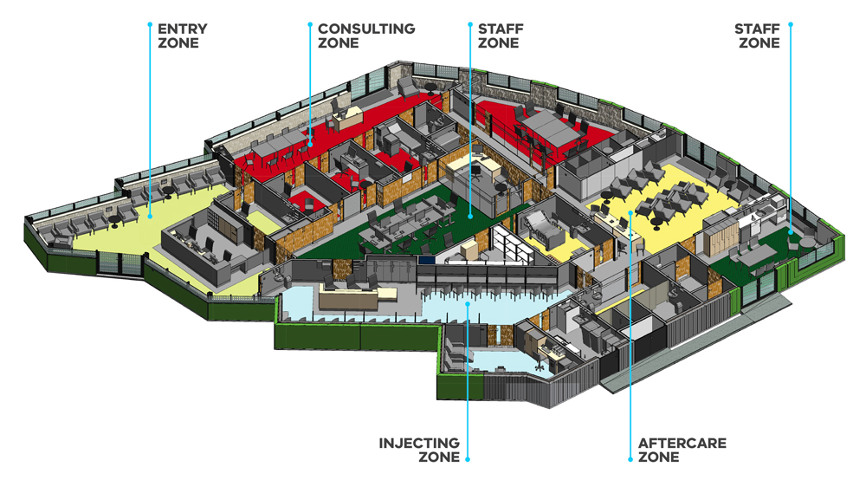
https://www.vhhsba.vic.gov.au/mental-health/alcohol-and-other-drugs/medically-supervised-injecting-room

Slide 9
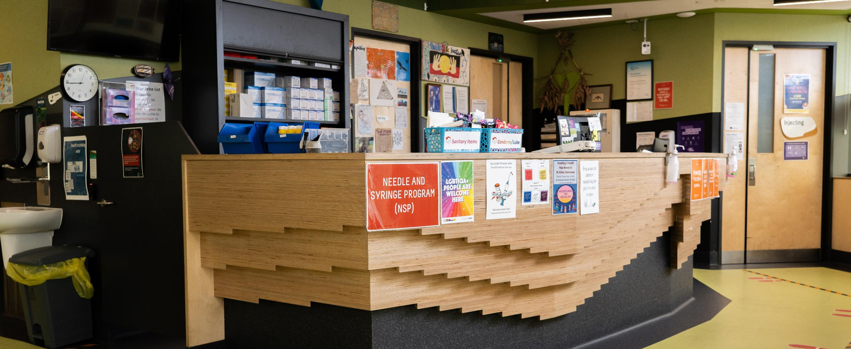

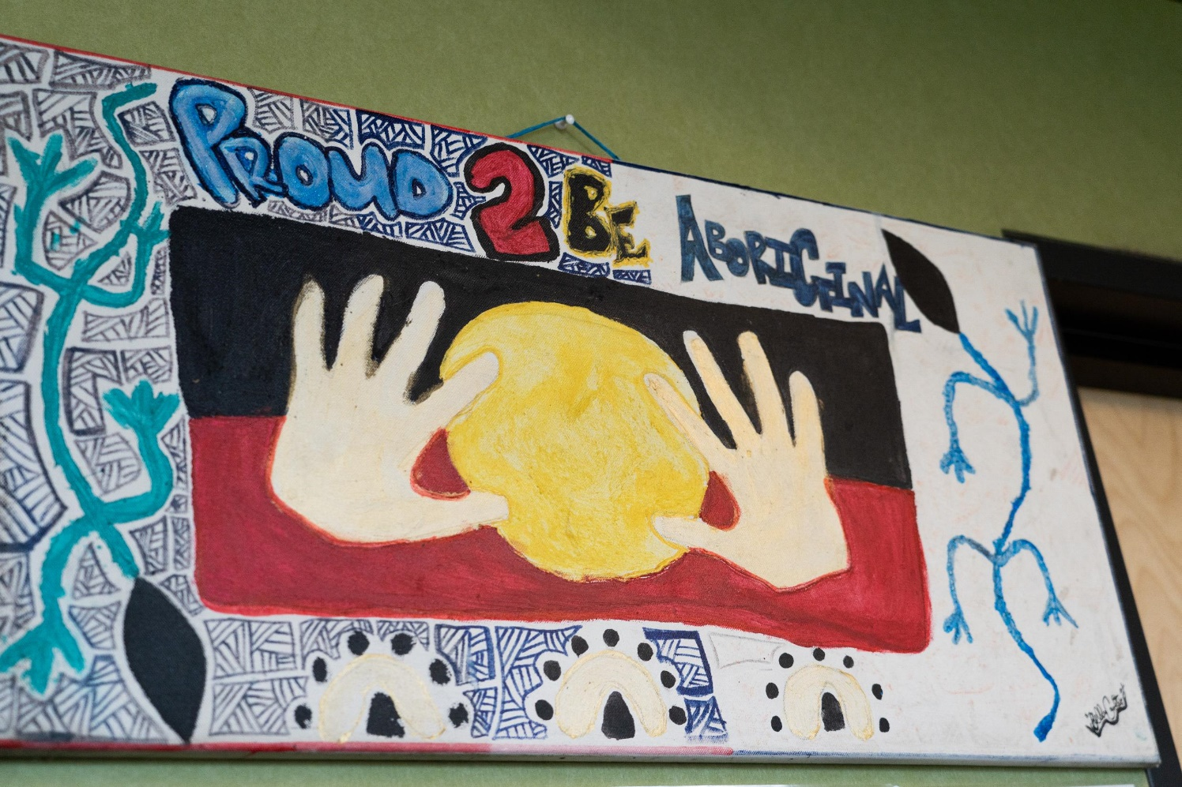


Slide 10
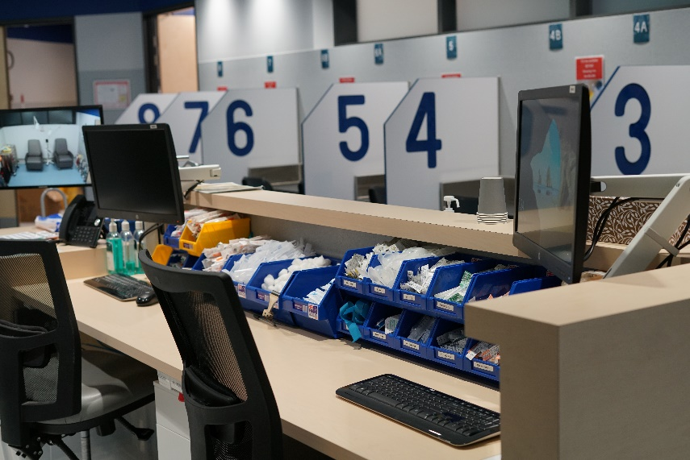
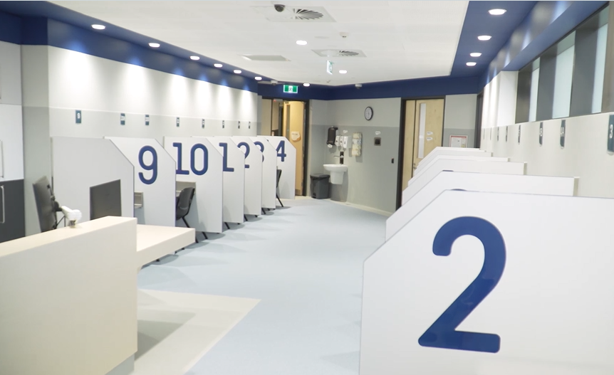
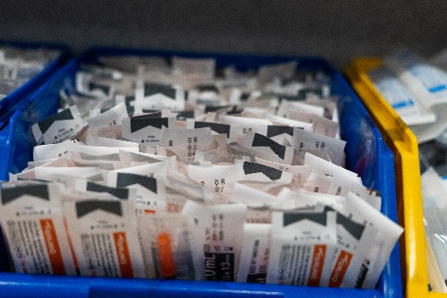
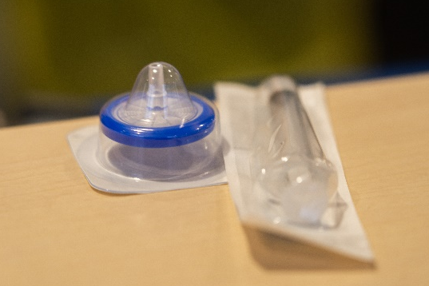
Inside the facility: Injecting Zone

Slide 11
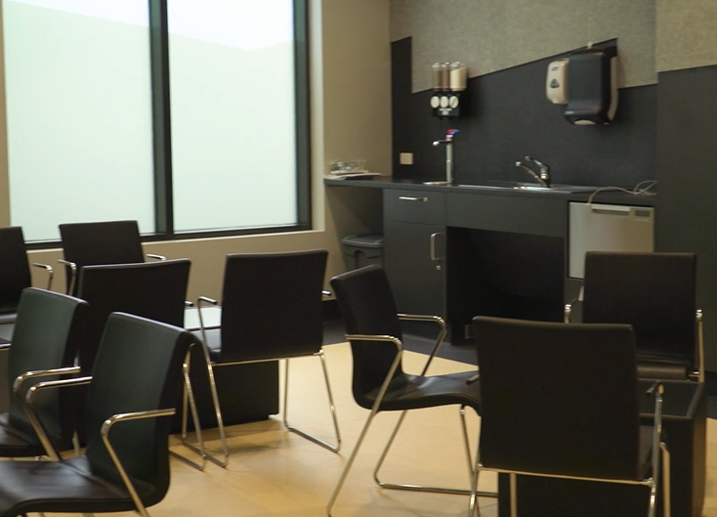
Inside the facility: Aftercare Zone
Zone 3
Hepatitis and BBV testing and treatment.
A range of health supports and referral to clinical services.
Material aid and social support services.
Opportunities for engagement, support and structured activities.

Slide 12
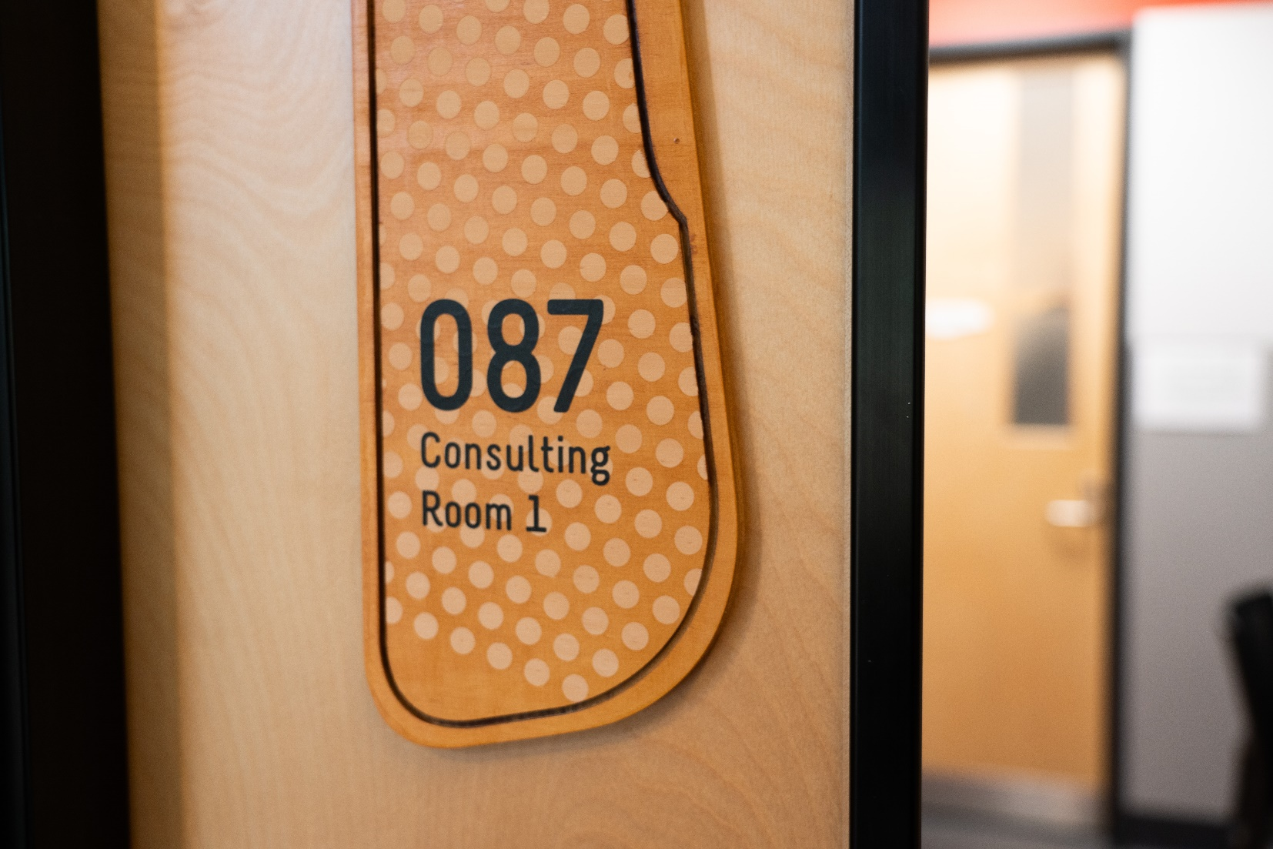
Inside the facility: Consulting Area
Zone 4
Provides a range of immediate healthcare interventions and support.
Operates separately to the MSIR (people excluded from the MSIR can access health services).
Operates as a drop-in service.
Operates a ‘twilight clinic’ to enable greater access to services

Slide 13
What does the service provide

Slide 14
What does the MSIR provide?
A safe place for people who don’t want to die from an overdose during that period in their life that they are injecting drugs.
A positive healthcare experience for onsite
An opportunity to support people who are often in vulnerable situations and with significant complex health and social support needs.
  Harm reduction advice.
  Acute clinical presentations.
  Primary healthcare services.
  On-site drug treatment services.
  BBV testing and treatment.
  A range of social support services (inc. family violence, housing and legal).

Slide 15

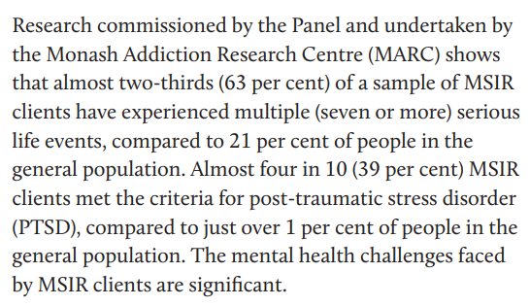
People who use the service have complex health needs

Slide 16
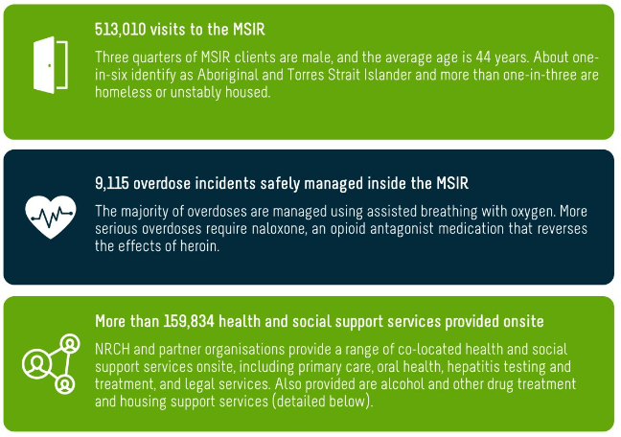
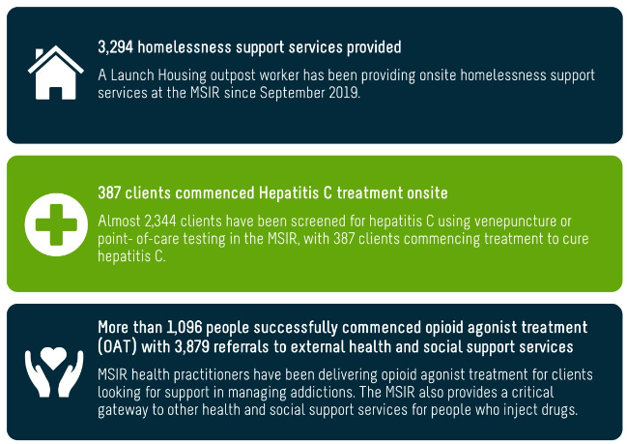
Some quick stats…
June 2018 to June 2024
No deaths at the MSIR despite >9,000 opioid overdoses on-site.
https://nrch.com.au/services/medically-supervised-injecting-room/

Slide 17
Learnings

Slide 18
Objectives of the MSIR
(abbreviated from the Drugs, Poisons and Controlled Substances Act (2023))
To reduce the number of avoidable deaths and the harm cause by overdose;
To be a gateway to health and social support services for people who use the MSIR (including drug treatment, rehabilitation support, healthcare, mental health treatment and support and counselling);
To reduce overdose-related ambulance attendance and hospitals admissions;
To reduce the number of discarded needles and syringes in public places and public injecting in the vicinity of the MSIR;
To improve the amenity of the neighbourhood for residents and businesses in the vicinity of the MSIR;
To assist in reducing the spread of blood-borne diseases including HIV and hepatitis C

Slide 19
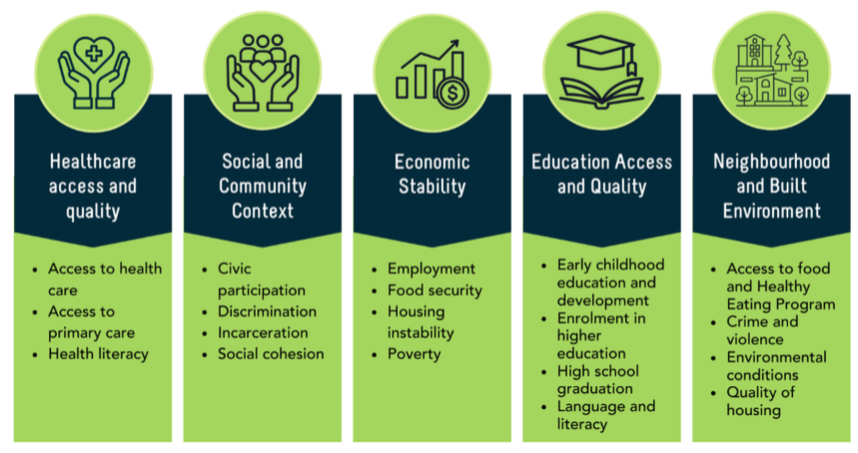
Social Determinants of Health Model of Care
As a community health service, NRCH has the capability to address many of the social determinants of health onsite.

Slide 20
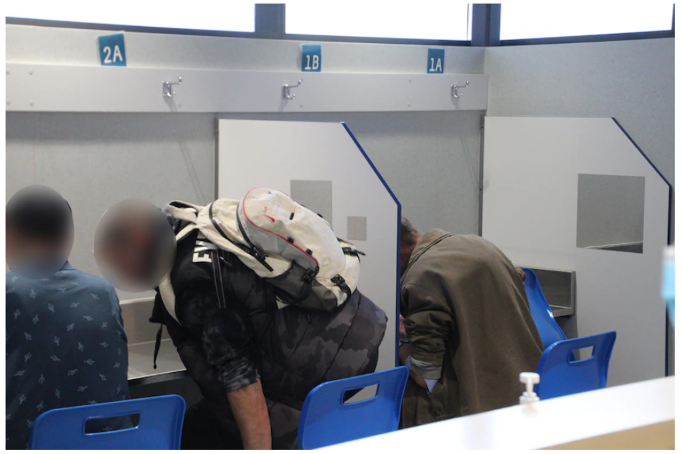
The Clients
Every client’s journey is unique and individual
Health and wellbeing needs are complex
Prevalence of challenging mental health
63% multiple serious life events
39 per cent experience PTSD symptoms

Slide 21
Learnings (Clients)
Complex health presentations / volatile working environment.
Sanction policies
Balancing duty of care with organisational risk.
The ‘sweet spot’ for effective harm reduction and high-quality clinical care.

Slide 22
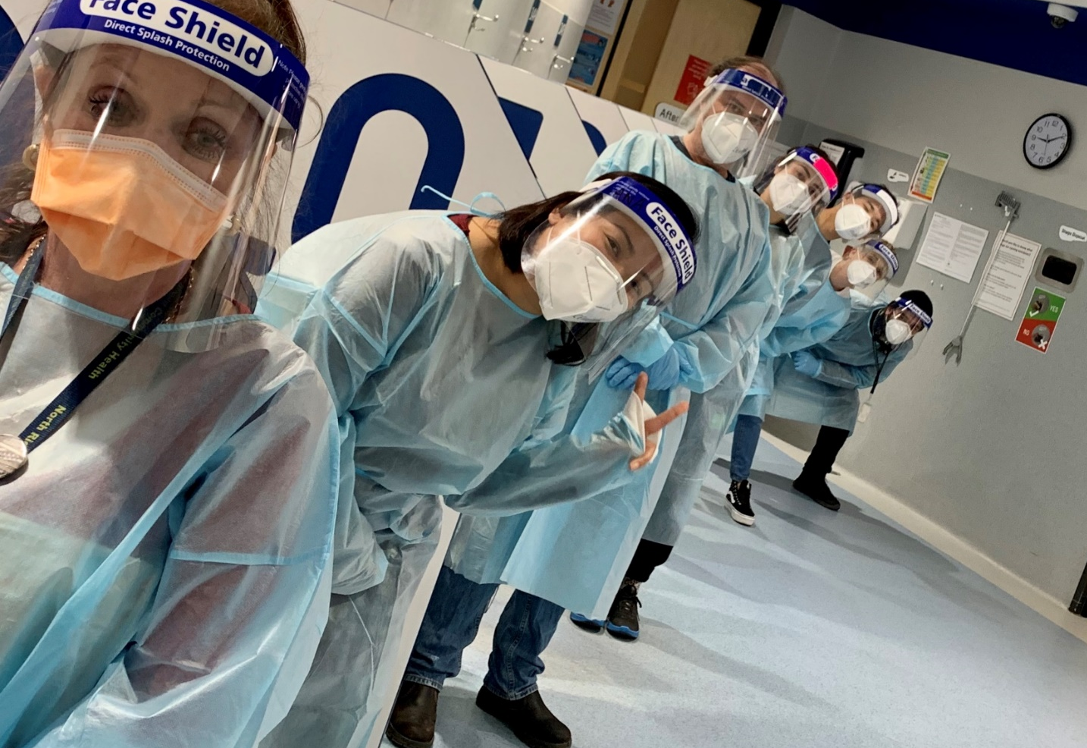
The staff
Dedicated staff
Clinical and non-clinical personnel
Lived and living experience

Slide 23
Learnings (workforce)
Balancing Clinical and Harm Reduction Practitioner philosophies
Enhancing Support for Diverse Lived and Living Experience Roles

Slide 24
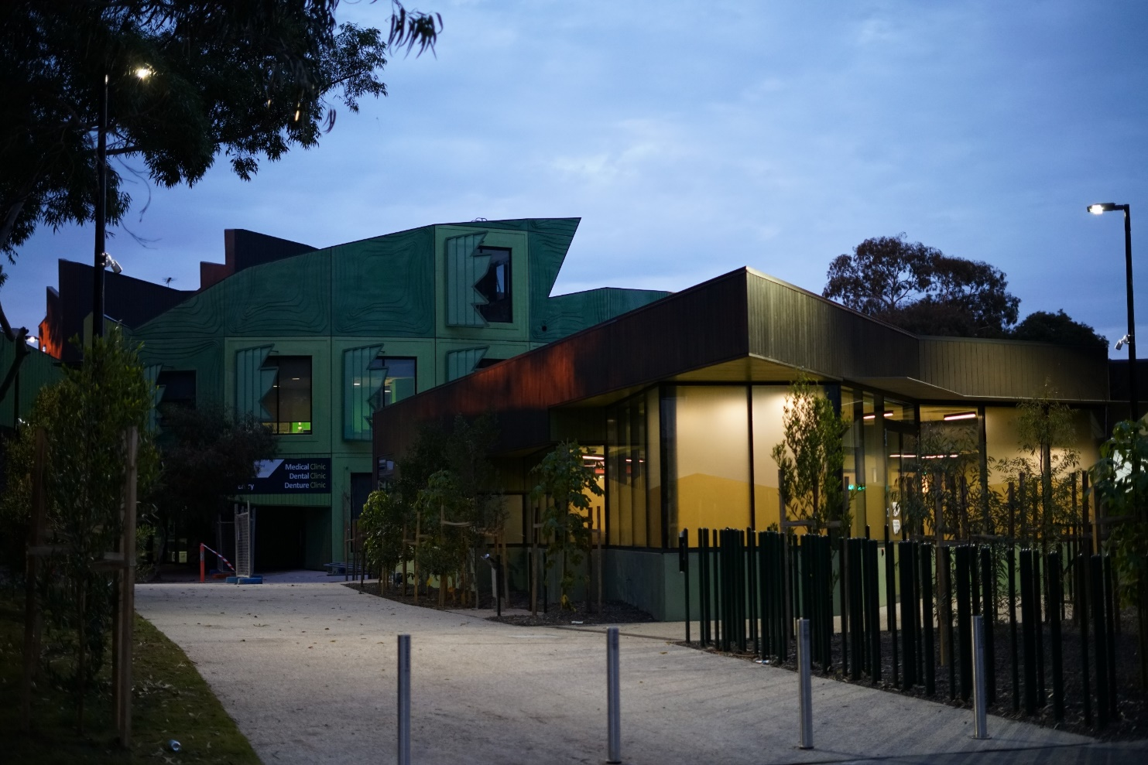


The Environment
NRCH throughput evidences that client flow is effective
DATA
Average of 300 to 350 injecting visits per day
8 to 12 overdoses per day managed on-site

Slide 25
Learnings (Environment)
Clinical environment
Insufficient building size to accommodate operational needs and capacity for harm reduction.
Commitment to safety and challenges in balancing a secure environment for clients and staff.

Slide 26
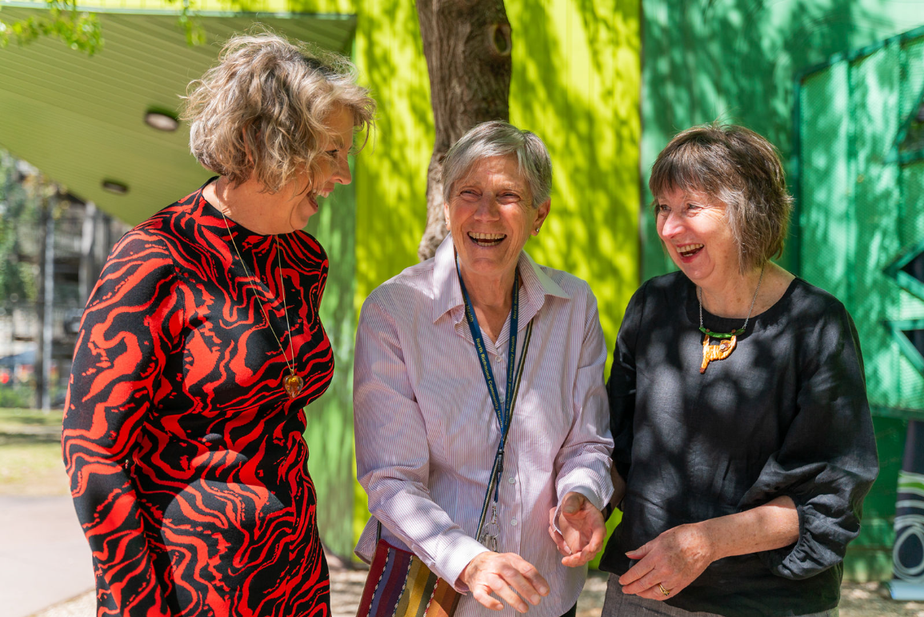
The Stakeholders
Several stakeholders are involved and hold significant interest.

Slide 27
Learnings (Stakeholders)
Managing impact of reputation of stakeholders
Proactive stakeholder engagement
Understanding and respecting motivations

Slide 28
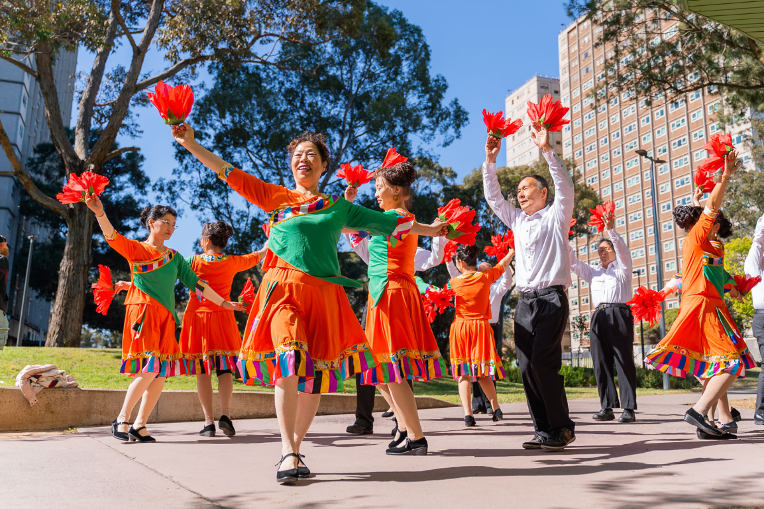
The Community
Public perception of safety
Drug paraphernalia and public injecting
Governments have investments to enhance community amenities
Congregation

Slide 29
Learnings (Community)
Immediate community engagement
Social license awareness
Solutions for drug paraphernalia
Collective responsibility to deliver on action

Slide 30

The Reviews
NRCH continues to face ongoing service review
North Richmond Community Health AOD Program
Hamilton Review
Safer Care Victoria Review
2021
Ryan Review
2023

Slide 31

Community
Staff
Clients
Stakeholders
NRCH
Ammenities

Slide 32
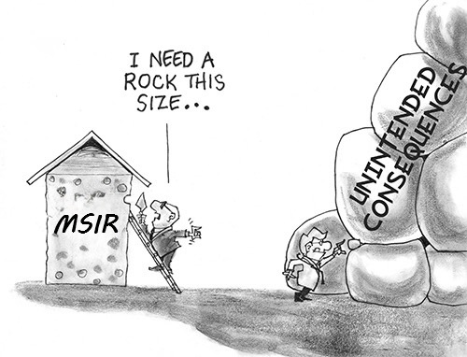


Slide 33


Slide 34
Themes

Slide 35
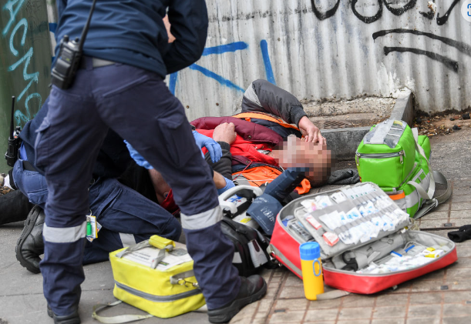
Supervised injecting facilities save lives
Decrease the number of deaths related to overdoses.
Mitigate the harms associated with injecting drugs.
Serve as an effective means for individuals to access clinical care and social support services.
Provide a way for individuals to obtain pharmacotherapy and other drug treatment services when they are ready.

Slide 36
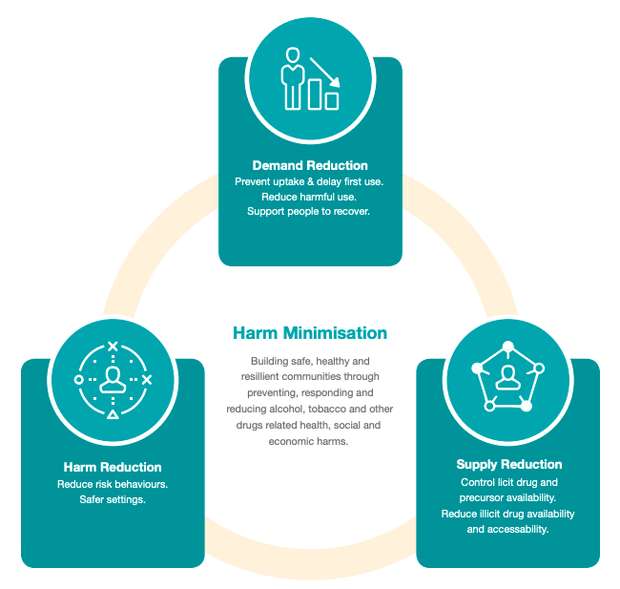
Supervised injecting facilities are not a silver bullet
The require integration with broader harm reduction strategy
Not capable in solving all issues - clear and realistic objectives is essential.
Challenging to impact or influence individuals who do not engage with the service.
The location (especially its proximity to the drug market) and the number of available services are important factors.

Slide 37

Alignment with the National Drug Strategy
AIM
To build safe, healthy and resilient Australian communities through preventing and minimising alcohol, tobacco and other drug-related health, social, cultural and economic harms among individuals, families and communities.
But they are also an easy target...
It takes commitment and courage.

Slide 38
Thank you.

Slide 39
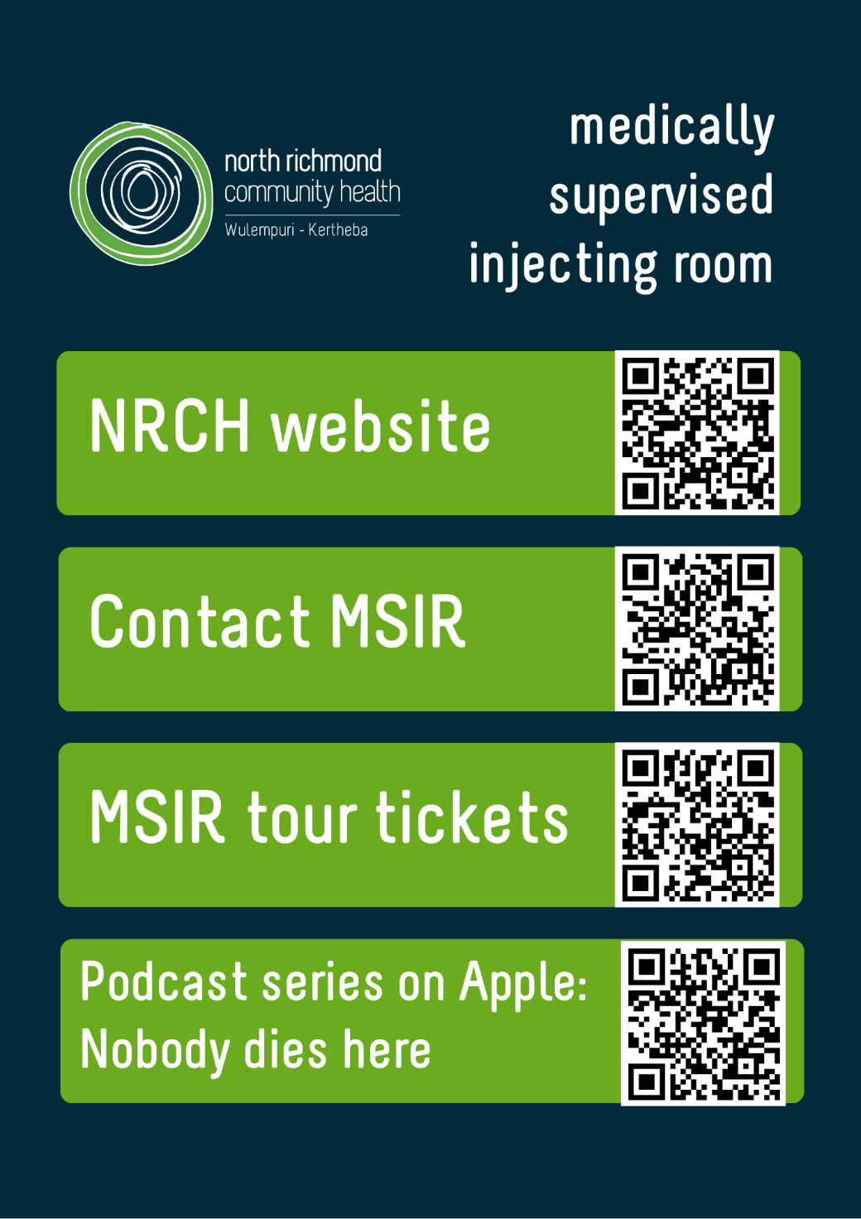
Want more information?

