Slide 1
Reform Lab 1: Data, Outcomes and Accountability
A/Prof Nicola Warren

Slide 2

Data is important
Created by Canva AI

Slide 3
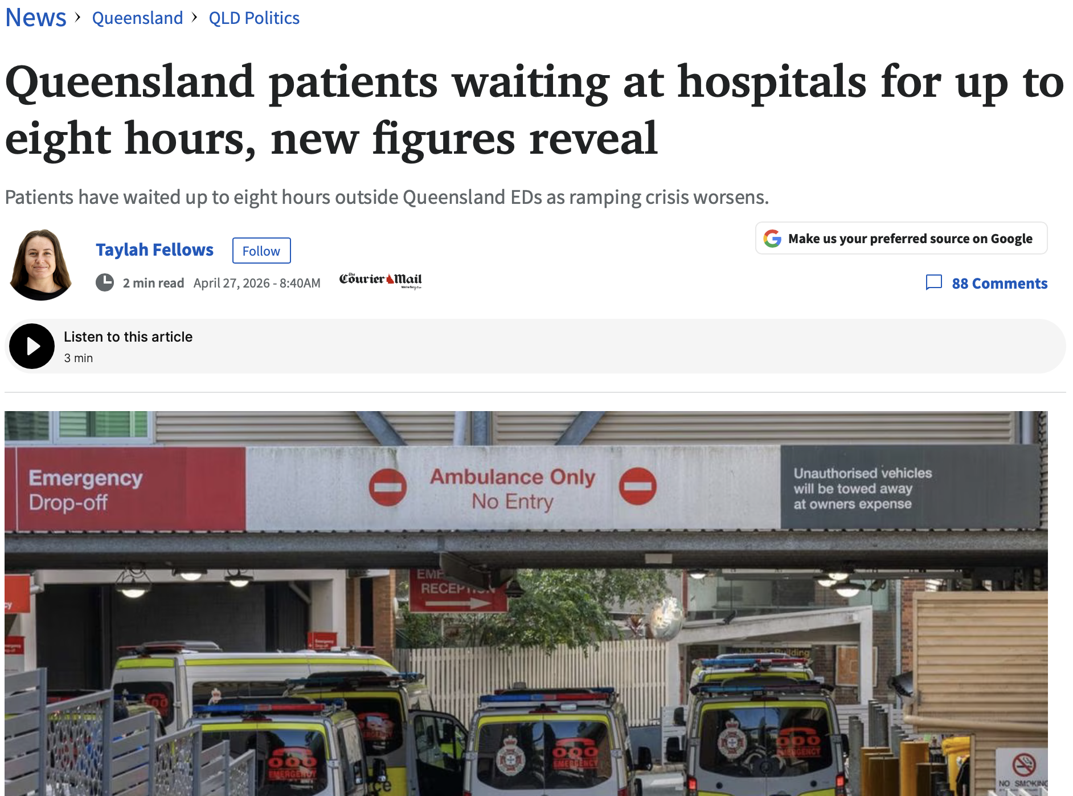
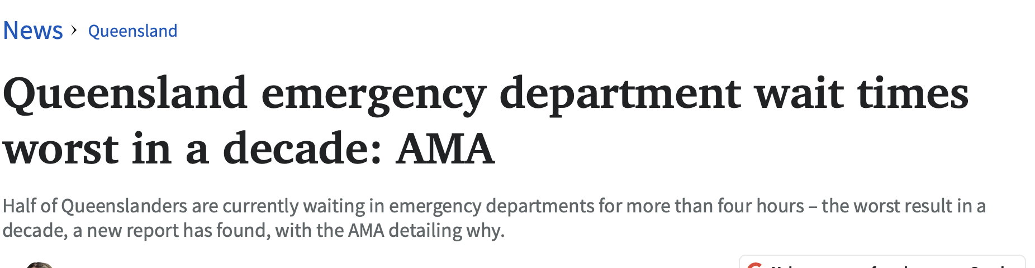

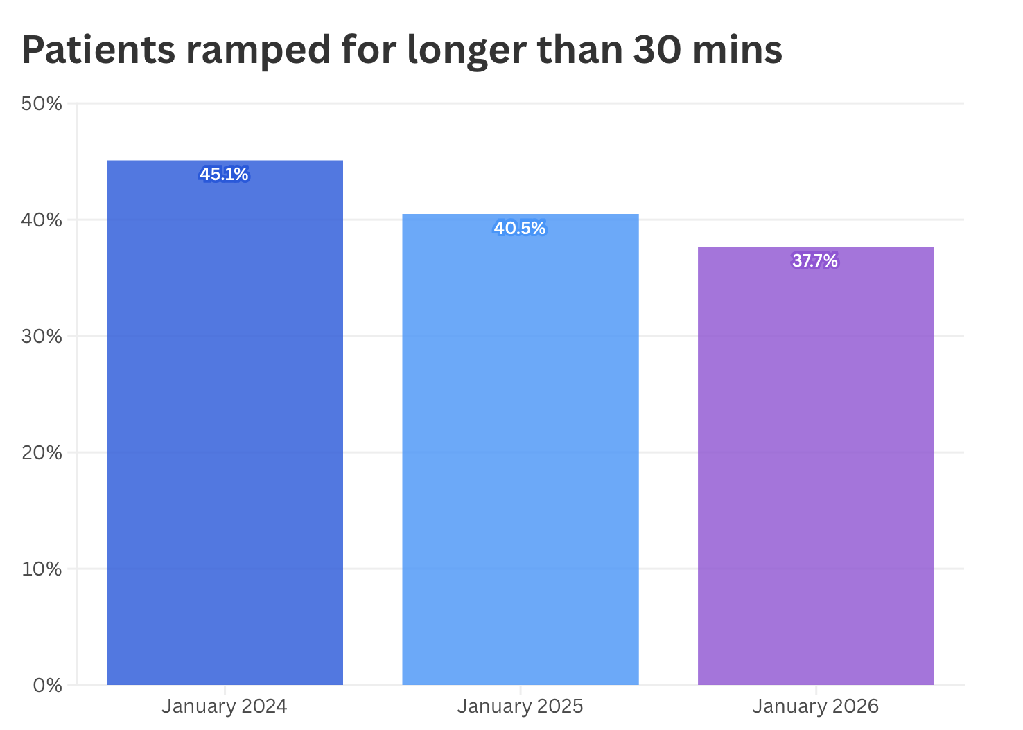
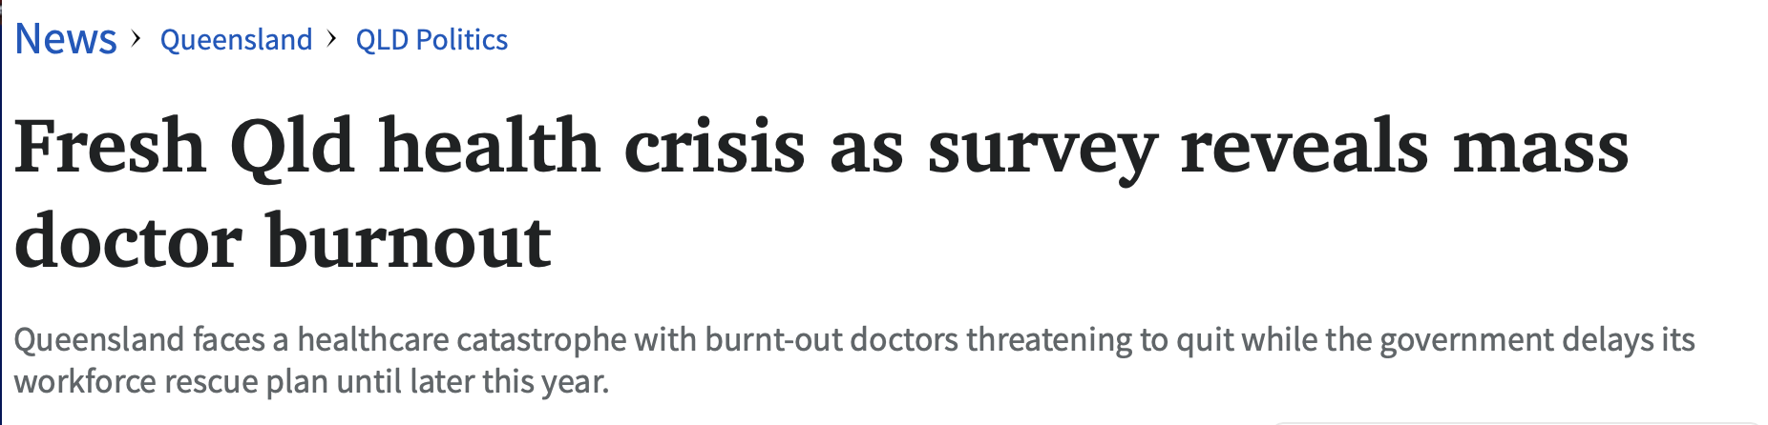
Courier Mail, accessed 20/5/26

Slide 4
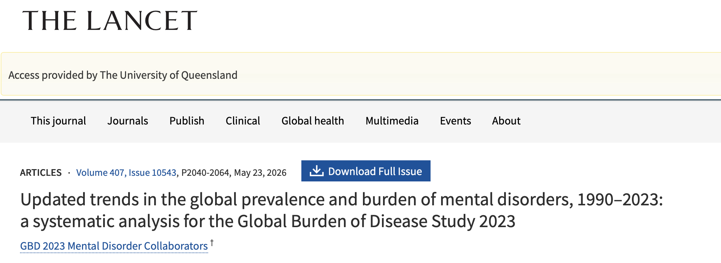

Slide 5



Slide 6
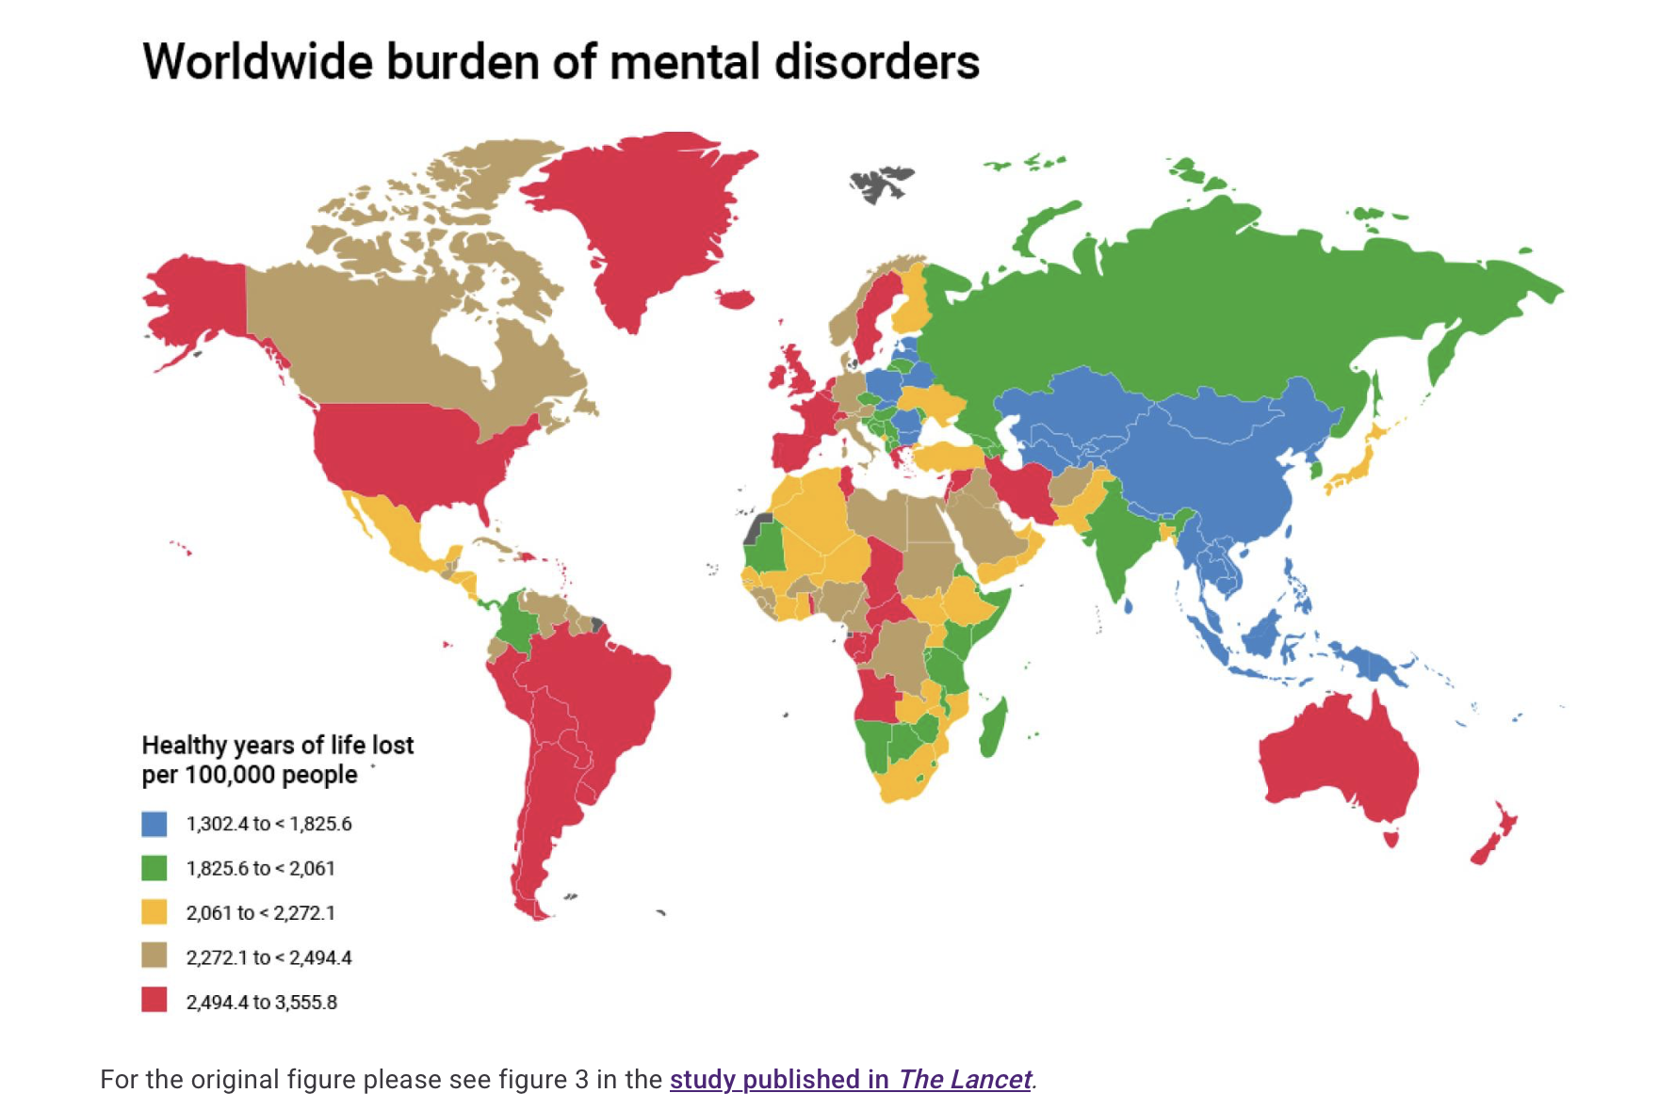

Slide 7

Data challenges
Created by Canva AI

Slide 8
Data Collection and
Input
Data Extraction and
Analysis
Data Translation and Implementation

Slide 9
Data collection and input
Burden to the individual
Ensuring data quality
Right data for the right question

Slide 10
Data extraction and analysis
Lacks integration and linking
Systems outside of health – justice and child safety
Complexity of analysis

Slide 11
Translation and implementation
Responsibility to use data that is collected
Accountability

Slide 12

There is so much potential
Created by Canva AI

Slide 13
Thank you
nicola.warren@health.qld.gov.au

