Slide 1
Managing funding from the mental health levy
QMHC Leading Reform Summit 2026
25 May 2026
Darren Brown
Notes:
Please add the report information

Slide 2

Welcome
Acknowledgement of country
I begin today by respectfully acknowledging the Yugara and Turrbal People who are the Traditional Owners of the land on which this event is taking place, and Elders past and present.
I also recognise those whose ongoing effort to protect and promote Aboriginal and Torres Strait Islander cultures will leave a lasting legacy for future Elders and leaders.
Notes:
I begin today by respectfully acknowledging the Yugara and Turrbal People who are the Traditional Owners of the land on which this event is taking place, and Elders past and present.
I also recognise those whose ongoing effort to protect and promote Aboriginal and Torres Strait Islander cultures will leave a lasting legacy for future Elders and leaders.

Slide 3
Agenda
What we do
Audit scope
Report overview
Conclusion and key findings
Looking forward: recommendations and what’s next
Q&A

Slide 4
What we do
The Queensland Audit Office (QAO) is the Queensland Parliament's independent auditor of state and local government public sector entities.
We aim for our work to have a lasting impact.
It’s about making sure public money is being spent well and that Queenslanders receive the services they need and expect.
Essential part of the integrity system
Helps improve accountability and performance
Established under the Auditor-General Act 2009 and adheres to auditing standards
Fully independent
Notes:
The Auditor-General together with Queensland Audit Office provides independent assurance and insights that support the integrity of government.
The role is an essential part of Queensland’s integrity system of government as what we do helps ensure transparency and accountability of the executive government, and serves to drive improvements in the delivery of public services. There has been an Auditor-General in Queensland since 1860.
The Auditor-General is an officer of parliament, independent of government and not subject to direction or influence. They are appointed by the Governor in Council for a fixed, non-renewable 7-year term.
Our work is governed by the Auditor-General Act 2009, and guided by various auditing and accounting standards.

Slide 5



Audit scope
What did we look at?
This report assesses whether the mental health levy in Queensland is effectively managed to achieve its intended purposes.
This audit focused on how:
the levy is managed as a whole across the mental health, alcohol and other drugs system
Queensland Treasury and the Department of Health manage their respective responsibilities for the levy.
We audited:
Queensland Mental Health Commission
Department of Health
Queensland Treasury
Notes:
We looked at whether the mental health levy is effectively managed to achieve its intended purposes.
We examined how the levy as a whole is managed, and also how Queensland Treasury and the Department of Health manage their respective responsibilities.
We primarily looked at the Department of Health and Treasury. However, we also scoped in all 16 HHSs and the Mental Health Commission due to their important roles in the MHAOD system.

Slide 6
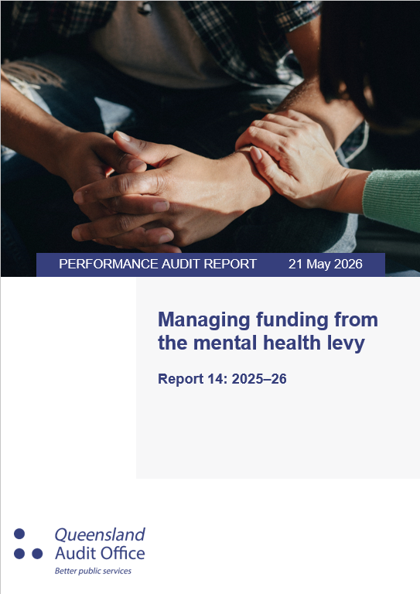
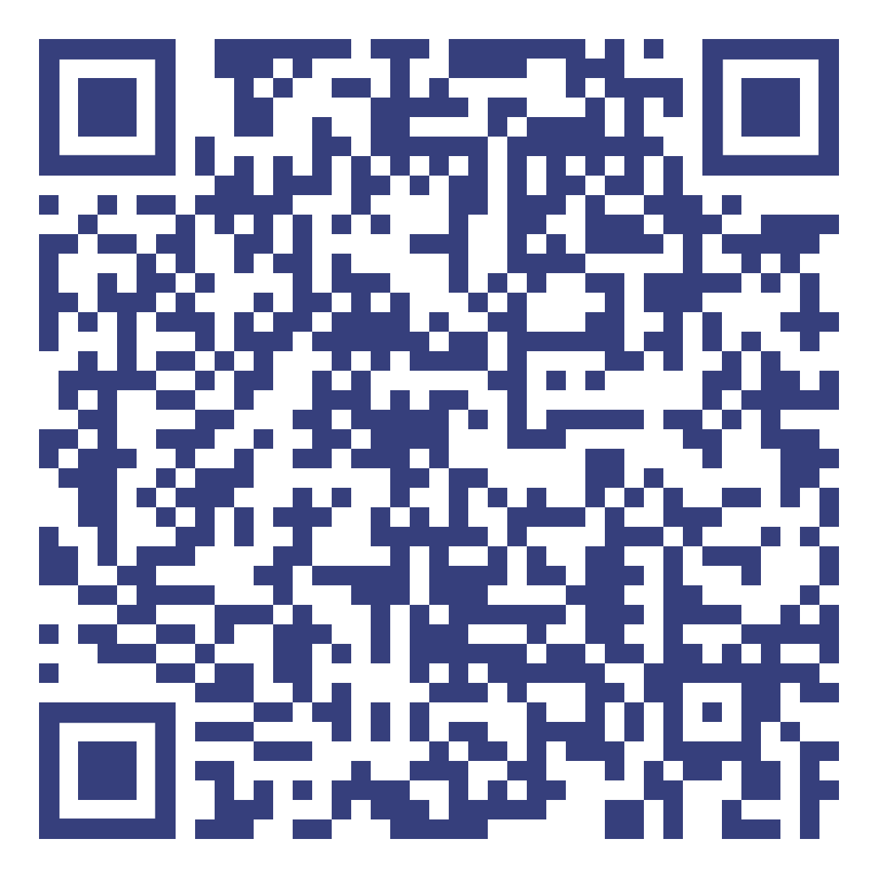
Report overview
Notes:
This report was tabled in parliament on Friday, 22 May 2026. You can scan this QR code to access the report on our website.

Slide 7
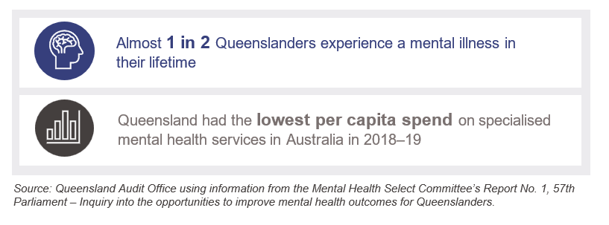
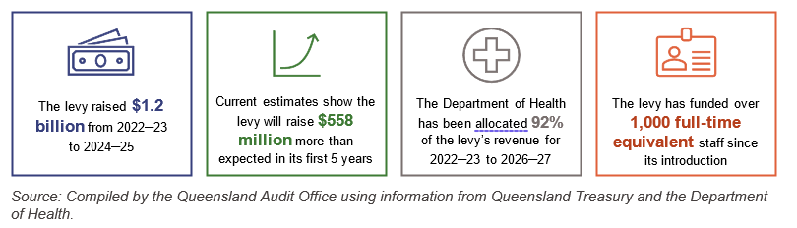
Report overview
Key information about the levy
Notes:
Almost 1 in 2 Queenslanders will experience a mental illness in their lifetime.
Despite this, Queensland had the lowest per capita spend on specialised MH services of all states and territories in 2018-19.
This was one factor that prompted the Mental Health Select Committee’s inquiry in 2022.
Queensland’s mental health levy was introduced as part of the government’s response to one recommendation from this inquiry.
The levy has raised about $1.2b up to FY 25, and is expected to raise more than originally estimated. Most revenue has been allocated to the Department of Health.

Slide 8
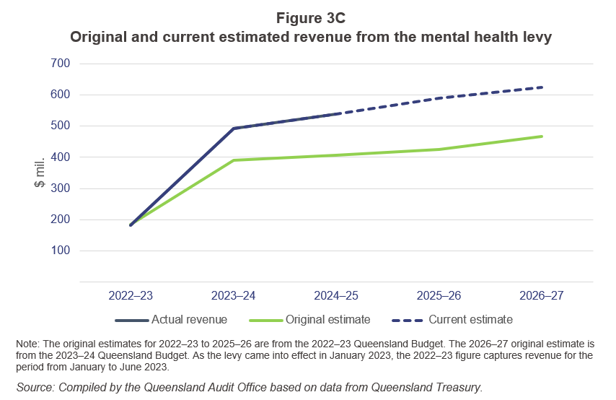
Report overview
Key information about the levy
Notes:
This graphic shows that the levy has raised more than originally expected.

Slide 9
Audit conclusion
What did we conclude?
The mental health levy is not effectively managed as a whole to achieve its intended purposes.
Because:
Effective governance was not established, including not defining scope, outcomes and responsibilities.
As a result there is no consolidated view of whether the levy as whole is allocated appropriately to maximise its effectiveness
Notes:
Our conclusion was that the mental health levy is not effectively managed as a whole to achieve its intended purposes.

Slide 10

Key findings
The mental health levy is not effectively managed as a whole to achieve its intended purposes.
There is no coordinated approach to managing the levy as a whole.
This is primarily because governance arrangements were not established when the levy was first introduced. This included not defining:
the scope of the levy’s use
its outcomes
responsibilities for:
  planning funding across the MHAOD continuum to maximise impact
  monitoring, and reporting on performance and expenditure.
Notes:
We had three key findings that support our conclusion.
Firstly, we found that there is no coordinated approach to managing the levy as a whole. This is primarily because the government did not establish governance arrangements for the levy when it was first introduced.
The levy was introduced through an amendment to the Payroll Tax Act 1971. This included provisions for how it can be used. However, the legislation is principles-based, and there is ambiguity about what activities are in scope. In practice, responsible entities had different perspectives about how the levy can be used, which reduced their ability to provide consistent planning and advice to government.
The levy’s intended outcomes and roles and responsibilities for oversight were also not clearly defined. In practice, we found that no entity had responsibility for monitoring and reporting on how the levy as a whole was operating.

Slide 11


Key findings
The mental health levy is not effectively managed as a whole to achieve its intended purposes.
There is no coordinated approach to managing the levy as a whole.
The levy may not be targeted to achieve its intended purposes.
The levy has committed more funding to expand and enhance MHAOD services
The levy has replaced existing funding sources for some initiatives.
Most funding has gone to specialised services, and entities have not planned how funds should be allocated across the continuum to achieve the levy’s intended purposes. For example, the levy was intended to reform the MHAOD system.
Notes:
Our second key finding is that levy funding may not be targeted to achieve its intended purposes.
We found that the levy has committed more funding to MHAOD services, which is a positive finding. However, we also found instances where the levy was used to replace existing funding sources for some initiatives. Because of the ambiguity in the levy’s scope, it is not clear to what extent the levy was intended to increase net expenditure in the MHAOD system.
Finally, as I will show in the next two slides, most levy funding has gone to specialised services. Entities have not planned how funds should be allocated across the MHAOD continuum of care to achieve the levy’s intended purposes.

Slide 12
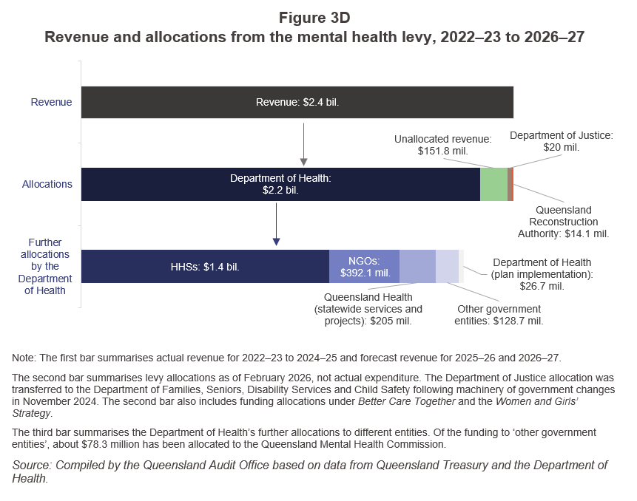
Key findings
Most levy funding has been allocated to the Department of Health to date

Slide 13
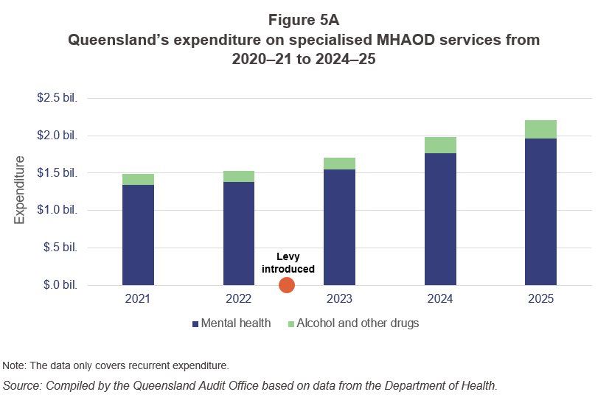
Key findings
Queensland’s expenditure on specialised MHAOD services has increased
Notes:
This graphic shows Queensland’s expenditure on specialised MHAOD services. The levy has contributed to an increase in this expenditure.

Slide 14


Key findings
The mental health levy is not effectively managed as a whole to achieve its intended purposes.
There is no coordinated approach to managing the levy as a whole.
The levy may not be targeted to achieve its intended purposes.
There are opportunities for both Queensland Treasury and the Department of Health to improve how they govern and oversee levy funding.
The Department of Health generally manages its funding well, but could improve its governance approach.
There were gaps in how Queensland Treasury administered funding.
Notes:
Our third key finding is that there were opportunities for both treasury and health to improve how they manage their respective responsibilities.
The Department of Health manages its largest allocation of funding for the Better Care Together plan generally well. However, it did not use the same approach for smaller funding allocations. We also found gaps in the operating effectiveness of some of its governance committees.
There were also several gaps in Queensland Treasury’s administration of funding. For example, it did not have oversight of all expenditure or the rationale for deferral requests.

Slide 15
Looking forward: Recommendations
3
Recommendations to Queensland Treasury, to:
consult with key entities to establish governance of the levy as a whole
implement an internal policy for administering the levy
provide guidelines to entities who receive levy funding.
2
Recommendations to the Department of Health, to:
improve governance of all its allocations of levy funding
inform planning for whole-of-levy investment by progressing and enhancing its evaluations and joint regional planning for MHAOD.
Notes:
This is a slide for key takeaways for staff. Aim for 3 minutes max.
Tailor the layout and number of points on the side to suit. If this layout doesn’t work, use a key findings slide instead for this information.
Reflect on your report/audit and processes:
What information should staff know and can pass on to clients/key stakeholders?
What questions might clients/key stakeholders ask in relation to this report?
Were there any specific learnings for the report or audit process/project? For example, relationship management, audit process findings, data collation across the business? Any changes in process or improvements for next year?
Is there anything may staff need to know for future audits/reports?
Highlight additional resources or learnings:
Did you make recommendations? If yes, provide a high-level overview of how many, their main themes, and which entities they apply to.
Did you include any additional resources (dashboards, fact sheets, better practice guides, etc.)?
Did you include guidance boxes for entities within the report?
Keep this as an overview and high level. Staff can read the report for more information.

Slide 16

Looking forward: What’s next?
Report is tabled in the Legislative Assembly
Report is referred to the Health, Innovation, and Environment Committee
The committee reviews the report’s findings and may choose to conduct further inquiries or make recommendations
We ask entities to report on their progress in implementing our recommendations through our annual Status of Auditor-General’s recommendations report
QAO may consider conducting a follow-up or follow-on audit on the topic where relevant

Slide 17
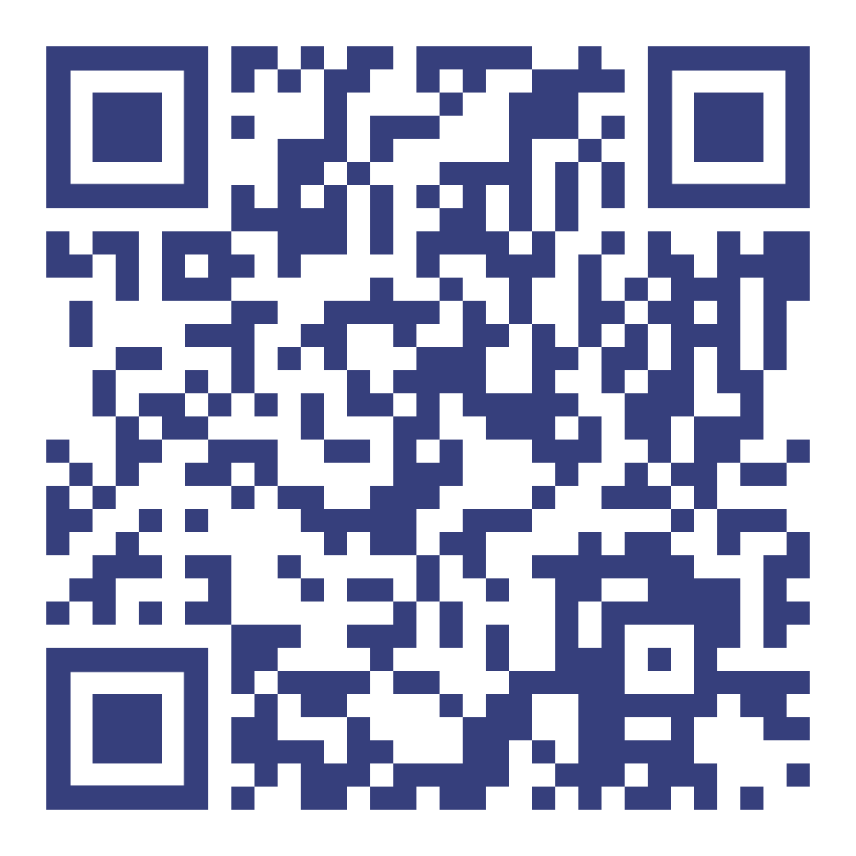
Questions
For more information and to read the report, please visit our website:
Notes:
Q&A slide.

