Slide 1



What if we started from wellbeing?
Evidence and an architecture for a wellbeing-centred system
Dr. Joep van Agteren
CEO Be Well Co
Join me on LinkedIn
Notes:
I want to start this talk off with a question. One that's different to the title of this slide.
I want to ask you: how much evidence does it take for you to reconsider, or refute, a certain idea.
Is it one good study? 5 studies? 10? Is it 100 good studies?
I want you to summon your inner Judge Judy — and see if, by the end of this talk, my case makes you seriously doubt a foundational idea of our system. An idea that's killing our ability to put wellbeing at its heart.

Slide 2
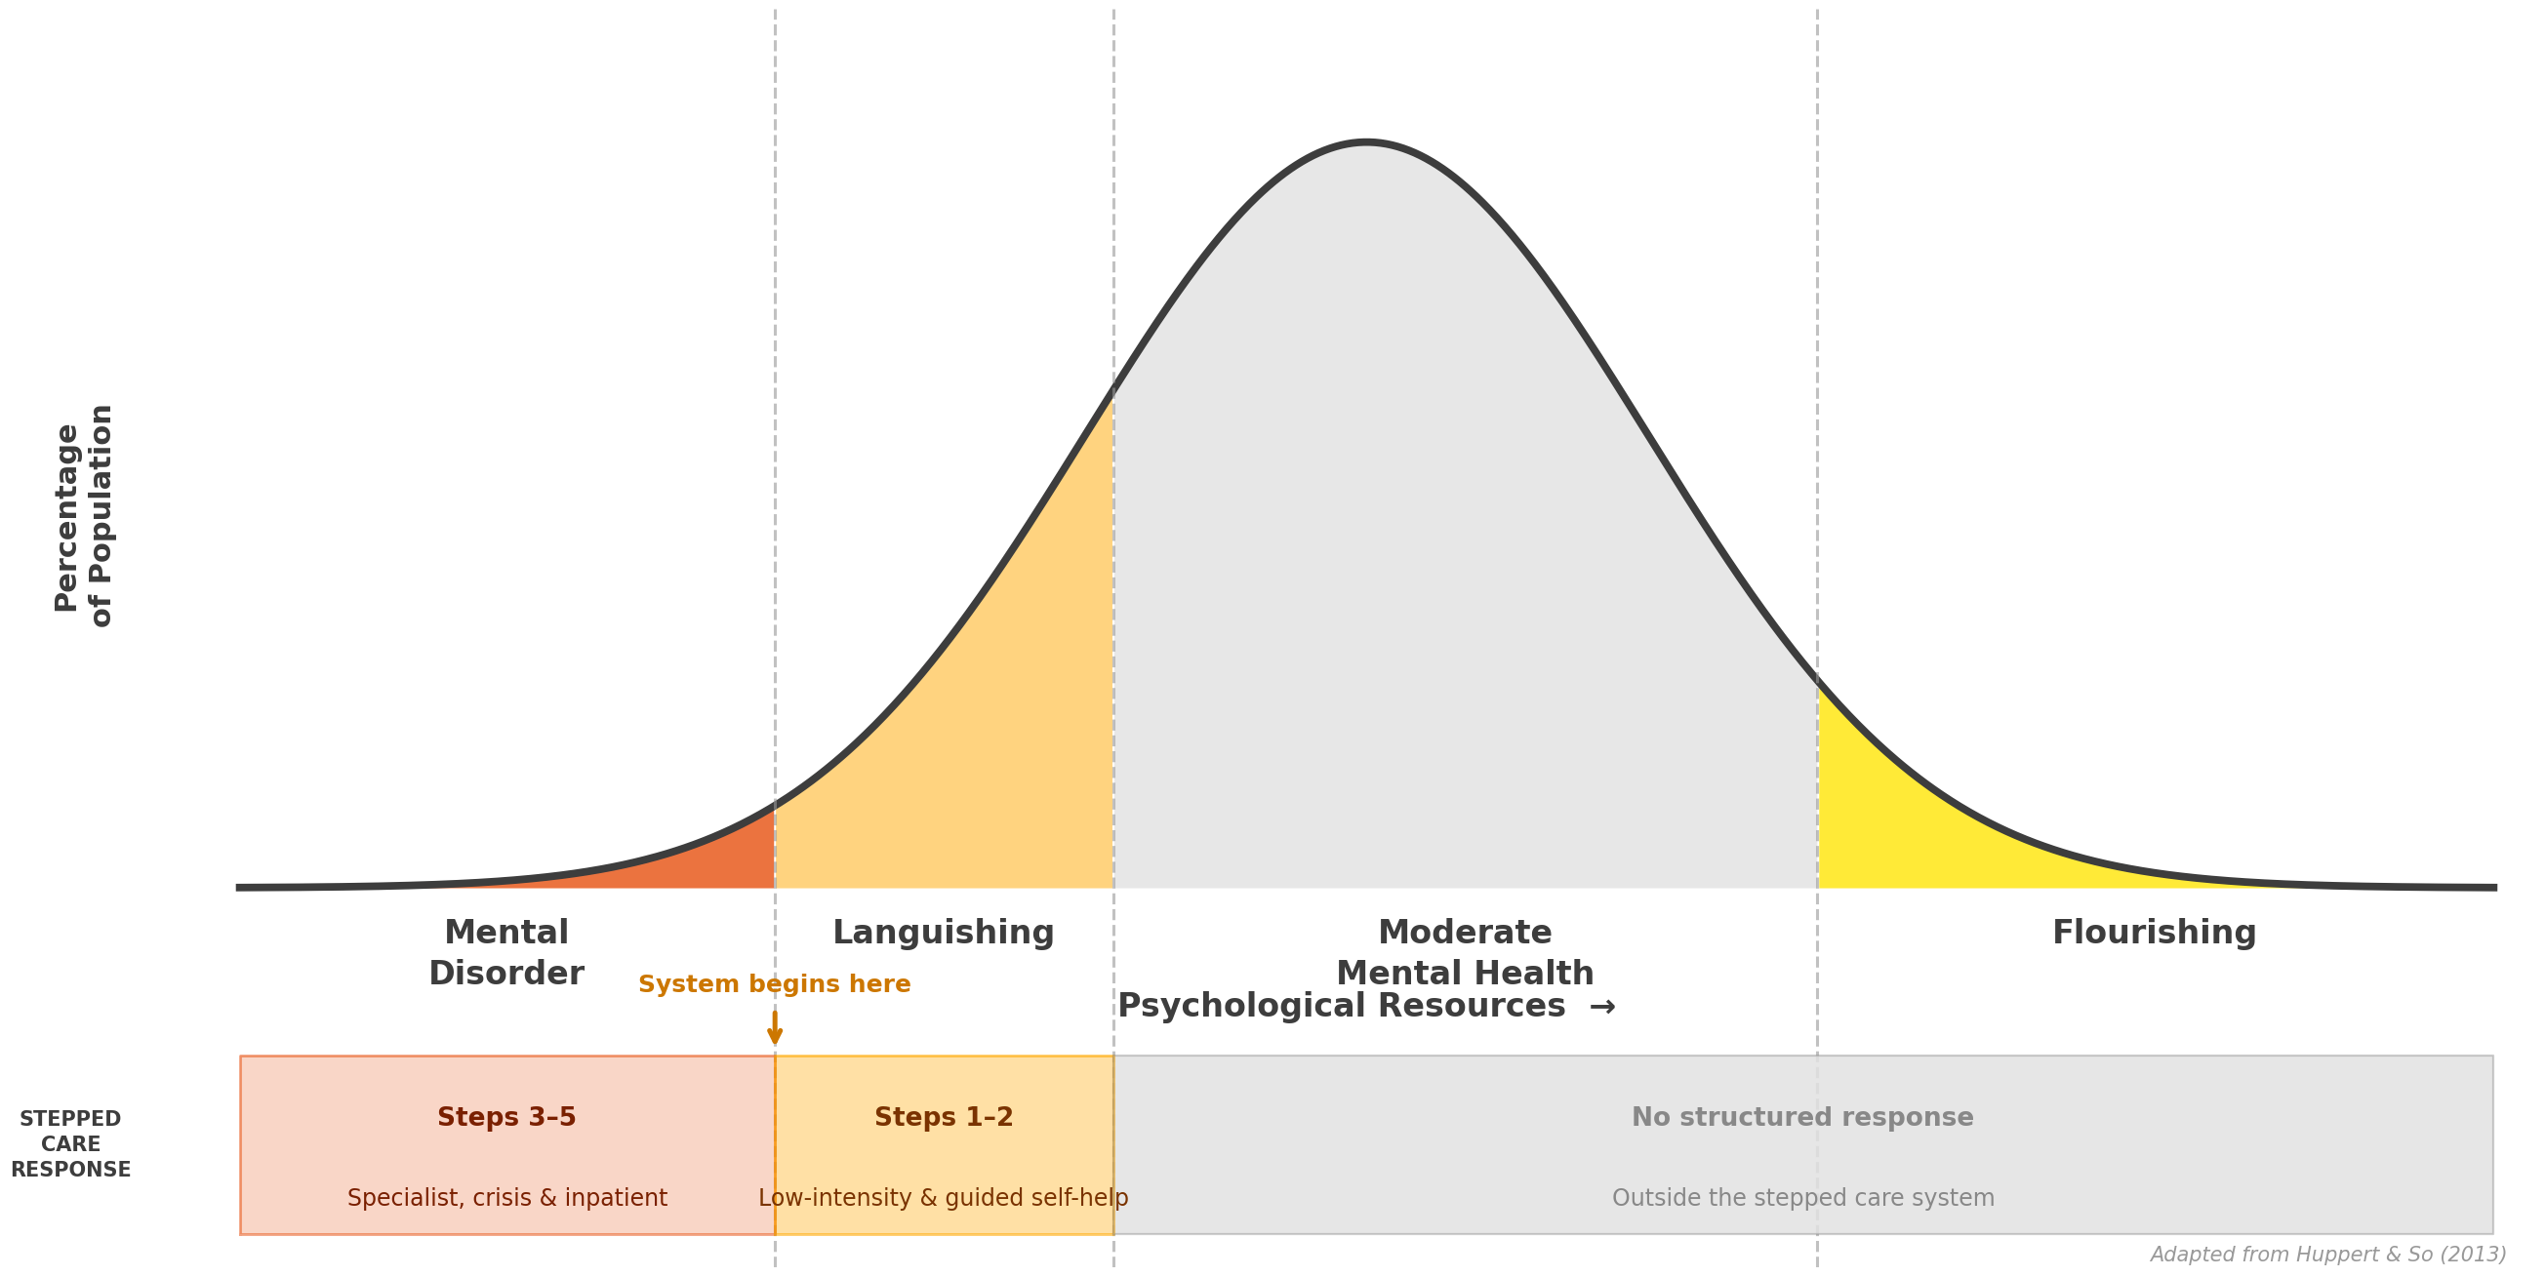
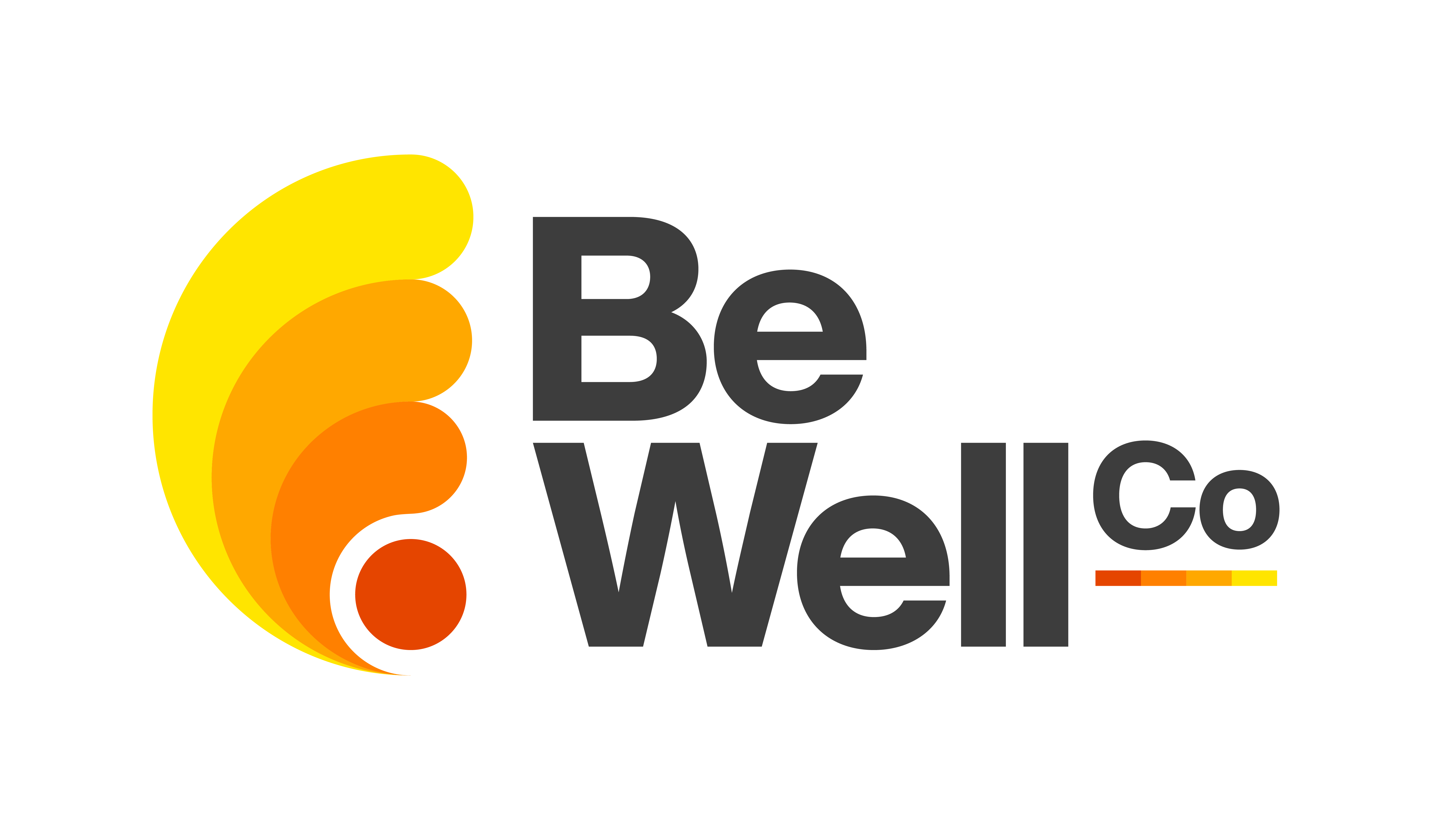
Lived experience and empirical evidence challenge systems that see wellbeing and mental illness as polar opposites.
Mental illness
Languishing
Moderate
Mental Health
Flourishing
Steps 4–5
Step 3
Step 2
Step 1: No structured response, includes limited prevention efforts & wellbeing promotion
Specialist,
acute / crisis & inpatient
Private + community therapy
services
Low-intensity & guided
self-help
Largely outside the ”system”
Huppert & So 2013; Australian Government Department of Health 2019
Notes:
Alright. Let's go straight to it.
Our existing system is based on the notion of bipolarity, right. The idea that mental health, in essence, operates on a single spectrum — thriving wellbeing on one hand, struggling with significant illness on the other.
The idea is we can all be plotted along this sliding scale. Most people sitting somewhere in the middle, as represented by the shape of this normal curve.
This thinking is a fundamental concept that underpins our stepped care models. The majority sit outside the system, without much structured support. Bit of self-help stuff. Bit of wellbeing.
Once you start showing symptoms of a mental health condition, we start ramping up the services — more complexity demanding more support.
Pretty simple idea. Matching services to complexity makes sense. And it makes for a nifty diagram.
When we talk about wellbeing, we often start arguing that this grey zone here is where we need to 'start' for wellbeing. Earlier service delivery, and so on.
To me that’s the wrong way to approach the question. The uncomfortable truth is that this way of thinking doesn't line up with lived experience, or a ton of empirical research.
Let's strap in.

Slide 3
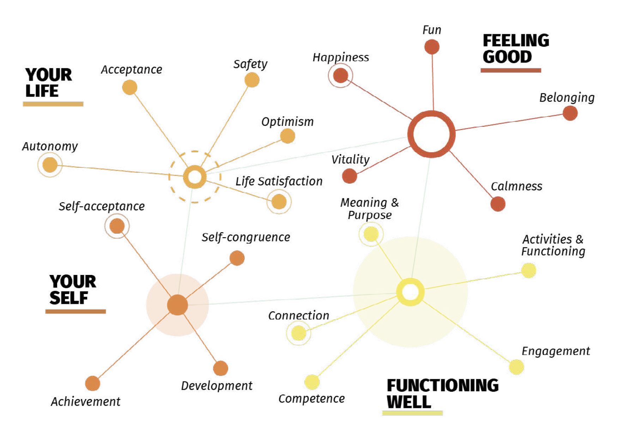
If you have a mental illness, does that really rule you out from experiencing wellbeing?
Iasiello 2026
Notes:
My team specialises in evidence syntheses. We review large bodies of research, and use the collective power of the studies to answer difficult questions — or end up with a more coherent understanding on a topic.
We do this specifically in the area of mental wellbeing, or positive mental health. We're interested in understanding what it means to flourish, and how we get more people to that state.
To do this, we embark on projects that result in this figure. We were getting a bit annoyed with there being a million wellbeing models out there, all claiming to be unique but clearly having overlap.
So my colleague Matthew Iasiello led our team of international collaborators in tearing through 200 reviews on how people measure positive mental health. The result? 155 different tools, claiming to measure over 410 constructs. We said: look, thats BS. Its too much.
So me Matt and the team spent a lot of time sorting through it all, killing off our already sad social lives in the process.
But the good thing was that we landed on a couple dozen dimensions, validated them on an Aussie and US sample, then asked 122 global experts: did we miss anything, do you agree?
Three years. And out comes this taxonomy.
You have things like autonomy. Safety. Competence. Belonging. Achievement.
So here comes the first test. I want anyone to raise their hand who thinks these dimensions are out of reach for people who — for example — have anxiety. Raise it if you think you can't have positive relationships if you have anxiety. Or meaning and purpose. Or that you can't have fun anymore. Or can't grow and develop as a human. No social connection.
If you did — let's chat. Because I surely hope you don't think that.
Mental illness and wellbeing are not polar opposites. They don't cancel each other out.
It gets even clearer when you put the symptom clusters of illness next to them.

Slide 4
The ‘dimensions’ or ‘processes’ that lead to mental health symptoms or mental wellbeing are largely distinct.
Illness-only processes
Shared mechanistic ground
Wellbeing-only dimensions
Aim: treat symptoms and reduce impairment
“Processes” that – when targeted – may impact both wellbeing and symptoms of illness
Aim: promote wellbeing and build capabilities for life
Externalising
Disinhibition
Externalised neg. affect
Distress (Depressed mood & anhedonia)
↔ Happiness
Meaning & purpose
Callousness
Antagonism
Distress (Anxiousness) / Fear ↔ Calmness
Life satisfaction
Antisocial behaviour
Harmful substance use
Distress (Depressed mood & anhedonia)
↔ Vitality
Optimism
Harmful substance use
Self-derogation ↔ Self-acceptance *
Self-congruence
Mania / low detachment
Fear ↔ Acceptance*
Development & growth
Mania
Detachment
Low sexual function
Social withdrawal ↔ Connection
Achievement
Thought disorder
Internalising (Several) ↔ Activities & Functioning
Belonging
Diss. Experiences
Positive Psychosis
Fun
Maj. Loss of bodily control
Other spectra/ subspectra
Sense of safety
All somatoform
Dysreg. Sleep & trauma
Engagement
Eating pathology
Neurodevelopmental
Autonomy
Cognitive difficulties
Illness-only
Forbes 2024 vs Iasiello 2026
Shared zone
Wellbeing-only
Notes:
I took Miri Forbes' work — her team mapped the unique symptom clusters that run across diagnoses. Awesome stuff, go check it out.
We lined those clusters up against our taxonomy. Looked for overlap. Lo and behold: barely any.
Mental illness has its own processes. Mania. Psychosis. Eating disorders. Antisocial behaviour.
These aren't opposites to the dimensions we found, shown on the right. None of them are opposites to one another.
There are some dimensions where overlap exists — shown here in the middle. But they mainly load onto internalising symptoms. Happiness versus depression. Fear versus acceptance.
And depending on what you struggle with, you might get none at all.
This should already make you pretty uncomfortable if you still use a single spectrum model in your work. But I'm not stopping.

Slide 5
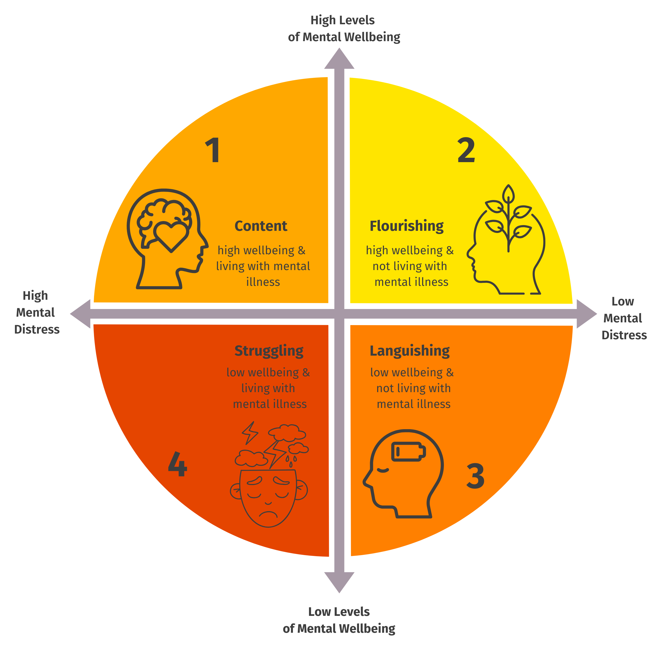
Not opposite ends of one scale
Wellbeing & illness can overlap, but
can also occur independently.
Keyes 2005; Iasiello 2021; Be Well Co 2025
Notes:
This idea isn't new. It's been around for decades. Corey Keyes pushed dual continua models in the mid-2000s. In these models, we have two overlapping axes on top of one another. One to represent the mental illness spectrum. One to represent the mental wellbeing spectrum.
We did a scoping review on it 5 years ago — found over 80 studies supporting it. 80 studies.
Like our physical health, our mental health consists of wellbeing — or fitness — and illness. Two related, but distinct, areas.
There should be efforts helping you wo moves you to the right by focusing on working with symptoms
And efforts that moves you up
So when I argue to start a system of wellbeing — I mean actually start one. One that requires its own measurement methods, its own interventions, its own systems.

Slide 6
You need dedicated wellbeing assessment tools to capture dimensions of wellbeing; ‘distress’ proxies do not cut it.
Iasiello 2026
Notes:
Wellbeing measurement, while fractured, is well established. We created item banks for each of the dimensions that anyone can take and use. Or you can rely on readily accessible measures — like Keyes' Mental Health Continuum, or VanderWeele's Flourishing Index. Adding these short measures to evaluation tells you so much more about someone's mental health trajectory than the K10 does.
They add a tremendous amount of variation to distress measures that you just can't get from the K10 alone.

Slide 7
Wellbeing can be improved using 20+ intervention, that often target different processes than their clinical counterparts.
Mindfulness
Sustained attention to present-moment experience; reduces emotional reactivity
ACT
Building psychological flexibility through values-led action
Mainly effective for clinical groups
Compassion training
Cultivates self-compassion and care for others; reduces self-criticism
Forgiveness
Deliberate release of resentment to improve emotional wellbeing
Multi-component PPIs
Combines multiple positive psychology techniques for broader wellbeing gains
Life coaching
Goal-oriented supported conversations building agency and sustaining change
CBT-based
Restructures unhelpful thinking patterns to shift mood and behaviour
Reminiscence
Structured reflection on positive memories to strengthen meaning
Expressive writing
Narrative writing about experiences to process emotion and find meaning
Psychoeducation
Building knowledge about mental health to support self-management
Mind & meaning
Social prescribing
Links individuals to community activities to address social determinants
Physical activity
Structured exercise improves mood, reduces anxiety and builds resilience
Yoga
Combines movement, breathwork and mindfulness for broad benefit
Arts-based
Creative group activities fostering expression and shared meaning-making
Nature-based
Natural environments reduce stress and restore attentional capacity
Prosocial programs
Builds generosity, cooperation and a sense of belonging
Dance & movement
Expressive movement integrating emotional regulation and social connection
Leisure & play
Intentional enjoyable activities that replenish positive affect and energy
Social support
Peer support and group programs strengthening relational buffers to distress
Nutrition & diet
Mediterranean-style diets linked to improved mood and cognition
Gardening
Growing plants builds purpose and calm through nature contact
Connection & community
Body & movement
Environment & lifestyle
Van Agteren 2021; van Agteren 2024
Evidence strength:
OK
Emerging
Very
Strong
Strong
Notes:
ame goes for interventions. We did two big reviews — one very scientific one, the other a more practice-friendly one we did for Beyond Blue.
We see 20-plus intervention types that target different processes than their clinical counterparts. We have those focused on our mind and behaviour: ACT, positive psychology, mindfulness. They get poo-pooed a bit — but their evidence is pretty solid.
We have social prescribing. We have nutrition. We have physical activity. We have arts-based interventions
These interventions are accessible. They don't require tons of upskilling. The skills are there — we just haven't formalised it yet.

Slide 8
Stepped Integrated Promotion & Treatment (SIPT) Model
MENTAL ILLNESS TREATMENT SYSTEM
Reduce symptoms & functional impairment
HOW THE TWO
SYSTEMS CONNECT
MENTAL WELLBEING PROMOTION SYSTEM
Build, strengthen & maintain wellbeing
T4+5
Specialist Clinical Care
Complex illness: acute symptom management, care coordination, intensive support
T3
Specialised Clinical Wellbeing Supports
Intensive personalised support: clinical wellbeing protocols, social & functional support by trained clinical professionals and peers
INTEGRATED WITHIN
CLINICAL TEAMS
T3
Moderate Clinical Care
Evidence-based therapy, medication & case management
T2
Embedded Wellbeing Supports
Wellbeing embedded into clinical care, often group-based and delivered by peers
INTERATED WITHIN A SERVICE OR ACTIVE COLLABORATION
T2
Low Intensity Clinical Care
Brief interventions, psychoeducation, digital & self-help
T1
General Population Wellbeing Supports
Universal & population-specific: wellbeing literacy, skills, connection & infrastructure
OPERATES LARGELY
IN PARALLEL
T1
Prevention & Health Promotion
Mental health literacy, stigma & risk-factor reduction
ADDRESSING SOCIAL DETERMINANTS OF HEALTH
Housing
& stability
Education
& skills
Employment
& income
Social connection
& inclusion
Physical health
& lifestyle
Safe environments
& communities
Equity, rights
& culture
Notes:
nd that finally brings me to the system that starts from wellbeing. We should not position it at the start of one that prioritises clinical complexity. We should develop a parallel system that integrates with it.
One system that really focuses on clinical symptoms. And another that focuses on the promotion of mental wellbeing. Two distinct systems that work together. Relying on their own professional standards.
The clinical system — shown here on the left — works as it currently does. A stepped care architecture, where we ramp up service delivery in line with symptom complexity. I'm not talking about what happens within the tiers — there's much to improve, but the principle stands.
That system is matched by a wellbeing system that also ramps up support depending on complexity.
So for the majority of the population, services are delivered in the community. They don't involve clinical expertise.
But once clinical symptoms start emerging, people can access wellbeing services from within the clinical system — upskilled health professionals, and lived experience workers.
At the tier where people require wrap around care, services are provided integrated within the teams. The mandate gets expanded — so wellbeing isn't an add-on. It becomes embedded within the clinical team.
And each of these systems is underpinned by the social determinants.
So when it comes to investment, I reckon it comes down to three questions.
What do we do to treat illness? What do we do to promote wellbeing? And what do we do to build the foundations that help both?

Slide 9

Who of you had 1000+ studies as your benchmark to rethink things?
Notes:
That brings me back to where I started.
So — show me a hand. Who here needed over 1000 studies before they'd question whether we've got this right?
As judge judy would say: case closed

Slide 10
The question is not:
Do we have enough evidence to envision a system that starts from wellbeing?
The question is:
What’s stopping us from being motivated to build such a humancentric – and practically achievable - system in the first place?
Dr. Joep van Agteren
CEO Be Well Co
Join me on LinkedIn
Notes:
The question isn't whether we can build a system that starts from wellbeing. We've got over a thousand studies telling us we should.
The real question is what's stopping us — the people in this room, the people responsible for change — from actually building it.

