Slide 1
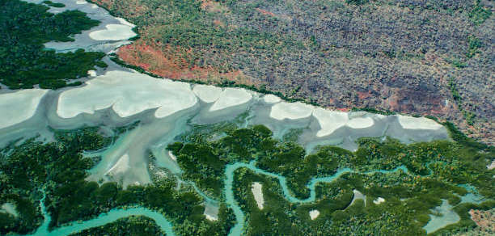

What if we started with wellbeing?
Dr Katherine Trebeck, Economic Change Program Director
Notes:
15 mins
What if started from wellbeing? Cf illness
Beyond crisis driven and silos
Systems not designed around people
Other options
Aus and intl egs + lessons
Economic lens
Abstract for mental health: What if we designed for wellbeing first? Current action prioritizes reaction: repair, healing, fixing. Vital work, yet downstream: costly in fiscal terms, and predicated on harm already incurred. The wellbeing economy agenda gets things right from the start by aligning economic systems with the needs of people and planet. This talk explores what must change in our economic structures. It highlights real-world examples proving that an economy in service of us, rather than the other way around, is not only necessary, but entirely possible and already emerging.

Slide 2
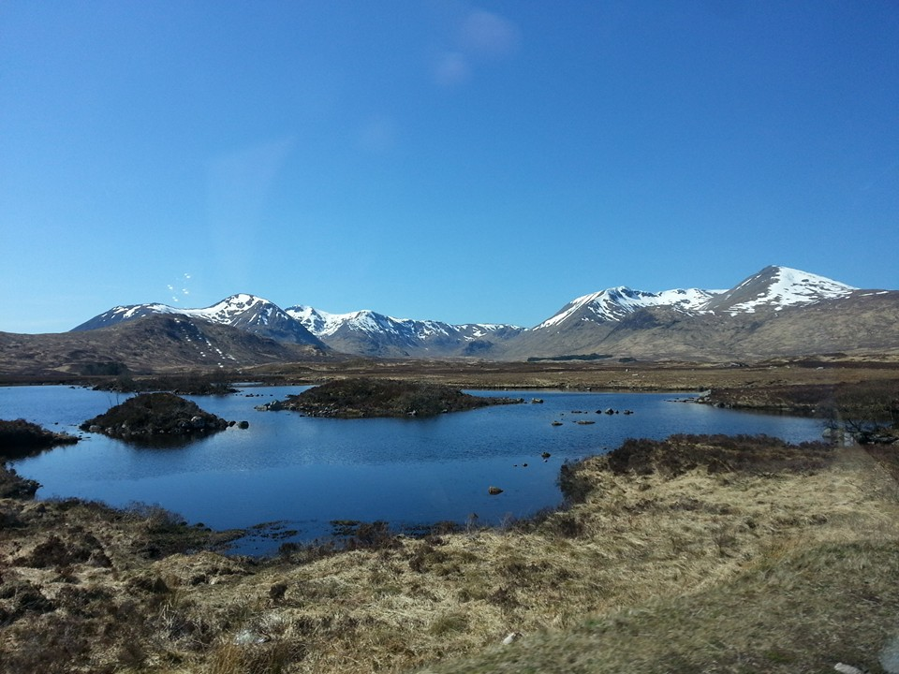

Slide 3


Slide 4
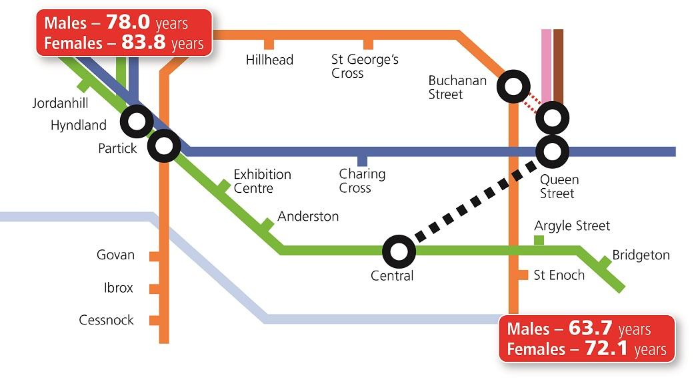
Credit: Dr Gerry McCartney, NHS Scotland
Notes:
In Glasgow the life expectancy gap for men living just a few train stops apart, but between the poor and rich areas is 14 years

Slide 5
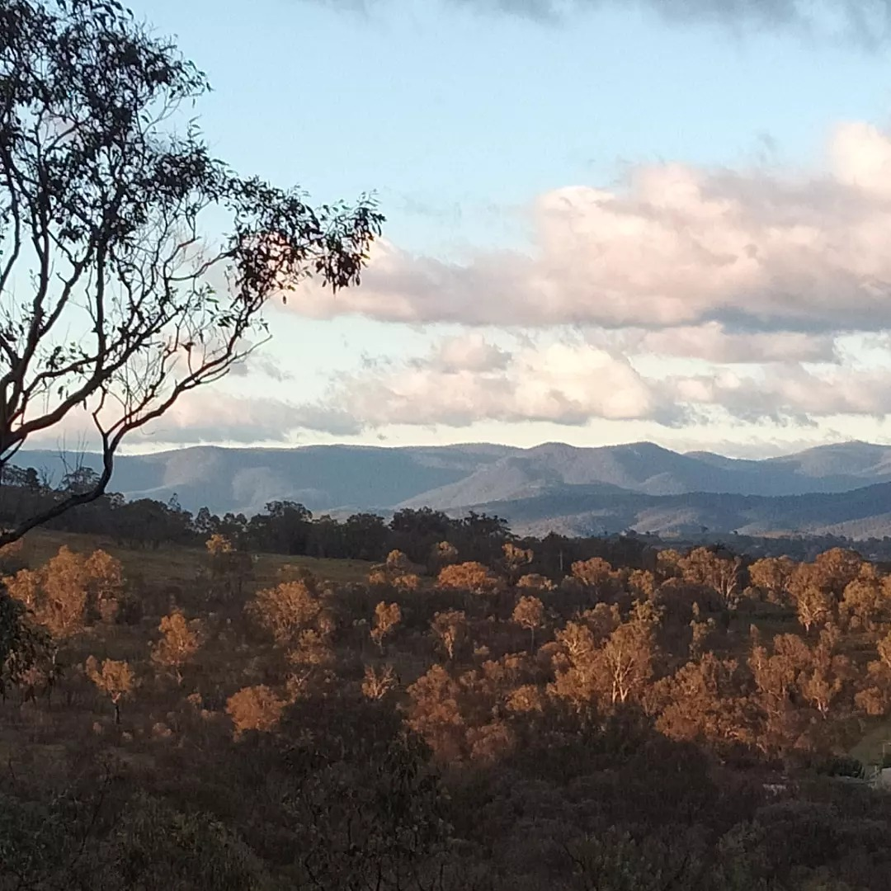
Australia performs strongly on global metrics like life expectancy, education & income

Slide 6
….but measures calculated as averages conceal entrenched inequalities
in housing, food security, employment & basic services

Slide 7
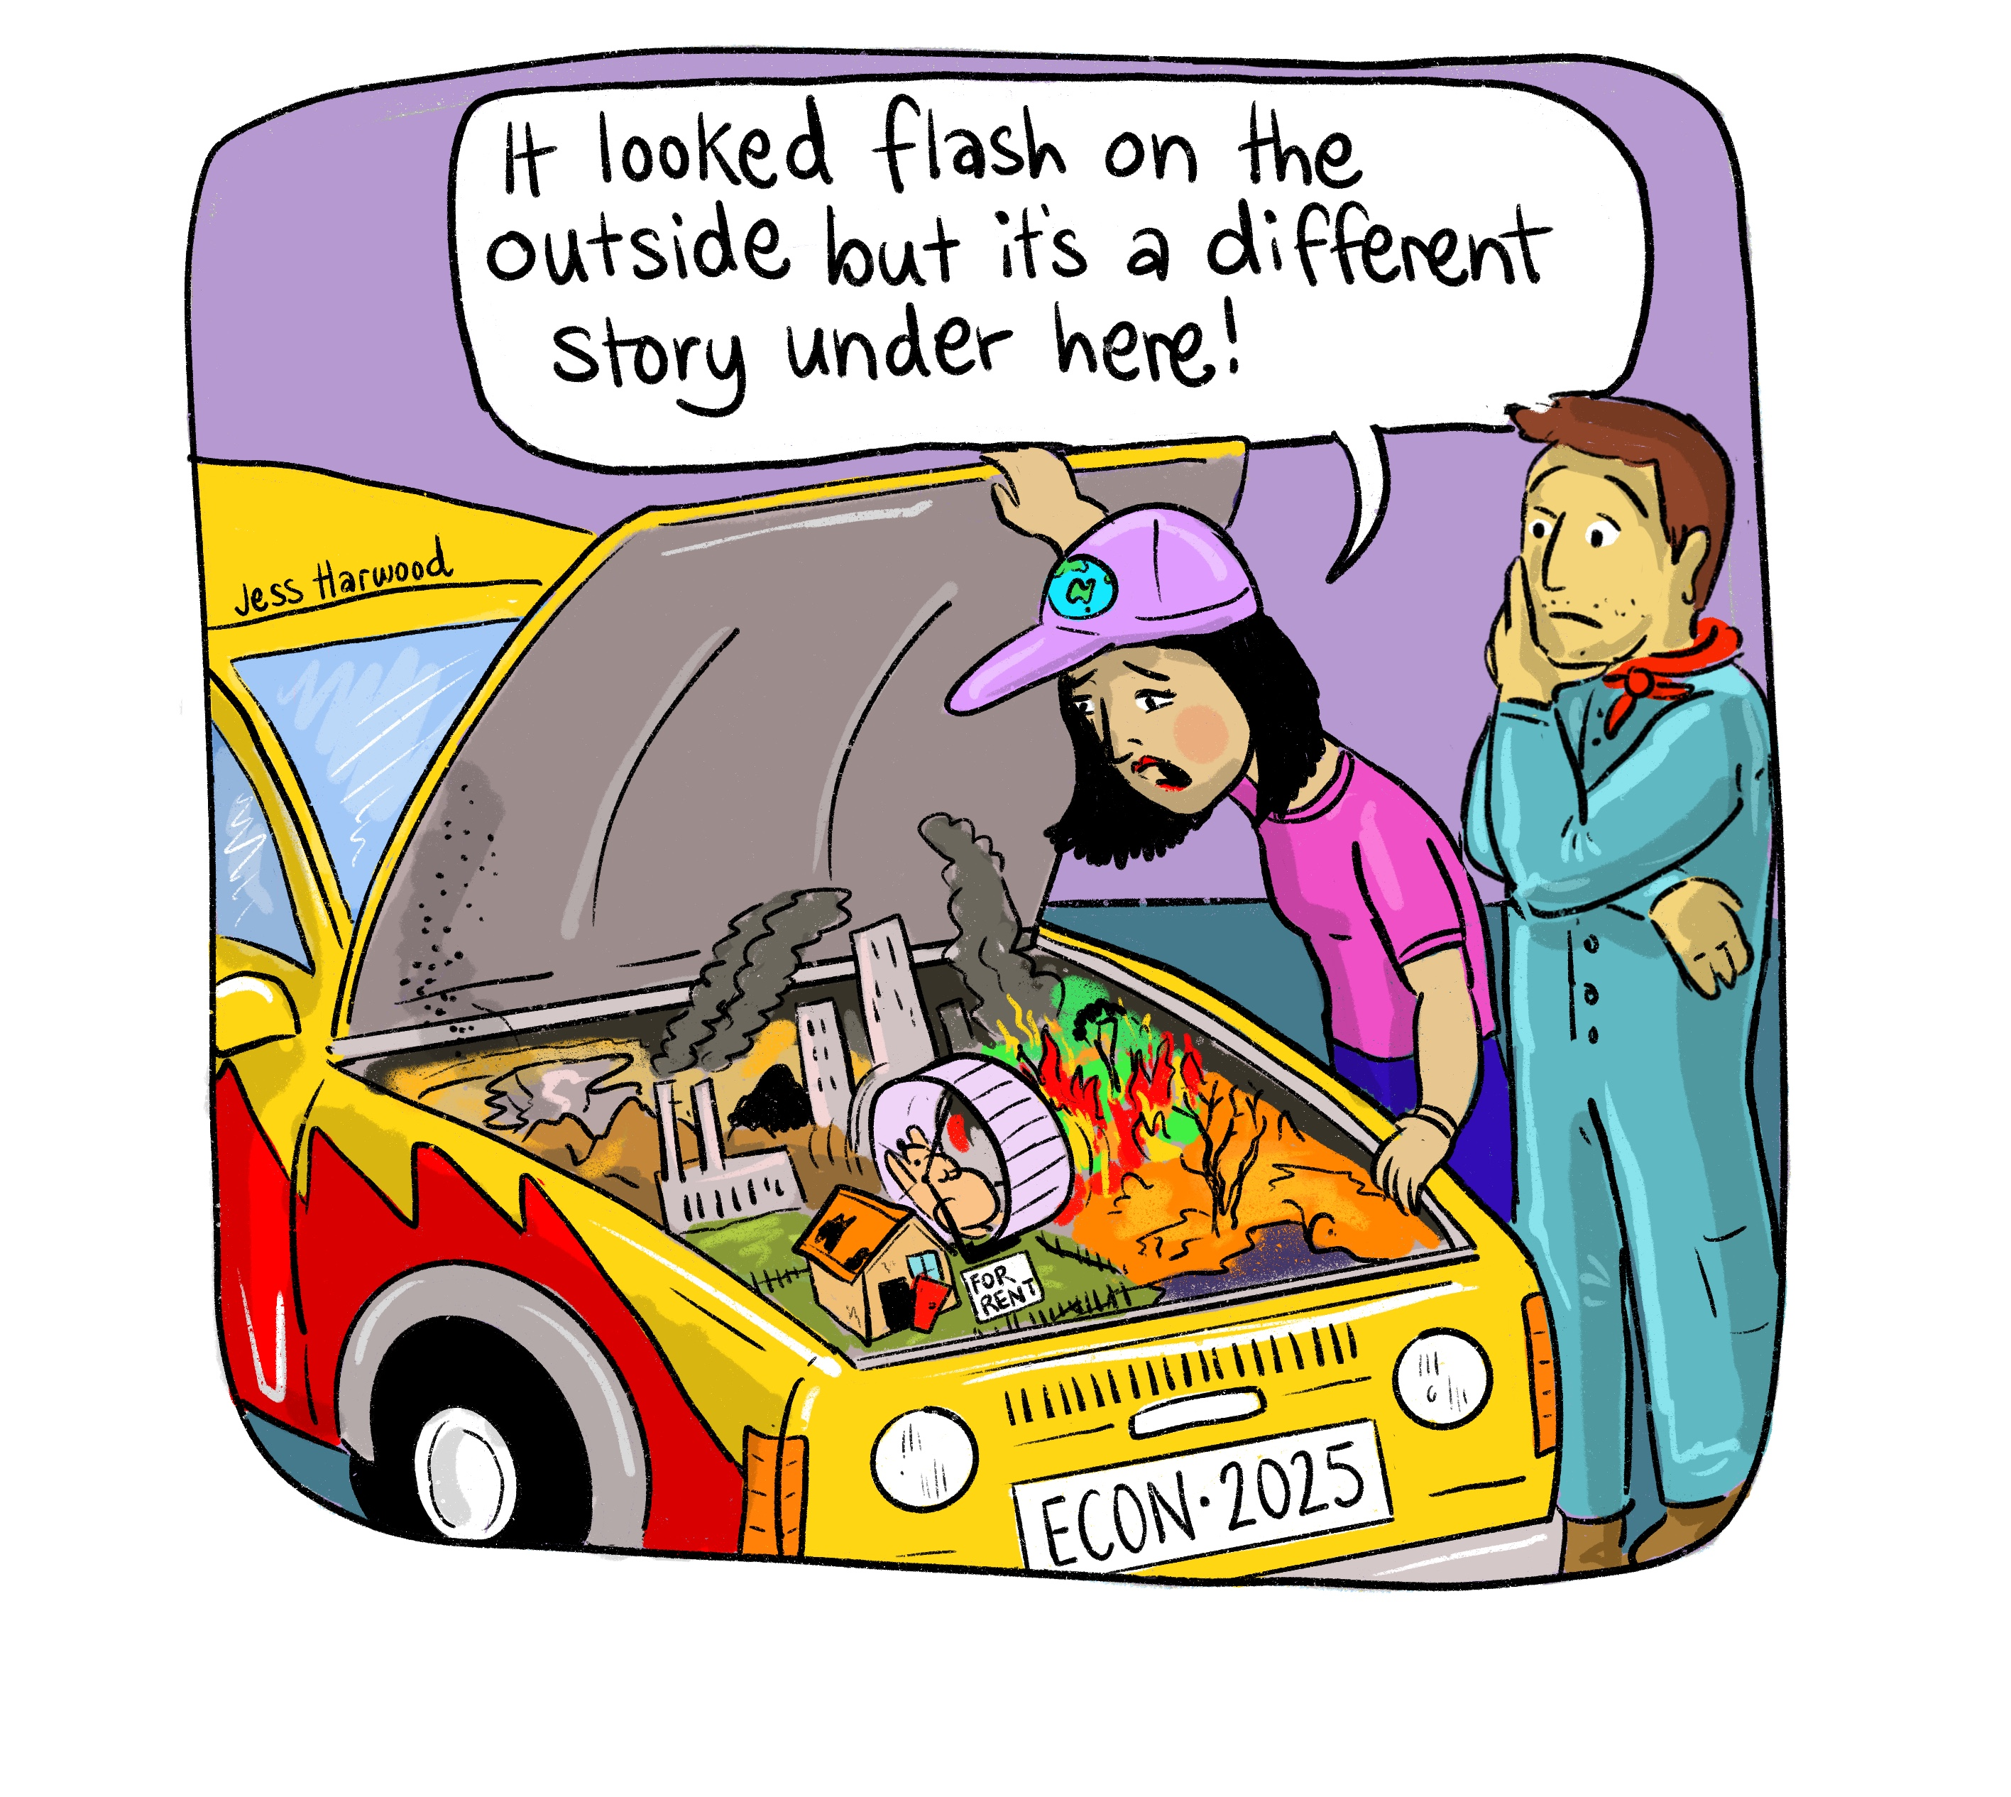

Slide 8

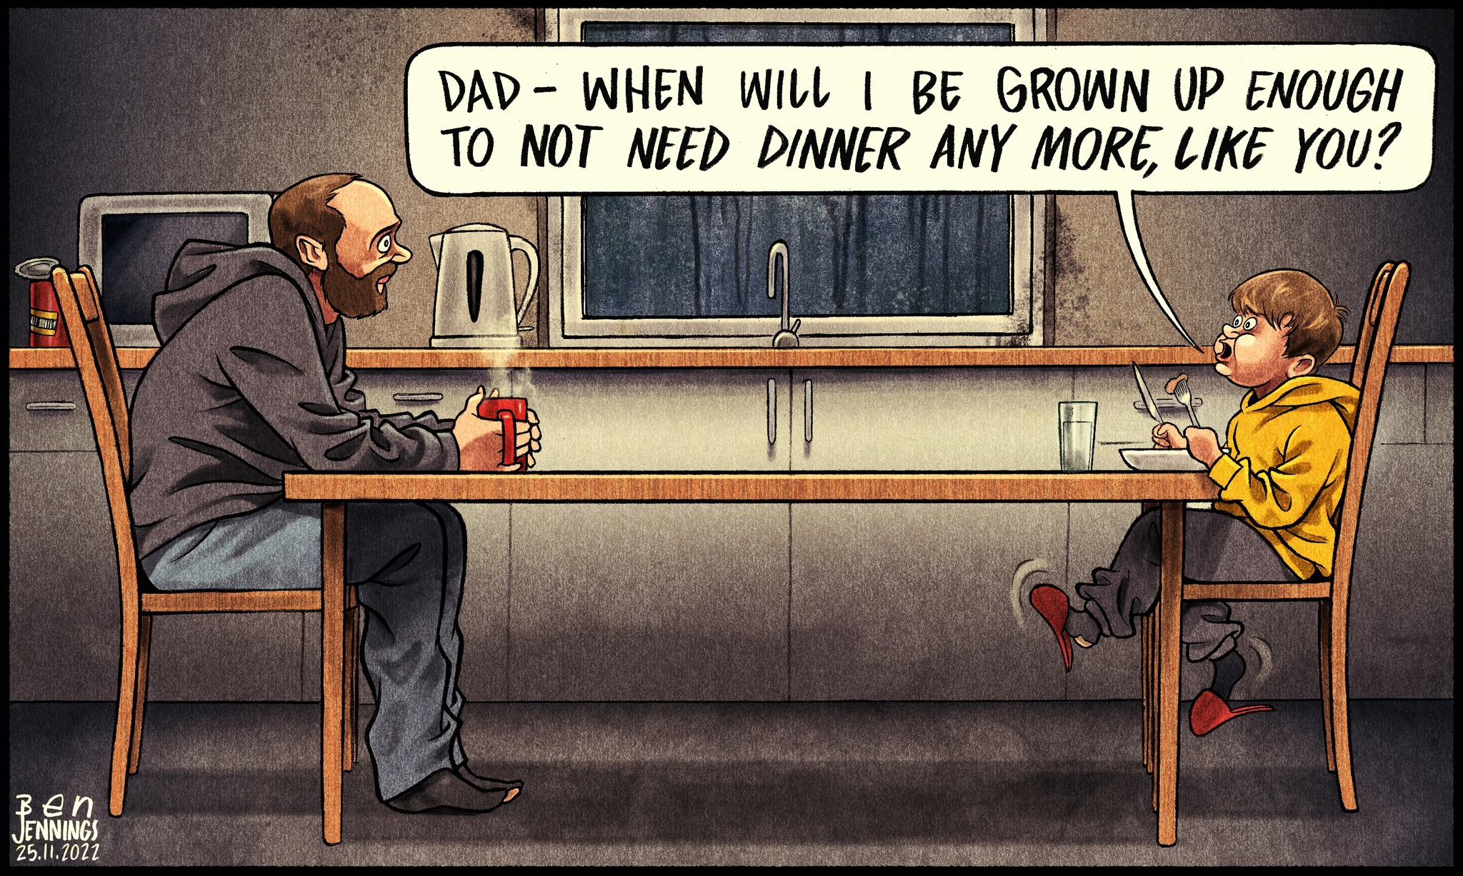
A country that is unequal
Credit: Karon Photography

Slide 9
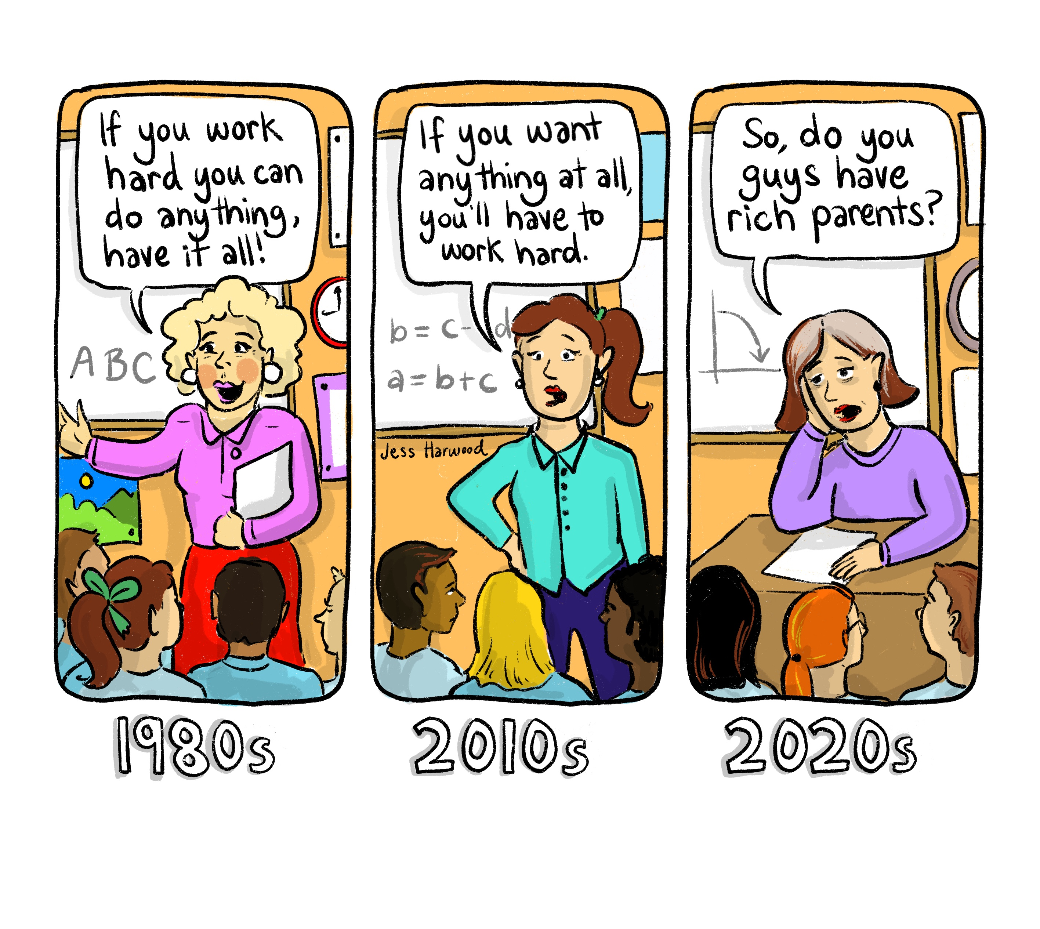

Slide 10
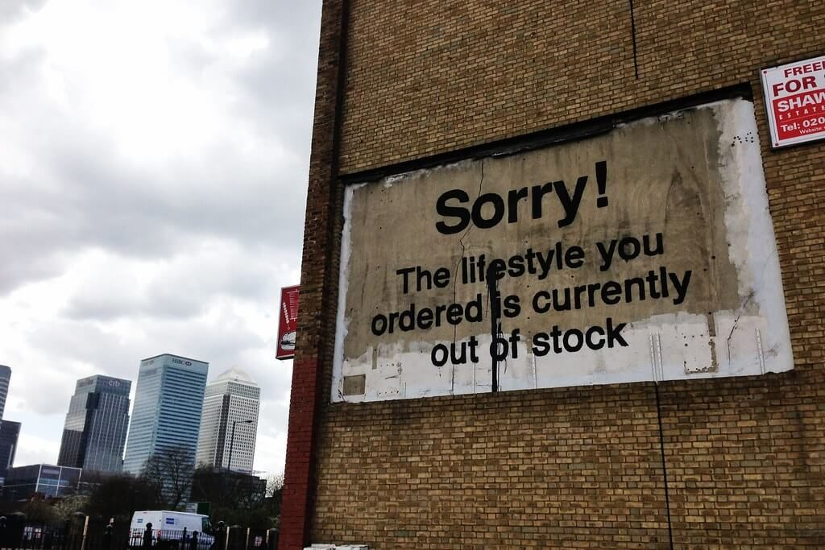
In Australia:
- 62% have a moderate or high sense of grievance
(“a belief that government and business make their lives harder and serve narrow interests, and wealthy people benefit unfairly from the system”)
- Less than 1 in 5 Australians believe that things will be better for the next generation
https://www.edelman.com/au/trust/2025/trust-barometer
A world
that is
creating
despair
Credit: Banksy map

Slide 11
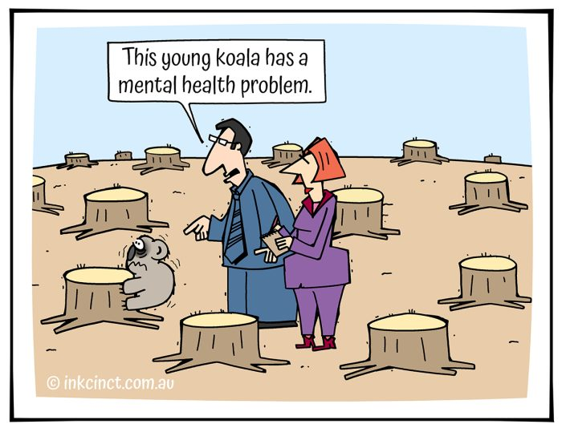

Slide 12

The lenses we adopt matter
Credit: Stephen Kraakmo

Slide 13
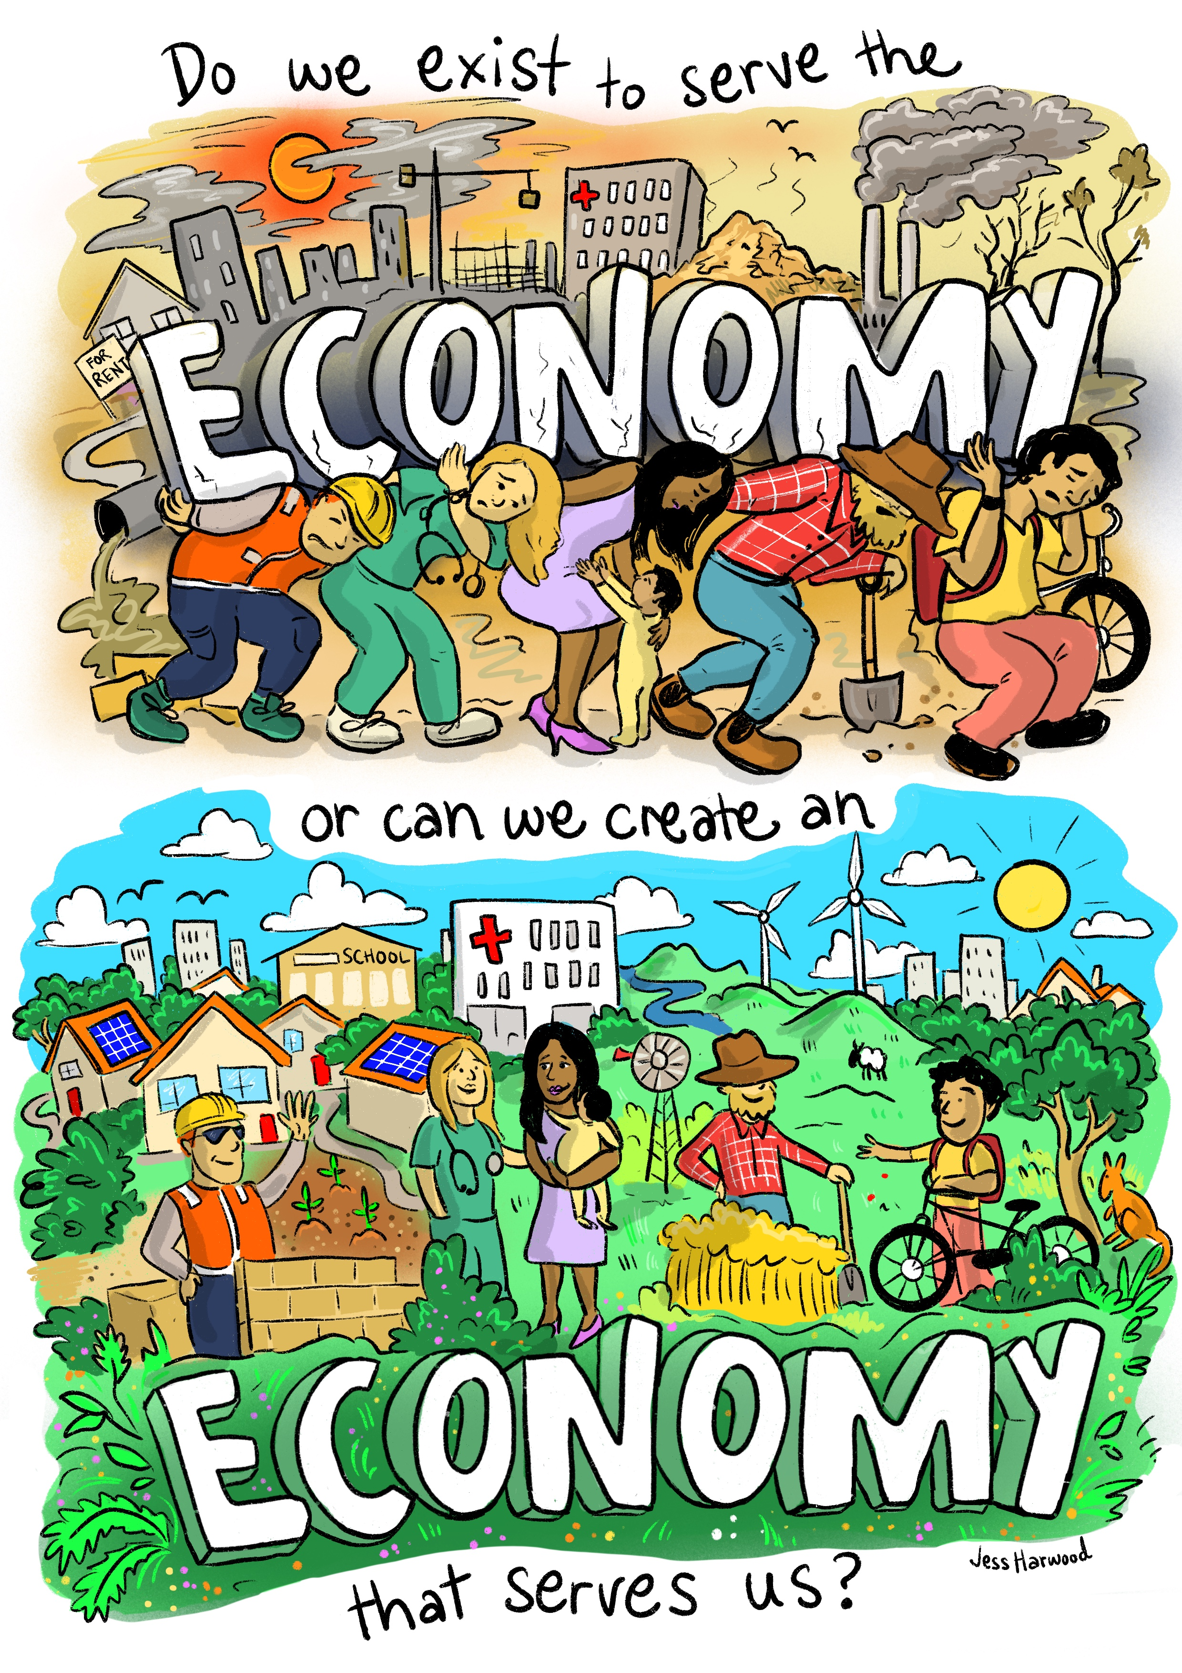
Notes:
Overall point is to open up this conversation

Slide 14

The material basis
of wellbeing

Slide 15

A wellbeing economy:
An economy designed to deliver what
people and planet need
Credit: Thomas Lipke

Slide 16
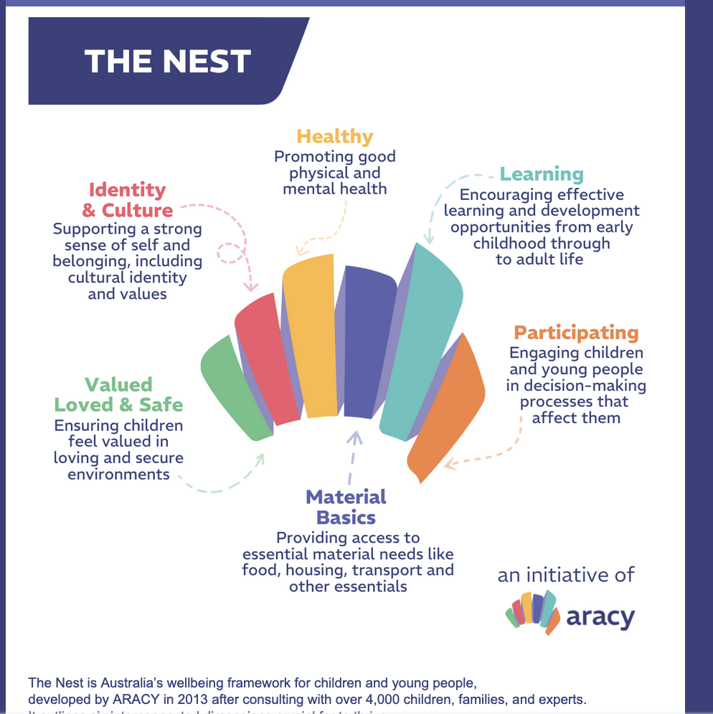

Slide 17

Bronnie Ware, a palliative nurse, documented common regrets of patients in their last days:
I wish I'd had the courage to live a life true to myself, not the life others expected of me
I wish I hadn't worked so hard ( ‘every male patient’)
I wish I'd had the courage to express my feelings
I wish I had stayed in touch with my friends
I wish that I had let myself be happier
Credit: Aditya Joshi
Credit: Jorge Lopez

Slide 18
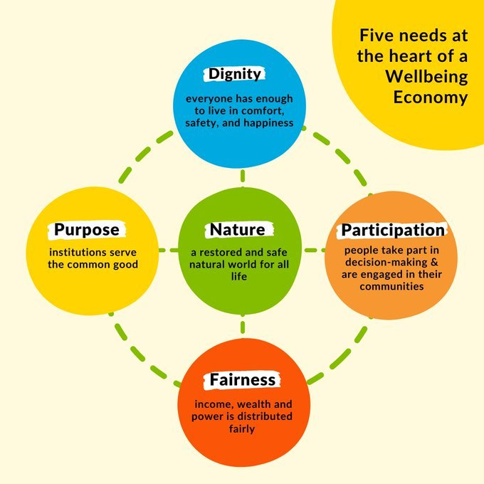

Slide 19
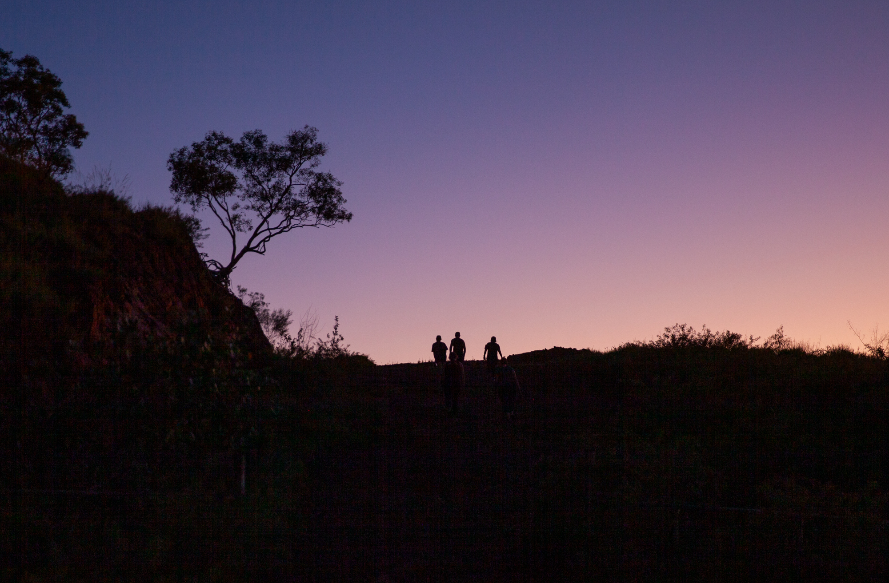
So what changes in the economy are needed to align it with the future Australians want for themselves & their communities?

Slide 20

Purpose
Prevention
Predistribution
People powered
Credit: Bianca Ackermann

Slide 21

The role of government
Credit: Aditya Joshi

Slide 22
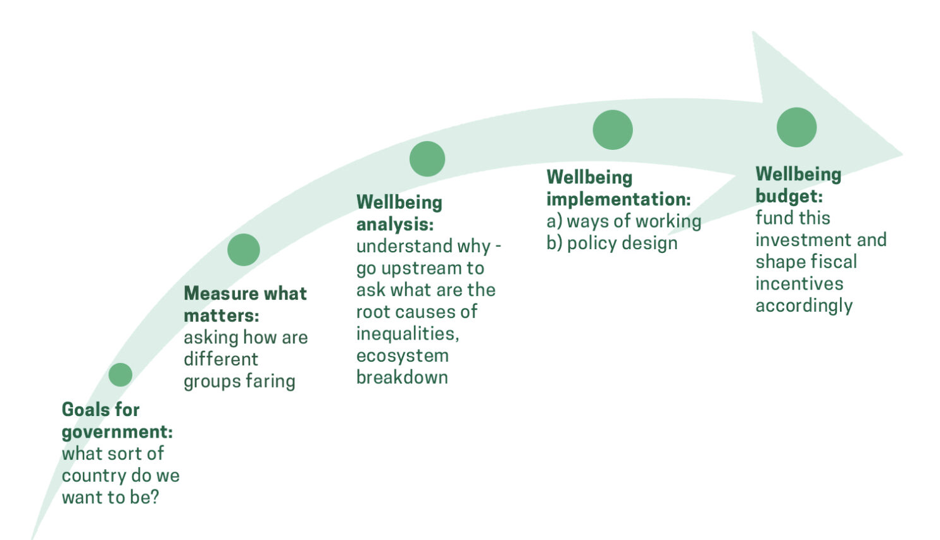


Slide 23
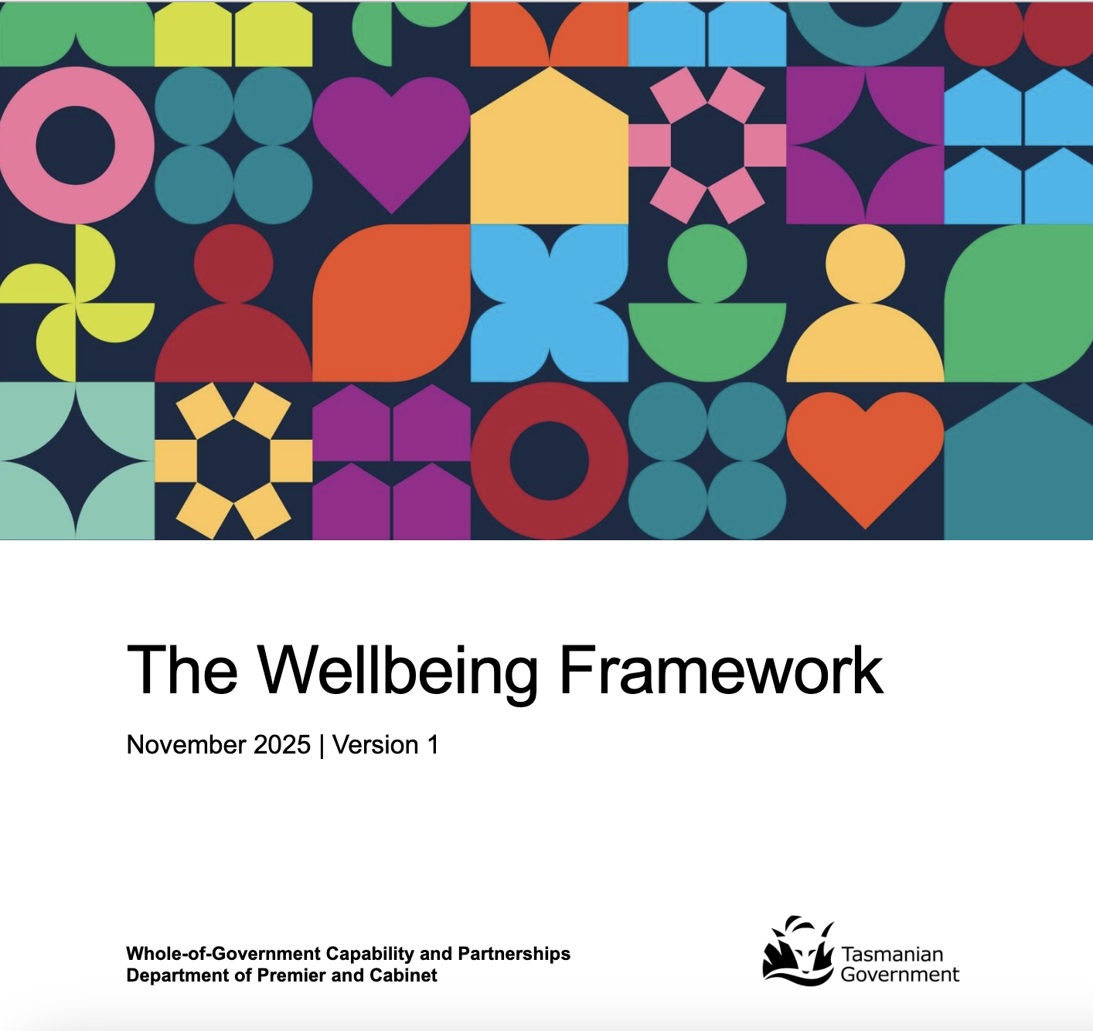
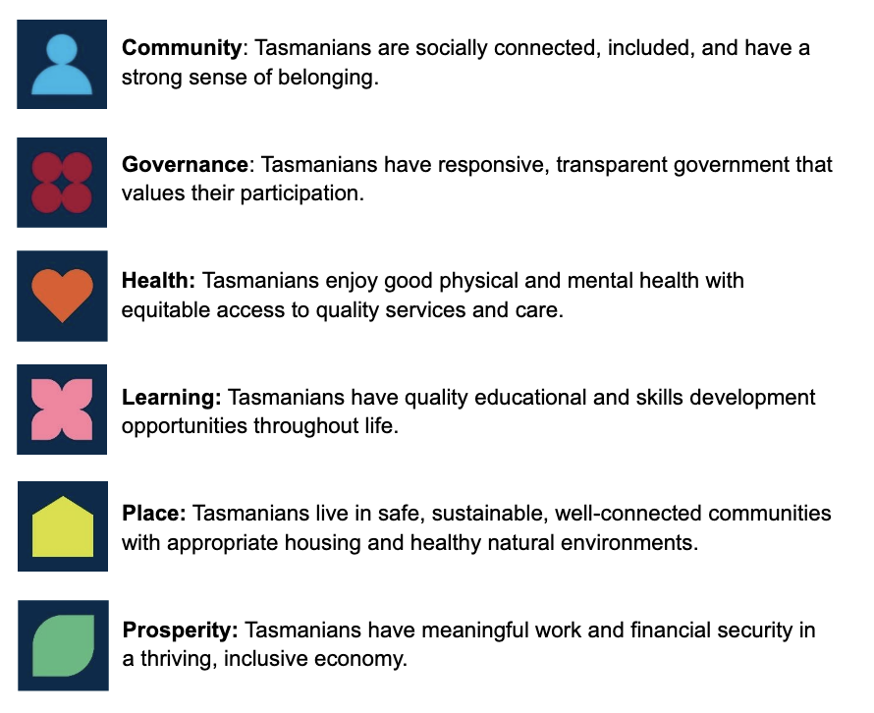
“…a shift from economic indicators alone to a holistic view that encompasses the social, environmental, cultural, and economic dimensions of life in our island state”
Notes:
The domains and population
outcomes were developed through extensive research and consultation from 2023 to
2025. Here’s how the process unfolded:
• Public consultation: Over 1,600 Tasmanians shared their views in public
consultations led by the University of Tasmania (UTAS). These insights provided
an initial understanding of what wellbeing means for our state.
• Inclusive analysis: To ensure a wide range of perspectives were considered,
UTAS analysed existing consultation data to include insights from under-
represented groups. DPAC also conducted literature reviews to further inform the
framework’s development.
• Draft domain and outcome development: Based on the foundational work of
UTAS,5 DPAC further developed the draft wellbeing domains and population
outcomes. The population outcomes were designed to articulate the specific,
desired conditions that would indicate wellbeing in each domain area.
The domains and population outcomes were crafted to be aspirational yet
actionable, providing clear direction while allowing flexibility in implementation.
• Workshops: DPAC hosted six online workshops with participants from state
government agencies, local government, and non-government organisations.
About 230 people took part, providing valuable feedback on the draft wellbeing
domains and population outcomes. This positive engagement helped refine and
improve these key elements.
• Final refinement: Feedback from state government agencies was gathered to
further refine the wellbeing domains and population outcomes. This input was
crucial in shaping the final version, ensuring they reflect the needs and
aspirations of all Tasmanians. Particular attention was paid to ensuring the
outcomes were clear, compelling, and actionable across different contexts and
sector

Slide 24
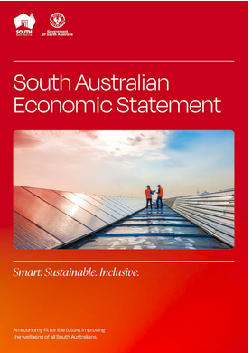
‘We will know we have succeeded…
when our industries are sustainable & powered by renewable energy
…When more South Australians are in meaningful & skilled work
& are paid fairly for their contribution.
When all South Australians feel the benefits of our strong economy,
we’ll know we got it right’
– South Australian Economic Statement
…One where we care as much about the state
our children and their children will inherit,
as the headline statistics of today…
Notes:
SA economic strategy: ‘We will know we have succeeded when we export more of our knowledge and services, while adding greater value to what we dig up and grow out of the ground. When our industries are sustainable and powered by renewable energy, ensuring their competitiveness across the world. When more South Australians are in meaningful and skilled work, and are paid fairly for their contribution. When all South Australians feel the benefits of our strong economy, we’ll know we got it right’.

Slide 25
Steering, supporting, servicing, stopping

Slide 26
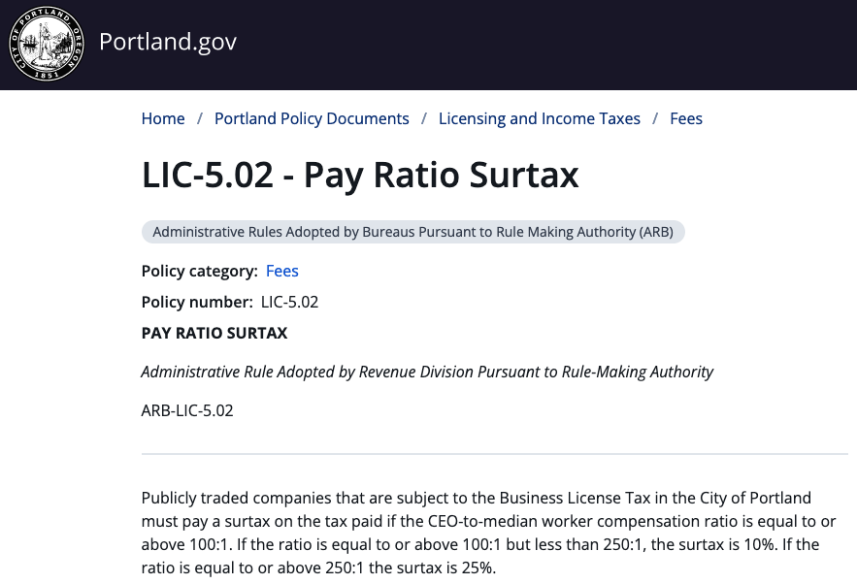

Slide 27
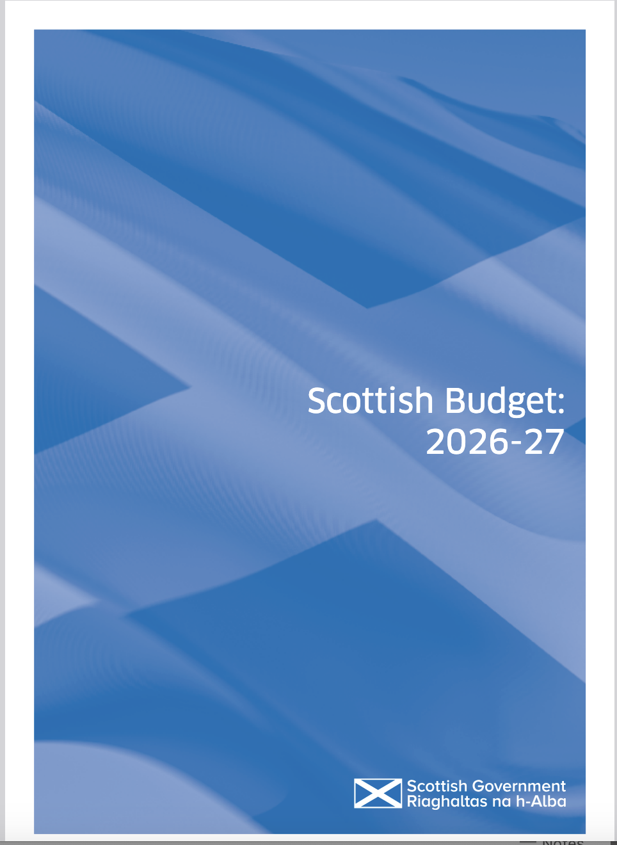
Tax on private jets
and
higher council tax on
houses over £1million
Notes:
https://www.gov.scot/news/scottish-budget-2026-27-2/
“from April 2027, an Air Departure Tax (ADT) will come into force and the framework offered by the new ADT will be used to introduce a private jet supplement the introduction by April 2028 of two new council tax bands for the most expensive properties in Scotland, those worth more than £1 million, on an up-to-date valuation”

Slide 28

Credit: Brazilian Government
Notes:
“lista suja or “dirty list”. This is a registry that publicly discloses the names of companies found to host forced labour in their supply chains. Firms on the dirty list are publicly shamed and risk being denied government funding and tax subsidies. A São Paulo state law goes further, banning companies that benefit from forced labour for up to ten years” https://theconversation.com/we-need-to-combat-forced-labour-and-in-work-poverty-brazil-and-india-offer-some-lessons-106570?utm_medium=email&utm_campaign=Latest%20from%20The%20Conversation%20for%20November%2013%202018%20-%201159310487&utm_content=Latest%20from%20The%20Conversation%20for%20November%2013%202018%20-%201159310487+CID_d6ce7dca939f5d57845c0cc4e62d3679&utm_source=campaign_monitor_uk&utm_term=We%20need%20to%20combat%20forced%20labour%20and%20in-work%20poverty%20%20Brazil%20and%20India%20offer%20some%20lessons
Since 2023

Slide 29
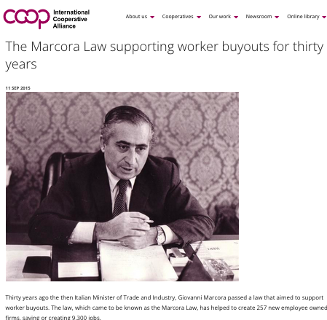
Notes:
https://traveltomorrow.com/france-bans-short-haul-domestic-flights-in-favour-of-train-travel/
France: Abolish domestic flights on routes than can be covered by train in under two-and-a-half hours
Other countries – eg Spain – considering the same
Italy (‘Marcora Law’) supporting coops via stakeholder links and finance. Other laws/ public policy in Italy in support of coops:Other public policy support and incentives that the legislation provides include: 1. A lower rate of corporation tax for social co­operatives compared to other companies 2. A lower VAT rate for social coperatives: 4 per cent compared to the standard 21 per cent rate 35 3. Type B social coperatives exemptions from national insurance contributions for their disadvantaged workers 4. Tax relief available for donors to social co­operatives 5. Trading surpluses are not taxable if placed in capital reserves 6. Investment returns of up to 80 per cent of profits can be distributed to multi­stakeholder members. However the rate of profit that can be shared is capped for each share at a maximum level that is no more than 2 per cent above the current rate on bonds available from the Italian Postal Service.36 7. Public investment stakes are permitted up to 7 per cent for Type A social co­operatives and up to 50 per cent for Type B.37’

Slide 30

Bologna: cooperative region
- Highest female participation in L force
- Political activism
- Resistance to public service cuts
- High wages
- Richest city

Slide 31
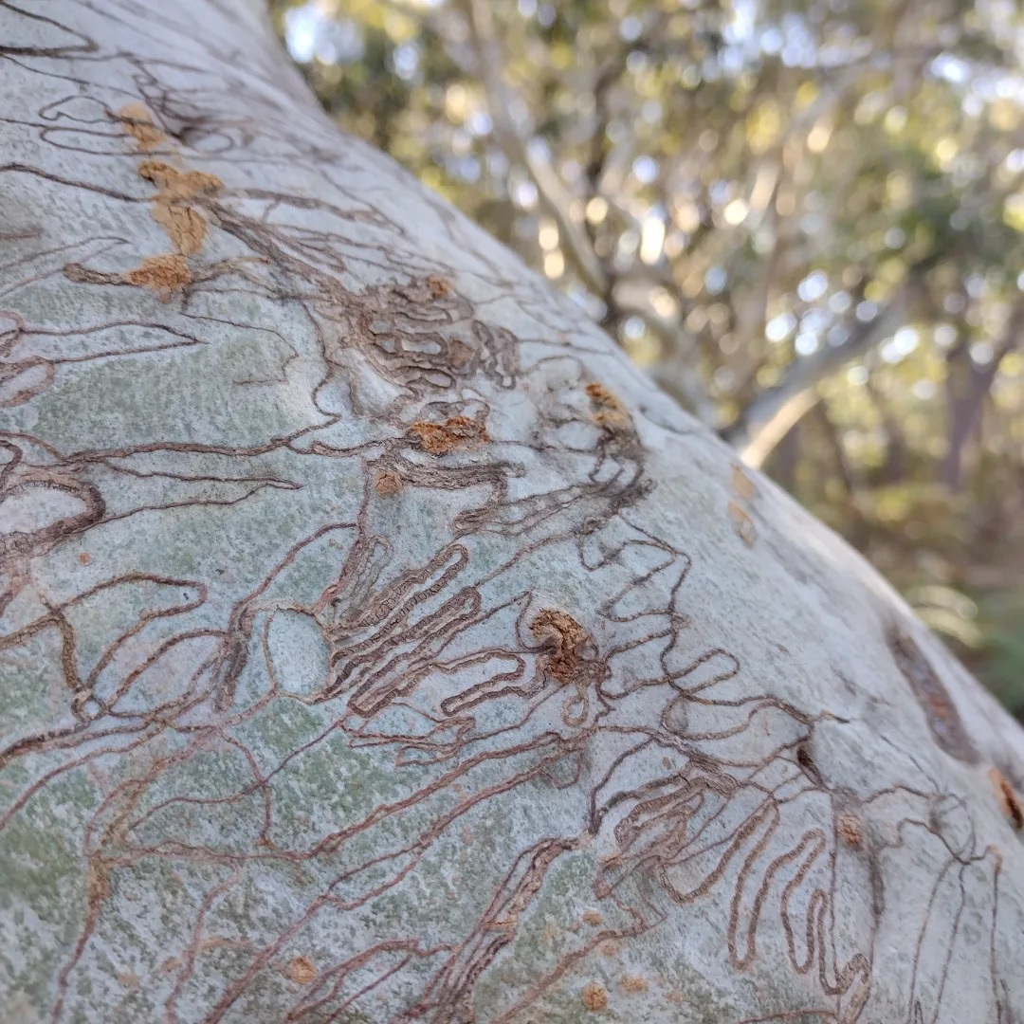
Australia has the ideas, evidence & energy to build a wellbeing economy…

Slide 32
Australia has the ideas, evidence & energy to build a wellbeing economy…
…but progress remains fragmented & vulnerable to reversal

Slide 33
Australia has the ideas, evidence & energy to build a wellbeing economy…
…but progress remains fragmented & vulnerable to reversal
Upstream change is held back by crisis-driven responses, narrow mindsets, vested interests and systems that reward the status quo

Slide 34

Beyond single heroes to a mosaic movement
"Ma whero ma pango
ka oti ai te mahi"
- Maori proverb
Credit: TK

Slide 35
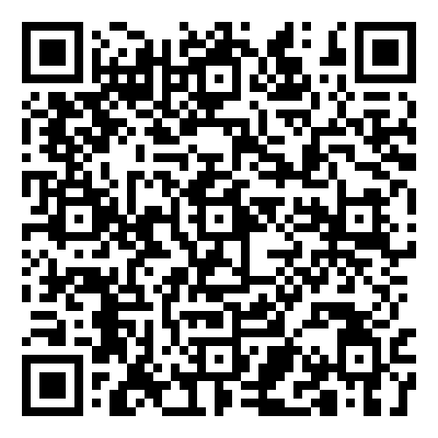
Thank you!
Get the report here:
Notes:
This paper seeks to spark a conversation about the economy we could have in Australia, rather than provide a manifesto for government to ‘plug and play’
It has charted some of the key junctures and decisions that have given rise to the economy of today and set out just some of the harms this set up has caused to people across Australia and to our environment.
It has pointed to some of the economic root causes of the divides facing Australia, divides which should give cause for fundamental rethinking of what has been tried in the past.
It has outlined a range of levers and instruments to build a wellbeing economy across three levels of action: mindsets, policy and practice, and shared signs of possibility for all levels of government in Australia.
Australia has shifted its economy in a substantial way before and today has incredible potential for leading the world in building an economy that works for people and planet, not the other way around.
This will be possible if the innovative forerunners can be seen as sparks of a better economy, if the policy examples that show what is possible in government can be rolled out to other areas and more jurisdictions, and if our imaginations and mindsets about who
the economy is for shifts from outdated thinking to ambitious ideas that position the economy as a means, not an end in itself.
The Next Economy looks forward to working with all and everyone who is keen for this conversation to explore the upstream roots of the challenges and
how to build an economy that no longer divides but creates collective wellbeing and nurtures our precious planetary home.
Doing better than simply ‘Lego wins’ and system compliant fixes is possible. It requires action upstream and transforming the economy into one that supports, as the Wiradjuri phrase ‘yindyamarra winhanganha’, puts it: having the knowledge to live a life worth living ‘in a world worth living in’.

