Slide 1
Population mental health: now and into the future
Beyond Blue CEO Georgie Harman AO
May 2026
Notes:
[Presentation orientation]
Precis: Beyond Blue CEO Georgie Harman AO will join outgoing Commissioner Ivan Frkovic for a wide-ranging discussion about future directions in population-level mental health support, including particular needs and opportunities in Queensland. The session will examine the story so far: where impact has been uneven, persistent stigma for complex mental illness, debates about medical models of distress and a system increasingly under pressure from rising demand. As financial stress, loneliness, and shifting patterns of help-seeking reshape community needs, the keynote will explore notions of scale, address the role of emerging technology, and discuss how strengthening cross-sector collaboration and measurable outcomes offer a way forward, along achieving a better balance between upstream prevention with downstream care.
Overview: Georgie will open with 20 minute-presentation with this flow: Beyond Blue – short overview, the problem and how we’re addressing it – current trends in mental health and wellbeing with a focus on Qld – key achievements, NASBO, TWB / Nicky Reavley stats– looking to the future
In conversation with Ivan: Suggested questions at the end of this slide deck (Slide 17)

Slide 2
The current system is too often crisis-driven. People often only get support when they’re at breaking point
Healthy
We are sharpening our focus here
Unsettled
Struggling
In crisis
Notes:
[Introduction]
Most people will have heard of Beyond Blue – we are the national depression and anxiety initiative and we’ve been working now for 25 years, supporting people in the moment and, in parallel, advocating to change places and systems to make better moments for people.
We’re here today to talk a bit about population-level approaches to mental health so I’ll talk a little bit about our work, given that population mental health is what we’re here to do.
Right now, we have a strong focus on prevention and earlier intervention.
In a deliberate step we believe best serves the community, we have sharpened our focus here because the current system is too often crisis-driven – and people often only get support when they’re at breaking point.
Again – we know that the sector is overwhelming and confusing and the community don’t know where to go for information and support.
So we have decided that we want to be here for all Australians, no matter what they’re going through – from those who want to look after their mental health, to those in high distress and crisis.
But earlier intervention is where we think we need to be to shift the dial, and we need to bring the whole population with us, away from that crisis focus and towards action that starts much farther upstream.

Slide 3

Beyond Blue
Earlier. Easier. Together.
What we do:
How we do it:
Our services:
Our Vision
All people in Australia achieve their best possible mental health.
We provide trustworthy information and services to support people to have the knowledge, skills and confidence to look after their mental health.
Beyond Blue 24/7 Support Service: free, immediate counselling, advice and referral
Be You in early learning services and schools
Online Community Forums: safe, moderated peer support 24/7
Beyond Blue website
New Access for Community
New Access for Small Business Owners
Before Blue for workplaces
We work with the community to create supportive environments where looking after mental health is normal.
Our Role
We work with the community to improve mental health and make it easier for people to feel better earlier, get well and stay well.
We advocate for system reform and social change to shape better mental health.
Our Focus
Prevention: addressing the social, economic, environmental and historical causes.
Earlier intervention: helping people early, before they reach crisis.
We identify system gaps and incubate new services and products to meet community need.
We contribute to society’s understanding of mental health through research and development.
Notes:
[How we do this]
A little about how we do this.
For the most part, we have and continue to operationalize our strategic goals through our advocacy – to governments, and through industry bodies – and of course through our service delivery.
Beyond Blue is probably best known for its support service, which takes calls two calls a minute, 24/7 from right across Australia (about a quarter of these are from Queensland though this could be higher due to data collection limitations)
We do quite a bit more than that … and you can see some of our services here
​

Slide 4
Our impact
95%
5000+
Be You now has 23,000 educators, 2,800 schools and
early learning
Services
in Qld
33,000
of Qld’ers (94% of Australians)
are aware of Beyond Blue
Community mental health coaching
sessions
delivered to Qld’ers each year*
Qld’ers engaged with our online peer forums
458
Lived experience volunteers from Qld
1 in 6
13% of
Australians engaged with Beyond Blue’s content and services*
Calls to the Support Service were from Queensland
252,000
website sessions
Source: Queensland Government six-monthly report July-Dec 2025
*Internal dashboard
Notes:
[Impact report]
The data here comes from our Impact Report … this is national data that hopefully gives a sense of what we’re doing
You can see that people in Queensland do have some awareness of us
As far as Qld goes, we do get good uptake across our range of services [Source: Qld gov report six months to Dec 25]:
Online peer-to-peer forums … good uptake from Qld … In the last six months of 2025, about 33,000 Queenslanders accessed Beyond Blue’s online Peer Support Forums (which is about 17 percent of its national users)
We actually ran Australia’s first low-intensity CBT program at scale … it was called NewAccess and it’s being wound down now … but since 2021 it has offered about 26,000 sessions to Queenslanders, which is more than 5000.
Be You … the National Mental Health in Education initiative, which we run in partnership with Headspace and Early Childhood Australia, has almost 2800 Queensland schools and early learning services, 23,000 individual educators registered
We had about a quarter of a million website sessions from Qld over the last six months of 2025
[Note: NewAccess coaching sessions figure of 5000 came from Data and Insights and represents an average across the last five years]

Slide 5
In the end, what we do is simple …
“The work you do reaches people. Really reaches them. Not in the way that looks good in a report or sounds right in a meeting. In the way that matters at 3am when a person does not know if they are going to be okay. I know because I have been that person.”
Notes:
[Talk through BBSS]
A quote here from a Support Service user … in terms of service delivery, don’t underestimate the power of just being available … being accessible in the moment a person needs you or has the motivation to act on their distress … this can make all the difference …

Slide 6
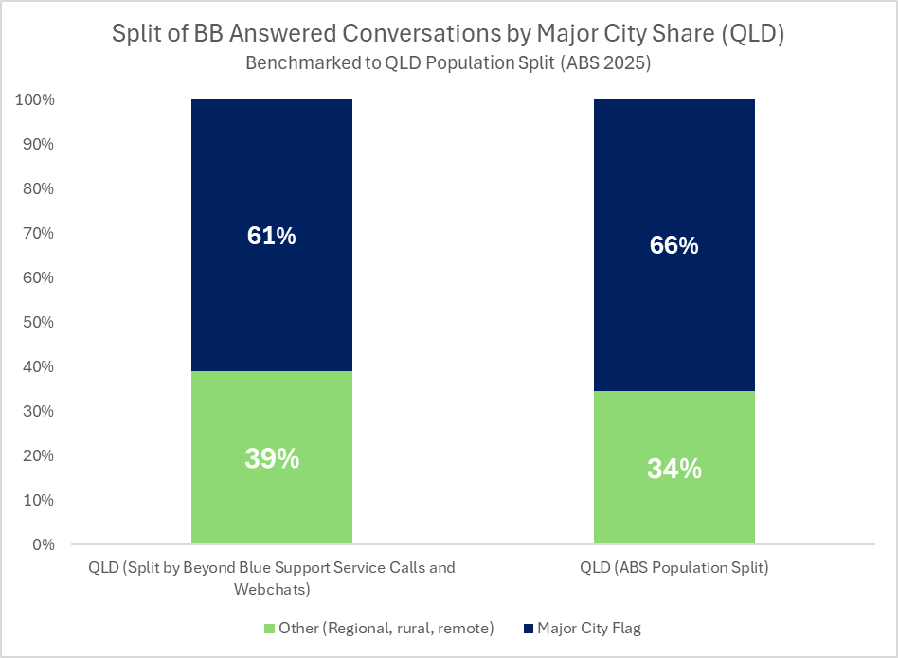
Beyond Blue Support Service: Qld regionality
Two in five Queensland contacts are from the regions
39%
34%
Notes:
[Talk through BBSS trends]
We often get questions about the community trends we witness through our services … what we’re seeing nationally is:
Complexity Trends
Presentations are increasingly complex, with more contacts involving chronic distress, suicidal ideation, and uncertainty around safety.
Greater prevalence of third‑party disclosures and safeguarding concerns is driving additional coordination across services.
Complexity is extending interaction time and requiring more intensive clinical judgement for our support service
Volume Trends
Consumer demand for our support service remains persistently high with contacts up 12%, reflecting sustained community need rather than short‑term spikes.
[Stats below are from first quarter of calendar 2026, ie 1 Jan to 31 Mar 2026 via NLP analysis]
Queensland trends
Regional Queensland is contacting Beyond Blue at strong rates, relative to the state’s geographic distribution - indicating proportionally more support seeking from regional Qlders
Proportionally similar themes in presenting contacts from Queensland relative to national trends between January and March this year
About 20 percent of contacts relate to anxiety or panic
About 15 percent are about relationships
About 10 percent relate to depression
Some indications that relative to the national average
We saw more presentations about alcohol and self-harm/suicidality
Fewer presentations about work and study stress and physical health/chronic illness

Slide 7
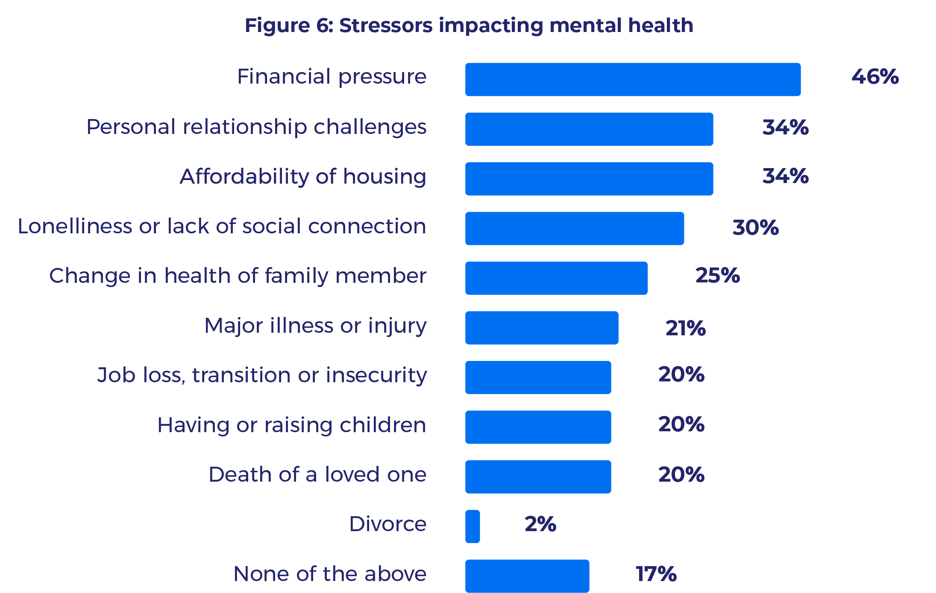
Life stressors driving distress
Financial pressure is the leading cause of distress
(~ one in two)
Relationship challenges, affordability of housing and loneliness (~ one in three)
Notes:
[Explain impact of external stressors on distress]
We undertake some robust research to more deeply understand the insights we see in our services.
Australia’s Mental Health and Wellbeing Check is a population-level survey of more than 5000 people, that Beyond Blue conducts with the Australian National University every two years. We will be receiving the 2026 update to this dataset later this year. While this is national data, there’s no statistically difference between states so it’s reasonable to say this is representative of the Qld experience, as well as the national one.
In our study, nearly half of people reported symptoms of mental health conditions and 2 in 5 reported a diagnoses – so higher than ABS estimates.
When we asked people the types of issues that were impacting their mental health they told us:
Financial challenges were identified as the leading cause of distress impacting Australia’s mental health and wellbeing, impacting almost half of all people in Australia (46%).
Relationship challenges, as well as loneliness and lack of social connection, housing affordability, affecting approximately one third of the population.
The key take-away here is that distress is very often associated with social determinants and it plays out where we live, work and play. That’s why Australia needs to be looking beyond the health care system if we’re going to shift the dial on mental health in this country.
That’s also why Beyond Blue is careful to talk about distress in general terms, rather than conflating all distress with mental health conditions – we spend a lot of time normalising emotional responses that people have.
And we recognise that whether it’s a mental health condition or situational, self-limiting distress people are managing, people will often require some kind of support – and that support might be from the health care system or it might be from their own personal support networks. The point is, that if we’re serious about earlier intervention, this is where we need to be operating.

Slide 8
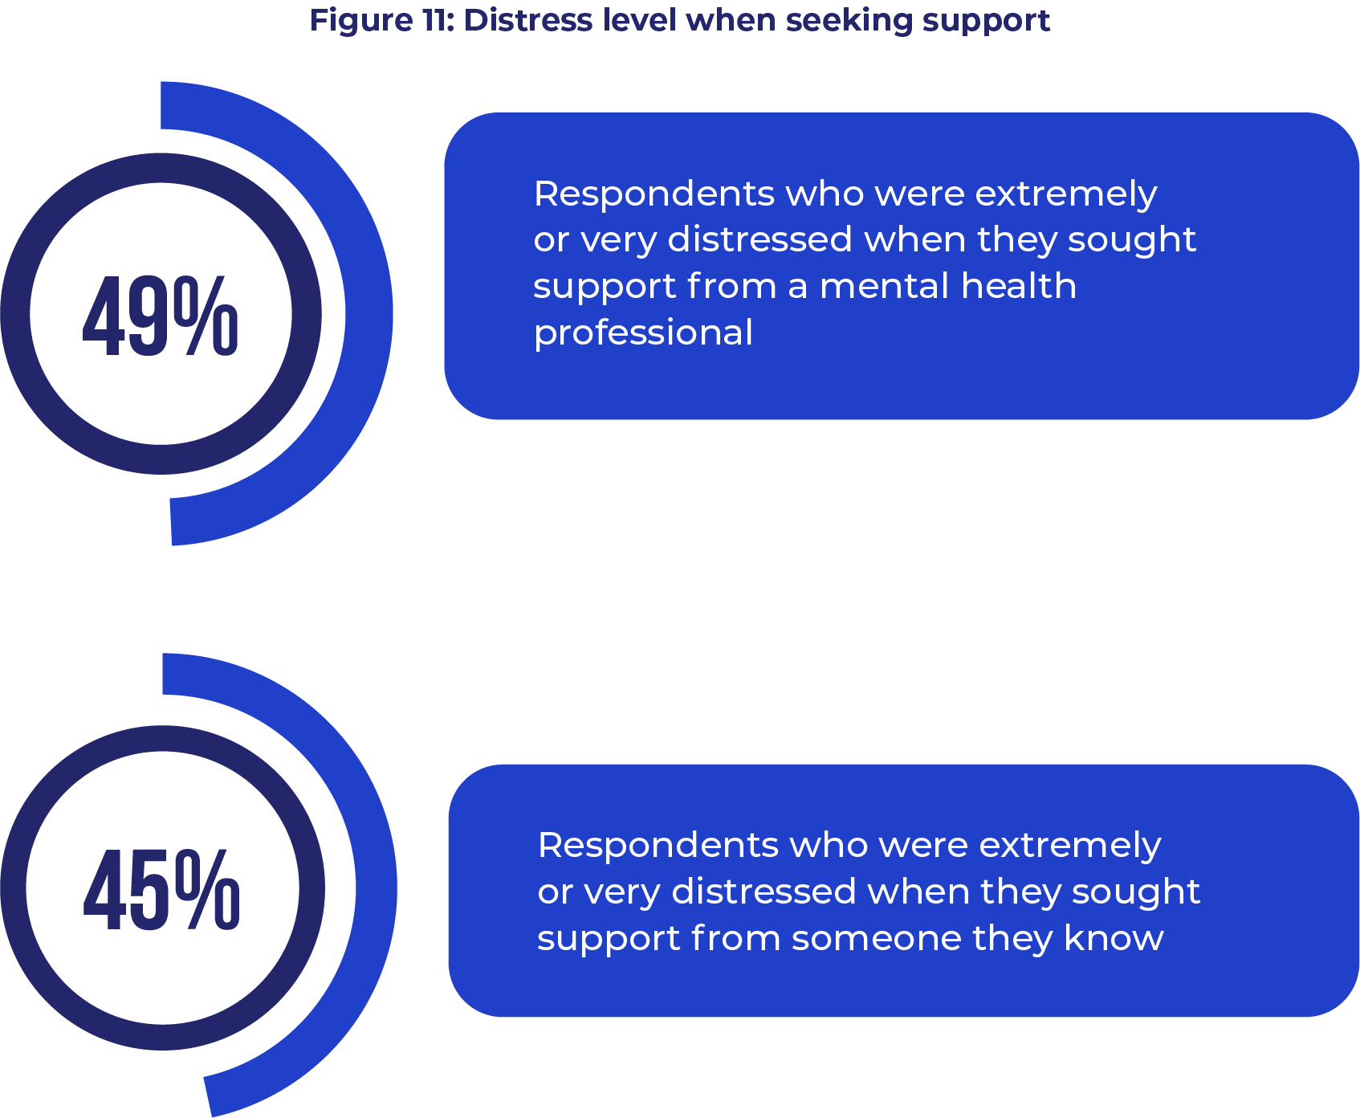
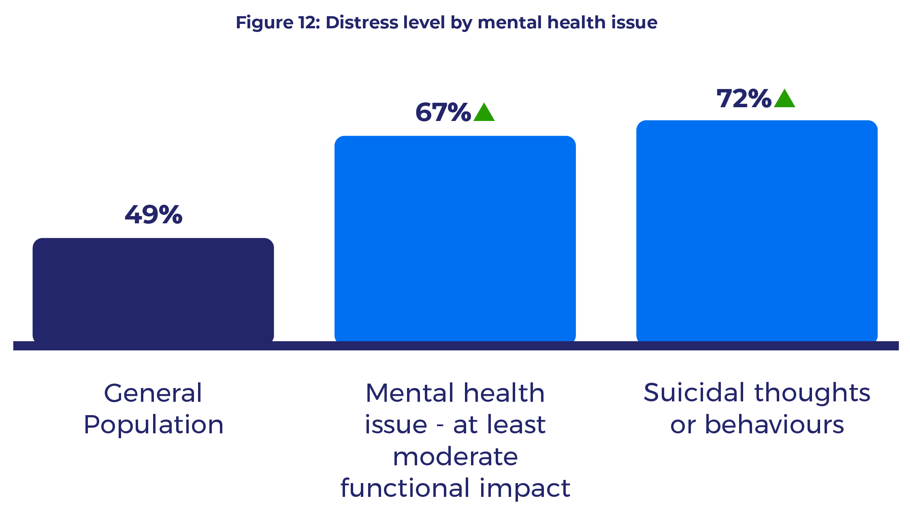
Half of all people are highly distressed when seeking help
Notes:
[Case for earlier intervention]
This summit is about prevention so let’s look more closely at what the data tells us about how people are approaching their help-seeking
No surprises here.
We found that far too many people aren’t reaching out for support or are putting in off for far too long.
Nearly one in four report delaying or not seeking professional support.
Around half of all people who ended up reaching out for support waited until they were very or extremely distressed before doing so.
Some people are waiting up to 10 years before the reach out for support.

Slide 9
Top reasons for delaying or not seeking professional support
~ 1 in 2 people
~ 1 in 3 people
Significant
Significant
Notes:
[Cost of living and economic pressures are only going to increase]
When we asked people the reasons for delaying or not seeking support – we heard that costs were the number one barriers, followed by not thinking their problem was serious enough, and waiting lists.

Slide 10
Shame and stigma have increased …
Significant
Notes:
[We need to consider internal barriers to support seeking too]
Concerning we also saw shame on the increase – increasing by 9% over the past two years. When we think about the progress we’ve made in help-seeking stigma reduction – these results demonstrate we have a long way to go around self-stigma.
We might pick that up in our discussion shortly Ivan.

Slide 11
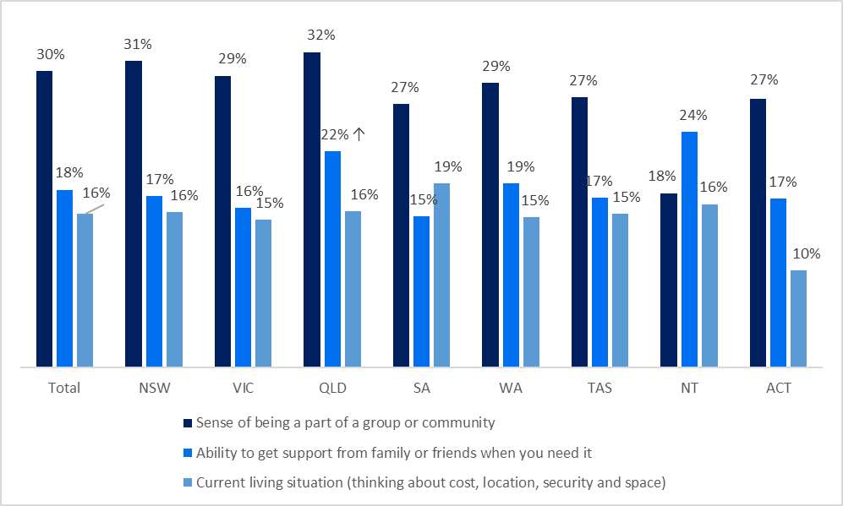
Social support and mental health
Social supports explored in this survey included ‘current living situation’, 'social support' and ‘being part of a community’.
Respondents in QLD showed a statistically significant difference in their ability to get support from friends and family. 22% respondents from QLD rated this as fair and poor in comparison to the total (18%).
% fair and poor
Overall, how would you rate your:
Base: All respondents (n = 5,014)
Notes:
[Where Queensland is different]
I mentioned earlier that most data was consistent, nationally. There were a few differences and this one stood out for Queensland.
Queenslanders rate their ability to get support from the people around them much lower than the rest of the country - by four percentage points in fact.
This is worth noting because the data generally shows that about half of all highly distressed support seekers actually turn to people they know when they need support. Maybe some opportunities to promote resources about supporting others, and equipping people to have conversations about mental health.

Slide 12
Beyond Blue’s impact over the years
“Beyond Blue’s sustained focus and measurable success in improving mental health literacy, reducing stigma and facilitating help-seeking for depression and anxiety remains largely unmatched (globally)”
Engagement with Beyond Blue predicted significantly lower stigma related to seeking professional help
Recognition of Beyond Blue was associated with less stigmatising beliefs
Association between recognition of Beyond Blue and:
  More accurate recognition of mental health problems
  More favourable beliefs about evidence-based treatments and self-help interventions
Source: Reavely, N., Beyond awareness: 25 years of population data on the impact of Australia’s Beyond Blue, under review, 2026. University of Melbourne.
Notes:
Some interesting findings … noting this is yet to be published but has undergone peer review

Slide 13
Service innovation
NewAccess for Small Business
NewAccess
The Way Back Support Service
One in six clients is from Qld
Most aged 35-54
Sole traders
Work in healthcare
Outcomes:
91% - felt more productive and able to address future business challenges
96% - felt better able to manage their mental health challenges
26,805 sessions delivered in Qld
Informed the development of the Commonwealth’s new Medicare Mental Health Check-In
Just been closed to new clients and will cease operating in June 2026
Helped 40,000 people nationally since 2014
7000 referrals in Qld
63% reduction in suicidal ideation
86% improvement in wellbeing
28% reduction in psychological distress
Handed to Commonwealth July 2023
Notes:
[Service achievements]
Mental health literacy and reducing stigma and discrimination are important parts of the Beyond Blue story … but there’s more happening here than awareness-raising … service innovation is in our DNA
These are the services we’ve piloted and scaled over the years
NASBO has supported more than XXXXXX Queenslanders
95% of participants felt NASBO helped them address and understand their challenges
91% felt more productive and able to address future business challenges
96% felt better able to manage their mental health challenges
NewAccess
Nationally, since the program began in 2014, it has helped 40,000 people. In Qld since Jan 2021 it has received:
Enquiries – 15,415
Booked assessments – 7,550
Sessions delivered – 26,805
This service informed the development of the Commonwealth’s new Medicare Mental Health Check-In and has been closed to new clients
The Way Back Support Service
TWBSS received 7000 referrals from its ten Queensland sites (600 over target) in three years
Independent NOUS evaluation showed:
63% reduction in suicidal ideation
86% improvement in wellbeing
28% reduction in psychological distress

Slide 14
Where to next?
Notes:
Where to Next
It starts in everyday environments where early signals of distress emerge. People encounter mental health content often before they are ready to seek help — across social platforms, search, private networks and community spaces — and not as a single, intentional moment.
We know that digital and physical environments now overlap, merge and influence each other continuously.
People move fluidly between private conversations, public platforms, trusted institutions, and community settings — often within the same day or moment of need.
If we treat services, products, channels, platforms and content separately, we risk fragmented experiences that do not reflect how people live, seek help, or build trust. ​
​
Shifting from a service‑led system and services to an integrated, experience‑led system and services
Integration allows us all to respond earlier, by connecting content, tools and services into a guided experience rather than expecting people to stumble through options.

Slide 15
Emerging population trends
The world has become markedly more complex, as geopolitical, social, economic and technological pressures converge to drive information overload and rising distress across the community. These pressures will persist, with rising distress caused by:
Ongoing housing instability and cost‑of‑living pressures, continuing to place financial strain on individuals & families
Sustained high levels of loneliness and growing tensions in social cohesion, exacerbating feelings of isolation and disconnection, seven in ten people unwilling to trust people who are different from them
Cost and wait times acting as significant barriers to mental health care, with around 20% of people reportedly delaying or foregoing care due to cost — an issue likely to intensify as living pressures increase
By 2030, Australia will have a larger, older and more culturally and linguistically diverse population, with:
Two million more people
An older population with 19% estimated in the 65+ age group
9 million or 30% of people born overseas
2m
Notes:
[System and services in context]
We have a history of impact through scale
Looking ahead, what if scale looks different?
Volume scales out but we also need to be conscious of scaling deep – giving people useful experiences that build trust and shift cultures and norms
Too often, systems over‑reward visible outputs and under‑value these less visible, easily-tracked metrics like sustained wellbeing, trust, and social connection
AT this point, I’d normally talk about the “polycrisis” – the growing number of interconnected problems affecting our health and wellbeing – but these days I’m hearing that term replaced with words like “metacrisis” or “omni-shambles”, which feels about right when we’re referring to the large-scale systemic upheaval that’s happening around us …
Insurers, start-ups, algorithms, new comp - not one another. Who are we and where are we going next? Seeking support in different ways, what is our role? Why we've chosen the lane we've chosen, what we've given up, why that's hard, facing into difficult economic circumstances. Same not good enough, services need to look different.
The mental health system and its services need to be flexible and dynamic in order to respond to an environment that is changing rapidly, with profound consequences for our mental health
For all of us policy makers and service providers – shape and face of Australia is changing – BB thinking deeply about the implications for us a population health org – support to all people in Australia
continued challenges and risks to reach and relevance –wide variation in how different generations, and demographic groups look for, access, and engage with information and support.
The 2026 Edelman Trust Barometer describes a world retreating into insularity—where seven in ten people are unwilling or hesitant to trust someone who is different from them
Trust in shared institutions is weakened by insularity, grievance, and declining belief that systems work for “people like me.” In developed countries, including Australia, institutional trust remains fragile and uneven, with trust shifting away from abstract national institutions toward employers, local actors, and familiar intermediaries.
This has direct implications for scaled initiatives:
Policy reforms and service models do not diffuse automatically; they travel through trust.
Beyond Blue acts as a trusted intermediary, not just an advocate—connecting policymakers, service systems, workplaces, and communities in ways that respect lived experience and local realities

Slide 16
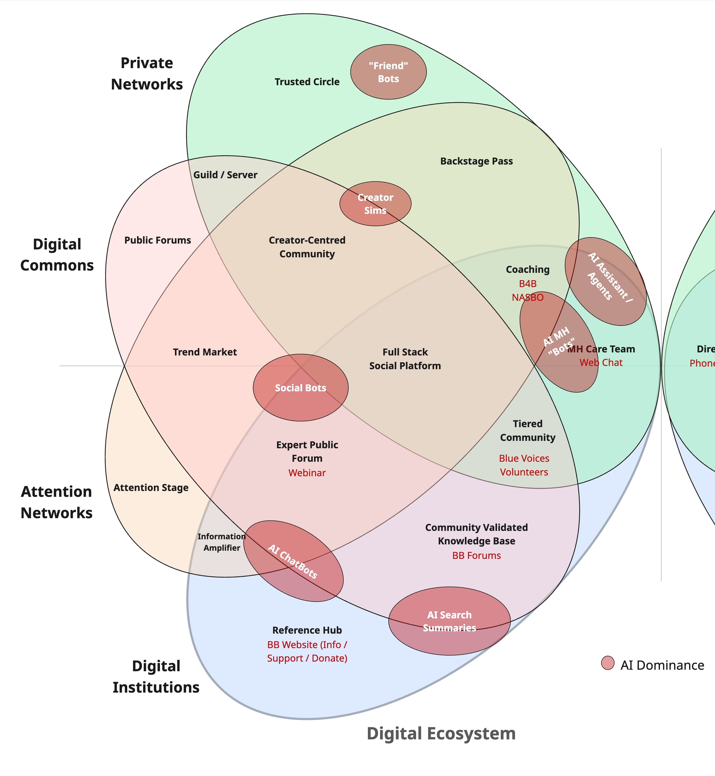
How is AI impacting the current operating environment?
Notes:
[Looking ahead]
We need to start really embracing the idea that earlier intervention doesn’t start in services
As AI tools develop further and become more embedded into day-to-day community behaviour, digital mental health services carries significant risk exposure from disintermediation.
Many of the current and growing AI use cases directly overlap with existing digital mental health services and capabilities as shown on the diagram.
We need to continue to engage in these spheres, however, also need to acknowledge that AI will become permanent features of this ecosystem and we need to find meaningful ways to both leverage and co-exist.
A focus then should be on uniqueness, tool development and engaging in human interaction. At the same time need to ensure technical excellence in content production and publishing, so it can be consumed by AI tools for recombination via AI engines / Search Engines.

Slide 17
Questions
Notes:
In conversation with Ivan:
Questions:
There is a lot of debate here and in the UK about this notion of concept creep in mental health … how normal negative emotions are being pathologized. Are they?
[GH answer: sometimes, probably yes, sometimes no. BB careful to share balanced messages that are first and foremost about normalising human experience, and we also want to equip people with not just the skills but the belief that they can cope, to empower them to adapt either by reaching out for any support they need or by applying some skills or using their own resources. Oxford University researcher Lucy Foulkes has been active on this issue – arguing perhaps mental health awareness efforts are promoting better recognition – which is a good thing – but on the flip side, might be encouraging people to interpret mild distress as mental health problems.
University of Melbourne recently had an article published in BMJ Public Health that is showing that young people were more likely to give subthreshold depression a label of ‘depression’ instead, which meant they were more likely to seek professional help and possibly use medication. However CALD communities, according to the research, seems to be missing signs of major depression and even suicidality. Nuance and balance, different sections of the community need to hear different things. The task now is getting the balance right – equipping people with self-management skills where they need them without deterring help-seeking.
What is the outlook for non-profits? How is Beyond Blue managing? Will be getting help from robots in 20 years?
[GH answer: Pro-human. Insurers, start-ups, algorithms, new comp - not one another. Who are we and where are we going next? Seeking support in different ways, what is our role? Why we've chosen the lane we've chosen, what we've given up, why that's hard, facing into difficult economic circumstances. Same not good enough, services need to look different.]
Stigma – is it still a problem?
GH answer: yes. We do see reductions in help-seeking stigma, but there remains a sense of self-stigma – “I should be able to manage” that’s getting in the way. And there is research there that says while anxiety and depression are less stigmatising now, more complex conditions remain highly stigmatised.
The National Mental Health Commission and SANE is developing some surveys about stigma experiences now. They talk about the fact that:
three in four young people in Australia believe mental illness is stigmatized
three in five people with lived experience were treated unfairly or discriminated against in the past year.
three in ten carers and support people said others avoided or ignored them because of their support role.
still a problem in keeping a job, in dating/intimate relationships, in housing [https://pubmed.ncbi.nlm.nih.gov/41630387/]

Slide 18
Our impact
95%
16,000
Be You now has 214,000 educators, 15,000 schools and
early learning
services
1 in 20
of Qld’ers* (94% of Australians)
are aware of Beyond Blue
Mental health coaching
sessions
delivered
Australians have engaged with our interactive services
5.6M
Speaker program’s estimated reach
1 in 6
303,000+
Australians engaged with Beyond Blue’s content and services
Contacts reached out to the Support Service
2.6+million website sessions
Source: 2024/2025 Beyond Blue Impact Report
*Queensland Government six-monthly report July-Dec 2025
Notes:
[Impact report]
The data here comes from our Impact Report … this is national data that hopefully gives a sense of what we’re doing
You can see that people in Queensland do have some awareness of us
As far as Qld goes, we do get good uptake across our range of services [Source: Qld gov report six months to Dec 25]:
Online peer-to-peer forums … good uptake from Qld … In the last six months of 2025, about 33,000 Queenslanders accessed Beyond Blue’s online Peer Support Forums (which is about 17 percent of its national users)
We actually ran Australia’s first low-intensity CBT program at scale … it was called NewAccess and it’s being wound down now … but over the past years, it has offered about 26,000 sessions to Queenslanders.
Be You … the National Mental Health in Education initiative, which we run in partnership with Headspace and Early Childhood Australia, has almost 2800 Queensland schools and early learning services, 23,000 individual educators registered
We had about a quarter of a million website sessions from Qld over the last six months of 2025

