Slide 1
Reimagining health
Social prescribing, civic infrastructure and wellbeing-centred reform
Prof J.R. Baker
Chair, ASPIRE

Slide 2
The reform problem
Queensland is asking the right question: how do we do things differently across government, with providers
and communities?
Despite decades of investment, the system is still too often designed around crisis, diagnosis and service activity.
Crisis-weighted
Siloed
Resources concentrate when people are already struggling.
Portfolios purchase adjacent pieces without shared stewardship.
Service-led
Equity-blind
Success is too often throughput, not lives changed.
The social, structural and place-based of health are treated as background conditions and context, not reform targets.
Reform means changing what we purchase, what we value and who is responsible for the conditions that help people live well.
Leading Reform Summit 2026 | Queensland Mental Health Commission

Slide 3
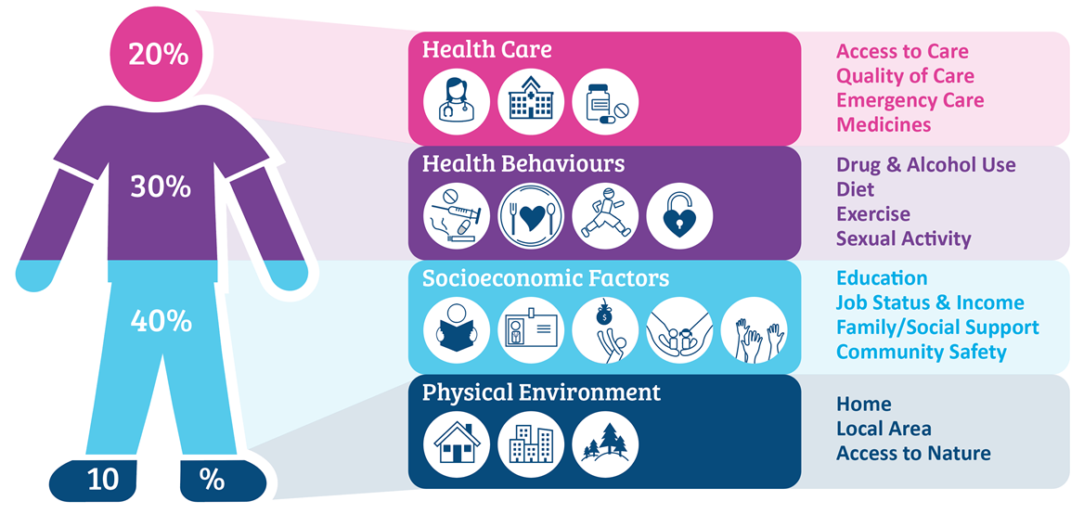
Social prescribing starts with a different question
Not only: “What is the matter with you?”
But: “What matters to you, what is around you, and what would help you live well?”
What you can access
Where you live
What you have
What you can contribute
Cost, culture, confidence, language, disability access, time and welcome.
Housing, transport, safety, green space, distance and local services.
Relationships, skills, identity, income, purpose and confidence.
Opportunities to be valued, useful, connected and part of something larger.
Leading Reform Summit 2026 | Queensland Mental Health Commission

Slide 4
What social prescribing is
A practical mechanism for turning a wellbeing conversation into a supported connection.
A structured way for trusted referrers to connect people to non-clinical supports that matter to them, with enough help to make the connection work.
Ask
Connect
Support
Contribute
Learn
What matters to you? What is getting in the way? What would help?
A warm pathway to arts, music, nature, sport, learning, culture, peers or practical help.
Link workers help remove barriers and find something that fits real life.
People join, create, move, learn, volunteer, restore, play, mentor or lead.
The system sees unmet need, pathway gaps and local infrastructure needs.
It is not a pamphlet, a directory or a “nice extra”. It is a supported pathway from clinical need to everyday life.
Leading Reform Summit 2026 | Queensland Mental Health Commission

Slide 5
The health infrastructure outside the health system
Many of the things that keep people well are not owned by health.
Civic canvases
Community halls, churches, sports fields, courts, libraries, parks, beaches, cultural venues and council spaces.
Community offers
Arts programs, Music on Prescription, bushwalking, sport, gardening, historic preservation, volunteering, learning and peer-led groups.
Relational Infrastructure
Connection and meaning, identity, routine, movement, purpose, confidence, belonging and practical support.
The reform move is to see these assets as health-generating infrastructure, not optional extras.
Leading Reform Summit 2026 | Queensland Mental Health Commission

Slide 6
Why this matters for reform
Social prescribing changes where health investment can land.
Demand
Prevention
Value multipliers
Equity
Earlier, lighter and more local pathways can reduce pressure on hospitals, GP clinics and specialist services.
Investment moves towards maintaining health, primary prevention, secondary prevention and recovery support.
Communities already pay for parks, venues, clubs, libraries, cultural programs and neighbourhood infrastructure. Social prescribing helps those assets produce more wellbeing value.
The model exposes the practical barriers that determine who can actually access wellbeing.
The opportunity is not to medicalise community life. It is to let community life do more of the work of health.
Leading Reform Summit 2026 | Queensland Mental Health Commission

Slide 7
Cross-portfolio purchasing changes what becomes possible
Health
Communities
Arts & Culture
referral, clinical governance, prevention
local capacity, neighbourhood centres, inclusion
creative participation, identity, expression
Sport & Rec
Housing / Transport
Education / Work
movement, mateship, confidence, routine
access, stability, practical barriers
skills, purpose, contribution
Shared investment in the conditions for wellbeing, not only treatment episodes.
Leading Reform Summit 2026 | Queensland Mental Health Commission

Slide 8
Queensland has live opportunities to learn in public
WiseCarer
QLD Social Prescribing Trial
Other Australian Evidence
Carer-centred social prescribing and practical support.
Depression symptoms reduced by 56%
Anxiety symptoms reduced by 64%
Psychological distress reduced by 35%
Place-based work through community and neighbourhood infrastructure.
Quality of life improved to levels comparable with the general Australian population
Confidence to join social activities increased across all age groups
Community connection improved significantly within 12 weeks
Non-clinical supports improving health-related quality of life and mental health.
Australian social prescribing programs showed positive wellbeing and social connection outcomes
Quality of life and loneliness were consistently identified as key outcome measures
Link worker models demonstrated benefits across health, wellbeing and community participation outcomes
The point is not one perfect model. The point is a learning system that can adapt across place, population and portfolio.
Leading Reform Summit 2026 | Queensland Mental Health Commission

Slide 9
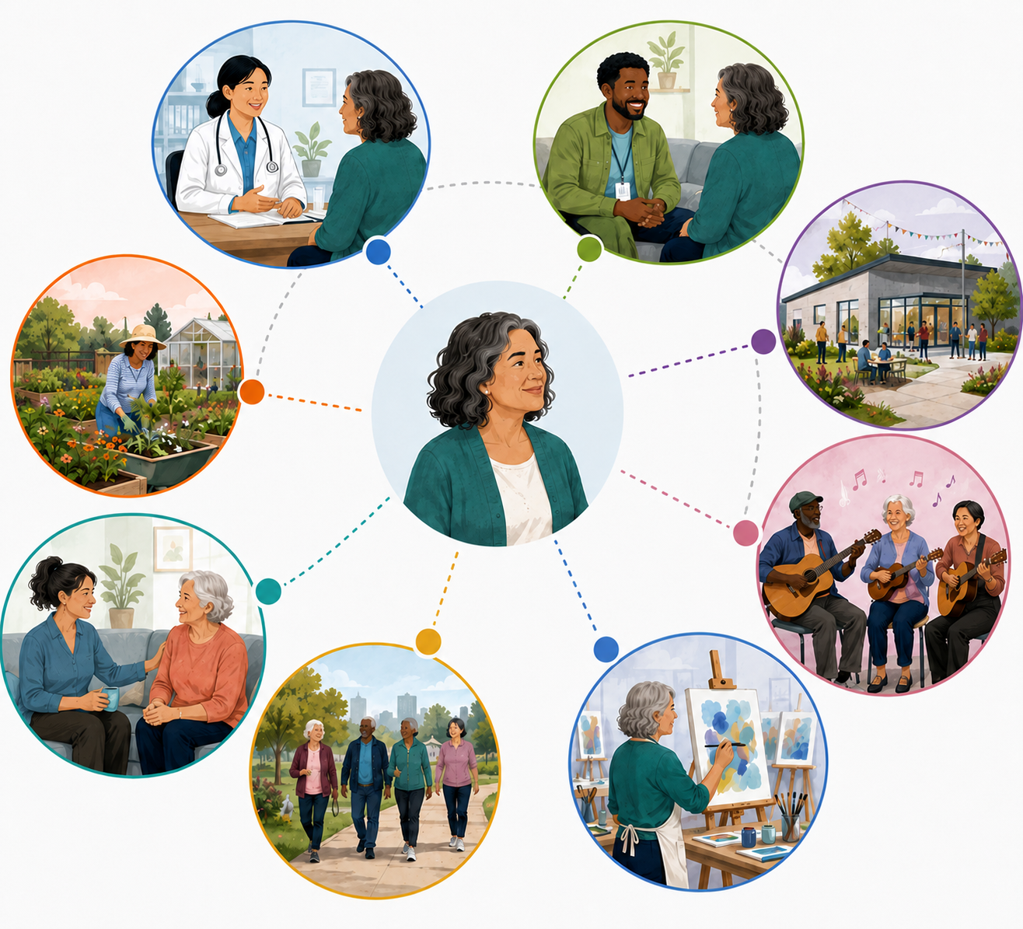
Do not just buy the prescription. Build the system that makes it work.
Prescription
A person connects to something meaningful: arts, music, sport, nature, peers, learning, volunteering, cultural connection or practical help.
Dispensing system
Referral pathways, link workers, safeguarding, transport, community capacity, supervision, data and feedback loops.
Commissioning intelligence
What people ask for, where pathways fail, who is excluded and which local assets need investment.
Programs such as Upbeat Arts or Chill Chef become mainstream only when the system around them is intentionally supported.
Leading Reform Summit 2026 | Queensland Mental Health Commission

Slide 10
What we really want to see with the data
1. Personal change
2. System learning
3. Portfolio value
Health-related quality of life, mental wellbeing, loneliness, confidence, hope and agency.
Referral source, unmet need, barriers, failed pathways and community gaps by place.
Reduced avoidable demand, earlier help, stronger civic infrastructure and better use of existing assets.
A NSW social prescribing program returned AUD$5.80 for every AUD$1 invested (McNamara et al., 2025).
Quality of life improved by around 30% and self-reported health by 33% in 281 Australian adults with chronic disease following a 12-week social prescribing program (Freak-Poli et al., 2025b).
Psychological distress reduced by 24% and self-reported health improved by 31% in 398 Australian adults with diagnosed mental health conditions following a 12-week social prescribing program (Freak-Poli et al., 2025a).
Loneliness and social trust improved significantly in lonely Australian adults after 8 weeks of social prescribing compared to GP treatment-as-usual (Dingle et al., 2024).
GP visits reduced by 33% (M: 1.45 to 0.97) and significant improvements were observed across quality of life, mental wellbeing, self-reported health, and psychological distress in carers completing a 12-week social prescribing program (Aggar et al., 2025).
Leading Reform Summit 2026 | Queensland Mental Health Commission

Slide 11
From care to contribution
The deeper promise is not only that people receive support. It is that people are seen as capable, valued and able to contribute.
What matters to you
You matter to others
Contribution
Reciprocity
Care starts with the person’s goals, identity, culture, interests, strengths and local realities.
The pathway should build belonging, mutual recognition and roles that are not defined by sickness.
People may join, help, teach, restore, create, play, mentor, preserve, care, grow or lead.
Wellbeing is created through relationships, not just delivered through services.
Social prescribing becomes a bridge between treatment, community development and civic renewal.
Leading Reform Summit 2026 | Queensland Mental Health Commission

Slide 12

Provocation for reform
If wellbeing is created across everyday life, why do we still purchase mental health as if it sits inside one portfolio?
NEXT STEP: Pick one population, one place and one shared outcome, then purchase the enabling system together.
Thank you
Leading Reform Summit 2026 | Queensland Mental Health Commission

Slide 13

Thank you!
Prof J.R. Baker
Associate Professor,
Southern Cross University
Chair, ASPIRE
jrbaker@sp.edu.au

