Slide 1



V
Faculty of Medicine, Health
and Human Science
Implementing evidence-based mental health care at scale
Jeffrey Braithwaite
PhD, FIML, FCHSM, FFPHRCP, FAcSS, Hon FRACMA, FAHMS
Professor and Director
Australian Institute of Health Innovation
Director
Centre for Healthcare Resilience and Implementation Science
Chair
International Academy of Quality and Safety
2026 Leading Reform Summit
Tuesday May 26th 2026
9:30 am – 9:55 am
25 min Keynote
InterContinental Brisbane

Slide 2

Acknowledgement of Country
The artwork Circles of the Night Sky is created by Professor Liz Cameron,
Dharug woman and Macquarie University alumnus
We acknowledge the traditional custodians of the land on which Macquarie University is situated, the Wallumattagal people of the Dharug nation, whose cultures and customs have nurtured, and continue to nurture, this land since the Dreamtime.
We pay our respects to all First Nations People joining us today and to Elders past, present and emerging.

Slide 3


AUSTRALIAN INSTITUTE OF HEALTH INNOVATION
Our goal is to co-create high-impact health services and systems research that drives positive change in policy, practice and behaviour for the benefit of all.
aihi.mq.edu.au
AUSTRALIAN INSTITUTE OF HEALTH INNOVATION | MACQUARIE UNIVERSITY

Slide 4




Australian Institute of Health Innovation
AIHI
NHMRC Partnership Centre for Health System Sustainability
Professor
Jeffrey Braithwaite
Founding Director, AIHI
Director, Centre for Healthcare Resilience and Implementation Science
Professor
Johanna Westbrook
Director, Centre for Health Systems and Safety Research
Professor
Enrico
Coiera
Director, Centre for Health Informatics
Professor
Henry
Cutler
Director, Macquarie University Centre for the Health Economy
NHMRC Centre of Research Excellence in Implementation Science in Oncology
NHMRC Centre of Research Excellence in Digital Health
AUSTRALIAN INSTITUTE OF HEALTH INNOVATION | MACQUARIE UNIVERSITY

Slide 5

Applications of our work
RAPID CHANGES & INNOVATION
COMPLEXITY
EMERGING RISKS
PANDEMICS
RETHINKING CURRENT APPROACHES
CLIMATE CHANGE
AUSTRALIAN INSTITUTE OF HEALTH INNOVATION | MACQUARIE UNIVERSITY

Slide 6


Australian Institute of Health Innovation
AIHI
AUSTRALIAN INSTITUTE OF HEALTH INNOVATION | MACQUARIE UNIVERSITY

Slide 7
Prologue:
How do you feel about the future of Healthcare?
It’s not about me, it’s about you …

Slide 8
So let’s see what you think …
We are in deep trouble. The polycrisis is upon us:
Strongly agree Neutral Strongly disagree
5 4 3 2 1
AUSTRALIAN INSTITUTE OF HEALTH INNOVATION | MACQUARIE UNIVERSITY

Slide 9
Polycrisis defined
The state of the world out there is existential
Its not just the health system that’s facing headwinds
Wars, droughts, ecological degradation, wildfires, changing vector-borne diseases, rising seas, cyclones …
So it is multiple mental health crises happening simultaneously
AUSTRALIAN INSTITUTE OF HEALTH INNOVATION | MACQUARIE UNIVERSITY

Slide 10
Tackling this …
… would address a great deal of the growing mental health burden across the world
But we must do what we can in the domains that we can influence
Let’s have a look at this
AUSTRALIAN INSTITUTE OF HEALTH INNOVATION | MACQUARIE UNIVERSITY

Slide 11


















MOBILE PHONES
INTERNET
Notes:
Earth reference: https://unsplash.com/photos/earth-with-clouds-above-the-african-continent-vhSz50AaFAs?utm_content=creditShareLink&utm_medium=referral&utm_source=unsplash

Slide 12
Part 1:
What you want and what I did

Slide 13
The Summit
“The summit brings together 300+ leaders in Queensland’s mental health, alcohol and other drugs, and suicide prevention sectors. It is intended to be a catalyst to align leaders, develop solutions to problems, introduce new strategies, fuel collaboration, harness the collective knowledge of sector leaders and drive the reform agenda forward.”
AUSTRALIAN INSTITUTE OF HEALTH INNOVATION | MACQUARIE UNIVERSITY

Slide 14
The Summit
“Our job is to encourage and facilitate change to improve the mental health and wellbeing of all Queenslanders, with a focus on:
● improving the mental health and wellbeing of all Queenslanders
● preventing and reducing the impact of mental illness
● preventing and reducing the impact of problematic alcohol and other drug use
● preventing and reducing the impact of suicide”
AUSTRALIAN INSTITUTE OF HEALTH INNOVATION | MACQUARIE UNIVERSITY

Slide 15
The Summit
“Leading Reform Summit key themes
● State of the State – the reform landscape
● System design that starts with people, place, and partnerships
● Where do we need to go – what if we started with wellbeing?”
AUSTRALIAN INSTITUTE OF HEALTH INNOVATION | MACQUARIE UNIVERSITY

Slide 16
The Summit
“Leading Reform Summit key themes continued
● The role of funding in driving reform
● Implementing evidence-based mental health care at scale
● Young people’s voices: what a future Queensland system must deliver”
AUSTRALIAN INSTITUTE OF HEALTH INNOVATION | MACQUARIE UNIVERSITY

Slide 17
My response
So we are doing all that but let’s especially focus on:
implementing evidence-based mental health care at scale
AUSTRALIAN INSTITUTE OF HEALTH INNOVATION | MACQUARIE UNIVERSITY

Slide 18
Part 2:
My perspective

Slide 19
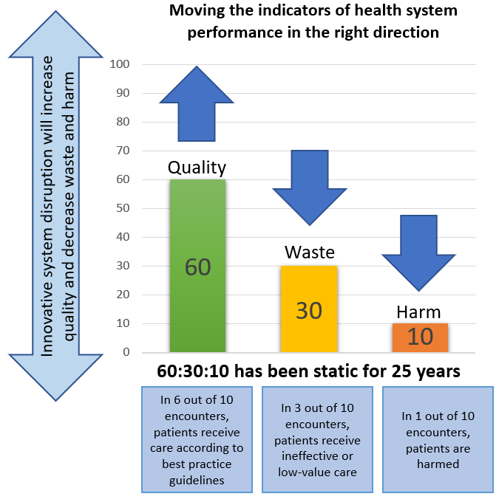
Just three numbers – 60:30:10
[Braithwaite, J., Glasziou, P. & Westbrook, J. (2020). The three numbers you need to know about healthcare: the 60-30-10 Challenge. BMC Medicine.
doi: 10.1186/s12916-020-01563-4]
AUSTRALIAN INSTITUTE OF HEALTH INNOVATION | MACQUARIE UNIVERSITY

Slide 20


Existing Situation:
60-30-10 Challenge
60%: Delivery of care in-line with level one evidence
30%: Wasteful health expenditure
10%: Rate of adverse events
[Braithwaite et al. (2020). The three numbers you need to know about healthcare: the 60-30-10 Challenge. BMC Medicine. doi: 10.1186/s12916-020-01563-4]

Slide 21

These numbers seem to have flatlined

Slide 22
Also …
It takes an average of 17 years for only 14% of new scientific discoveries to enter day-to-day clinical practice
[Balas & Boren. (2020). Managing Clinical Knowledge for Health Care Improvement. Yearbook of Medical Informatics]
AUSTRALIAN INSTITUTE OF HEALTH INNOVATION | MACQUARIE UNIVERSITY

Slide 23
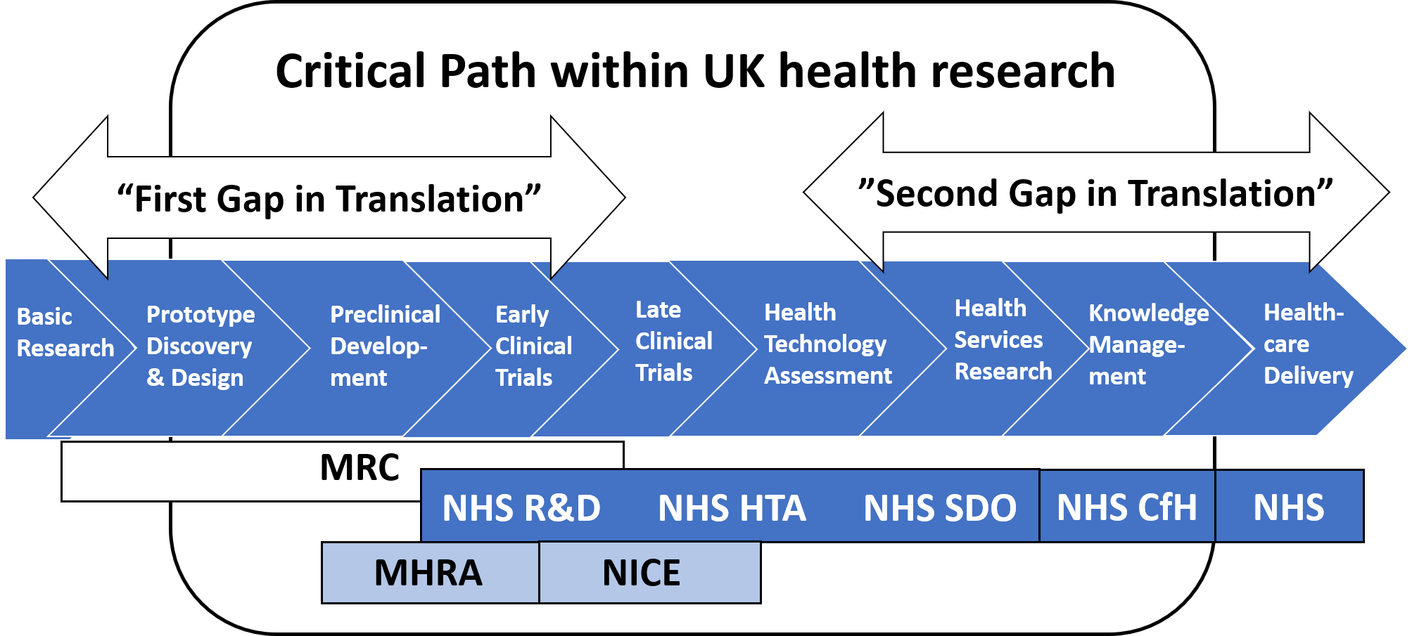
A “solution” - the knowledge pipeline
[Cooksey, D. (2006). A review of UK health research funding]

Slide 24
But the pipeline is an idealisation
Blockages and fractures
Failure
[Westfall et al. (2007). Practice-Based Research —“Blue Highways” on the NIH Roadmap. JAMA]

Slide 25
The pipeline model suggests solutions are linear

Slide 26
The health system is not linear but complex – incredibly complex

Slide 27





Complex systems are everywhere

Slide 28
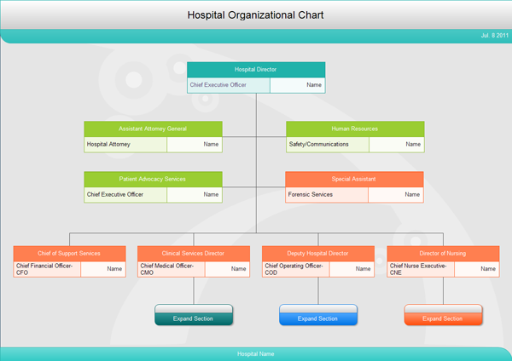
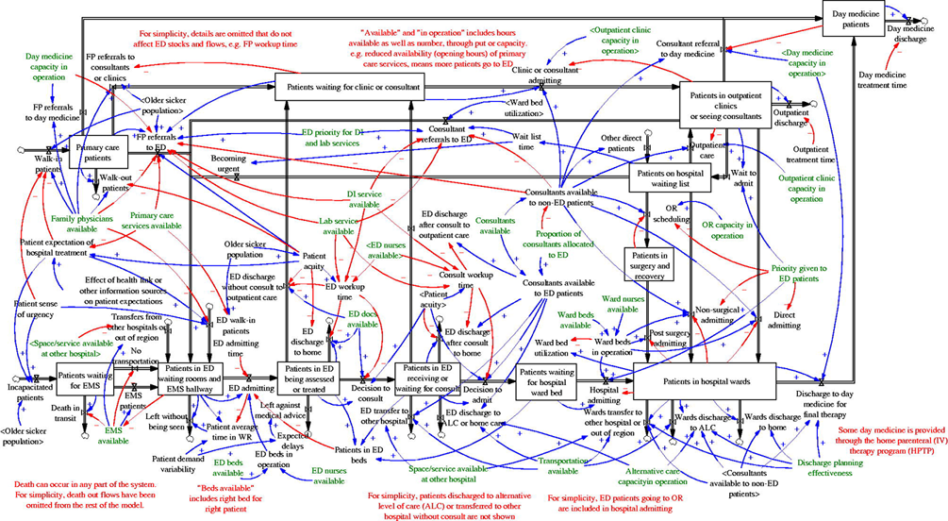
Two views of the world
Not like this
Like this
AUSTRALIAN INSTITUTE OF HEALTH INNOVATION | MACQUARIE UNIVERSITY

Slide 29
Complex organisational thinking
Mental healthcare as a CAS depicted through a Casual Loop Diagram, representing aspects of the dynamic complexity of all the interactions.
[Braithwaite, 2015. Modelling causal pathways in health services: A critique. Retrieved from: https://www.slideshare.net/CLAHRC_WM/modelling-causal-pathways-in-health-services-critique-jeffreybraithwaite]

Slide 30
Part 3:
So we need to take a complex systems, EBM approach

Slide 31
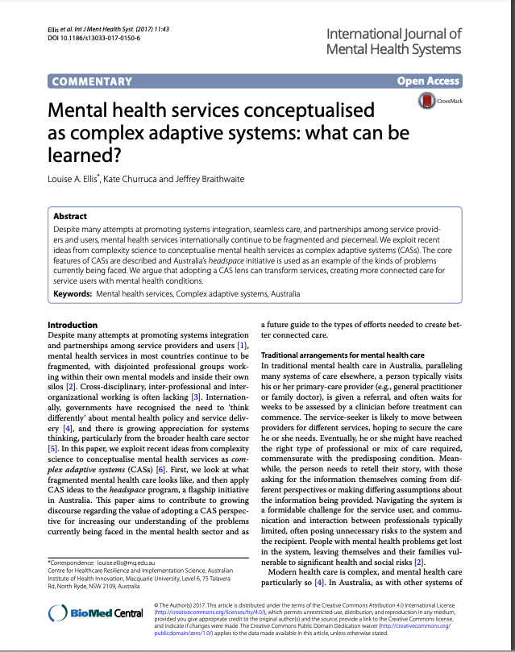



Mental health services conceptualised as complex adaptive systems: what can be learned?
Notes:
LE

Slide 32
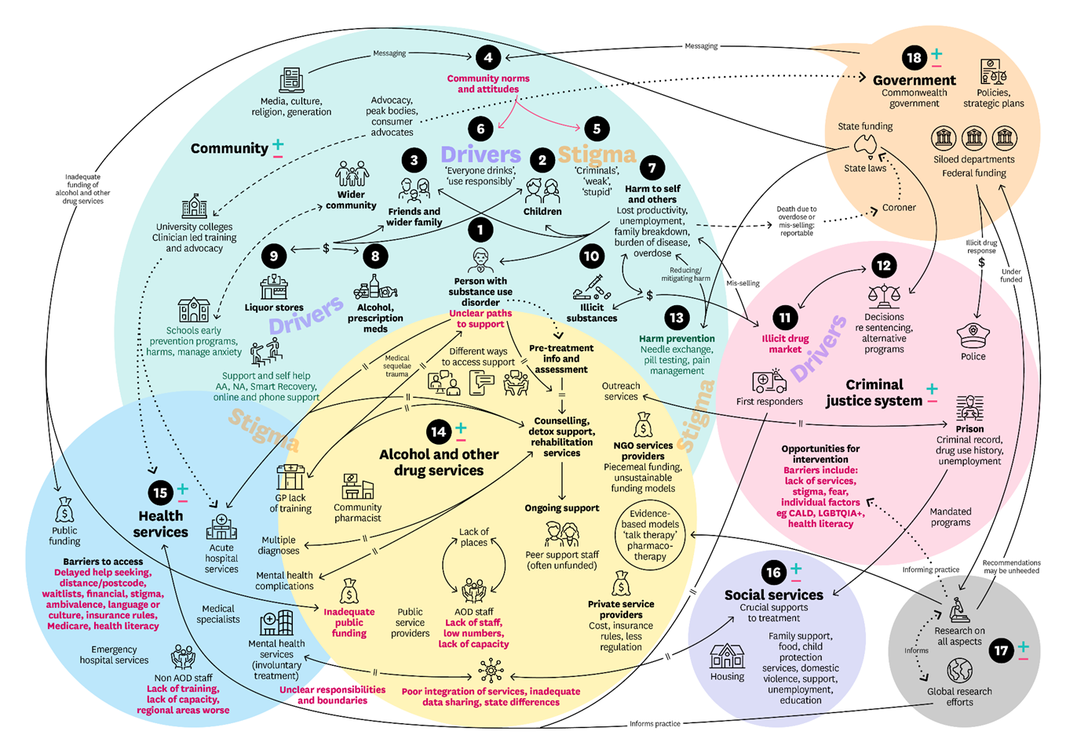
To show the power of multiple perspectives – draw a picture
[Long et al, 2025. Rich picture of addiction for Prof Dan Lubman and Turning Point]
AUSTRALIAN INSTITUTE OF HEALTH INNOVATION | MACQUARIE UNIVERSITY

Slide 33
Better than 60% in Australian kids’ mental health
The CareTrack Kids study
[Braithwaite et al. (2018). CareTrack Kids study. JAMA. doi: 10.1001/jama.2018.0162]

Slide 34










Complexity Science in Health Care:
A White Paper
AUSTRALIAN INSTITUTE OF HEALTH INNOVATION | MACQUARIE UNIVERSITY

Slide 35
Key features of complexity in health and mental health care
Populations of agents + artefacts
Interacting
Dynamically
With emergent rules and governance mechanisms, and bottom-up networks
AUSTRALIAN INSTITUTE OF HEALTH INNOVATION | MACQUARIE UNIVERSITY

Slide 36
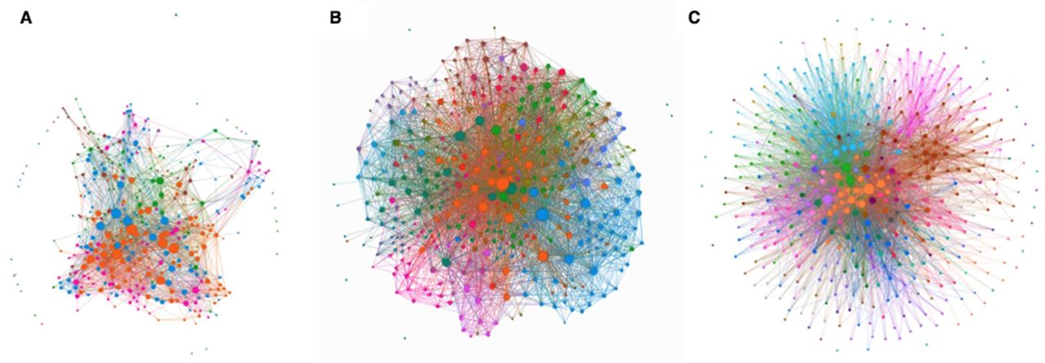
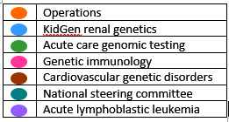
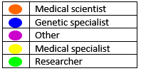
Social Network Analysis
Pre-2016
2018
We worked with people to produce an expanded genomics network
[Long et al. (2022). Mapping continuous learning using social network research: a social network study of Australian Genomics as a Learning Health System. BMC Open. doi: 10.1136/bmjopen-2022-064663]
AUSTRALIAN INSTITUTE OF HEALTH INNOVATION | MACQUARIE UNIVERSITY

Slide 37
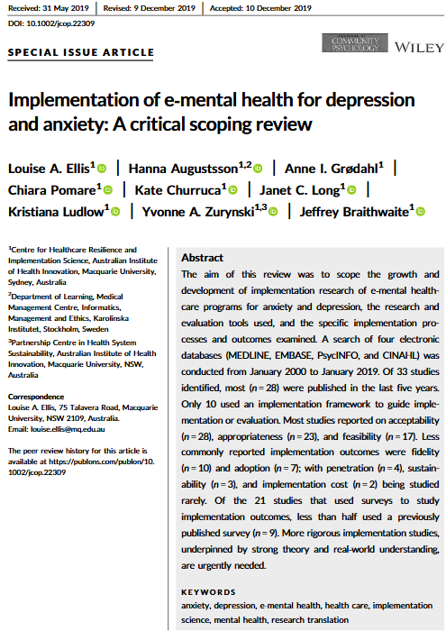
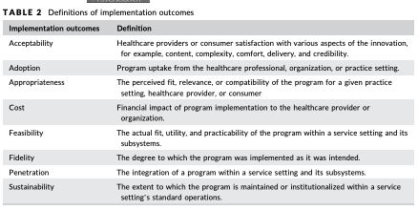

Implementation of e-mental health programs
A CRITICAL REVIEW
< half used an implementation science framework
Most reported on acceptability, appropriateness and feasibility
Less commonly reported outcomes were fidelity and adoption; with penetration, sustainability and cost rarely reported.
Notes:
LE

Slide 38

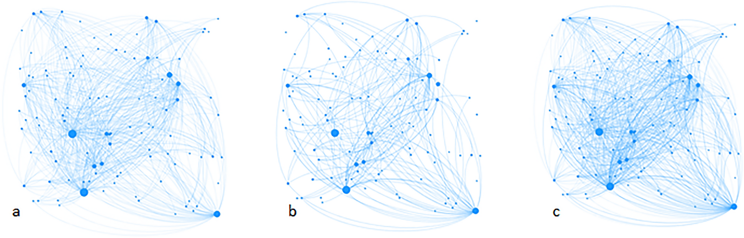
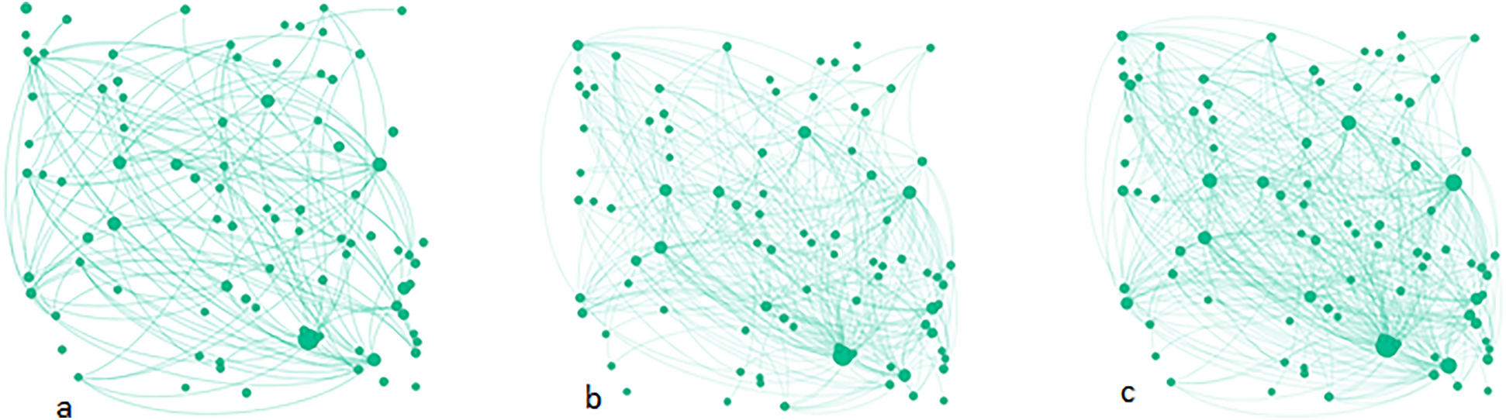
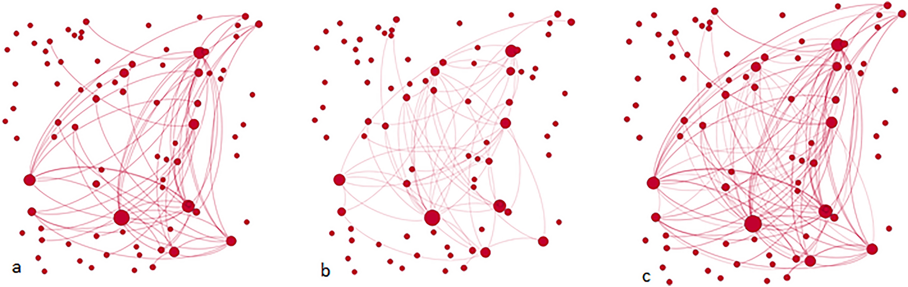

A prevention network in regional Australia: the LifeSpan suicide prevention initiative
Alpha site
Existing ties
New ties
LifeSpan ties
Beta site
Gamma site
[Long et al., (2022). International Journal of Mental Health Systems]
Notes:
YZ

Slide 39



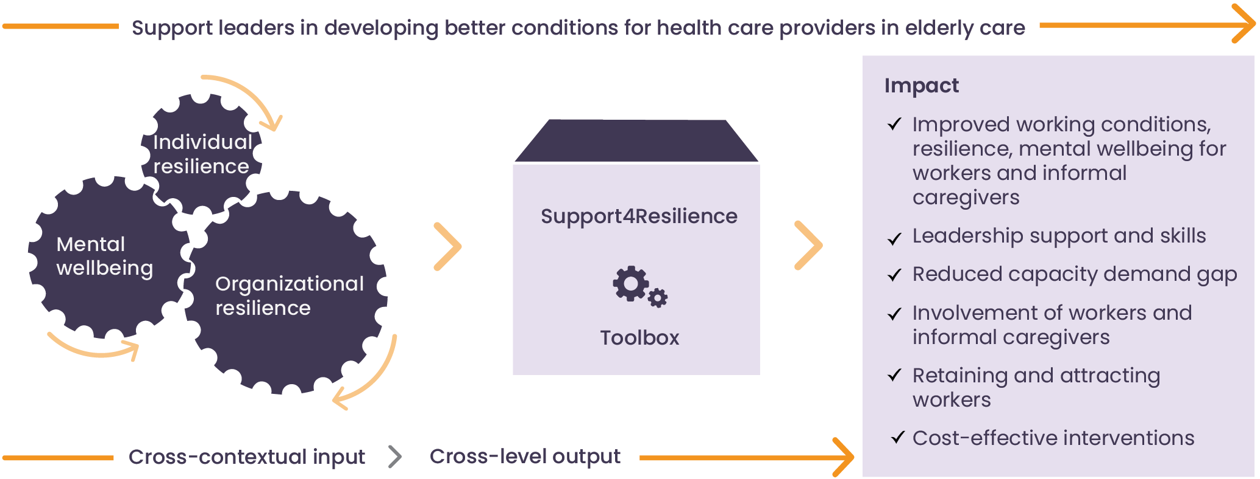
Support4Resilience (S4R)
Horizon Europe Grant (2024 - 2028): 14 partners, including AIHI
NHMRC-EU Collaborative Research Grant
AUSTRALIAN INSTITUTE OF HEALTH INNOVATION | MACQUARIE UNIVERSITY
Notes:
LE

Slide 40
Part 4:
Next generation mental health research

Slide 41
Discussion
Important of context
‘Mental health services conceptualised as complex adaptive systems: what can be learned?’ highlights that the most significant aspect of complexity lies not in the intervention itself, but rather in the context into which the intervention is introduced and interacts.

Slide 42
Discussion
Important of context
Helpful tools
Implementation science frameworks: e.g., Theoretical Domains Framework (TDF); Consolidated Framework for Implementation Research (CFIR)
Context mapping tools: e.g., SAFE-LEAD Context tool

Slide 43
Part 5:
An early warning system: The Lancet Psychiatry Commission

Slide 44
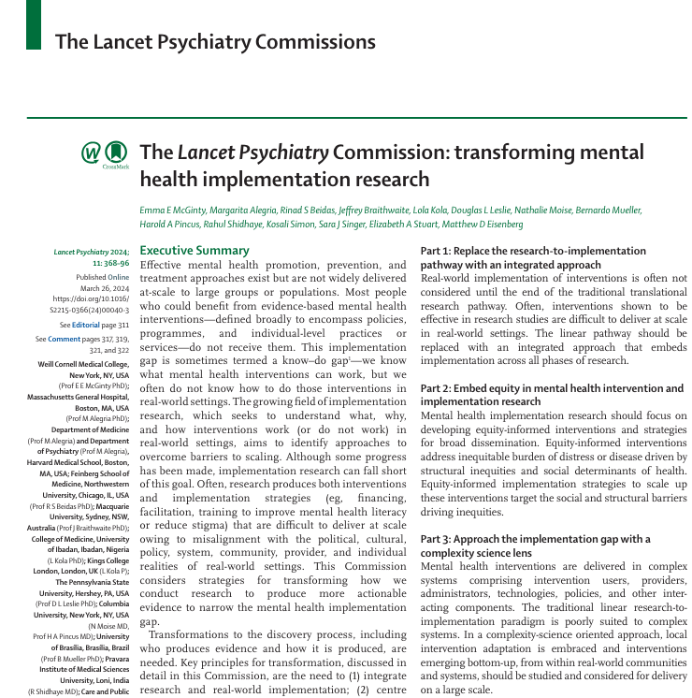
The Lancet Psychiatry Commission for transforming mental health implementation research
AUSTRALIAN INSTITUTE OF HEALTH INNOVATION | MACQUARIE UNIVERSITY
[McGinty et al. (2024). Lancet Psychiatry.]

Slide 45
The Lancet Psychiatry Commission:
Summary
Integrate research and real-world implementation;
Promote equity in mental health intervention and implementation research;
Apply a complexity science lens to mental health research;
Expand designs beyond the randomised clinical trial (RCT), including embracing rigorous non-experimental approaches;
Value transdisciplinarity across endeavours.
[McGinty et al. (2024). Lancet Psychiatry.]

Slide 46
Conclusion:
Reform and renewal: systems suggestions ….

Slide 47
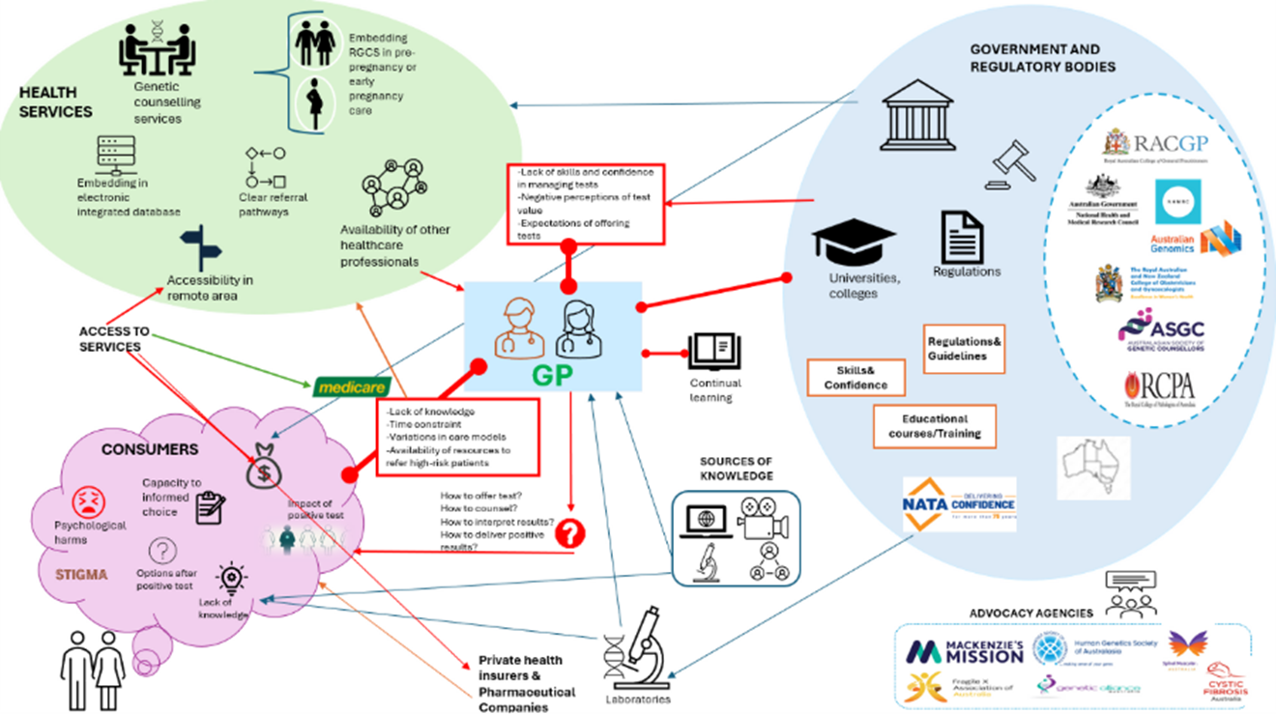
So … to reform and renew – picture the system to reform and renew
AUSTRALIAN INSTITUTE OF HEALTH INNOVATION | MACQUARIE UNIVERSITY
[Long et al. Rich picture graphics, various publications]

Slide 48
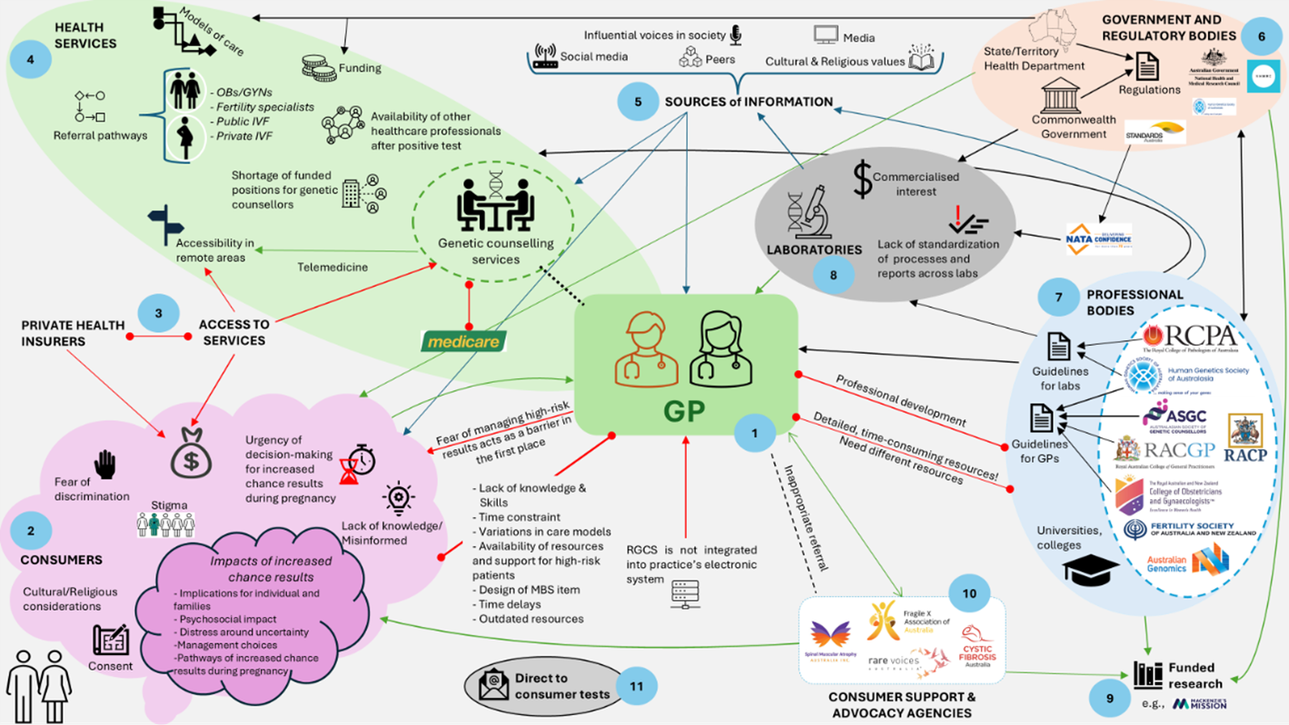
So … to reform and renew – picture the system to reform and renew
AUSTRALIAN INSTITUTE OF HEALTH INNOVATION | MACQUARIE UNIVERSITY
[Long et al. Rich picture graphics, various publications]

Slide 49
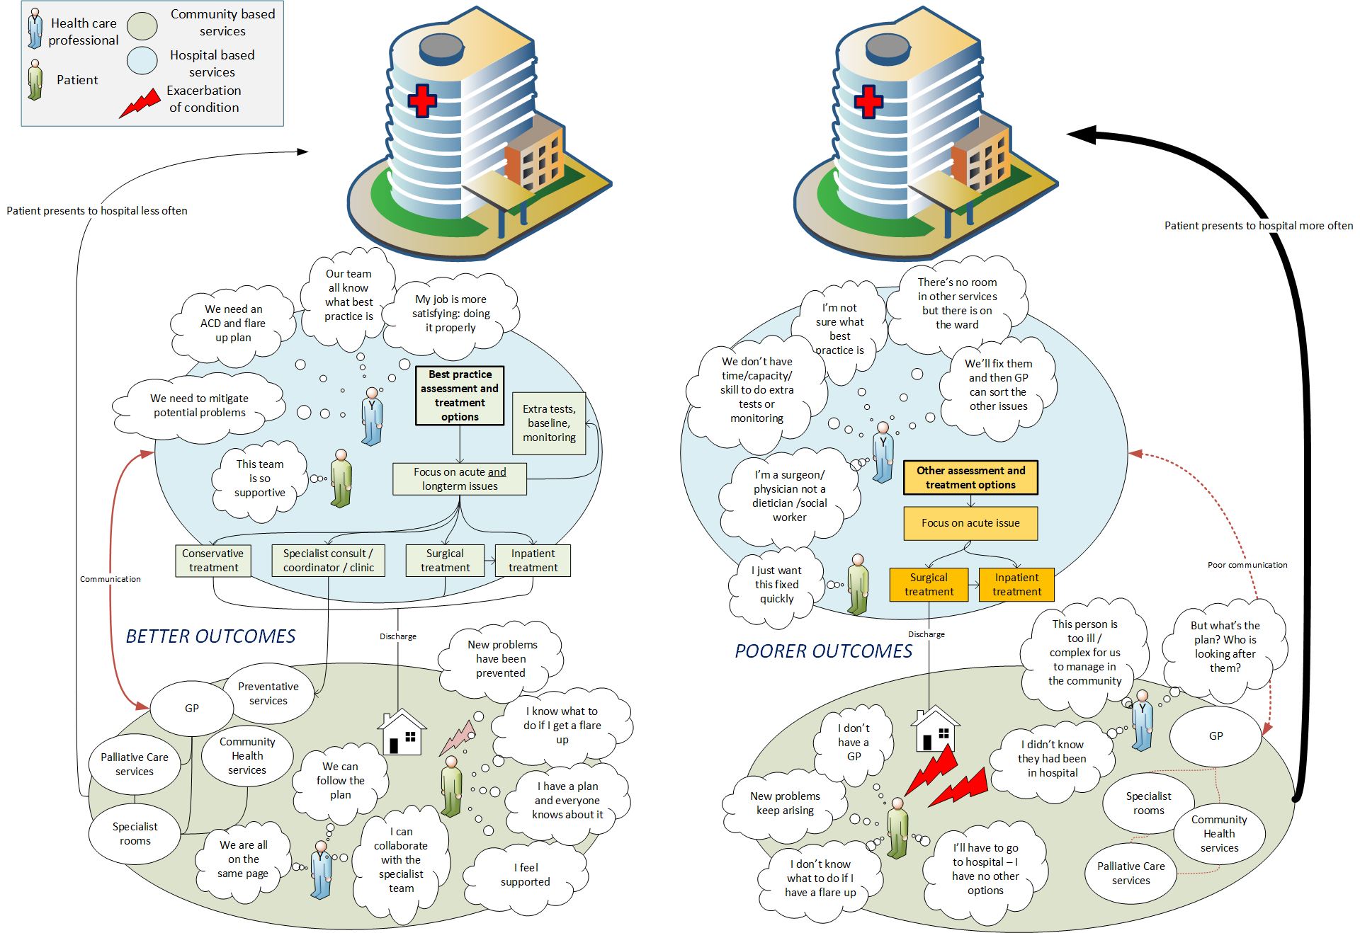
So … to reform and renew – picture the system to reform and renew
AUSTRALIAN INSTITUTE OF HEALTH INNOVATION | MACQUARIE UNIVERSITY
[Long et al. Rich picture graphics, various publications]

Slide 50
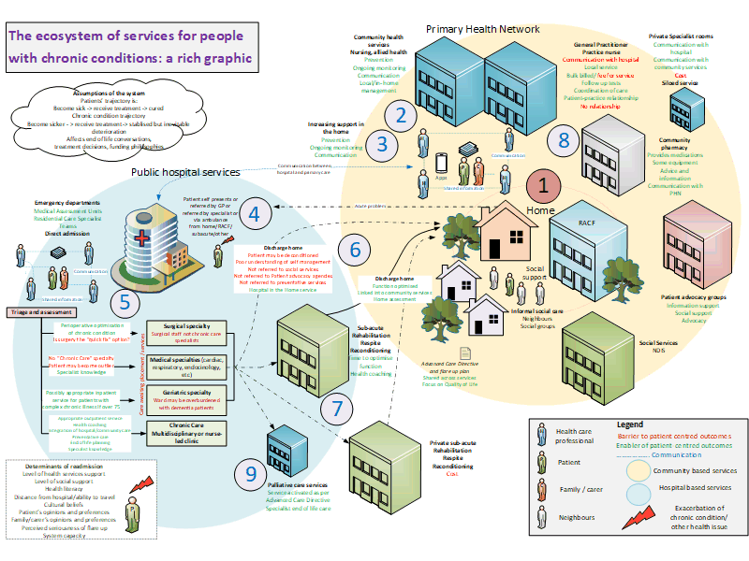
So … to reform and renew – picture the system to reform and renew
AUSTRALIAN INSTITUTE OF HEALTH INNOVATION | MACQUARIE UNIVERSITY
[Long et al. Rich picture graphics, various publications]

Slide 51
Discussion: comments, questions, observations?

Slide 52
Acknowledgements
Complexity Science/ Genomics/ LHS
Dr Kate Churruca
A/ Prof Louise Ellis
A/ Prof Janet Long
Dr Mitchell Sarkies
Dr Georgia Fisher
Dr Samantha Spanos
Dr Lisa Pagano
Maree Saba
Current Research Candidates
Sheila Pham
Faran Naru
Sagda Osman
Dr Darran Foo
Professional and
Project Support
Caroline Proctor
Rachel Yang
Dr Kirk Olsen
Partnership
Centre for Health System Sustainability
Prof Yvonne Zurynski
Dr Trent Yeend
Dr K-lynn Smith
Isabelle Meulenbroeks
Dr Karen Hutchinson
Human Factors and
Resilience
Prof Robyn Clay-Williams
Dr Elizabeth Austin
Dr Collen Cheek
Dr Luke Testa
Dr Emilie Francis-Auton
Dr Nema Heyba
Lieke Richardson
Dr Jen Evans
CareTrack Aged/
Patient Safety
Hon. Prof Peter Hibbert
Dr Louise Wiles
Dr Gaston Arnolda
Dr Rebecca Bilton
Ms Charlie Molloy
Dr Louise Raggett
MRFF Genomics
A/ Prof Janet Long
Dr Klay Lamprell
Dr Samantha Spanos
Dr Maryam Vizheh
Romika Patel
Professional Research Administration
Chrissy Clay
Romika Patel
Imogen Benson
Tina Vickery
Health Outcomes
Prof Rebecca Mitchell
Dr Reidar Lystad
Dr Tolesa Okuba
National Paediatric Applied Research Translation Initiative (N-PARTI)
Prof Reema Harrison
Dr Virginia Mumford
Prof Rebecca Mitchell
Dr Georgia Fisher
Dr Gaston Arnolda
Prof Yvonne Zurynski
Hon. Prof Peter Hibbert

Slide 53














Recently published books
2024 – Routledge Handbook of Climate Change and Health System Sustainability
2022 – Transforming Healthcare with Qualitative Research
2021 – Muddling Through With Purpose
2020 – Transforming Healthcare with Qualitative Research
2019 – Working Across Boundaries
2018 – Delivering Resilient Health Care
2018 – Healthcare Systems: Future Predictions for Global Care
2017 – Health Systems
Improvement Across the Globe:
Success Stories from 60 Countries
2017 – Reconciling Work-as-imagined and Work-as-done
2016 – The Sociology of Healthcare Safety and Quality
2015 – Healthcare Reform, Quality and Safety: Perspectives, Participants, Partnerships and Prospects in 30 Countries
2015 – The Resilience of Everyday Clinical Work
2013 – Resilient Health Care
2010 – Culture and Climate in Health Care Organizations
AUSTRALIAN INSTITUTE OF HEALTH INNOVATION | MACQUARIE UNIVERSITY

Slide 54



Forthcoming books
Gaps: the Surprising Truth Hiding in the In-between
Surviving the Anthropocene
Counterintuitivity: How your brain defies logic
AUSTRALIAN INSTITUTE OF HEALTH INNOVATION | MACQUARIE UNIVERSITY

Slide 55





Jeffrey Braithwaite
PhD, FIML, FCHSM, FFPHRCP, FAcSS, Hon FRACMA, FAHMS
Founding Director
Australian Institute of Health Innovation
Director
Centre for Healthcare Resilience and Implementation Science
Professor
Faculty of Medicine, Health and Human Sciences, Macquarie University
Sydney, Australia
Immediate Past President
International Society for Quality in Health Care (ISQua)
 | Email: | jeffrey.braithwaite@mq.edu.au
 | AIHI website: | http://aihi.mq.edu.au
 | Twitter: | @JBraithwaite1
 | Wikipedia: | http://en.wikipedia.org/wiki/Jeffrey_Braithwaite
AUSTRALIAN INSTITUTE OF HEALTH INNOVATION | MACQUARIE UNIVERSITY

Slide 56
Appendices

Slide 57
Based on this what would an early warning system look like?
Measure population distress, e.g., regular surveys
Monitor service pressure points e.g. ED mental health attendees
Digital and social signals – online, social media
Sentinel settings – Schools, universities, workplaces, rural and remote settings
Have an early warning dashboard

Slide 58
Based on this what would an early warning system look like?
5. What an early warning dashboard would look for:
Sudden spikes
Sustained upward trends
Geographic hotspots
Widening inequities
Service bottlenecks
Groups not reaching care until crisis point

Slide 59
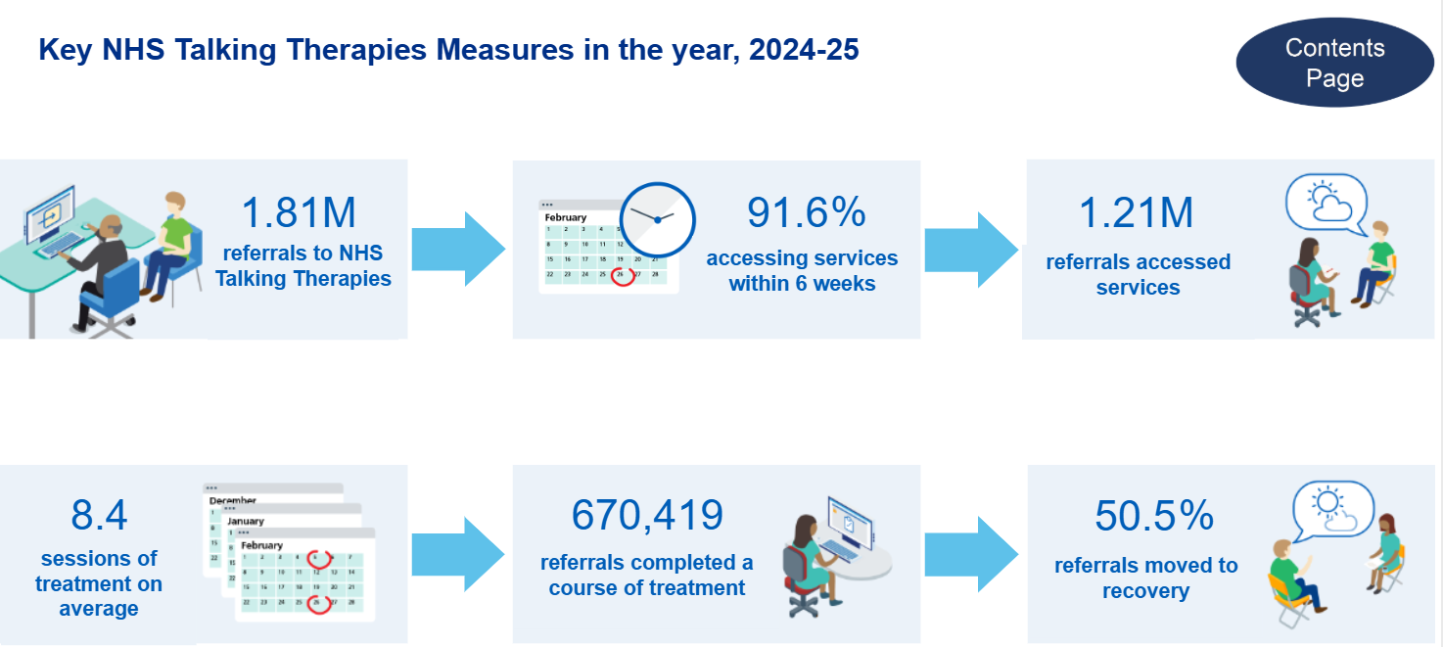
E.g., Case study #1: England’s national-scale access to psychological therapies
England’s Talking Therapies program – key measures, 2024-2025
One in two people completing treatment ‘recover’;
two in three show improvement
[Source: NHS Talking Therapies, for anxiety and depression, Annual reports, 2024-25 - NHS England Digital; NHS Talking Therapies for anxiety and depression, Annual report 2024 - 2025 ]

Slide 60
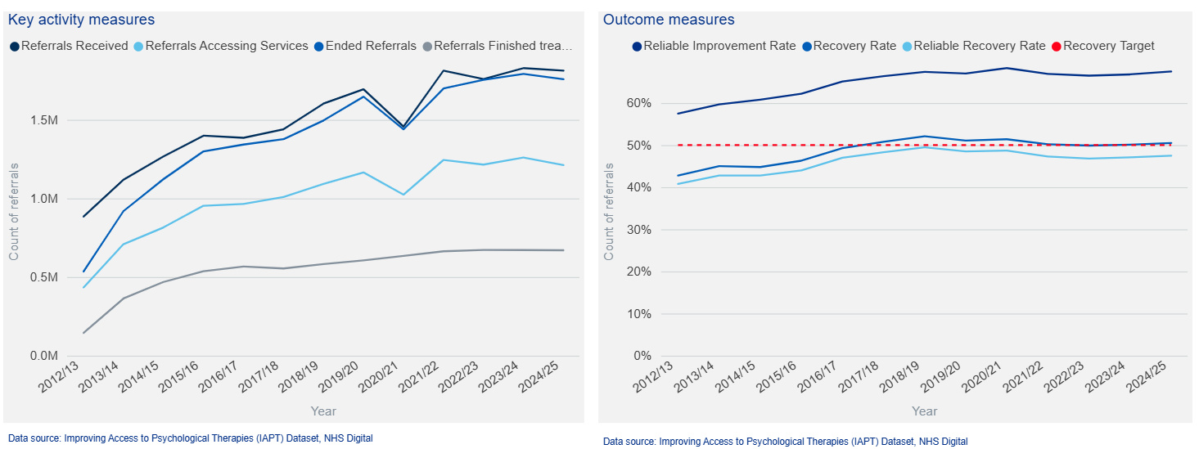
E.g., Case study #1: England’s national-scale access to psychological therapies
England’s Talking Therapies program – year on year key activity measures
[Source: NHS Talking Therapies, for anxiety and depression, Annual reports, 2024-25 - NHS England Digital; NHS Taking Therapies for anxiety and depression, Annual report 2024 - 2025]

Slide 61
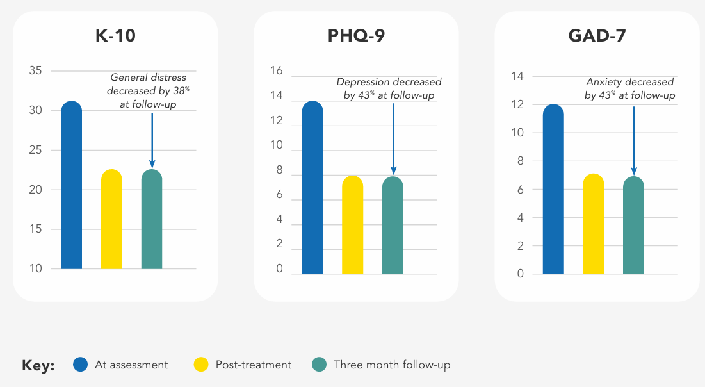
E.g., Case study #2: Australian national digital psychological care
MindSpot Clinic
Scalable mental health intervention, improving anxiety and depression: >250,000 assessed; >50,000 enrolled
[Source: MindSpot. 2023 - Results Report]
AUSTRALIAN INSTITUTE OF HEALTH INNOVATION | MACQUARIE UNIVERSITY

Slide 62
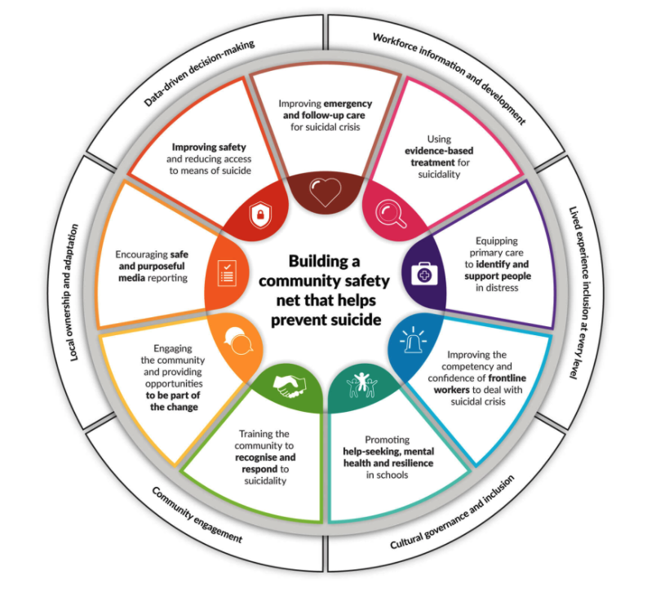
A complex intervention - example
The LifeSpan Initative
9 evidence-based strategies for suicide prevention
Community-led approach
Health, education, frontline services, business and the community
Sought to reduce suicide by building social capital between these agents
[Ellis et al., 2017. Int J Ment Health Syst ]

Slide 63
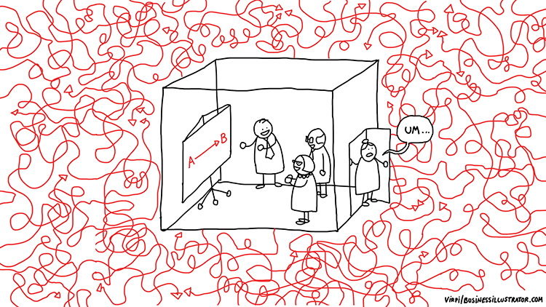
1. The inside and outside world —everyone is in their own box
So get out of your box, embrace the complexity, and lead your bit of the needed transformation
AUSTRALIAN INSTITUTE OF HEALTH INNOVATION | MACQUARIE UNIVERSITY

Slide 64
2. Have a plan based on implementation science
PHASE 1
Preparing for change
PHASE 2
Capacity for implementation
People
B) Organisational
PHASE 3
Types of implementation
PHASE 4
Resources; Leverage
PHASE 5
Sustainability
Desirable implementation features (e.g. communication, incentives, feedback)
[Braithwaite J, Marks D, and Taylor N. (2014). Harnessing implementation science to improve care quality and patient safety: a systematic review of targeted literature. International Journal for Quality in Health Care]

Slide 65
3. Know that you have two jobs: do your job and improve things
“Do your job”
“Improve things”
AUSTRALIAN INSTITUTE OF HEALTH INNOVATION | MACQUARIE UNIVERSITY

Slide 66
4. Understand deeply that our problems and solutions are not linear
AUSTRALIAN INSTITUTE OF HEALTH INNOVATION | MACQUARIE UNIVERSITY

Slide 67
5. Focus on the important
Just three numbers – 60:30:10
[Braithwaite, J., Glasziou, P. & Westbrook, J. (2020). The three numbers you need to know about healthcare: the 60-30-10 Challenge. BMC Med.
doi: 10.1186/s12916-020-01563-4]
AUSTRALIAN INSTITUTE OF HEALTH INNOVATION | MACQUARIE UNIVERSITY

Slide 68
6. Continuous Evaluation and
Implementation
Capacity for implementation
People and setting
Capacity for implementation
People and setting
Types of implementation
Prepare for change
Capacity for implementation
People and setting
Types of implementation
Leverage and resources
Capacity for implementation
People and setting
Prepare for change
IMPROVEMENT
Types of implementation
Sustainability
Leverage and resources
Types of implementation
Prepare for change
Capacity for implementation
People and setting
Leverage and resources
Sustainability
Prepare for change
Leverage and resources
Sustainability
Types of implementation
Prepare for change
Sustainability
Leverage and resources
Sustainability
TIME
[Adapted from Braithwaite et al. (2014). Harnessing implementation science to improve care quality and patient safety: a systematic review of targeted literature. Int J Qual Health Care; Braithwaite et al. (2007). An action research protocol to strengthen system-wide inter-professional learning and practice. BMC Health Serv Res]

Slide 69
7. Implementation at scale
LARGE-SCALE SYSTEM-WIDE INTERVENTIONS
Change or patient outcomes potentially established or influenced by interventions
Requirements to achieve such change or patient outcomes
Next stage requirements for successful future interventions
Organisational and cultural factors affecting, mediating or supporting implementation
[Clay-Williams et al. (2014). Large-scale hospital- and system-wide interventions.
BMC Health Services Research]
AUSTRALIAN INSTITUTE OF HEALTH INNOVATION | MACQUARIE UNIVERSITY

